Slide 1
VON WILLEBRAND DISEASE
Module 2
How to screen for von Willebrand disease?
May 2022
CME credit available
Visit programme home page on:
The programme is supported by an independent educational grant from Takeda.
The programme is therefore independent; the content is not influenced by the
supporter and is under the sole responsibility of the experts.

Slide 2
What will you learn in this micro e-learning programme
about von Willebrand disease?
This micro e-learning programme consists of three modules aiming to increase awareness, knowledge and understanding of the existence, diagnosis, treatment and implications of von Willebrand disease among healthcare professionals outside of haematology.
Upon completion of the three modules, you will:
be aware of the potential existence of von Willebrand disease in your patient population
be able to recognise the signs and symptoms of von Willebrand disease
understand how to search for von Willebrand disease, effectively using the screening tools available and signposting patients towards earlier diagnosis
be aware of the impact of von Willebrand disease on other care
AFTER MODULE 1 YOU WILL
be aware of the potential existence of von Willebrand disease among your patient population
be able to recognise the signs and symptoms of von Willebrand disease
AFTER MODULE 2 YOU WILL
Current Module
understand you can help diagnose von Willebrand disease
be able to effectively use the screening tools available
understand the next steps to take when suspecting von Willebrand disease
AFTER MODULE 3 YOU WILL
be aware of the impact of von Willebrand disease on provision of general care
understand the key aspects of von Willebrand disease affecting your clinical practice
understand the importance of a multidisciplinary approach in von Willebrand disease care
2

Slide 3
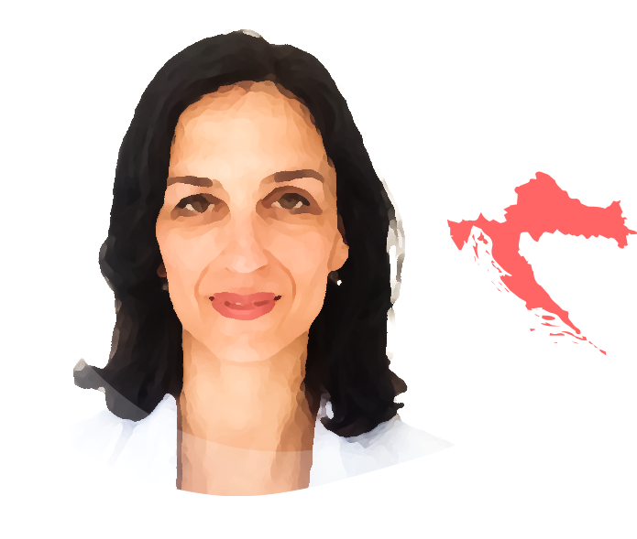
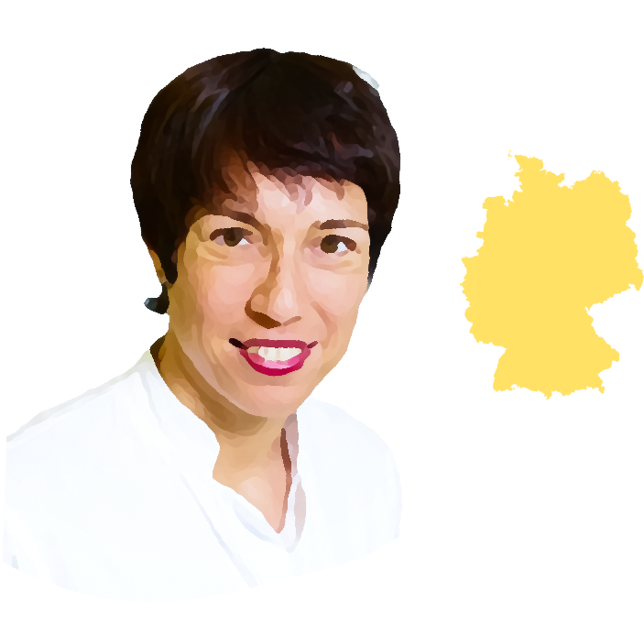
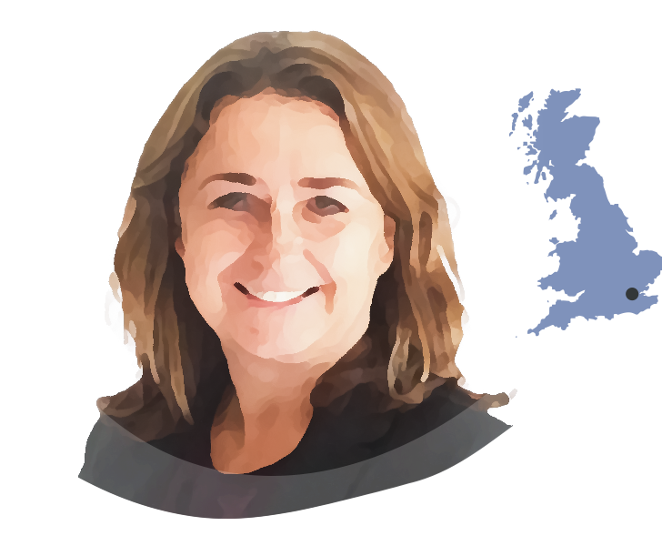
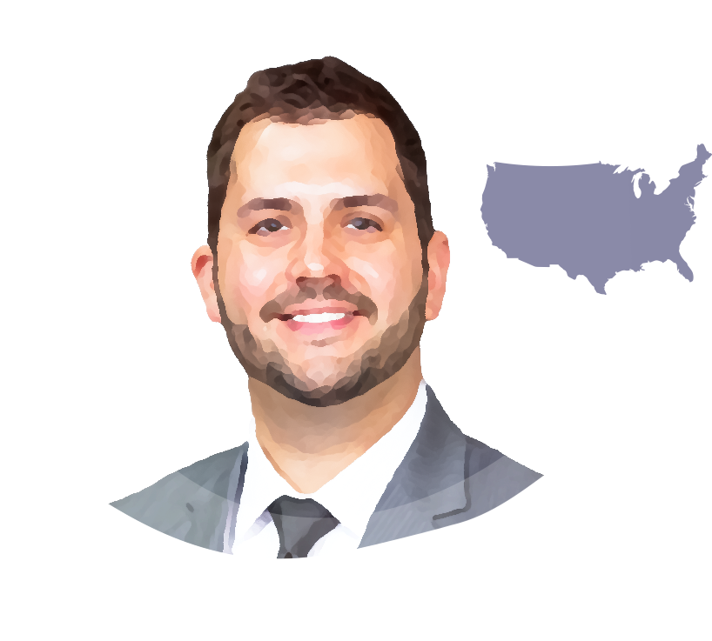
This micro e-learning module has been developed by a
multidisciplinary panel of experts
Dr. Gianluigi Pasta
Dr. Michael A. Mazzeffi
Dr. Alison Dougall
Prof. Ana Boban
IRELAND
ITALY
CROATIA
USA
Dental consultant medically complex patients at Dublin Dental Hospital
Director of doctorate programme in special care dentistry, Trinity College Dublin
Former chair of World Federation of Haemophilia Dental Committee
Medical advisory board member of European Haemophilia Consortium (EHC)
President of International Society for Disability and Oral Health
Orthopaedic consultant at the Haemophilia Centre at Fondazione IRCCS Policlinico San Matteo di Pavia
Chair of the Musculoskeletal Committee of the World Federation of Haemophilia (WFH)
Coordinator of Musculoskeletal Group of Italian Haemophilia Centres Association
Cardiothoracic anaesthesiologist and intensive care physician
Executive vice chair and director of cardiac intensive care at George Washington University School of Medicine in Washington, DC
Head of Haemophilia Centre at the University Hospital Centre Zagreb
Professor of internal medicine at the School of Medicine of the University of Zagreb, Croatia
Specialist degrees in internal medicine and haematology
Executive committee member of the European Association for Haemophilia and Allied Disorders (EAHAD)
Dr. Med. Rosa Sonja Alesci
Prof. Jan Blatný
CZECH REPUBLIC
Dr. Vickie McDonald
GERMANY
Consultant Haematologist, director of Haemophilia Comprehensive Care Centre and medical director of Paediatrics at University Hospital in Brno
Associate professor of paediatrics at Masaryk University in Brno
Active member of International Society on Thrombosis and Haemostasis (ISTH), Vice president of EAHAD and MAG member of EHC
Paediatric coordinator of the Czech National Haemophilia Programme
Haematology consultant and health economist
Director of the IMD Blood Coagulation Centre in Bad Homburg/Frankfurt/Wiesbaden
Active member of German Society of Haematology and Oncology
Member of medical advisory board German Alliance for Security of Haemophilia
Dr. Jonathan C. Roberts
UK
USA
Consultant Haematologist at the Royal London Hospital, London
Honorary senior lecturer at Queen Mary University of London
National chief investigator for the UK immune thrombocytopenia (ITP) registry
Associate medical director and associate research director at the Bleeding & Clotting Disorders Institute (BCDI)
Assistant professor of Paediatrics and Medicine at the University of Illinois College of Medicine at Peoria in Peoria, IL
Haematologist with BCDI
The views expressed in this slide deck are the personal opinions of the experts. They do not necessarily represent the views of the experts’ institutions or the rest of the HEMOSTASIS CONNECT group.
3

Slide 4
When to suspect von Willebrand disease
Module 1 summary
Module 1 of this micro e-learning programme described how von Willebrand disease is the most common inherited bleeding disorder, occurring in men, women, and children. Signs and symptoms of von Willebrand disease include:
General
Paediatric
Gynaecological
Family history of a bleeding disorder
Nosebleeds
Heavy menstrual bleeding, especially since menarche
Notable bruising without injury
Bleeding during teething in small children
Bleeding during ovulation
Prolonged/excessive bleeding, even from minor wounds
Notable bruising without injury
Primary and late post-partum haemorrhage
Dental
Excessive bleeding from minor wounds
Surgical
Prolonged bleeding following invasive dental procedures
Joint pain and/or bleeds
ENT
Prolonged bleeding from the gums following deep cleaning
Nosebleeds
Prolonged and/or severe bleeding after minor or major surgery
Severe (potentially life-threatening) bleeding after tonsillectomy/ adenoidectomy
Gastrointestinal
Recurrent ulcers and pallor of the mucosa associated with anaemia
Bleeding of gastrointestinal tract with or without an obvious anatomic lesion in adults
ENT, ear, nose, and throat
This slide is based on the clinical experience of the authors
4

Slide 5
Next steps when suspecting von Willebrand disease in your patient
The key first step is taking a thorough bleeding history, including a detailed family history.¹
Practical tips:
The personal bleeding history and family history will guide you in determining the likelihood of an underlying bleeding disorder and provide justification for performing further laboratory testing
Be mindful of bias. Bleeding symptoms may be seen as normal in families with (undiagnosed) bleeding disorders, leading patients to underestimate or trivialise their symptoms.
Note that the ISTH-SSC BAT lacks specificity for bleeding disorders in patients with oral bleeding.³ This may reinforce the inaccurate perception that gum bleeding is related to bleeding disorders rather than gingivitis.
Use a validated bleeding assessment tool (BAT) for this, such as the ISTH-SSC BAT²
The second step is laboratory assessment.¹
In patients with a low probability of von Willebrand disease (e.g., in the primary care setting), initial screening with a validated BAT helps determine who needs specific blood testing
In patients with a high probability of von Willebrand disease (e.g., because they have an affected first-degree relative), laboratory assessment should be performed regardless of their BAT score
BAT, bleeding assessment tool; ISTH, International Society on Thrombosis and Haemostasis; SSC, Scientific and Standardization Committee 1. James PD, et al. Blood Adv. 2021;5:280-300; 2. Rodeghiero F, et al. J Thromb Haemost. 2010;8:2063-5; 3. Dougall A, et al. Res Pract Thromb Haemost. 2020;4 suppl 1:PB1595. (ISTH 2020 poster presentation)
5

Slide 6
Use a validated screening tool
ISTH-SSC BAT
The ISTH-SSC subcommittees have developed
a tool to assess patients with a suspected
inherited bleeding disorder.
The ISTH-SSC bleeding assessment tool scores the following symptoms
1.
Epistaxis
9.
Heavy menstrual bleeding
The questionnaire is to be collected by an
adequately trained healthcare professional,
who will score symptoms and related
treatments before or at diagnosis (or both).
2.
Cutaneous bruising
10.
Post-partum haemorrhage
3.
Bleeding from minor wounds
11.
Muscle haematomas
4.
Oral cavity bleeding
12.
Haemarthrosis
5.
Gastrointestinal bleeding
13.
Central-nervous system bleeding
6.
Haematuria
14.
Other bleeding problems
An abnormal score indicates that further testing is required:
7.
Dental extraction bleeds
8.
Surgical bleeding
≥3 in children
≥4 in adult males
≥6 in adult females
An online version of the ISTH bleeding assessment tool is available at
https://bleedingscore.certe.nl
BAT, bleeding assessment tool; ISTH, International Society on Thrombosis and Haemostasis; SSC, Scientific and Standardization Committee
Elbatarny M, et al. Haemophilia. 2014;20:831-5; Rodeghiero F, et al. J Thromb Haemost. 2010;8:2063-5.
6

Slide 7
Laboratory assessment
Tests you can perform yourself
Full Blood Count
Iron and ferritin status
Assessment of iron status, haemoglobin, and red blood cell count is not specific to von Willebrand disease, but findings provide important information for clinical management.
MCV Low/normal
Hb Low/normal
Iron deficiency with or without anaemia is common in patients with bleeding symptoms and can easily be diagnosed and treated.
Serum iron Low
Ferritin <30μg/L
Even without anaemia, iron deficiency can be symptomatic and impact quality of life, causing e.g., fatigue, muscular weakness, or hair and skin issues
Total iron-binding capacity
Normal/high
sTfR-F index
High
Iron deficiency anaemia may precede clinically significant bleeding, so bleeding disorder evaluation is required
Transferrin saturation
Low/normal
Hb, haemoglobin; MCV, mean corpuscular volume, sTfR-F, soluble transferrin receptor/ferritin O’Brien SH. Blood. 2018;132:2134-42; VanderMeulen H, et al. Transfus Apher Sci. 2018;57:735-8
7

Slide 8
Laboratory assessment
Tests you can perform yourself
Coagulation Screening
Routine coagulation screening can be performed, but these tests are abnormal in only a minority of patients with von Willebrand disease.
PT and aPTT
Evaluate the intrinsic (aPTT) and extrinsic (PT) coagulation pathway
INR is not used in bleeding disordersª
Common causes of prolonged aPTT and/or PT
Even if the coagulation screening is normal, patients with bleeding symptoms and/or an abnormal BAT score should still be referred to a haematologist.
Medication
Reduced nutritional intake or malabsorption
Systemic disease
Consumptive coagulopathy
Severe clotting factor deficiencies
!
Normal PT and aPTT do not exclude von Willebrand disease
Fibrinogen activity
Evaluates the level and function of fibrinogen (factor I)
ª INR reflects PT in the management of warfarin and in hepatology aPTT, activated partial thromboplastin time; BAT, bleeding assessment tool; INR, international normalised ratio; PT, prothrombin time Green D. Blood Coagul Fibrinolysis. 2010;21 Suppl 1:S3-6; Hayward CPM. Int J Lab Hematol. 2018;40 Suppl 1:6-14; Kamal AH, et al. Mayo Clin Proc. 2007;82:864-73; Simon D, et al. Haemophilia. 2008;14:1240-9; O’Brien S. Blood. 2018;132:2134-42; Federici AB. Semin Thromb Hemost. 2006;32:555-65
8

Slide 9
Laboratory assessment
Tests where haematology support is required
There are many pitfalls in the interpretation of diagnostic laboratory tests, so refer to a haematologist or make sure you have haematology support available for interpretation.
VWF Tests focusses on:
How VWF is present
How VWF functions
VWF is an acute phase reactant; there are many factors impacting VWF levels.
Quantitative VWF antigen (VWF:Ag) testing
Qualitative VWF activity assays
Impacted by stress, infection, illness, exercise, high-dose hormonal therapy, pregnancy, trauma and blood group (lower in blood group O)
Examine the platelet binding function of VWF (VWF:RCo)
Repeat VWF testing is needed to establish a true baseline
Additional second-line VWF tests
Platelet function analysis is also performed by the haematologist.
Additional second-line VWF testing can be performed by a coagulation haematologist in a Haemophilia Treatment Centre, including assessment of VWF multimers, specialised VWF activity testing (platelet binding [VWF:GPIb assays], collagen binding [VWF:CB], ability to carry factor VIII [factor VIII activity]) and genetic testing
A normal platelet count is not an indication of good platelet function
!
Platelet function tests expose platelets to specific triggers to check responses (e.g. PFA-100)
Expert interpretation of results of these tests and patient history are essential for diagnosis of von Willebrand disease
Ag, antigen; CB, collagen binding; GPIbM, glycoprotein Ib mutation; PFA, Platelet Function Analyzer; RCo, ristocetin cofactor; VWF, von Willebrand factor Leebeek FWG, et al. N Engl J Med. 2016;375:2067-80; Ng C, et al. Blood. 2015;125:2029-37; Favaloro EJ, et al. Haemophilia. 2004;10 Suppl 4:164-8
9

Slide 10
Management of von Willebrand disease
A multidisciplinary approach
Symptomatic treatment can be started in first line, even in absence of a definite diagnosis
Iron replacement therapy for iron deficiency with or without anaemia
Antifibrinolytics (tranexamic acid or aminocaproic acid) for bleeding symptoms (e.g., nosebleeds, excessive bleeding from minor wounds, heavy menstrual bleeding, prolonged bleeding after dental extraction)
Note: gum bleeding should not be treated with tranexamic acid but needs intervention from a dental care professional
Hormonal therapy for heavy menstrual bleeding
For specific treatment, patients need to be referred to specialists
Haematologist for haemostatic treatment (antifibrinolytics, DDAVP and/or VWF replacement therapy)
Gynaecologist for heavy menstrual bleeding and planning of pregnancy and delivery
Dental care professional for tailored oral health education and dental hygiene programmes alongside preventive dental care to treat gingivitis and periodontal disease
MSK experts (i.e., physiotherapist, orthopaedic surgeon, physiatrist) in case of suspected joint bleeds
Anaesthesiologist before planning surgery
For more details on the management of von Willebrand disease, please refer to Module 3 of this programme
DDAVP, desmopressin; MSK, musculoskeletal; VWF, von Willebrand factor Connell NT, et al. Blood Adv. 2021;5:301-25; Peyrin-Biroulet L, et al. Am J Clin Nutr. 2015;102:1585-94
10

Slide 11
Next steps when suspecting von Willebrand disease
Von Willebrand disease may be difficult to diagnose, refer patients in whom you suspect von Willebrand disease to a haematologist for diagnostic laboratory assessment and treatment.
Symptomatic treatment may be started in first line.
Please refer to the other modules of this micro e-learning programme for more information on:
Module 1: Pathophysiology and symptoms
Module 3: A multidisciplinary approach: impact of von Willebrand disease on the provision of general care
11

Slide 12
Summary
When you suspect von Willebrand disease, take a thorough bleeding history, including a detailed family history, using a validated BAT
Perform laboratory testing; general tests can be performed in first line, whereas expert interpretation is required for diagnostic testing
The management of von Willebrand disease requires a multidisciplinary approach
12

Slide 13
Next steps
Please now proceed to the assessment quiz in the e-learning to test your knowledge
Visit Module 1 of this micro e-learning programme to learn more about:
the potential existence of von Willebrand disease among your patient population
the signs and symptoms of von Willebrand disease
Visit Module 3 of this micro e-learning programme to learn more about:
the impact of von Willebrand disease on provision of general care
the key aspects of von Willebrand disease affecting your clinical practice
the importance of a multidisciplinary approach
Note: you will be able to claim your CME credit after passing at least 2 of the 3 modules
CME credit available
Visit programme home page on:
13

