Slide 1
VON WILLEBRAND DISEASE
Module 3
How to care for a patient with von Willebrand disease?
May 2022
The programme is supported by an independent educational grant from Takeda.
The programme is therefore independent; the content is not influenced by the
supporter and is under the sole responsibility of the experts.
CME credit available
Visit programme home page on:

Slide 2
What will you learn in this micro e-learning programme
about von Willebrand disease?
This micro e-learning programme consists of three modules aiming to increase awareness, knowledge and understanding of the existence, diagnosis, treatment and implications of von Willebrand disease among healthcare professionals outside of haematology.
Upon completion of the three modules, you will:
be aware of the potential existence of von Willebrand disease in your patient population
be able to recognise the signs and symptoms of von Willebrand disease
understand how to search for von Willebrand disease, effectively using the screening tools available and signposting patients towards earlier diagnosis
be aware of the impact of von Willebrand disease on other care
AFTER MODULE 1 YOU WILL
be aware of the potential existence of von Willebrand disease among your patient population
be able to recognise the signs and symptoms of von Willebrand disease
AFTER MODULE 2 YOU WILL
understand you can help diagnose von Willebrand disease
be able to effectively use the screening tools available
understand the next steps to take when suspecting von Willebrand disease
AFTER MODULE 3 YOU WILL
Current Module
be aware of the impact of von Willebrand disease on provision of general care
understand the key aspects of von Willebrand disease affecting your clinical practice
understand the importance of a multidisciplinary approach in von Willebrand disease care
2

Slide 3
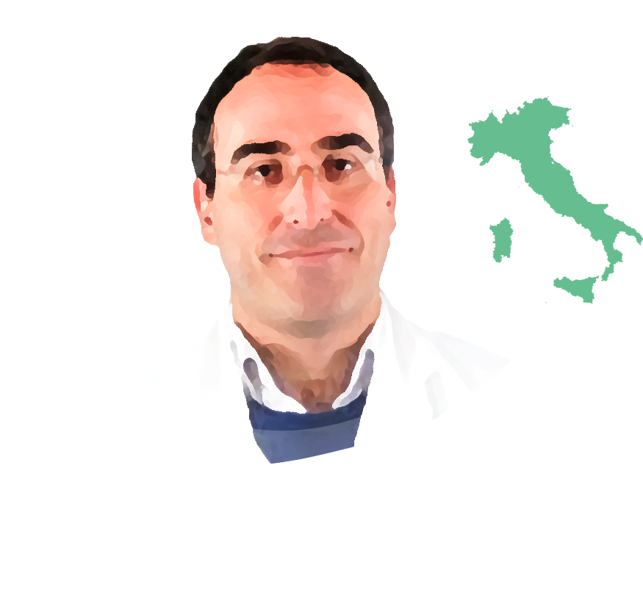
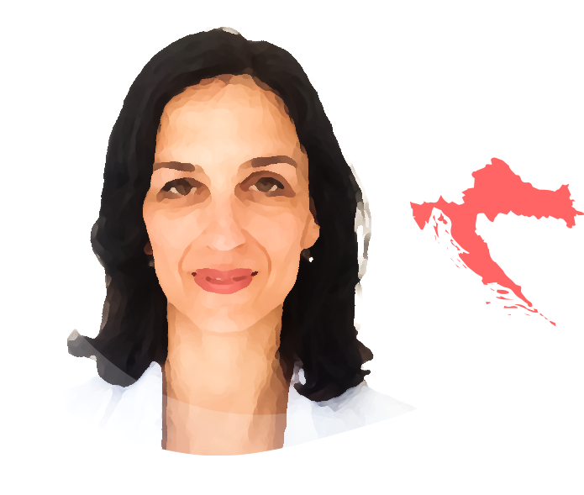
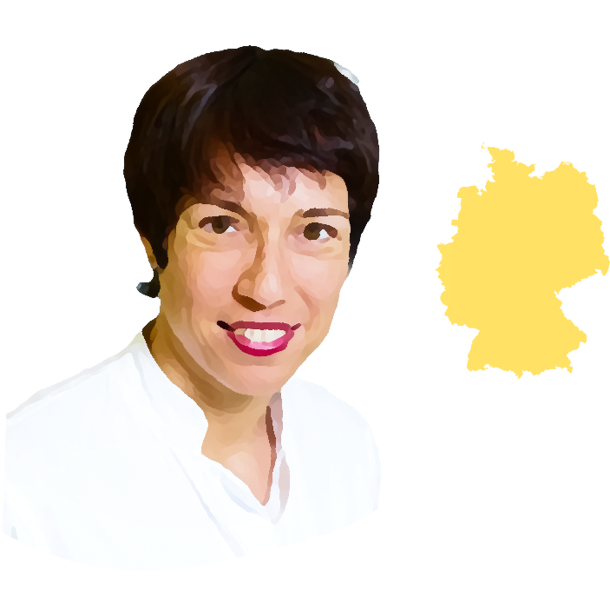
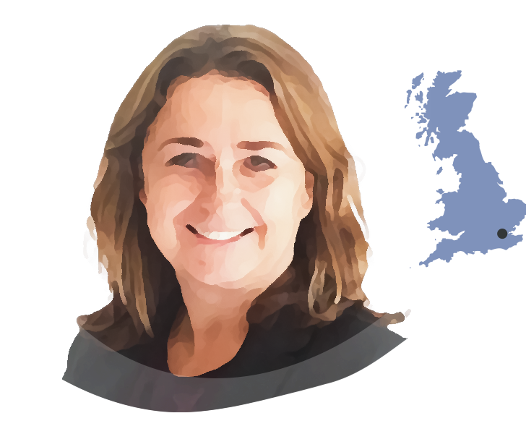
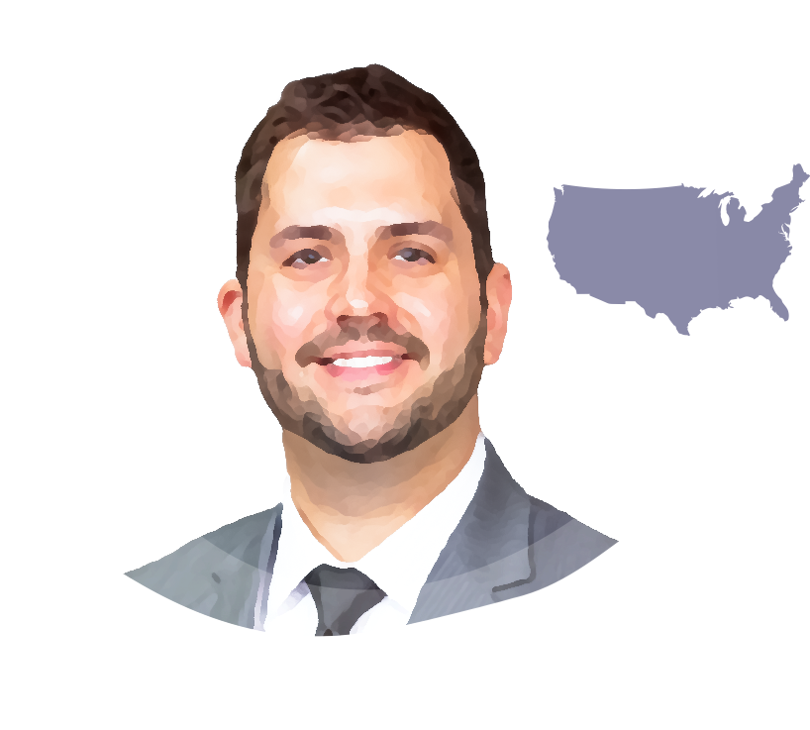
This micro e-learning module has been developed by a
multidisciplinary panel of experts
Dr. Gianluigi Pasta
Dr. Michael A. Mazzeffi
Dr. Alison Dougall
Prof. Ana Boban
IRELAND
ITALY
CROATIA
USA
Dental consultant medically complex patients at Dublin Dental Hospital
Director of doctorate programme in special care dentistry, Trinity College Dublin
Former chair of World Federation of Haemophilia Dental Committee
Medical advisory board member of European Haemophilia Consortium (EHC)
President of International Society for Disability and Oral Health
Orthopaedic consultant at the Haemophilia Centre at Fondazione IRCCS Policlinico San Matteo di Pavia
Chair of the Musculoskeletal Committee of the World Federation of Haemophilia (WFH)
Coordinator of Musculoskeletal Group of Italian Haemophilia Centres Association
Cardiothoracic anaesthesiologist and intensive care physician
Executive vice chair and director of cardiac intensive care at George Washington University School of Medicine in Washington, DC
Head of Haemophilia Centre at the University Hospital Centre Zagreb
Professor of internal medicine at the School of Medicine of the University of Zagreb, Croatia
Specialist degrees in internal medicine and haematology
Executive committee member of the European Association for Haemophilia and Allied Disorders (EAHAD)
Dr. Med. Rosa Sonja Alesci
Prof. Jan Blatný
CZECH REPUBLIC
Dr. Vickie McDonald
GERMANY
Consultant Haematologist, director of Haemophilia Comprehensive Care Centre and medical director of Paediatrics at University Hospital in Brno
Associate professor of paediatrics at Masaryk University in Brno
Active member of International Society on Thrombosis and Haemostasis (ISTH), Vice president of EAHAD and MAG member of EHC
Paediatric coordinator of the Czech National Haemophilia Programme
Haematology consultant and health economist
Director of the IMD Blood Coagulation Centre in Bad Homburg/Frankfurt/Wiesbaden
Active member of German Society of Haematology and Oncology
Member of medical advisory board German Alliance for Security of Haemophilia
Dr. Jonathan C. Roberts
UK
USA
Consultant Haematologist at the Royal London Hospital, London
Honorary senior lecturer at Queen Mary University of London
National chief investigator for the UK immune thrombocytopenia (ITP) registry
Associate medical director and associate research director at the Bleeding & Clotting Disorders Institute (BCDI)
Assistant professor of Paediatrics and Medicine at the University of Illinois College of Medicine at Peoria in Peoria, IL
Haematologist with BCDI
The views expressed in this slide deck are the personal opinions of the experts. They do not necessarily represent the views of the experts’ institutions or the rest of the HEMOSTASIS CONNECT group.
3

Slide 4
When to suspect von Willebrand disease
Module 1 summary
Module 1 of this micro e-learning programme described how von Willebrand disease is the most common inherited bleeding disorder, occurring in men, women, and children. Signs and symptoms of von Willebrand disease include:
General
Paediatric
Gynaecological
Family history of a bleeding disorder
Nosebleeds
Heavy menstrual bleeding, especially since menarche
Notable bruising without injury
Bleeding during teething in small children
Bleeding during ovulation
Prolonged/excessive bleeding, even from minor wounds
Notable bruising without injury
Primary and late post-partum haemorrhage
Dental
Prolonged/excessive bleeding from minor wounds
Surgical
Prolonged bleeding following invasive dental procedures
Joint pain and/or bleeds
ENT
Nosebleeds
Prolonged and/or severe bleeding after minor or major surgery
Prolonged bleeding from the gums following deep cleaning
Severe (potentially life-threatening) bleeding after tonsillectomy/ adenoidectomy
Gastrointestinal
Recurrent ulcers and pallor of the mucosa associated with anaemia
Bleeding of gastrointestinal tract with or without an obvious anatomic lesion in adults
ENT, ear, nose, and throat
This slide is based on the clinical experience of the authors
4

Slide 5
When to suspect von Willebrand disease
Module 2 summary
Module 2 of this micro e-learning programme described the next steps to take when you suspect von Willebrand disease in your patient:
History
Take a thorough bleeding history, including a detailed family history
Use a validated bleeding assessment tool (BAT), such as the ISTH-SSC BAT
Laboratory assessment
Perform general laboratory assessment
Assessment of iron status, haemoglobin, and red blood cell count provide important information for clinical management
Refer to/consult a haematologist for diagnostic laboratory assessment
There are many pitfalls in the interpretation of diagnostic laboratory tests
Management
Management of von Willebrand disease requires a multidisciplinary approach
Surgical procedures require a multidisciplinary risk assessment and proportionate personalised management plan
BAT, bleeding assessment tool; ISTH, International Society on Thrombosis and Haemostasis; SSC, Scientific and Standardization Committee
5

Slide 6
Treatment of von Willebrand disease
Several treatment options are available to improve haemostasis
They are used to manage symptoms and prevent excessive/prolonged bleeding after surgery or delivery
The treatment choice is impacted by:
Type and severity of von Willebrand disease
Clinical circumstances
Oral or intravenous anti-fibrinolytics (tranexamic acid or aminocaproic acid) bind to the lysine-binding sites of plasminogen and delay the breakdown of blood clots
Intravenous VWF replacement therapy directly supplements (functional) VWF
Nasal or intravenous DDAVP (desmopressin) induces release of VWF from storage sites in endothelial cells
(Fluid restrictions are required)
Other commonly used treatment options in patients with von Willebrand disease:
Hormonal therapy for the treatment of heavy menstrual bleeding
Iron replacement therapy for the treatment of iron deficiency with or without anaemia
DDAVP, desmopressin; VWF, von Willebrand factor Connell NT, et al. Blood Adv. 2021;5:301-25
6

Slide 7
Von Willebrand disease
impacts many aspects of healthcare
All healthcare practitioners should be aware of the diagnosis of von Willebrand disease and its impact on the care they provide.
Psychological and primary care
Anaesthesia and pain management
Obstetrics and gynaecology
Quality of life issues
Misinterpretation of bruising
Neuraxial anaesthesia
NSAID use
Increased risk for needing a blood transfusion
Heavy menstrual bleeding
Prolonged/excessive bleeding with pregnancy, delivery, and fertility procedures
Surgery
Dentistry
Invasive procedures
Prolonged/excessive bleeding during or after invasive dental procedures
Prolonged/excessive bleeding during or after invasive procedures, such as endoscopy or fertility procedures
Prolonged/excessive bleeding during or after surgery
Orthopaedic surgery for arthropathy (rare*)
Multidisciplinary care is key, building of network of teams who provide wider care for patients with von Willebrand disease, including nurses, dental care specialists, surgeons, primary care physicians, psychologists, etc.
In many countries, diagnosed patients receive an emergency card from their haematologist to show to healthcare providers in case of emergency, helping patients to advocate for themselves.
* von Willebrand disease is rarely associated with arthropathy requiring orthopaedic surgery; this complication is more common with haemophilia
NSAID, non-steroidal anti-inflammatory drug
7

Slide 8
Careful planning is required with invasive procedures, pregnancy and delivery
On a day-to-day basis, von Willebrand disease may not cause major issues.
However, there are specific circumstances where caution should be exercised, such as:
Pregnancy
Delivery
Minor elective surgery
Major surgery
Invasive procedures (e.g., endoscopy, fertility procedures)
Patients with von Willebrand disease have an increased bleeding risk, so involve a haematologist early, as careful planning is required.
Ensure a haemostasis care plan is in place for the prevention and treatment of bleeding complications
Do not hesitate to contact the haematologist, as it is preferable to avoid bleeding, instead of treating it when it happens.
It is important not to under-treat patients with von Willebrand disease
8

Slide 9
Planning care for a patient with von Willebrand disease
Consult a haematologist upfront whenever there is concern for bleeding risk
To decide on the most appropriate haemostasis care plan, the haematologist will consider:
Type and severity of von Willebrand disease
Bleeding risk associated with the situation or procedure
Other circumstances (such as comorbidity)
Patients with severe disease may need VWF replacement therapy, where in patients with milder phenotypes anti-fibrinolytics or DDAVP may suffice
In milder von Willebrand disease, pregnancy and surgery can increase VWF levels (sometimes to normal range), but for others additional therapy may be needed
Pregnant patients should be followed up in a high-risk antenatal clinic
If VWF levels do not sufficiently increase during pregnancy, additional treatment is required for delivery
VWF levels drop significantly after delivery, so awareness of postpartum bleeding is required
For minor procedures, antifibrinolytics may be sufficient to manage the bleeding risk
DDAVP may not be suitable for some patients, including elderly patients with an increased cardiovascular risk and patients who cannot tolerate the fluid restrictions
DDAVP, desmopressin; VWF, von Willebrand factor
Doherty D, et al. J Thromb Haemost. 2021;19:701-10
9

Slide 10
Planning dental care
for a patient with von Willebrand disease
Dental Care
Dental procedures
Gum bleeding is common but often ignored in patients with VWD.¹⁻³
Healthcare providers and patients mistakenly think gum bleeding is acceptable or inevitable and caused by the VWD itself from brushing too hard. Untreated, this leads to periodontal disease and tooth loss over time.
Dental cleaning, fillings, sealants and dental injections are usually not high-risk procedures.
Higher-risk procedures include gum surgery or dental extractions.
Managing the risk
Managing the risk
Educate patients on how to care for their gums
Give patients permission to brush in the presence of bleeding to ensure the plaque biofilm is removed thoroughly to reduce local inflammation
Dental cleaning can usually be carried out under anti-fibrinolytic cover alone^{4,5}
Dental procedures require upfront risk assessment and careful planning
Higher-risk procedures require a dentist applied local measures, systemic antifibrinolytic therapy and/or replacement therapy plus careful post-operative instructions
VWD, von Willebrand disease 1. Carcao MD, et al. Haemophilia. 2010;16:943-8; 2. Noone D, et al. Haemophilia. 2021;27 issue S2:143; 3. Epping L, et al. PLoS One. 2018;13:e0191291; 4. Doherty D, et al. J Thromb Haemost. 2021;19:701-10; 5. van Galen KP, et al. Cochrane Database Syst Rev. 2019;4:CD011385
10

Slide 11
Planning care for a patient with von Willebrand disease:
the role of the patient
Before surgery, patients should:
Know and be able to summarise their type of von Willebrand disease, bleeding history and prior treatments
Be aware of any pre-operative preparation (e.g., starting oral anti-fibrinolytic therapy)
Optimise their nutritional and iron status
Understand the procedure and the bleeding risk
Be aware of their options for pain relief
Note NSAIDs are relatively contraindicated
Before higher-risk dental procedures, patients should:
Time the dental appointment to gain optimal protection from the systemic haemostatic measures and plan procedures at the beginning of the week, so any post-procedural bleeding occurs during weekdays, not on the weekend
Thoroughly clean the teeth during the week before, to remove plaque and reduce local inflammation that may increase bleeding from the wound
Shop for soft foods to prevent traumatising the wound and causing a rebleed
Prepare to not smoke post-operatively; nicotine replacement patches may be of help
Start oral antifibrinolytics the evening before or the morning of the procedure (if applicable)
Do not leave the dental clinic until haemostasis has been gained using local measures, including biting on s-gauze pack for at least 20-30 minutes
NSAID, non-steroidal anti-inflammatory drug
This slide is based on the clinical experience of the authors.
11

Slide 12
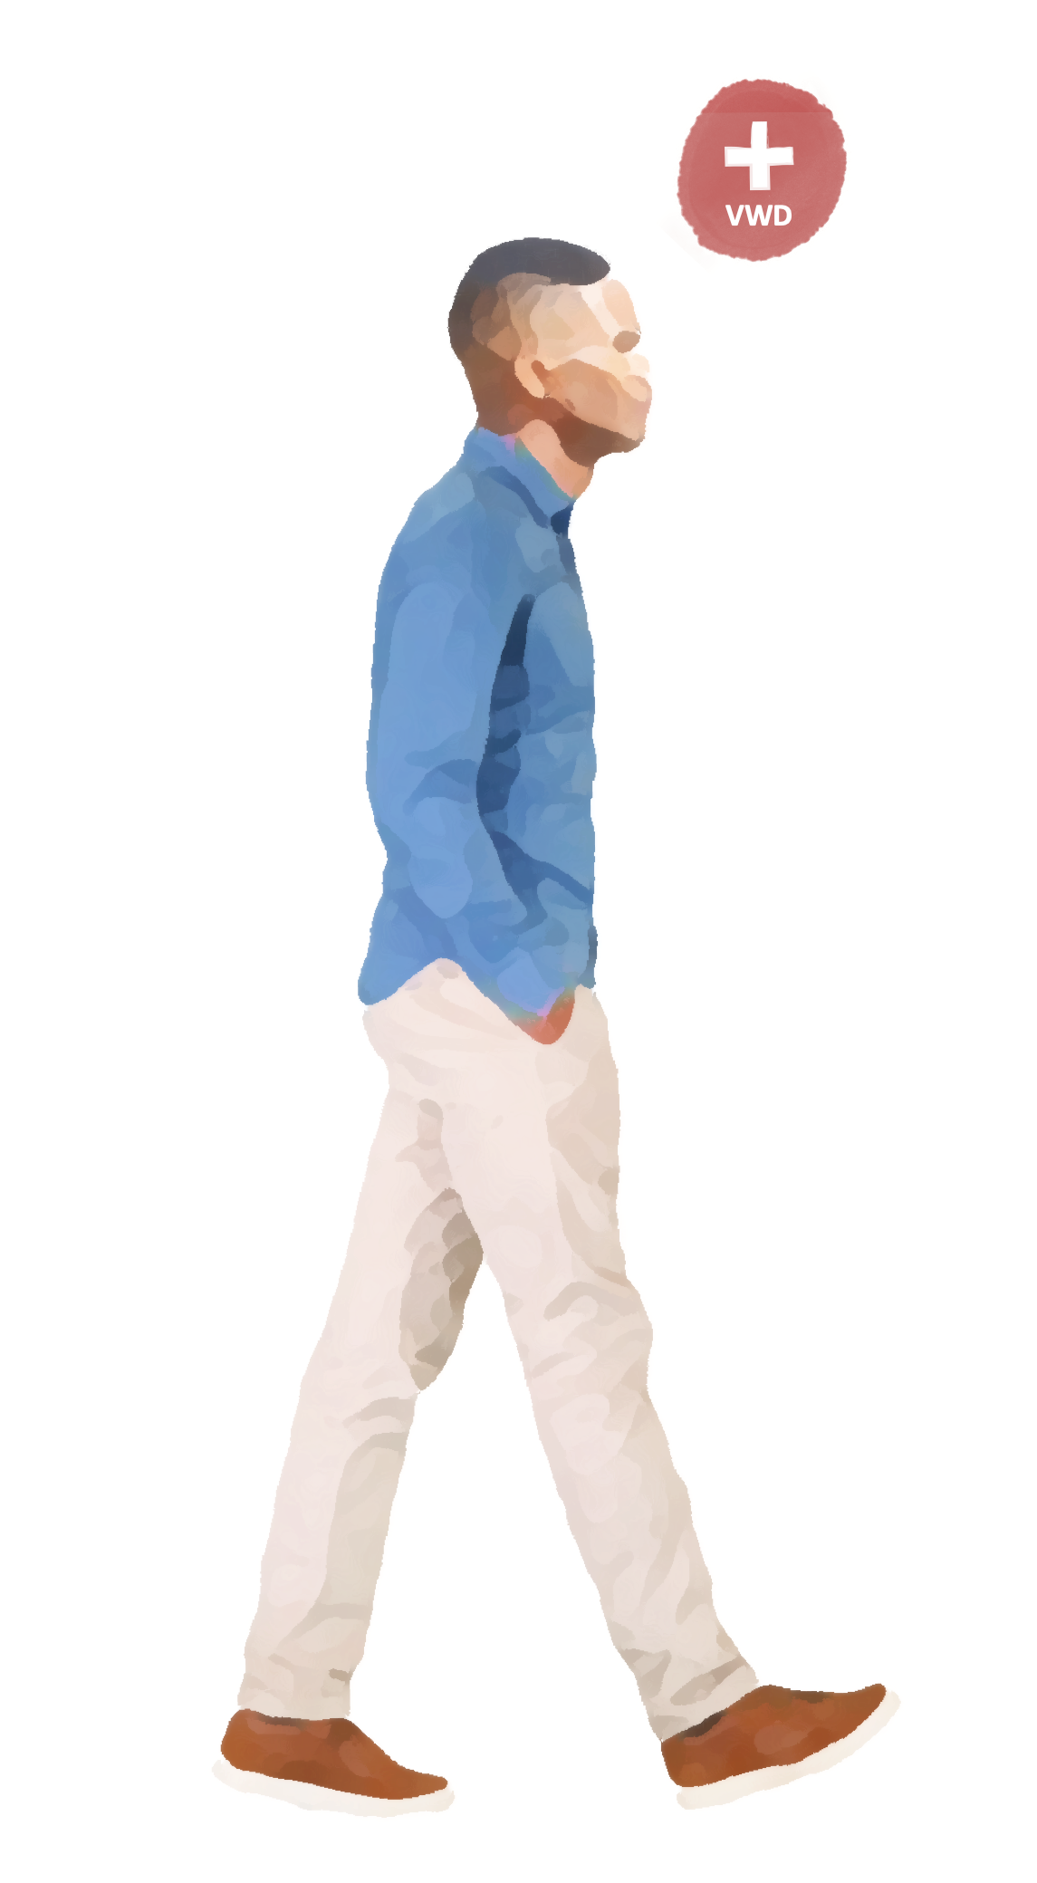
Acute care
for a patient with von Willebrand disease
Prepare for excessive bleeding and prioritise the bleeding
In case of acute medical situations…
If possible, always consult a haematologist
Bleeding events or other conditions requiring acute medical care
Ask the patient for the type of von Willebrand disease, bleeding history and treatment of choice
(or check the guidelines)
Inform the primary care physician where applicable
The role of the patient in acute care
Make sure:
patients know the local emergency pathway and emergency contact numbers
any factor replacement patients have at home is always in date (if applicable)
when travelling, patients have international insurance and are aware of the nearest haemophilia centres (for patients with a more severe bleeding phenotype), as well as have a supply of any (emergency) treatment they may need (e.g. tranexamic acid, von Willebrand factor)
12

Slide 13
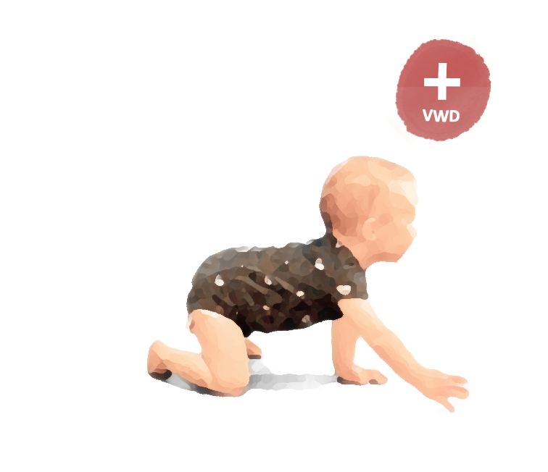
Caring for a patient with von Willebrand disease
Von Willebrand disease is a chronic disorder, so the key is to support patients in living a ‘normal’ life.
Allow time for patients to discuss issues relating to the impact of the bleeding disorder on their daily life.
Von Willebrand disease may influence concomitant medication.
NSAIDs and aspirin are relatively contraindicated, as they influence platelet function¹
Paracetamol and COX-2 inhibitors can be used for pain relief
If NSAIDs or aspirin are needed, carefully consider risks and benefits on a case-by-case basis
Before starting any new medication, check for a potential impact on clotting and discuss the individual risk-benefit profile with a haematologist
Psychological/
practical support
Lifestyle support
Work
School
Relationships
Sport
Manual jobs
Travel
Recurrent nosebleeds
Heavy menstrual bleeding
Emergency help
Exercise
Diet
Weight
Iron supplements
Patient education
Use written information to reinforce support and aid decision making
Patient advocacy groups often provide helpful information and support
Consider at least yearly haematology follow up.
13

Slide 14
Summary
Von Willebrand disease impacts many aspects of healthcare, including planned and acute care, so a multidisciplinary approach is required
Consult a haematologist upfront whenever there's concern for bleeding risk, to develop a haemostatic treatment plan and be actively involved in the care team
Von Willebrand disease may influence the choice of other medication patients may need, such as pain medication
14

Slide 15
Next steps
Please now proceed to the assessment quiz in the e-learning to test your knowledge.
Visit Module 1 of this micro e-learning programme to learn more about:
the potential existence of von Willebrand disease among your patent population
the signs and symptoms of von Willebrand disease
Visit Module 2 of this micro e-learning programme to learn more about:
how you can help diagnose von Willebrand disease
how to effectively use the screening tools available
the next steps to take when suspecting von Willebrand disease
Note: you will be able to claim your CME credit after passing at least 2 of the 3 modules
CME credit available
Visit programme home page on:
15

