Slide 2
PRACTICAL CONSIDERATIONS WHEN SEQUENCING TREATMENTS FOR mCRPC PATIENTS in CLINICAL PRACTICE Joanne Chien, MSN, RN, GNP-BC Stanford Health Care, Palo Alto, CA, USA AUGUST 2021
mCRPC, metastatic castration-resistant prostate cancer

Slide 3
Disclaimer and disclosure
Please note: The views expressed within this presentation are the personal opinions of the author. They do not necessarily represent the views of the author’s academic institution or the rest of the GU NURSES CONNECT group.
This content is supported by an Independent Educational Grant from Bayer.
Joanne Chien does not have any relevant financial relationships to disclose.

Slide 4
introduction
Treatment options for metastatic castration-resistant prostate cancer (mCRPC) have increased dramatically over recent years
Prior treatments during metastatic castration-sensitive prostate cancer (mCSPC) and non-metastatic castration-resistant prostate cancer (nmCRPC) impact future treatment decisions
mCRPC patients may have already received treatment with an androgen-receptor pathway inhibitor (ARPI)
Sequencing is evolving: numerous studies ongoing to develop new therapies, optimise sequencing and/or combination therapies
Cross-resistance can occur with ARPIs so it is preferable to select subsequent therapies with a different mechanism of action
Real-world findings provide valuable information, including data in patients with comorbidities
ARPI, androgen receptor pathway inhibitor; mCRPC, metastatic castration-resistant prostate cancer; mCSPC, metastatic castration-sensitive prostate cancer; nmCRPC, non-metastatic castration-resistant prostate cancer
1. Lowrance W, et al. Advanced Prostate Cancer: AUA/ASTRO/SUO guideline. Available from https://www.auanet.org/guidelines/advanced-prostate-cancer. Accessed Jul 30, 2021; 2. NCCN Clinical Practice Guidelines in Oncology – Prostate Cancer, version 2.2021. Accessed Jul 30, 2021

Slide 5
APPROVED TREATMENTS FOR mCSPC and nmCRPC
Abiraterone
Enzalutamide
Feb 2018
Dec 2019
FDA approvals in mCSPC
2015/2016
Sept 2019
Docetaxel*
Apalutamide
Enzalutamide
July 2018
FDA approvals in nmCRPC
Feb 2018
July 2019
Apalutamide
Darolutamide
*Level-1 evidence, no SNDA filed
FDA, Food & Drug Administration; mCSPC, metastatic castration-sensitive prostate cancer; nmCRPC, non-metastatic castration-resistant prostate cancer; SNDA, supplementary new drug application
www.fda.gov

Slide 6
APPROVED TREATMENTS FOR mCRPC
Treatment choice for mCRPC is dependent on prior treatments received during mCSPC (doce, abi, enza, apa) or nmCRPC (apa, enza, daro)
Abiratetone (pre-taxane-based chemotherapy)
Sipuleucel-T
Enzalutamide (post-taxane-based chemotherapy)
Enzalutamide (pre-taxane-based chemotherapy)
Rucaparib* (deleterious BRCA mutation germline and/or somatic)
Cabazitaxel (2nd Line)
2010
2012
2014
2020
FDA approvals in mCRPC
2004
2011
2013
2017
2020
Docetaxel
Abiratetone (post-taxane-based chemotherapy)
Radium-223
Pembrolizumab (dMMR or MSI-H)
Olaparib** (HRR mutations)
*Progressed following androgen-axis targeted treatment and taxane-based chemotherapy; **Progressed following treatment with enzalutamide or abiraterone
abi, abiraterone; apa, apalutamide; BRCA, breast cancer; daro, darolutamide; dMMR, deficient DNA mismatch repair; doce, docetaxel; enza, enzalutamide; FDA, Food & Drug Administration; HRR, homologous recombination repair; mCRPC, metastatic castration-resistant prostate cancer; mCSPC, metastatic castration-sensitive prostate cancer; MSI-H, microsatellite instability-high. www.fda.gov

Slide 7
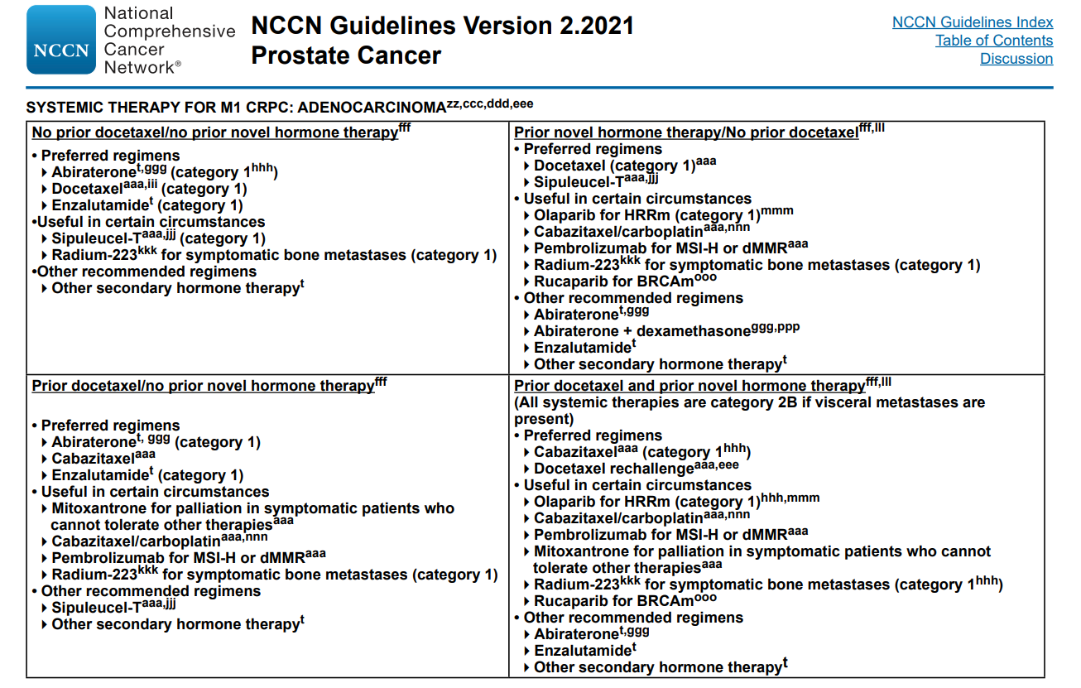
BRCAm, breast cancer mutated; dMMR, deficient DNA mismatch repair; HRRm, homologous recombination repair mutated; MSI-H, microsatellite instability-high
NCCN Clinical Practice Guidelines in Oncology – Prostate Cancer, version 2.2021. Accessed Jul 30, 2021

Slide 8
Treatment Patterns in Patients with mCRPC in a Real-World Clinical Practice Setting in the United States
Patients with mCRPC receiving various life- prolonging therapies in the 1L, 2L and 3L settings
Duration of mCRPC treatment by line of therapy for 1L, 2L and 3L therapies
Treatment | Treatment duration, monthsª
 | 1L |  | 2L |  | 3L
 | N | Median (min-max) | N | Median (min-max) | N | Median (min-max)
Docetaxel | 293 | 4.6 (0.03-28.9) | 137 | 3.8 (0.03-37.2) | 101 | 4.1 (0.03-20.8)
Abiraterone | 742 | 5.4 (0.03-47.5) | 193 | 4.8 (0.03-53.4) | 59 | 4.2 (0.3-17.5)
Enzalutamide | 552 | 5.8 (0.03-48.6) | 326 | 5.4 (0.03-36.5) | 68 | 4.0 (0.03-27.2)
Other combination | 107 | 4.7 (0.27-28.6) | 112 | 4.3 (0.03-24.0) | 51 | 4.9 (0.03-28.4)
Sipuleucel-T | 140 | 3.5 (0.03-51.4) | 16 | 2.5 (0.03-6.8) | 14 | 2.8 (0.03-13.2)
Cabazitaxel | 22 | 2.2 (0.03-6.3) | 61 | 2.6 (0.03-26.3) | 46 | 3.1 (0.03-24.5)
Radium overall | 94 | 6.0 (0.03-34.4) | 85 | 5.0 (0.03-22.7) | 56 | 4.4 (0.03-13.1)
Radium-223 | 47 | 4.7 (0.03-16.1) | 32 | 4.9 (0.03-13.3) | 33 | 5.1 (0.03-11.0)
Radium combination | 47 | 7.3 (0.7-34.4) | 53 | 5.2 (0.4-22.7) | 23 | 4.1 (0.8-13.1)
Other | 30 | 1.9 (0.03-18.4) | 39 | 1.9 (0.03-22.9) | 19 | 1.7 (0.4-12.9)
ªIn cases in which patients were treated with combination therapy, the duration of therapy was defined as the period between the first and last administration of any agent(s) in the combination
1L (N=1980)
2L (N=969)
3L (N=414)
Patients (%)
Monotherapy
Combination therapy with radium-223
Other Combination therapy
1L, first line; 2L, second line; 3L, third line; mCRPC, metastatic castration-resistant prostate cancer
George D, et al. Clinical Genitourinary Cancer. 2020;18:284-94

Slide 9
Treatment Patterns in Patients with mCRPC in a Real-World Clinical Practice Setting in the United States
THE PROPORTION OF PATIENTS WITH mCRPC RECEIVING LIFE-PROLONGING ANTICANCER THERAPIES IN THE 1L, 2L AND 3L SETTINGS
The median OS was longer in patients who received life-prolonging therapies (23.7 months; 95% CI: 22.3-25.1 months) than in those who did not (10.1 months; 95% CI: 9.1-11.5 months)
Underutilisation of life-prolonging treatment
Most common therapies per line: abiraterone/prednisone (1L), enzalutamide (2L), docetaxel (3L)
Back-to-back use of abiraterone/prednisone and enzalutamide was common despite known cross-resistance
The results suggested an underutilisation of radium-223 and BHAs
mCRPC (N=2,559)
1L
2L
3L
43% (414/969)
29% (122/414)
77% (1,980/2,559)
49% (969/1,980)
28% (267/969)
23% (447/1,980)
Patients with mCRPC (N=2,559)
Patients receiving life-prolonging therapy (1L, n=1,980; 2L, n=969; 3L, n=414)
Patients who died without receiving a subsequent line of therapy
A total of 23%, 28% and 29% of patients did not receive a subsequent line of therapy after 1L, 2L and 3L therapy, respectively. In this Sankey diagram, a node to the right illustrates patients with mCRPC (grey) transitioning to a subsequent line of therapy (green) or death without receiving a subsequent line (blue).
1L, first line; 2L, second line; 3L, third line; BHAs, bone health agents; CI, confidence interval; mCRPC, metastatic castration-resistant prostate cancer; OS, overall survival
George D, et al. Clinical Genitourinary Cancer. 2020;18:284-94

Slide 10
CARD study design
Phase 4 trial of cabazitaxel vs. abiraterone or enzalutamide in previously treated mCRPC patients
Multicenter, randomised, open-label study
Enrolment: Nov 2015 – Nov 2018
Median follow-up: 9.2 months
Cabazitaxel (25 mg/m² Q3W) + prednisone + G-CSF n=129
Endpoints
Primary: rPFS
Key secondary: OS, PFS, PSA response, tumour response
Other secondary: Pain response, time to symptomatic skeletal event, safety, HRQoL, biomarkers
Patients with mCRPC who progressed ≤12 months on prior alternative ARTA (before or after docetaxel)
N=255
R 1:1
Abiraterone (1000 mg QD) + prednisone OR Enzalutamide (160 mg QD) n=126
Stratification factors:
ECOG PS (0/1 vs 2)
Time to progression on prior alternative ARTA (0–6 vs >6–12 months)
Timing of ARTA (before vs after docetaxel)
ARTA, androgen receptor-targeted agents; ECOG PS, eastern cooperative oncology group performance status; G-CSF, granulocyte colony stimulating factor; HRQoL, health-related quality of life; mCRPC, metastatic castration-resistant prostate cancer; OS, overall survival; Q3W, every three weeks; QD, once daily; (r)PFS, (radiographic) progression free survival; PSA, prostate-specific antigen
1. de Wit R, et al. Ann Oncol. 2019;30(suppl_5):v851-v934; 2. de Wit R, et al. N Engl J Med. 2019;381:2506-18.

Slide 11
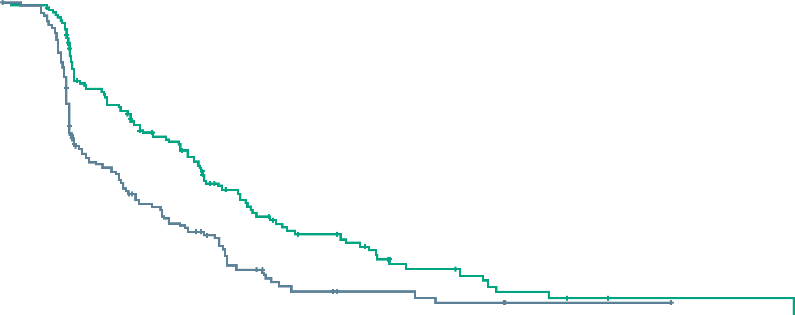
CARD study: Primary Endpoint
Radiographic progression-free survival
100
 | No. of patients | Median imaging-based progression-free survival (95% CI) mo
Cabazitaxel | 129 | 8.0 (5.7-9.2)
Androgen-signaling–targeted inhibitor | 126 | 3.7 (2.8-5.1)
Hazard ratio for imaging-based progression or death, 0.54 (95% CI, 0.40-0.73) P<0.001
90
80
70
60
Percentage of patients with progression-free survival
50
Cabazitaxel
40
30
Androgen- signalling– targeted inhibitor
20
10
0
0
3
6
9
12
18
24
30
No. at risk
Cabazitaxel
Androgen-signalling– targeted inhibitor
129
126
91
61
64
36
41
22
23
7
9
3
2
1
1
0
CI, confidence interval
de Wit, R et al. N Engl J Med. 2019;381:2506-18

Slide 12
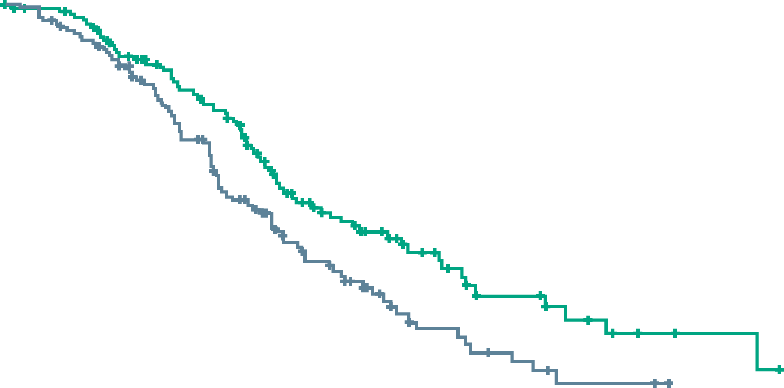
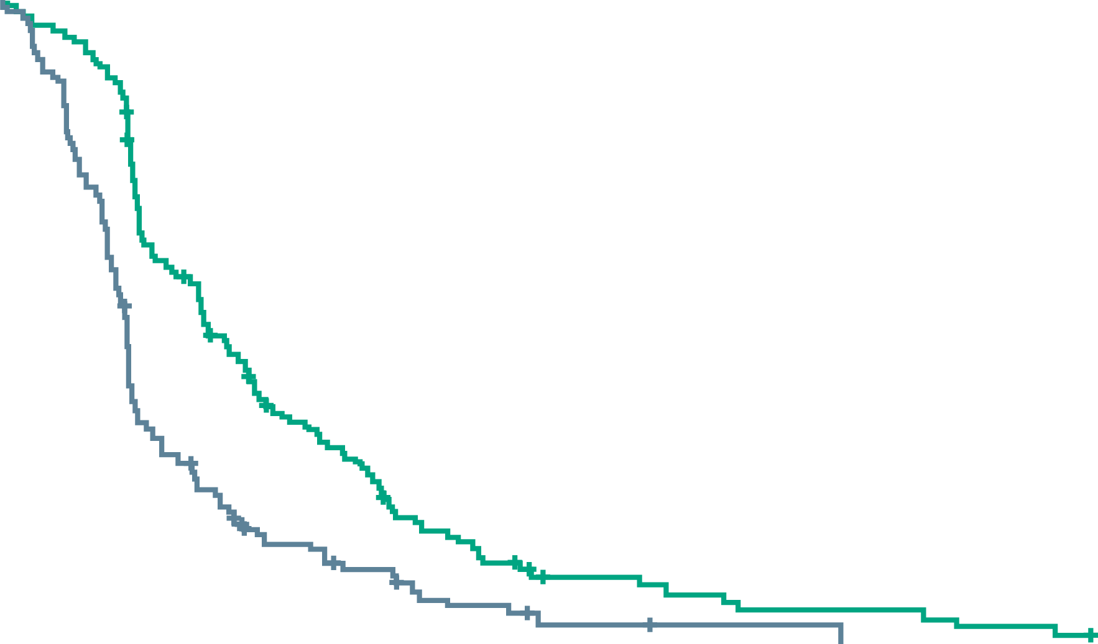
CARD study: secondary Endpoints
OVERALL SURVIVAL
PROGRESSION-FREE SURVIVAL
 | No. of patients | Median overall survival (95% CI) mo
Cabazitaxel | 129 | 13.6 (11.5-17.5)
Androgen-signaling– targeted inhibitor | 126 | 11.0 (9.2-12.9)
Hazard ratio for death, 0.64 (95% CI, 0.46-0.89) P=0.008
 | No. of patients | Median progression-free survival (95% CI) mo
Cabazitaxel | 129 | 4.4 (3.6-5.4)
Androgen-signaling– targeted inhibitor | 126 | 2.7 (2.4-2.8)
Hazard ratio for progression or death, 0.52 (95% CI, 0.40-0.68) P<0.001
100
100
90
90
80
80
70
70
60
60
Percentage of patients who were alive
Percentage of patients with progression-free survival
50
50
40
40
Cabazitaxel
30
Cabazitaxel
30
20
Androgen-signalling– targeted inhibitor
20
Androgen- signalling– targeted inhibitor
10
10
0
0
0
3
6
9
12
18
24
30
0
3
6
9
12
18
24
No. at risk
Cabazitaxel
Androgen-signalling– targeted inhibitor
Months
No. at risk
Cabazitaxel
Androgen-signalling– targeted inhibitor
Months
129
126
122
116
96
88
77
64
51
39
21
11
8
3
2
0
129
126
82
42
39
16
20
7
8
2
4
1
0
0
Chemotherapy with cabazitaxel was superior to the alternate NHA:
Improved OS, PFS, PSA response, tumour response, pain response, time to SSE
No new safety signals were observed
Improved QOL favouring cabazitaxel
Cabazitaxel should be offered prior to 2nd NHA
CI, confidence interval; NHA, novel hormonal agents; OS, overall survival; PFS, progression-free survival; PSA, prostate-specific antigen, SSE, symptomatic skeletal event; QOL, quality of life
1. de Wit, R et al. N Engl J Med. 2019;381:2506-18; 2. Fizazi K, et al. Lancet Oncol. 2020:21:1513-25

Slide 13
Real-World Evidence For Patients with mCRPC treated with Cabazitaxel
Comparison with the RandomiSed Clinical Study CARD
 | CARD-like cohort cabazitaxel (N=452) | CARD study cabazitaxel (N=129)
Treatment duration Median duration of treatment exposure, weeks (range) Treatment with first ARTA, weeks (range) ≤12 months >12 months Median number of cycles, n (range) | 12.9 (1.0-117.4) 21.6 (1.0-117.4), n=136 25.9 (1.0-108.6), n=297 6 (1-15)^{b} | 22.0 (3.0-88.0) 23.9 (3.0-87.9) 21.6 (6.0-51.7) 7.0 (1.0-29.0)
Treatment reduction Patients with ≥1 cycle administered at reduced dose, n (%) | 250 (55.3) | 27 (21.4)
Treatment discontinuation Patients who discontinued treatment, n (%) | 452 (100) | 120 (95.2)
Reasons for discontinuation Disease progression Adverse event Investigator decision Patient request Other reason To improve quality of life Not reported | 293 (64.8) – – 39 (8.6) 29 (8.6) 24 (5.3) 57 (12.6) | 55 (43.7) 25 (19.8) 21 (16.7) 12 (9.5) 7 (5.6) – 0
More patients received both abi and enza before cabazitaxel despite evidence of cross-resistance
More patients received lower dose; however, duration of treatment was comparable to the CARD study despite poorer ECOG and more aggressive disease features
Treatment with ARTA beyond PSA progression is common
Reflective of the CARD study population
Abi, abiraterone; ARTA, androgen receptor-targeted agent; ECOG, Eastern Cooperative Oncology Group; enza, enzalutamide; mCRPC, metastatic castration-resistant prostate cancer; PSA, prostate-specific antigen
de Wit R, et al. Ann of Oncol. 2020:31(suppl_4):S518 (ESMO 2020 poster)

Slide 14
Concurrent or Layered Treatment with Radium-223 and Enzalutamide or Abiraterone/prednisone
0.5
Any SSE
Pathologic fracture
1.0
With concomitant BHAs
Without concomitant BHAs
0.5
With concomitant BHAs
Without concomitant BHAs
0.9
0.4
0.8
0.4
0.7
0.3
0.6
0.3
SSE incidence rate (per person-year)
SSE incidence rate (per person-year)
Pathologic fracture incidence rate (per person-year)
0.5
0.2
0.4
0.2
0.3
0.1
0.2
0.1
0.1
0.0
0.0
0.0
Concurrent abiraterone/ prednisone
Layered abiraterone/ prednisone
Concurrent enzalutamide
Layered enzalutamide
All patients
Concurrent abiraterone/ prednisone
Layered abiraterone/ prednisone
Concurrent enzalutamide
Layered enzalutamide
All patients
Concurrent abiraterone/ prednisone
Layered abiraterone/ prednisone
Concurrent enzalutamide
Layered enzalutamide
All patients
SUMMARY OF OVERALL SURVIVAL
 | Radium-223 + abiraterone/prednisone (N=136) |  | Radium-223 + enzalutamide (N=167) |  | All patients (N=625)
 | Concurrent (n=39) | Layered (n=97) | Concurrent (n=44) | Layered (n=123)
Median follow-up time, months (range) | 13 (0-40) | 10 (0-42) | 12 (1-40) | 10 (0-32) | 9 (0-46)
Median OS from mCRPC diagnosis, months (95% CI) | 28.3 (18.4-NR) | 34.5 (25.9–50.9) | 28.1 (16.7-NR) | 26.9 (25.0-34.4) | 28.1 (25.7-30.4)
Median OS from radium-223 initiation, months (95% CI) | 22.1 (14.7-NR) | 19.3 (11.3-27.5) | 19.1 (12.3-NR) | 15.2 (11.6-16.3) | 15.2 (13.2-16.3)
Combination of radium-223 with either abiraterone/prednisone or enzalutamide was common in the US clinical setting
Layered approach (≥30 days) was more common than concurrent (within 30 days)
Lower incidence of pathological fracture in patients receiving BHAs
BHAs were underutilized
BHA, bone health agent; CI, confidence interval; mCRPC, metastatic castration-resistant prostate cancer; NR, not reached; OS, overall survival; SSE, symptomatic skeletal event
Shore N, et al. Prostate Cancer and Prostatic Dis. 2020;23:680-8

Slide 15
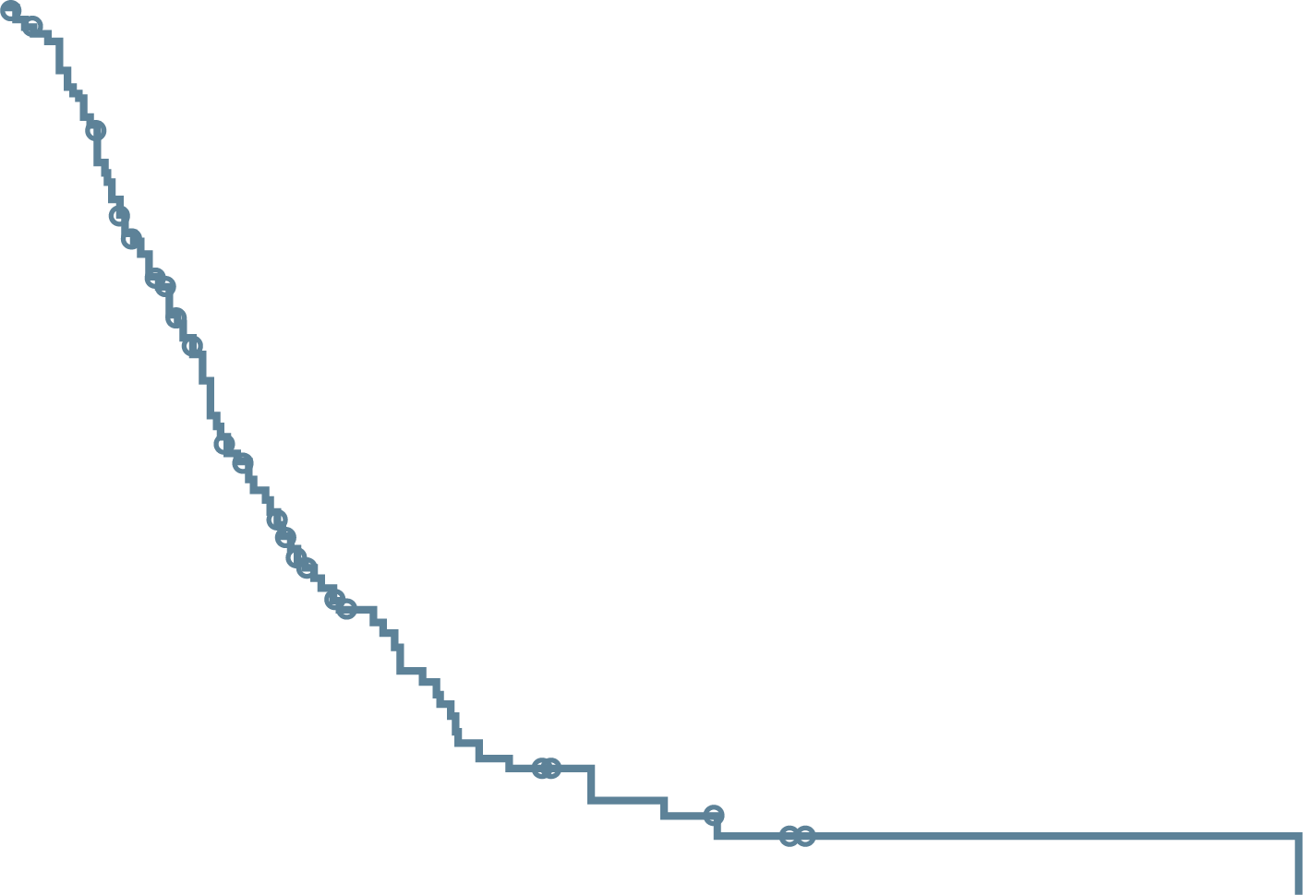
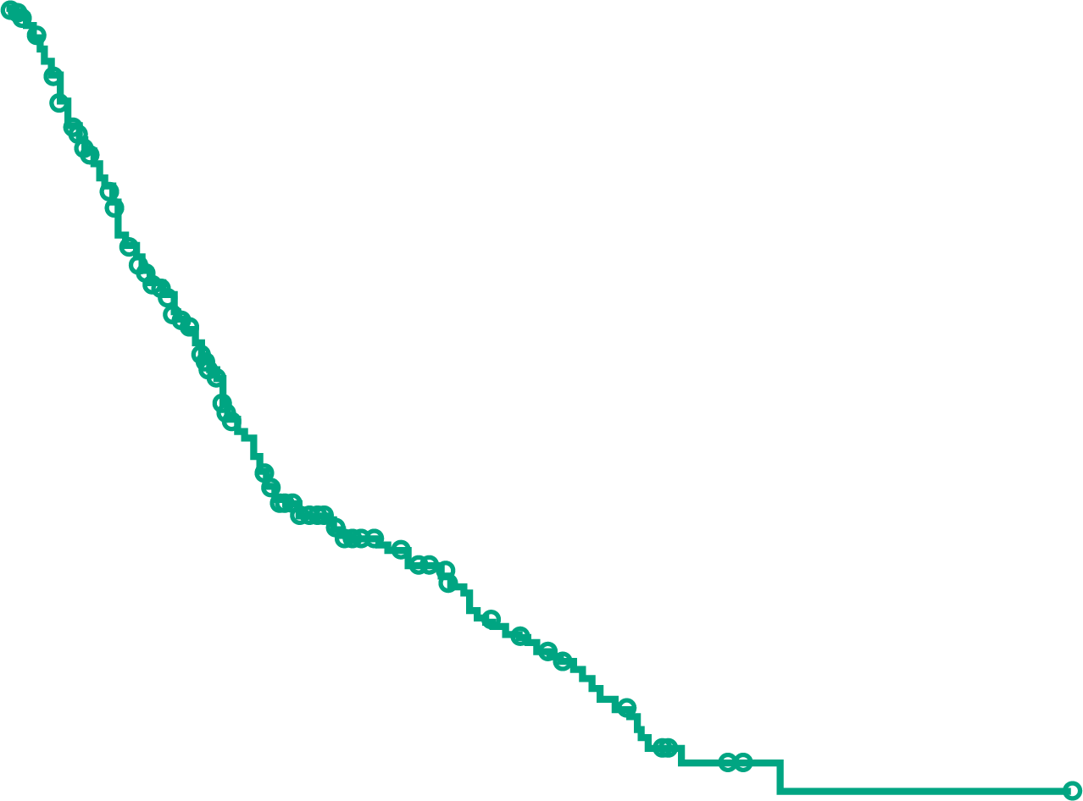
PHENIX real-world Study: sequential NAH or Ra-223 after progression on 1L NAH
SUBSEQUENT LIFE-PROLONGING THERAPY AFTER 2L RA-223 OR 2L NAH
OVERALL SURVIVAL FROM START OF 2L THERAPY
1.0
2L Ra-223:
Median OS (95% CI) 10.8 (9.3-12.9) months
1.0
2L NAH:
Median OS (95% CI) 11.2 (10.0-13.2) months
0.9
0.9
Any subsequent therapy
0.8
0.8
0.7
0.7
0.6
0.6
Survival probability
Survival probability
0.5
0.5
No:
61
(51%)
Yes:
59
(49%)
No:
138
(61%)
Yes:
88
(39%)
0.4
0.4
0.3
0.3
Ra-223
2L NAH
0.2
0.2
0.1
0.1
0.0
0.0
0
6
12
18
24
30
36
42
48
54
60
66
0
6
12
18
24
30
36
42
48
54
60
66
Patients at risk (n)
2L Ra-223
Time from 2L Ra-223 start (months)
Patients at risk (n)
2L NAH
Time from 2L NAH start (months)
120
83
43
22
10
6
3
1
1
1
1
0
226
147
76
44
27
15
4
1
1
1
0
0
SYMPTOMATIC SKELETAL EVENTS
Patients on 2L Ra-223 had similar rates of subsequent life-prolonging therapies as patients on 2L NAH (49% vs 39%)
The rate of SSEs after 2L start was similar in both cohorts
Patients with SSEs after 2L start, n/N (%)
All patients
32/120 (27)
Patients with prior SSEs before 2L start
18/61 (30)
2L Ra-223
All patients
49/226 (22)
Patients with prior SSEs before 2L start
23/75 (31)
2L NAH
57% of the 2L Ra-223 cohort and 58% of the 2L NAH cohort were taking bone health agents (mostly denosumab) at start of 2L therapy
2L, second line; BHA, bone health agents; CI, confidence interval; NAH, novel antihormone; Ra-223, radium-223; OS, overall survival; SSE, symptomatic skeletal event
Sartor O, et al. J Clin Oncol. 2021;39(suppl_6):abstract 48 (ASCO GU 2021 poster)

Slide 16
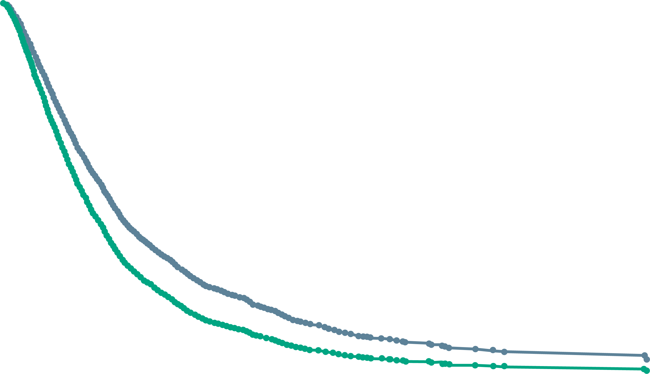
Ra-223 early vs late in the treatment sequence Real-world data
Patients who received Ra-223 in second-line versus third-line or later had better outcomes
Patients who received Ra-223 early received less chemotherapy, but had better survival
EFS was better in the early vs late Ra-223 cohort (HR 0.71, 95% CI 0.58-0.86)
OVERALL SURVIVAL
1.0
Adjusted Cox model of overall survival:
Early-use vs late-use of Ra-223
0.8
HR 0.79 (95% CI: 0.66-0.95)
Early Ra-223 (2nd line)
Primary outcomes
Overall survival
Secondary outcomes
Event free survival
Time to first hospitalisation
Time to first emergency department visit
Adjusted median survival time: 10.7 months in early-use and 8.3 months in late-use groups
versus
0.6
Probability of survival
All men with mCRPC receiving at least 2 lines of life-prolonging therapy (LPT) for mCRPC between 2012 and 2017 in Ontario, Canada
Cox regression models using counting process data
0.4
Ra-223 Early use
Ra-223 Late use
Late Ra-223 (3rd or later)
0.2
Adjusted for fixed and time-varying covarietes, including age, prostate- specific antigen, haemoglobin, Charlson Comorbidity Index (CCI), use of bone health agents, prior systemic treatments, Gleason score TNM score, androgen deprivation therapy (ADT) and standardised pain score
0
0
6
12
18
24
30
36
42
48
54
60
66
72
At risk
Early use
Late use
Follow-up time (months)
442
496
89
75
20
13
≤5
≤5
0
0
ADT, androgen deprivation therapy; CCI, Charlson Comorbidity Index; CI, confidence interval; EFS, event-free survival; HR, hazard ratio; LPT, life-prolonging therapy; mCRPC, metastatic castration-resistant prostate cancer; Ra-223, radium-223; TNM, tumour, node, metastasis
Mbuagbaw L, et al. J Clin Oncol. 2021;39(suppl_6):abstract 136 (ASCO GU 2021 poster presentation)

Slide 17
VISION trial: Lutetium-177-PSMA-617 for mCRPC
Eligible patients:
Previous treatment with both
≥1 androgen receptor pathway inhibitor
1 or 2 taxane regimens
Protocol-permitted standard of care (SOC) planned before randomisation
Excluding chemotherapy immunotherapy, radium-223, investigational drugs
ECOG performance status 0-2
Life expectancy >6 months
PSMA-positive mCRPC on PET/CT with ⁶⁸Ga-PSMA-11
Protocol-permitted SOC + ¹⁷⁷Lu-PSMA-617
7.4 GBq (200 mCi) every 6 weeks 4 cycles, increasable to 6
Endpoints
Primary: rPFS
Key secondary: OS, PFS, PSA response, tumour response
Other secondary: Pain response, time to symptomatic skeletal event, safety, HRQoL, biomarkers
R 2:1
Treatment
Final analysis
Follow-up
Protocol-permitted SOC alone
Randomisation stratified by:
ECOG status (0-1 or 2)
LDH (high or low)
Liver metastases (yes or no)
Androgen receptor pathway inhibitors in SOC (yes or no)
CT/MRI/bone scans:
Every 8 weeks (treatment)
Every 12 weeks (follow-up)
Blinded independent central review
CT, computerised tomography; ECOG, Eastern Cooperative Oncology Group; Ga, gallium; GBq, gigabecquerel; LDH, lactate dehydrogenase; Lu-177, lutetium-177; mCi, millicurie; mCRPC, metastatic castration-resistant prostate cancer; MRI, magnetic resonance imaging PET, positron emission tomography; PSMA, prostate-specific membrane antigen; SOC, standard of care
Sartor O, et al. N Engl J Med. 2021. DOI: 10.1056/NEJMoa2107322 (ASCO 2021 oral presentation)

Slide 18
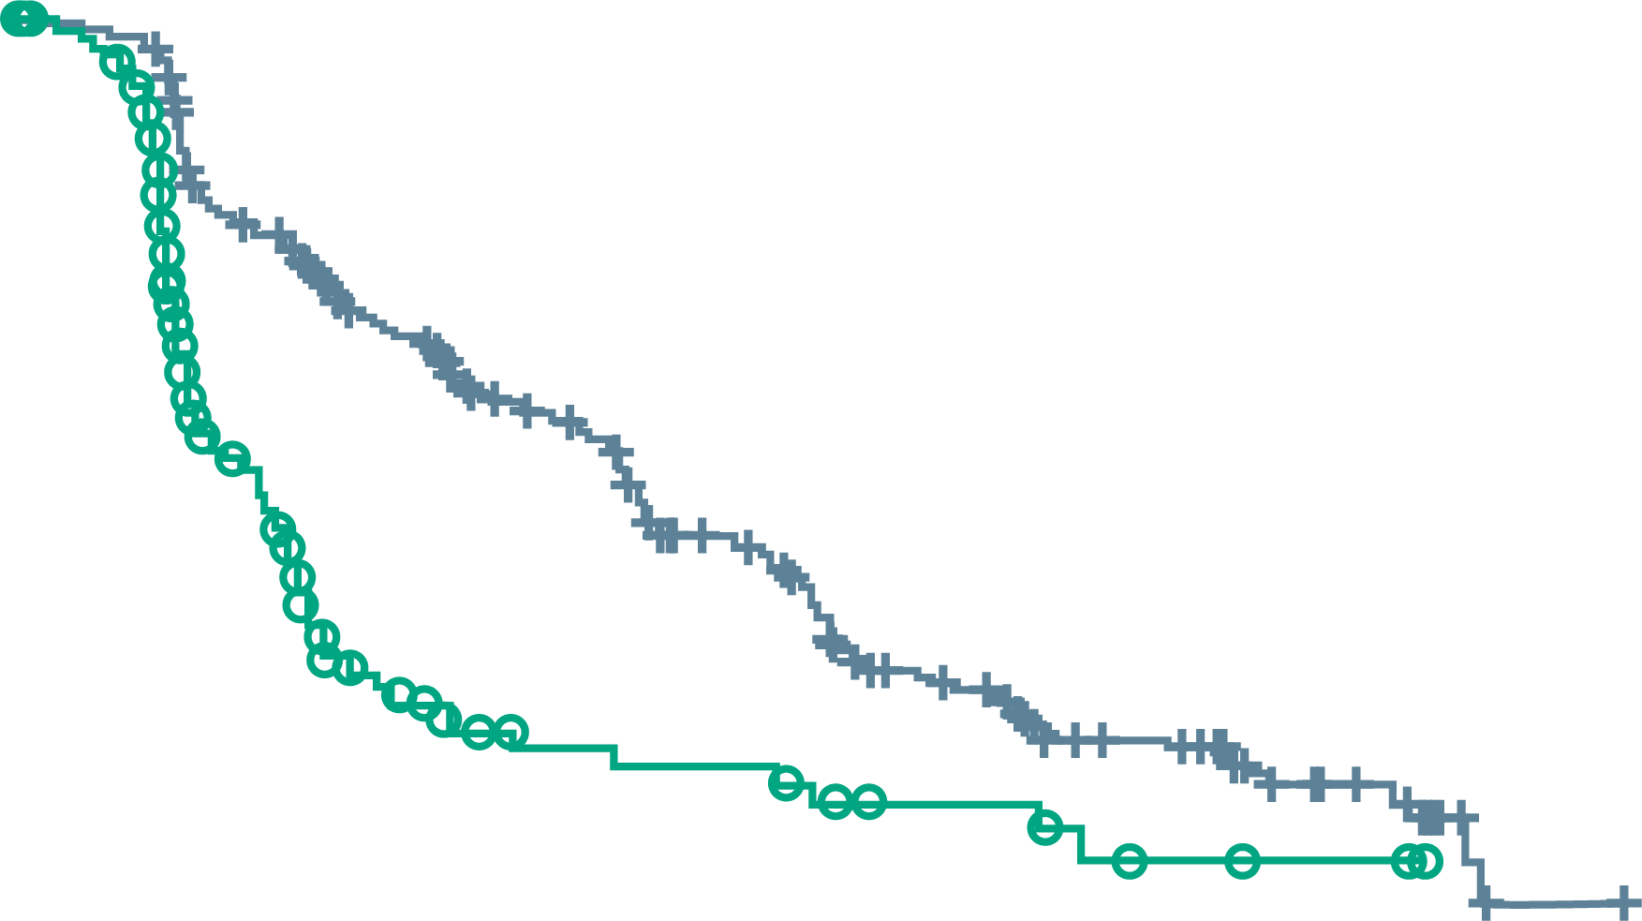
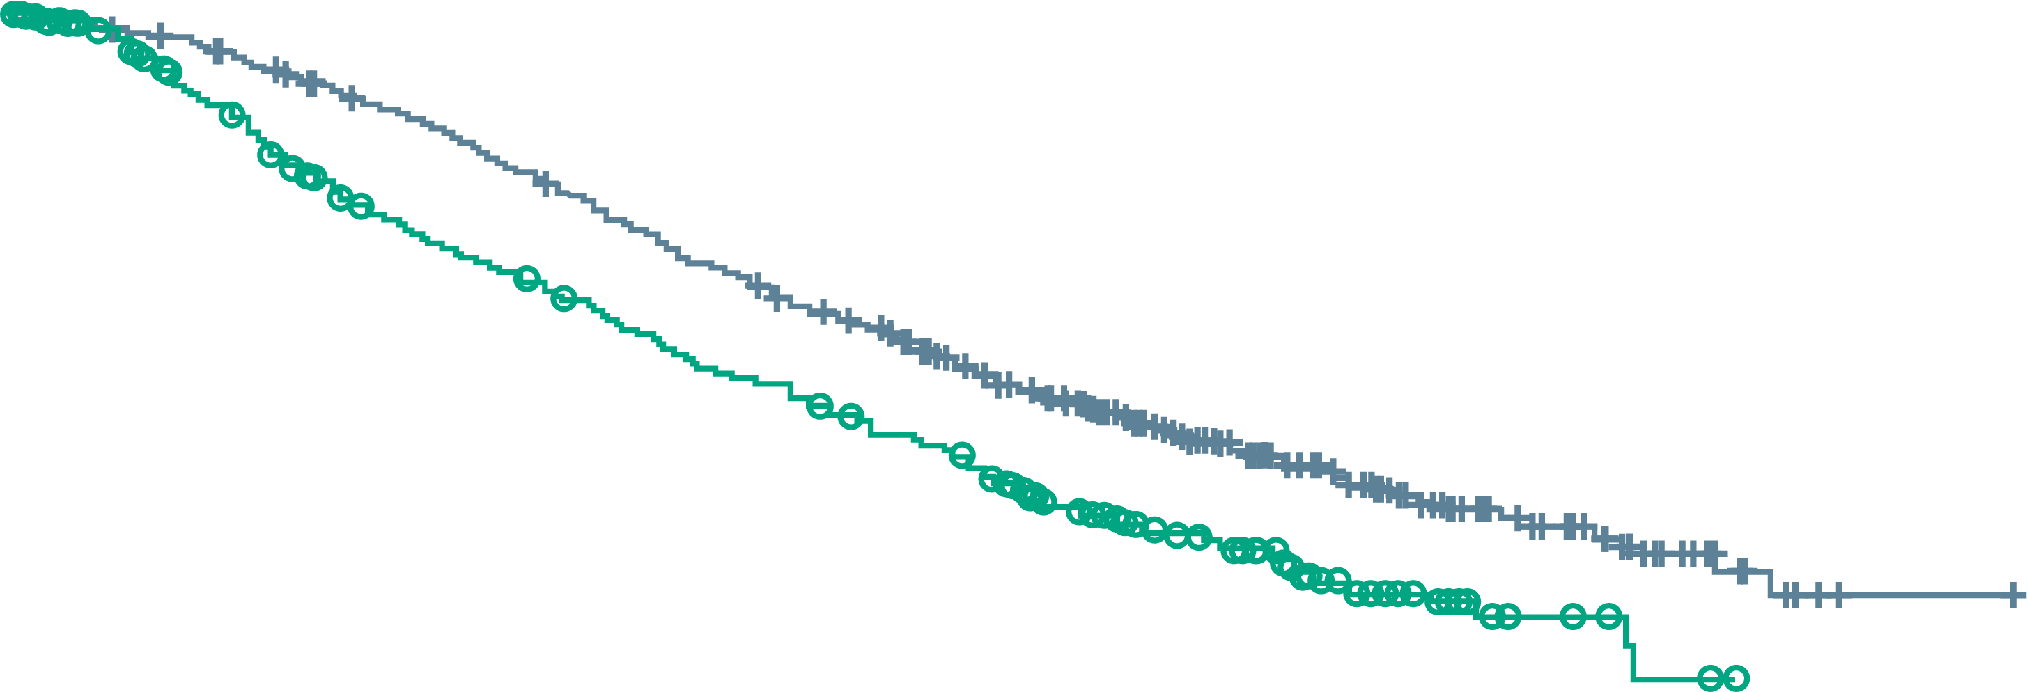
VISION trial: Lutetium-177-PSMA-617 for mCRPC
Alternate primary endpoints
Imaging-based progression-free survival
100
 | No. of events/ No. of patients | Median mo
¹⁷⁷Lu-PSMA-617 + standard care | 254/385 | 8.7
Standard care alone | 93/196 | 3.4
Hazard ratio for progression or death, 0.40 (99.2% CI, 0.29-0.57) P<0.001
90
80
70
¹⁷⁷Lu-PSMA-617 + standard care
60
Percent of patients without disease progression
50
40
30
20
Standard care alone
10
 | No. of events/ No. of patients | Median mo
¹⁷⁷Lu-PSMA-617 + standard care | 343/551 | 15.3
Standard care alone | 187/280 | 11.3
Hazard ratio for death, 0.62 (95% CI, 0.52-0.74) P<0.001
0
0
2
4
6
8
10
12
14
16
18
20
22
No. at risk
¹⁷⁷Lu-PSMA-617 + standard care
Standard care alone
Months since randomisation
Overall survival
385
196
362
119
272
36
215
19
182
14
137
13
88
7
71
7
49
3
21
2
6
0
1
0
100
90
¹⁷⁷Lu-PSMA-617 + standard care
80
Lu177 + SOC significantly improved PFS and OS vs SOC alone
Potential new treatment option in mCRPC post both ARI and taxane chemotherapy
70
60
Percent of patients alive
Standard care alone
50
40
30
20
10
0
0
2
4
6
8
10
12
14
16
18
20
22
24
26
28
30
32
No. at risk
¹⁷⁷Lu-PSMA-617 + standard care
Standard care alone
Months since randomisation
551
280
535
238
506
203
470
173
425
155
377
133
332
117
289
98
236
73
166
51
112
33
63
16
36
6
15
2
5
0
2
0
0
0
ARI, androgen receptor inhibitor; CI, confidence interval; Lu-177, lutetium-177; mCRPC, metastatic castration-resistant prostate cancer; OS, overall survival; PFS, progression-free survival; PSMA, prostate-specific membrane antigen; SOC, standard of care; QOL, quality of life
Sartor O, et al. N Engl J Med. 2021. DOI: 10.1056/NEJMoa2107322

Slide 19
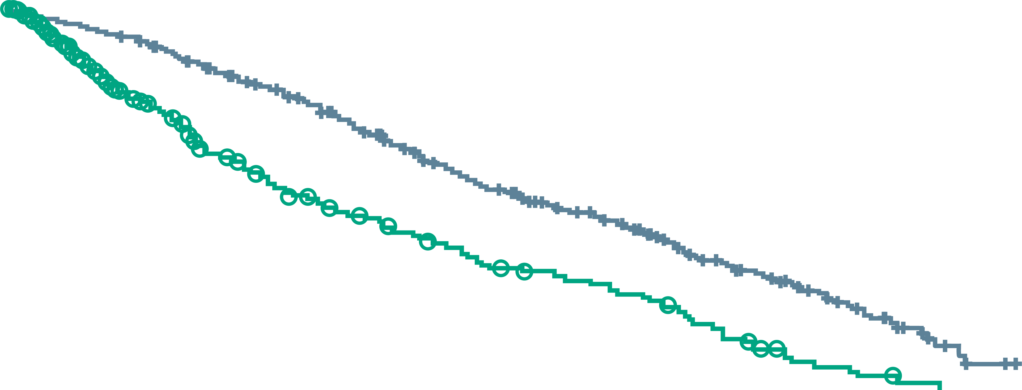
VISION trial: Lutetium-177-PSMA-617 for mCRPC
SECONDARY endpoint
Lu-177 prolonged time to symptomatic skeletal events compared with SOC
Time to first symptomatic skeletal event
100
 | No. of events/ No. of patients | Median mo
¹⁷⁷Lu-PSMA-617 + standard care | 256/385 | 11.5
Standard care alone | 137/196 | 6.8
Hazard ratio, 0.50 (95% CI, 0.40-0.62) P<0.001
90
80
¹⁷⁷Lu-PSMA-617 + standard care
70
60
Percent of patients free from event
50
40
30
Standard care alone
20
10
0
0
2
4
6
8
10
12
14
16
18
20
22
Months since randomisation
No. at risk
¹⁷⁷Lu-PSMA-617 + standard care
Standard care alone
385
196
363
141
329
104
290
75
240
61
189
48
153
36
117
29
73
15
34
6
12
2
2
0
CI, confidence interval; Lu-177, lutetium-177; mCRPC, metastatic castration-resistant prostate cancer; PSMA, prostate-specific membrane antigen; SOC, standard of care
Sartor O, et al. N Engl J Med. 2021. DOI: 10.1056/NEJMoa2107322

Slide 20
summary
Practical considerations when sequencing mCRPC treatments:
Consider prior therapies and sandwich therapies of different mechanism of actions or consider combination therapy
Consider sites of metastases (visceral vs. bone disease)
Is the patient symptomatic vs. asymptomatic?
Presence vs. absence of genomic/germline mutations indicates suitability for PARPi, immunotherapy, clinical trials
Patient preferences: oral vs. IV; side effects of therapies; goals of care; quality of life
Supportive care (BHA for mCRPC, managing side effects)
Goal is to choose the right therapy at the right time, deliver all effective life-prolonging therapies and balance quality of life
BHA, bone health agents; IV, intravenous; mCRPC, metastatic castration-resistant prostate cancer; PARPi, Poly (ADP-ribose) polymerase inhibitors

Slide 21
REACH GU NURSES CONNECT VIA TWITTER, LINKEDIN, VIMEO & EMAIL OR VISIT THE GROUP’S WEBSITE https://gunursesconnect.info/
Follow us on Twitter @gunursesconnect
Follow the GUNURSESCOR2ED
Group on LinkedIn
Watch us on the Vimeo Channel GUNURSES CONNECT
Email sam.brightwell @cor2ed.com

