Slide 2
Challenging clinical situations:
Bleeding risk
Dr. Sergio Raposeiras Roubín, MD
University Hospital Alvaro Cunqueiro, Vigo, Spain
APRIL 2021

Slide 3
Disclaimer and disclosures
Please note: The views expressed within this presentation are the personal opinions of the authors.
They do not necessarily represent the views of the author’s academic institution or the rest of the CORONARY CONNECT group.
These slides are adapted from the virtual ACS Forum event which was held in December 2020.
The ACS Forum and this content are supported by an Independent Educational Grant from Amgen.
Dr. Sergio Raposeiras Roubín, MD has received financial support/sponsorship for research support, consultation or speaker fees from the following companies:
Amgen, AstraZeneca, Boehringer Ingelheim, Daichii-Sankyo, Pfizer

Slide 4
INTRODUCTION
Haemorrhagic complications have emerged as an independent risk factor for subsequent mortality in patients with acute coronary syndromes (ACS) and in those undergoing percutaneous coronary intervention (PCI)
The cornerstones of ACS treatment are antithrombotic therapies and PCI, however, these treatments increase the risk of bleeding
Current strategies to reduce hemorrhagic complications include the use of bleeding risk scores to identify patients at high risk for major bleeding events and the use of newer antithrombotic medications with reduced potential for bleeding and avoidance of overdosing
Collet J-P, et al. Eur Heart J. 2020. DOI: 10.1093/eurheartj/ehaa575; Mehran R, et al. JACC 2010; 2556-2566

Slide 5

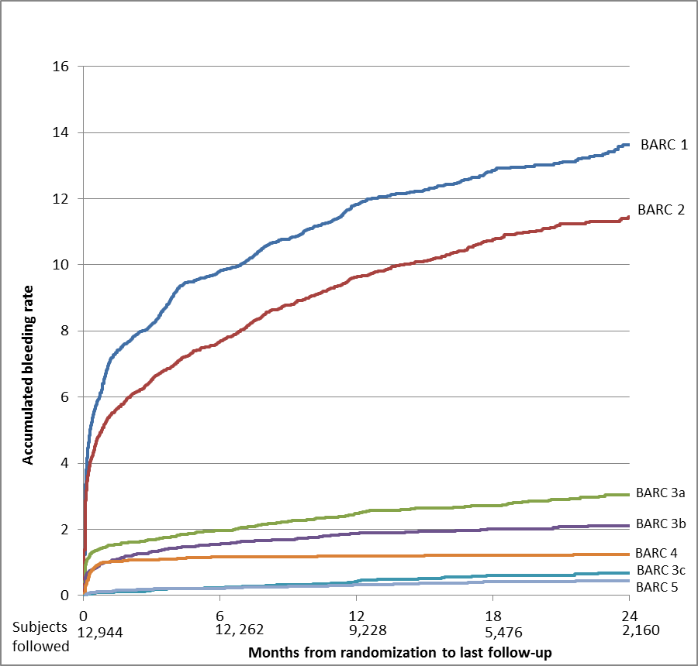
Incidence and location of bleeding
16
Most bleeding in first 30 days
14
BARC 1
22.4%
12
BARC 2
Major bleeding
Cumulative incidence
~3% per year
10
Most bleeds
are non-major
Accumulated bleeding rate (%)
8
6
4
BARC 3a
6.3%
2
BARC 3b
BARC 4
BARC 3c
0
BARC 5
40
Bleeding events over 30 days
40
Bleeding events over 1 year
Subjects
followed
0
12,944
6
12,262
12
9,228
24
2,160
Months from randomisation to last follow-up
Vranckx P, et al. J Am Coll Cardiol. 2016;67:2135-44 (online material)
30
30
61.7%
~60% gastrointestinal
60
Proportion of 30-day bleeding (%)
Proportion of 1-year bleeding (%)
20
20
40
10
10
Bleeding events (%)
20
12.2%
0
0
8.6%
7.4%
7.0%
3.2%
Other
Other
Epistaxis
Genitourinary
Retroperitoneal
Pericardial
Intracranial
Genitourinary
Intracranial
Gastrointestinal
Gastrointestinal
Retroperitoneal
0
274/444
54/444
38/444
33/444
31/444
14/444
Vascular access site
Vascular access site
Surgery-related
Gastrointestinal
Peripheral
Genitourinary
CNS
Access site
Retroperitoneal
Généreux P, et al. J Am Coll Cardiol. 2015;66:1036-45
Koskinas K, et al. Circ Cardiovasc Interv. 2015;8:e002053
BARC, Bleeding Academic Research Consortium grade; CNS, central nervous system

Slide 6
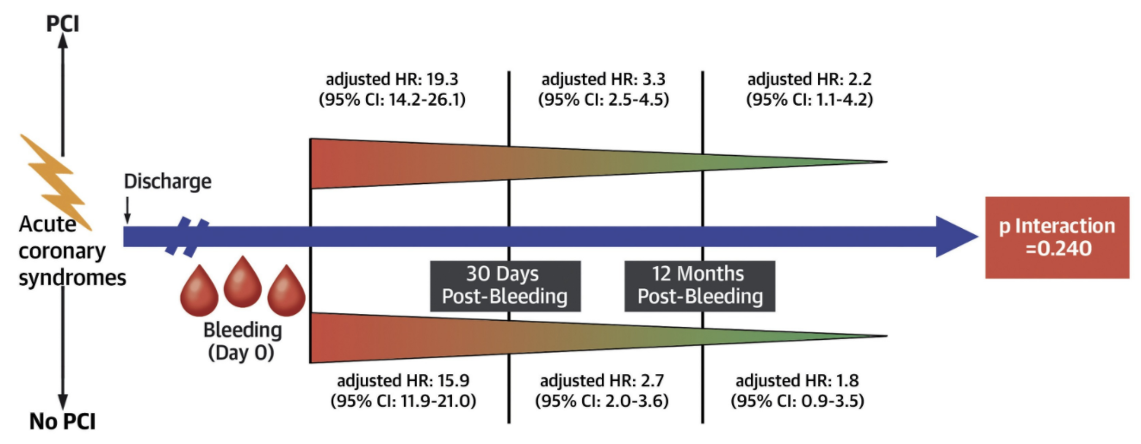
Prognostic impact of bleeding
Major bleeding increases mortality 5-fold
Clinical bleeding predictors:
Atherosclerosis risk factors
History of previous bleeding
Anaemia
Chronic kidney disease (CKD)
Low platelet reactivity
Pharmacological bleeding predictors:
Oral anticoagulation
Prolonged dual antiplatelet therapy
(DAPT)
High-potency DAPT
Post-discharge bleeding
No post-discharge bleeding
15
12
13.0%
9
p<0.0001
Mortality (%)
6
5.1%
3
3.2%
p<0.0001
BLEEDING
0
1.9%
0
3
6
9
12
15
18
21
24
DAPT
discontinuation
Blood
extravasation
Blood
transfusion
No. at risk
PDB
No PDB
Months after discharge
535
8,042
529
7,840
520
7,795
506
7,756
492
7,631
480
7,446
467
7,369
461
7,306
289
4,739
Rebound platelet
reactivity
+
Incomplete stent
endothelialisation
Haemoglobin drop
Hypovolaemia/
hypotension
Transfusion-related
effects
Inflammatory
cascade activation
Vasoconstriction
Platelet aggregation
Decreased
oxygen delivery
Atherothrombotic event (stent
thrombosis/myocardial infarction [MI])
Cardiac or
cerebrovascular event
DEATH
CI, confidence interval; HR, hazard ratio; PCI, percutaneous coronary intervention; PDB, post-discharge bleeding
Généreux P, et al. J Am Coll Cardiol. 2015;66:1036-45; Marquis-Gravel G, et al. J Am Coll Cardiol. 2020;76:162-71

Slide 7
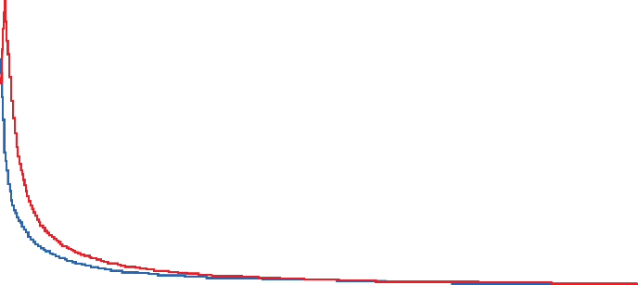
Trade-off of MI vs bleeding
Early phase
Late phase
Ischaemic
risk
Bleeding
risk
Ischaemic
risk
Bleeding
risk
Ischaemic
risk
Bleeding
risk
Ischaemic
risk
Bleeding
risk
1.4
~
~
<
<
>
1.2
1.0
0.8
Average daily rate (%)
0.6
Difference: +0.11%
(95%CI: -0.35 to 0.58);
p=0.63
Difference: -0.50%
(95%CI: -0.72 to -0.29);
p<0.0001
Difference: -0.39%
(95%CI: -0.58 to -0.20);
p<0.0001
Difference: +1.51%
(95%CI: 1.04-1.98);
p<0.0001
0.4
0.2
2
Ischaemia
exceeds
bleeding
0.0
0
30
60
90
120
150
180
210
240
270
300
330
360
Days after primary PCI for STEMI
1
Least square mean difference, %
(ADIR-ADBR)
In the first 30 days following
ACS, bleeding is more
frequent than reinfarction
0
Bleeding
exceeds
ischaemia
-1
-2
Acute period
(≤24 Hours)
Subacute period
(Day 1 to Day 30)
Early period
(Day 0 to Day 30)
Late period
(Day 30 to Day 365)
ACS, acute coronary syndrome; ADIR-ADBR, average daily ischemic rate significantly exceeds the average daily bleeding rate; CI, confidence interval; MI, myocardial infarction; PCI, percutaneous coronary intervention; STEMI, ST-elevation myocardial infarction
Giustino G, et al. J Am Coll Cardiol. 2017;70:1846-57

Slide 8
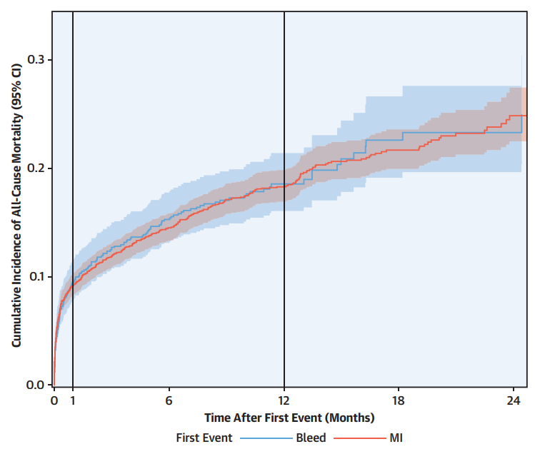
Trade-off of MI vs bleeding
Mortality after MI = mortality after major bleeding
a.) Timing¹
b.) Severity²
Estimate of
relative risk
(ratio of HRs)
with 95% CI
0.3
First event
MI vs bleeding
p value
Adjusted HRs
0.2
MI vs minor bleedingª
3.15
(2.08-4.77)
<0.001
Cumulative incidence of
all-cause mortality (95%CI)
(BARC 2)
5.36
1.70
0.1
MI vs major bleedingª
0.94
(0.63-1.40)
0.747
(BARC 3)
5.36
5.73
0.0
0
1
6
12
18
24
MI vs major bleeding^{b}
2.23
(1.36-3.64)
Time after first event (months)
(BARC 3a)
0.001
6.15
2.77
PCI
MI vs major bleeding^{b}
1.37
(0.81-2.30)
Bleeding (GUSTO moderate +)
<30 days 24.5 (17.5-34.3)
30-365 days 3.8 (2.7-5.4)
>365 days 2.9 (1.5-5.9)
0.242
(BARC 3b)
6.15
4.51
MI
<30 days 24.3 (19.2-30.8)
30-365 days 3.6 (2.9-4.5)
>365 days 2.6 (1.8-3.9)
MI vs major bleeding^{b}
0.22
(0.13-0.36)
<0.001
(BARC 3c)
6.15
1
2
3
4
5
10
15
25
35
Adjusted HR (95%CI) vs neither event
28.2
BARC, Bleeding Academic Research Consortium grade; CI, confidence interval; GUSTO, global use of strategies to open occluded coronary arteries;
HR, hazard ratio; MI, myocardial infarction; PCI, percutaneous coronary intervention
1. Marquis-Gravel G, et al. J Am Coll Cardiol. 2020;76:162-71; 2. Valgimigli M, et al. Eur Heart J. 2017;38:804-10

Slide 9
Impact on guidelines
Bleeding risk
Type and duration of DAPT
LOW
HIGH
VERY HIGH
A
P
A
C
1 months
OR
A
T
A
C
A
T
Treatment
duration
3 months
OR
A
C
C
6 months
12 months’
DAPT
T
A
12 months
A
R
A
T
Antithrombotic
drugs
OR
A
P
A
C
A
= Aspirin
DAT
>12 months
DAPT
>12 months
C
= Clopidogrel
P
= Prasugrel
R
= Rivaroxaban
Ischaemic risk
T
= Ticagrelor
DAPT, dual antiplatelet therapy; DAT, dual antithrombotic therapy
Collet J-P, et al. Eur Heart J. 2020. DOI: 10.1093/eurheartj/ehaa575

Slide 10
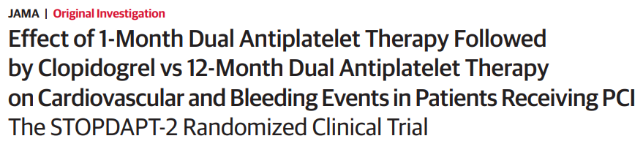
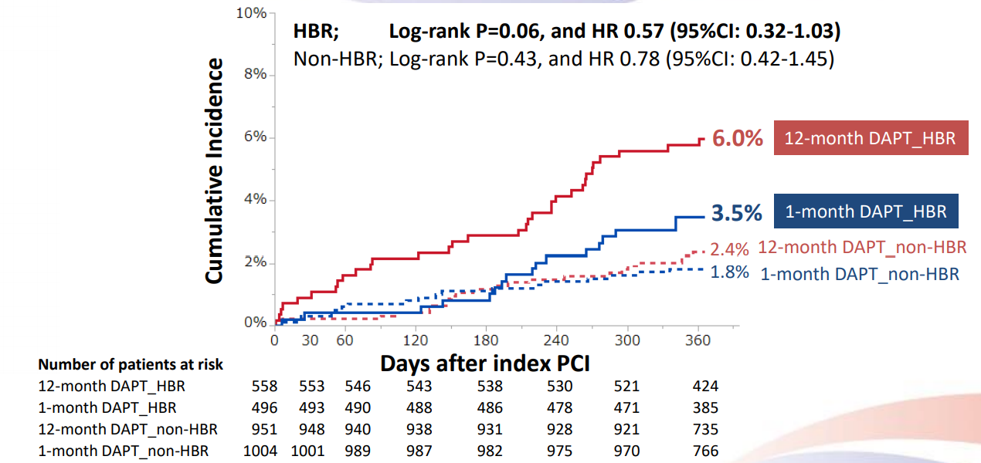
Short-duration DAPT with clopidogrel
Subgroup analysis:
high bleeding risk
Short-duration DAPT with clopidogrel
Enrolled and randomised
N=3,045
Primary outcome:
composite of CV death, MI, ST, stroke, TIMI (major/minor)
Stratified by Center
1-month DAPT arm
N=1,523
12-month DAPT arm
N=1,522
23 withdrew
consent
13 withdrew
consent
ITT population
N=1,500
ITT population
N=1,509
Non-HBR patients
in 1-month DAPT group
N=1,004 (66.9%)
HBR patients
in 1-month DAPT group
N=496 (33.1%)
Non-HBR patients
in 12-month DAPT group
N=951 (63.0%)
HBR patients
in 12-month DAPT group
N=558 (37.0%)
38% with ACS
35% with HBR
ACS, acute coronary syndrome; CI, confidence interval; CV, cardiovascular, DAPT, dual antiplatelet therapy; HBR, high bleeding risk; HR, hazard ratio; ITT, intention-to-treat;
MI, myocardial infarction, PCI, percutaneous coronary intervention; ST, stent thrombosis; TIMI, thrombolysis in myocardial infarction
Watanabe H, et al. Circulation. 2019;140:1957-9; Watanabe H, et al. TCT 2019, oral presentation (https://www.tctmd.com/slide/stopdapt-2-hbr-1-year-outcomes-randomized-trial-clopidogrel-monotherapy-vs-dapt-beginning-1. Accessed 19-Nov-20)

Slide 11
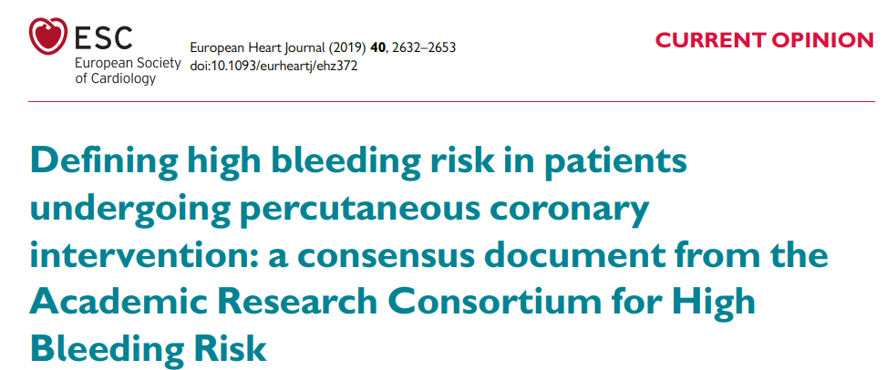
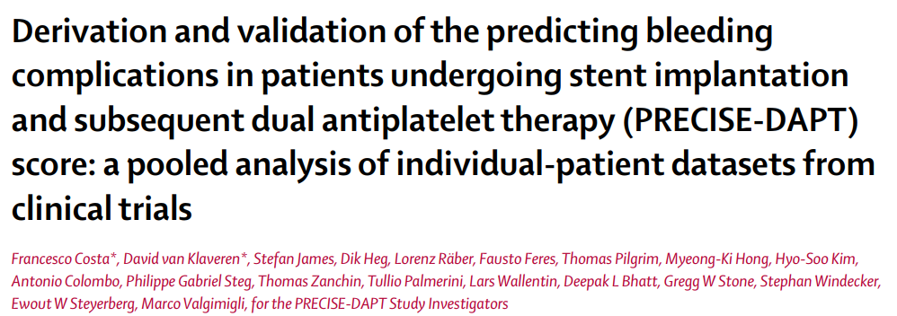
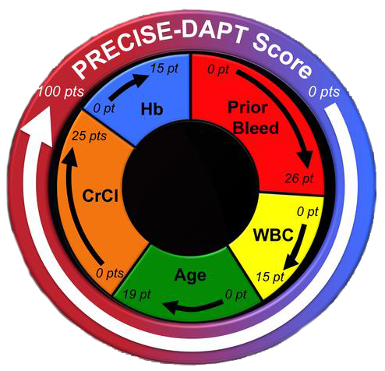
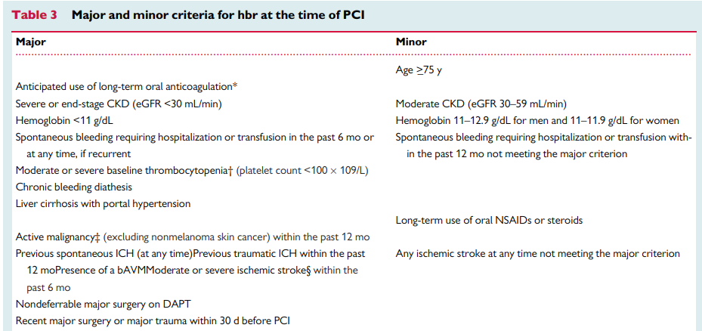
How to calculate bleeding risk?
ARC-HBR criteria
PRECISE-DAPT score
How to calculate bleeding risk?
25
points
* This excludes vascular protection doses. † Baseline thrombocytopenia is defined as thrombocytopenia before PCI. ‡ Active malignancy is defined as diagnosis within 12 months and/or ongoing requirement for treatment (including surgery, chemotherapy, or radiotherapy). § National Institutes of Health Stroke Scale score >_5.
ARC-HBR, academic research consortium-high bleeding risk; bAVM, brain arteriovenous malformation; CKD, chronic kidney disease; CrCl, creatinine clearance; DAPT, dual antiplatelet therapy; eGFR, estimated glomerular filtration rate; ICH, intracranial haemorrhage; mo, month(s); NSAID, nonsteroidal anti-inflammatory drug; PCI, percutaneous coronary intervention; pt, point; WBC, white blood cell; y, years
Costa F, et al. Lancet 2017;389:1025-34; Urban P, et al. Eur Heart J. 2019;40:2632-53

Slide 12

Balance ischaemic and bleeding risks
Overall risk
of adverse
events
High bleeding risk &
low ischaemic risk
High ischaemic risk &
high bleeding risk
Consider shorter duration
(1, 3 or 6 months) of DAPT
Prioritise bleeding avoidance
strategies minimising
residual ischaemic risk
Increase in bleeding risk
Low ischaemic risk &
low bleeding risk
High ischaemic risk &
low bleeding risk
Uncertain expected
treatment benefit
Consider extended
(≥12 months) DAPT
Prioritise patient’s
preference and expected
compliance
Increase in ischaemic risk
DAPT, dual antiplatelet therapy
Giustino G, Costa F. JACC Cardiovasc Interv. 2019;12:831-4

Slide 13
Bleeding in elderly patients
Elderly patients: high bleeding and ischaemic risk
80
Data from CardioCHUVI registry
(ClinicalTrials.gov Identifier: NCT03664388)
Ischaemic
events
60
Age <75 years
Age ≥75 years
40
Primary efficacy endpoint (%)
ARC
High bleeding risk
ARC
High bleeding risk
20
0
20
30
40
50
60
70
80
90
100
110
Age at consent (years)
11.9%
77.1%
20
15
Bleeding
events
PRECISE ≥25
PRECISE ≥25
TIMI major bleeding (%)
10
22.7%
90.9%
5
0
20
30
40
50
60
70
80
90
100
110
Age at consent (years)
ACS, acute coronary syndrome; ARC, Academic Research Consortium; CardioCHUVI, Registry of
Acute Coronary Syndrome from University Hospital of Vigo; TIMI, thrombolysis in myocardial infarction
Roe M, et al. Circulation. 2013;128:823-33

Slide 14
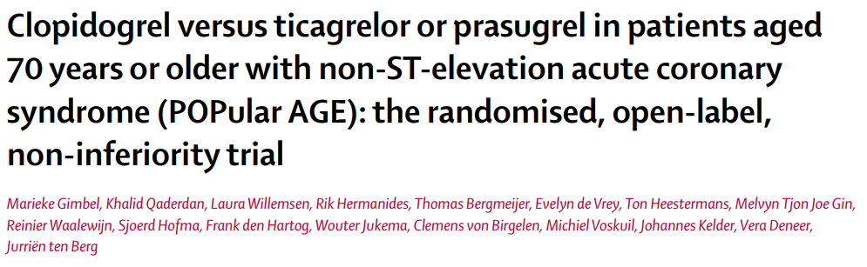
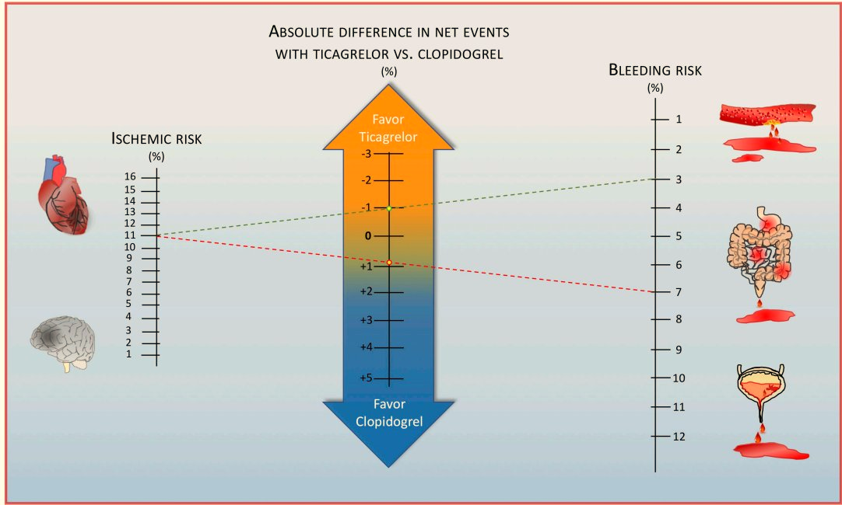

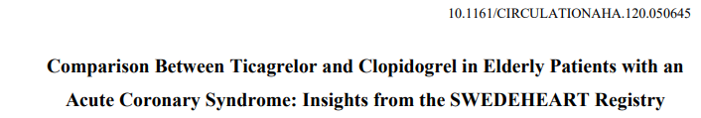
Bleeding in elderly patients
76-year-old male, STEMI
Proximal LAD artery → DES
Leucocytes 9,000/uL, haemoglobin 12.9 g/dL
eGFR 61 mL/min.
No prior bleeding, no more bleeding risk factors
Bleeding in elderly patients
Gimbel M, et al. Lancet. 2020;395:1374-81
Savonitto S, et al. Circulation. 2018;137:2435-45
Capranzano P, et al. Circulation. 2020;142:1709-12
Szummer S, et al. Circulation. 2020;142:1700-8
DES, drug-eluting stents; eGFR, estimated glomerular filtration rate; LAD, left-anterior descending; STEMI, ST-elevation myocardial infarction

Slide 15
conclusions
After ACS, bleeding events are as frequent as ischaemic events
Conclusions
Mortality after major bleeding is similar to that after MI
Bleeding risk is key to decide the type and duration of DAPT
Integrating bleeding risk with ischaemic risk is necessary to decide
the best antithrombotic strategy
Short-duration DAPT with clopidogrel is the most reasonable
strategy for most patients at high risk of bleeding
More evidence is needed to know how to manage ACS patients
with high and very high bleeding risk
ACS, acute coronary syndrome; DAPT, dual antiplatelet therapy; MI, myocardial infarction

Slide 16




REACH CORONARY CONNECT VIA
TWITTER, LINKEDIN, VIMEO & EMAIL
OR VISIT THE GROUP’S WEBSITE http://www.coronaryconnect.com/
Follow us on Twitter
@CoronaryConnect
Follow the
CORONARY CONNECT
Group on LinkedIn
Watch us on the
Vimeo Channel
CORONARY CONNECT
Email
carrie.brubaker
@cor2ed.com

