Slide 2
Highlights in Multiple myeloma
How to treat triple- or penta-refractory
Multiple Myeloma?
María-Victoria Mateos, MD, PhD
University Hospital of Salamanca-Ibsal
Salamanca, Spain
Notes:
2
PHENOTYPE OF WM B-LYMPHOCYTE

Slide 3
Conflict of Interest and Funding
This LYMPHOMA & MYELOMA CONNECT programme is supported through an independent educational grant from Karyopharm Therapeutics. The programme is therefore independent, the content is not influenced by the supporters and is under the sole responsibility of the experts.
Please note: The views expressed within this presentation are the personal opinions of the authors.
They do not necessarily represent the views of the author’s academic institution, or the rest of the LYMPHOMA & MYELOMA CONNECT group.
María-Victoria Mateos has received honoraria derived from lectures and participation in
advisory boards from:
Abbvie, Adaptive, Amgen, Celgene, GSK, Janssen, Karyopharm, Pfizer, Regeneron, Roche, Seattle Gennentech, Takeda

Slide 4
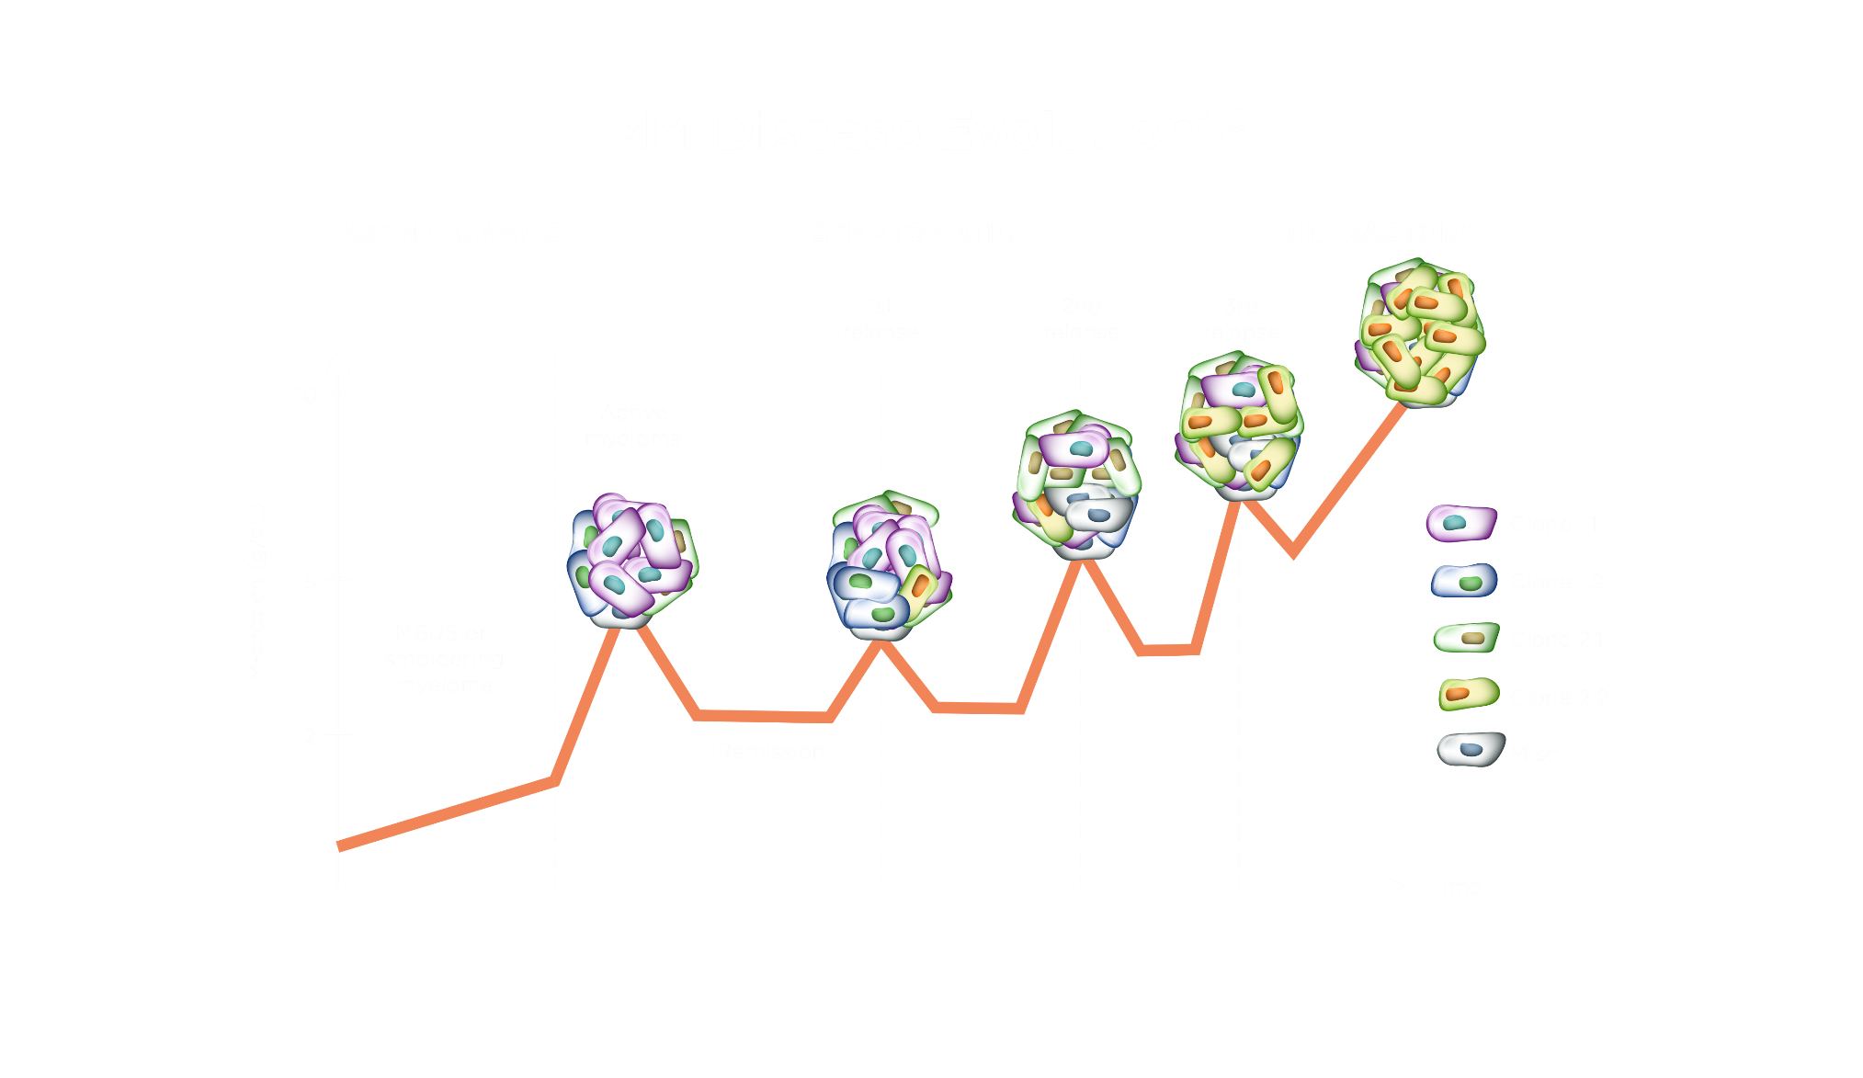
Poor prognosis and high risk of relapse in relapsed/refractory multiple myeloma (RRMM) despite advances in treatment
multiple myeloma (MM) disease evolution
ASYMPTOMATIC
SYMPTOMATIC
REFRACTORY
1st
relapse
2nd
relapse
3rd
relapse
10
Active
myeloma
Clone 1.1
5
Clone 1.2
Myeloma-protein (g/L)
MGUS or
smoldering
myeloma
Clone 2.1
Clone 2.2
2
Remission
Misc
Time
MGUS, monoclonal gammopathy of undetermined significance

Slide 5
Summary of management of MM patients
ESMO 2017 guidelines
Eligibility for ASCT
After 2nd and especially 3rd line of therapy, most MM patients have been exposed to proteasome inhibitors, IMiDs and anti-CD38 monoclonal antibodies
Is this population an unmet medical need?
Yes
No
Induction:
3-drug regimens:
VTD, VCD, PAD, RVD
First option:
VMP or Rd or VRd
Second option:
MPT or VCD
Other options:
CTD, MP, bendamustine, prednisone
200 mg/m² melphalan
→ ASCT
Lenalidomide maintenance
First relapse after IMiD-based induction
First relapse after bortezomib-based induction
Doublets
Kd / Vd
Triplets based bortezomib
DaraVD or PanoVD or
EloVD or VCD
Rd
Triplets (Rd backbone)
DaraRd or KRd or IxaRd
or EloRd
At second or subsequent relapse
Pomalidomide-Dex (backbone)
+ Cyclo or Ixa or Bort or
Dara or Elo
Daratumumab
(single agent or
combination)
Clinical trial
ASCT, autologous stem cell transplantation; Bort, bortezomib; CTD, cyclophosphamide, thalidomide, dexamethasone; Cyclo, cyclophosphamide; Dara, daratumumab; DaraRd, daratumumab, lenalidomide, dexamethasone; DaraVD, daratumumab, bortezomib, dexamethasone; Dex, dexamethasone; Elo, elotuzumab; EloRd, elotuzumab, lenalidomide, dexamethasone; EloVD, elotuzumab, bortezomib, dexamethasone; ESMO, European Society for Medical Oncology; IMiD, immunomodulatory drug; Ixa, izaxomib; IxaRd, izaxomib, lenalidomide, dexamethasone; Kd, carfilzomib, dexamethasone; KRd, carfilzomib, lenalidomide, dexamethasone; MP, melphalan, prednisone; MM, multiple myeloma; MPT, melphalan, prednisone, thalidomide; PAD, bortezomib, doxorubicin, dexamethasone; PanoVD, panobinostat, bortezomib, dexamethasone; Rd, lenalidomide plus low-dose dexamethasone; RVD, lenalidomide, bortezomib, dexamethasone; VCD, bortezomib, cyclophosphamide, dexamethasone; Vd, bortezomib, dexamethasone; VMP, bortezomib, melphalan, prednisone; VRd, lenalidomide plus low-dose dexamethasone plus bortezomib; VTD, bortezomib, thalidomide, dexamethasone.
Moreau P, et al. Ann Oncol. 2017;28(suppl_4):iv52-iv61

Slide 6



The MAMMOTH study
Monoclonal Antibodies in MM: Outcomes after Therapy
Patients from 14 US academic institutions
Study population
 | Active MM and refractory to daratumumab or isatuximab, alone or in combination (index regimen) |  | Excluded: patients with ongoing response to CD38 mAB or discontinued due to reasons other than PD
 | At least 4 weeks of CD38 mAB- containing index regimen treatment
 | Evidence of PD while on index regimen or within 60 days of last doseª
×
Patient characteristics
Disease characteristics
All therapies administered before and after T₀
Survival status
High-risk cytogenetics
Retrospective
analysis
ªAs defined by International Myeloma Working Group Response Criteria
CD38 mAB, CD38-targeted monoclonal antibodies; MM, multiple myeloma; PD, progressive disease; T_{0,} time at which patients met PD criteria.
Gandhi UH, et al. Leukemia. 2019;33:2266-2275

Slide 7
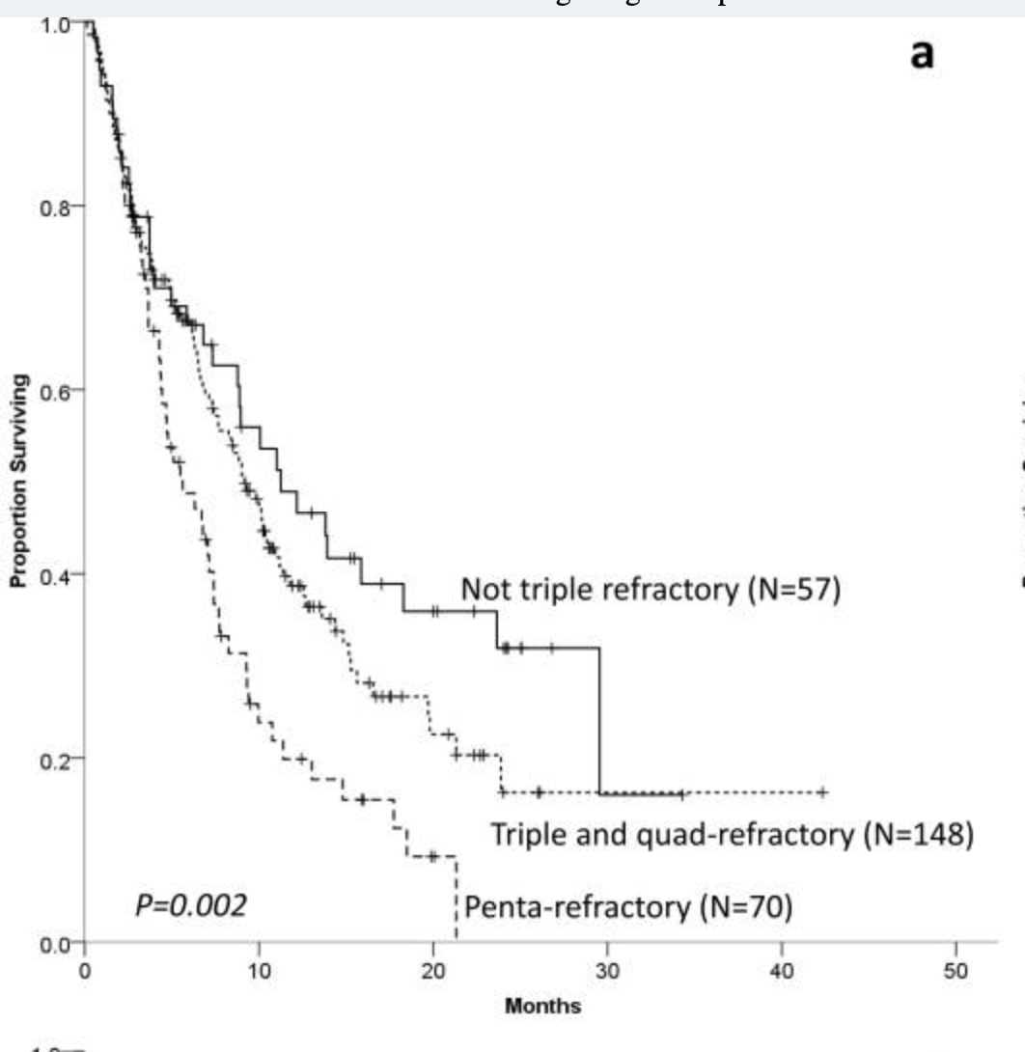
MEDIAN OVERALL SURVIVAL was <1 year in all refractory status groups
Most patients analysed were triple- or quad-refractory (54%)
Refractory group status
Median OS, months (95% CI) from T₀
1.0
All: 8.6 (7.2-9.9)
Not triple-refractory: 11.2 (5.4-17.1)
Triple- and quad-refractory: 9.2 (7.1-11.2)
Penta-refractory: 5.6 (3.5-7.8)
Penta-
refractory
25%
Not triple-
refractory
21%
0.8
0.6
Triple- and
quad-refractory
54%
Proportion surviving
0.4
Most patients (93%) were daratumumab-refractory;
7% were isatuximab-refractory
Most patients were refractory to lenalidomide (77%), pomalidomide (65%), and bortezomib (68%)
0.2
0.0
0
10
20
30
40
50
Months
CI, confidence interval; OS, overall survival; PD, progressive disease; T₀, time at which patients met PD criteria after starting index regimen
Gandhi UH, et al. Leukemia. 2019;33:2266-2275

Slide 8
What happens at third line and beyond?
First relapse after PI and/or IMiD-based induction, LEN-refractory
CD38-based
Non-CD38-based
VD-DARA (infrequent use)
Kd+daraª
Kd+isatuximabª
Pom-dex-daraª
Pom-cyclo-dex-daraª
Pom + Vdª
Pom + cyclo + dex
Pom-dex + K
Pom-dex + belamaf
Vd + selinexorª
Vd + venetoclax^{b}
Kd ± cyclo
2nd and subsequent relapses
Pom-dex + isatuximab
Pom-dex + elotuzumab
Selinexor
Melflufen
Belantamab mafodotin
Cell therapy
CAR-T cells
Pom-dex + isa or elo are approved but according to the label, they will move to earlier relapses if available
ª Based on phase 3 randomised trials. ^{b} Venetoclax-based combinations for patients with t(11;14) and/or overexpression of bcl-2.
Cyclo, cyclophosphamide; dara, daratumumab; dex, dexamethasone; elo, elotuzumab; IMiD, immunomodulatory drug; isa, isatuximab; K, carfilzomib; Kd, carfilzomib, dexamethasone; LEN, lenalidomide; PI, protease inhibitor; pom, pomalidomide; Vd, bortezomib, dexamethasone
Mateos MV. Personal perspective

Slide 9
Selinexor and Melflufen

Slide 10
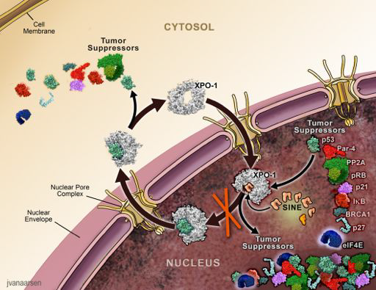
XPO1-Inhibitor Selinexor in RRMM
First-in-class, oral Selective Inhibitor of Nuclear Export (SINE) that inhibits XPO1 and activates tumour suppressor proteins & reduces oncoproteins¹
Cancer cells (and MM) overexpress XPO1, causing increased export of tumour suppressors and growth regulatory proteins from the nucleus
Selinexor inhibits XPO1 mediated nuclear-cytoplasmic transport by transiently binding to the XPO1 cargo
binding site
Accumulation of tumour suppressors in the nucleus amplifies the natural apoptotic function in cancer cells with damaged DNA
STORM study²
  122 patients received selinexor-dex after a median of 7 prior lines of therapy (68% penta-refractory and
  100% three-drug class refractory)
  ORR 26%, including two patients in stringent CR
    Minimal response or better observed in 39%→ sustained across different subgroups
  Median PFS of 3.7 months and OS of 8.6 months
  Safety profile: thrombocytopenia (58% grade 3-4) and some GI events (nausea and anorexia, grade 3 in 5-10%)
Selinexor-dex is approved by FDA in US and EMA in EU
CR, complete response; dex, dexamethasone; EMA, European Medicines Agency; EXPO1, exportin 1; FDA, Food and Drug Administration; G, grade; GI, gastro-intestinal; MM, multiple myeloma; OS, overall survival; ORR, overall response rate; PFS, progression-free survival; RRMM, relapsed/refractory multiple myeloma
1. Tai YT, et al. Leukemia. 2014;28:155-165; 2. Chari A, et al. N Engl J Med. 2019;381:727-738

Slide 11
STOMP: Selinexor plus Pom-dex in RRMM patients
After the phase 1 part, the RP2D was selinexor 60 mg qw plus Pom and Dex at conventional doses in 4-weeks cycles
65 patients (20 at the RP2D) were included after a median of 3 prior lines of therapy, all len-exposed and 80% len-refractory;
90% bortezomib-exposed; 50% carfilzomib-exposed and 20% dara-exposed and refractory
Clinical response
Progression-free survival
 | N | ORR (%) | CBR (%)
POM naive or nonrefractory | 46 | 25 (54) | 33 (72)
POM refractory | 14 | 5 (36) | 9 (64)
RP2D: selinexor 60 mg qw + POM 4 mg | 20 | 12 (60) | 15 (75)
1.0
0.0
0.8
0.6
Safety
Probability of PFS
n (%) | Any grade | Grade 3/4
Neutropenia | 38 (60) | 34 (54)
Thrombocytopenia | 34 (54) | 20 (32)
Nausea | 38 (60) | 1 (2)
Decreased appetite | 28 (44) | 1 (2)
Fatigue | 32 (51) | 6 (10)
0.4
0.2
0.0
0
2
4
6
8
10
12
14
16
18
20
22
24
26
28
30
Months
CBR, clinical benefit rate; dara, daratumumab; Dex, dexamethasone; len, lenalidomide; ORR, overall response rate; PFS, progression-free survival; Pom, pomalidomide; qw, once weekly; RP2D, recommended phase 2 dose; RRMM, relapsed/refractory multiple myeloma
Chen C, et al. ASH 2020. Abstract #726. Oral presentation

Slide 12
Selinexor plus Dara-dex in RRMM patients
After the phase 1 part, the RP2D was selinexor 100 mg weekly plus Dex and Dara at conventional doses in 4-weeks cycles
34 patients were included after a median of 3 prior lines, 65% len-refractory; 85% PI-refractory; 6% dara-exposed and refractory
Group | No. of patients | No. of patients (%)
 |  | ORR | CBR | VGPR | PR
Overall | 32 | 22 (69) | 26 (81) | 11 (34) | 11 (34)
Daratumumab-naïve | 30 | 22 (73) | 26 (87) | 11 (37) | 11 (37)
Lenalidomide-refractory | 20 | 13 (65) | 15 (75) | 6 (30) | 7 (35)
Bortezomib-refractory | 19 | 13 (68) | 16 (84) | 5 (26) | 8 (42)
Pomalidomide-refractory | 10 | 5 (50) | 8 (80) | 2 (20) | 3 (30)
Bortezomib/lenalidomide-refractory | 16 | 11 (69) | 13 (81) | 4 (25) | 7 (44)
Progression-free survival
1.00
0.75
Median PFS: 12.5 months
0.50
Proportion
Patients with dara-refractory disease did not respond
0.25
 | Any grade | Grade 3/4
Neutropenia | 50% | 26.5%
Thrombocytopenia | 70.6% | 47%
Nausea | 70.6% | 8.8%
Decreased appetite | 35.3% | -
Fatigue | 61.8% | 17.6%
0.00
0
3
6
9
12
15
18
21
24
27
30
Months
No. at risk
32
22
13
10
5
4
3
1
1
1
1
CBR, clinical benefit rate; Dara, daratumumab; Dex, dexamethasone; len, lenalidomide; ORR, overall response rate; PFS, progression-free survival; PI, proteasome inhibitor; PR, partial response; RP2D, recommended phase 2 dose; RRMM, relapsed/refractory multiple myeloma; VGPR, very good partial response
Gasparetto C, et al. eJHaem. 2021;2:56-65

Slide 13
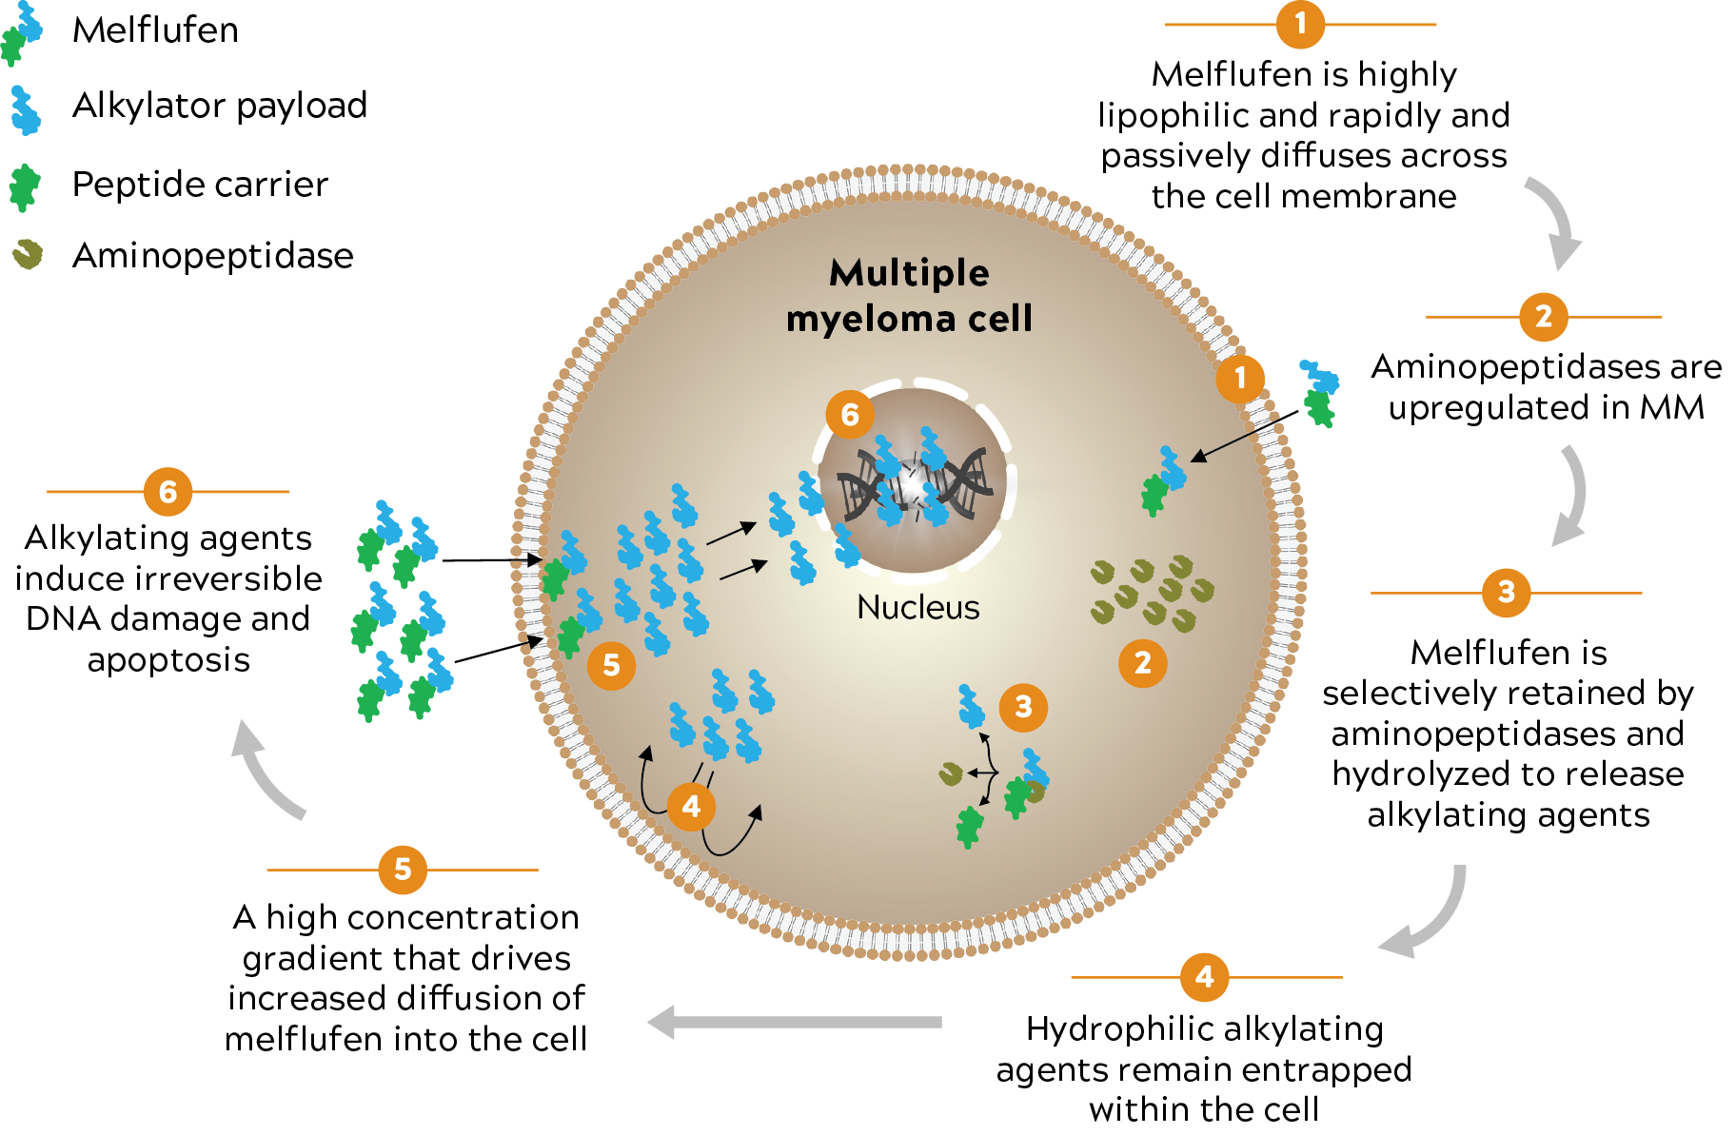
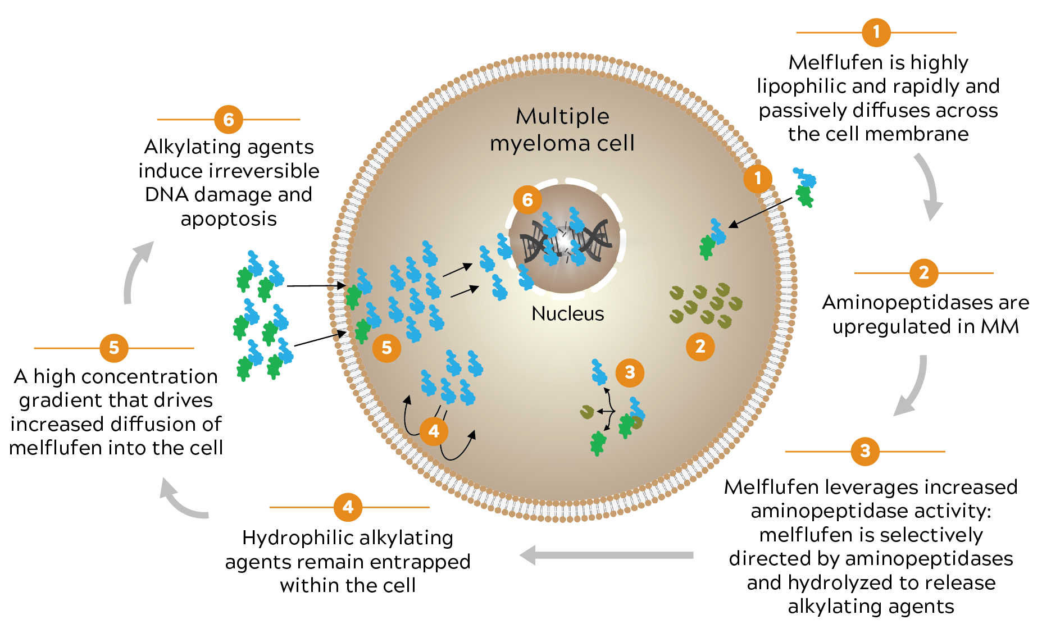
Melflufen in RRMM
  Melphalan flufenamide (melflufen) is an investigational first-in-class peptide-drug conjugate (PDC) that targets aminopeptidases and rapidly releases alkylating agents into tumour cells.¹⁻⁵
In the pivotal, phase 2, HORIZON study, melflufen plus dexamethasone showed clinically meaningful efficacy and a safety profile characterised primarily by clinically manageable haematologic AEs in patients with heavily pretreated and poor-risk RRMM.⁶
Outcome⁶ | Overall Population (N=157)
ORR (95% CI), % | 29 (22-37)
OS, median (95% CI), months | 11.6 (9.3-15.4)
PFS, median (95% CI), months | 4.2 (3.4-4.9)
DOR (≥PR), median (95% CI), months | 5.5 (3.9-7.6)
  At ASH 2020, Melflufen has demonstrated to maintain the efficacy in: – EMD
  – Patients with HR CA (especially +1q)⁷
  – Patients exposed and/or refractory to
  melphalan
Melflufen is approved by FDA
Mateos MV, et al. ASH 2020 #3237
AE, adverse event; ASH, American Society of Hematology; CI, confidence interval; DOR, duration of response; EMD, extramedullary disease; FDA, Food and Drug Administration; HR CA, high-risk cytogenetic abnormalities; MM, multiple myeloma; ORR, overall response rate; OS, overall survival; PFS, progression-free survival; PR, partial response; RRMM, relapsed/refractory multiple myeloma
1. Chauhan D, et al. Clin Cancer Res. 2013;19:3019-3031; 2. Ray A, et al. Br J Haematol. 2016;174:397-409; 3. Wickström M, et al. Oncotarget. 2017;8:66641-66655; 4. Wickström M, et al. Invest New Drugs.
2008;26:195-204; 5. Strese S, et al. Biochem Pharmacol. 2013;86:888-895; 6. Richardson PG, et al. EHA 2020. Abstract EP945. Poster presentation; 7. Mateos MV, et al. ASH 2020. Abstract #3237

Slide 14
Anchor: Melflufen plus dex and
Dara or Bortezomib
Progression-free survival
Study design – daratumumab cohort
33 patients with median of 2 prior lines of therapy
(36% double-refractory; 64% IMiD refractory) received 28-day
treatment cycles until PD or unacceptable toxicity
  Malflufen (iv): 40/30/20 mg on Day 1
  Daratumumab (iv): 16 mg/kg on Days 2/1, 8, 15, 22 (cycles 1/2),
  Days 1 and 15 (cycles 3-6), and Day 1 from cycle 7 onward
  Dexamethasone (po): 40 mg weekly
1.0
0.8
0.6
PFS probability
0.4
0.2
Subgroup | Best confirmed response (n) |  |  |  |  |  |  | Patients (%)
 | >CR | VGPR | PR | MR | SD | PD | NA | ORR | CBR
Melflufen 30 mg (n=6) | 0 | 4 | 1 | 0 | 0 | 0 | 1ª | 83 | 83
Melflufen 40 mg (n=27) | 2 | 6 | 11 | 1 | 2 | 1 | 4^{b} | 70 | 74
Total (N=33) | 2 | 10 | 12 | 1 | 2 | 1 | 5 | 73 | 76
ª 1 patient had unconfirmed PD in 30 mg group ^{b} 4 patients had unconfirmed responses in the 40 mg group (2 PD, 1 SD, 1 PR)
0.0
0
5
10
15
20
25
30
Time (months)
Safety profile:
Grade ≥3 thrombocytopenia, 73%
Neutropenia 67%
Pneumonia 6%
2 fatal sepsis
CBR, clinical benefit rate; CI, confidence interval; CR, complete response; DARA, daratumumab; DEX, dexamethasone; IMiD, immunomodulatory drug; iv, intravenous; mo, month; MR, minimal response; NA, not available; ORR, overall response rate; PD, progressive disease; PFS, progression-free survival; po, orally; PR, partial response; SD, stable disease; VGPR, very good partial response
Ocio E, et al. ASH 2020. Abstract #417. Oral presentation.

Slide 15
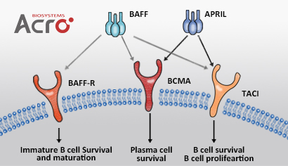
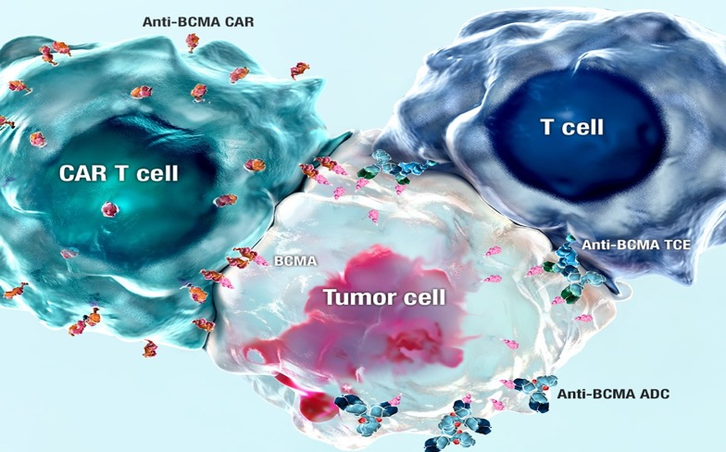

What are the cell therapy options for MM?
2
1
3
BCMA is extensively studied and is an approved target^{1,2}
1
CAR T-cell therapy (CAR-T)
BCMA expression in PC
In normal physical functions
Survival of long-lived PCs
Production of antibodies
Class switching of immunoglobulin
In MM
Promotes proliferation and survival of MM cells
Associated with immunosuppressive BM microenvironment
Increased sBCMA level is associated with disease progression and poorer outcome
2
T-cell engager antibody (TCE)
ADC, antibody-drug conjugate; APRIL, a proliferation-inducing ligand; BAFF, B-cell activating factor; BAFF-R, BAFF receptor; (s)BCMA, (serum) B-cell maturation antigen; BM, bone marrow; CAR-T, chimeric antigen receptor T-cell; IMiD, immunomodulatory agent; mAb, monoclonal antibody; MM, multiple myeloma; PC, plasma cell; TACI, transmembrane activator and calcium-modulating cyclophilin ligand interactor; TCE, T-cell engager antibody
1. https://www.ema.europa.eu/en/documents/product-information/blenrep-epar-product-information_en.pdf. Accessed Sept 2020; 2. Yu B, et al. J Hematol Oncol. 2020;13:125

Slide 16
BCMA-ADC

Slide 17
Belantamab mafodotin
Pivotal DREAMM-2 study: single-agent belantamab mafodotin (GSK2857916) in patients with RRMM refractory to PIs, IMiDs, and refractory and/or intolerant to anti-CD38 mABs
belantamab mafodotin
belantamab mafodotin
2.5 mg/kg
(N=97)
3.4 mg/kg
(N=99)
N=293
belantamab mafodotin
3.4 mg/kg Q3W frozen liquid
configuration
ORR:
31%
(97.5% CI: 20.8-42.6)
34%
(97.5% CI: 23.9-46.0)
SCREENING
RANDOMISE 1:1
mPFS:
2.9 months
(95% CI: 2.1-3.7)
4.9 months
(95% CI: 2.3-6.2)
belantamab mafodotin
2.5 mg/kg Q3W frozen liquid
configuration
CR:
3 (3%)
3 (3%)
mDOR:
11 months
6.2 months
Stratified by prior lines of
therapy (≤4 vs >4) and high-
risk cytogenetic features
mOS:
13.7 months
14 months
Toxicity profile: Ocular events (keratopathy in >70% of any grade [25% G3-4 in both arms]); thrombocytopenia in 35% and 57% of any grade in 2.5 and 3.4 mg/kg cohorts, respectively
Responders: half of them had a treatment hold for ≥3 cycles and were able to re-start. Most (88%) maintained their response
Belantamab mafodotin (2.5 mg/kg Q3W) has been approved by EMA for the treatment of adult patients with RRMM who have received at least 4 prior therapies including lenalidomide, a PI and anti-CD38 mAB and have demonstrated disease progression on the last therapy
CI, confidence interval; CR, complete response; EMA, European Medicines Agency; G, grade; mDOR, median duration of response; IMiD, immunomodulatory drug; mAB, monoclonal antibody; mOS, median overall survival; mPFS, median progression-free survival; ORR, overall response rate; PI, proteasome inhibitor; Q3W, every 3 weeks; RRMM, relapsed/refractory multiple myeloma
Lonial S, et al. EHA 2020. Abstract EP970. Poster presentation

Slide 18
ALGONQUIN: Belantamab mafodotin + Pom-dex
Study design
PART 2
RP2D N=23 (+12 in PART 1 = 35 evaluable for ORR)
 | N=37
Median (range) no. prior lines of therapy | 3 (1-15)
Lenalidomide status Exposed Refractory | 37 (100.0) 33 (89.2)
PI status Exposed Refractory | 37 (100.0) 30 (81.1)
DARA status Exposed Refractory | 16 (43.2) 16 (43.2)
Lenalidomide and PI refractory | 27 (73.0)
Lenalidomide, PI and DARA refractory | 13 (35.1)
PART 1:
DLT 3+3
PART 1: RP2D determination phase ≤12
patients/cohort
D1
D8
D15
D21
C2D1
C3D1
POM 4 mg po
Dex 40 mg po | D | D | D | D | D | D | D | D | D | D
1.92/2.5 mg/kg SINGLE iv | B |  |  |  | B |  |  |  | B
2.5/3.4 mg/kg SPLIT iv | B | B |  |  | B | B |  |  | B | B
BELAMAF loading iv | 2.5 |  |  |  | 1.92 |  |  |  | 1.92
ORR 100%
≥VGPR 72%
ORR 88%
≥VGPR 68%
ORR 92%
≥VGPR 75%
Outcome | All patients | IMiD/PI refractory | IMiD/PI/ DARA refractory
Median PFS, mos (95% CI) | NR (10.8-NR) | NR (10.8-NR) | 11.1 (4.9-NR)
Median follow-up, mos (range) | 7.8 (1.9-20.3) | 7.8 (1.9-18.9) | 7.4 (2.1-16.1)
Patients (%)
All
N=34
Double refractory
N=24
Triple refractory
N=11
C, cycle; D, day; CI, confidence interval; CR, complete response; DARA, daratumumab; Dex, dexamethasone; DLT, dose limiting toxicity; IMiD, immunomodulatory drug; iv, intravenous; mos, months; NR, not reached; ORR, overall response rate; PFS, progression-free survival; PI, proteasome inhibitor; po, orally; POM, pomalidomide; PR, partial response; RP2D, recommended phase 2 dose; VGPR, very good partial response
Trudel S, et al. ASH 2020. Abstract #725. Oral presentation

Slide 19
ALGONQUIN: Belantamab mafodotin + Pom-dex
TEAE, n (%) | Any grade | Grade ≥3
Keratopathy | 28 (75.7) | 19 (51.4)
Neutropenia | 21 (56.8) | 15 (40.5)
Thrombocytopenia | 18 (48.6) | 12 (32.4)
Decreased visual acuity | 17 (45.9) | 6 (16.2)
Fatigue | 15 (40.5) | 4 (10.8)
Response rates (%)
100
80
PR
VGPR
CR
60
Response rate (%)
40
20
0
1.92 mg/kg
Q4W
n=11
2.5 mg/kg
Q4W
n=12
2.5 mg/kg
Combined
n=19
AE, adverse event; C, cycle; D, day; CR, complete response; Dex, dexamethasone; DLT, dose limiting toxicity; iv, intravenous; ORR, overall response rate; po, orally; POM, pomalidomide; PR, partial response; Q4W, every 4 weeks; RP2D, recommended phase 2 dose; TEAE, treatment-emergent AE; VGPR, very good partial response
Trudel S, et al. ASH 2020. Abstract #725. Oral presentation

Slide 20
BCMA CAR-T

Slide 21
Autologous CAR-T cell summary
 | CARTITUDE-1¹ Cilta-cel Phase 1 | CRB-401² Ide-cel Phase 1 | CRB-402³ Bb21217 Phase 1 | LUMMICAR-2⁴ CT053 Phase 1b | PRIME⁵ BCMA-101 Phase 1/2 | GC012F⁶ Dual CAR-T BCMA + CD19
Patients | 97 | 62 | 69 | 20 | 55 | 16
Median prior regimens | 6 | 6 | 6 | 5 | 8 | NR
Triple refractory | 87.6% | 69.4% | 64% | 85% | 60% | NR
CAR-T dose | 0.75 × 10⁶ (range 0.5-1.0 × 10⁶) | 50, 150, 450 and 800 × 10⁶ | 150, 300 and 450 × 10⁶ | 1.5-1.8/2.5-3.0 × 10⁸ | 0.75-15 × 10⁶ | 1.0-3.0 × 10⁵
ORR | 96.9% | 75.8% | 68%/84%ª | 94% | 67% | 93.8%
CR/sCR | 67% | 38.7% | 28%/32%ª | 77%/83%^{b} | NR | 56.3%
CRS, all grades | 94.8% | 75.8% | NR | 15%/17%^{b} | 17% | 100%
CRS, grade 3/4 | 4% | 6.5% | NR | 0% | 0% | 12.5%
Neurotoxicity, all grades | 20.6% | 35.5% | NR | 15%/17%^{b} | 3.8% | 0%
Neurotoxicity, grade 3/4 | 10.3% | 1.6% | NR | 8%/0^{c} | 3.8% | 0%
ª CAR-Ts made using original manufacturing process/updated manufacturing process ^{b} 1.5-1.8/2.5-3.0 × 10⁸ dose
BCMA, B-cell maturation antigen; CAR-T, chimeric antigen receptor T-cell; CRS, cytokine release syndrome; CR/sCR, complete response/stringent CR; NR, not reported; ORR, overall response rate
1. Madduri D, et al. ASH 2020. Abstract #177. Oral presentation; 2. Lin Y, et al. ASH 2020. Abstract #131. Oral presentation; 3. Alsina M, et al. ASH 2020. Abstract #130. Oral presentation; 4. Kumar S, et al. ASH 2020. Abstract #133. Oral presentation; 5. Costello C, et al. ASH 2020. Abstract #134. Oral presentation; 6. Jiang H, et al. ASH 2020. Abstract #178. Oral presentation

Slide 22
BCMA X CD3 Antibodies

Slide 23
BCMA X CD3 Bispecific antibodies
Drug | Type and administration | N | Safety | Population | Response | DOR/PFS
Teclistamab¹ | Bi-specific Administered weekly IV/SC (RP2D 1500 µg/kg SC) | 40 at RP2D | CRS 70% at RP2D, all G1-2 Neurotoxicity 1% at RP2D (G1) Infections 45% at RP2D (23% G3-4) | Median of 5 prior lines 83% triple refractory 38% penta refractory | At RP2D, ORR: 65% with 40% sCR/CR | Median DOR not reached; 85% alive after median f/u of 7.1 months
AMG 701² | BiTe IV Weekly | 85 | CRS G1-2 55%, G3-4: 9% No ICANs 21% thrombocytopenia | Median of 6 prior lines 62% triple refractory | 83% ORR at the top dose level and 50% VGPR | No mature data
REGN5458³ | Bi-specific IV Weekly, every other week from C4 | 49 | CRS 39%, no G3-4 ICANs 12% Cytopenias 47% and infections 18% | Median of 5 prior lines 100% triple refractory 57% penta refractory | ORR 62.5% at 96 mg (95% in VGPR) Some CR in lower dose levels | Preliminary median DOR: 6 months
TNB-383B⁴ | Triple chain anti-BCMA bi-specific IV fixed doses Every 3 weeks | 58 | CRS 45%, no G3-4 No ICANS Anaemia 21% and ≥G3 infections 14% | Median of 6 prior lines 64% triple refractory 34% penta refractory | 80% (13% CR) at dose levels 40-60 mg | No mature data
PF-3135⁵ | Bi-specific SC Weekly | 18 | CRS 61% and no G3-4 No ICANs Cytopenias G3 in 11% | Median of 7 prior lines 100% dara exposed 22% prior BCMA-based therapy | 75% at the top two dose levels | No mature data
Key aspects:
Efficacy,
especially durability of response and PFS/OS
Route of administration:
IV vs SC
Administration schedule: weekly vs every two weeks vs monthly
Priming dose (yes/no) and number of hospitalisation days requirement
1. Krishnan AY, et al. ASCO 2021. Abstract #8007. Oral presentation; 2. Harrison SJ, et al. ASH 2020. Abstract #181. Oral presentation; 3. Madduri D, et al. ASH 2020. Abstract #291. Oral presentation; 4. Rodriquez C, et al. ASH 2020. Abstract #293. Oral presentation; 5.Lesokhin AM, et al. ASH 2020. Abstract #3206. Poster presentation
BCMA, B-cell maturation antigen; BiTe, bispecific T-cell engager; C, cycle; CRS, cytokine release syndrome; CR/sCR, complete response/stringent CR; dara, daratumumab; DOR, duration of response; f/u, follow up; G, grade; ICAN, immune effector cell associated neurotoxicity syndrome; IV, intravenous; m, month; ORR, overall response rate; PFS, progression-free survival; OS, overall survival; RP2D, recommended phase 2 dose; SC, subcutaneous; VGPR, very good partial response

Slide 24
summary
Patients exposed to three or more drug classes are an unmet medical need
New molecules are available, such as melflufen and selinexor
BCMA-targeted therapy is also promising, using antibody-drug conjugates, CAR-T cells or bi-specific monoclonal antibody
Challenging situations:
What is the optimal sequencing?
How to select the optimal BCMA-targeted therapy ?
BCMA, B-cell maturation antigen; CAR-T, chimeric antigen receptor T-cell

Slide 25
Patient- and disease-related factors are relevant in the selection of the rescue therapy
Frailty
Disease morbidity
Risk assessment
Treatment history
Lifestyle
Age
Refractory
disease
R-ISS
Previous
therapies
Patient
preference
Performance status
Renal
impairment
Cytogenetics
Travel
Familiar support
Disability
Extramedullary disease
Comorbidities
Aggressiveness
The most effective regimen,
safe and maintaining QoL
QoL, quality of life; R-ISS, Revised International Staging System.
Binder M, et al. Haematologica. 2016;101:P665; Chen X, et al. Clin Interv Aging. 2014;9:433-441; Chng WJ, et al. Leukemia. 2016;30:1071-1078; Chung TH, et al. PLoS One. 2013;20:e66361;
Clegg A, et al. Lancet. 2013;381:752-762; Faiman BM, et al. Clin J Oncol Nurs. 2011;15:66-76; Greipp PR, et al. J Clin Oncol. 2005;23:3412-420; Handforth C, et al. Ann Oncol. 2015;26:1091-1101;
Jhaveri M, et al. Haematologica. 2016;101:E1312; Merz M, et al. Haematologica. 2016;101:P650; Miceli TS, et al. Clin J Oncol Nurs. 2011;15:9-23; Palumbo A, et al. Blood. 2015;125:2068-2074;
Ramsenthaler C, et al. BMC Cancer. 2016;16:427; Ramasamy K, et al. Haematologica. 2017;102:E1457; Sonneveld P, et al. Leukemia. 2013;27:1959-1969; Williams LA, et al. J Clin Oncol. 2016;34:e18127

Slide 26
REACH LYMPHOMA & MYELOMA CONNECT
VIA TWITTER, LINKEDIN, VIMEO & EMAIL
OR VISIT THE GROUP’S WEBSITE http://www.lymphomaconnect.info
Follow us on Twitter
@LYM_MM_CONNECT
Follow the
LYMPHOMA & MYELOMA CONNECT
group on LinkedIn
Watch us on the
Vimeo Channel
LYMPHOMA & MYELOMA CONNECT
Email
froukje.sosef
@cor2ed.com

