Slide 2
EXPERTS KNOWLEDGE SHARE targeting advanced prostate cancer with parp INHIBITORS: who, when and how? Prof. Fred Saad, MD FRCS (Canada) Assoc. Prof. Tanya Dorff, MD (USA) Prof. Gerhardt Attard, MD FRCP PhD (UK) 7th March 2022
PARPi, poly-ADP ribose polymerase inhibitors

Slide 3
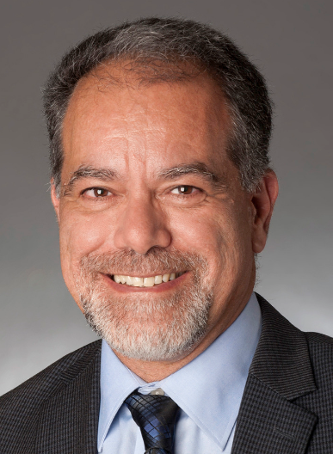
Introducing the scientific committee
Fred Saad
Tanya Dorff
Gerhardt Attard
Professor and Chairman of Urology,
Director of GU Oncology Raymond Garneau Chair in Prostate Cancer University of Montreal Hospital Center, Canada
Associate Professor of Medicine Section Chief, Genitourinary Cancers,
City of Hope Comprehensive Cancer Centre, USA
Clinician Scientist and Team Leader at University College London Cancer Institute
Honorary medical oncology consultant at
Royal Marsden NHS Foundation Trust, UK
President of the National Cancer Institute of Canada G‐U Group, the Canadian Urologic Oncology Group and GU Global
Member of ten editorial boards and serves as a reviewer for more than 30 urology and oncology journals. Published over 300 scientific articles and book chapters and has collaborated on over 800 scientific abstracts presented at scientific meetings around the world.
Co‐editor of several books, including the first two editions of Understanding Prostate Cancer, which sold over 150,000 copies.
Main research interests include molecular prognostic markers in prostate cancer and new treatments for advanced prostate cancer. He is currently coordinating more than 40 clinical and basic research projects in urologic oncology.
Medical oncologist and GU CONNECT member
Authored more than 45 peer reviewed articles as well as 35 review articles /commentaries.
Associate editor for Clinical Genitourinary Cancer and Seminars in Urologic Oncology and has lectured on prostate and bladder cancer treatment nationally and internationally and has presented her research at national meetings.
Principal investigator for more than a dozen clinical trials, involving targeted therapy and immunotherapy, for genitourinary cancers.
Current research interests include the effects of fasting on chemotherapy side effects and cancer control and immunotherapy for prostate cancer.
Medical oncologist and GU CONNECT member
Experienced clinical trialist in CRPC and a co-author of more than 100 peer-reviewed manuscripts, including several important papers on advanced prostate cancer.
Associate editor with ESMO official journal Annals of Oncology and sits on the scientific advisory boards of several companies.
Main research interest is dissecting treatment resistance, currently with a focus on plasma DNA analysis, in order to inform on the development of novel therapeutics and biomarkers for castration-resistant prostate cancer (CRPC).
Awards include the ASCO Foundation Annual Merit Award in 2007, the Medical Research Society/Academy of Medical Sciences Sue McCarthy Prize in 2010 and the Cancer Research UK Future Leaders Award in 2017.

Slide 4
EXPERTS KNOWLEDGE SHARE Educational objectives
Targeting advanced prostate cancer with PARP INHIBITORS: Who, When and How?
Be able to implement testing strategies to predict if the prostate cancer is likely to respond to a PARP inhibitor or some other treatment
Understand the data of combination studies with PARP inhibitors, the appropriate implementation in treatment strategies and the impact on clinical practice
Recognise the efficacy and safety profiles of PARP inhibitors for patients with prostate cancer, including an overview of the data in other tumour types

Slide 5
EXPERTS KNOWLEDGE SHARE
targeting advanced prostate cancer with parp INHIBITORS: who, when and how?
Content
Overview and scene setting | Prof. Fred Saad
Who should you treat? | Prof. Gerhardt Attard
Why you should treat | Assoc. Prof. Tanya Dorff
When to consider combinations | Prof. Fred Saad
Future perspectives and summary | Prof. Fred Saad

Slide 6
Disclaimer
This meeting is supported by an independent medical educational grant from AstraZeneca. The programme is therefore independent; the content is not influenced by AstraZeneca and is the sole responsibility of the experts
Please note:
The views expressed within this presentation are the personal opinions of the experts. They do not necessarily represent the views of the experts’ academic institutions or the rest of the faculty

Slide 7
targeting advanced prostate cancer with parp INHIBITORS: who, when and how? Overview and scene setting Prof. Fred Saad, MD FRCS Professor and Chairman of Urology, Director of GU Oncology Raymond Garneau Chair in Prostate Cancer University of Montreal Hospital Center, Montreal, QC, Canada
PARPI, poly-ADP ribose polymerase inhibitors

Slide 8
THE PROSTATE CANCER LANDSCAPE
Docetaxel
Abiraterone
Enzalutamide
Apalutamide
NEWLY DIAGNOSED mHSPC
PRIMARY PROGRESSIVE mHSPC
LOCALISED OR LOCALLY ADVANCED PROSTATE CANCER
BIOCHEMICAL RECURRENCE
mCRPC
TERMINAL DISEASE (DEATH)
nmCRPC
Docetaxel
Enzalutamide
Cabazitaxel
Apalutamide
Abiraterone
Darolutamide
Enzalutamide
Radium 223
Olaparib
All monotherapeutic options added to ADT
Lutetium-617
ADT, androgen deprivation therapy; mHSPC, metastatic hormone sensitive prostate cancer; (n)mCRPC, (non-)metastatic castration resistant prostate cancer

Slide 9
WHO SHOULD YOU TREAT? Prof. Gerhardt Attard, MD FRCP PhD University College London Cancer Institute London, United Kingdom #Attardlab www.Attardlab.com

Slide 10
disclosures
Prof. Gerhardt Attard has received received financial support/sponsorship for research support, consultation, or speaker fees from the following companies:
Abbott Laboratories, Astellas Pharma, AstraZeneca, Bayer Healthcare Pharmaceuticals, Essa Pharmaceuticals, Innocrin Pharma, Janssen-Cilag, Millennium Pharmaceuticals, Novartis, Pfizer, Roche/Ventana, Sanofi-Aventis, Takeda, Veridex

Slide 11
Genomic Instability is a Targetable Hallmark of Cancer
HALLMARKS OF CANCER
Sustaining proliferative signalling
Emerging hallmarks & enabling characteristics
Evading growth
suppressors
Unlocking phenotypic plasticity
Nonmutational epigenetic reprogramming
Deregulating cellular
metabolism
Avoiding immune
destruction
Resisting cell death
Enabling
replicative
immortality
Genome instability & mutation
Tumour-promoting inflammation
Senescent cells
Polymorphic microbiomes
Inducing or accessing vasculature
Activating invasion & metastasis
Adapted from Hanahan, D. Cancer Discov. 2022;12:31-46

Slide 12
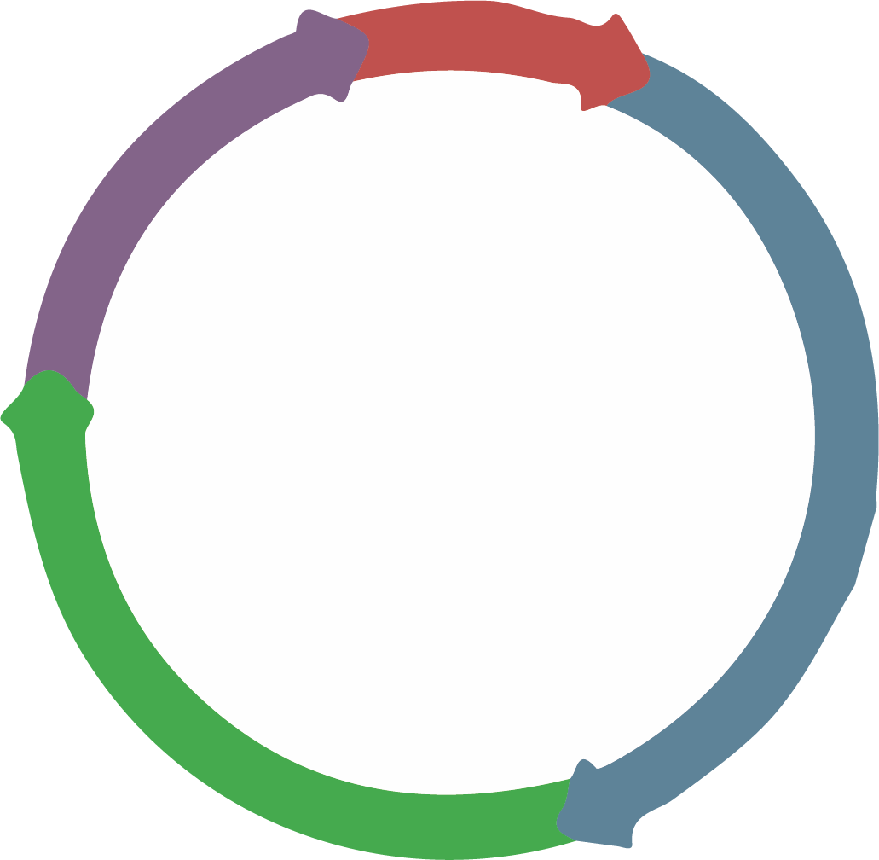
DSB repair: cell cycle
“HR”
M
“NHEJ”
G2
G1
DSB
DSB
S
G0
End joining
DSB resection
5’
REPAIR
3’
Strand invasion
“Error prone”
DNA synthesis
REPAIR
“Error free”
DSB, double-strand break; G, growth; HR, homologous recombination; M, mitosis; NHEJ, non-homologous end joining; S, synthesis

Slide 13
DSB repair defects: cancer predisposition
“HR”
M
“NHEJ”
G2
G1
DSB
DSB
S
G0
DEFECTIVE
Breast Cancer
Prostate Cancer
Ovarian Cancer
BRCA1 BRCA2
Pancreatic Cancer
Melanoma
BRCA1/2, breast cancer type 1/2 susceptibility protein; DSB, double-strand break; G, growth; HR, homologous recombination; M, mitosis; NHEJ, non-homologous end joining; S, synthesis

Slide 14
DSB repair defects: therapeutic exploitation in cancer
“HR”
M
“NHEJ”
G2
G1
DSB
DSB
S
G0
DEFECTIVE
0
Log surviving
fraction
PARP inhibitors: therapeutic exploitation in cancer
−1
−2
−3
Wild type
BRCA2 +/−
BRCA2 −/−
Helleday, Jackson, Ashworth
−4
0
10⁻⁹
10⁻⁸
10⁻⁷
10⁻⁶
10⁻⁵
10⁻⁴
PARP inhibitor concentration (M)
BRCA2, breast cancer type 2 susceptibility protein; DSB, double-strand break; G, growth; HR, homologous recombination; M, mitosis; M, molarity; NHEJ, non-homologous end joining; PARP, poly-ADP ribose polymerase; S, synthesis
Bryant HE, et al. Nature. 2005;434:913-917; Farmer H, et al. Nature. 2005;434:917-921; Tutt ANJ, et al. Cold Spring Harb Symp Quant Biol. 2005;70:139-148

Slide 15
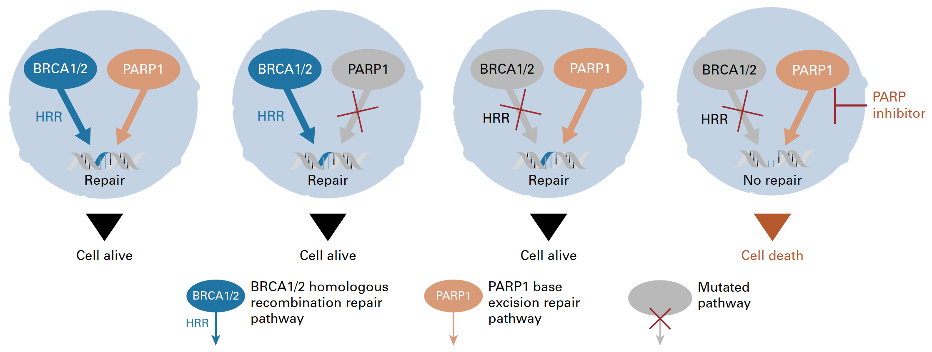
PARP inhibitors: ‘Synthetic Lethality’ in cancer
BRCA: “copy editor”; homologous recombination repair (HRR)
PARP: “spell check”; base excision repair (BER)
BER
BER
BER
BER
BER
PARP is required for single-strand break repair (e.g. via BER)
MOA – inhibiting SSB/BER is synthetic lethal with HRD
BER, base excision repair; BRCA1/2, breast cancer type 1/2 susceptibility protein; HRD, homologous recombination deficiency; HRR, homologous recombination repair; MOA, mode of action; PARP, poly-ADP ribose polymerase; SSB, single-strand break
Adapted from Gourley C, et al., J Clin Oncol. 2019;37(25):2257-2269; Banerjee S, et al. Nat Rev Clin Oncol 2010; 7: 508-519

Slide 16
Androgen receptor inhibition impairs double strand DNA repair
AR
Transcriptional activity
Coactivator
D
D
140
Ku70
AR
MRE11A
NBN
ATR
PARP1
LIG3
+
120
**
AR
AR
DNAPKcs
100
+
+ IR
80
BER
P
Normalised mean staining intensity in nuclei (%)
***
DNA damage sensors
60
***
**
FANCI FANCC USP1
DNAPKcs
40
XRCC4
XRCC5
RAD54B
RAD51C
MSH2
MSH6
+
20
***
***
Active
D
D
***
0
AR
AR
Tumour cell survival
Baseline
Castration
Baseline
DSB repair
Castration + RT
RT
NHEJ
HR
MMR
Fanconi
RT + castration
Arm 1
Arm 2
AR, androgen receptor; BER, base excision repair; DSB, double-strand break; HR, homologous recombination; MMR, mismatch repair; NEHJ, non-homologous end-joining; RT, radiotherapy
Polkinghorn W, et al. Cancer Discovery. 2013;3:1245-53; Goodwin J, et al. Cancer Discovery. 2013;3:1254-71; Tarish F, et al., Sci Transl Med. 2015;7:312re11

Slide 17
CO-OPERATION OF INHIBITION OF PARP AND AR: A RANDOMIZED PHASE 2 mCRPC TRIAL
HRRm
 | Olap + Abi (n=11) | Abi (n=10)
Events, n (%) | 8 (73) | 7 (70)
KM median, months | 17.8 | 6.5
HR (95% CI) | 0.74 (0.26‒2.12)
HRRpc*
Olap + Abi (n=45) | Abi (n=41)
30 (67) | 30 (73)
13.1 | 6.4
0.67 (0.40‒1.13)
HRRwt
Olap + Abi (n=15) | Abi (n=20)
8 (53) | 17 (85)
15.0 | 9.7
0.52 (0.24‒1.15)
1.0
0.8
0.6
Proportion of patients event-free
0.4
0.2
0.0
0
6
12
18
24
30
0
6
12
18
24
30
0
6
12
18
24
30
Time from randomisation (months)
*80/86 patients HRRwt by plasma and/or germline testing
Abi, abiraterone; CI, confidence interval; HR, hazard ratio; HRR(m)(pc)(wt), homologous recombination repair (mutation)(partially characterised)(wild-type); KM, Kaplan-Meir; Olap, olaparib
Clarke N, et al. The Lancet Oncology. 2018;19:975-86

Slide 18
DDR Mutations in Metastatic Prostate Cancer
Prevalence and Screening

Slide 19
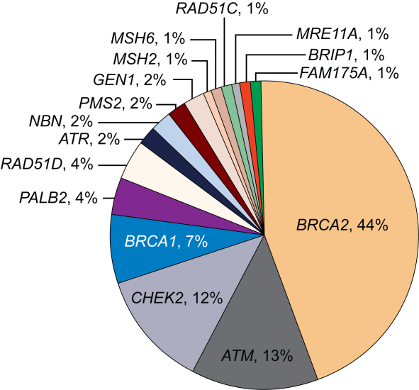
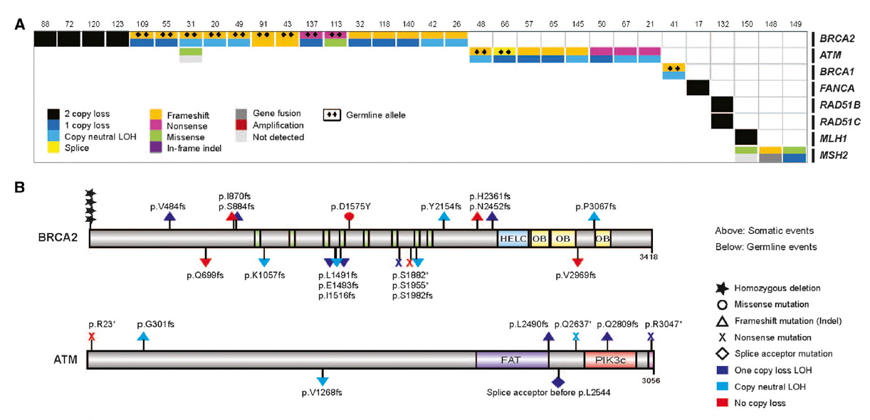
DNA Repair Gene Alterations (Somatic and Germline) Are Common in Metastatic prostate cancer
Somatic
Germline
~23% of men with mCRPC have DNA repair pathway aberrations
The incidence of DNA repair alterations is higher in men with metastatic prostate cancer than those with localised disease
~12% of men with metastatic prostate cancer have germline mutations in one or more of 16 DNA repair genes
LOH, loss of heterozygosity; mCRPC, metastatic castration resistant prostate cancer; PC, prostate cancer
1. Robinson D, et al. Cell. 2015;161:1215-1228; 2. Pritchard CC, et al. N Engl J Med. 2016;375:443-453; 3. Antonarakis ES, et al. Eur Urol. 2018;74:218-225

Slide 20
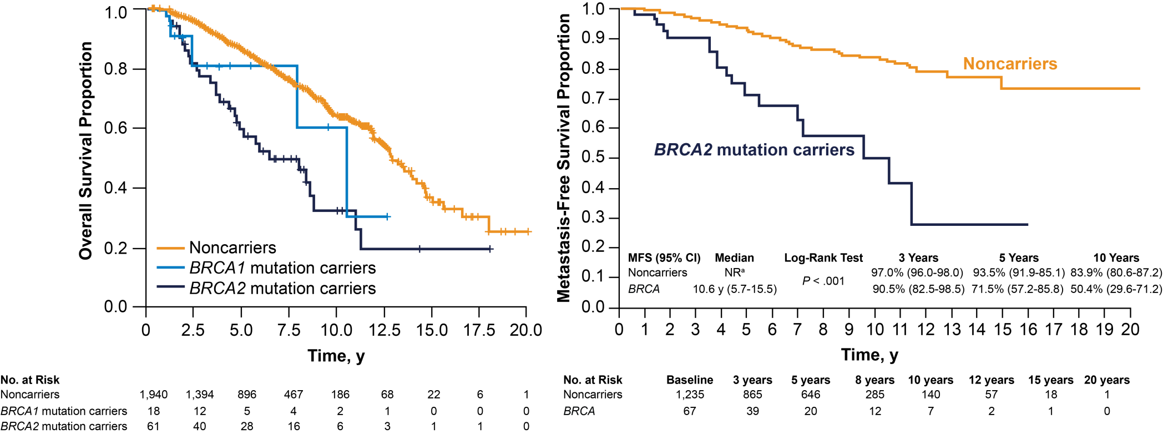
BRCA2 Carriers With M0 Prostate Cancer Have Worse Prognosis^{1,2}
Noncarriers
BRCA1/2 mutation carriers
ª Median survival not reached after a median of 64 months of follow-up
BRCA1/2, breast cancer type 1/2 susceptibility protein; CI, confidence interval; MFS, metastasis-free survival; NR, not reached; y, years
1. Castro E, et al. J Clin Oncol. 2013;31:1748-1757; 2. Castro E, et al. Eur Urol. 2015;68:186-193

Slide 21
Family History Is the strongest known Risk Factor for prostate cancer
A father or brother with prostate cancer doubles a man’s risk of prostate cancer
A mother or sister with breast cancer diagnosed before age 50 significantly increases a woman’s risk of breast cancer
A mother or sister with breast cancer can affect a man’s risk of prostate cancer
Chen YC, et al. Prostate. 2008;68(14):1582-1591; Colditz GA, et al. Breast Cancer Res Treat. 2012;133(3):1097-1104
Notes:
4907

Slide 22
NCCN Guidelines (V3.2022) for Genetic Testing
Germline testing | Somatic tumour testing
Germline testing is recommended for patients with a personal history of PC in the following scenarios: Metastatic, regional (node +), very high-risk localised, high-risk localised PC By family historyª and/or ancestry ≥ 1 first-, second- or third-degree relative with: breast cancer at ≤50 y, male breast cancer, ovarian cancer, exocrine pancreatic cancer or metastatic, regional, very-high risk, high-risk PC at any age ≥ 1 first-degree relative (brother/father) with PC^{b} at ≤60 y ≥ 2 first-, second- or third-degree relatives with: breast or PC^{b} at any age ≥ 3 first- or second- degree relatives with: Lynch syndrome-related cancers especially if diagnosed < 50y A known family history of familial cancer risk mutation mutation (e.g. BRCA1/2, ATM, PALB2, CHEK2, MLH1, MSH2, MSH6, PMS2, EPCAM) Ashkenazi Jewish ancestry Personal history of breast cancer | Recommend evaluating tumour for alterations in homologous recombination DNA repair genes, such as BRCA1, BRCA2, ATM, PALB2, FANCA, RAD51D, CHEK2, and CDK12 in patients with metastatic PC Can be considered in men with regional PC Testing for microsatellite instability-high or mismatch repair deficient status is recommended in patients with metastatic castration resistant prostate cancer (mCRPC), and may be considered in patients with regional or castration-naïve metastatic PC TMB testing may be considered in patients with mCRPC
ª Close blood relatives include 1st, 2nd and 3rd degree relatives on the same side of the family; ^{b}Family history of PC should not include relatives with clinically localised Grade Group 1 disease
ATM, ataxia telangiectasia mutated; BRCA1/2, breast cancer type 1/2 susceptibility protein; mCRPC, metastatic castration resistant prostate cancer; PC, prostate cancer; TMB, tumour mutational burden
National Comprehensive Cancer Network. Prostate Cancer (Version 3.2022). https://www.nccn.org/professionals/physician_gls/pdf/prostate.pdf. Accessed Feb 2022

Slide 23
Cascading Impact
Tailored screening and risk-reduction
Full family history should be collected:
3 or 4 generation pedigree
Ancestry and consanguinity information
Any prior genetic testing
Family history:
Guides choice of broad vs narrow gene panel
Determines a patient's criteria for testing
Identifies the most appropriate family members for testing
Informs screening if test is negative
~50% chance of inheriting same DNA repair mutation
↑ risk of PC, more aggressive
~23% of men with mCRPC have DNA pathway aberrations
Tailored screening, risk-reduction
~12% of men with PC carry an inherited DNA repair gene mutation – implications for cancer screening and for their relatives
Treatment opportunities
PARP inhibitors, platinum-based chemotherapy, etc.
↑ risk of PC, more aggressive
HR, homologous recombination; mCRPC, metastatic castration resistant prostate cancer; PARP, poly-ADP ribose polymerase; PC, prostate cancer
Cheng HH, et al. J Natl Compr Canc Netw. 2019;17:515-521; Pritchard CC, et al. N Engl J Med. 2016;375:443-453; Szymaniak BM, et al. JCO Oncol Pract. 2020;16:811-819; Antonarakis ES, et al. Eur Urol. 2018;74:218-225 Figure adapted from Cheng H. https://www.ustoo.org/Pathways-Seattle-Webcast

Slide 24
How do we test?
Germline
Somatic
Academic/In house

Slide 25
Conclusions
DDR mutations are a therapeutic target in metastatic prostate cancer
PARPi work by the concept of “synthetic lethality”
Somatic (in ~40% of cases = germline) mutations related to DDR occur in 15-30% of metastatic prostate cancer
Somatic and germline testing should be considered for all patients with metastatic prostate cancer and some patients with high-risk regional and locally-advanced prostate cancer
AR inhibition induces HRR deficiency and could increase susceptibility to PARP inhibition in both DDR mutant and WT prostate cancer
DDR, DNA damage repair; PARPi, poly-ADP ribose polymerase inhibitors

Slide 26
Why you should treat PARP inhibitors: key efficacy and safety considerations Tanya Dorff, MD Associate Professor of Medicine Section Chief, Genitourinary Cancers, City of Hope, Los Angeles, USA
PARP, poly ADP ribose polymerase (PARP) inhibitors

Slide 27
disclosures
Assoc. Prof. Tanya Dorff has received financial support/sponsorship for research support, consultation or speaker fees from the following companies:
Advanced Accelerator Applications, Bayer, BMS, Exelixis, Seattle Genetics

Slide 28
PROfound: phase 3 data with Olaparib in mCRPC
Olaparib 300 mg BID (n=162)
Primary endpoint
rPFS in cohort A (RECIST 1.1 and PCWG3 by BICR)
Key eligibility criteria
mCRPC with disease progression on prior NHA (abiraterone acetate or enzalutamide)
Alterations in ≥1 of any qualifying gene with a direct or indirect role in HRR ª
Cohort A BRCA1, BRCA2, or ATM alteration (N=245)
Physician’s choice ^{b} (n=83)
2:1 randomisation (Open label)
Upon progression by BICR, physician’s choice patients were allowed to cross over to olaparib
Key secondary endpoints
rPFS in cohorts A and B (by BICR) Confirmed radiographic objective response rate in cohort A (by BICR) Time to pain progression in cohort A OS in cohort A
Cohort B Other alterations (N=142)
Olaparib 300 mg BID (n=94)
Physician’s choice ^{b} (n=48)
Stratification factors
Previous taxane
Measurable disease
ª An investigational clinical trial assay, based on the FoundationOne® CDx next-generation sequencing test, used to prospectively select patients with alteration of BRCA1, BRCA2, ATM, BARD1, BRIP1, CDK12, CHEK1, CHEK2, FANCL, PALB2, PPP2R2A, RAD51B, RAD51C, RAD51D, or RAD54L in their tumour tissue
^{b} Physician’s choice: enzalutamide 160 mg/day, or abiraterone 1,000 mg/day + prednisone 5 mg BID
ATM, ataxia telangiectasia mutated; BICR, blinded independent central review; BID, twice daily; BRCA1/2, breast cancer type 1/2 susceptibility protein; HRR, homologous recombination repair; mCRPC, metastatic castration resistant prostate cancer; NHA, new hormonal agent; OS, overall survival; PCWG3, Prostate Cancer Working Group 3; RECIST, Response Evaluation Criteria In Solid Tumours; rPFS, radiographic progression-free survival; QD, once daily
de Bono J, et al. N Engl J Med. 2020;382:2091-2102; Hussain M, et al. N Engl J Med. 2020;383(24):2345-2357

Slide 29
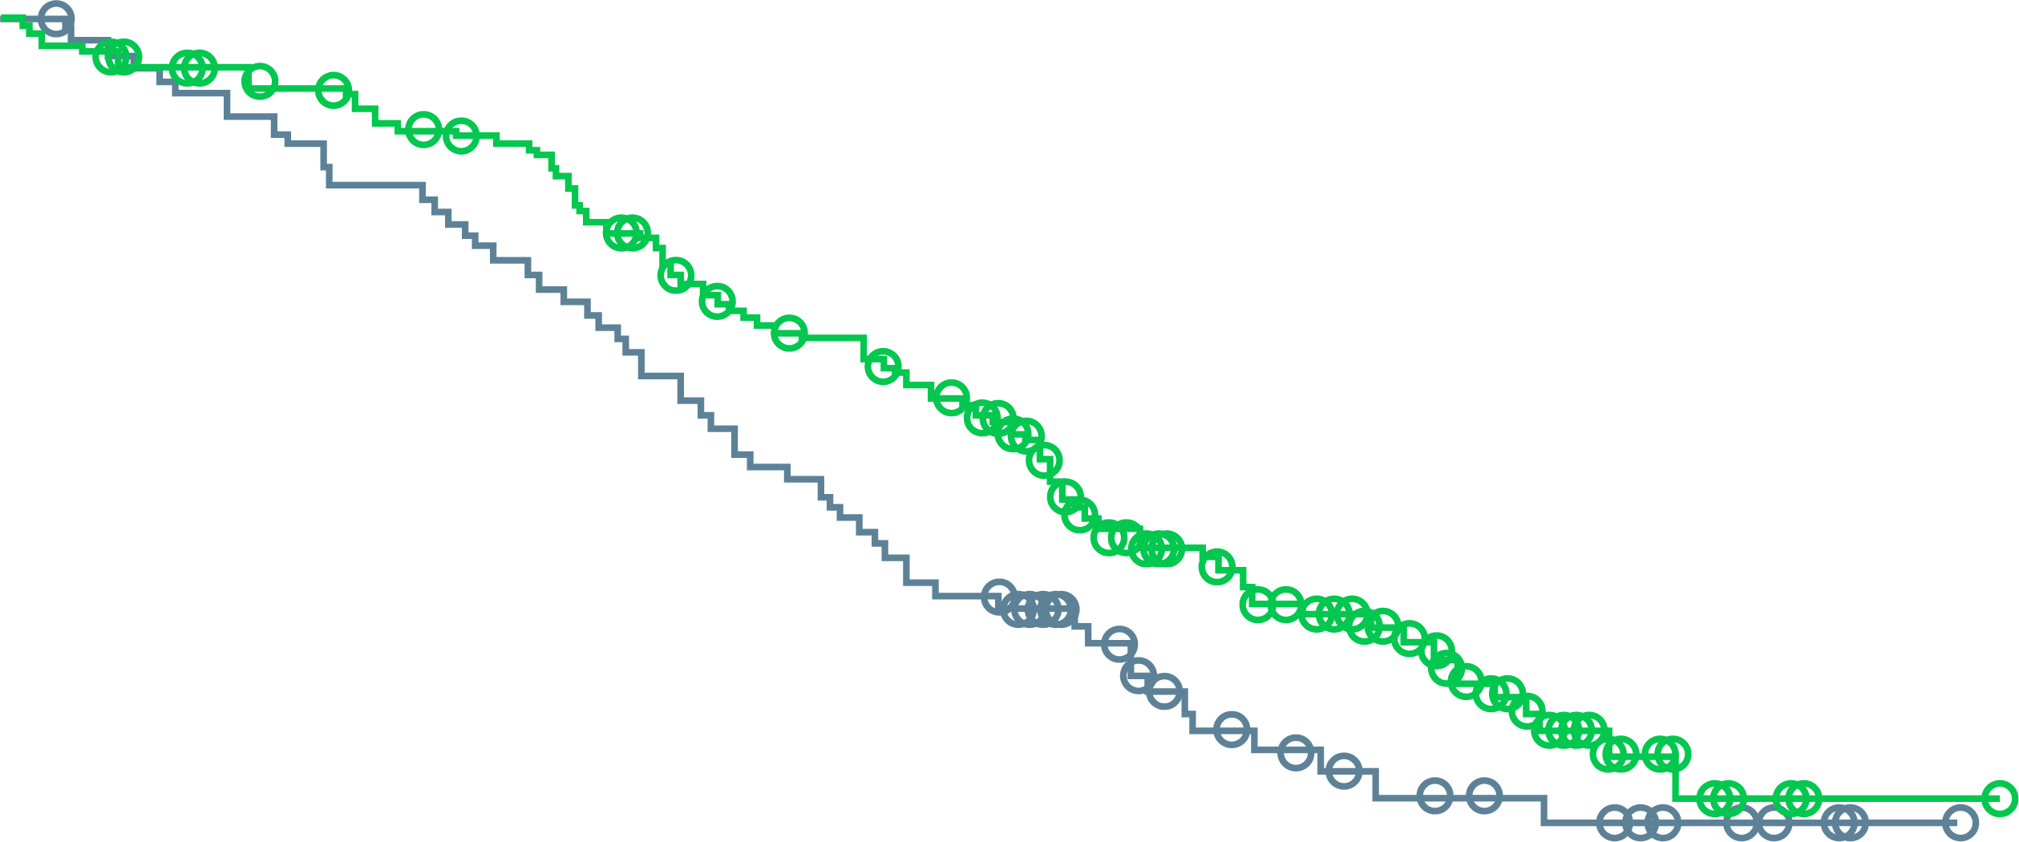
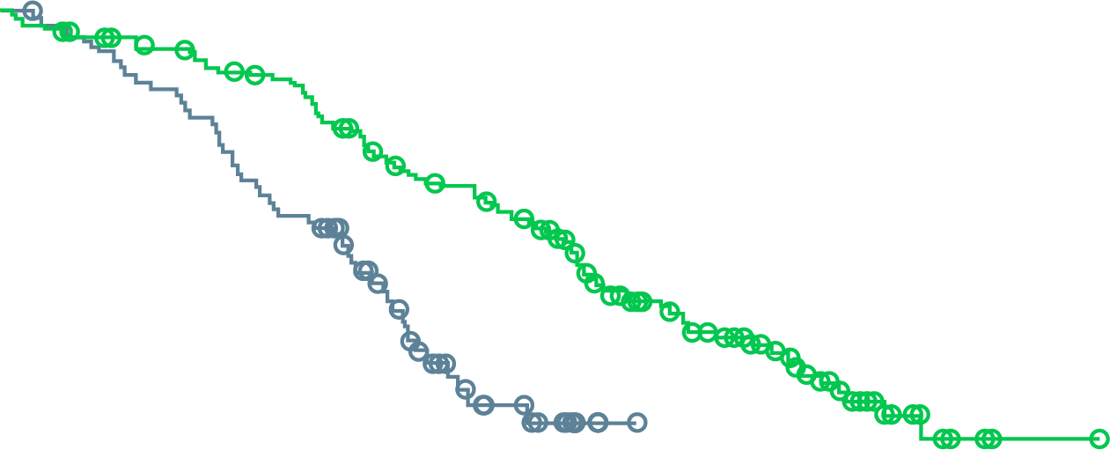
profound: FINAL OVERALL SURVIVAL
OS in cohort A (BRCA1&2, ATM)
CROSSOVER-ADJUSTED OS in COHORT A
 | No. of Deaths/ No. of Patients | Median OS (95% CI), months
Olaparib | 91/162 | 19.1 (17.4-23.4)
Control | 57/83 | 14.7 (11.9-18.8)
Hazard ratio for death, 0.69 (95% CI, 0.50-0.97) 2-sided p=0.02
Patients who crossed over, 67% (56/83) Hazard ratio for death, 0.42 (95% CI, 0.19-0.91)
100
91%
84%
100
90
73%
61%
90
80
54%
42%
80
70
70
60
60
Percent of patients alive
Percent of patients alive
50
50
40
40
30
Olaparib
30
Olaparib
20
Control
20
Control
10
10
0
0
0
2
4
6
8
10
12
14
16
18
20
22
24
26
28
30
32
34
0
2
4
6
8
10
12
14
16
18
20
22
24
26
28
30
32
34
No. at risk
Olaparib
Control
Months since randomisation
No. at risk
Olaparib
Control
Months since randomisation
162
83
155
79
150
74
142
69
136
64
124
58
107
50
101
43
91
37
71
27
56
18
44
15
30
11
18
9
6
6
2
3
1
1
0
0
162
83
155
79
150
73
142
67
136
56
124
47
107
29
101
15
91
9
71
3
56
0
44
0
30
0
18
0
6
0
2
0
1
0
0
0
>80% crossover!
ATM, ataxia telangiectasia mutated; BRCA1/2, breast cancer type 1/2 susceptibility protein; CI, confidence interval; HR, hazard ratio; OS, overall survival Hussain M, et al. N Engl J Med. 2020;383(24):2345-2357

Slide 30
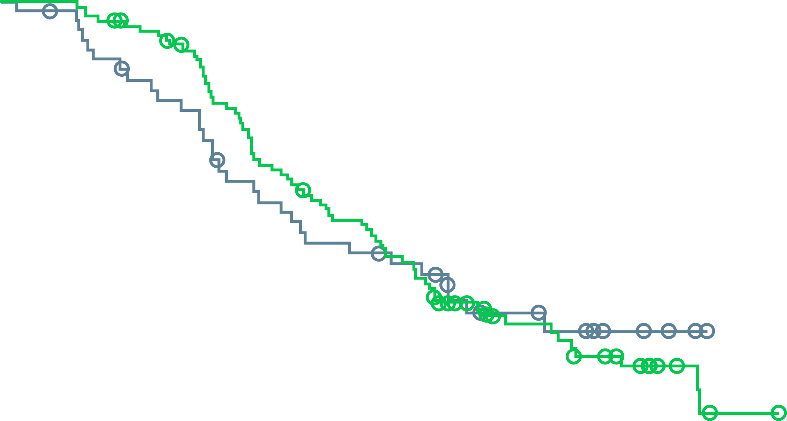
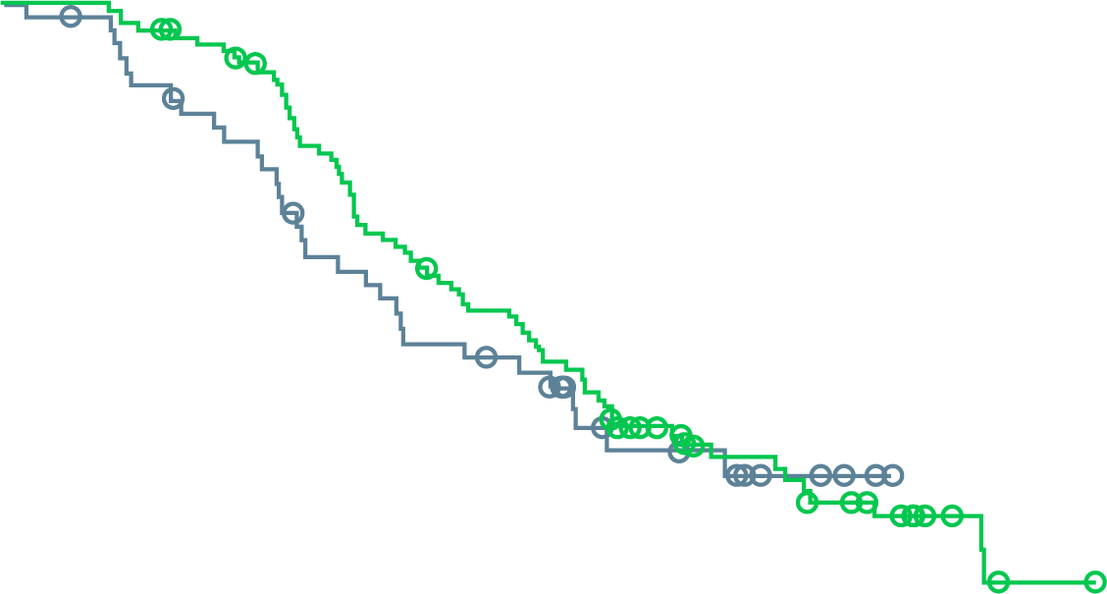
profound: FINAL OVERALL SURVIVAL
OS in cohort B
CROSSOVER-ADJUSTED OS in COHORT B
 | No. of Deaths/ No. of Patients | Median OS (95% CI), months
Olaparib | 69/94 | 14.1 (11.1-15.9)
Control | 31/48 | 11.5 (8.2-17.1)
Hazard ratio for death, 0.96 (95% CI, 0.63-1.49)
Patients who crossed over, 63% (30/48) Hazard ratio for death, 0.83 (95% CI, 0.11-5.98)
100
94%
81%
100
90
57%
47%
90
80
34%
32%
80
70
70
60
60
Percent of patients alive
Percent of patients alive
50
50
Control
40
40
Control
30
Control
30
20
Olaparib
20
Olaparib
10
10
0
0
0
2
4
6
8
10
12
14
16
18
20
22
24
26
28
30
32
34
0
2
4
6
8
10
12
14
16
18
20
22
24
26
28
30
32
34
No. at risk
Olaparib
Control
Months since randomisation
No. at risk
Olaparib
Control
Months since randomisation
94
48
94
46
90
41
86
37
73
32
58
25
50
21
45
20
35
18
25
10
17
9
12
7
9
4
4
2
1
0
0
0
0
0
0
0
94
48
94
46
90
41
86
37
73
29
58
25
50
21
45
19
35
11
25
9
17
7
12
4
9
1
4
0
1
0
0
0
0
0
0
0
CI, confidence interval; HR, hazard ratio; OS, overall survival Hussain M, et al. N Engl J Med. 2020;383(24):2345-2357

Slide 31
Olaparib: Side effect profile
Event | Olaparib (N=256) |  | Control (N=130) |  | Crossover (N=83)
 | All grades | Grade ≥3 | All grades | Grade ≥3 | All grades | Grade ≥3
Any adverse event, n (%) | 246 (96) | 133 (52) | 115 (88) | 52 (40) | 77 (93) | 49 (59)
Anaemia | 127 (50) | 58 (23) | 20 (15) | 7 (5) | 43 (52) | 24 (29)
Nausea | 110 (43) | 4 (2) | 27 (21) | 0 | 24 (29) | 2 (2)
Fatigue or asthenia | 107 (42) | 8 (3) | 43 (33) | 7 (5) | 21 (25) | 8 (10)
Decreased appetite | 80 (31) | 4 (2) | 24 (18) | 1 (<1) | 15 (18) | 2 (2)
Diarrhoea | 55 (21) | 2 (<1) | 9 (7) | 0 | 12 (14) | 0
Vomiting | 51 (20) | 6 (2) | 17 (13) | 1 (<1) | 16 (19) | 1 (1)
Constipation | 49 (19) | 0 | 19 (15) | 0 | 12 (14) | 0
Back pain | 36 (14) | 2 (<1) | 18 (14) | 2 (2) | 8 (10) | 0
Peripheral oedema | 34 (13) | 0 | 10 (8) | 0 | 3 (4) | 0
Cough | 29 (11) | 0 | 3 (2) | 0 | 4 (5) | 0
Dyspnoea | 27 (11) | 6 (2) | 5 (4) | 0 | 4 (5) | 1 (1)
Arthralgia | 26 (10) | 1 (<1) | 14 (11) | 0 | 4 (5) | 0
Urinary tract infection | 21 (8) | 5 (2) | 15 (12) | 5 (4) | 12 (14) | 3 (4)
Any serious adverse event, n (%) | 94 (37) | NA | 39 (30) | NA | 27 (33) | NA
Interruption of treatment because of adverse event, n (%) | 119 (46) | NA | 25 (19) | NA | 44 (53) | NA
Hussain M, et al. N Engl J Med. 2020;383(24):2345-2357

Slide 32
TRITON2: open label, single-arm, phase 2 study of rucaparib in mCRPC patients
Screening
Key eligibility criteria
Treatment
28-day cycles
Identification of a deleterious somatic or germline alteration in HRR gene*
mCRPC
Deleterious somatic or germline alteration in HRR gene
Disease progression on AR-directed therapy (eg, abiraterone, enzalutamide, or apalutamide) for PC and 1 prior taxane-based chemotherapy for CRPC
ECOG PS 0 or 1
No prior PARP inhibitor, mitoxantrone, cyclophosphamide, or platinum-based chemotherapy
Rucaparib 600 mg BID
HRR genes
BRCA1 BRCA2 ATM | BARD1 BRIP1 CDK12 CHEK2 | FANCA NBN PALB2 RAD51 | RAD51B RAD51C RAD51D RAD54L
Tumour assessments every 8 weeks for 24 weeks, then every 12 weeks
PSA assessments every 4 weeks
Treatment until radiographic progression or discontinuation for other reason
Primary endpoints†
Patients with measurable disease at baseline: confirmed ORR per modified RECIST/PCWG3 by central assessment
Patients with no measurable disease at baseline: confirmed PSA response (≥50% decrease) rate§
*Alterations detected by local testing or central testing of blood or tumour samples. † Efficacy analyses in TRITON2 will be conducted separately based on HRR gene with alteration and presence/absence of measurable disease. ‡ RECIST modified to include up to 10 target lesions, maximum 5 per site, not including prostatic bed or bone lesions; MRI allowed. § The proportion of patients with a ≥50% decrease from baseline confirmed by a second consecutive measurement; PSA measurements performed by local laboratory.
AR, androgen receptor; BID, twice daily; CRPC, castration-resistant prostate cancer; ECOG PS, Eastern Cooperative Oncology Group Performance Status; HRR, homologous recombination repair, mCRPC, metastatic castration-resistant prostate cancer; MRI, magnetic resonance imaging; ORR, objective response rate; PARP, poly (ADP-ribose) polymerase; PC, prostate cancer; PCWG3, prostate cancer working group 3; PSA, prostate specific antigen; RECIST, Response Evaluation Criteria in Solid Tumours version 1.1
Abida W, et al. J Clin Oncol 2020; 38:3763-3772

Slide 33
TRITON2: Rucaparib Efficacy in mCRPC patients with BRCA1 & 2 alterations
Tumour response (evaluable population)
PSA RESPONSE (EFFICACY POPULATION)
A
B
100
+ = Confirmed radiographic response
o = Ongoing
100
+ = Confirmed PSA response
o = Ongoing
80
80
60
60
40
40
20
20
Change from baseline (%)
0
0
Change from baseline (%)
-20
-20
-40
-40
-60
-60
-80
-80
-100
-100
Germline/somatic status:
Germline
Somatic
Germline/somatic status:
Germline
Somatic
BRCA1
BRCA1
BRCA2
BRCA2
Best change from baseline in (A) sum of target lesion(s) in the independent radiology review-evaluable population and in (B) prostate-specific antigen (PSA) in the overall efficacy population
BRCA1/2, breast cancer type 1/2 susceptibility protein; PSA, prostate specific antigen
Abida W, et al. J Clin Oncol. 2020;38:3763-3772

Slide 34
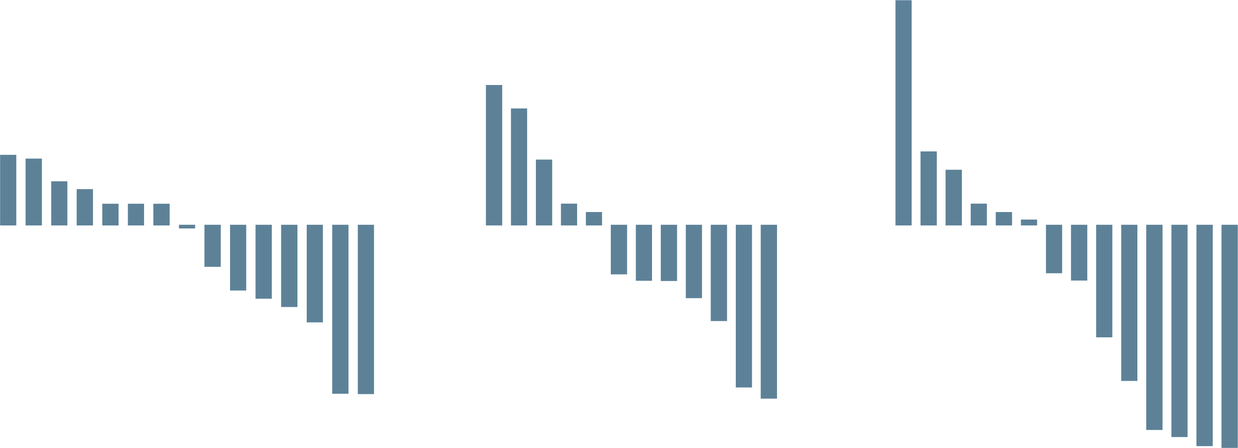
TRITON2: Rucaparib in mCRPC non-BRCA DDR gene alterations
78 patients
ATM 49 patients
CDK12 15 patients
CHEK2 12 patients
Other DDR gene 14 patients
Measurable disease 19 patients
No measurable disease 30 patients
Measurable disease 10 patients
No measurable disease 5 patients
Measurable disease 9 patients
No measurable disease 3 patients
Measurable disease 14 patients
B
C
D
A
100
90
80
70
60
50
40
30
20
10
0
-10
-20
-30
-40
-50
-60
-70
-80
-90
-100
+ = Confirmed PSA response
o = Ongoing
100
90
80
70
60
50
40
30
20
10
0
-10
-20
-30
-40
-50
-60
-70
-80
-90
-100
+ = Confirmed PSA response
o = Ongoing
100
90
80
70
60
50
40
30
20
10
0
-10
-20
-30
-40
-50
-60
-70
-80
-90
-100
+ = Confirmed PSA response
o = Ongoing
100
90
80
70
60
50
40
30
20
10
0
-10
-20
-30
-40
-50
-60
-70
-80
-90
-100
+ = Confirmed PSA response
o = Ongoing
o
o
o
o
o
Change from baseline (%)
o
Change from baseline (%)
o
o
o
o
o
o
o
o
o
o
o
o
+
o
+
o
+
+
o
+
o
+
+
o
+
o
+
o
+
o
Patient | 1 | 2 | 3 | 4 | 5 | 6 | 7 | 8 | 9 | 10 | 11 | 12 | 13 | 14 | 15 | 16 | 17 | 18 | 19 | 20 | 21 | 22 | 23 | 24 | 25 | 26 | 27 | 28 | 29 | 30 | 31 | 32 | 33 | 34 | 35 | 36 | 37 | 38 | 39 | 40 | 41 | 42 | 43 | 44 | 45 | 46 | 47 | 48 | 49
Treatment duration (mo) | 1 | 2 | 2 | 2 | 6 | 4 | 14 | 3 | 1 | 5 | 3 | 11 | 7 | 4 | 3 | 6 | 8 | 1 | 5 | 4 | 2 | 2 | 3 | 5 | 2 | 3 | 12 | 7 | 5 | 7 | 6 | 3 | 13 | 3 | 4 | 4 | 6 | 10 | 22 | 3 | 4 | 6 | 2 | 5 | 2 | 3 | 6 | 7 | 7
Radiographic response |  |  |  |  |  |  |  |  |  |  |  |  |  |  |  |  |  |  |  |  |  |  |  |  |  |  |  |  |  |  |  |  |  |  |  |  |  |  |  |  |  |  |  |  |  |  |  | PR | PR
Best change in SLD (%) |  | 3 |  | -12 |  |  |  |  |  |  |  |  | -17 |  |  |  |  |  |  | 13 | 31 |  |  |  | 1 |  |  | -49 | -13 | -9 | -6 |  |  |  | 7 |  | -23 | -21 |  |  | 13 |  |  | 11 | -26 |  |  | -39 | -66
ATM | U | B | U | B | U | U | U | B | U | U | M | M | U | U | U | U | U | U | B | U | M | U | U | U | B | U | B | U | M | U | M | U | U | U | U | B | B | B | B | U | M | B | U | U | U | U | U | U | U
BRIP1
CDK12
CHEK2 |  |  |  |  |  |  |  |  |  |  |  |  | U |  |  |  |  |  | U |  |  |  |  |  | B |  |  | U |  |  |  |  |  |  |  |  |  |  |  |  |  | U |  |  |  |  |  |  | U
FANCA |  |  |  |  |  |  |  |  |  |  |  |  |  |  |  |  |  |  |  |  |  |  |  |  | B
NBN
PALB2
RAD51
RAD51B
RAD54L |  |  |  |  |  |  |  |  |  |  |  |  |  |  |  |  |  |  |  |  |  |  |  |  |  |  |  | U
BRCA2 |  |  |  |  |  |  |  |  |  |  |  |  |  |  |  |  |  |  |  |  |  |  | U
Patient | 50 | 51 | 52 | 53 | 54 | 55 | 56 | 57 | 58 | 59 | 60 | 61 | 62 | 63 | 64
Treatment duration (mo) | 2 | 6 | 2 | 2 | 4 | 4 | 13 | 5 | 6 | 4 | 3 | 7 | 10 | 5 | 8
Radiographic response
Best change in SLD (%) | -14 | -14 |  | 31 |  | -12 |  |  | -13 | 5 | -13 | 14 |  |  | -5
ATM
BRIP1
CDK12 | U | M | B | B | U | B | B | B | U | M | M | B | B | B | B
CHEK2 |  |  |  |  |  |  |  |  |  |  | B |  | U
FANCA
NBN
13 | 65 | 19 | 25 | 28 | 66 | 67 | 42 | 60 | 62 | 49 | 68
7 | 1 | 5 | 2 | 7 | 5 | 2 | 6 | 3 | 10 | 7 | 4
 |  |  |  |  |  |  |  |  |  | PR
-17 | 37 |  | 1 | -49 | -4 | -6 |  | -13 |  | -66 | -14
U |  | B | B | U |  |  | B |  |  | U
 |  |  |  |  |  | M
 |  |  |  |  |  |  |  | M | B
U | U | U | B | U | B | M | U | B | U | U | U
 |  |  | B |  | B
 |  |  |  |  | B
69 | 70 | 71 | 25 | 28 | 72 | 66 | 67 | 73 | 74 | 75 | 76 | 77 | 78
2 | 3 | 4 | 2 | 7 | 7 | 5 | 2 | 4 | 6 | 8 | 13 | 14 | 14
 |  |  |  |  |  |  |  |  | PR | PR |  | CR | PR
 | -15 | 1 | 1 | -49 | -18 | -4 | -6 | 7 | -44 | -44 | -47 | -100 | -63
 |  |  | B | U
 |  |  |  |  |  |  | M |  |  |  |  |  | M
 |  |  | B | U |  | B | M
 | U |  | B |  |  | B |  |  |  |  |  | M
 |  | U |  |  | B | B |  | M
Best change from baseline in PSA in patients with an ATM alteration (A), CDK12 alteration (B), CHEK2 alteration (C), or other DDR gene alteration (D). PSA increases for patients 1-5 were 319%, 142%, 126%, 109%, and 106%; bars were capped at 100% for visual clarity. Patients 55, 56, 57, 61, 62, 63, and 64 had 2 distinct CDK12 alterations identified through tissue and/or plasma testing and were considered to have biallelic loss.
Measurable disease
Germline
Somatic
Unknown
ATM, ataxia telangiectasia mutated; BRCA (2), breast cancer type (2) susceptibility protein CR, complete response; DDR, DNA damage repair; mCRPC, metastatic castration resistant prostate cancer; mo, month; PR, partial response; PSA, prostate specific antigen; SLD, sum of the longest diameter
Abida W, et al. Clin Cancer Res. 2020;26:2487-2496

Slide 35
Rucaparib side effects
Individual TEAE (preferred terms) occurring in ≥15% of patients | Any grade | Grade ≥3
Asthenia/fatigue | 71 (61.7) | 10 (8.7)
Nausea | 60 (52.2) | 3 (2.6)
Anaemia/decreased hemoglobin | 50 (43.5) | 29 (25.2)
ALT/AST increased | 38 (33.0) | 6 (5.2)
Decreased appetite | 32 (27.8) | 2 (1.7)
Constipation | 31 (27.0) | 1 (0.9)
Thrombocytopenia/decreased platelets | 29 (25.2) | 11 (9.6)
Vomiting | 25 (21.7) | 1 (0.9)
Diarrhoea | 23 (20.0) | 0
Dizziness | 21 (18.3) | 0
Blood creatinine increased | 18 (15.7) | 1 (0.9)
ALT, alanine aminotransferase; AST, aspartate aminotransferase; TEAE, treatment-emergent adverse event
Abida W, et al. J Clin Oncol. 2020;38:3763-3772

Slide 36
Other PARPi in development: relative strength
PARP inhibitor | Enzyme FP IC₅₀ª | Relative PARP trapping | Dose for pivotal trials
Olaparib | PARP1: 7 nM PARP2: 6 nM | 1 | 300 mg bid
Niraparib | PARP1: 34 nM PARP2: 1,302 nM | 2 | 300 mg qd
Rucaparib | PARP1: 7 nM PARP2: 123 nM | 1 | 600 mg bid
Talazoparib | PARP1: 5 nM PARP2: 12 nM | 100 | 1 mg qd
bid, twice daily; FP, fluorescence polarisation; IC50, 50% inhibitory concentration; PARP, poly-ADP ribose polymerase; qd, once daily
ª The smaller the value, the lower the concentration of drug required to have an effect
Antonarakis E, et al. Eur Urol Oncol. 2020;3(5):594-611

Slide 37
PARPi in development for mCRPC
Clinical trial | Study Type | Treatment | Key efficacy results | Key safety results (PARP inhibitor arm)
GALAHAD¹ (NCT02854436) | Phase 2, single arm, open label | Niraparib | Final analysis median follow-up duration: 10 months ORR: BRCA cohort: 34.2% (n=26/76); non-BRCA cohort: 10.6% (n=5/47) Median rPFS (mo): BRCA cohort (n=142): 8.08 non-BRCA (N=81): 3.71 | Most common grade 3+ AEs: Anaemia: 33% Thrombocytopenia: 16% Neutropenia: 10%
TALAPRO-1² (NCT03148795) | Phase 2, single arm, open label | Talazoparib | Median follow-up: 16.4 months ORR (n=104): BRCA1/2: 46% ATM: 12% PALB2: 25% Other: 0% Median rPFS (mo): BRCA1/2 (n=61): 11.2 PALB2 (n=4): 5.6 ATM (n=17): 3.5 | Most common grade 3+ AEs: Anaemia: 31% Thrombocytopenia: 9% Neutropenia: 8%
AEs, adverse events; ATM, ataxia telangiectasia mutated; BRCA1/2, breast cancer type 1/2 susceptibility protein; m, mutated; mCRPC, metastatic castration resistant prostate cancer; mo, months; OS, overall survival; ORR, objective response rate; PARP, poly-ADP ribose polymerase; PSA, prostate specific antigen; RECIST, Response Evaluation Criteria In Solid Tumours; rPFS, radiographic progression free survival. Antonarakis E, et al. Eur Urol Oncol. 2020;3(5):594-611; 1. Smith M, et al. Lancet Oncology 2022. 23: 362-373; 2. de Bono J, et al. Lancet Oncol. 2021; 22: 1250-1264;

Slide 38
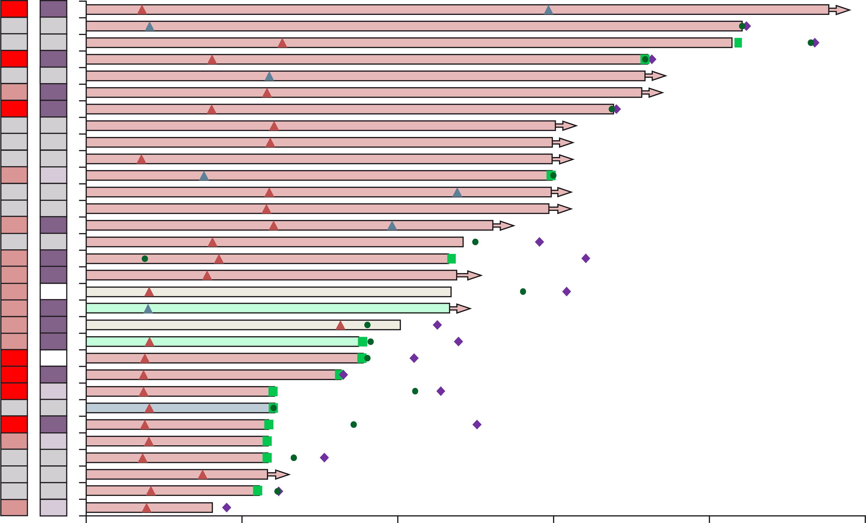
What should you/your patient expect: RESPONSE
TALAPRO-1ª: RESPONSE TO TALAZOPARIB IN mCRPC PATIENTS
Tumour alteration origin
Germline
Somatic
Unknown
Not evaluable
Zygosity
Homozygous
Heterozygous
Unknown
Not evaluable
Patients
Complete response
Partial response
Progressive disease
Start of anti-cancer therapy
Ongoing response
Talazoparib off treatment
Hierarchical mutation subgroup
BRCA1 (n=2)
BRCA2 (n=26)
PALB2 (n=1)
ATM (n=2)
Tumour alteration origin
0
20
40
60
80
100
Zygosity
Time from first treatment (weeks)
ªOpen-label, single arm, phase 2 trial
ATM, ataxia telangiectasia mutated; BRCA1/2, breast cancer type 1/2 susceptibility protein
DeBono JS, et al. Lancet Oncol. 2021;22:1250-1264
Notes:
Many responses occurred by 8 weeks, but clearly some LATE RESPONSES therefore try to avoid early discontinuation

Slide 39
Talazoparib side effects
Talapro-1 study: All-cause TEAEs incidence ≥10% (N=127)
 | Grade 1-2 | Grade 3 | Grade 4
Any treatment-emergent adverse event | 50 (39%) | 57 (45%) | 4 (3%)
Non-haematological
Nausea | 39 (31%) | 3 (2%) | 0
Decreased appetite | 32 (25%) | 4 (3%) | 0
Asthenia | 25 (20%) | 5 (4%) | 0
Fatigue | 23 (18%) | 2 (2%) | 0
Constipation | 22 (17%) | 1 (1%) | 0
Diarrhoea | 21 (17%) | 0 | 0
Peripheral oedema | 20 (16%) | 1 (1%) | 0
Back pain | 16 (13%) | 1 (1%) | 0
Dyspnoea | 15 (12%) | 2 (2%) | 0
Vomiting | 15 (12%) | 2 (2%) | 0
Dizziness | 15 (12%) | 0 | 0
 | Grade 1-2 | Grade 3 | Grade 4
Haematological
Any | 22 (17%) | 41 (32%) | 5 (4%)
Anaemia | 23 (18%) | 39 (31%) | 0
Thrombocytopenia | 13 (10%) | 7 (6%) | 4 (3%)
Neutropenia | 11 (9%) | 10 (8%) | 0
Leukopenia | 12 (9%) | 1 (1%) | 0
Lymphopenia | 4 (3%) | 4 (3%) | 2 (2%)
Data are n (%). Data presented are for events reported in at least 10% of patients
DeBono JS, et al. Lancet Oncol. 2021;22:1250-1264

Slide 40
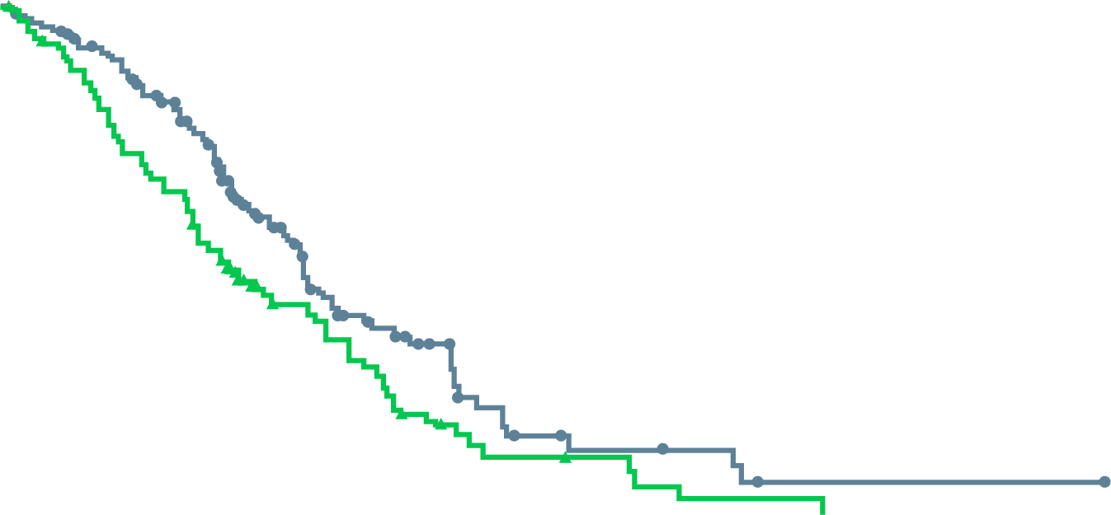
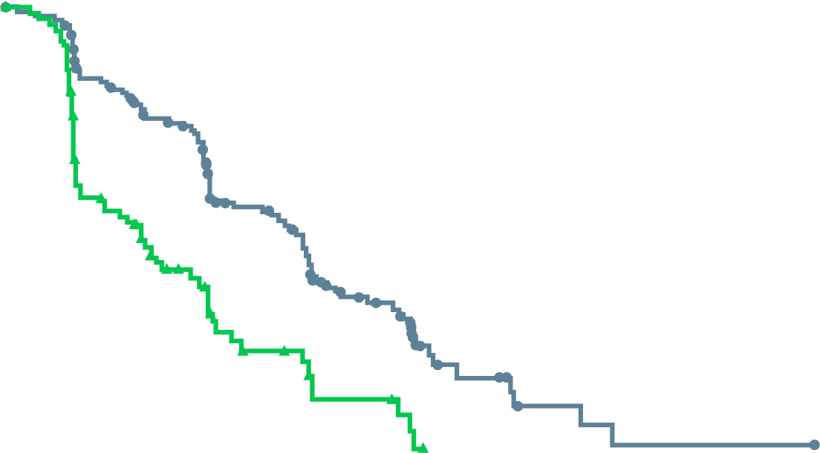
Niraparib: galahad, phase 2, single-arm study
OBJECTIVE RESPONSE RATE
 | Measurable BRCA cohortª (N=76) | Measurable non-BRCA cohort^{b} (N=47)
Objective response rate | 26 (34.2%; 23.7-46.0) | 5 (10.6%; 3.5-23.1)
Complete response | 2 (3%) | 0
Partial response | 24 (32%) | 5 (11%)
Data are n (%; 95% CI) or n (%). ª Primary efficacy analysis cohort. ^{b} Objective response rate in measurable non-BRCA patients with a secondary efficacy endpoint
RADIOGRAPHIC PROGRESSION-FREE SURVIVAL
OVERALL SURVIVAL
100
100
BRCA
Non-BRCA
90
BRCA
Non-BRCA
90
80
80
70
70
60
13.01 months (95% CI: 11.04-14.29)
Overall survival (%)
60
50
Radiographic progression- free survival (%)
50
8.08 months (95% CI: 5.75-8.97)
40
40
30
30
20
9.63 months (95% CI: 8.05-13.44)
20
3.71 months (95% CI: 1.97-5.49)
10
10
0
0
0
4
8
12
16
20
24
28
32
36
40
44
48
0
4
8
12
16
20
24
Number at risk (number censored)
BRCA
Non-BRCA
Time since enrolment (months)
Number at risk (number censored)
BRCA
Non-BRCA
142 (0) 81 (0)
126 (5)
66 (2)
100 (11)
49 (2)
53 (33)
23 (13)
26 (43)
16 (13)
12 (49)
7 (15)
7 (50)
5 (15)
5 (51)
2 (16)
2 (52)
1 (16)
1 (53)
0 (16)
1 (53)
0 (16)
1 (53)
0 (16)
0 (54)
0 (16)
142 (0) 81 (0)
91 (19) 27 (15)
49 (33) 10 (21)
9 (51) 0 (24)
2 (54) 0 (24)
1 (54) 0 (24)
0 (55) 0 (24)
CI, confidence interval
Smith M, et al. Lancet Oncol. 2022;23:362-373

Slide 41
Niraparib side effects
Galahad study: All-cause TEAEs (N=288)
 | Grade 1-2 | Grade 3 | Grade 4 | Grade 5
Nausea | 154 (53%) | 15 (5%) | 0 | 0
Vomiting | 101 (35%) | 10 (3%) | 0 | 0
Constipation | 95 (33%) | 5 (2%) | 1 (<1%) | 0
Fatigue | 87 (30%) | 19 (7%) | 0 | 0
Decreased appetite | 85 (29%) | 8 (3%) | 0 | 0
Anaemia | 61 (21%) | 92 (32%) | 2 (1%) | 1 (<1%)
Thrombocytopenia | 52 (18%) | 24 (8%) | 23 (8%) | 0
Back pain | 51 (18%) | 13 (4%) | 0 | 0
Arthralgia | 38 (13%) | 6 (2%) | 0 | 0
Asthenia | 37 (13%) | 11 (4%) | 0 | 0
Neutropenia | 27 (9%) | 17 (6%) | 11 (4%) | 0
Bone pain | 23 (8%) | 9 (3%) | 0 | 0
Hypertension | 22 (8%) | 12 (4%) | 0 | 0
Blood alkaline phosphatase increased | 15 (5%) | 11 (4%) | 0 | 0
Stomatitis | 15 (5%) | 6 (2%) | 0 | 0
Leukopenia | 14 (5%) | 11 (4%) | 3 (1%) | 0
γ-glutamyl transferase increased | 13 (4%) | 11 (4%) | 1 (<1%) | 0
Lymphopenia | 11 (4%) | 12 (4%) | 1 (<1%) | 0
Hypophosphataemia | 7 (2%) | 6 (2%) | 1 (<1%) | 0
Spinal cord compression | 1 (<1%) | 7 (2%) | 0 | 0
General physical health deterioration | 1 (<1%) | 7 (2%) | 1 (<1%) | 4 (1%)
Data are n (%). Data are presented for grade 1–2 treatment-emergent adverse events with a combined incidence of ≥20% or any higher-grade (grade 3–5) treatment-emergent adverse events with an incidence of ≥2%.
Smith M, et al. Lancet Oncol. 2022;23:362-373

Slide 42
Parp inhibitors in other cancer
Approved indications
 | Olaparib | Rucaparib | Niraparib | Talazoparib
Ovarian Cancer | √ | √ | √
Breast Cancer | √ |  |  | √
Pancreatic Cancer | √
Prostate Cancer | √ | √
Extensive safety data reported across all tumour types
Product Prescribing Information

Slide 43
Safety of PARP inhibitors in other cancers/ LTFU
Maintenance Olaparib in Ovarian CA with BRCA mutation^{1,2} (SOLO1/GOG3004) n=260
1% MDS/AML in primary report; no additional cases in the long-term follow up
Olaparib LTFU Breast/Ovarian/Fallopian tube cancer³ n=21:
Grade 2+ anaemia most common in cycles 1-6 (29%); dropped to 19% in cycles 7-12 and 18% in cycles 13-24 while grade 2+ lymphopaenia stable over time
Rucaparib maintenance Ovarian CA (ARIEL3)⁴
23% grade 3+ anaemia in those taking >12 months, 21% in 6-≤ 12 months
Niraparib LTFU Ovarian CA (ENGOT-OV16/NOVA)⁵
Grade ≥ 3 thrombocytopenia decreased from 28% (month 1) to 9% and 5% (months 2 and 3, respectively) with protocol-directed dose interruptions and/or reductions
AML and MDS were reported in 2 and 6 niraparib-treated patients, respectively, and in 1 placebo patient each
Talazoparib final OS analysis Breast CA (EMBRACA trial)⁶
Haematologic grade 3-4 AEs in 56.6% of patients treated with talazoparib and 38.9% of patients, respectively.
Grade 3 or 4 anaemia was reported in 40.2% of patients who received talazoparib and 4.8% of patients who received placebo
No confirmed cases of MDS. 1 case of AML in a patient who received capecitabine and 1 case of AML in a patient who received talazoparib
AML, acute myeloid leukaemia; CA, cancer; LTFU, long-term follow-up; MDS, myelodysplastic syndromes; OS, overall survival
1. Moore K, et al. N Engl J Med. 2018;379(26):2495-505; 2. Banerjee S, et al. Lancet Oncol. 2021;22:1721-31; 3. Van der Noll R, et al. Br J Cancer. 2015;113:396-402; 4. Clamp AR, et al. Int J Gyn Cancer. 2021;31:949-58; 5. Mirza M, et al. Gynecol Oncol 2020;159:442-8; 6. Litton J, et al. Annals of Oncology. 2020;31:1526-35
Notes:
In SOLO1 260 received Olaparib (130 on placebo)
Toxicity profile not impacted by age in ARIEL3

Slide 44
Toxicity management
Bone marrow toxicities are predominant cause of treatment discontinuation
Anaemia
In TALAPRO-1: 35% received ≥1 blood transfusion
In PROfound: 21% grade 3+ anaemia
In TRITON2: 25.2% grade 3+ anaemia, 28% ≥1 transfusion
Leukopenia/infection
8% grade 3 ANC talazoparib, 4% grade 3+ olaparib
Pulmonary emboli
PROfound: 4% with olaparib vs 1% with abi/enza control; 6% in TALAPRO-1
No MDS or AML seen
Abi, abiraterone; AML, acute myeloid leukaemia; ANC, absolute neutrophil count; enza, enzalutamide; MDS, myelodysplastic syndromes
DeBono J, et al. N Engl J Med. 2020;382(22):2091-2102; Abida W, et al. J Clin Oncol. 2020;38:3763-3772; DeBono J, et al. Lancet Oncol. 2021;22:1250-1264

Slide 45
Questions of sequencing
Most PARPi trials mCRPC include post-docetaxel majority
PROFOUND: 35% of patients without prior taxanes
TALAPRO-1: nearly 50% had two prior lines of taxane chemo
TRITON2: rucaparib lumped AR and chemo lines
PROfound
TRITON2
 | ORR in IRR-evaluable population
 |  | ORR, No./No. (%) [95% CI]
No. of prior lines of therapy
1 |  | NA
2 |  | 15/32 (46.9) [29.1 to 65.3]
≥3 |  | 12/30 (40.0) [22.7 to 59.4]
Cohort A Subgroup | Hazard ratio for progression or death (95% CI)
All patients |  | 0.34 (0.25-0.47)
Previous taxane use
Yes |  | 0.28 (0.19-0.41)
No |  | 0.55 (0.32-0.97)
0.06
0.25
1.00
4.00
16.00
0
20
40
60
80
100
ORR (95% CI)
Olaparib better
Control better
AR, androgen receptor; chemo, chemotherapy; CI, confidence interval; IRR, independent radiology review; mCRPC, metastatic castration resistant prostate cancer; ORR, objective response rate; PARPi, poly-ADP ribose polymerase inhibitors
DeBono J, et al. N Engl J Med. 2020;382(22):2091-2102; Abida W, et al. J Clin Oncol. 2020;38:3763-3772; DeBono J, et al. Lancet Oncol. 2021;22:1250-1264; DeBono J, et al. Journal of Clinical Oncology 2020; 38, no. 6_suppl: 119-119.

Slide 46
CONCLUSIONS
Level 1 evidence for overall survival prolongation with olaparib in HRR-mutated (particularly BRCA) mCRPC
Mostly post-taxane chemo
Lower-level evidence for ATM and other HRD (non-BRCA mutations)
Need more patients with these alterations
Level 2 evidence for rucaparib, talazoparib
Strong efficacy signal
Toxicity: primarily myelosuppression (ANAEMIA)
Optimal sequence of PARPi is unknown
Combination strategies and patient selection are still being defined
ATM, ataxia telangiectasia mutated; BRCA, breast cancer type susceptibility protein; chemo, chemotherapy; HRD, homologous repair defects; HRR, homologous recombination repair; mCRPC, metastatic castration resistant prostate cancer; PARPi, poly-ADP ribose polymerase inhibitors

Slide 47
when to consider combinations Combination therapy with parpi strategy for improving first-line therapy in mcrpc Prof. Fred Saad, MD FRCS Professor and Chairman of Urology, Director of GU Oncology Raymond Garneau Chair in Prostate Cancer University of Montreal Hospital Center, Montreal, QC, Canada
mCRPC, metastatic castration resistant prostate cancer; PARPI, poly-ADP ribose polymerase inhibitors

Slide 48
disclosures
Prof. Fred Saad has received honorarium as a consultant and funding for research (institution) from the following companies:
Amgen, Astellas, AstraZeneca, Bayer, BMS, Janssen, Myovant, Pfizer, Sanofi

Slide 49
Phase 3 trials in mCRPC
All studies monotherapeutic and had an inactive/non-life prolonging control arm
Study | Agents | N | Indication | HR | ∆OS (mo)
TAX-327¹ | DOC / P vs mito / P | 1006 | mCRPC, symptomatic or not | 0.76 | +2.4
COU-AA-302² | ABI / P vs P | 1088 | mCRPC (pre-DOC), mild / no symptoms No visceral metastases | 0.81 | +4.4
COU-AA-301³ | ABI / P vs P | 1195 | mCRPC (post-DOC) | 0.74 | +4.6
PREVAIL⁴ | ENZ vs PBO | 1717 | mCRPC (pre-DOC), mild / no symptoms | 0.77 | +4.0
AFFIRM⁵ | ENZ vs PBO | 1199 | mCRPC (post-DOC) | 0.63 | +4.8
TROPIC⁶ | CABA / P vs mito / P | 755 | mCRPC (post-DOC) | 0.70 | +2.4
ALSYMPCA⁷ | Radium-223 vs PBO | 921 | mCRPC (post-DOC or ineligible/declined DOC) | 0.70 | +3.6
PROfound⁸ | Olaparib vs NHT | 245ª | mCRPC post-NHT (with HRRm) | 0.69ª | +4.4
ªResults for cohort A of study: patients with alterations in BRCA1, BRCA2, ATM
ABI, abiraterone; CABA, cabazitaxel; DOC, docetaxel; ENZ, enzalutamide; HR, hazard ratio; HRRm, homologous recombination repair gene mutation; mCRPC, metastatic castration resistant prostate cancer; mito, mitoxantrone; mo, months; NHT, neoadjuvant hormonal therapy; OS, overall survival; P, prednisone; PBO, placebo 1. Tannock IF, et al. N Engl J Med. 2004;351:1502-1512; 2. Ryan CJ, et al. Lancet Oncol. 2015;16:152-160; 3. Fizazi K, et al. Lancet Oncol. 2012;13(10):983-992; 4. Beer TM, et al. Eur Urol. 2017;71:151-154; 5. Scher HI, et al. N Engl J Med. 2012;367:1187-1197; 6. de Bono JS, et al. Lancet. 2010;376:1147-1154; 7. Parker C, et al. N Engl J Med. 2013;369: 213-23; 8. Hussain M, et al. N Engl J Med. 2020;383:2345-2357

Slide 50
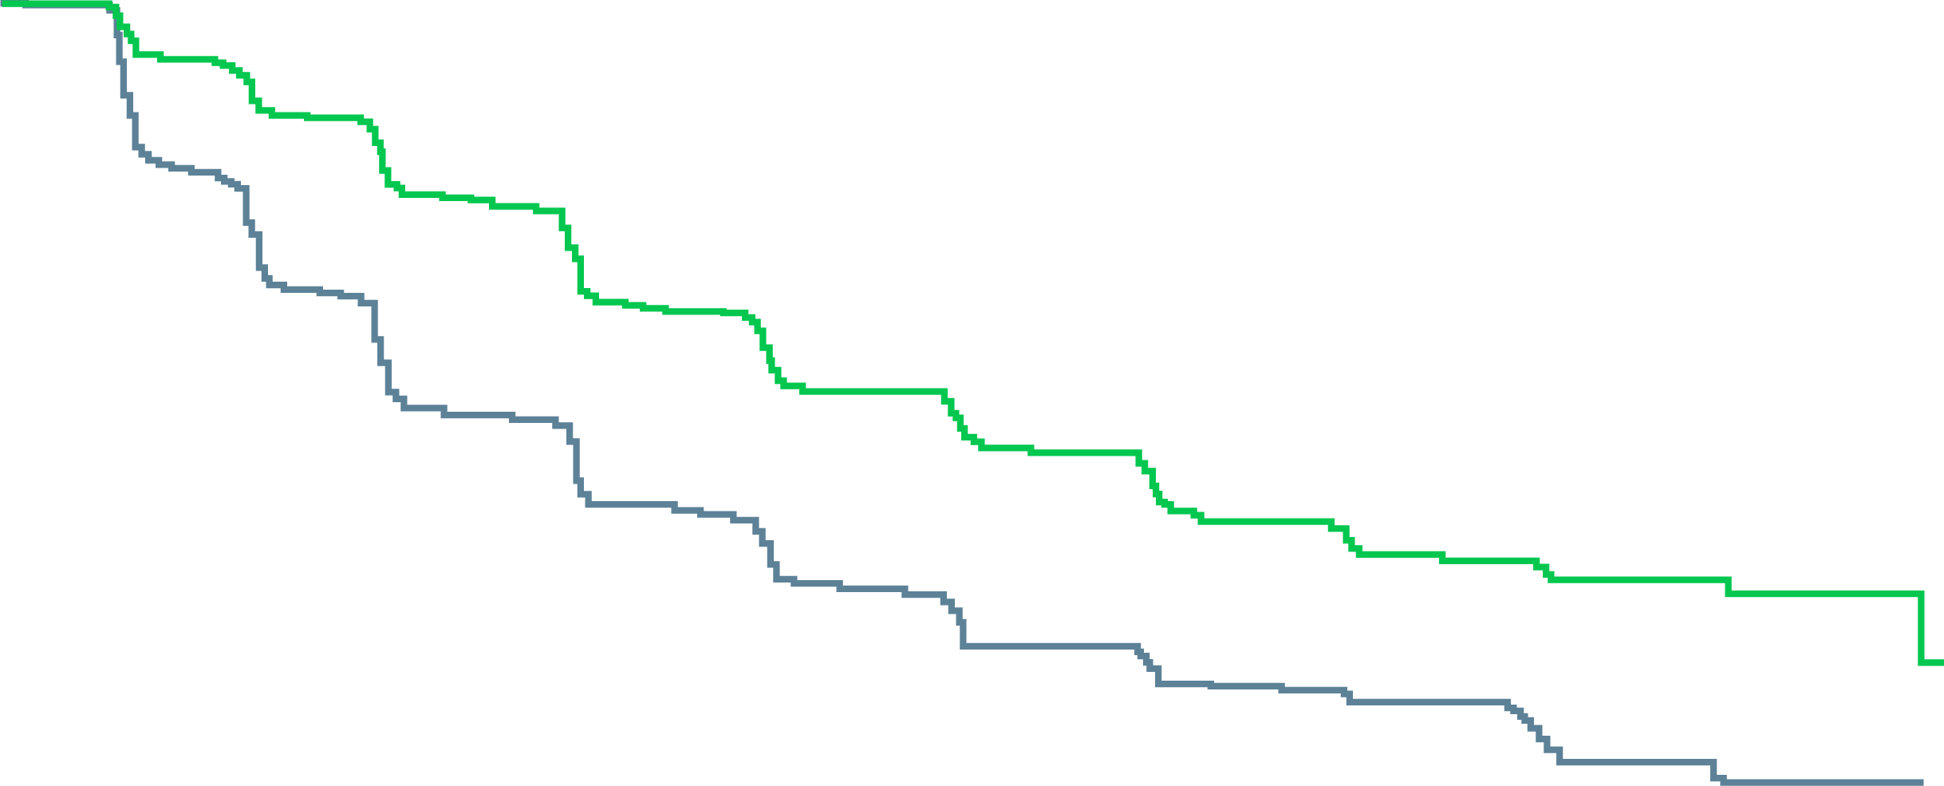
Abiraterone: radiographic Progression-Free Survival
100
HR: 0.53 (95% CI, 0.45-0.62) p<0.001
80
60
Abiraterone-prednisone, 16.5 mo
Progression-free survival (%)
40
Prednisone alone, 8.3 mo
No. of Events Abiraterone-prednisone: 271
Prednisone alone: 336
20
0
0
3
6
9
12
15
18
21
24
27
30
Months
AA + P P alone
546
542
485
406
389
244
311
177
240
133
195
100
155
80
85
37
38
14
9
1
0
0
AA, abiraterone acetate; CI, confidence interval; HR, hazard ratio; P, prednisone
Ryan C, et al. N Engl J Med 2013; 368:138-148

Slide 51
Abiraterone First-Line: Overall Survival
100
80
ABI + P
Median 34.7 mo
60
Overall survival (%)
40
HR=0.81
95% CI (0.70-0.93)
p=0.0033
20
P + PBO
Median 30.3 mo
0
0
3
6
9
12
15
18
21
24
27
30
33
36
39
42
45
48
51
54
57
60
Time to death (months)
ABI + P
P + PBO
546
542
538
534
525
509
504
493
483
466
453
438
422
401
394
363
359
322
330
292
296
261
273
227
235
201
218
176
202
148
189
132
118
84
59
42
15
10
0
1
0
0
ABI, abiraterone; CI, confidence interval; HR, hazard ratio; mo, months; P, prednisone; PBO, placebo
Ryan CJ, et al. Lancet Oncol. 2015;16:152-160

Slide 52
Why did patients live so long? Patients better treated than in the real world
Subsequent therapy¹ | ABI + P (N=546 ) | P + PBO (N=542)
N (%) with selected subsequent therapy | 365 (67%) | 435 (80%)
Subsequent therapies
Abiraterone | 69 (13%) | 238 (44%)
Cabazitaxel | 100 (18%) | 105 (19%)
Docetaxel | 311 (57%) | 331 (61%)
Enzalutamide | 87 (16%) | 54 (10%)
Ketoconazole | 42 (8%) | 68 (13%)
Radium-223 | 20 (4%) | 7 (1%)
Sipuleucel-T | 45 (8%) | 32 (6%)
ABI, abiraterone; P, prednisone; PBO, placebo
1. Ryan CJ, et al. Lancet Oncol. 2015;16:152-160

Slide 53
Real-world Treatment Patterns in mCRPC
Patients With mCRPC Receiving Life-prolonging Anti-cancer Treatment by Line of Therapy
mCRPC (N=2,559)
1L
2L
3L
38% of all mCRPC patients received 2L therapy (969/2,559) | 16% of all mCRPC patients received 3L therapy (414/2,559)
43% (414/969)
29% (122/414)
77% (1,980/2,559)
49% (969/1,980)
28% (267/969)
23% (447/1,980)
Patients with mCRPC (N=2,559)
Patients receiving life-prolonging therapy (1L, n=1,980; 2L, n=969; 3L, n=414)
Patients who died without receiving a subsequent line of therapy
A total of 23%, 28% and 29% of patients did not receive a subsequent line of therapy after 1L, 2L and 3L therapy, respectively. In this Sankey diagram, a node to the right illustrates patients with mCRPC (grey) transitioning to a subsequent line of therapy (green) or death without receiving a subsequent line (blue).
1L, first line; 2L, second line; 3L, third line; mCRPC, metastatic castration resistant prostate cancer
George DJ, et al. Clin Genitourin Cancer. 2020;18(4):284-294
Notes:
Fred Saad

Slide 54
Real-world Treatment Patterns and Outcomes in Patients With mCRPC: Results
OS in patients with mCRPC
Median OS: 21.2 months (95% CI: 19.6-22.5)
Survival %
0 | 10 | 20 | 30 | 40 | 50 | 60
Months
Number at risk
2549
1984
1435
1003
688
484
312
178
100
61
23
6
0
CI, confidence interval; mCRPC, metastatic castration resistant prostate cancer; OS, overall survival
George DJ, et al. Clin Genitourin Cancer. 2020;18(4):284-294
Notes:
Fred Saad

Slide 55
Rationale for combining PARP inhibitors and NHAs
Interaction between PARP signalling and AR signalling pathways may explain the combined effect of agents observed in preclinical models
PARP inhibitor + NHA²⁻⁴
PARP involved in androgen-receptor dependent transcription; PARP inhibition may increase activity of NHAs²
NHA-induced HRR deficiency increasing susceptibility to PARP inhibition^{3,4}
Combined effect
Antitumour activity in HRRm and non-HRRm prostate cancer²⁻⁴
AR, androgen receptor; HRR, homologous recombination repair; HRRm, homologous recombination repair gene mutation; NHA, novel hormonal agent; PARP, poly-ADP ribose polymerase
Adapted from 2. Schiewer MJ, et al Cancer Discov. 2012;2:1134-1149; 3. Polkinghorn WR, et al. Cancer Discov. 2013;3:1245-1253; 4. Asim M, et al. Nat Commun. 2017;8:374; Saad F, et al. J Clin Oncol 40, 2022 (suppl 6; abstr 11)

Slide 56
Phase 3 PARPi + NHA combination studies in 1L mCRPC
 | PROpel | TALAPRO-2 | MAGNITUDE | CASPAR
Treatments | Olaparib 300 mg BID + Abiraterone 1000 mg QD | Talazoparib 0.5 mg QD + Enzalutamide 160 mg QD | Niraparib 200 mg QD + Abiraterone 1000 mg QD | Rucaparib + Enzalutamide QD
Primary endpoint | rPFS (INV) all-comers | rPFS (BICR) in ITT and DDR | rPFS (BICR) in DDR and in patients on co-formulation | rPFS, OS in ITT
Setting and therapy-related exclusion criteria | PCa: may have received taxane in mCSPC mCRPC: no prior therapy | PCa: may have received taxane or abiraterone in mCSPC mCRPC: no prior therapy | mCRPC: no prior therapy (<4 months of abiraterone allowed) mHSPC: taxane and NHA allowed in mCSPC (no prior abiraterone) | mCRPC: no prior treatment Non-mCRPC: prior abiraterone, apalutamide and darolutamide allowed mCSPC, nmCSPC and nmCRPC: prior docetaxel and/or NHA allowed
Stratification factors | Metastases: bone only vs visceral vs other Docetaxel treatment in mCSPC: yes vs no | Prior treatment NHA/taxanes: yes or no DDR mutations status: deficient vs non-deficient/unknown | Prior chemo mCSPC Prior ARi nmCRPC/ mCSPC Prior AAP for L1 mCRPC BRCA1/2 vs other HRR gene alterations (HRR BM+ cohort) | Not available
Study design and diagnostic testing | Randomised, double-blind, Phase 3 Retrospective biomarker analysis (tissue) | Randomised, double-blind, Phase 3 DDR prospective testing (blood/tissue, liquid biopsy) | Randomised, double-blind, Phase 3 Prospective biomarker analysis (blood/tissue) | Randomised, double-blind, Phase 3 DDR prospective testing (tissue)
1L, first-line; BICR, blinded independent central review; BID, twice daily; DDR, DNA damage repair; INV, investigator-assessed; ITT, intention to treat; (n)mCRPC, (non)metastatic castration resistant prostate cancer; (n)mCSPC, (non)metastatic castration-sensitive prostate cancer; NHA, novel hormonal agents; OS, overall survival; PARPI, poly-ADP ribose polymerase inhibitors; PCa, prostate cancer; QD, once daily; rPFS, radiographic progression-free survival; Internally created summary document based on data contained in these respective ClinicalTrials.gov reference sources

Slide 57
PROpel Study Design
a global, randomised, double-blind phase 3 trial
Key eligibility criteria
1L mCRPC
Docetaxel allowed at mCSPC stage
No prior abiraterone
Other NHAs allowed if stopped ≥12 months prior to enrolment
Ongoing ADT
ECOG performance status 0-1
Stratification Factors
Site of distant metastases: bone only vs visceral vs other
Prior taxane at mCSPC: yes vs no
Primary endpoint:
Radiographic progression or death (rPFS) by investigator assessment
Key secondary endpoint:
OS (alpha control)
Additional endpoints:
TFST, ORR, PFS2
HRRm^{b} prevalence (retrospective testing)
Health-related quality of life
Safety and tolerability
Olaparib 300 mg BID + abiraterone 1000 mg QDª (n=399)
Randomise
1:1
Placebo + abiraterone 1000 mg QDª (n=397)
NCT03732820
First patient randomized: Nov 2018​; Last patient randomized: Mar 2020; DCO1: July 30, 2021, for interim analysis of rPFS and OS.
Multiple testing procedure is used in this study: 1-sided alpha of 0.025 fully allocated to rPFS. If the rPFS result is statistically significant, OS to be tested in a hierarchical fashion with alpha passed on to OS. ªFull dose of Olaparib and/or abiraterone used, in combination with prednisone or prednisolone 5 mg bid. ^{b}HRRm, homologous recombination repair mutation, including 14 genes panel.
1L, first-line; ADT, androgen deprivation therapy; BICR, blinded independent central review; BID, twice daily; ECOG, Eastern Cooperative Oncology Group ; HRR, homologous recombination repair; mCRPC, metastatic castration resistant prostate cancer; mHSPC, metastatic hormone sensitive prostate cancer; NHA, novel hormonal agents; ORR, objective response rate; OS, overall survival; PFS2, time to second progression; PO, orally; QD, per day; rPFS, radiographic progression-free survival; TFST, time to first subsequent therapy or death; TTPP, time to pain progression
Clarke NW, et al. J Clin Oncol. 2019;37, no. 7_suppl:TPS340; ClinicalTrials.gov identifier: NCT03732820. Accessed Feb 2022. https://clinicaltrials.gov/ct2/show/NCT03732820; Saad F, et al. J Clin Oncol 40, 2022 (suppl 6; abstr 11)

Slide 58
PROpel: baseline patient characteristics
Well-balanced between treatment arms
 | Olaparib + abiraterone (n=399) | Placebo + abiraterone (n=397)
Median (range) age, years | 69.0 (43–91) | 70.0 (46–88)
ECOG performance status, n (%) 0 1 | 286 (71.7) 112 (28.1) | 272 (68.5) 124 (31.2)
Symptomatic (pain),ªn (%) | 103 (25.8) | 80 (20.2)
Site of metastases, n (%) Bone Distant lymph nodes Locoregional lymph nodes Lung Liver | 349 (87.5) 133 (33.3) 82 (20.6) 40 (10.0) 15 (3.8) | 339 (85.4) 119 (30.0) 89 (22.4) 42 (10.6) 18 (4.5)
Docetaxel treatment at mHSPC stage, n (%) | 90 (22.6) | 89 (22.4)
Median PSA, ug/L (IQR) | 17.90 (6.09–67.00) | 16.81 (6.26–53.30)
HRRm status^{b} HRRm Non-HRRm HRRm unknown | 111 (27.8) 279 (69.9) 9 (2.3) | 115 (29.0) 273 (68.8) 9 (2.3)
ªPatients with symptomatic pain at baseline: BPI-SF item #3 score ≥4 and/or opiate use at baseline.
^{b}The HRRm status of patients in PROpel was determined retrospectively using results from tumour tissue and plasma ctDNA HRRm tests. Patients were classified as HRRm if (one or more) HRR gene mutation was detected by either test; patients were classified as non-HRRm if no HRR gene mutation was detected by either test; patients were classified as unknown HRRm if no valid HRR test result from either test was achieved.
BPI-SF, Brief Pain Inventory – Short Form; ctDNA, circulating tumour DNA; HRRm, homologous recombination mutation; IQR, interquartile range; PSA, prostate-specific antigen.
Saad F, et al. J Clin Oncol. 2022; 40 (suppl 6; abstr 11)

Slide 59
PROpel primary endpoint: rPFS by investigator-assessment
34% risk reduction of progression or death with olaparib + abiraterone
12-month rate
71.8%
63.4%
1.0
24-month rate
51.4%
33.6%
0.9
 | Olaparib + abiraterone (n=399) | Placebo + abiraterone (n=397)
Events, n (%) | 168 (42.1) | 226 (56.9)
Median rPFS (months) | 24.8 | 16.6
HR (95% CI) | 0.66 (0.54‒0.81); p<0.0001
0.8
0.7
0.6
0.5
Probability of rPFS
0.4
0.3
0.2
Pre-specified 2-sided alpha: 0.0324
0.1
Median rPFS improvement of 8.2 months
favors olaparib + abirateroneª
0.0
0
2
4
6
8
10
12
14
16
18
20
22
24
26
28
30
Time from randomisation (months)
No. at risk
Olaparib + abiraterone
399
395
367
354
340
337
313
309
301
277
274
265
251
244
277
221
219
170
167
163
104
100
87
59
57
28
26
25
5
4
4
0
Events: 394; Maturity 49.5%
ªIn combination with prednisone or prednisolone CI, confidence interval; HR, hazard ratio.
Placebo + abiraterone
397
393
359
356
338
334
306
303
297
266
264
249
232
228
198
190
186
143
141
137
87
84
73
45
43
21
17
16
2
2
1
0
CI, confidence interval; HR, hazard ratio; rPFS, radiographic progression-free survival
Saad F, et al. J Clin Oncol. 2022; 40 (suppl 6; abstr 11)

Slide 60
PROpel: rPFS by blinded independent central reviewª
39% risk reduction of progression or death with olaparib + abiraterone. Highly consistent with the primary analysis
12-month rate
73.8%
60.6%
1.0
 | Olaparib + abiraterone (n=399) | Placebo + abiraterone (n=397)
Events, n (%) | 157 (39.3) | 218 (54.9)
Median rPFS (months) | 27.6 | 16.4
HR (95% CI) | 0.61 (0.49‒0.74) p<0.0001^{b}
24-month rate
53.7%
34.1%
0.9
0.8
0.7
0.6
0.5
Probability of rPFS
0.4
0.3
0.2
0.1
Median rPFS improvement of 11.2 months
favours olaparib + abiraterone^{c}
0.0
0
2
4
6
8
10
12
14
16
18
20
22
24
26
28
30
Time from randomisation (months)
No. at risk
ªPredefined sensitivity analysis. ^{b}Nominal. ^{c}In combination with prednisone or prednisolone
Olaparib + abiraterone
399
389
353
347
332
331
314
309
303
283
275
267
249
240
221
217
215
165
161
159
96
89
80
55
53
30
28
26
5
4
4
0
Placebo + abiraterone
397
388
345
340
322
319
294
289
282
251
245
226
209
204
177
172
168
131
126
124
73
70
62
39
38
21
16
15
2
2
1
0
CI, confidence interval; HR, hazard ratio; rPFS, radiographic progression-free survival
Saad F, et al. J Clin Oncol. 2022; 40 (suppl 6; abstr 11)

Slide 61
PROpel: subgroup analysis of rPFS
rPFS benefit observed across all pre-specified subgroups
Number of patients, n
Median rPFS, months
HR (95% CI)
All patients
796
16.6
0.66 (0.54‒0.81)
24.8
Age at randomisation
<65
227
16.4
0.51 (0.35‒0.75)
NR
≥65
569
16.7
0.78 (0.62‒0.98)
22.0
ECOG performance status at baseline
0
558
16.8
0.67 (0.52‒0.85)
24.9
1
14.6
0.75 (0.53‒1.06)
236
17.5
Global interaction test not significant at 10% level
Site of distant metastases
Bone only
434
22.2
0.73 (0.54‒0.98)
27.6
Visceral
105
10.9
0.62 (0.39‒0.99)
13.7
Other
257
13.7
0.62 (0.44‒0.85)
20.5
Docetaxel treatment at mHSPC stage
Yes
13.8
0.61 (0.40‒0.92)
189
27.6
No
16.8
0.71 (0.56‒0.89)
607
24.8
Baseline PSA
Below median baseline PSA
22.0
0.75 (0.55‒1.02)
396
25.2
Above or equal to median baseline PSA
13.8
0.63 (0.48‒0.82)
397
18.5
HRRm statusª
HRRm
13.9
0.50 (0.34‒0.73)
226
NR
Non-HRRm
19.0
0.76 (0.60‒0.97)
552
24.1
0.1
1
10
Olaparib + abiraterone better
Placebo + abiraterone better
Global interaction test not significant at 10% level. ªThe HRRm status of patients in PROpel was determined retrospectively using results from tumour tissue and plasma ctDNA HRRm tests. Patients were classified as HRRm if (one or more) HRR gene mutation was detected by either test; patients were classified as non-HRRm patients if no HRR gene mutation was detected by either test; patients were classified as unknown HRRm if no valid HRR test result from either test was achieved. 18 patients did not have a valid HRR testing result from either a tumour tissue or ctDNA test and were excluded from the subgroup analysis. This subgroup analysis is post hoc exploratory analysis.
CI, confidence interval; ctDNA, circulating tumour DNA; ECOG, Eastern Cooperative Oncology Group; HR, hazard ratio; HRR(m), homologous recombination (mutation); mHSPC, metastatic hormone sensitive prostate cancer; NR, not reached; PSA, prostate specific antigen; rPFS, radiographic progression-free survival
Saad F, et al. J Clin Oncol. 2022; 40 (suppl 6; abstr 11)

Slide 62
PROpel: overall survival
28.6% maturity; trend towards improved OS with olaparib + abiraterone
1.0
0.9
 | Olaparib + abiraterone (n=399) | Placebo + abiraterone (n=397)
Events, n (%) | 107 (26.8) | 121 (30.5)
Median OS (months) | NR | NR
HR (95% CI) | 0.86 (0.66‒1.12) p=0.29
0.8
0.7
0.6
0.5
Probability of OS
0.4
0.3
0.2
Pre-specified 2-sided alpha: 0.001
0.1
0.0
0
2
4
6
8
10
12
14
16
18
20
22
24
26
28
30
32
Time from randomisation (months)
No. at risk
Olaparib + abiraterone
399
398
398
394
391
387
385
379
374
369
364
359
349
343
333
322
316
313
290
263
231
193
159
135
116
92
73
51
37
24
11
4
1
0
Placebo + abiraterone
397
394
392
386
385
383
381
377
374
371
368
363
353
345
335
322
314
308
286
258
223
186
151
121
104
88
63
44
22
13
6
0
0
0
Events: 228
CI, confidence interval; HR, hazard ratio; NR, not reached; OS, overall survival
Saad F, et al. J Clin Oncol. 2022; 40 (suppl 6; abstr 11)

Slide 63
PROpel: TFST and PFS2
TFST and PFS2 results support longer-term benefit with olaparib + abiraterone
Time to first subsequent therapy or death (TFST)
Time to second progression or death (PFS2)
1.0
1.0
0.9
0.9
0.8
0.8
0.7
0.7
0.6
0.6
Probability of not experiencing first subsequent therapy or death
Probability of second progression-free survival
0.5
 | Olaparib + abiraterone (n=399) | Placebo + abiraterone (n=397)
Events, n (%) | 183 (45.9) | 221 (55.7)
Median TFST (months) | 25.0 | 19.9
HR (95% CI) | 0.74 (0.61‒0.90) P=0.004ª
0.5
 | Olaparib + abiraterone (n=399) | Placebo + abiraterone (n=397)
Events, n (%) | 70 (17.5) | 94 (23.7)
Median PFS2 (months) | NR | NR
HR (95% CI) | 0.69 (0.51‒0.94) P=0.0184ª
0.4
0.4
0.3
0.3
0.2
0.2
0.1
0.1
0.0
0
2
4
6
8
10
12
14
16
18
20
22
24
26
28
30
32
0.0
0
2
4
6
8
10
12
14
16
18
20
22
24
26
28
30
32
No. at risk
Time from randomisation (months)
No. at Risk
Time from randomisation (months)
Olaparib + abiraterone
Olaparib + abiraterone
399
396
387
383
372
366
353
347
338
326
318
311
300
297
291
284
282
279
261
237
209
177
148
126
106
85
68
49
34
22
10
4
1
0
399
398
396
385
374
365
358
345
338
328
317
308
295
285
272
260
250
245
222
202
174
148
124
104
87
67
53
41
28
19
8
3
1
0
Placebo + abiraterone
Placebo + abiraterone
397
394
381
374
367
363
351
346
339
322
320
312
300
294
286
276
269
259
239
212
179
152
124
99
85
71
50
36
18
11
5
0
0
0
397
394
390
377
368
354
345
329
319
313
303
292
273
261
250
231
222
214
191
174
147
121
98
76
63
53
38
25
12
6
4
0
0
0
ªNominal
CI, confidence interval; HR, hazard ratio; NR, not reached;
Saad F, et al. J Clin Oncol. 2022; 40 (suppl 6; abstr 11)

Slide 64
PROpel: most common adverse events
AE profile was consistent with the known toxicity profiles for the individual drugs
Olaparib + abiraterone (n=399)
Placebo + abiraterone (n=399)
ª
Grade ≥3
All grade
Grade ≥3
All grade
Safety was assessed through the reporting of AEs according to the National Cancer Institute Common Terminology Criteria for Adverse Events (NCI CTCAE v4.03) and laboratory assessments. ªAnaemia category includes anaemia, decreased haemoglobin level, decreased red-cell count, decreased haematocrit level, erythropenia, macrocytic anaemia, normochromic anaemia, normochromic normocytic anaemia, and normocytic anaemia.
AE, adverse event
Saad F, et al. J Clin Oncol. 2022; 40 (suppl 6; abstr 11)

Slide 65
MAGNITUDE: Randomised, Double-Blind, Placebo-Controlled Study
Prospectively selected biomarker cohorts designed to test HRR BM+ and HRR BM–
Study start: February 2019
Prescreening for
BM statusª
Allocation
to cohort
1:1
randomisation
Patient eligibility
L1 mCRPC
≤4 months prior AAP allowed for mCRPC
ECOG PS 0 or 1
BPI-SF worst pain score ≤3
Stratifications
Prior taxane-based chemo for mCSPC
Prior ARi for nmCRPC or mCSPC
Prior AAP for L1 mCRPC
BRCA1/2 vs other HRR gene alterations (HRR BM+ cohort)
Primary endpoint
rPFS by central review
HRR BM+
Planned N=400
Niraparib + AAP
HRR BM+ panel:
ATM
BRCA1
BRCA2 BRIP1 CDK12 CHEK2 FANCA HDAC2 PALB2
Secondary endpoints
Time to cytotoxic chemotherapy
Time to symptomatic progression
OS
Placebo + AAP
Other prespecified endpoints
Time to PSA progression
ORR
PFS2
Time to pain progression
Patient-reported outcomes
Niraparib + AAP
HRR BM–
Planned N=600
Placebo + AAP
Note: Patients could request to be unblinded by the study steering committee and go on to subsequent therapy of the investigator's choice.
Clinical data cut-off was October 8, 2021 for the final rPFS analysis.
ª Tissue and Plasma assays: FoundationOne tissue test (FoundationOne®CDx), Resolution Bioscience liquid test (ctDNA), AmoyDx blood and tissue assays, Invitae germline testing (blood/saliva), local lab biomarker test results demonstrating a pathogenic germline or somatic alteration listed in the study biomarker gene panel.
AAP, abiraterone acetate + prednisone/prednisolone; AR, androgen receptor; ARi, androgen receptor inhibitor; BM, biomarker; BPI-SF, Brief Pain Inventory–Short Form; ctDNA, circulating tumor deoxyribonucleic acid; ECOG PS, Eastern Cooperative Oncology Group performance status; HRR, homologous recombination repair; L1, first line; mCRPC, metastatic castration-resistant prostate cancer; mCSPC, metastatic castration-sensitive prostate cancer; nmCRPC, nonmetastatic castration-resistant prostate cancer; ORR, overall response rate; OS, overall survival; PFS, progression-free survival; PFS2, progression-free survival on first subsequent therapy; PSA, prostate-specific antigen; rPFS, radiographic progression-free survival.
Chi K, et al. J Clin Oncol. 2022; 40 (suppl 6; abstr 12)
Notes:
Kim Chi to voiceover
Importance/stringency of BICR
Study is grounded in RW clinical practice (pts can receive prior AAP). Knowing more about what pts received prior to will allow us to see how, longitudinally, pts do
Patients could receive a subsequent PARP inhibitor (could request to be unblinded and go onto subseq therapy of investigator's choice).
Open label cohort was enrolled at a later time

Slide 66
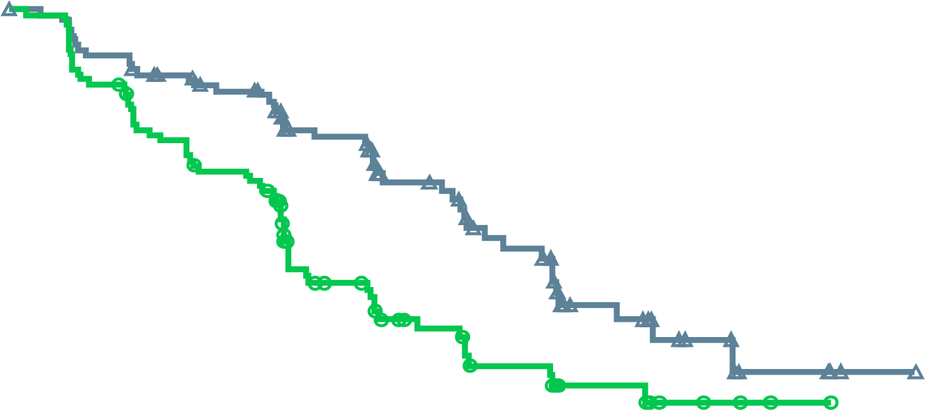
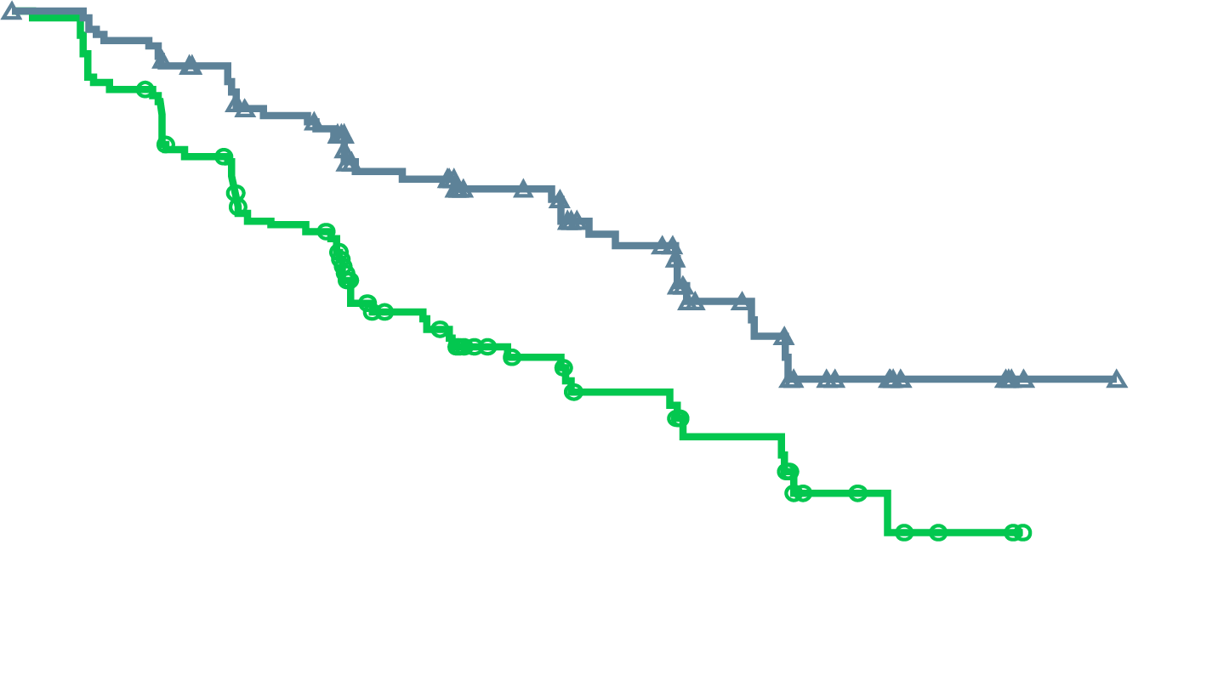
MAGNITUDE BRCA1/2-mutated: Primary Endpoint NIRA + AAP Reduced the Risk of rPFS or Death by 47%
rPFS assessed by central review
rPFS assessed by investigator
NIRA + AAP: 16.6 mo
NIRA + AAP: 19.3 mo
PBO + AAP: 10.9 mo
PBO + AAP: 12.4 mo
HR: 0.53 (95% CI, 0.36-0.79)
p=0.0014
HR: 0.50 (95% CI, 0.33-0.75)
Nominal p=0.0006
No. at risk
NIRA + AAP | 113 | 103 | 90 | 65 | 45 | 31 | 18 | 9 | 4 | 1 | 0
PBO + AAP | 112 | 97 | 77 | 43 | 28 | 20 | 11 | 5 | 2 | 0 | 0
No. at risk
NIRA + AAP | 113 | 107 | 90 | 64 | 49 | 36 | 23 | 10 | 5 | 1 | 0
PBO + AAP | 112 | 99 | 73 | 45 | 32 | 23 | 14 | 6 | 2 | 0 | 0
Median follow-up 16.7 months
Median follow-up 16.7 months
AAP, abiraterone acetate + prednisone/prednisolone; CI, confidence interval; HR, hazard ratio; NIRA, niraparib; PBO, placebo;
rPFS, radiographic progression-free survival.
Chi K, et al. J Clin Oncol. 2022; 40 (suppl 6; abstr 12)
Notes:
Here, control arm does worse which is driving the difference. The combination of Nira + AA provides a consistent benefit

Slide 67
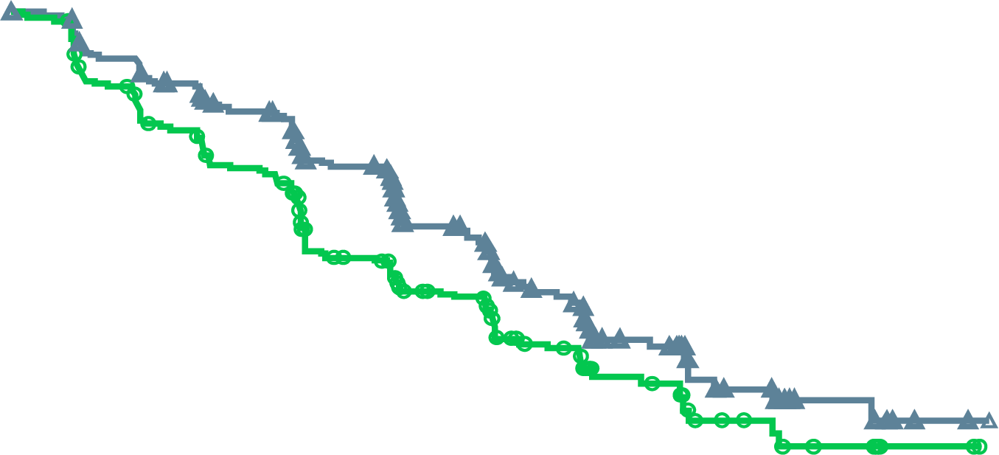
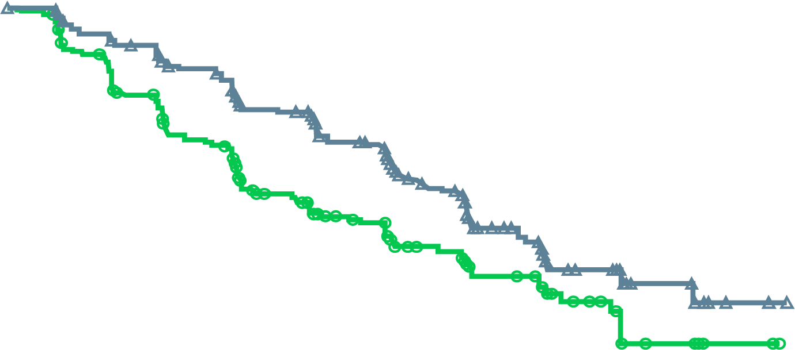
MAGNITUDE All HRR BM+: Primary Endpoint NIRA + AAP Reduced the Risk of rPFS or Death by 27%
rPFS assessed by central review
rPFS assessed by investigator
NIRA + AAP: 19.0 mo
NIRA + AAP: 16.5 mo
HR: 0.73 (95% CI, 0.56-0.96)
p=0.0217
PBO + AAP: 13.7 mo
HR: 0.64 (95% CI, 0.49-0.86)
Nominal P = 0.0022
PBO + AAP: 13.9 mo
No. at risk
NIRA + AAP | 212 | 192 | 167 | 129 | 96 | 64 | 45 | 21 | 10 | 2 | 0
PBO + AAP | 211 | 182 | 149 | 102 | 78 | 53 | 35 | 15 | 9 | 2 | 0
No. at risk
NIRA + AAP | 212 | 197 | 174 | 136 | 108 | 75 | 50 | 23 | 11 | 2 | 0
PBO + AAP | 211 | 187 | 145 | 103 | 81 | 58 | 41 | 20 | 9 | 2 | 0
Median follow-up 18.6 months
AAP, abiraterone acetate + prednisone/prednisolone; BM, biomarker; CI, confidence interval; HR, hazard ratio; HRR, homologous recombination repair; NIRA, niraparib; PBO, placebo; rPFS, radiographic progression-free survival.
Chi K, et al. J Clin Oncol. 2022;40 (suppl 6; abstr 12)
Notes:
Add a comment pertaining to the rigor of BICR-this can probably be voiced by Kim Chi

Slide 68
MAGNITUDE All HRR BM+: Prespecified Subgroup Analysis of rPFS
Median (months)
Events/N
Median (months)
Events/N
Variable
Subgroup
niraparib
control
HR (95% CI)
niraparib
control
Variable
Subgroup
niraparib
control
HR (95% CI)
niraparib
control
All HRR+ patients
All
16.5
13.7
0.74 (0.57–0.97)
100/212
117/211
Past taxane–based chemotherapy
Yes
13.4
10.9
0.89 (0.48–1.66)
20/40
21/41
Age group
<65
13.9
13.9
1.01 (0.61–1.66)
32/61
30/62
No
16.6
13.8
0.71 (0.53–0.96)
80/172
96/170
≥65-74
19.4
13.6
0.58 (0.38–0.89)
34/88
57/100
Past androgen receptor-targeted
therapyª
Yes
NE
4.3
0.19 (0.03–1.23)
2/8
3/4
≥75
16.4
10.9
0.76 (0.46–1.24)
34/63
30/49
No
16.5
13.8
0.76 (0.58-1.00)
98/204
114/207
Race group
Asian
22.0
10.9
0.48 (0.22–1.05)
9/29
22/41
Prior AAP use^{b}
Yes
13.9
14.6
0.95 (0.54–1.67)
23/47
26/45
White
14.4
13.8
0.83 (0.61–1.13)
82/160
83/153
No
16.7
12.7
0.71 (0.52–0.96)
77/165
91/166
Other
18.4
9.0
0.47 (0.20–1.14)
9/23
12/17
Presence of visceral metastases
Yes
11.0
8.1
1.03 (0.60–1.77)
34/51
22/39
Baseline ECOG performance
status
0
19.5
13.9
0.65 (0.46–0.92)
53/130
76/146
No
19.4
13.8
0.64 (0.47–0.87)
66/161
95/172
1
13.1
10.5
0.84 (0.55–1.28)
47/82
41/65
Bone only metastasis at entry
Yes
19.4
15.4
0.72 (0.45–1.14)
32/78
41/85
Baseline BPI-SF#3 Score
0
16.7
16.8
0.75 (0.51–1.12)
47/108
53/103
No
14.8
10.9
0.73 (0.53–1.02)
68/134
76/126
1 to 3
13.9
10.5
0.78 (0.52–1.17)
46/88
50/86
Number of bone lesions at baseline
≤10
19.4
15.4
0.76 (0.53–1.10)
54/127
65/128
>3
13.7
13.7
0.68 (0.26–1.79)
6/14
14/22
>10
13.8
8.4
0.69 (0.47–1.04)
46/85
52/83
Region
Asia Pacific
19.5
13.8
0.64 (0.35–1.17)
17/43
27/52
Baseline PSA above median
Yes
15.7
8.3
0.58 (0.40–0.82)
56/110
66/101
Europe
14.4
13.7
0.82 (0.58–1.14)
68/128
71/120
No
16.7
18.2
0.93 (0.62–1.40)
44/102
51/110
North and South America
16.6
16.4
0.60 (0.30–1.18)
15/41
19/39
Gene mutation type
BRCA
16.6
10.9
0.55 (0.38–0.81)
45/113
64/112
Other HRR
14.8
16.4
0.99 (0.68–1.45)
55/99
53/99
0.1
1
0.1
1
Favoring Niraparib
Favoring Control
Favoring Niraparib
Favoring Control
ªPast AR-targeted therapy was considered prior novel anti-androgen therapy, such as enzalutamide, apalutamide, or darolutamide.
^{b}Prior AAP use was up to 4 months prior to study start.
AAP, abiraterone acetate + prednisone/prednisolone; AR, androgen receptor; BM, biomarker; BPI-SF, Brief Pain Inventory–Short Form; CI, confidence interval; ECOG PS, Eastern Cooperative Oncology Group performance status; HR, hazard ratio; HRR, homologous recombination repair; NE, not estimable; PSA, prostate-specific antigen; rPFS, radiographic progression-free survival.
Chi K, et al. J Clin Oncol. 2022;40 (suppl 6; abstr 12)
Notes:
Statistically there was no heterogeneity of effect across subgroups. ECOG 0, no prior AAP use, no visceral metastases and patients with a BRCA alteration had the greatest benefit with niraparib.

Slide 69
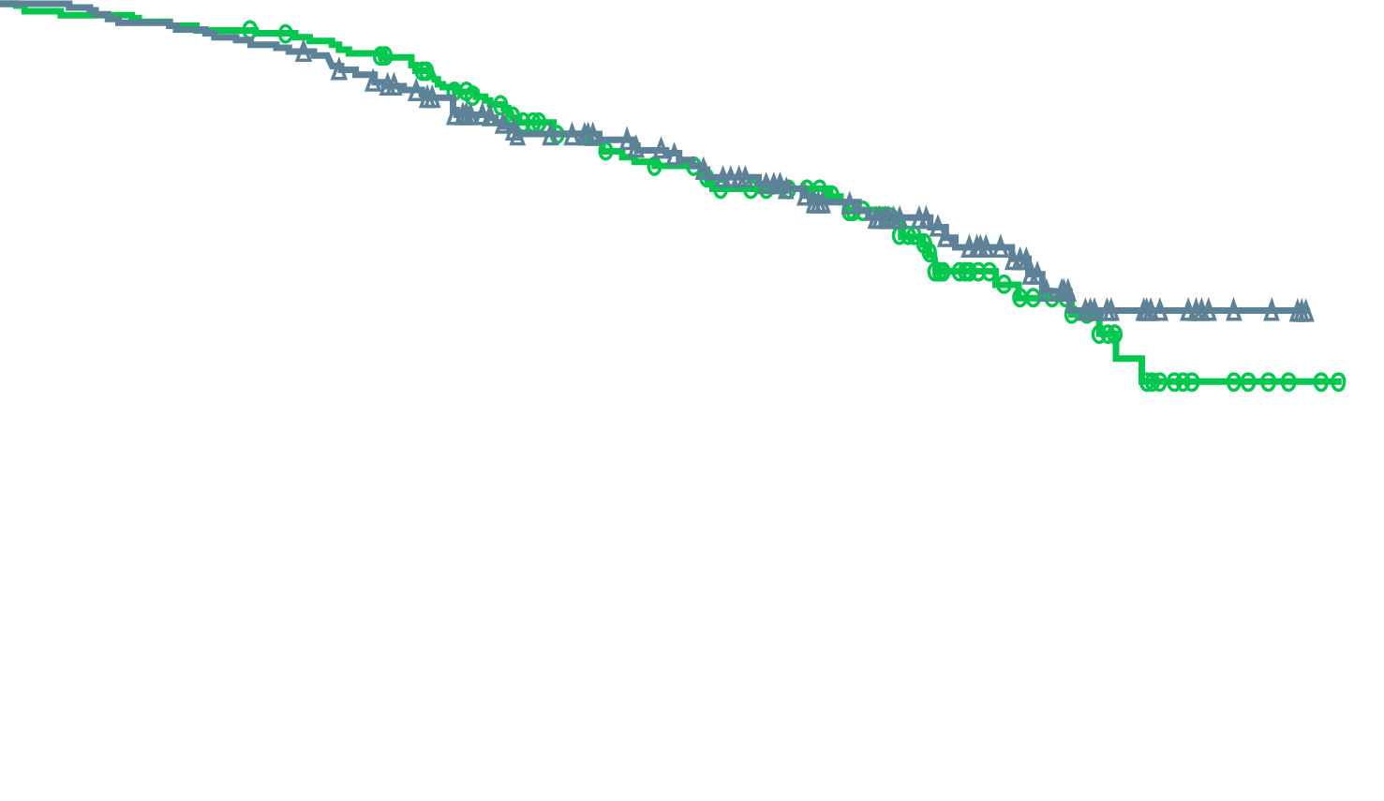
MAGNITUDE All HRR BM+: Overall Survival First Interim Analysis
NIRA + AAP: NE (55 death events)
PBO + AAP: NE (59 death events)
HR: 0.94 (95% CI, 0.65-1.36)
p=0.733 (boundary for significance, 0.0005)
No. at risk
NIRA + AAP | 212 | 207 | 200 | 180 | 146 | 110 | 84 | 52 | 20 | 4 | 0
PBO + AAP | 211 | 206 | 202 | 187 | 141 | 113 | 82 | 47 | 22 | 5 | 0
46.3% of the required death events for the final analysis observed and thus overall survival data are immature
.
AAP, abiraterone acetate + prednisone/prednisolone; BM, biomarker; CI, confidence interval; HR, hazard ratio; HRR, homologous recombination repair; NE, not estimable; NIRA, niraparib; PBO, placebo
Chi K, et al. J Clin Oncol. 2022;40 (suppl 6; abstr 12)
Notes:
Kim Chi to voiceover that the immature result was consistent across genetic alterations. Median FU time is 18.6 months

Slide 70
MAGNITUDE HRR BM+: TEAEs Consistent With the Known Safety Profile for Each Therapy
Treatment-emergent adverse events occurring at >20% in the NIRA arm or otherwise of clinical interest, n (%) |  | NIRA + AAP, n=212 |  | PBO + AAP, n=211
 |  | All grades | Grade ≥3 | All grades | Grade ≥3
Haematologic | Anaemia | 98 (46.2) | 63 (29.7) | 43 (20.4) | 16 (7.6)
 | Thrombocytopaenia | 45 (21.2) | 14 (6.6) | 18 (8.5) | 5 (2.4)
 | Neutropaenia | 29 (13.7) | 14 (6.6) | 12 (5.7) | 3 (1.4)
 | Acute myeloid leukaemia/ Myelodysplastic syndrome | 0 | 0 | 1 (0.5) | 1 (0.5)
Cardiovascular | Hypertension | 67 (31.6) | 33 (15.6) | 47 (22.3) | 30 (14.2)
 | Arrhythmia | 27 (12.7) | 6 (2.8)ª | 12 (5.7) | 3 (1.4)
 | Cardiac failure | 4 (1.9) | 3 (1.4)ª | 4 (1.9) | 1 (0.5)
 | Ischaemic heart disease | 4 (1.9) | 4 (1.9) | 8 (3.8) | 6 (2.8)^{b}
General disorders | Fatigue | 56 (26.4) | 7 (3.3) | 35 (16.6) | 9 (4.3)
Gastrointestinal | Constipation | 65 (30.7) | – | 29 (13.7) | –
 | Nausea | 50 (23.6) | 1 (0.5) | 29 (13.7) | 0
Hepatotoxicity |  | 25 (11.8) | 4 (1.9) | 26 (12.3) | 10 (4.7)
Cerebrovascular disorders |  | 6 (2.8) | 2 (0.9) | 2 (0.9) | 1 (0.5)ª
ª Includes 1 grade 5 event.
^{b} Includes 3 grade 5 events.
AAP, abiraterone acetate + prednisone/prednisolone; BM, biomarker; HRR, homologous recombination repair; NIRA, niraparib; PBO, placebo.
Chi K, et al. J Clin Oncol. 2022;40 (suppl 6; abstr 12)
Notes:
Additional details:
Re: arrhythmia: higher numbers of the following in NIRA vs PBO (all grade): Tachycardia (7 vs 4), Palpitations (6 vs 1), Atrial Fibrillation (5 vs 3), Sinus tachycardia (5 vs 0)
Sinus tachycardia was related to anemia, majority of arrhythmias were grade 1-2 and related to older age and anemia like extrasystoles, sinus tachycardia. The key is how many patients had atrial fibrillation or ventricular tachyarrhythmias which require specific acute and/or chronic management.
Grade 3 arrhythmias included tachycardia (n=1) atrial fibrillation (n=2) in the NIRA group; palpitations (n=1), atrial flutter (n=1), and ventricular tachycardia (n=1) in the PBO group
Grade 3+ cardiac failure included cardiac failure (n=1 gr4), cardiac failure congestive (n=1 gr3), and 1 death in the NIRA group; cardiac failure (n=1 gr3) in the PBO group
Grade 3+ ischemic heart disease included myocardial infarction (n=2 gr 3 and n=1 gr4) and 1 death due to cardiorespiratory arrest in the NIRA group; myocardial infarction (n=1 gr3), coronary artery disease (n=2 gr3), and 3 deaths (myocardial infarction n=2 and acute myocardial infarction n=1) in the PBO group

Slide 71
Personal view and challenges in mCRPC
Survival of men with mCRPC in the real world remains a problem
Good first-line options but early resistance/progression is a challenge
Second-line options are available, but many patients do not get more than 1 line of effective therapy in the real world
Less than half the men with prostate cancer will receive chemotherapy before dying from prostate cancer
Building on effective first-line options for mCRPC is critically needed
PARP/NHT combination fulfills an unmet need of effective and tolerable first-line combinations
mCRPC, metastatic castration resistant prostate cancer; NHT, novel hormonal therapy; PARP, poly-ADP ribose polymerase

Slide 72
REACH GU CONNECT VIA TWITTER, LINKEDIN, VIMEO & EMAIL OR VISIT THE GROUP’S WEBSITE https://guconnect.cor2ed.com/
Follow us on Twitter @guconnectinfo
Follow the GU CONNECT group on LinkedIn
Watch us on the Vimeo Channel GU CONNECT
Email sam.brightwell @cor2ed.com

