Slide 1
1

Slide 2
Experts Knowledge Share
Practical considerations around the use of thrombopoietin-receptor antagonists
(TPO-RAs) in immune thrombocytopenia (ITP)
Dr. Hillary Maitland, Dr. Michael Tarantino, and Dr. Vickie McDonald
Friday December 11th, 2020

Slide 3
EXPERTS KNOWLEDGE SHARE
THE OBJECTIVE of this meeting is to discuss
Practical considerations around the use of TPO-RAs in ITP
Your opportunity to discuss and share learnings on a challenging topic within the area of ITP
A chance to hear the views of Experts and allow them to answer the questions that are important to you
Review and discuss Patient Case Studies, using the questions that you have sent in advance of this event
ITP, immune thrombocytopenia; TPO-RA, thrombopoietin receptor agonist

Slide 4
EXPERTS KNOWLEDGE SHARE
Educational objectives
Understand the role of TPO-RAs in the treatment of chronic ITP in adults
Review all practical considerations, including:
When to start treatment
Efficacy and how to monitor it
Safety
Long-term remission and tapering
Administration
Adjusting treatment
ITP, immune thrombocytopenia; TPO-RA, thrombopoietin receptor agonist

Slide 5



Introducing the scientific committee
Hillary Maitland
Michael Tarantino
Vickie McDonald
University of Virginia, Charlottesville,
VA, USA
University of Illinois College of Medicine-Peoria, IL, USA
Royal London Hospital, London,
United Kingdom

Slide 6
Disclaimer
This meeting is based on an independent medical educational grant from Sobi. The programme is therefore independent; the content is not influenced by Sobi and is the sole responsibility of the experts
Please note:
The views expressed within this presentation are the personal opinions of the experts. They do not necessarily represent the views of the experts’ academic institutions or the rest of the faculty

Slide 7





Extending the reach for those not able to attend today
Experts Knowledge Share (EKS)
Newsletter
e-learning
Newsletter #1:
Summarising video and
slides from EKS
Newsletter #2:
Link to e-learning:
Videos, Slides and Supporting reading material
Assessment test to obtain continuing medical education (CME) credit

Slide 8
Experts knowledge share agenda
Practical considerations around the use of TPO-RAs in ITP
Time | Topic | Facilitator
5 minutes | Welcome and introductions | Iain Murdoch and Kim Grootscholten (COR2ED)
5 minutes | Overview and scene setting | Hillary Maitland
15 minutes | Initiation of treatment for ITP | Hillary Maitland
15 minutes | Monitoring safety and efficacy | Michael Tarantino
15 minutes | Long-term remission, tapering and adjusting treatment | Vickie McDonald
5 minutes | Lead-in to breakout sessions | Iain Murdoch (COR2ED)
25 minutes | Three breakout sessions Groups discussing questions and case studies and sharing experience | All
5 minutes | Closing remarks | Michael Tarantino and Iain Murdoch (COR2ED)
ITP, immune thrombocytopenia; TPO-RA, thrombopoietin receptor agonist

Slide 9
Initiation of treatment for ITP
Dr. Hillary Maitland, MD
University of Virginia, Charlottesville, VA, USA

Slide 10
Disclosures
Grants/honoraria from Dova and Sanofi

Slide 11



CASE
She underwent in vitro fertilization (IVF) with a donor egg and delivered her daughter in January
Ms. N
36-year-old female with a history of premature ovarian failure
In May she developed gingival bleeding and easy bruising and was found to have a platelet count of 8k
IVF, in vitro fertilisation

Slide 12
Initial Treatment of ITP
ASH guidelines
≤30 × 10⁹/L
Corticosteroids
IVIG
Anti D
Platelets
x 10⁹/L
>30 × 10⁹/L
Observe
Duration <6 weeks
Anti-D, anti-rhesus-D immunoglobulin; ASH, American Society of Hematology; ITP, immune thrombocytopenia; IVIG, intravenous immunoglobulin
Neunert C, et al. Blood Adv. 2019;3:3829-66
Notes:
Initial treatment goal platelets >30k
Steroids not recommended for long term use d/t sequalae

Slide 13
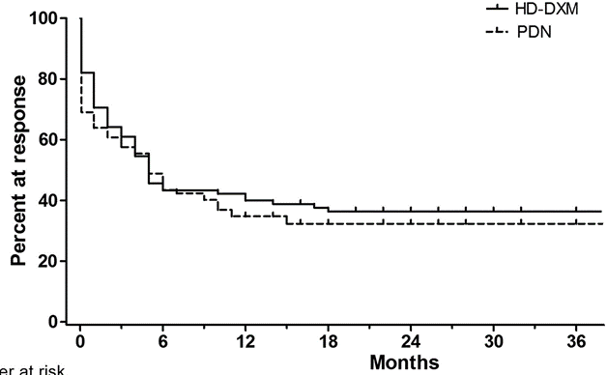
Dexamethasone or Prednisone?
High-dose dexamethasone
Prednisone
Not a sustained response
Wei Y, et al. Blood. 2016;127:296-302
Notes:
Most patient respond to steroids, complete response rates around 60% and 80-90% had partial response
Randomized:
HD DXM 4 days, repeat at day 10 if bleeding or plt <30k
PDN 1mg/kg daily for 4 weeks then tapered over 4-6 weeks
HD DXM worked more quickly and significantly reduced bleeding, trend toward better overall response was not significant
10 year relapse free survival 13%

Slide 14



CASE
Ms. N gets dexamethasone 40 mg daily for 4 days
Her platelet count normalises
One month later platelet count is 23k

Slide 15
Second-line therapy
ASH guidelines
Splenectomy
No splenectomy until 1 year out
Platelets
<20-30 × 10⁹/L
Rituximab
TPO-RA
ASH, American Society of Hematology; TPO-RA, thrombopoietin receptor agonist
Neunert C, et al. Blood Adv. 2019;3:3829-66

Slide 16
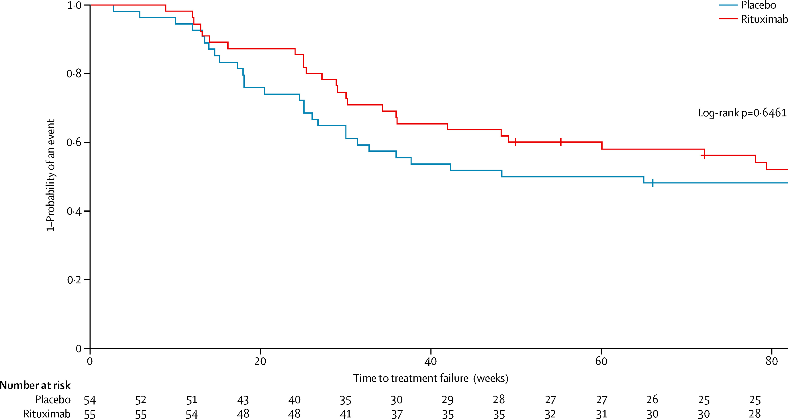
Rituximab
At 18 months
58% of patients on rituximab and
69% of patients on placebo had treatment failure
Second-line rituximab did not significantly reduce long-term treatment failure
Ghanima W, et al. Lancet. 2015;385:1653-61
Notes:
Ritux has an initial response rate or around 60% but few patient have long term response
Patient on steroids randomized to rituximab vs placebo
Treatment failure: plt <20 or need for pred 7.5mg/day or greater
13 (24%) of 55 patients receiving rituximab and eight (14%) of 54 patients receiving placebo had sustained responses, the long-term net rate of sustained responses (>78 weeks) provided by rituximab would be about 10%.

Slide 17
Second-line therapy
ASH guidelines¹
Splenectomy
Appropriate for patients who want to avoid long-term medication, high risk of relapse²
Platelets
<20-30 × 10⁹/L
Rituximab
Most beneficial in women <40 years old³
TPO-RA
ASH, American Society of Hematology; TPO-RA, thrombopoietin receptor agonist
1. Neunert C, et al. Blood Adv. 2019;3:3829-66; 2. Ghanima W, et al. Lancet. 2015;385:1653-61; 3. Marangon M, et al. Eur J Haematol. 2017;98:371-77

Slide 18
Case
Ms. N decides to start rituximab
During her first infusion she develops itching and tachycardia, so the infusion is stopped
Platelets are now 19k

Slide 19
Second-line therapy
ASH guidelines
Splenectomy
Highest clinical response rate
Platelets
<20-30 × 10⁹/L
Rituximab
TPO-RA
Best data for sustained response
TPO-RA, thrombopoietin receptor agonist
1. Neunert C, et al. Blood Adv. 2019;3:3829-66; 2. Cooper N and Ghanima W. N Engl J Med. 2019;381:945-55
Notes:
TPR response rate 80% vs 60% rituxan

Slide 20
thrombopoietin receptor agonists
 | Romiplostim | Eltrombopag | Avatrombopag
Dosing
Starting dose | 1 µg/kg/week (label) 3 µg/kg/week (realistic) 5 µg/kg/week (severe) | 50 mg daily 25 mg daily (Asian patients) | 20 mg daily
Min/max dose | 10 µg/kg/week 1 µg/kg/week | 75 mg/day (150 mg approved for AA) 12.5 mg/day | 40 mg/day 20 mg/week
Route | Subcutaneously once weekly | Oral, daily | Oral, daily
Administration considerations | Can patient self-administer injections Increased monitoring Cost (+/-) | Timing in relation to food containing calcium | Taken with any food
Safety considerations | Well tolerated, low AEs Increased platelet variability | Well tolerated, low AEs Hepatotoxicity Less bleeding events | Well tolerated, low AEs Headache Newer drug
AA, aplastic anaemia; AE, adverse event; CBC, complete blood count; LFT, liver function test
Forsythe A, et al. J Comp Eff Res. 2020;9:447-57; Al-Samkari H and Kuter DJ. Ther Adv Hematol. 2019;10:2040620719841735. Nplate (romiplostim) Prescribing Information. Promacta (eltrombopag) Prescribing Information. Doptelet (avatrombopag) Prescribing Information.
Notes:
eltrombopag vs romiplostim- significantly lower rates of BREs (including severe BREs), decreased use of rescue medications (including IVIG or corticosteroid injections) and platelet transfusions
fewer splenectomy
Avoid eltrombopag in patient with CLD d/t hepatotoxicity and thrombotic risk
Romiplostim has a better response rate in patients with elevated tpo levels
Romiplostin- consider staring 3ug, phase 3 study of 4ug starting dose has low thrombotic rates, can go up to 10ug for bleeding
Eltrombopag- no data on ITP at doses >75 but generally considered safe

Slide 21
CASE
We start Ms. N on avatrombopag 20 mg daily

Slide 22
Case
Hold
Restart at reduced dose
IVIG, intravenous immunoglobulin
Notes:
Better to dose reduce than to hold tpo for high platelet counts

Slide 23
Summary
Thrombopoietin receptor agonists
Try to limit steroid exposure to <6 weeks
Choice of second-line treatment is based on patient preference
TPO-RAs have similar efficacy and safety profiles
TPO-RA, thrombopoietin receptor agonist

Slide 24
Monitoring safety and efficacy of TPO-RAs
Michael Tarantino, MD
CEO, CMO and President
Bleeding and Clotting Disorders Institute
Professor of Pediatrics and Medicine
University of Illinois College of Medicine-Peoria, IL, USA

Slide 25
Disclosures
Honoraria/Grants from Amgen, Biogen, BioMarin, Genentech, Grifols, Hemabiologics, Novartis, NovoNordisk, Octapharma, Pfizer, Principia, Rigel, Spark Therapeutics, Sobi and Takeda

Slide 26
Clinical Consequences of ITP
Morbidity
Disease- related
Lifestyle- related
Therapy- related
Fatigue
ITP, immune thrombocytopenia

Slide 27
TPO-RAs: the many definitions of response
Monitoring Objectives
Quantitative
Platelet count
Rate of response (durable, overall, any)
Height of response (median, mean platelet counts)
Time to response
Durability of response (% of time [weeks] with response)
Odds of response (compared with placebo or SOC)
Qualitative
Bleeding prevention or cessation
Determining the hemostatic range for platelet count
In clinical trials, 50-200 × 10⁹/L
Real world: tailored to individual patient
Discontinuation of concomitant medications
Fatigue and other QoL improvement
QoL, quality of life; SOC, standard of care; TPO-RA, thrombopoietin receptor agonist

Slide 28
Assessing Response to ITP Treatments
Quality of response
CR: platelet count ≥100 × 10⁹/L and absence of bleeding
R: platelet count ≥30 × 10⁹/L and at least 2-fold increase the baseline count and absence of bleeding
NR: platelet count <30 × 10⁹/L or less than 2-fold increase of baseline platelet count or bleeding
Duration of response
Measured from the achievement of CR or R to loss of CR or R
Corticosteroid dependence
The need for ongoing or repeated doses administration of corticosteroids for at least 2 months to maintain a platelet count at or above 30 × 10⁹/L and/or to avoid bleeding (patients with corticosteroid dependence are considered non-responders)
CR, complete response; ITP, immune thrombocytopenia; NR, no response; R, response
Adapted from: Rodriguero F, et al. Blood. 2009;113:2386-93

Slide 29
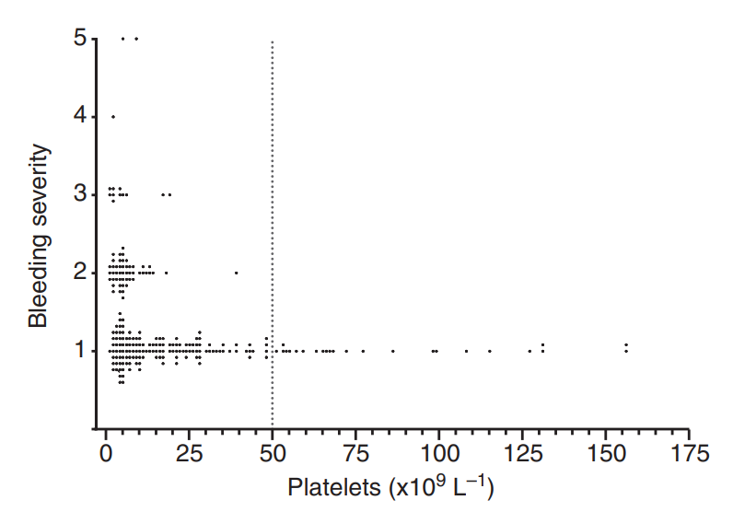
Evaluation of bleeding events during long‐term use of romiplostim in patients with chronic ITP
ITP, immune thrombocytopenia
Gernsheimer TB, et al. J Thromb Haemost. 2010;8:1372-82

Slide 30
Administration and dosing of the TPO-RAs
Name | Maker | Molecule | Route of administration | Approved starting dose
Romiplostim | Amgen | Peptibody | Subcutaneous | 1 mcg/kg
Eltrombopag | Novartis | Small molecule | Oral | 50 mg/day*
Avatrombopag | Sobi/Dova | Small molecule | Oral | 20 mg/day
*starting dose for patients of Asian ancestry and children 1 to <6 years of age is 25 mg/day
TPO-RA, thrombopoietin receptor agonist
Adapted from: Tarantino, MD, Chalmers S. Therapeutic Thrombopoietin Mimetics. In: Platelets in Thrombotic and Nonthrombotic Disorders: Pathophysiology, Pharmacology and Therapeutics. 2nd Edition. Cambridge University Press. Gresele P, et al, eds. 2016, pp 1417-29

Slide 31
Primary Outcome in Pivotal Trials of TPo-RAs
Agent | Platelet response metric
Romiplostim¹ | Durable Response: platelet count ≥50 × 10⁹/L during 6 or more of the last 8 weeks of treatment
Eltrombopag² | Odds of response to eltrombopag versus placebo
Avatrombopag³ | Cumulative number of weeks of platelet response (platelet count ≥50 × 10⁹/L) without rescue therapy for bleeding
TPO-RA, thrombopoietin receptor agonist
1. Kuter KJ, et al. Lancet. 2008;371:395-403; 2. Cheng G, et al. Lancet. 2011;377:379-402; 3. Jurczak W, et al. Br J Haematol. 2018;183:479-90

Slide 32
Additional Efficacy Metrics for TPo-RAs for Chronic ITP
Drug | Dose | Response rate |  | Selected toxicities
 |  | Rate | Time to
Rituximab¹ | 375 mg/m² IV weekly × 4 | 60% overall 40% CR 20-25% at 5 years | 1-8 weeks | Infusion reactions, serum sickness, HBV reactivation, PML (rare)
Romiplostim¹ | 1-10 μg/kg SC weekly | 80% overall 40-50% persistent | 1-4 weeks | Reticulin fibrosis, rebound thrombocytopenia, thrombosis
Eltrombopag¹ | 25-75 mg PO daily | 80% overall 40-50% persistent | 1-2 weeks | Reticulin fibrosis, rebound thrombocytopenia, thrombosis, hepatotoxicity
Avatrombopag² | 20 mg PO weekly – 40 mg PO daily | 66% overall (day 8) 34% durable | 1-2 weeks | HA, URI, thrombosis (class effect), rebound thrombocytopenia
Fostamatinib³ | 100-300 mg PO daily | 44% overall 17% durable | 2 weeks | HTN, transaminitis, hyperbilirubinemia, neutropenia
CR, complete response; HA, headache; HBV, hepatitis B virus; HTN, hypertension; ITP, immune thrombocytopenia; IV, intravenous; PML, progressive multifocal leukoencephalopathy; PO, orally; SC, subcutaneous; TPO-RA, thrombopoietin receptor agonist; URI, upper respiratory infection
1. Adapted from: Cuker A and Neunert CE. Blood. 2016;128:1547-54; 2. Jurczak W, et al. Br J Haematol. 2018;183:479-90; 3. Bussel JB, et al. Am J Hematol. 2019;94:546-53

Slide 33
Approximate Time to Response for Second-Line ITP Treatments
0
1
2
3
4
5
6
Months
ITP, immune thrombocytopenia; MMF, mycophenolate mofetil
Provan D, et al. Blood. 2010;115:168-86

Slide 34
Dose Adjustment Algorithms for TPO-RAs
Romiplostim
The starting dose: 1 μg/kg
Target 50-200 × 10⁹/L:
  If platelet count 10 × 10⁹/L or less: increase dose by 2 μg/kg every week
  If platelet count 11-50 × 10⁹ increase by 2 μg/kg every 2 weeks
  If platelet count >50 × 10⁹/L, the maintenance algorithm was used:
    increased by 1 μg/kg every week if 10 × 10⁹/L or less
    increased by 1 μg/kg after 2 weeks if 11 to 50 × 10⁹/L
    reduced by 1 μg/kg after 2 consecutive weeks at 201 to 400 × 10⁹/L
    withheld if >400 × 10⁹/L and subsequent doses reduced by 1 μg/kg and given after count was less than 200 × 10⁹/L
The maximum allowed dose was 15 μg/kg
TPO-RA, thrombopoietin receptor agonist
Kuter KJ, et al. Lancet. 2008;371:395-403

Slide 35
Pivotal Study Protocol:
Avatrombopag
Core study design
PRE-RANDOMISATION
CORE STUDY
Screening period
Baseline/
randomis-
ation
Titration
ITP concomitant medication
reduction
Maintenance
Dose
tapering
Follow-
up
Days -14 to -1
Day 1
Days 5 ± 1-28
Weeks 6 to 16
Weeks 18 to 26
Weeks 27 to 30
Weeks 31 to 34
AVA
20 mg
avatrombopag
5 to 40 mg once daily
Double-blind
R
2:1
EOT
PBO
Matching placebo
Eligible subjects enrol into
Extension Phase
AVA, avatrombopag; EOT, end of treatment; ITP, immune thrombocytopenia; PBO, placebo; R, randomisation
Jurczak W, et al. Br J Haematol. 2018;183:479-90

Slide 36
Efficacy and safety of TPO-RAs
Consideration | Romiplostim¹⁻⁵ | Eltrombopag⁶⁻⁸ | Avatrombopag^{9,10}
Efficacy
Onset of action | 1-4 weeks | 1-2 weeks | 1-2 weeks
Rate of response | 79-88% | 70-81% | 66% (day 8)
Remission potential | 32% adult 23% children | 10% | NE
Experience around surgery | + | + | +
Safety
Dietary restrictions | - | + | -
Drug interactions | - | +* | +**
Thromboembolism | 7% | 6% | 7%
Hepatobiliary effect | - | 12% | -
Reticulin fibrosis/accumulation | 3.7% | <10% | -
Rebound thrombocytopenia | 7% | 11% | NR
Neutralising antibodies | 0.4% | - | -
* Competitively binds to transporter proteins, chelates polyvalent cations
** Binds OAT3, BRCP, competes for Pgp
NE, not evaluated; NR, not reported;
1. Kuter DJ, et al. Br J Haematol. 2013;161:411-23; 2. Cines DB, et al. Int J Hematol 2015;102:259-70; 3. Nplate (romiplostim) Prescribing Information; 4. Newland A, et al. Br J Haematol. 2016;172:262-73; 5. Tarantino MD, et al. Haematologica. 2019;104:2283-2291; 6. Bussel JB, et al. Lancet 2009;373: 641-8; 7. Wong RSM, et al. Blood. 2017;130:2527-36; 8. Promacta (eltrombopag) Prescribing Information; 9. Piatek CI, et al. 62nd Annual Meeting of the Am Soc Hematol. abstract 844; 10. Doptelet (avatrombopag) Prescribing Information.

Slide 37
Monitoring TPO-RA based on Goals of Treatment
Goal | Means
Bleeding | At what platelet count is bleeding resolved?
Fatigue | At what platelet count is fatigue mitigated or resolved?
Discontinuation of concomitant medication | Does treatment allow reduction or discontinuation of concomitant medication?
Successful surgery | Does treatment reliably achieve hemostatic platelet count for surgery?
Liberation of activity | What platelet count will allow safe participation?
TPO-RA, thrombopoietin receptor agonist

Slide 38
TPO-RAs
Monitoring for Safety
Adverse Event | Trigger | Cause | Action
Thrombocytosis | Platelet count | Drug sensitivity | Dose adjustment
Thrombocytopenia | Platelet count | Drug insensitivity | Dose adjust
 |  | Reticulin/Collagen fibrosis | Bone marrow examination Discontinue TPO-RA
 |  | Anti-drug antibody | Specific assay Discontinue drug
 |  | Poor adherence | Improve adherence
VTE, arterial thrombosis | Related signs/symptoms | Appropriate imaging | Discontinue drug
Hepatitis | Screening HFP | Unknown | Decrease dose or discontinue
Cataract | Visual field change Surveillance ocular examination | Unknown | Discontinue if TEAE
HFP, hepatic function panel; TPO-RA, thrombopoietin receptor agonist; TEAE, treatment-emergent adverse event; VTE, venous thromboembolism

Slide 39
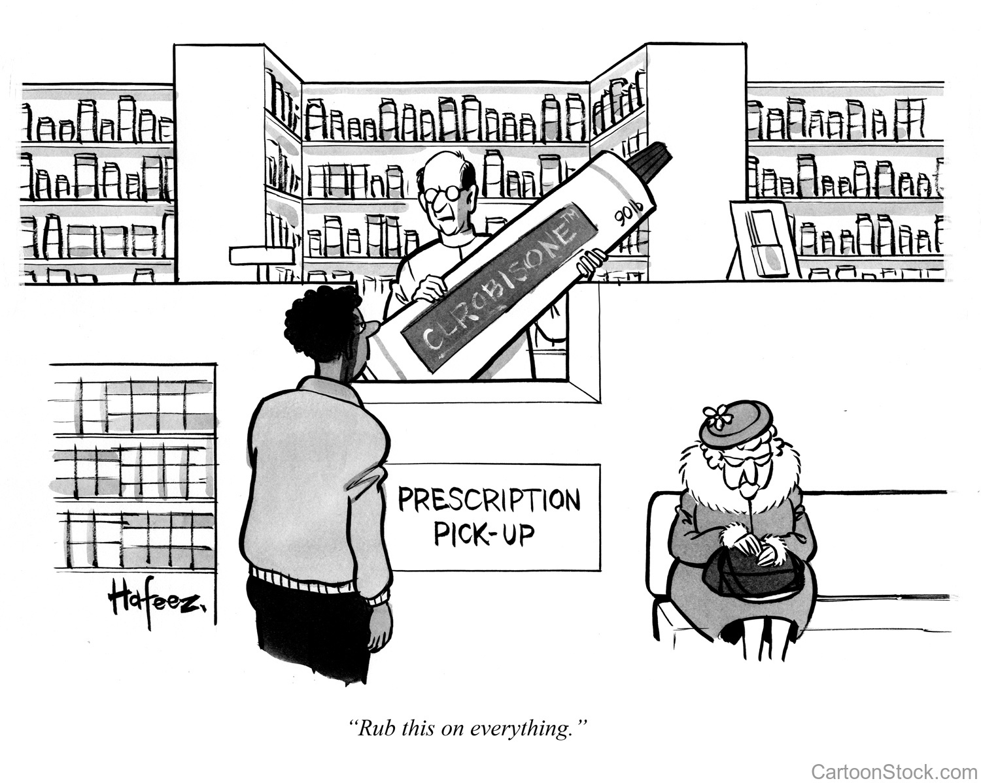
39

Slide 40
Long-term remission, tapering and adjusting treatment with TPO-RAs
Dr. Vickie McDonald, MD
Royal London Hospital, London, United Kingdom

Slide 41
Disclosures
Honoraria/Grants from Amgen, Bayer, Grifols, Novartis, Rigel and Sobi

Slide 42
Outline
How are TPO-RAs dosed?
What are the goals of therapy in ITP?
Does that alter how we approach TPO-RA therapy?
Is there data to support long-term remission of ITP after TPO-RA therapy?
Tapering of TPO-RAs
ITP, immune thrombocytopenia; TPO-RA, thrombopoietin receptor agonist

Slide 43
Sequencing treatment:
When to use a TPO-RA?
Newly diagnosed
0-3 months
Persistent
3-12 months
Chronic
12 months+
Agent choice determined by comorbidities / patient preference:
TPO-RA
Rituximab
MMF
Other agents…
Avoid long term steroids
2nd line (consider comorbidities):
Rituximab
Mycophenolate mofetil (MMF)
Other agents…
Manage bleeding
Steroids / intravenous immunoglobulin (IVIG)
Average course prednisolone ~10 weeks
If low counts / fall on weaning: early 2nd line treatment
TPO-RA
IVIG, intravenous immunoglobulin; MMF, mycophenolate mofetil; TPO-RA, thrombopoietin receptor agonist
1. Neunert C, et al. Blood Adv. 2019;3:3829-66; 2. Provan D, et al. Blood Adv. 2019;3:3780-817
Notes:
We understand better the place of the TPO-RA in treatment of ITP and some of these elements have been discussed earlier
Newly diagnosed: guidelines/ consensus recommend steroids/ IVIG
Either prolonged course of steroids OR 2nd line treatment if platelets fall on weaning
Persistent: avoid toxicity of long term steroids. 2nd line agents determined by co-morbidities: can they be immunosuppressed? Do they have a high thrombotic risk. Adv of using TPO early is that a proportion achieve remission and in these we avoid immunosuppression altogether
There is some evidence to suggest TPO-RA used early improves response rates

Slide 44
Identical frequencies of platelet response:
ITP ≤1 year vs >1 year
ITP-romi ≤1 year (n = 277)
ITP-romi >1 year (n = 634)
Response ≥75% of time
Response ≥90% of time
Durable response
(≥6 weeks in weeks 17–24)
ITP-romi, patients with immune thrombocytopenia treated with romiplostim
Kuter DJ, et al. Br J Haematol. 2019;185:503-13

Slide 45
DOSE ADJUSTMENT ‘BY THE BOOK’:
Romiplostim and eltrombopag
Romiplostim¹
Starting dose 1 µg/kg once weekly
Platelets <50 × 10⁹/L: increase by 1 µg/kg
Platelets >150: decrease by 1 µg/kg
Platelets >250: suspend; restart when platelets <150 at dose reduced by 1 µg/kg
Eltrombopag²
Starting dose 50 mg once daily
25 mg for Asian patients
Platelets <50 after at least 2 weeks of therapy: increase dose by 25 mg to max 75 mg
Platelets >150 to ≤250: decrease daily dose by 25mg – wait 2 weeks to assess effect
Platelets >250: stop, once platelets ≤100 restart at daily dose reduced by 25 mg
1. Nplate (romiplostim) summary of product characteristics 2013; 2. Revolade (eltrombopag) summary of product characteristics 2015

Slide 46
Dose adjustment ‘by the book’ avatrombopag
Titrate up or down as necessary, based on platelet count
40 mg
3 times
per week
Avatrombopag starting dose 20 mg
*40 mg once daily for patients on moderate or strong dual inducers of CYP2C9 and CYP3A4
Recommended starting dose
AND
20 mg
on 4 other days
40 mg
once
daily
Titrate down
Dose level 1
Dose level 2
Dose level 3
20 mg
once
daily
Dose level 5
Dose level 6
20 mg
1 time
per week
20 mg
2 times
per week
20 mg
3 times
per week
Titrate up
Dose level 4
OR
40 mg
1 time
per week
CYP, cytochrome P
Doptelet (avatrombopag) Prescribing Information.

Slide 47
Goals of therapy in ITP: what to target when deciding drug doses
Patients need a safe platelet count, not a normal platelet count:
  Platelets <10 × 10⁹/L usually need treatment
  Platelets >30 × 10⁹/L can usually be managed by observation
  Platelets 10 to 30 × 10⁹/L, more likely to treat if:
    High bleed risk, prior bleeding, active bleeding
    Age
    Symptoms
    Lifestyle, occupation and risks
    Co-morbidities/ concurrent medication: anticoagulation
Increased move to individualised therapy where possible
Individualise
Prevent bleeding
Minimise toxicity
QoL important
Moved from
“The platelet count is key”
to
“Platelets plus symptoms
(and minimising toxicity) are key”
ITP, immune thrombocytopenia; QoL, quality of life
1. Provan D, et al. Blood Adv. 2019;3:3780-817; 2. Neunert C, et al. Blood Adv. 2019;3:3829-66; 3. Matzdorff A, et al. Oncol Res Treat. 2018;41 suppl 5:1-30
Notes:
How do we determine what doses of TPO- to use, how to change dosing and when / if to consider stopping
To determine this we need to review the aims or goals of treatment
Once we have reached our ‘target’ and achieved stability, what should we then do about treatment: do we stop/ taper/ continue. If so, who should we consider for tapering?
And if we are to stop, is there any evidence that there is a durable response with TPO-RA ?
And for example, the clinical rationale for long term treatment on TPO-RA cam from evidence from studies that some patients, after stopping treatment, did drop their counts – but not all did. This generates interesting questions around the mechanism for this, predicting which patients would have a long term response and how best to use these agents long term

Slide 48
TPO-RAs can induce a long-lasting immunological response
Increased or improved T-regulatory cell activity¹
Increased B-regulatory cell activity²
Increased TGF-beta (mediates the increased T- and B-regulatory cell activity)³
Change in Fc receptors: reversal of Fc receptor balance towards FcRIIb (inhibitory)⁴
Reduces antiplatelet antibody levels in mice with ITP⁵
FcRIIb, Fc receptor IIb; ITP, immune thrombocytopenia; TGF, transforming growth factor; TPO-RA, thrombopoietin receptor agonist
1. Bao W, et al. Blood. 2010;116:4639-45; 2. Li X, et al. Blood. 2012;120:3318-25; 3. Wan YY and Flavell RA. Immunol Rev. 2007;220:199-213; 4. Liu X-G, at al. Blood. 2016;128:852-61; 5. Kapur R, et al. Platelets. 2020;31:399-402

Slide 49
Treatment-free “remission” in ITP terminology
Treatment-free remission vs thrombocytopenia-free remission
  Significance of terminology
  Complete response (CR): platelets ≥100 x 10⁹/L
  (Partial) response: platelets ≥30 x 10⁹/L and two-fold increase from baseline
Treatment-free remission
  No longer requiring active therapy, considered low risk for bleeding
What threshold?
  Platelets >50 x 10⁹/L
  Platelets >30 x 10⁹/L
For how long?
Mazzucconi et al (2017)¹
  “Durable response”: response or CR lasting ≥4 weeks with a stable dose of TPO-RA
  “Sustained response”: platelet count ≥30 × 10⁹/L after > 4 weeks since TPO-RA discontinuation, in the absence of concomitant treatments
CR, complete response; ITP, immune thrombocytopenia; TPO-RA, thrombopoietin receptor agonist
1. Mazzucconi MG, et al. Eur J Haematol. 2017;98:242-9
Notes:
The study by Mazzucconi et al. (2017) presented a real-world case series on the achievement of CR after interruption of a TPO-RA in 39 patients with primary ITP. The study also introduced two new definitions of clinical response: durable response, defined as simple re- sponse or CR lasting for at least 4 weeks with a stable dose of TPO-RA and sustained response, defined as the achievement of a platelet count of at least 30 × 109/L after > 4 weeks from TPO-RA discontinuation, in absence of concomitant treatments. These two new types of responses were added to the standard ones identified by Rodeghiero et al.: simple response, defined as a platelet count of at least 30 × 109/L and at least a twofold increase in the initial count and CR, defined as a platelet count of at least 100 × 109/L in absence of bleeding events

Slide 50
Uk Adult ITP registry data
Adults treated with romiplostim (N = 118)
Year of romiplostim initiation, n (%)
2009 | 1 (1)
2010 | 5 (4)
2011 (NICE recommendation) | 29 (25)
2012 | 26 (22)
2013 | 31 (26)
2014 | 26 (22)
Duration of romiplostim administration, months
Mean (SE) | 5.7 (0.9)
Median (IQR) | 1.4 (0.2-6.5)
Median (IQR) maximum weekly dose of romiplostim, mcg/kg | 3.0 (2.0-6.0)
≥ 6 months of follow-up after last romiplostim dose, n (%) | 84 (71)
Did not have romiplostim for > 6 months after receiving the last dose, n (%) | 45 (38)
Time from romiplostim initiation to the last dose for those who discontinued, n (%)
N | 84
<1 month | 37 (44)
1 to <3 months | 8 (10)
3 to <6 months | 10 (12)
6 to <12 months | 10 (12)
>12 months | 19 (23)
IQR, interquartile range; ITP, immune thrombocytopenia; NICE, National Institute for Health and Care Excellence; SE, standard error
Doobaree IU, et al. Eur J Haematol. 2019;102:416-23
Notes:
The first observational data about longer term remission was from an observational study

Slide 51
Sustained responses to TPO-RA off treatment¹
Study | TPO-RA | Patients, n | Patients who discontinued TPO-RA, n (% of all patients) | Patients with off-treatment responses, n (% of all patients) | Median follow-up, months
Leven et al, 2012 | E | 15 | 5 (33) | 5 (33) | 6+
Mahevas et al. 2014 | E, R | 54 | 20 (37) | 8 (15) | 13.5
Cervinek et al. 2015 |  | 46 | 11 (24) | 11 (24) | 33
Gonzalez-Lopez et al. 2015 | E | 12 | 12 (100) | 12 (100) | 7
Newland et al. 2016 | R | 4 | 3 (75) | 3 (75) | 29.5
Marshall et al. 2016 | R | 43 | 12 (28) | 12 (28) | 20
Bussel et al. 2016 | R | 302 | 10 (3) | 9 (3) | 6+
Carpenedo et al. 2015 | R | 27 | 13 (48) | 13 (48) | 26
Mazzucconi et al. 2017² | E,R | 39 | 7 (18) | 7 (18) | 19.4
E, eltrombopag; R, romiplostim; TPO-RA, thrombopoietin receptor agonist
1. Modified from: Zaja F, et al. Blood Rev. 2020;41:100647; 2. Mazzucconi MG, et al. Eur J Haematol. 2017;98:242-9
Notes:
Much of this data comes from small studies, but gives a flavour of responses. Variable responses in terms of percentages, buyt also shows remission is achieved across a broad range of studies, with both romiplostim and eltrombopag
Note that most of those who had the drug tapered, maintained the response at follow up – some of which is 2-3 years down the line
No data for avatrombopag
Mention TAPER study

Slide 52



POSSIBLE CRITERIA TO BE CONSIDERED AS PARAMETERS OF TPO-RA TAPERING AND DISCONTINUATION
  Response status
    Patients with a CR and treated with lower doses of a TPO-RA for ≥ 6 months
    *? CR or lower platelet count acceptable
  ITP duration
  Age of patient
    ? predictive
  Number of lines of previous treatment
    ? better if low
Response status
  Patients requiring high-dose TPO-RA
  Platelets < 50 x 10⁹/L
ITP that was previously hard to manage
Duration
  TPO-RA < 6/12 months
High risk of bleeding if treatment stopped
Concurrent medication
  Antiplatelets or anticoagulants
Significant comorbidities, risk of recurrent infection
CR, complete response; ITP, immune thrombocytopenia; TPO-RA, thrombopoietin receptor agonist
Bradbury C, et al. HemaSphere. 2(Suppl 1):PF668. Cooper N, et al. HemaSphere. 2(Suppl 1):PF670. Thachil J, et al. Br J Haematol. 2018;180:591–4. Zaja F, et al. Blood Rev. 2020;41:100647
Notes:
So how should tapering be considered

Slide 53
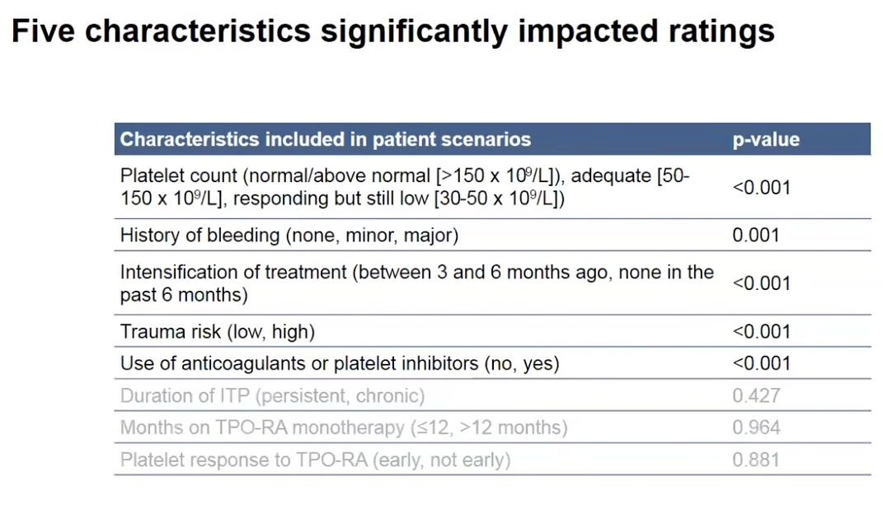
HOT OFF THE PRESS…
ITP, immune thrombocytopenia; TPO-RA, thrombopoietin receptor agonist
Cuker A, et al. Blood. 2020;136(Suppl 1):6-8

Slide 54
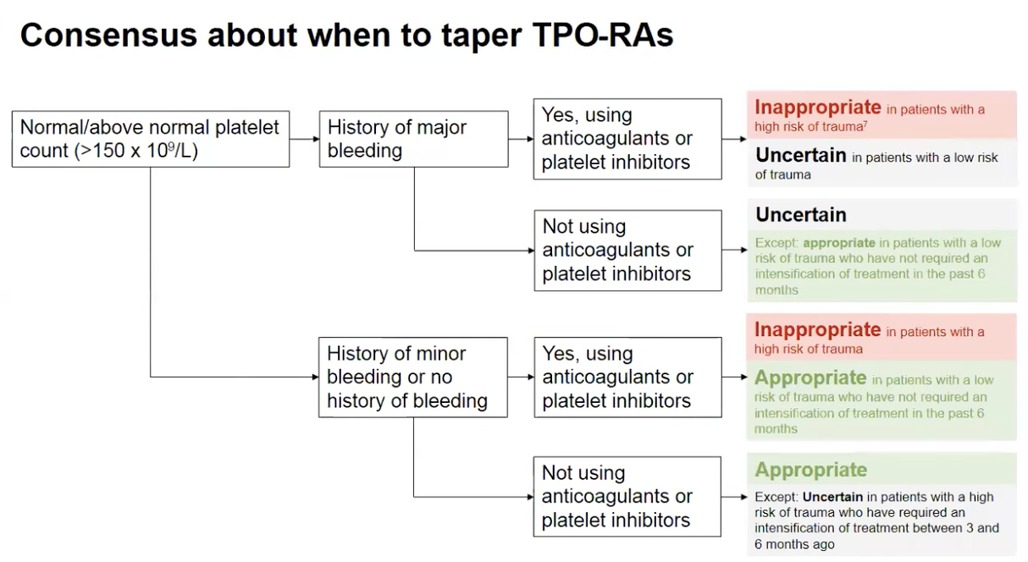
HOT OFF THE PRESS…
TPO-RA, thrombopoietin receptor agonist
Cuker A, et al. Blood. 2020;136(Suppl 1):6-8

Slide 55
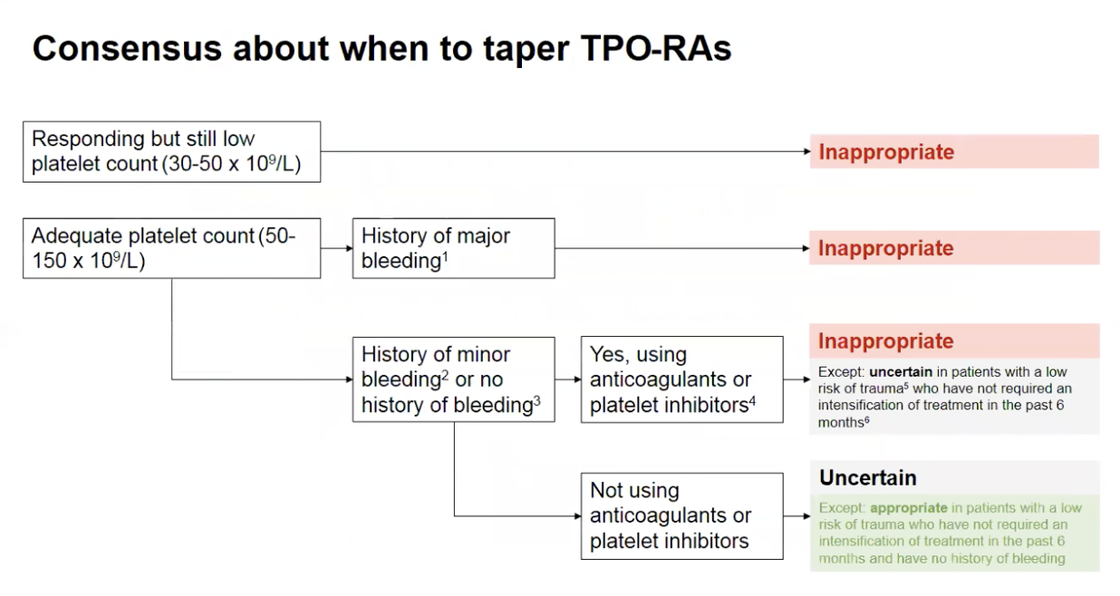
HOT OFF THE PRESS…
TPO-RA, thrombopoietin receptor agonist
Cuker A, et al. Blood. 2020;136(Suppl 1):6-8
Notes:
So how should tapering be considered

Slide 56
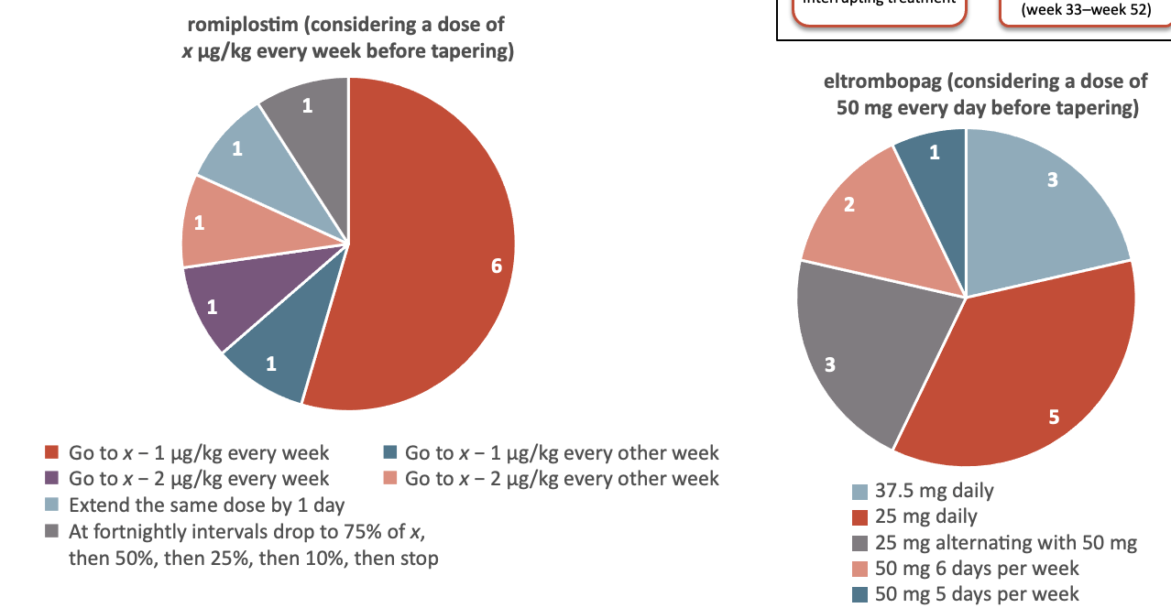
How to Taper:
No international consensus
Tapering
Dose reduction by
25 mg every 2 weeks,
to a minimum
dose of 25 mg every
4 days, before interrupting treatment
Period of tapering and
discontinuation
(week 25–week 32)
Expert opinion
DOSE REDUCTION: HOW QUICKLY?
Period of observation
(week 33–week 52)
romiplostim (considering a dose of
x μg/kg every week before tapering)
eltrombopag (considering a dose of
50 mg every day before tapering)
◼︎ Go to x − 1 μg/kg every week ◼︎ Go to x − 1 μg/kg every other week
◼︎ Go to x − 2 μg/kg every week ◼︎ Go to x − 2 μg/kg every other week
◼︎ Extend the same dose by 1 day
◼︎ At fortnightly intervals drop to 75% of x,
then 50%, then 25%, then 10%, then stop
37.5 mg daily
25 mg daily
25 mg alternating with 50 mg
50 mg 6 days per week
50 mg 5 days per week
Cooper N, et al. EHA 2019; abstract PB2251; Zaja F, et al. Blood Rev. 2020;41:100647

Slide 57
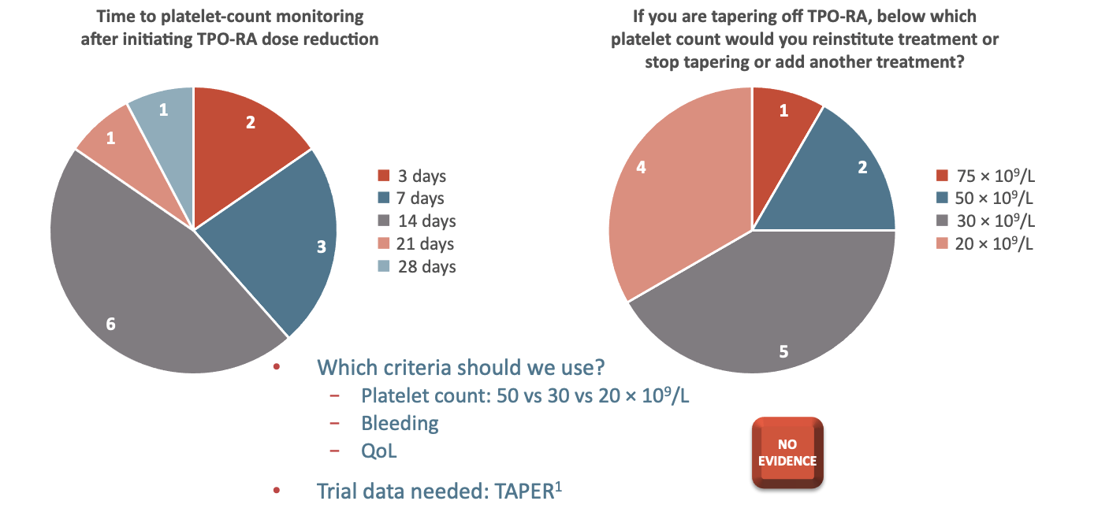
How do we monitor tapering and define failure?
Expert opinion
MONITOR: HOW CLOSELY?
TAPER FAILURE?
Time to platelet-count monitoring
after initiating TPO-RA dose reduction
If you are tapering off TPO-RA, below which
platelet count would you reinstitute treatment or
stop tapering or add another treatment?
◼︎ 3 days
◼︎ 7 days
◼︎ 14 days
◼︎ 21 days
◼︎ 28 days
◼︎ 75 × 10⁹/L
◼︎ 50 × 10⁹/L
◼︎ 30 × 10⁹/L
◼︎ 20 × 10⁹/L
Which criteria should we use?
  Platelet count: 50 vs 30 vs 20 × 10⁹/L
  Bleeding
  QoL
Trial data needed: TAPER¹
NO
EVIDENCE
QoL, quality of life; TPO-RA, thrombopoietin receptor agonist
1. Cooper N, et al. EHA 2019; abstract PB2251; 2. Zaja F, et al. Blood Rev. 2020;41:100647

Slide 58
SUMMARY
TPO-RAs are increasingly being used second line in the treatment of ITP
Treatment should be tailored to the patient’s platelet count, but wider symptoms should also be taken into consideration
Lowest dose that achieves a safe platelet count, with improvement in QoL should be used
There is an increasing body of evidence showing that TPO-RAs can lead to durable responses off treatment – and induce long-lasting immunological responses in some patients
At present there are no clear indicators for which patients are likely to achieve durable responses off treatment
Tapering is an ‘evidence-free zone’ and requires more studies
ITP, immune thrombocytopenia; QoL, quality of life; TPO-RA, thrombopoietin receptor agonist

Slide 59

Acknowledgements/ thanks
UK ITP registry team
H Miah
A Miah
L Taylor
F Chen
D Provan
A Newland
Royal London Hospital clinical trials fellows
Dr S Todd
Dr P Raheja
D A Zaidi

