Slide 2
A review of NTRK gene fusions and trk inhibitor therapy in gastrointestinal tumours
Prof. Andrea Sartore-Bianchi
Niguarda Cancer Center and University of Milano (La Statale)
Milano, Italy
JANUARY 2021

Slide 3
DISCLAIMER
Please note: Views expressed within this presentation are the personal opinions of the author.
They do not necessarily represent the views of the author’s academic institution or the rest of
NTRK CONNECT group.
This content is supported by an independent educational grant from Bayer.
Disclosures: Prof. Andrea Sartore-Bianchi has received honoraria from the following: Amgen, Bayer, Sanofi and Servier.

Slide 4
Executive summary
  NTRK gene fusions are rare in GI tumours
  NTRK gene fusions are associated with microsatellite instability high (MSI-H) metastatic colorectal cancer (mCRC) and exclusive with other genomic alterations such as BRAF and KRAS mutations
  Positive safety and efficacy data with TRK inhibitors; larotrectinib and entrectinib in patients with gastrointestinal (GI) tumours harbouring NTRK gene fusions are available
  Results with larotrectinib and entrectinib demonstrated that such targeted therapies are efficacious in patients with GI tumours harbouring NTRK gene fusions
GI, gastrointestinal; NTRK, neurotrophic receptor tyrosine kinase; TRK, tropomyosin receptor kinase

Slide 5
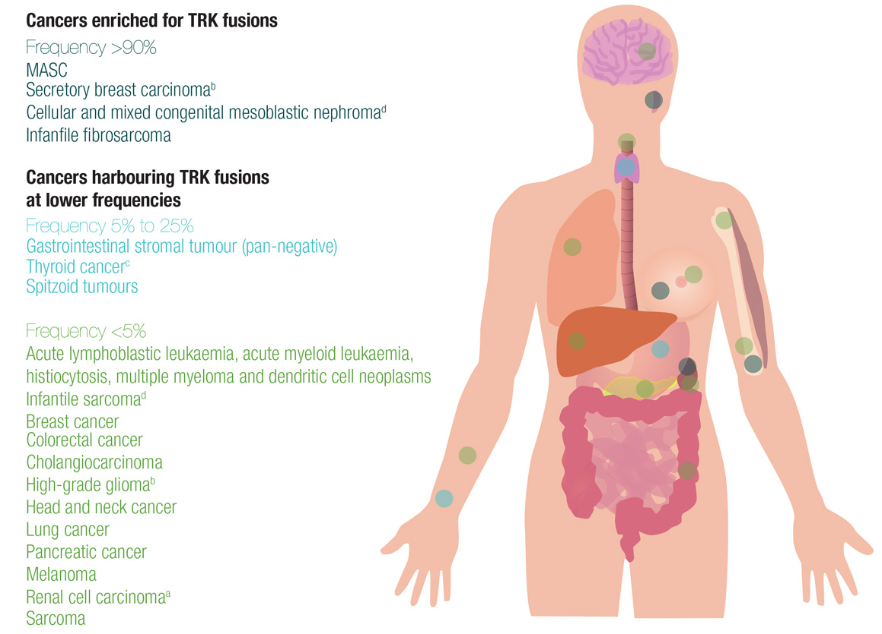
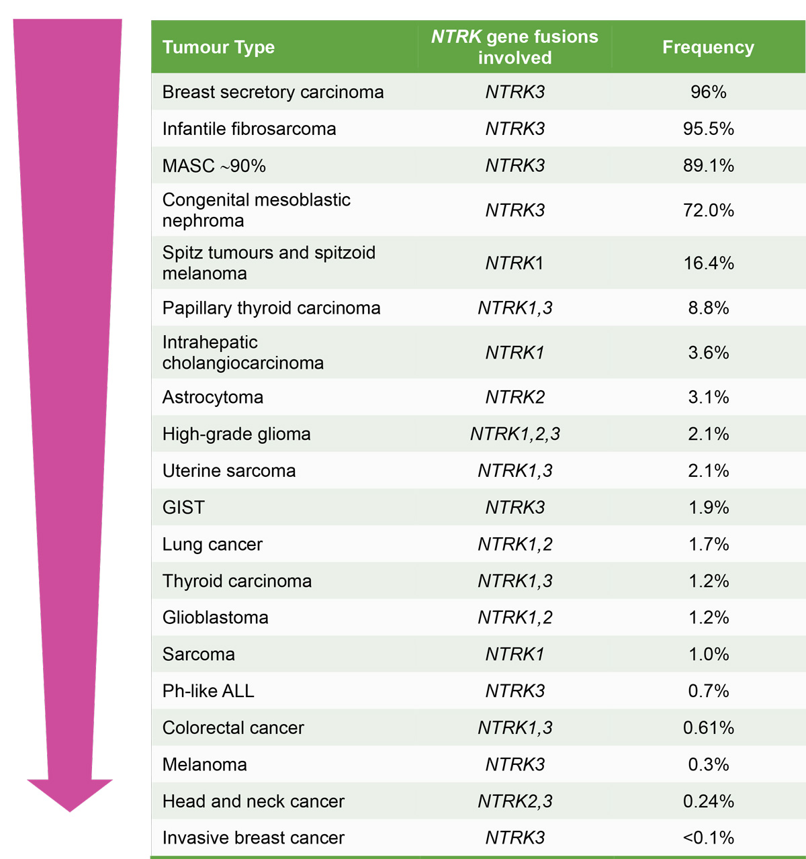
NTRK fusion prevalence among solid tumours INCLUDING GI TUMOURS
ª Found in adult cancers only, unless indicated; ^{b} found in adult and paediatric cases;
^{c} found in adult cases as thyroid cancer and papillary thyroid cancer in paediatric cases;
^{d} found in paediatric cases only
As reported by Chen and Chi (2018)¹
Source: ESMO oncologyPRO module provided by NTRK Connect
GI, gastrointestinal; GIST, gastrointestinal stromal tumours; MASC, mammary analogue secretory carcinoma; NTRK, neurotrophic receptor tyrosine kinase; Ph-like ALL, Philadelphia chromosome-like acute lymphoblastic leukaemia; TRK, tropomyosin receptor kinase
1. Chen Y and Chi P. J Hematol Oncol. 2018;11:78

Slide 6
NTRK fusion occurrence with other
GENOMIC alterations
Co-occurring biomarkers*, (%) | Cohort 1 (NTRK fusion) (N=29) | Cohort 2 (NTRK wild-type) (N=12,456)
TMB high (≥20 mut/mB) | 6 (20.7) | 657 (5.3)
TMB medium (<20, >5 mut/mB) | 3 (10.3) | 3239 (26.0)
MSI-H | 3/17** (17.6) | 94/7961 (1.2)
ALK rearrangement | 0 | 162 (1.3)
BRAF rearrangement | 1 (3.4) | 820 (6.6)
ERBB2 rearrangement | 0 | 470 (3.8)
EGFR rearrangement | 1 (3.4) | 962 (7.7)
ROS1 rearrangement | 0 | 90 (.07)
KRAS rearrangement | 3 (10.3) | 4836 (38.8)
Retrospective study of Flatiron Health‑Foundation Medicine Clinico-Genomic Database (CGDB) who had next-generation sequencing (NGS) between Jan 2011 and July 2018
Evaluable sample: 15,971 of 33,398 patients in the CGDB had one of 18 histologies where at least one NTRK fusion patient was identified
NTRK gene fusions identified in 29 patients
* Variants of “known” or “likely” functional status were included
** MSI status missing for 12 patients
Co-occurrence of the biomarkers ALK, BRAF, ERBB2, EGFR, ROS1, or KRAS = uncommon
What about MSI-H and tumour mutation burden high (TMB-H) tumours?
ALK, anaplastic lymphoma kinase; BRAF, serine/threonine-kinase B-Raf/proto-oncogene B-Raf; EGFR, epidermal growth factor receptor; NTRK, neurotrophic receptor tyrosine kinase; MSI-H, microsatellite instability high; mut/mB, mutations per megabase; TMB, tumour mutation burden
Jiao X. et al. Ann Oncol. 2019;30 (Suppl_5):v-25-v54

Slide 7
NTRK fusions in the molecular segmentation of CRC¹
CRC has significant molecular heterogeneity
NTRK gene rearrangements are known to be enriched in certain CRC subpopulations, in particular microsatellite instability status
Molecular heterogeneity in metastatic CRC
2006
2008
2013
2020
Laurent-Puig, et al. Cancer Res. 2006
Benvenuti, et al. Cancer Res. 2007
Di Nicolantonio, et al. J Clin Oncol. 2008
Douillard, et al. N Eng J Med. 2013
Misale, et al. Cancer Discov. 2014
Aisner, et al. Mol Cancer Res. 2014
Valtorta, et al. Mod Pathol. 2015
Amatu, et al. Br J Cancer. 2015
Sartore Bianchi, et al. J Natl Cancer Inst. 2015
Sartore Bianchi, et al. Lancet Oncol. 2016
Adapted from Sartore-Bianchi A and Siena S¹
ALK, anaplastic lymphoma kinase; Amp, amplification; BRAF, serine/threonine-kinase B-Raf/proto-oncogene B-Raf; CRC, colorectal cancer; ex, exon; fus, fusion; NTRK, neurotrophic receptor tyrosine kinase
1. Sartore-Bianchi A and Siena S. Handb Exp Pharmacol 2018;249:145-69

Slide 8
prevalence of TARGETABLE FUSIONS IN
COLON CANCER
Around 21,000 CRC tissue specimens characterized by Foundation Gene panels
18,107 patients tested for microsatellite instability (MSI) (4.5% of MSI CRC tumours)
KINASE | N (%) 18,107 | % MSI
ALK | 17 (0.09%) | 14.3%
BRAF | 23 (0.12%) | 16.7%
FGFR2 | 4 (0.02%) | 75%
NTRK1 | 26 (0.14%) | 84.6%
NTRK3 | 3 (0.0016%) | 100%
RET | 28 (0.15%) | 50%
TOTAL | 101 (0.5% | 46%
MSI-H enriched with NTRK gene fusions
ALK, anaplastic lymphoma kinase; BRAF, serine/threonine-kinase B-Raf/proto-oncogene B-Raf; CRC, colorectal cancer; FGFR2, fibroblast growth factor receptor 2; MSI-H, microsatellite instability high; NTRK, neurotrophic receptor tyrosine kinase
Source: Madison R. Ann Oncol. 2018;29 (Suppl_8):viii150-viii204

Slide 9
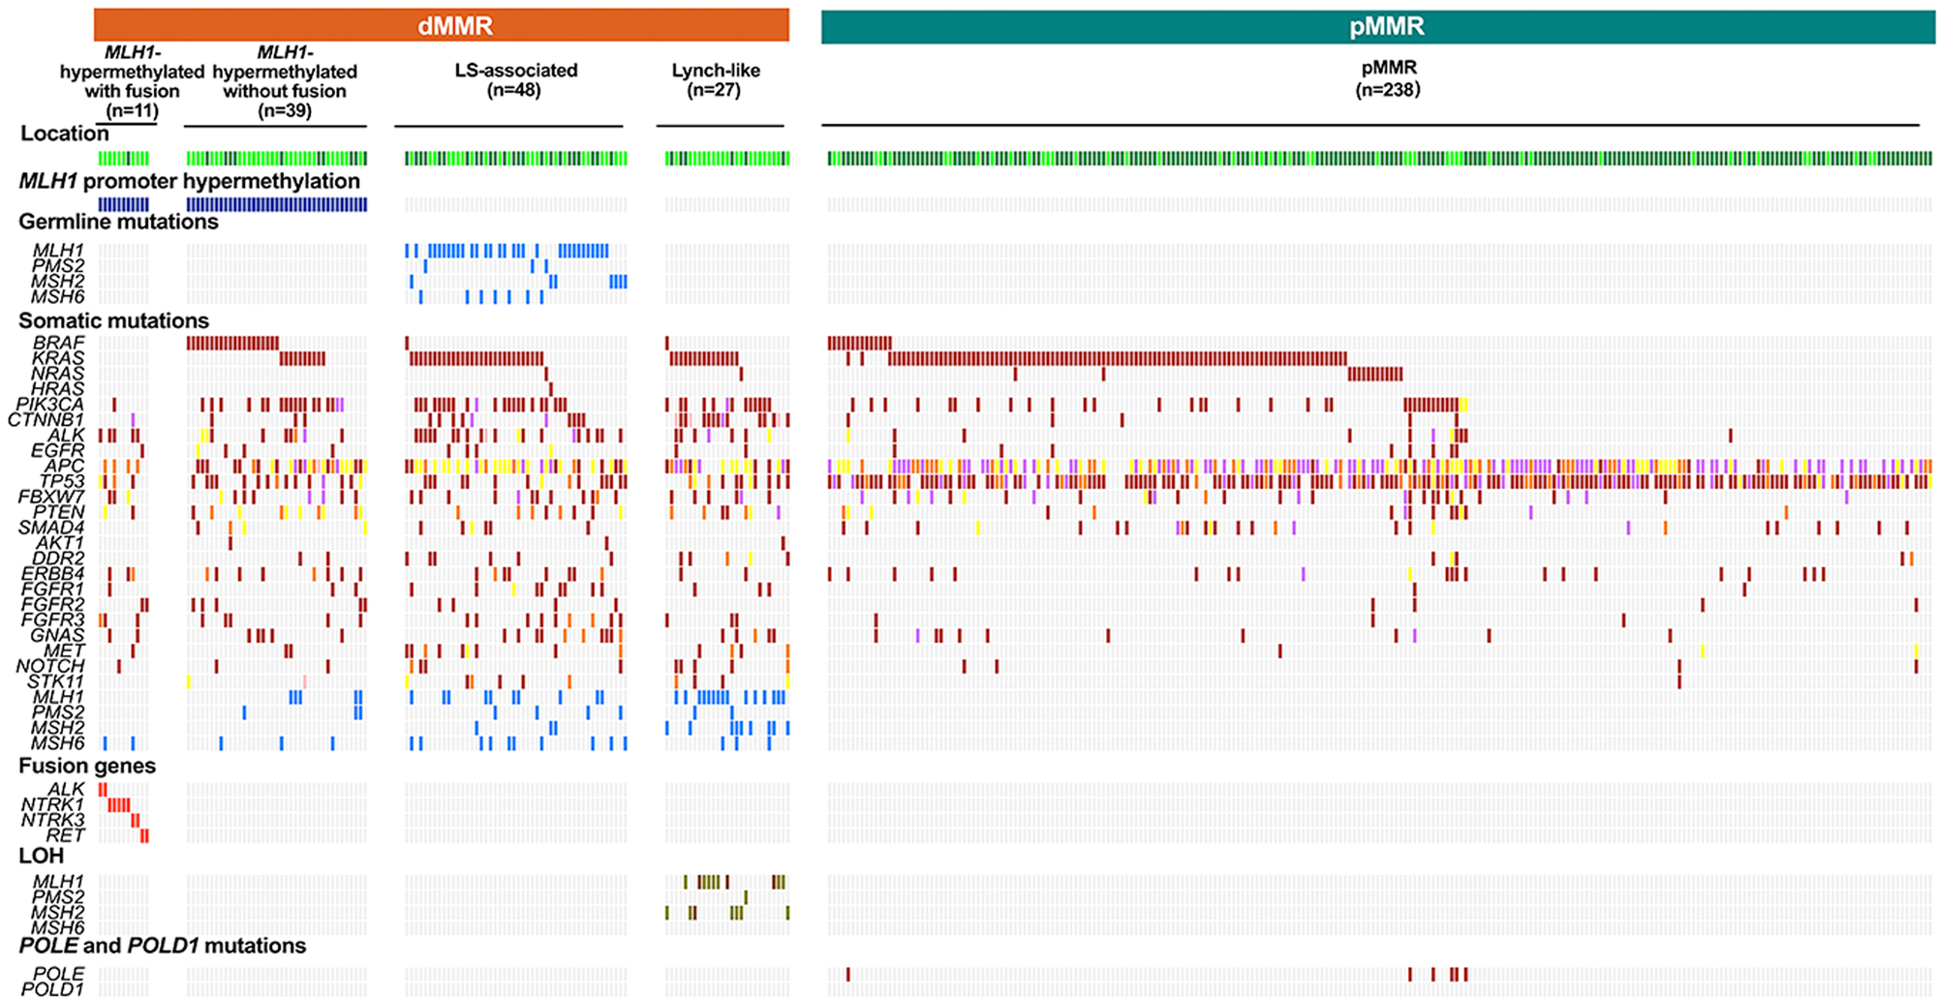
in dMMR CRC, gene fusions are enriched with MHL1 hypermethylation
NTRK gene fusions associated with MHL1 hypermethylation and mutually exclusive with BRAF and KRAS mutations
BRAF, serine/threonine-kinase B-Raf/proto-oncogene B-Raf; CRC, colorectal cancer; dMMR, deficient mismatch repair; LOH, loss of heterozygosity; LS, Lynch syndrome; MLH1, MutL homolog 1; pMMR, mismatch repair proficient
Source: Wang J, et al. Mod Pathol. 2019;32:1053-64

Slide 10
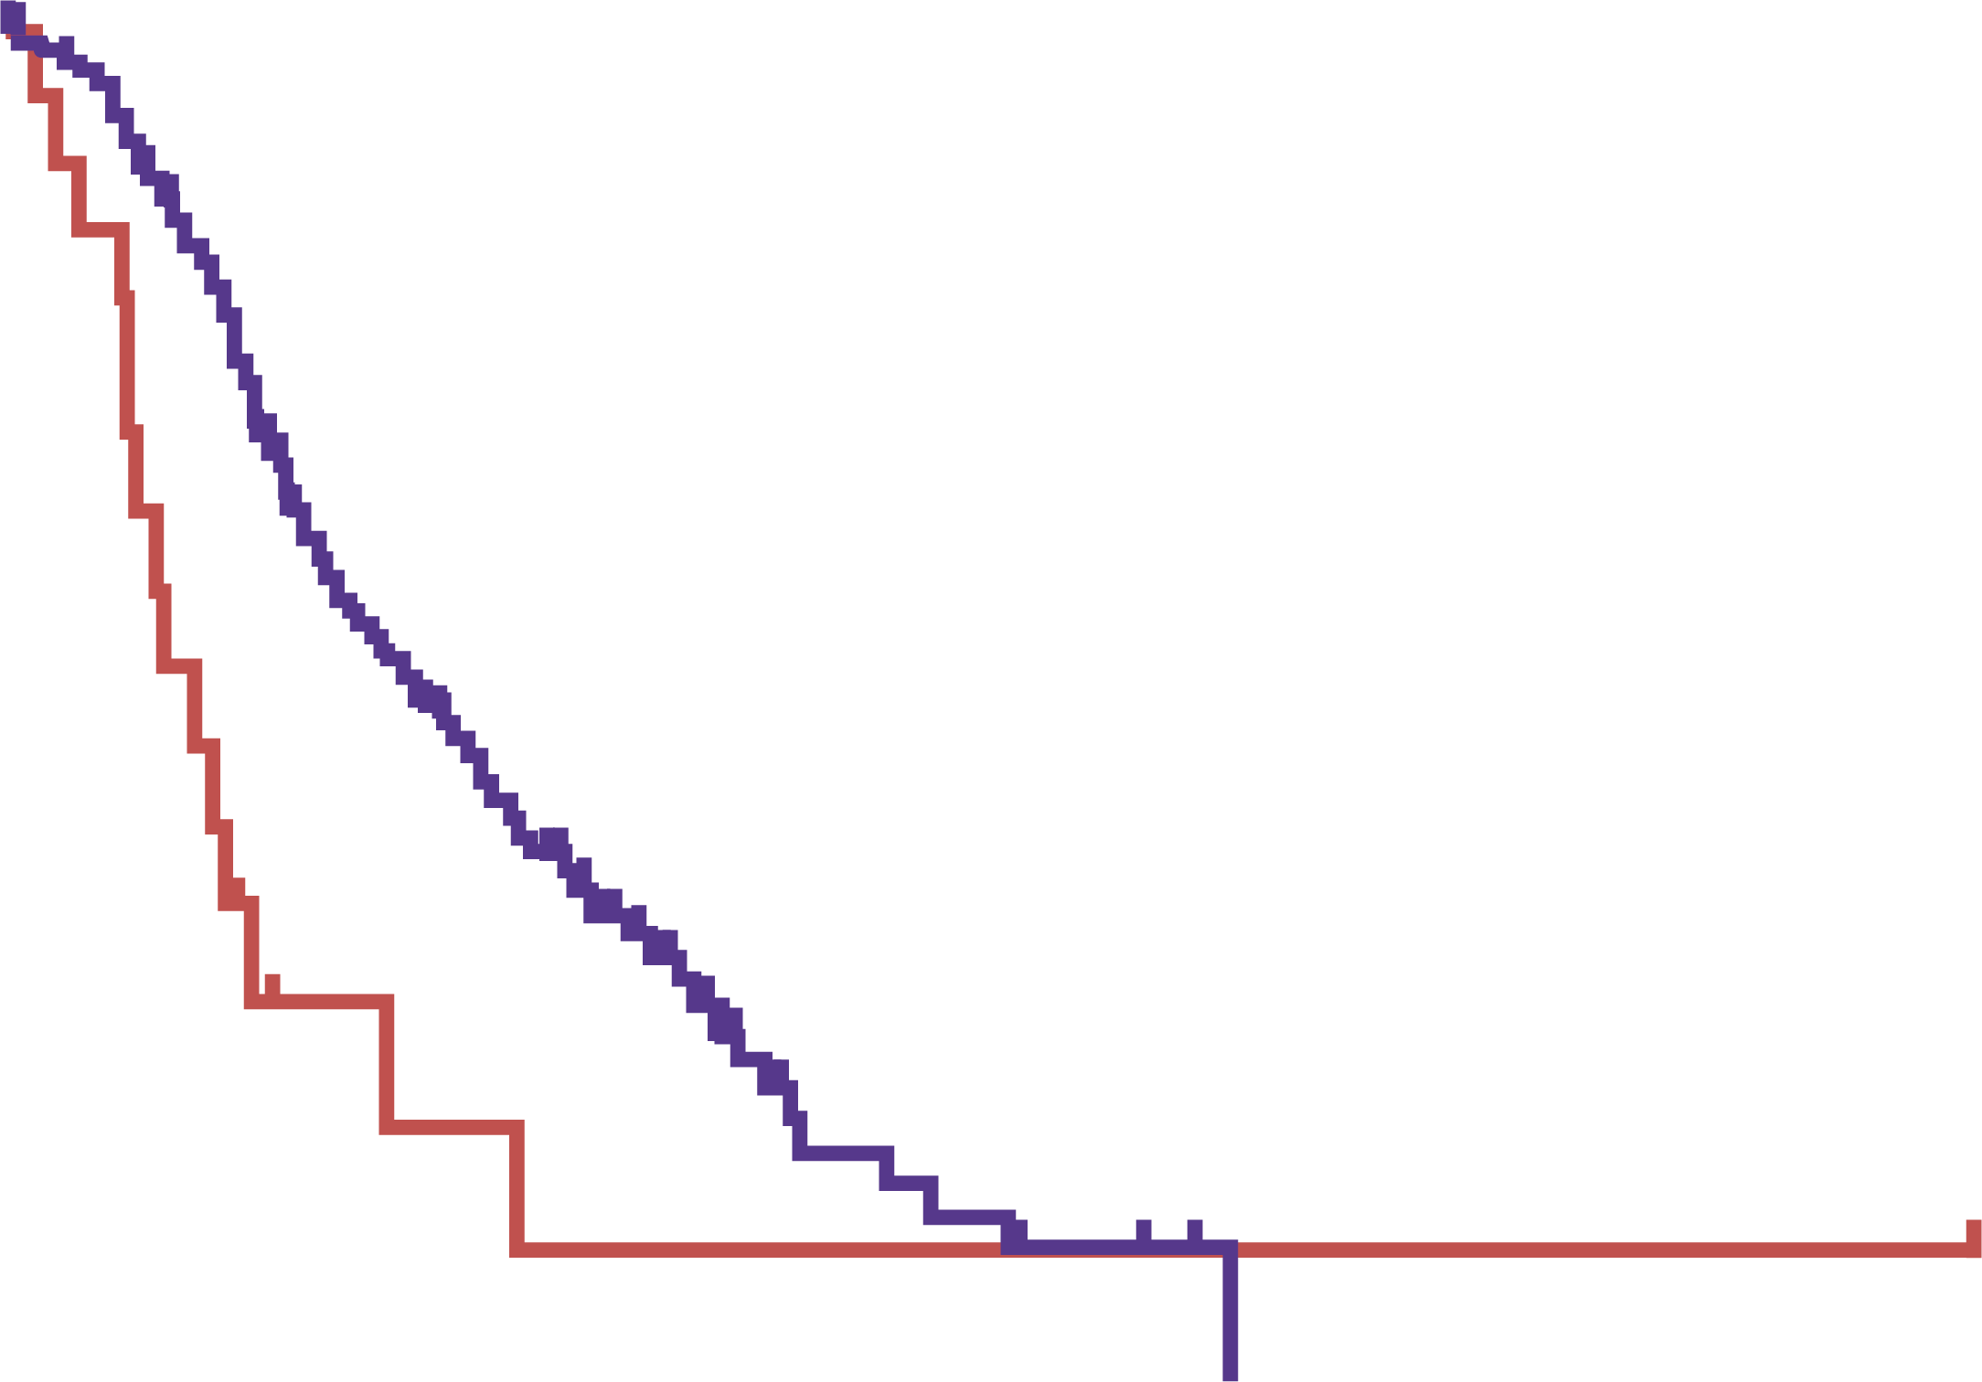
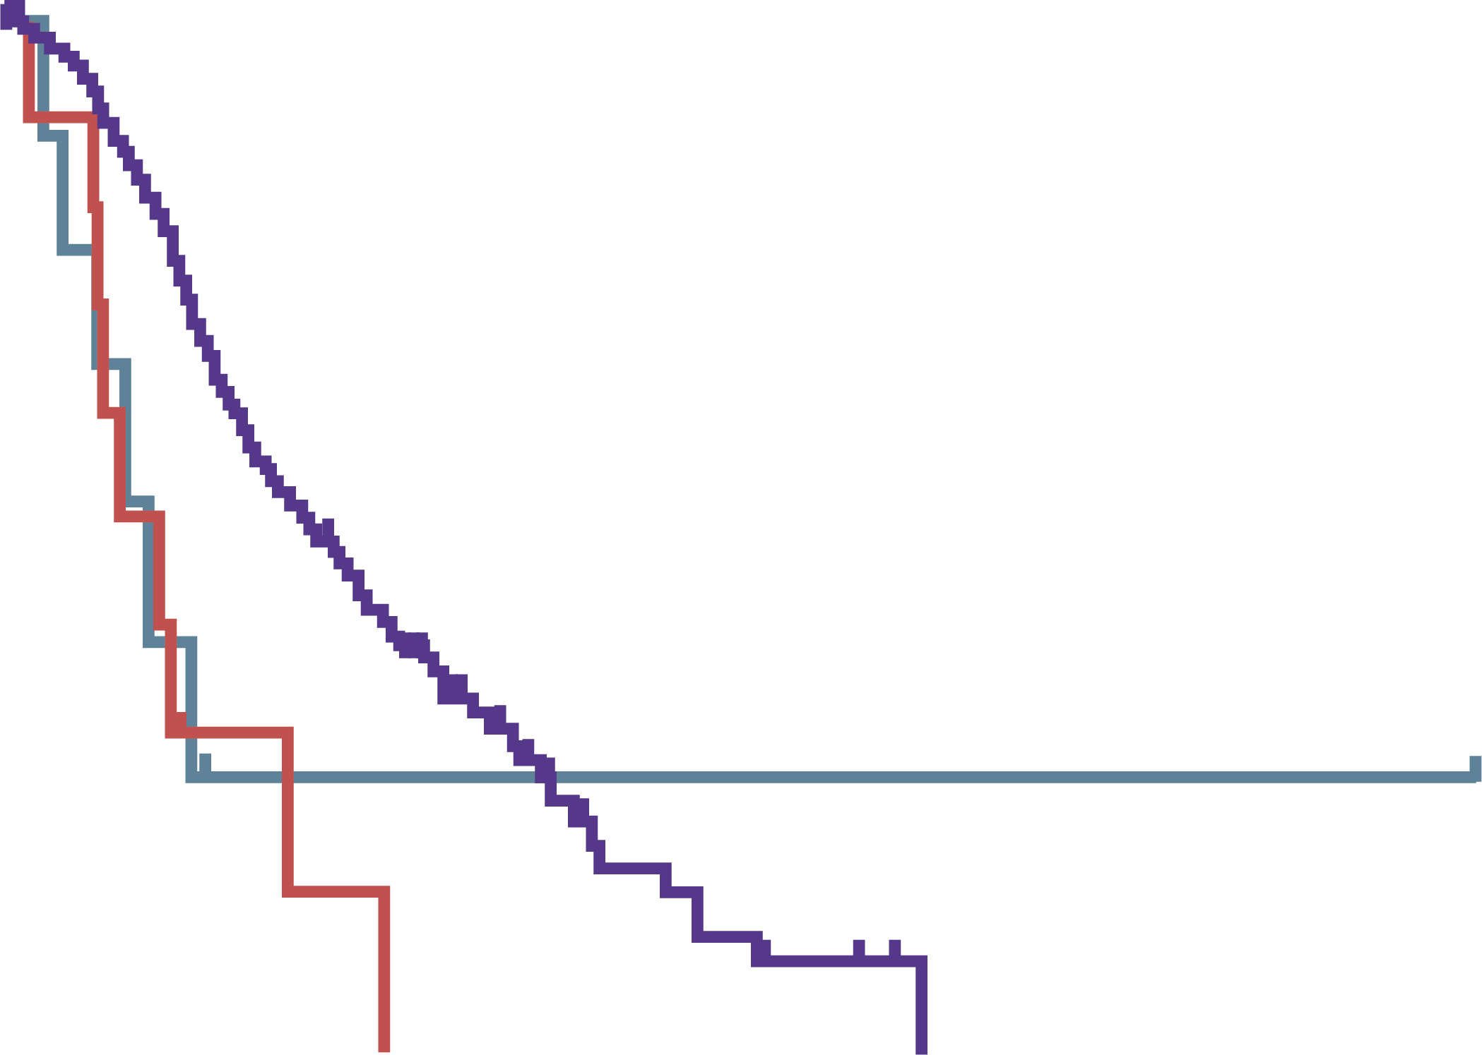
Prognostic significance of NTRK gene fusions in dMMR mCRC
Overall survival in CRC patients with ALK, ROS1, NTRK rearrangements (A) and according to deficient/proficient MMR status (B)
A
100
ALK, ROS, NTRK negative (No./died = 316/136)
ALK, ROS, NTRK rearranged (No./died = 20/15)
B
100
ALK, ROS, NTRK negative (No./died = 316/136)
ALK, ROS, NTRK rearranged and MMR proficient (No./died = 11/9)
ALK, ROS, NTRK rearranged and MMR deficient (No./died = 9/6)
Median follow-up: 28.5 mo
Median follow-up: 28.5 mo
75
75
ALK, ROS1, NTRK negative, median OS: 33.7 (95% CI: 28.3–42.1) mo
ALK, ROS1, NTRK rearranged and MMR proficient, median OS: 17.0 (95% CI: 10.0–31.4) mo
ALK, ROS1, NTRK rearranged and MMR deficient, median OS: 15.6 (95% CI: 10.0–20.4) mo
ALK, ROS1, NTRK negative, median OS: 33.7 (95% CI: 28.3–42.1) mo
ALK, ROS1, NTRK rearranged, median OS: 15.6 (95% CI: 0.0–20.4) mo
50
HR (95% CI): 2.17 (1.03–4.57)
p<0.001
50
ALK, ROS1, NTRK rearranged and MMR proficient vs MMR deficient:
HR (95% CI): 0.82 (0.29–2.30)
p<0.71
Survival (%)
Survival (%)
25
25
0
0
0
50
100
150
200
0
50
100
150
200
Time (months)
Time (months)
Negative
Rearranged
316
20
24
2
2
1
1
1
0
0
Negative
Rearr. MMR proficient
Rearr. MMR deficient
316
11
9
24
0
2
2
0
1
1
0
1
0
0
0
could NTRK gene fusions be a prognostic biomarker in dMMR mCRC?
ALK, anaplastic lymphoma kinase; CI, confidence interval; dMMR, deficient mismatch repair; HR, hazard ratio; mCRC, metastatic colorectal cancer; MMR, mismatch repair; mo, months; NTRK, neurotrophic receptor tyrosine kinase; OS, overall survival
Source: Pietrantonio F, et al. J Natl Cancer Inst. 2017; 109(12). doi: 10.1093/jnci/djx089

Slide 11
TRK inhibitors: Entrectinib efficacy and safety in NTRK fusion positive GI tumours
Entrectinib = potent inhibitor of TRK, ROS1 and ALK tyrosine kinase
ALKA-372-001: Phase 1
Solid tumours
EudraCT 2012-000148-88
STARTRK-1: Phase 1/2
Solid tumours
NCT02097810
STARTRK-2: Phase 2
Solid tumours
NCT02568267
Efficacy
Safety profile
 | Total (n=74) | GI tumours (n=12)
BICR ORR, % | 63.5 | 50.0
mPFS, month | 11.2 | 7.1
mOS, month | 23.9 | 16.0
mDoR, month | 12.9 | 12.9
58.7% TRAE: grade 1-2
Dysgeusia (39.7%), fatigue (31.5%), dizziness (27.2%) and constipation (24.0%)
TRAEs led to dose discontinuation in 24.6% of patients, interruptions in 27.0% and discontinuations in 4.6%
ALK, anaplastic lymphoma kinase; BICR, blinded independent central review; GI, gastrointestinal; mDoR, median duration of response; mOS, median overall survival; mPFS, median progression-free survival; NTRK, neurotrophic receptor tyrosine kinase; ORR, overall response rate; TRAE, treatment-related adverse event; TRK, tropomyosin receptor kinase
Source: Patel M, et al. Ann Oncol. 2020;31 (suppl_3):232-3

Slide 12
TRK inhibitors: larotrectinib efficacy and safety in NTRK fusion positive GI tumours
larotrectinib = potent TRK specific inhibitor
Adults patients with
advanced solid tumours harbouring NTRK fusions
Phase 1 (NCT02122913)
Paediatric patients with
advanced solid tumours harbouring NTRK fusions
Phase 1/2 SCOUT (NCT02637687)
Adult/adolescent patients with advanced solid tumours
harbouring NTRK fusions
Phase 2 NAVIGATE (NCT02576431)
Until
Larotrectinib 100 mg BID in continuing 28-days cycles
From March 2015 - February 2019
  159 patients with TRK fusion cancer were enrolled across those three clinical trials
  14/159 (8.8%) had TRK fusion GI cancer:
  colon (8), cholangiocarcinoma (2), pancreas (2), appendix (1), and hepatic (1)
Efficacy
Safety profile
mTTR: 1.8 months (range 1.7-2.1)
mPFS: 5.3 months (95% CI 2.2–9.0)
mOS: 33.4 months (95% CI 2.8–36.5)
7/8 patients with colon cancers were MSI-H
Larotrectinib was well tolerated
One patient with TRAE grade 3-4 (grade 3: nausea)
No TRAEs leading to dose reduction or discontinuation or death
BID, twice a day; GI, gastrointestinal; mOS, median overall survival; mPFS, median progression-free survival; MSI-H, microsatellite instability high; mTTR, median time to response; NTRK, neurotrophic receptor tyrosine kinase; TRAE, treatment-related adverse event; TRK, tropomyosin receptor kinase
Source: Berlin J, et al. J Clin Oncol 38 (no. 4_suppl):824-824

Slide 13
ConclusioNS
Discussion
NTRK gene fusions are rare in GI tumours but can represent an impactful therapeutic option
High likelihood of occurrence of NTRK gene fusions in tumours with MSI-H, TMB-H and MHL1 hypermethylation has been demonstrated in colorectal cancer, it is therefore important to look for this therapeutic target at least in this subset of patients
We now have focused subgroup analyses of pivotal trials with TRK inhibitors demonstrating efficacy and safety of larotrectinib and entrectinib, the two approved and available TRK inhibitors, in patients with GI tumours including colorectal, pancreatic and biliary tract histology
It should be further investigated how to improve selection of patients with GI tumours to test for NTRK fusions in the lab and what are the best strategies to prevent/overcome acquired resistance to TRK inhibitors in the clinic
GI, gastrointestinal; mCRC, metastatic colorectal cancer; MSI-H, microsatellite instability high; NTRK, neurotrophic receptor tyrosine kinase;
TMB-H, tumour mutation burden high; TRK, tropomyosin receptor kinase

Slide 14
REACH NTRK CONNECT VIA
TWITTER, LINKEDIN, VIMEO & EMAIL
OR VISIT THE GROUP’S WEBSITE http://www.ntrkconnect.info
Follow us on Twitter
@ntrkconnectinfo
Follow the
NTRK CONNECT
group on LinkedIn
Watch us on the
Vimeo Channel
NTRK CONNECT
Email
froukje.sosef
@cor2ed.com

