Slide 2
meeting summary
ASCo and EHA 2021, VIRTUAL MEETINGS
Multiple Myeloma
Dr. Hans Lee, MD
University of Texas, MD Anderson Cancer Center
Houston, TX, USA
HIGHLIGHTS FROM LYMPHOMA & MYELOMA CONNECT
JUNE 2021
Notes:
2
PHENOTYPE OF WM B-LYMPHOCYTE

Slide 3
Conflict of Interest and Funding
This LYMPHOMA & MYELOMA CONNECT programme is supported through an independent educational grant from Karyopharm Therapeutics. The programme is therefore independent, the content is not influenced by the supporters and is under the sole responsibility of the experts.
Please note: The views expressed within this presentation are the personal opinions of the authors.
They do not necessarily represent the views of the author’s academic institution, or the rest of the LYMPHOMA & MYELOMA CONNECT group.
Dr. Hans Lee has received financial support/sponsorship for research support or consultation from the following companies:
Amgen, Bristol Myers Squibb, and Celgene, Genentech, GlaxoSmithKline, Immunitis, Janssen, Karyopharm, Oncopeptides, Regeneron, Sanofi and Takeda

Slide 4
OS RESULTS WITH DARATUMUMAB, LENALIDOMIDE, AND DEXAMETHASONE
VERSUS LENALIDOMIDE AND DEXAMETHASONE IN TRANSPLANT-INELIGIBLE NDMM:
PHASE 3 MAIA STUDY
Facon T, et al.
EHA 2021. Abstract #LB1901. Oral presentation
NDMM, newly diagnosed multiple myeloma; OS, overall survival

Slide 5
study design
MAIA: a multicentre, randomised, open-label phase 3 study
D-Rd versus Rd alone in transplant-ineligible patients with NDMM
>40% of patients in each arm was ≥75 years of age (median age 73-74 years)
Updated results from a prespecified interim OS analysis, after a median follow-up of 56 months
Key eligibility criteria:
TIE NDMM
ECOG PS score 0-2
CrCl ≥30 mL/min
D-Rd
D: 16 mg/kg IV
QW Cycles 1-2, Q2W Cycles 3-6,
then Q4W thereafter until PD
R: 25 mg PO
Days 1-21 until PD
dª: 40 mg^{b} PO or IV
Days 1, 8, 15, 22 until PD
End-of treatment visit
(30 days after last dose)
Long-term follow-up
Primary endpoint:
PFS
Key secondary endpoints:
OS
PFS2
ORR
CR/sCR rate
MRD (NGS; 10⁻⁵)
1:1 randomisation
Rd
R: 25 mg PO Days 1-21 until PD
d: 40 mg PO
Days 1, 8, 15, 22 until PD
Cycles: 28 days
ªOn days when daratumumab is administered, dexamethasone will be administered to patients in the D-Rd arm and will serve as the treatment dose of steroid for that day, as well as the required pre-infusion medication; ^{b}For patients >75 years of age or with BMI <18.5 kg/m², dexamethasone was administered at a dose of 20 mg QW
BMI, body mass index; CR, complete response; CrCl, creatinine clearance; d, dexamethasone; D, daratumumab; ECOG PS, Eastern Cooperative Oncology Group performance status; IV, intravenous; MRD, minimal residual disease; NDMM, newly diagnosed multiple myeloma; NGS, next-generation sequencing; ORR, overall response rate; OS, overall survival; PD, progressive disease; PFS, progression-free survival; PO, oral; QW, once weekly; Q2W, once every 2 weeks; Q4W, once every 4 weeks; R, lenalidomide; sCR, stringent CR; TIE, transplant-ineligible. Facon T, et al. EHA 2021. Abstract #LB1901. Oral presentation

Slide 6
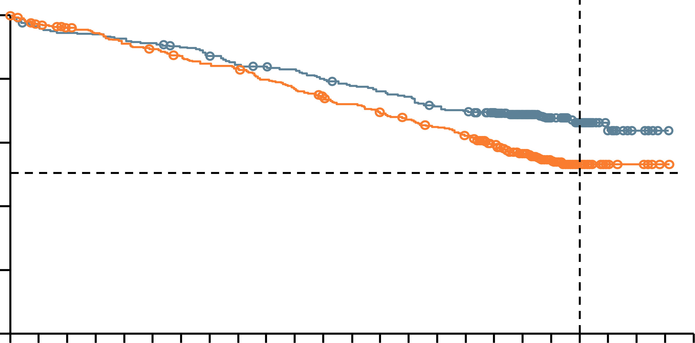
Results
Efficacy
D-Rd induced deeper responses compared with Rd
  After 56.2 months, ORR was 93% vs 82%
D-Rd continued to show a significant PFS benefit, with median PFS not reached with D-Rd
  After 60 months, the PFS rate was 52.5% vs 28.7%
After 5 years of follow up, a significant OS benefit is seen, with median OS not reached with D-Rd
  After 60 months, the OS rate was 66.3% vs 53.1%
Overall survival
60-month OS rate
100
80
66.3%
D-Rd:
median, NR
60
53.1%
Surviving (%)
Rd:
median, NR
40
20
HR, 0.68; 95% CI, 0.53-0.86;
P=0.0013
0
0
3
6
9
12
15
18
21
24
27
30
33
36
39
42
45
48
51
54
57
60
63
66
69
72
No. at risk
Rd
D-Rd
Months
369
368
351
350
343
346
336
344
324
338
317
334
308
328
300
316
294
305
281
302
270
297
258
286
251
280
241
273
232
266
223
255
213
249
183
228
134
170
85
118
42
63
14
22
5
6
1
1
0
0
Safety
Higher incidence of neutropenia (54% grade 3/4) and pneumonia (19% grade 3/4) in the D-Rd arm
  No new safety concerns were identified with longer follow up
CI, confidence interval; D, daratumumab; d, dexamethasone; HR, hazard ratio; NR, not reached; OS, overall survival; ORR, overall response rate; PFS, progression-free survival; R, lenalidomide
Facon T, et al. EHA 2021. Abstract #LB1901. Oral presentation

Slide 7
Clinical interpretation
New standard of care
Second study to show benefit
After the ALCYONE study showed the benefit of adding daratumumab to VMP, MAIA is the second study to show OS benefit with daratumumab in a frontline regimen in NDMM
D-Rd is a new standard of care in newly diagnosed transplant ineligible MM
MM, multiple myeloma; NDMM, newly diagnosed multiple myeloma; OS, overall survival; VMP, bortezomib, melphalan, and prednisone
Facon T, et al. EHA 2021. Abstract #LB1901. Oral presentation

Slide 8
Cilta-cel, A BCMA-directed CAR-T therapy, in R/R MM: Updated results from CARTITUDE-1
Usmani SZ, et al.
ASCO 2021. Abstract #8005. Oral presentation
EHA 2021. Abstract #EP964. Poster presentation
BCMA, B-cell maturation antigen; CAR-T, chimeric antigen receptor T-cell; cilta-cel, ciltacabtagene autoleucel; MM, multiple myeloma; R/R, relapsed/refractory

Slide 9
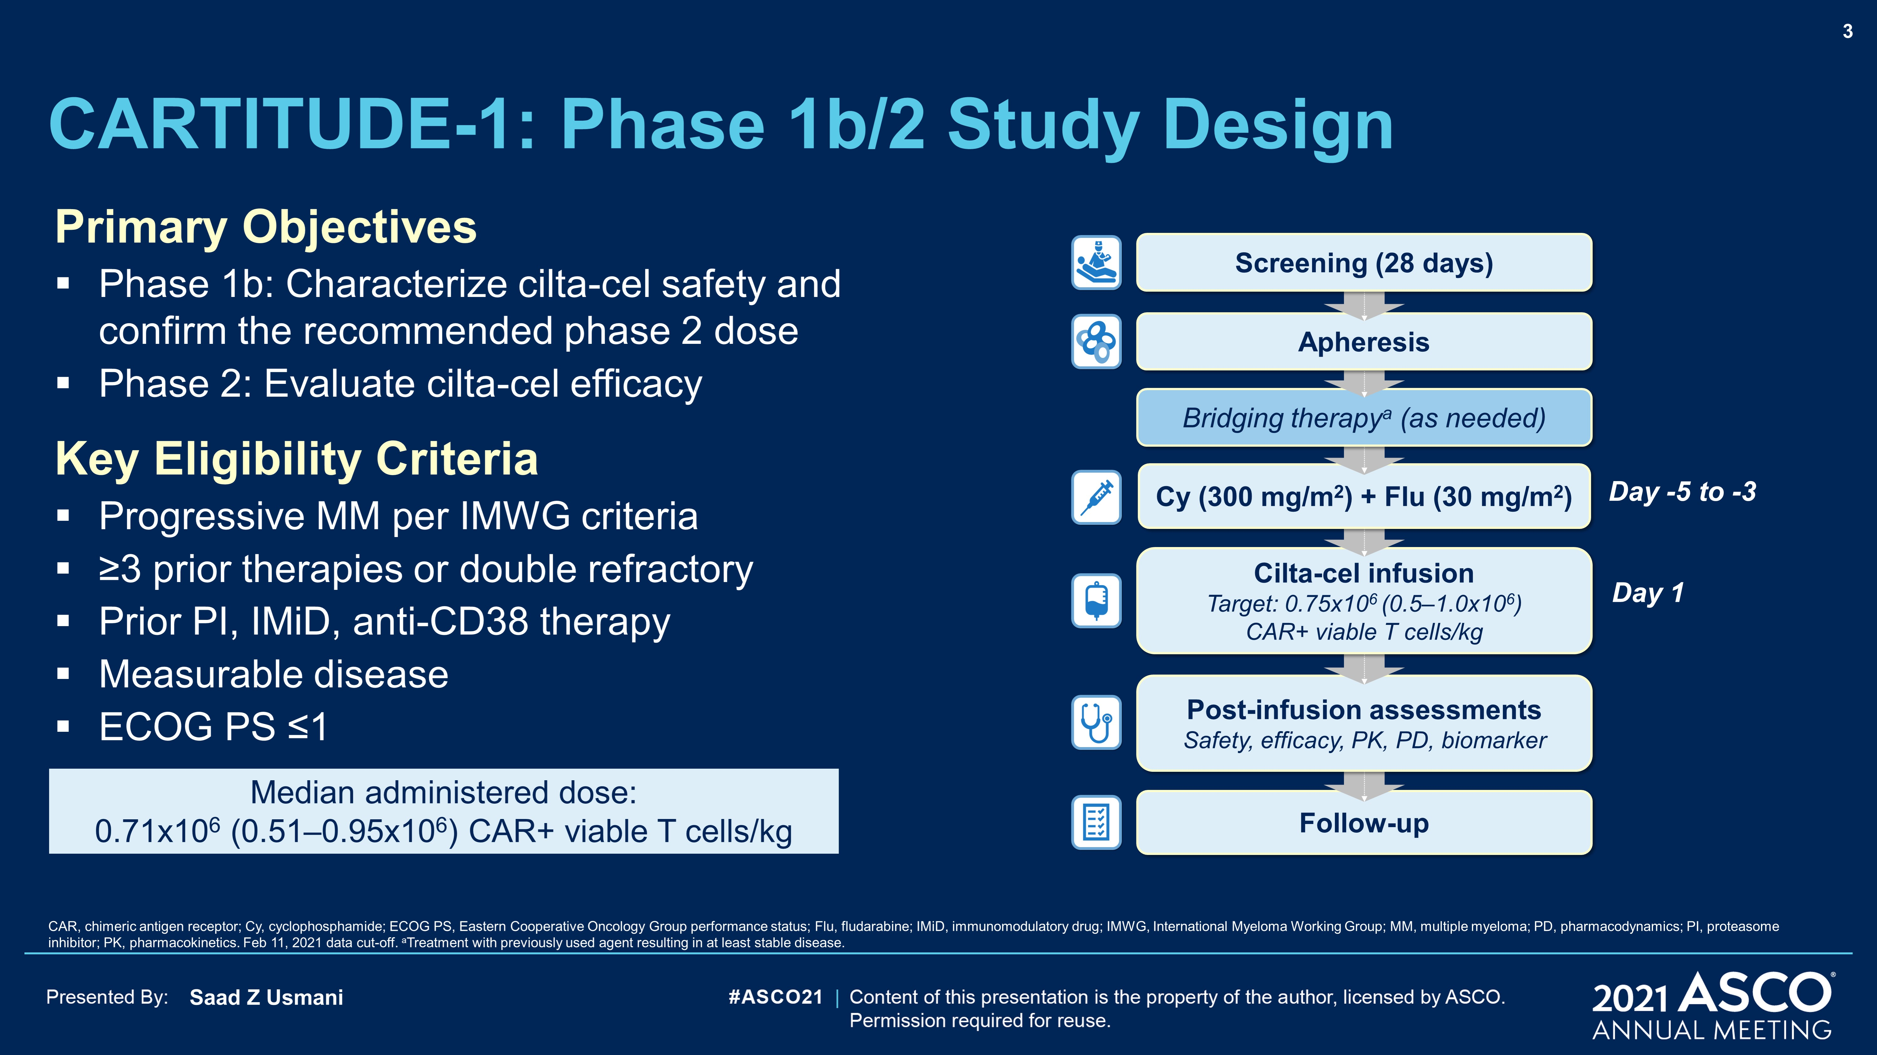
Background and study design
CARTITUDE-1: Phase 1b/2 study of cilta-cel in R/R MM
Ciltacabtagene autoleucel (cilta-cel) is a CAR-T cell therapy with two BCMA-targeting single-domain antibodies
CARTITUDE-1 primary objectives:
  Phase 1b: safety and RP2D
  Phase 2: efficacy
Results after median follow up of 18 months
Heavily pre-treated patients (N=97)
  Median of 6 prior lines of therapy (range 3-18)
  88% was triple-class refractory
  (refractory to IMiD, proteasome inhibitor,
  anti-CD38 monoclonal antibody)
Binding domains
Screening (28 days)
VHH
VHH
Apheresis
4-1BB
Bridging therapy (as needed)
CD3ζ
Cy (300 mg/m²) + Flu (30 mg/m²)
Day -5 to -3
Cilta-cel
Cilta-cel infusion
Target: 0.75 × 10⁶ (0.5-1.0 × 10⁶)
CAR+ viable T-cells/kg
Day 1
Post-infusion assessments
Safety, efficacy, PK, PD, biomarker
Follow up
BCMA, B-cell maturation antigen; CAR, chimeric antigen receptor; cilta-cel, ciltacabtagene autoleucel; Cy, cyclophosphamide; Flu, fludarabine; IMiD, immunomodulatory drug; MM, multiple myeloma; PD, pharmacodynamic; PK, pharmacokinetic; RP2D, recommended phase 2 dose; R/R, relapsed/refractory; VHH, variable heavy chain
Usmani SZ, et al. ASCO 2021. Abstract #8005. Oral presentation; Usmani SZ, et al. J Clin Oncol. 2021;39(suppl 15):8005-8005

Slide 10
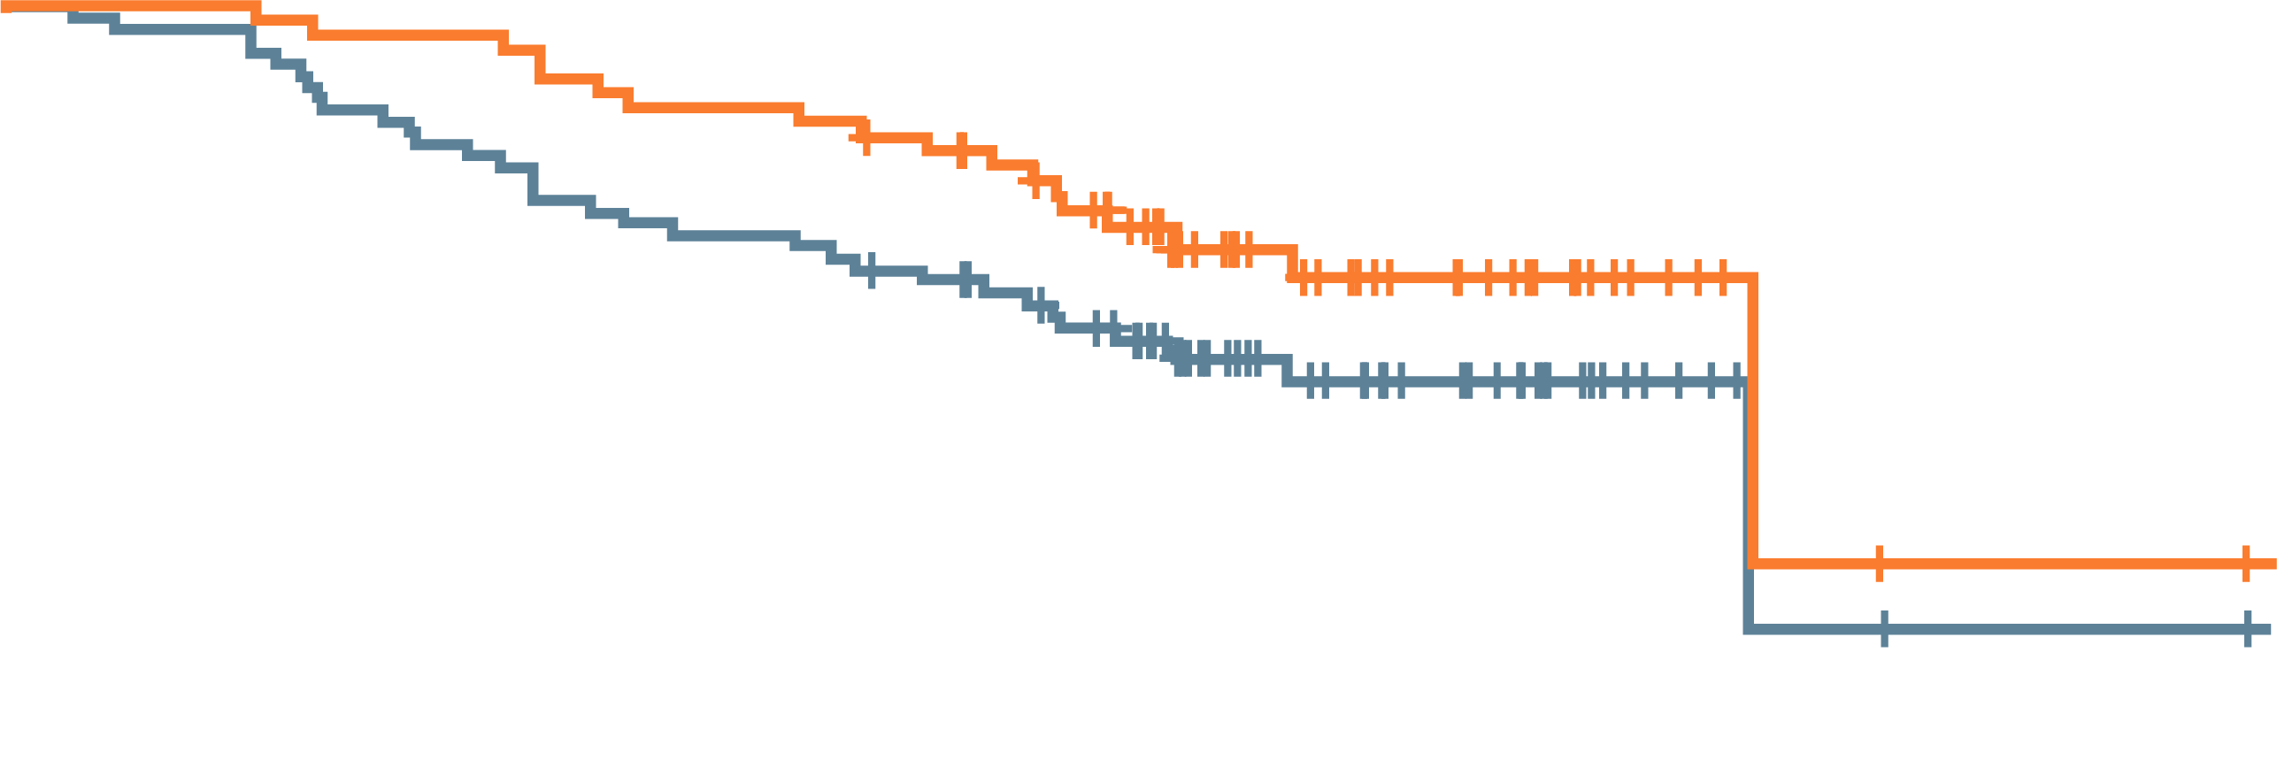
Results
Efficacy
Unprecedented ORR
and depth of response
  Median DoR
  21.8 months
66% 18-month PFS
81% 18-month OS
Response
PFS
ORR: 97.9%
100
90
80
70
Median:
Not reached
60
80.4%
sCR
Progression-free survival, patients (%)
50
Patients (%)
94.8%
≥VGPR
40
Median:
22.8 months
(95% CI, 22.8-NE)
30
20
All patients
sCR
10
0
0
3
6
9
12
15
18
21
24
27
30
No. at risk
All patients
Responders
with sCR
Time (months)
N=97
97
78
95
78
85
76
77
71
73
68
55
51
26
26
9
9
1
1
1
1
0
0
Best response
PR
VGPR
sCR
Safety
CRS occurred in 95% of patients (almost all grade 1/2)
Neurotoxicity occurred in 21% of patients (10% grade ≥3), including ICANS in 16.5% (2.1 grade ≥3)
CI, confidence interval; CRS, cytokine release syndrome; DoR, duration of response; ICANS, immune effector cell-associated neurotoxicity syndrome; NE, not estimable; ORR, overall response rate; OS, overall survival; PFS, progression-free survival; PR, partial response; sCR, stringent complete response; VGPR, very good PR
Usmani SZ, et al. ASCO 2021. Abstract #8005. Oral presentation; Usmani SZ, et al. J Clin Oncol. 2021;39(suppl 15):8005-8005

Slide 11
Authors’ conclusions and
Clinical interpretation
A single infusion of cilta-cel yielded early, deep, and durable responses in heavily pretreated patients with MM
Cilta-cel had a manageable safety profile at the RP2D
These cilta-cel data on a longer follow-up time continue to be very encouraging
Cilta-cel is undergoing review by FDA and EMA for regulatory approval
Cilta-cel, ciltacabtagene autoleucel; EMA, European Medicines Agency; FDA, Food and Drug Administration; MM, multiple myeloma; RP2D, recommended phase 2 dose
Usmani SZ, et al. ASCO 2021. Abstract #8005. Oral presentation; Usmani SZ, et al. J Clin Oncol. 2021;39(suppl 15):8005-8005

Slide 12
ide-cel (bb2121), a BCMA-directed
CAR-T cell therapy, in R/R MM:
Updated KarMMa results
Anderson LD, et al.
ASCO 2021. Abstract #8016. Poster presentation
BCMA, B-cell maturation antigen; CAR-T, chimeric antigen receptor T-cell; ide-cel, idecabtagene vicleucel; MM, multiple myeloma; R/R, relapsed/refractory

Slide 13
Background and study design
KarMMa: Phase 2 study of Ide-cel in R/R MM
Idecabtagene vicleucel (ide-cel) is a BCMA-directed CAR-T cell therapy approved by the FDA for
R/R MM after ≥4 lines of therapy, based on the KarMMa trial
At ASCO 2021, updated results after approx. 25 months of follow up were presented
Heavily pre-treated patients (N=128)
  Median of 6 prior lines of therapy
  (range 3-16)
  84% was triple-class refractory
  (refractory to IMiD, proteasome
  inhibitor, anti-CD38 monoclonal antibody)
ide-cel
manufacturing
(99% success rate)
1st response
assessment
(1 month)
R/R MM
≥3 prior regimens with
≥2 consecutive cycles each
(or best response of PD)
Previously exposed to:
  Immunomodulatory agent
  Proteasome inhibitor
  Anti-CD38 antibody
Refractory to last prior therapy
per IMWG
Leukapheresis
CAR-T infusion
Bridging
(≥14 days before lymphodepletion)
Flu (30 mg/m²)
Cy (300 mg/m²)
Days -5,-4,-3, 0
BCMA, B-cell maturation antigen; CAR-T, chimeric antigen receptor T-cell; Cy, cyclophosphamide; FDA, Food and Drug Administration; Flu, fludarabine; ide-cel, idecabtagene vicleucel; IMiD, immunomodulatory drug; IMWG, International Myeloma Working Group; MM, multiple myeloma; PD, progressive disease; R/R, relapsed/refractory
Anderson LD, et al. ASCO 2021. Abstract #8016. Poster presentation; Anderson LD, et al. J Clin Oncol. 2021;39(suppl 15):8016-8016

Slide 14
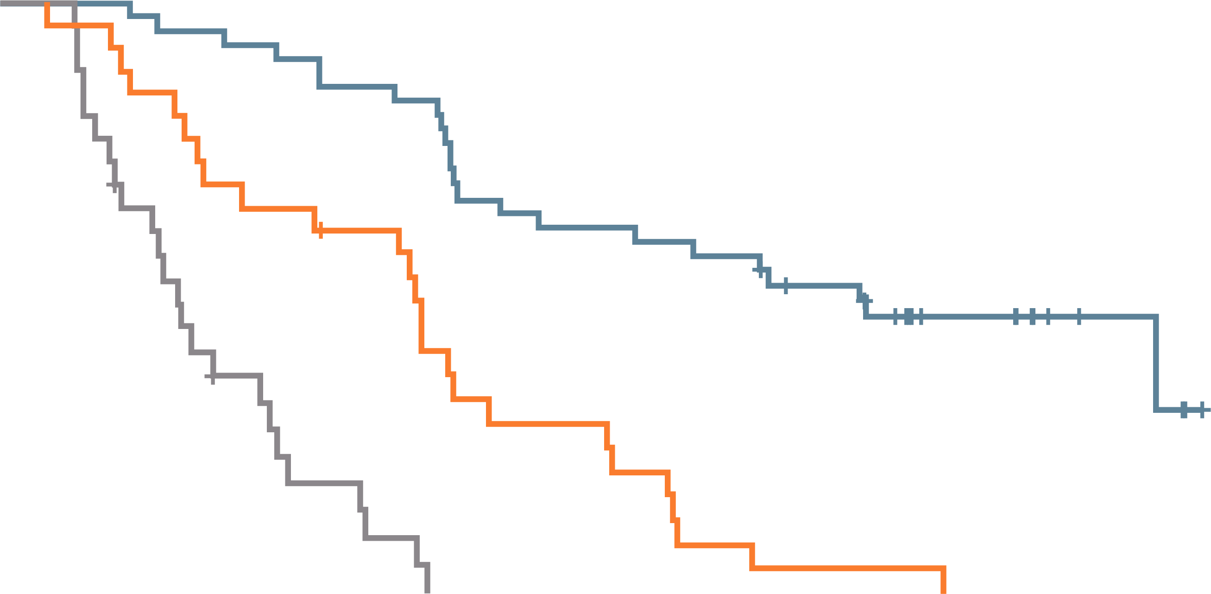
Results
Response
DoR
Efficacy
Unprecedented ORR and
depth of response
  Median DoR 10.9 months
Median PFS: 8.6 months
Median OS: 24.8 months
CR/sCR
VGPR
PR
1.0
 | Median (95% CI), months
≥ CR | 21.5 (12.5-NE)
VGPR | 10.4 (5.1-12.2)
PR | 4.5 (2.9-6.7)
0.8
ORR = 73%
0.6
Probability of DoR
CRR
33%
0.4
Response (%)
0.2
0
0
2
4
6
8
10
12
14
16
18
20
22
24
26
28
30
No. at risk
≥ CR
VGPR
PR
Time (months)
All ide-cel treated
(N=128)
42
26
26
42
25
23
40
22
14
39
18
8
36
16
4
35
15
2
28
8
0
26
7
0
25
5
0
24
2
0
20
1
0
17
1
0
10
0
0
6
0
0
3
0
0
0
Safety
CRS occurred in 84% of patients (78% grade 1/2) and neurotoxicity occurred in 18% of patients (4% grade 3)
The safety profile remained consistent with longer follow up
CI, confidence interval; CR, complete response; CRS, cytokine release syndrome; DoR, duration of response; NE, not estimable; ORR, overall response rate; OS, overall survival; PFS, progression-free survival; PR, partial response; sCR, stringent complete response; VGPR, very good PR
Anderson LD, et al. ASCO 2021. Abstract #8016. Poster presentation; Anderson LD, et al. J Clin Oncol. 2021;39(suppl 15):8016-8016

Slide 15
Clinical interpretation
BCMA CAR-T cell therapy with both ide-cel and cilta-cel shows very high ORR, DoR, and PFS compared with historic drug approvals in similarly heavily pre-treated myeloma patients
Ide-cel was FDA approved in March 2021 and EMA review is ongoing
BCMA, B-cell maturation antigen; CAR-T, chimeric antigen receptor T-cell; cilta-cel, ciltacabtagene autoleucel; DoR, duration of response; EMA, European Medicines Agency; FDA, Food and Drug Administration; ide-cel, idecabtagene vicleucel; MM, multiple myeloma; ORR, overall response rate; PFS, progression-free survival; R/R, relapsed/refractory
Anderson LD, et al. ASCO 2021. Abstract #8016. Poster presentation; Anderson LD, et al. J Clin Oncol. 2021;39(suppl 15):8016-8016

Slide 16
Subcutaneous daratumumab + VCd in patients with newly diagnosed AL amyloidosis: Updated results from the phase 3 ANDROMEDA study
Kastritis E, et al. ASCO 2021. Abstract #8003. Oral presentation
Kastritis E, et al. EHA 2021. Abstract #S189. Oral presentation
AL, light chain; VCD, bortezomib, cyclophosphamide, and dexamethasone

Slide 17
Background and study design
ANDROMEDA: Phase 3 study of daratumumab +/- VCD in AL Amyloidosis
Primary results from ANDROMEDA were presented at EHA 2020, at 11.4 months median follow-up
  Adding Dara to VCd led to significantly greater CR, VGPR rates, more rapid haematologic responses and improved organ responses at 6 months
  Led Dara-VCd to become the first FDA approved therapy for newly diagnosed AL amyloidosis; in June 2021 it was approved by EMA
At ASCO and EHA 2021, updated results after 20.3 months of follow up were presented
Treatment phase
Post-treatment phase
Key eligibility criteria:
AL amyloidosis with ≥1
organ impacted
No prior therapy for AL amyloidosis or MM
Cardiac stage I-IIIA
(Mayo 2004)
Estimated glomerular filtration rate ≥20 mL/min
DARA SC 1800 mg QW
Cycles 1-2 Q2W Cycles 3-6
+ VCd QW × 6 cycles
N=195
DARA SC 1800 mg Q4W
until major organ
deterioration–PFS or
maximum of
24 total cycles
Observation until major organ deterioration–PFS
(if DARA SC discontinued
prior to major organ
deterioration–PFS)
Screening (Day -28)
1:1 randomisation (N=388)
VCd
QW × 6 cycles
N=193
Observation until
major organ
deterioration–PFS
AL, light chain; CR, complete response; Dara, daratumumab; FDA, Food and Drug Administration; Mayo 2004, Mayo 2004 cardiac staging system; MM, multiple myeloma; PFS, progression-free survival; QW, once weekly; Q2W, once every 2 weeks; Q4W, once every 4 weeks; SC, subcutaneous; VCd, bortezomib, cyclophosphamide, and dexamethasone; VGPR, very good partial response
Kastritis E, et al. ASCO 2021. Abstract #8003. Oral presentation; Kastritis E, et al. J Clin Oncol. 2021;39(suppl 15):8003-8003; Kastritis E, et al. EHA 2021. Abstract #S189. Oral presentation; Kastritis E, et al. EHA 2020. Abstract #LB2604. Oral presentation

Slide 18
Results
Efficacy
Adding Dara to VCd increased the haematologic CR rate from 19% to 59%
  Benefit seen across all subgroups, including patients with cardiac AL amyloidosis
12-month cardiac and renal responses doubled with Dara + VCd vs VCd
  12-month cardiac response: 57% vs 28%
  12-month renal response: 57% vs 27%
Hematologic CR at a median
follow-up of 20.3 months
Odds ratio 5.9
95% CI 3.7-9.4; P<0.0001
Haematologic CR (%)
Safety
The safety profile remained consistent with longer follow up
In the Dara-VCd group from cycle 7 (Dara monotherapy) grade 3-4 TEAEs occurred in <5% of patients
CI, confidence interval; CR, complete response; D, daratumumab; Dara, daratumumab; VCd, bortezomib, cyclophosphamide, and dexamethasone; TEAE, treatment-emergent adverse event
Kastritis E, et al. ASCO 2021. Abstract #8003. Oral presentation; Kastritis E, et al. J Clin Oncol. 2021;39(suppl 15):8003-8003; Kastritis E, et al. EHA 2021. Abstract #S189. Oral presentation

Slide 19
Clinical interpretation
In January 2021, SC datatumumab + VCd was approved by FDA for newly diagnosed AL amyloidosis
In June 2021 it was approved by EMA
Daratumumab + VCd is a new standard
of care for newly diagnosed
AL amyloidosis patients
AL, light chain; EMA, European Medicines Agency; FDA, Food and Drug Administration; SC, subcutaneous; VCd, bortezomib, cyclophosphamide, and dexamethasone
Kastritis E, et al. ASCO 2021. Abstract #8003. Oral presentation; Kastritis E, et al. J Clin Oncol. 2021;39(suppl 15):8003-8003; Kastritis E, et al. EHA 2021. Abstract #S189. Oral presentation

Slide 20
REACH LYMPHOMA & MYELOMA CONNECT
VIA TWITTER, LINKEDIN, VIMEO & EMAIL
OR VISIT THE GROUP’S WEBSITE http://www.lymphomaconnect.info
Follow us on Twitter
@LYM_MM_CONNECT
Follow the
LYMPHOMA & MYELOMA CONNECT
group on LinkedIn
Watch us on the
Vimeo Channel
LYMPHOMA & MYELOMA CONNECT
Email
froukje.sosef
@cor2ed.com

