Slide 2
Adherence to guideline directed medical therapy (GDMT): post acute coronary syndrome (ACS)
Prof. Dr. Jeanine Roeters van Lennep, MD
Erasmus University, Rotterdam, Netherlands

Slide 3
Disclaimer and disclosures
Please note: The views expressed within this presentation are the personal opinions of the authors.
They do not necessarily represent the views of the author’s academic institution, or the rest of the CORONARY CONNECT group.
These slides are adapted from the virtual ACS Forum event which was held in December 2020.
The ACS Forum and this content are supported by an Independent Educational Grant from Amgen.
Prof. Dr. Jeanine Roeters van Lennep, MD has received financial support/sponsorship for research support, consultation or speaker fees from the following companies:
Amryt Pharma

Slide 4
INTRODUCTION
Current ESC guidelines recommend five categories of guideline-directed medical therapy (GDMT) for patients following an acute coronary syndrome (ACS) event¹
Despite established benefits of such treatments, registry studies reveal substantial underutilization of and nonadherence to prescriptions in a real-world clinical setting²
Durable intervention strategies are required to address gaps in prescription and adherence of GDMT in order to maximise reduction of cardiovascular risk
ESC, European Society of Cardiology
1. Collet J-P, et al. Eur Heart J. 2020. DOI: 10.1093/eurheartj/ehaa575; 2. Ge Z, et al. Catheter Cardiovasc Interv. 2019;93:E112-9

Slide 5
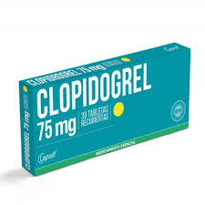
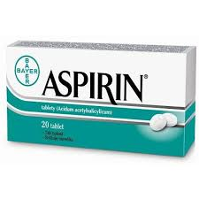
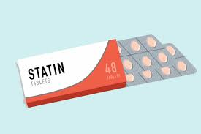
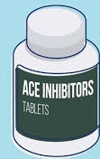
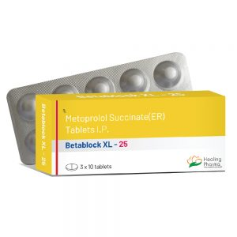
“The Big 5”: ESC Guidelines
Recommendations | Classª | Level^{b}
In patients with NSTE-ACS treated with coronary stent implantation, DAPT with a P2Y₁₂ receptor inhibitor on top of aspirin is recommended for 12 months unless there are contraindications such as excessive risk of bleeding | I | A
Lipid-lowering drugs
Statins are recommended in all NSTE-ACS patients. The aim is to reduce LDL-C by ≥50% from baseline to achieve LDL-C <1.4 mmol/L (<55 mg/dL) | I | A
ACE inhibitors or ARBs
ACE inhibitors (or ARBs in cases of intolerance to ACE inhibitors) are recommended in patients with heart failure with reduced LVEF (<40%), diabetes, or CKD unless contraindicated (e.g. severe renal impairment, hyperkalaemia, etc.) in order to reduce all-cause and cardiovascular mortality and cardiovascular morbidity | I | A
Beta-blockers
Beta-blockers are recommended in patients with systolic LV dysfunction or heart failure with reduced LVEF (<40%) | I | A
P2Y12
Inhibitors
“The Big 5”: ESC Guidelines
ARBs
Beta-blocker
ª Class of recommendation; ^{b} Level of evidence
ACE, angiotensin-converting enzyme; ARB, angiotensin-receptor blocker; CKD, chronic kidney disease; DAPT, dual antiplatelet therapy; ESC, European Society of Cardiology;
LDL-C, low density lipoprotein cholesterol; LV, left ventricular; LVEF, left ventricular ejection fraction; NSTE-ACS, non-ST-segment elevation acute coronary syndrome
Collet J-P, et al. Eur Heart J. 2020. DOI: 10.1093/eurheartj/ehaa575

Slide 6
GDMT: prescribing patterns
PROMETHEUS multicentre observational registry: 19,914 patients with acute coronary syndrome (ACS) undergoing percutaneous coronary intervention (PCI)
69.4%
~30% of patients not receiving GDMT post-ACS
Patients (%)
Percentage of GDMT at discharge in patients with AMIª
ª 4,834 patients with AMI were included in the analysis
ACE, angiotensin-converting enzyme; AMI, acute myocardial infarction; ARB, angiotensin-receptor blocker; GDMT, guideline-directed medical therapy
Ge Z, et al. Catheter Cardiovasc Interv. 2019;93:E112-9

Slide 7


Who receives GDMT?
Sex differences in efficacy and safety of dual antiplatelet therapy have remained uncertain because of the underrepresentation of women in cardiovascular trials
Women are less likely to be treated with high potent P2Y₁₂ inhibitors than men in clinical practice
Higher chance if you are:
  White
  A man
  Younger
  Do not have comorbidities (diabetes, hypertension)
GDMT, guideline-directed medical therapy
Schreuder M, et al. J Am Heart Soc. 2020;9:e014457; Ge Z, et al. Catheter Cardiovasc Interv. 2019;93:E112-9

Slide 8
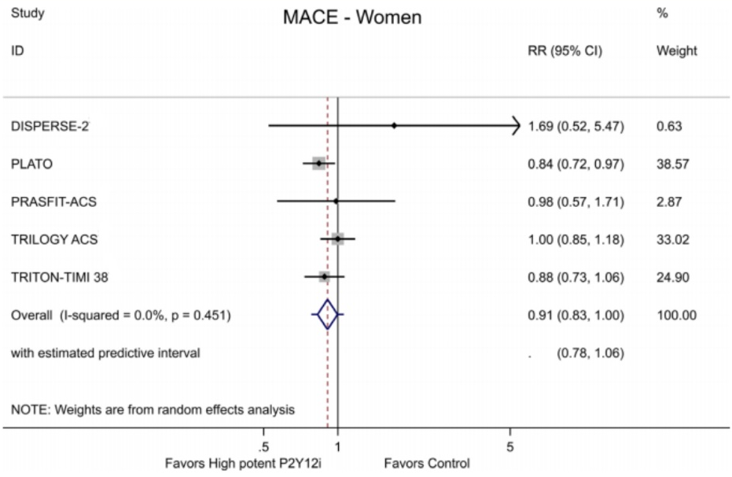
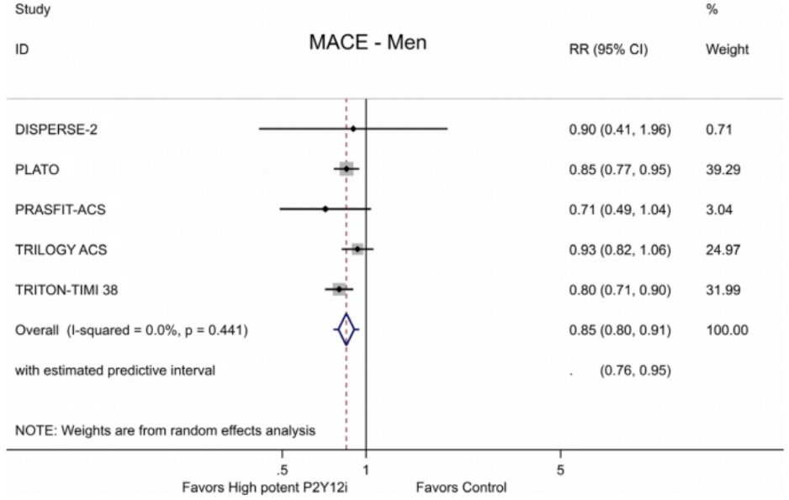
Should women not receive DAPT?
Meta-analysis of 6 randomised clinical trials comparing prasugrel/ticagrelor vs clopidogrel in 43,990 patients (13,030 women)
High potent P2Y12i (prasugrel or ticagrelor) + aspirin was associated with an additional reduction in MACE compared with clopidogrel + aspirin. Women and men had similar relative risk reduction
CI, confidence interval; DAPT, dual antiplatelet therapy; MACE, major adverse cardiovascular events; RR, relative risk
Schreuder M, et al. J Am Heart Soc. 2020;9:e014457

Slide 9
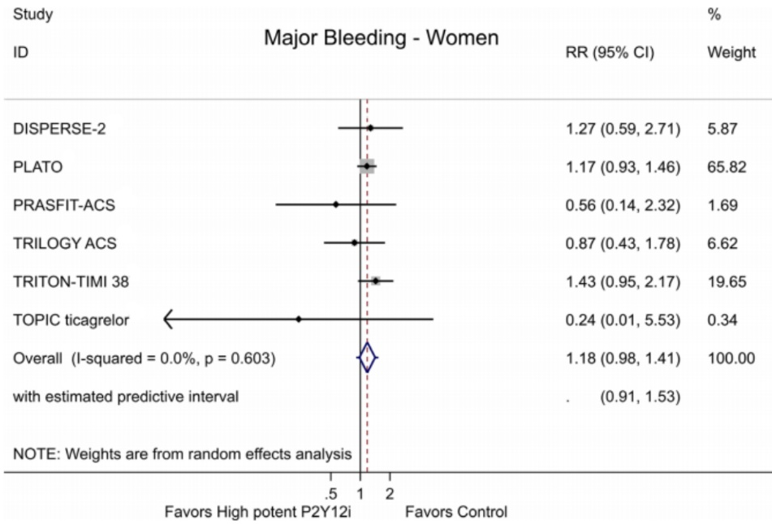
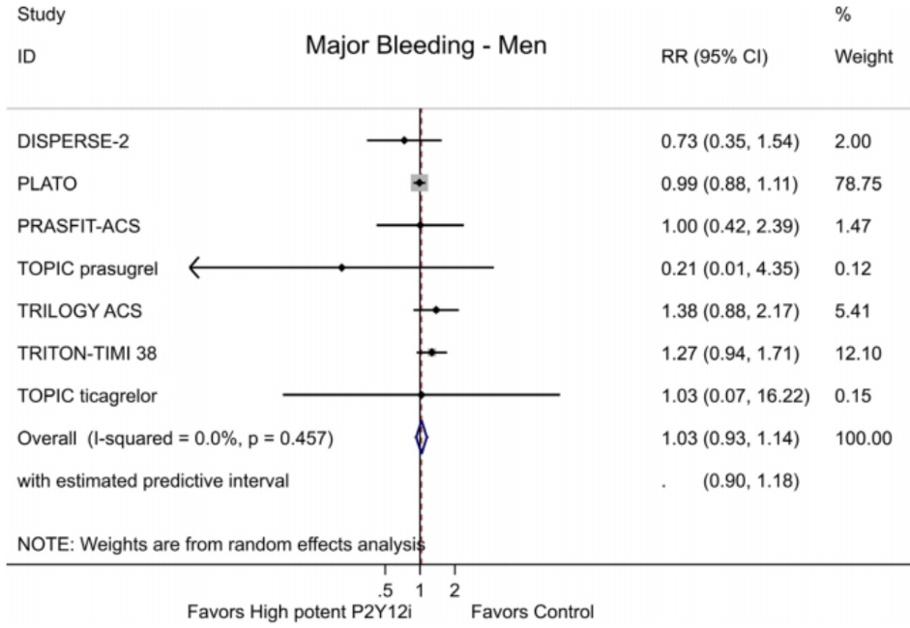
Should women not receive DAPT?
Meta-analysis of 6 randomised clinical trials comparing prasugrel/ticagrelor vs clopidogrel in 43,990 patients (13,030 women)
No differences between women and men for major bleeding in patients randomised to high potent DAPT versus clopidogrel + aspirin
CI, confidence interval; DAPT, dual antiplatelet therapy; RR, relative risk
Schreuder M, et al. J Am Heart Soc. 2020;9:e014457

Slide 10
Importance of adherence
Post-myocardial infarction patients (n=4,015)
45
40
35
30
25
Cumulative incidence (%)
20
26%
31%
43%
PDC <40%
PDC 40-79%
PDC ≥80%
15
10
Log-rank p=0.0002
5
0
0
6
12
18
24
30
36
42
Number at risk:
4,015
Time (months)
3,541
2,421
1,510
871
438
99
0
Kaplan–Meier curves for MACE according to adherence categories post-MI
MACE, major adverse cardiovascular events; PDC, proportion of days covered; post-MI, post myocardial infarction
Bansilal S, et al. J Am Coll Cardiol. 2016;68:789-801

Slide 11
Importance of adherence: costs
 | Post-MI cohort (per patient per year)
 | Non-adherent | Partially adherent | Fully adherent
MI | $844.46 | $774.09 | $404.64
Stroke | $178.49 | $133.87 | $89.24
Revascularisation | $3,375.21 | $3,070.50 | $2,531.41
Angina and CV atherosclerosis | $1,432.86 | $1,527.12 | $1,093.50
All-cause ED visits | $256.97 | $219.56 | $182.64
Cardiac-related ED visits | $14.77 | $12.80 | $13.29
Outpatient visits to cardiologist | $639.38 | $657.47 | $645.19
Outpatient visits to cardiologist with CV testing | $558.76 | $553.16 | $576.67
Total | $7,300.84 | $6,935.77 | $5,536.58
Importance of adherence: costs
CV, cardiovascular; ED, emergency department; MI, myocardial infarction
Bansilal S, et al. J Am Coll Cardiol. 2016;68:789-801

Slide 12


Intervention strategies
Nurse-based
e-health

Slide 13
Nurse-based intervention strategies
1,013 ACS patients randomised to:
Control: regular treatment and annual follow-up
Intervention: nurse-guided discussion of lifestyle, risk factors, and personal medication adjustments/month
Proportion (%)
Control off treatment
Control on treatment
Intervention off treatment
Intervention on treatment
Follow-up interval (month)
ACS, acute coronary syndrome
Daniel H, et al. Sci Rep. 2019;9:12079

Slide 14

e-health intervention strategies
Behavioural economics-based telehealth intervention
130 patients with ACS: intervention vs control at 90 days
Adherence was 90% vs 81%; rehospitalisation 13% vs 24%
50$/
month
-2$/
day
Payment for taking aspirin daily
Deducted for missing a dose
‘Gamified’ health intervention
Task self-efficacy
Maintenance self-efficacy
Recovery self-
efficacy
Point levels
Feedback
Rewards
Feedback
Points, levels
Story
Outcome
expectancies
Action control
Rewards
Intention
Action planning
Feedback
Individualised
goal-setting
Rewards
Disengagement
Risk
perception
Coping planning
Trigger
Action
Rewards
Abilities
Quests
Leaderboard
Barriers and resources
Social support
Preintenders
Intenders
Actors
ACS, acute coronary syndrome
Ehrler F, et al. AMIA Annu Symp Proc. 2018;2018:413-21; Riegel B, et al. Pharmacoepidemiol Drug Saf. 2020;29:513-7

Slide 15
SUMMARY
GDMT consists of drugs which are:
  Proven to reduce CVD events
  Not expensive
Prescription is not rocket science…
  But we should do it for all patients with ACS
Taking pills every day is not rocket science…
  But adherence is a huge problem (lifestyle/economic factors)
  Maybe new concepts can help?
ACS, acute coronary syndrome; CVD, cardiovascular disease; GDMT, guideline-directed medical therapy

Slide 16




REACH CORONARY CONNECT VIA
TWITTER, LINKEDIN, VIMEO & EMAIL
OR VISIT THE GROUP’S WEBSITE http://www.coronaryconnect.com/
Follow us on Twitter
@CoronaryConnect
Follow the
CORONARY CONNECT
Group on LinkedIn
Watch us on the
Vimeo Channel
CORONARY CONNECT
Email
carrie.brubaker
@cor2ed.com

