Slide 2
An alternative cause of acute coronary syndrome:
Case study 2
Prof Dr J. Wouter Jukema, MD
Leiden University Medical Center, Leiden, Netherlands
March 2021

Slide 3
Disclaimer and disclosures
Please note: The views expressed within this presentation are the personal opinions of the authors.
They do not necessarily represent the views of the author’s academic institution or the rest of the CORONARY CONNECT group.
These slides are adapted from the virtual ACS Forum event which was held in December 2020.
The ACS Forum and this content are supported by an Independent Educational Grant from Amgen.
Prof. Dr. J. Wouter Jukema has received financial support/sponsorship for research support, consultation or speaker fees from the following companies:
Amgen, Athera, AstraZeneca, Biotronik, Boston Scientific, Dalcor, Daiichi-Sankyo, Lilly, Medtronic, Merck, Pfizer, Roche, Sanofi Aventis, The Medicines Company, Netherlands Heart Foundation, Netherlands CardioVascular Research Committee (CVON), Netherlands Heart Institute, and the European Community Framework KP7 Programme

Slide 4
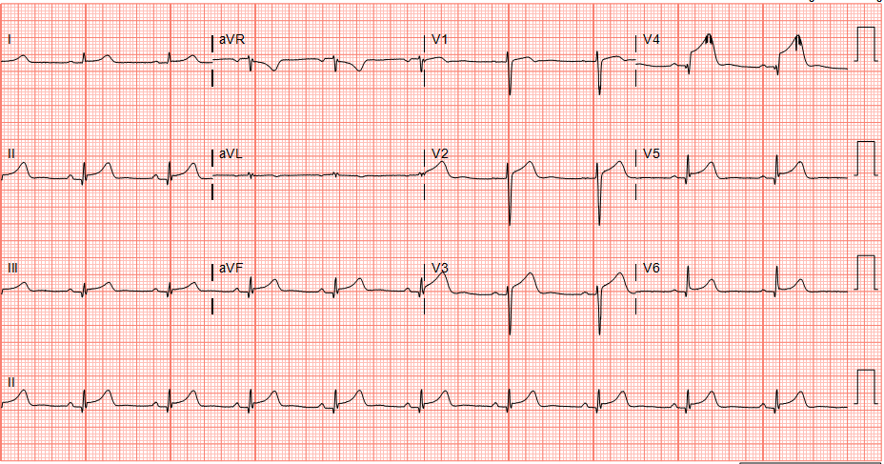
Clinical presentation
38-year-old female: weight 67 kg; height 173 cm
Cardiovascular (CV) risk factors: none
No previous medical history, regularly active (sports)
Admitted at 16:00 for acute chest pain (40 min.) during a car ride
Emergency room: normal clinical examination
  BP 135/76
  HR 78 bpm
BP, blood pressure; bpm, beats per minute; HR, heart rate

Slide 5
In your opinion, what is the most likely diagnosis?
Acute coronary syndrome (ACS) due to:
Plaque rupture
Coronary spasm
Spontaneous coronary artery dissection (SCAD)
Stress-related (Takostubo) cardiomyopathy

Slide 6
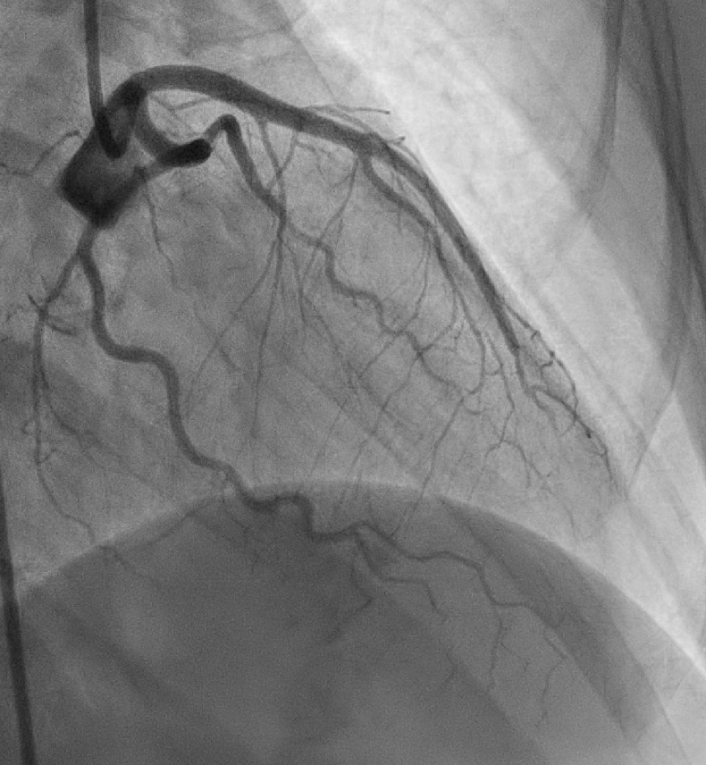
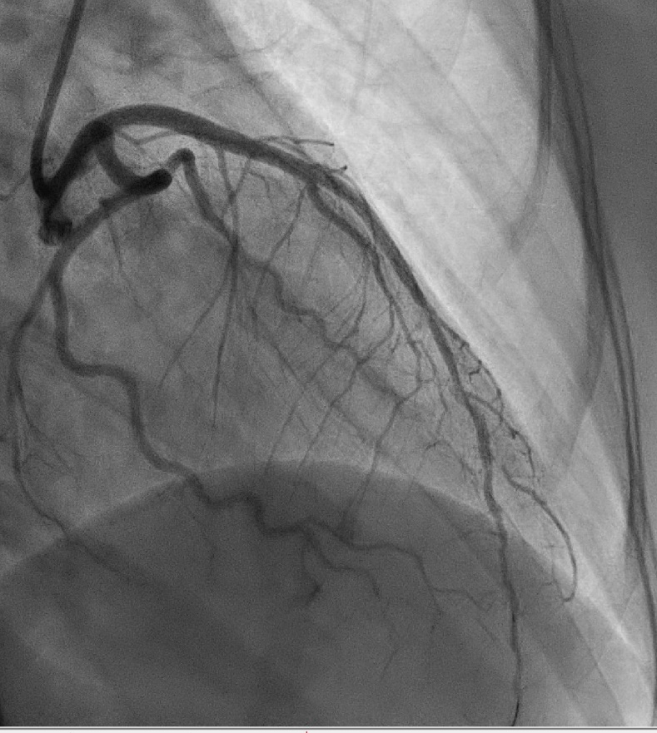
Right coronary artery and right circumflex artery: normal LAD artery: SCAD
Pre-wiring
Post-wiring
LAD, left anterior descending; SCAD, spontaneous coronary artery dissection

Slide 7
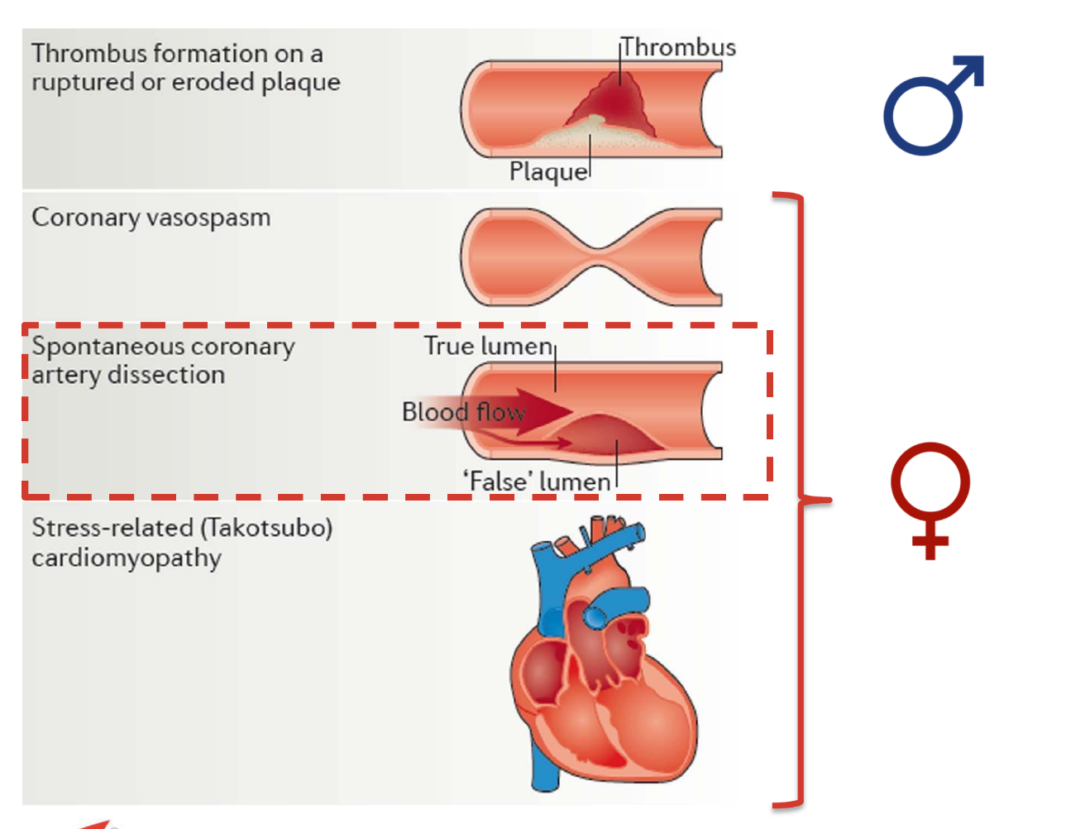

ACS types
ACS, acute coronary syndrome

Slide 8
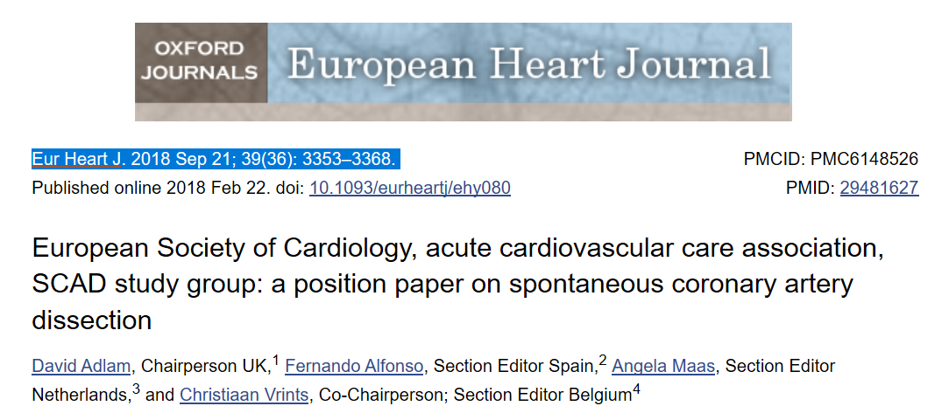
Definition of SCAD
SCAD refers to the acute development of a false lumen within the coronary
artery wall, which may compromise coronary flow by external compression
of the true lumen
SCAD, spontaneous coronary artery dissection

Slide 9
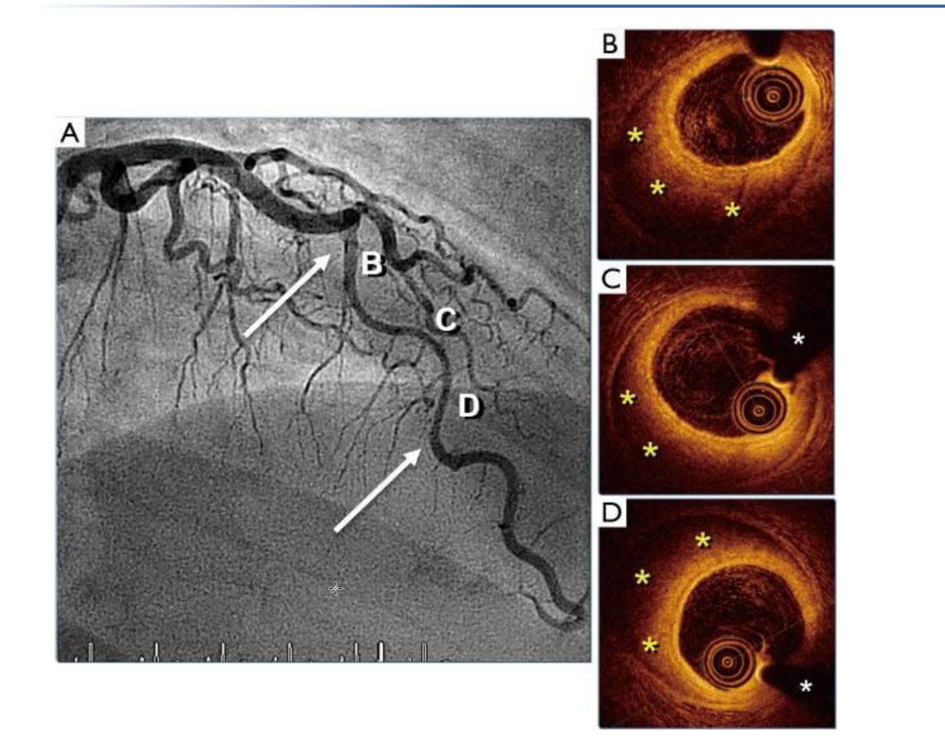
SCAD on angiography and OCT
Young woman presenting with chest pain and anterior ST-segment changes on electrocardiogram
Coronary angiogram of a patient with SCAD demonstrating a diffuse narrowing (arrows) in the mid-segment of a tortuous LAD artery (A)
  Unchanged after the administration of intracoronary nitroglycerine
OCT images depicting a long intramural haematoma (yellow ‘*’) with a relatively preserved coronary lumen (B-D)
  White ‘*’ denotes wire artifact
LAD, left anterior descending; OCT, optical coherence tomography; SCAD, spontaneous coronary artery dissection
Alfonso F, et al. Thorac Dis. 2018;10:4602-8

Slide 10
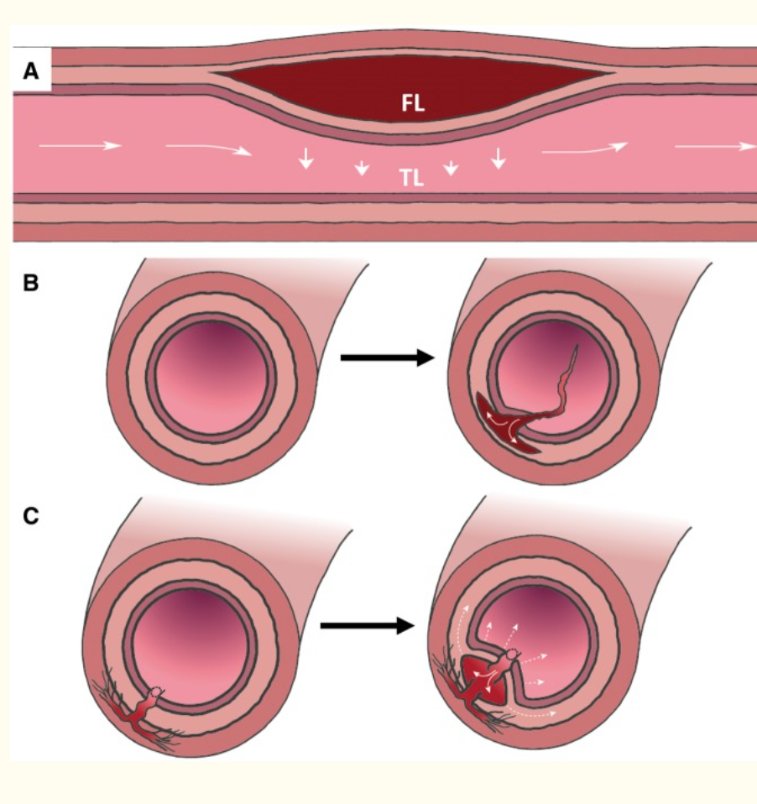
Bleeding: inside out or outside in
Schematic illustration of SCAD
Accumulation and axial propagation of blood forms a false lumen in the outer third of the tunica media, leading to external compression of the true lumen (A)
Blood may enter through an endothelial-intimal disruption or ‘tear’ (B) or as a result of bleeding from a microvessel within the vessel wall (C) leading to an expanding and compressing false lumen (dotted arrows)
FL, false lumen; SCAD, spontaneous coronary artery dissection; TL, true lumen
Adlam D, et al. Eur Heart J. 2018;39:3353-68

Slide 11
Epidemiology of SCAD
Although SCAD has been described across a broad demographic, it is a frequent cause of ACS in young to middle-age women and inpatients with myocardial infarction during pregnancy or post-partum
Pregnancy-associated SCAD accounts for a minority of cases
ACS, acute coronary syndrome; SCAD, spontaneous coronary artery dissection
Adlam D, et al. Eur Heart J. 2018;39:3353-68

Slide 12
Pathophysiology of SCAD
The strong female predisposition and association with pregnancy suggest a role for female sex hormones in the pathogenesis of SCAD, but the mechanism remains unknown
SCAD is frequently associated with extra-coronary arteriopathies including fibromuscular
dystrophia (FMD)
SCAD is not a strongly inherited condition
Research is needed to better understand the pathophysiology of SCAD
Patients with SCAD usually present with ACS
Delayed diagnosis is common, and SCAD should be actively considered in the differential diagnosis
of ACS presentations in low-risk patients
ACS, acute coronary syndrome; SCAD, spontaneous coronary artery dissection
Adlam D, et al. Eur Heart J. 2018;39:3353-68

Slide 13
Management of SCAD
Coronary revascularisation is associated with an increased risk of complications and adverse outcomes when compared with atherosclerotic coronary disease
Conservatively managed SCAD (i.e. without revascularisation) usually heals completely within
a few months
Where flow is maintained and in the absence of ongoing ischaemia or infarction, a conservative approach should be considered, followed by a period of inpatient observation
Further research is needed to clarify the optimal PCI strategy in cases where revascularisation
is necessary
The acute and convalescent medical strategies in SCAD may have key differences from post-atherosclerotic acute myocardial infarction, and further research is needed to establish the optimal treatment approach
PCI, percutaneous coronary intervention; SCAD, spontaneous coronary artery dissection
Adlam D, et al. Eur Heart J. 2018;39:3353-68

Slide 14
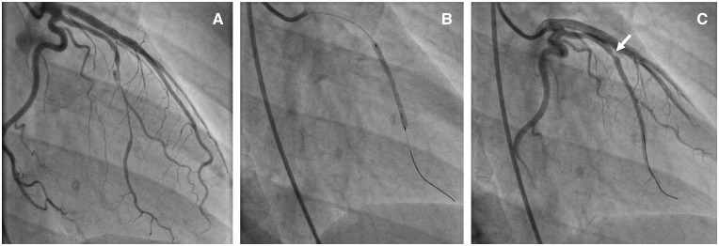
PCI in SCAD II
False-lumen propagation during stenting
A Type 2A dissection affecting a high obtuse marginal branch of the circumflex with maintained distal flow (A)
Stenting (B) leads to proximal haematoma migration (arrow; C)
Two further stents were required in this case to fully exclude the haematoma from luminal restriction
PCI, percutaneous coronary intervention; SCAD, spontaneous coronary artery dissection
Adlam D, et al. Eur Heart J. 2018;39:3353-68

Slide 15
Lipid-lowering medication in SCAD: what do you advise?
Maximum tolerated statin dose
Low-dose statin or ezetimibe monotherapy
Statin + PCSK-9 inhibitor if LDL-C remains >1.8 mmol/L (>70 mg/dL)
Start/continue lipid-lowering medication only in the presence of cardiovascular disease (CVD)
LDL-C, low-density lipoprotein cholesterol; PCSK-9, proprotein convertase subtilisin/kexin type 9; SCAD, spontaneous coronary artery dissection

Slide 16
Leiden University Medical Center’s approach to SCAD
When stented: start DAPT according to existing ACS guidelines
Not stented: start ASA monotherapy; continue after 1 year only in the presence of atherosclerotic CVD
Stop low-molecular-weight heparin (higher chance of intramural haematoma)
Start beta blockers (lower re-SCAD reported if started)
Start/continue lipid-lowering medication only in the presence of
atherosclerotic CVD
Start heart-failure medication in the presence of reduced left-ventricular ejection fraction according to the guidelines
Check for other arteriopathies (e.g. FMD)
ACS, acute coronary syndrome; ASA, acetylsalicylic acid; CVD, cardiovascular disease; DAPT, dual antiplatelet therapy; FMD, fibromuscular dysplasia;
SCAD, spontaneous coronary artery dissection

Slide 17




REACH CORONARY CONNECT VIA
TWITTER, LINKEDIN, VIMEO & EMAIL
OR VISIT THE GROUP’S WEBSITE http://www.coronaryconnect.com/
Follow us on Twitter
@CoronaryConnect
Follow the
CORONARY CONNECT
Group on LinkedIn
Watch us on the
Vimeo Channel
CORONARY CONNECT
Email
carrie.brubaker
@cor2ed.com

