Slide 2
Clinical review of nmCRPC: key trials and endpoints Prof. Steven Joniau, MD, PhD Urology Department, UZ Leuven, Belgium MARCH 2021
nmCRPC, non-metastatic castration resistant prostate cancer

Slide 3
DISCLAIMER AND DISCLOSURES
Please note: The views expressed within this presentation are the personal opinions of the author. They do not necessarily represent the views of the author’s academic institution or the rest of the GU CONNECT group.
This content is supported by an Independent Educational Grant from Bayer.
Prof. Steven Joniau has received financial support/sponsorship for research, consultation or speaker fees from the following companies:
Astellas, AstraZeneca, Bayer, Ferring, GSK, Ipsen, Janssen, MDX Health, Pfizer, Roche, Sanofi

Slide 4
introduction
Non-metastatic castration-resistant prostate cancer (nmCRPC) is characterised by rising levels of prostate-specific antigen (PSA) despite castration levels of testosterone, the absence of radiographic progression, and the absence of distant metastases (as determined by imaging)
Many years may elapse between detection of rising PSA levels and metastasis or death
During this long survival period, patients may receive multiple therapies which could affect an overall survival (OS) endpoint
Metastasis-free survival (MFS) has therefore emerged as an FDA-accepted endpoint for nmCRPC clinical trials
Apalutamide (APA) was the first drug approval in nmCRPC, and represents the first use of MFS as a primary endpoint to support drug approval
Approval was based on data from the SPARTAN trial
Subsequently, enzalutamide (ENZA) and darolutamide (DARO) were also approved by the FDA for patients with nmCRPC on the basis of the MFS endpoints in the PROSPER and ARAMIS trials
Here we review data from these key trials
Beaver J, et al. N Engl J Med. 2018;378:2458-60; www.accessdata.fda.gov/. Accessed 15 January 2021

Slide 5
The m0 CRPC patient
Patients with nmCRPC are a heterogeneous population
Disease evolution patterns to the clinical states of nmCRPC
No relapse
Watchful waiting
Treatment with curative intent
Rising PSA only
Rising
PSA
Rising PSA only
nmCRPC
Diagnosis of localised or locally advanced prostate cancer (PC)
Relapse
Local relapse
ADT ± other treatments
Distant metastasis
Distant metastasis
Not suitable for curative intent
Androgen deprivation therapy (ADT) ± other treatments
Rising
PSA
Rising PSA only
nmCRPC
Distant metastasis
nmCRPC, non-metastatic castration-resistant prostate cancer; PSA, prostate specific antigen
Mateo J, et al. Eur Urol. 2019;75:285-93

Slide 6
Study population and design: SPARTAN, PROSPER, and ARAMIS
Patients with a (PSADT) ≤10 months were included in all trials; these patients are at significant risk of metastases or death
3.0
2.8
2.6
2.4
Relative risk for bone
metastasis or death
2.2
Increasing risk
2.0
1.8
1.6
1.4
20
18
16
14
12
10
8
6
4
2
PSADT (months)
Shorter PSADT
PSADT, prostate specific antigen doubling time
Smith MR, et al. J Clin Oncol. 2013;31:3800-6

Slide 7
High-risk nmCRPC: Treatment
APA, DARO, and ENZA are androgen receptor (AR)-signalling inhibitors
Mechanism of action^{1,2}
Inhibit androgen binding to AR
Inhibit nuclear translocation of AR
Inhibit AR binding to DNA
Structure
DARO is structurally distinct from APA and ENZA, and is characterised by low blood–brain barrier penetration^{2,3,4}
This could result in less central nervous system toxicity and improved tolerability
ENZA
APA
DARO
APA, apalutamide; DARO, darolutamide; ENZA, enzalutamide
1. Tran C, et al. Science 2009;324:787-90; 2. Fizazi K, et al. Clinical Genitourinary Cancer 2018; 16: 322-40; 3. Zurth C, et al. J Clin Oncol. 2018;36 suppl 6S:345 (ASCO GU 2018 presentation); 4. Zurth C, et al. J Clin Oncol. 2019;37 suppl 7S:156 (ASCO GU 2019 presentation)
Images from PubChem database: https://pubchem.ncbi.nlm.nih.gov/

Slide 8
Study population and design: SPARTAN,¹ PROSPER,² and ARAMIS³
Each trial had a similar 2-arm, randomised-study design
Active treatment + ADT
MF
S
2:1
randomisation
SPARTAN | PROSPER | ARAMIS
APA | ENZA | DARO
Placebo + ADT
MFS
Randomisation
MFS (primary endpoint)
ADT, androgen deprivation therapy; APA, apalutamide; DARO, darolutamide; ENZA, enzalutamide; MFS, metastasis-free survival
1. Smith MR, et al. N Engl J Med. 2018;378:1408-18; 2. Hussain M, et al. N Engl J Med. 2018;378:2465-74; 3. Fizazi K, et al. N Engl J Med. 2019;380:1235-46

Slide 9
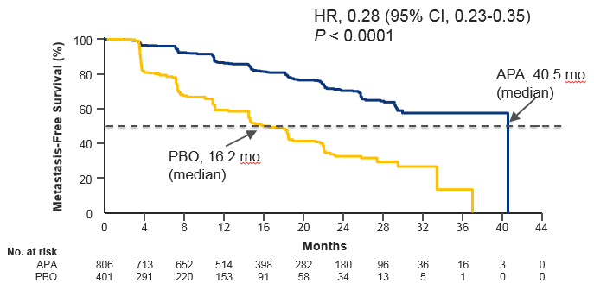
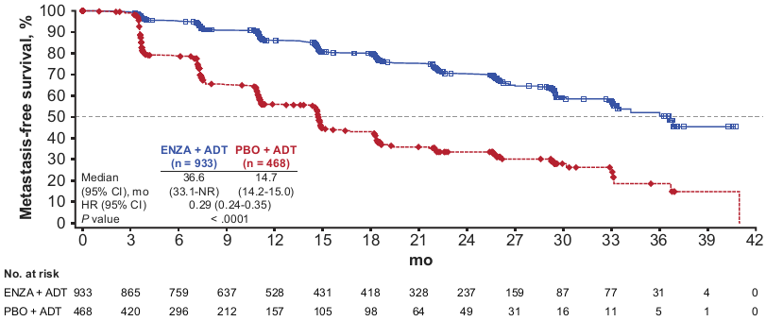
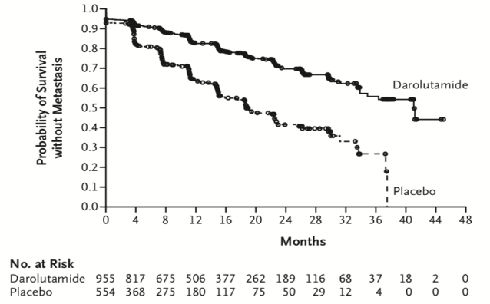
Primary endpoint: MFS
SPARTAN¹
72% risk reduction
PROSPER²
71% risk reduction
ARAMIS³
59% risk reduction
HR 0.28 (95% CI 0.23-0.35);
p<0.001
HR 0.29 (95% CI 0.24-0.35);
p<0.001
HR 0.41 (95% CI 0.34-0.50);
p<0.001
APA: 40.5 months (median)
ENZA: 36.6 months (median)
DARO: 40.4 months (median)
MFS (%)
MFS (%)
Probability of survival without metastasis
PBO: 16.2 months (median)
PBO: 14.7 months
(median)
PBO: 18.4 months
(median)
Months
Months
Months
 | SPARTAN |  | PROSPER |  | ARAMIS
MFS | APA (n=806) | PBO (n=401) | ENZA (n=933) | PBO (n=468) | DARO (n=955) | PBO (n=554)
Median, months | 40.5 | 16.2 | 36.6 | 14.7 | 40.4 | 18.4
Δ MFS, months | 24.3 |  | 21.9 |  | 22.0
95% CI | NR-NR | 14.59-18.4 | 33.1-NR | 14.2-15.0 | 34.3-NR | 15.5-22.3
HR (95% CI) | 0.28 (0.23-0.35) |  | 0.29 (0.24-0.35) |  | 0.41 (0.34-0.50)
p value | <0.001 |  | <0.001 |  | <0.001
APA, apalutamide; CI, confidence interval; DARO, darolutamide; ENZA, enzalutamide; HR, hazard ratio; MFS, metastasis-free survival; NR, not reached; PBO, placebo
1. Smith MR, et al. N Engl J Med. 2018;378:1408-18; 2. Hussain M, et al. N Engl J Med. 2018;378:2465-74; 3. Fizazi K, et al. N Engl J Med. 2019;380:1235-46

Slide 10
Secondary endpoint: OS – final analysis
SPARTAN¹
PROSPER²
ARAMIS³
100
APA–ITT
100
ENZA
100
DARO
90
PBO–ITT
90
PBO
90
PBO
80
80
80
70
APA: 73.9 months
(median)
70
70
60
60
60
Patients who were alive (%)
50
OS (%)
50
Patients who survived (%)
PBO: 59.9 months (median)
50
40
40
 | ENZA (n=933) | PBO (n=468)
Median, months | 67.0 | 56.3
(95% CI) | (64.0–NR) | (54.4–63.0)
HR (95% CI) | 0.73 (0.61–0.89)
p value | 0.001
40
30
14.0 months
30
30
20
20
20
10
HR for death 0.78 (95% CI 0.64-0.96);
10
10
HR for death 0.69 (95% CI 0.53-0.88);
0
p=0.016
0
0
p=0.003
0
4
8
12
16
20
24
28
32
36
40
44
48
52
56
60
64
68
72
76
0
4
8
12
16
20
24
28
32
36
40
44
48
52
56
60
64
68
72
0
4
8
12
16
20
24
28
32
36
40
44
48
52
56
60
Time from randomisation (months)
Time from randomisation (months)
Time from randomisation (months)
No. of patients at risk
No. of patients at risk
No. of patients at risk
APA
806
791
774
758
739
717
691
658
625
593
558
499
376
269
181
100
47
19
4
0
ENZA
933
926
910
897
874
850
822
782
700
608
517
424
327
244
169
89
33
4
0
DARO
955
932
908
863
816
771
680
549
425
293
214
129
69
37
12
0
PBO
401
392
385
373
358
339
328
306
286
263
240
204
156
114
82
38
21
6
2
0
PBO
468
467
459
444
428
404
381
363
321
274
219
177
140
106
64
30
16
3
0
PBO
554
530
497
460
432
394
333
261
182
130
93
54
28
16
4
0
 | SPARTAN |  | PROSPER |  | ARAMIS
OS | APA (n=806) | PBO (n=401) | ENZA (n=933) | PBO (n=468) | DARO (n=955) | PBO (n=554)
Median follow-up, months | 52.0 |  | 48.0 |  | 29.0
Median, months | 73.9 | 59.9 | 67.0 (95% CI 64.0-NR) | 56.3 (95% CI 54.4-63.0) | NR | NR
Δ OS, months | 14.0 |  | 10.7 |  | –
HR | 0.78 |  | 0.73 |  | 0.69
p value | 0.016 |  | 0.001 |  | 0.003
CI, confidence interval; DARO, darolutamide; ENZA, enzalutamide; HR, hazard ratio; ITT, intention to treat; NR, not reached; PBO, placebo
1. Smith MR, et al. Eur Urol. 2021;79:150-8; 2. Sternberg CN, et al. N Engl J Med. 2020;382:2197-206; 3. Fizazi K, et al. N Engl J Med. 2020;383:1040-9

Slide 11
safety
Safety | SPARTAN^{1,2} |  | PROSPER³ |  | ARAMIS⁴
 | APA (N=803) | PBO (N=398) | ENZA (N=930) | PBO (N=465) | DARO (N=954) | PBO (N=554)
Any AE, n (%) | 781 (97) | 373 (94) | 876 (94) | 380 (82) | 818 (85.7) | 439 (79.2)
Any serious AE, n (%) | 290 (36) | 99 (25) | 372 (40) | 100 (22) | 249 (26.1) | 121 (21.8)
AE leading to discontinuation, % | 120 (15) | 29 (7.3) | 158 (17) | 41 (9.0) | 85 (8.9) | 48 (8.7)
Grade 3 or 4 AEs, n (%) | 449 (56) | 145 (36) | 446 (48) | 126 (27) | 251 (26.3) | 120 (21.7)
AE leading to death, n (%) | 24 (3) | 2 (0.5) | 51 (5) | 3 (1) | 38 (4.0)ª | 19 (3.4)ª
AE of special interest, EAIR for any grade per 100 patient-years
Fatigue | 32.3^{b} | 27.2^{b} | 19 | 17 | 8.3 | 7.4
Hypertension | 36.3^{b} | 38.7^{b} | 7 | 5 | 4.9 | 5.8
Rash | 19.0 | 8.7 | 2 | 2 | 2.0 | 1.0
Falls | 12.0 | 9.6 | 9 | 4 | 3.3 | 4.3
Fractures | 9.5 | 8.3 | 9 | 5 | 3.4 | 3.2
Mental impairment disorder^{c} | 3.9^{b} | 3.4^{b} | 3 | 2 | 1.3 | 1.6
AEs with EAIR that was ≥3 events per 100 patient-years higher in the treatment group than in the control group^{d}
ª Reported as Grade 5 adverse event; ^{b} Data taken from first interim analysis as not reported in final analysis¹; ^{c} SPARTAN: disturbance in attention, memory impairment, cognitive disorder and amnesia; PROSPER: as per SPARTAN trial with the addition of Alzheimer's disease, mental impairment, vascular dementia and senile dementia; ARAMIS trial: MedRA High Level Group Term
Presented for information, safety comparisons across trials should not be made; ^{d} Based on criteria applied in the PROSPER study analysis³
AE, adverse event; APA, apalutamide; DARO, darolutamide; EAIR, exposure-adjusted incidence rate; ENZA, enzalutamide; NR, not reported; PBO, placebo
1. Smith MR, et al. N Engl J Med. 2018;378:1408-18; 2. Smith MR, et al. Eur Urol. 2021;79:150-8; 3. Sternberg CN, et al. N Engl J Med. 2020;382:2197-206; 4. Fizazi K, et al. N Engl J Med. 2020;383:1040-9

Slide 12
Do the safety profiles differ?
Conclusions should not be drawn by comparing safety data from different trials due to differences in the clinical trial design and populations
Recent analyses have attempted to compare safety profiles across the 3 AR-signalling inhibitors:
Author | Title | Conclusions | Limitations
Drago et al, ASCO GU 2020¹ | Adverse event profiles of APAL, ENZA, and DARO in SPARTAN, PROSPER, and ARAMIS: How confident are we about which drug is safest? | While conducted in similar patient populations, these trials had remarkable differences in AE reporting and in absolute AE risks between PBO arms. | Rather than indicating better safety, low absolute AE numbers decrease confidence in AE profiles. Published data are insufficient to differentiate the AE profiles of these agents in nmCRPC.
Jiang et al, ASCO 2020² | Safety outcomes of DARO versus APAL and ENZA in nmCRPC: Matching-adjusted indirect comparisons. | After adjusting for trial differences, DARO showed favorable safety profile in fall, dizziness, mental-impairment, hypertension, rash, fatigue, and fracture. | Patient-level data used from ARAMIS and compared to published trial data for PROSPER and SPARTAN: Only known baseline factors that were consistently reported across trials were included among the matching covariates in the MAICs As with any comparison of non-randomised treatment groups, such comparisons are subject to potential bias due to unobserved or unmeasurable confounding factors, The results of the study may not be generalisable beyond the study sample
George et al, ESMO 2020³ | DARO, ENZA and APAL, the risk of adverse events in patients with nmCRPC: Number needed to harm | NNH can help contextualize the risk of AEs. Findings show a consistent trend of higher NNH for DARO compared to APAL and ENZA, and that AE profile may be noteworthy for healthcare systems as well as patients | Prospective comparative trials are needed to further confirm these findings.
Ultimately, randomised head-to-head trials are required in order to truly compare safety profiles
DaroAcT Trial (NCT04157088) – directly comparing DARO and ENZA to assess differences in physical and cognitive function; expected to complete 2022
AE, adverse event; APAL, apalutamide; AR, androgen receptor; DARO, darolutamide; ENZA, enzalutamide; MAIC, matched-adjusted indirect comparison; nmCRPC, non-metastatic castration-resistant prostate cancer; NNH, number needed to harm; PBO, placebo
1. Drago J, et al. J Clin Oncol. 2020;38 suppl:318 (ASCO GU 2020 poster presentation); 2. Jiang S, et al. J Clin Oncol. 2020;38 suppl:5561 (ASCO 2020 poster presentation); 3. George D, et al. Ann Oncol. 2020;31 suppl 4: S507-S549 (ESMO 2020 poster presentation)

Slide 13
Treatment Is Associated With Maintenance of HRQoL
SPARTAN¹
FACT-P
PROSPER²
FACT-P
ARAMIS³
FACT-P PCS
APA
Placebo
7
120
6
100
5
Favours enzalutamide
4
80
Mean score
3
2
60
1
LSM (95% CI) treatment difference
Mean (95% CI)
0
40
-1
20
-2
Favours placebo
-3
0
50
-4
DARO
-5
−20
Placebo
0
-6
-7
-40
Baseline
Cycle
BL
17
33
49
65
81
97
D1
16
32
48
64
80
96
112
128
144
160
176
192
EOT
Patients in each cycle
APA | 797 | 781 | 767 | 742 | 717 | 695 | 676 | 649 | 614 | 590 | 456 | 352 | 257 | 167
Placebo | 395 | 389 | 379 | 371 | 350 | 301 | 283 | 265 | 221 | 199 | 136 | 83 | 54 | 35
No. at risk
ENZA
Placebo
Study week
No. at risk
DARO
Placebo
Study week
– –
815
403
718
329
621 239
522 183
427 139
354 90
938
546
882
501
820
376
669
269
512
186
387
119
270
79
199
52
121
31
73
15
37
8
19
1
2
0
191
253
APA, apalutamide; AUC, area under the curve; BL, baseline; CI, confidence interval; DARO, darolutamide; ENZA, enzalutamide; FACT-P, Functional Assessment of Cancer Therapy–Prostate; HRQoL, health-related quality of life; LSM, least squares mean; PBO, placebo; PCS, Prostate Cancer Subscale
1. Saad F et al. Lancet Oncol. 2018;19:1404-1416; 2. Tombal B, et al. Lancet Oncol. 2019;20:556-69; 3. Fizazi K, et al. J. Clin Oncol 2019; 37; no. 15_suppl: 5000-5000

Slide 14
Conclusions
High-risk nmCRPC patients are at a very high-risk to develop metastatic disease within 2 years of diagnosis¹
Extending MFS and preserving quality of life has been an unmet need for a long time
APA, ENZA, and DARO delay MFS and time to next-line treatment by an impressive ~2 years
All three molecules also significantly improve OS
APA, ENZA, and DARO have a very good safety profile
Quality of life is preserved and disease-related symptoms are significantly delayed with APA, ENZA, and DARO
APA, ENZA, and DARO should be considered new standards in the treatment of nmCRPC
APA, apalutamide; ENZA, enzalutamide; DARO, darolutamide; MFS, metastasis-free survival; nmCRPC, non-metastatic castration-resistant prostate cancer; OS, overall survival
1. Mateo J, et al. European Urology 2019; 75: 285-293

Slide 15
REACH GU CONNECT VIA TWITTER, LINKEDIN, VIMEO & EMAIL OR VISIT THE GROUP’S WEBSITE http://www.guconnect.info
Follow us on Twitter @guconnectinfo
Follow the GU CONNECT group on LinkedIn
Watch us on the Vimeo Channel GU CONNECT
Email sam.brightwell@cor2ed.com

