Slide 2
Current opinions on managing nmcrpc and the implications of new imaging modalities
Alexander Drzezga MD, PhD
Professor and Chair Department of Nuclear Medicine, University Hospital of Cologne, Germany
David Pfister MD, PhD
Professor and Deputy Director Department of Urology, University Hospital of Cologne, Germany
Alicia Morgans MD, MPH
Associate Professor Robert H. Lurie Cancer Center, Northwestern University, Chicago, Illinois, USA

Slide 3
you will learn about…
The application of conventional imaging vs. new imaging modalities in nmCRPC
The potential impact of next-generation imaging on treatment options for nmCRPC patients
Alternative treatment approaches:
Delay time to systemic therapy
Use systemic medications sooner
nmCRPC, non-metastatic castration resistant prostate cancer

Slide 4
content

Slide 5
Introducing the scientific committee
Alicia Morgans
Alexander Drzezga
David Pfister
Associate Professor Robert H. Lurie Cancer Center, Northwestern University, Chicago, Illinois, USA
Professor Department of Nuclear Medicine, University Hospital, University of Cologne, Germany
Professor and Deputy Director
The Department of Urology, University Hospital of Cologne, Germany

Slide 6
Imaging controversies in crpc: Does nmCRPC really exist? Prof. Alexander Drzezga, MD Department of Nuclear Medicine, University Hospital, University of Cologne, Germany FEBRUARY 2021
(nm)CRPC, (non-metastatic) castration resistant prostate cancer

Slide 7
Disclaimer and disclosures
Please note: The views expressed within this presentation are the personal opinions of the author. They do not necessarily represent the views of the author’s academic institution or the rest of the GU CONNECT group.
This content is supported by an Independent Educational Grant from Bayer.
Prof. Alexander Drzezga has received financial support/sponsorship from the following companies:
Research support: AVID Radiopharmaceuticals, GE Healthcare, Life Molecular Imaging, Siemens Healthineers
Speaker Honorary/Advisory Boards: GE Healthcare, Sanofi, Siemens Healthineers
Stock: Siemens Healthineers
Patents: Patent pending for 18F-PSMA7 (PSMA PET imaging tracer)

Slide 8
Potential of imaging in metastasised prostate cancer
Metastatic prostate cancer indicates a palliative situation (prolonging life/maintaining quality of life)
mHSPC: Treatment with systemic ADT e.g., LHRH analogues, GnRH antagonists, (possibly plus CTx, AR-A, surgery, RTx).¹ Resistance occurs after 2-3 years (median)²
mCRPC: Treatment options (depending on previous treatment for HSPC): abiraterone, cabazitaxel, docetaxel, enzalutamide, radium-223, sipuleucel-T.¹ Expected survival 2.2-2.8 years.³
‘Non-metastatic’ prostate cancer - without detectable metastases by conventional imaging (bone scan and CT)
nmCRPC: Treatment with apalutamide, enzalutamide or darolutamide to patients with nmCRPC and a high risk of developing metastasis (PSADT <10 months) to prolong time to metastases¹
Clinical trials (e.g. SPARTAN, PROSPER, ARAMIS) directed towards (conventional) detection of metastases over time⁴⁻⁶
PSMA-PET imaging can detect metastatic disease in a significant proportion of nmCRPC patients potentially leading to restaging⁷
Oligometastatic prostate cancer – generally ≤5 metastatic sites on imaging⁸
Individualized localized/image guided approaches (salvage surgery, RTx) may be beneficial in addition/prior to further systemic therapies
Oligometastastic stages may be more frequently found in nmCRPC than mCRPC. How to find these cases? Sensitive diagnostic methods. Value of PSMA-PET imaging?
ADT, androgen deprivation therapy; AR-A, androgen receptor antagonist; CT, computed tomography; CTxX, chemotherapy; GnRH: gonadotrophin-releasing-hormone; LHRH: luteinising hormone releasing hormone; mHSPC, metastatic hormone sensitive prostate cancer; (n)(m)CRPC, (non-)(metastatic) castration resistant prostate cancer; PSADT, prostate-specific antigen-doubling time; PSMA-PET, positron emission tomography-prostate-specific membrane antigen; RTx, radiotherapy
1. European Association of Urology guidelines prostate cancer 2020. https://uroweb.org/guideline/prostate-cancer/Accessed 21-Jan-21; 2. Pienta KJ, et al. Clin Cancer Res. 2006;12:1665-71; 3. Francini E, et al. Journal of Clinical Oncology 2018; 36, no. 6_suppl: 203-203; 4. Smith MR, et al. Eur Urol. 2021;79:150-8; 5. Sternberg CN, et al. N Engl J Med. 2020;382: 2197-206; 6. Fizazi K, et al. N Engl J Med. 2020; 383: 1040-1049; 7. Fourquet A, et al. Sci Rep 2020; 10; 2104; 8. Rao A, et al. American Society of Clinical Oncology Educational Book 2019; 39: 309-320, DOI: 10.1200/EDBK_239041

Slide 9
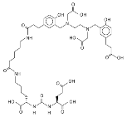
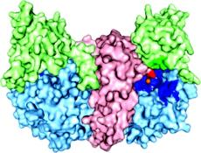
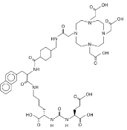
Improved detection of metastatic disease with PSMA-PET
PSMA: prostate-specific membrane antigen = glutamate-carboxypeptidase II
Overexpressed on prostate tumour cells (particularly in castration resistance)
Ideal target for molecular imaging (PSMA-PET, labelling with short-lived PET radionuclides)
⁶⁸Ga
¹⁸F
PET-
Diagnostics
PSMA
¹⁷⁷Lu
PSMA-
therapy
Images courtesy of Drzezga A, et al, University of Cologne
PET, positron emission tomography; PSMA, prostate-specific membrane antigen
1. Davis M, et al. Proc Natl Acad Sci USA. 2005;102;5981-6; 2. Eder M, et al. Bioconjug Chem. 2012;23:688-97; 3. Barinka C, et al. J Med Chem. 2008;51;7737-43

Slide 10
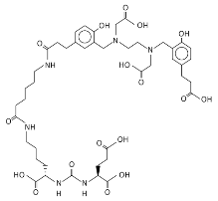
5 different PSMA-tracers in use at University of Cologne
[⁶⁸Ga]-PSMA-HBED-CC
DKFZ Heidelberg^{1,3}
[¹⁸F]DCFPyL
Collaboration with
Johns Hopkins University²
[¹⁸F]-JK-PSMA-7
University of Cologne³
⁶⁸Ga
X-18F
[^{99m}Tc]PSMA I&S
TU München⁴
[¹⁸F]PSMA-1007
University of Heidelberg⁵
PSMA, prostate-specific membrane antigen
1. Afshar-Oromieh A, et al. Eur J Nucl Med Mol Imaging. 2013;40:486-95; 2. Szabo Z, et al. Mol Imaging Biol. 2015;17:565-74; 3. Zlatopolskiy B, et al. J Nucl Med. 2019;60:817-23; 4. Robu S, et al, J Nucl Med. 2017;58:235-42; 5. Giesel F, et al. Eur J Nucl Med Mol Imaging. 2017;44:678-88

Slide 11
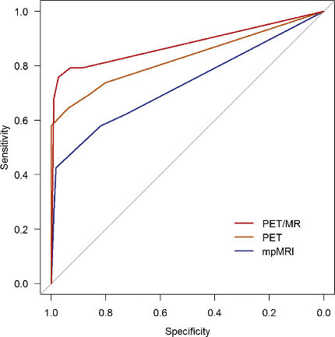
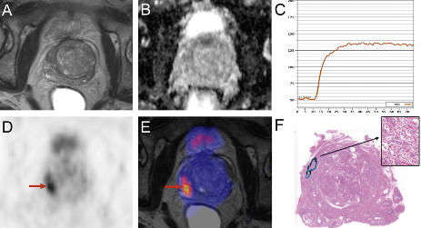
Value of PSMA-PET in primary diagnosis/ T-staging
TNM
PSMA-PET: Great diagnostic value in various diagnostic situations including diagnosis of primary tumour (T)
Detection-rates:
mpMRI: 66%
PSMA-PET: 92%
PSMA-PET/MRI: 98%
(mp)MRI, (multi-parametric) magnetic resonance imaging; PET, positron emission tomography; PSMA, prostate-specific membrane antigen
Eiber M, et al. Eur Urol. 2016;70:829-36

Slide 12
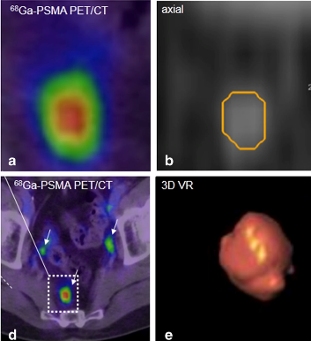
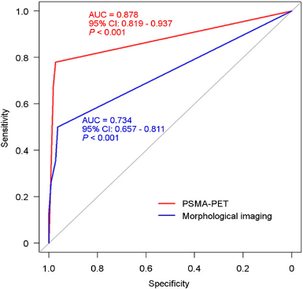
Value of PSMA-PET in N-staging
TNM
PSMA-PET: lymph node staging
80% of lymph node metastases <8mm!
Low sensitivities of CT and MRI (<40%)
PSMA-PET detecting lymph node metastases in 2/3 of CT-negative patients
Majority (78 %) <8mm and radiologically not suspicious²
Generally higher sensitivity of PSMA-PET (78%) versus CT (27%)³
1 cm
CT, computed tomography; MRI, magnetic resonance imaging; PET, positron emission tomography; PSMA, prostate-specific membrane antigen
1. Heesakkers R, et al. Lancet Oncol. 2008;9:850-6; 2. Giesel F, et al. Eur J Nucl Med Mol Imaging. 2015;42:1794-800; 3. Rauscher I, et al. J Nucl Med. 2016;57:1713-9

Slide 13
¹⁸F-DCPyL versus ⁶⁸Ga-PSMA
Detection rate at PSA-level 0.5 µg/l
33%
PSA 3.87 ng/ml
62%
¹⁸F-DCPyL-PET
⁶⁸Ga-PSMA-PET
¹⁸F-DCFPyL: optimised image quality & contrast
PET, positron emission tomography; PSA, prostate-specific antigen; PSMA, prostate-specific membrane antigen
Dietlein M, et al. Mol Imaging Biol. 2015;17:575-84
Dietlein F, et al. J Nucl Med. 2017;58:947-52

Slide 14
Therapeutic consequences of PSMA-PET imaging: Radiation therapy
270 patients with recurrence following radical prostatectomy, PSA-levels <1.0 ng/ml.
PSMA-PET/CT: In 52 cases (19%) lesions outside of the standard radiation field!
Calais J, et al. J Nucl Med. 2018;59:230-7
PSA, prostate specific antigen; PSMA-PET/CT, prostate specific membrane antigen-positron emission tomography/computed tomography
PSA, prostate-specific antigen; PSMA-PET/CT, prostate-specific membrane antigen-positron emission tomography/computed tomography
Notes:
I

Slide 15
177Lu-PSMA-Therapy
PSMA: target not only for diagnostics but also for therapy (theranostics)
For therapy: labelling with 177-Lutetium (beta-emitter, half-life 6.7 days)
PSMA
⁶⁸Ga
¹⁸F
PET-
Diagnostics
¹⁷⁷Lu
PSMA-
therapy
Images courtesy of Drezga A, et al, University of Cologne
PET, positron emission tomography; PSMA, prostate-specific membrane antigen
1. Davis M, et al. Proc Natl Acad Sci USA. 2005;102;5981-6; 2. Eder M, et al. Bioconjug Chem. 2012;23:688-97; 3. Barinka C, et al. J Med Chem. 2008;51;7737-43

Slide 16
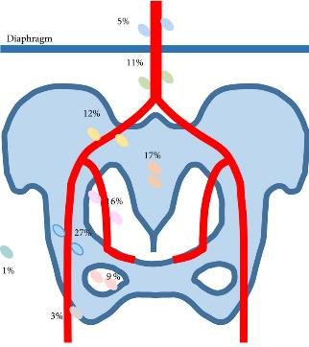
PSMA-PET to detect metastasis in different diagnostic situations
Primary staging
Primary tumour detected in 92%, metastases 12.1% (in 6.4% with ISUP grade 2-3 and 21% with ISUP grade 4-5, in 8.2% with PSA level <10 ng/ml, 43% with PSA level >20 ng/ml¹
47.7% of lymph node metastases outside the boundaries of extended pelvic lymph node dissection. Skeletal metastases in 4.7%
Prospective trial shows additional lymph node metastases in 25% and bone metastases in 6% of patients compared to conventional imaging. Change in management in 21 % of cases²
Systemic review of 12 studies on high-risk prostate cancer: ⁶⁸Ga-PSMA PET outperforms conventional imaging, specificity >90% across studies³
Guidelines recommend “at least CT/MRI and a bone scan” in high risk/locally advanced disease⁴
CT, computed tomography; ISUP, International Society of Urological Pathology; MRI; magnetic resonance imaging; PSA, prostate-specific antigen; PSMA-PET, prostate-specific membrane antigen positron emission tomography
1. Yaxley, et al. BJUI. 2019;124:401-7; 2. Roach P, et al. J Nucl Med. 2018;59:82-8; 3. Corfield J, et al. World J Urol. 2018;36:519-27; 4. European Association of Urology guidelines prostate cancer 2020. https://uroweb.org/guideline/prostate-cancer/Accessed 21-Jan-21

Slide 17
Value of PSMA-PET/CT in PSA-recurrence: Detection efficacy
Eiber et al: 248 patients undergoing ⁶⁸Ga-PSMA PET/CT, detection efficacy 89.5% including PSA <0.5 ng/ml
Raucher et al: 272 patients confirming detection rate of 55% in very low (0.2-0.5 ng/ml) and 74% in low (>0.5-1.0 ng/ml) PSA-values
Perera et al: Meta-analysis: Per-patient sensitivity 86%, specificity 86%, (PSA categories: <0.2: 42%, 0.2-1: 58%, 1-2: 76%, >2: 95%)
Caroli et al: Prospective trial confirms PSA-dependent sensitivity. Demonstrates 41% extrapelvine metastases!
Roach et al: Prospective trial, change in management in 62% of cases (with BCR after surgery/RT) as compared to conventional staging
93.06%
96.77%
Eiber et al.
72.73%
57.89%
Percent
Perera et al.
0.2-<0.5 ng/ml
0.5-<1 ng/ml
1-<2 ng/ml
≥2 ng/ml
BCR, biochemical recurrence; CT, computed tomography; PSA, prostate-specific antigen; PSMA PET, prostate-specific membrane antigen positron emission tomography; RT, radiotherapy
1. Eiber M, et al. J Nucl Med. 2015;56:668-74; 2. Rauscher I, et al. Eur Urol. 2018;73:656-61; 3. Perera M, et al. Eur Urol. 2016;70:926-37; 4. Caroli, et al. EJNM. 2018;45:2035-44; 5. Roach P, et al. J Nucl Med. 2018;59:82-8

Slide 18
Cologne data: Metastasis depending on PSA-value in patients with biochemical recurrence
FOLLOWING RADICAL PROSTATECTOMY
FOLLOWING RADIATION THERAPY
*S3-guideline AWMF recommends salvage-RT up to
PSA 0.5 µg/l often without imaging!
*S3-Guideline AWMF: BCR at ∆ PSA ≥2.0 µg/l
<2
>2
AWMF, Association of the Scientific Medical Societies in Germany; BCR, biochemical recurrence; PSA, prostate-specific antigen; RT, radiotherapy
Dietlein, et al. Nuklearmedizin und Urologie, Univ. of Cologne, unpublished data

Slide 19
Value of PSMA-PET/CT in PSA-recurrence
Caroli et al: Prospective trial confirms superiority over choline PET/CT.
67% of patients negative on choline PET/CT were found positive on PSMA-PET
40
Choline
Morigi et al.
35
PSMA
30
25
20
Number of lesions
15
10
5
0
Local
Bone
Lymph nodes
CT, computed tomography; PET, positron emission tomography; PSMA PET, prostate-specific membrane antigen positron emission tomography
1. Perera M, et al. Eur Urol. 2016;70:926-37; 2. Caroli P, et al. Eur J Nucl Med Mol Imaging. 2018;45:2035-44; 3. Afshar-Oromieh A, et al. Eur J Nucl Med Mol Imaging. 2014;41:11-20; 4. Morigi J, et al. J Nucl Med. 2015;56:1185-90; 5. Roach P, et al. J Nucl Med. 2017;58(suppl 1):706; Rauscher I, et al. Eur Urol. 2018;73:656-61

Slide 20
PSMA-PET imaging in mCRPC
Literature review of 11 studies:
Compared to bone scan, PSMA-PET is more sensitive and specific to detect metastases
Often patients were up-staged from non-metastatic CRPC (nmCRPC) to metastatic CRPC (mCRPC)
PSMA-guided metastasis-directed radiotherapy may alleviate local symptoms and has the potential to defer systemic treatment in patients with oligoprogressive CRPC
Currently no consensus on therapeutic consequences of PSMA-PET results in the setting of CRPC
EAU guidelines:
Guidelines recommend: “bone scan and CT”. The use of PSMA PET/CT scans for progressing CRPC is unclear and most likely not as beneficial as for patients with BCR or hormone-naïve disease
Results from randomised clinical trials required??
“Up-staging”
“Down-staging”
BCR, biochemical recurrence; CT, computed tomography; (n)(m)CRPC, (non)(metastatic) castration resistant prostate cancer; PSMA, prostate-specific membrane antigen; PSMA PET, prostate-specific membrane antigen positron emission tomography
1. Fankhauser C, et al. World J Urol. 2019;37:457-67; 2. European Association of Urology guidelines prostate cancer 2020. https://uroweb.org/guideline/prostate-cancer/Accessed 21-Jan-21
Notes:
I

Slide 21
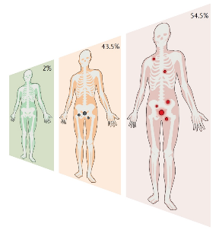
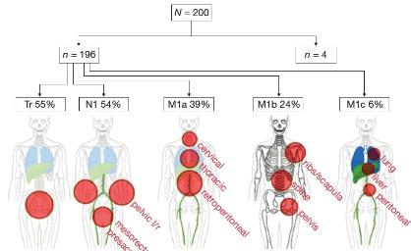
PSMA-PET imaging in nmCRPC
Patients: Multicentre, retrospective, 200 patients with nmCRPC, PSA >2 ng/ml, high risk for metastases (PSADT) of ≤10 months and/or Gleason score of ≥8. Selection criteria similar to SPARTAN, PROSPER, and ARAMIS studies
Pre-PSMA imaging: 91% CT. 15% MRI, 11% bone scan, 3% other PET scans, all demonstrating M0 disease
Results PSMA-PET:
98% PSMA-positive lesions
44% disease limited to the pelvis
incl. 24% disease confined to the prostate bed
55% M1 disease
extrapelvic nodes (39%), bone (24%) visceral organs (6%)
Risk factors for M1 disease included high PSA
M1 detection rate did not correlate with PSADT or Gleason score
Patients with M1 benefited from androgen receptor therapy
N=200
N=196
N=4
Tr 55%
N1 54%
M1a 39%
M1b 24%
M1c 6%
Fendler W, et al. Clin Cancer Res. 2019;25:7448-54
nmCRPC, non-metastatic castration resistant prostate cancer; CT, computed tomography; M0, non-metastatic; M1, metastatic; MRI, magnetic reasonance imaging; PET, positron emission tomography; PSA(DT), prostate-specific antigen (doubling time); PSMA, prostate-specific membrane antigen; PSMA PET, prostate-specific membrane antigen positron emission tomography

Slide 22
PSMA-PET imaging in nmCRPC
Patients: Single-centre, retrospective, 30 patients with nmCRPC (rise in PSA despite castrate serum testosterone levels, <50 ng/dl incl. cases with PSA <2 ng/ml)
Pre-PSMA-PET imaging: ¹⁸F-Fluorocholine PET/CT
Results:
90% PSMA-positive lesions
100% positivity rate in PSA >2 ng/ml
70% in <2 ng/ml (7/10 = 70%)
7% disease confined to the prostate bed,
20% oligometastastic disease
63% polymetastatic disease
PSMA-11 PET/CT impacted disease management in 70% of cases
Successful
2nd generation ADT
Successful
stereotactic radiation therapy
ADT, androgen deprivation therapy; nmCRPC, non-metastatic castration resistant prostate cancer; PET/CT, positron emission tomography/computed tomography; PSA, prostate-specific antigen; PSMA PET, prostate-specific membrane antigen positron emission tomography
Fourquet A, et al. Sci Rep. 2020 Feb 7;10(1):2104

Slide 23
summary
PSMA-PET
Is a highly effective universal diagnostic tool in various situations /disease stages of PC
Will frequently lead to an upstaging (primary diagnosis, BCR, mCRPC, nmCRPC)
Shows that metastases are generally much more common at lower PSA-values than previously assumed
May have considerable diagnostic consequences, particularly regarding localised therapeutic approaches and already has demonstrated change in management
BCR, biochemical recurrence; (n)mCRPC, (non-) metastatic castration resistant prostate cancer; PC, prostate cancer; PSA, prostate-specific antigen; PSMA PET, prostate-specific membrane antigen positron emission tomography

Slide 24
summary
nmCPRC:
In majority of cases is in fact metastatic disease, “non-metastatic“ only in a minority of cases (~50%) (micrometastasis?)
Is misleading/wrong as a description of a disease stage (rather “progress of non-detected origin“)
Holds potential for PSMA-imaging, but no consensus on consequences of change from non-metastatic to mCRPC
benefit of second-generation ADT in nmCPRC independent from metastatic stage
no prospective data on salvage treatment of locoregional disease (prostate/pelvis) or localised metastasis-directed therapy (radiation)
Inclusion into trials and data on therapeutic efficacy is often determined with conventional imaging
In future trials, PSMA-PET staging should be considered in both mCPRC and nmCPRC for patient inclusion and follow-up
Huge proportion of PSMA-positive metastatic lesions across disease stages further supports the notion that PSMA-therapy should be included in the catalogue of potential therapy options
ADT, androgen deprivation therapy; (n)mCRPC, (non) metastatic castration resistant prostate cancer; PSMA, prostate-specific membrane antigen; PSMA PET, prostate-specific membrane antigen positron emission tomography
Fendler W, et al. Clin Cancer Res. 2019;25:7448-54

Slide 25
With thaNks!
Urology
Prof. A. Heidenreich
Prof. D. Pfister
Team Urology
External
Prof. Schwaiger, TUM
Prof. Dr. Eiber, TUM
Prof. Wester, TUM
Prof. Haberkorn, Univ. Heidelberg
Dr. Kratochwil, Univ. Heidelberg
Prof. Baum, Bad Berka
Prof. Pomper, Johns-Hopkins USA
All patients and their family members
Nuclear Medicine/Radiochemistry
Prof. M. Dietlein
Prof. C. Kobe
Prof. M. Schmidt
Dr. Ph. Täger
Dr. J. Hammes
Dr. mult. Felix Dietlein
Team NucMed
Prof. K. Schomäcker, Team Radiopharmacy
Prof. Neumaier, IREMB, Team PET-Radiochemistry
M. Wild/Dr. M. Hohberg & Team Medical Physics

Slide 26
nmCRPC: Case STUDY 1
nmCRPC, non-metastatic castration resistant prostate cancer

Slide 27
PATIENT Case 1
Mr. PH is a 57 year old man referred to urology with PSA of 6.8 ng/mL
PMH: (+) seizures, controlled with meds (oxcarbazepine)
FH: (+) breast cancer (mother, sister), (+) pancreas (brother)
DRE was notable for a firm nodule on the left side.
Underwent a prostate biopsy notable for Gleason Group 3 (3 + 4) in 3 cores on the left, 75% involvement
Bone scan/CT scan: negative for metastases
ECOG PS 0
CT, computed tomography; DRE, digital rectal examination; ECOG, Eastern Cooperative Oncology Group; FH, family history; nmCRPC, non-metastatic castration resistant prostate cancer; PMH, previous medical history; PSA, prostate specific antigen

Slide 28
PATIENT Case 1 (cont.)
3-Months Later (Feb 2016)
Robotically-assisted radical prostatectomy and extended lymph node dissection
Final Pathology: pT3bN0R1M0, GG 4 (4 + 4), (+) surgical margin to apex
6 weeks postop: PSA 0.15 ng/mL; baseline serum testosterone 420 ng/mL
He was advised to consider adjuvant EBRT to prostate bed due to a positive margin, pT3b
He declined adjuvant EBRT based on the RADICALS study
PSA rose to 0.2 ng/mL in November 2016
He undergoes early salvage EBRT and PSA becomes undetectable
PSA starts to rise in July 2017 (see table)
Restaging (bone/CT scan): negative for metastasis
ADT initiated, depot leuprolide 45 mg SC
PSA 0 ng/mL
Date | PSA
Jul 2017 | 0.18 ng/mL
Oct 2017 | 0.58 ng/mL
Jan 2018 | 2.8 ng/mL
May 2018 | 4.2 ng/mL
ADT, androgen deprivation therapy; CT, computed tomography; EBRT, external beam radiation therapy; GG, Gleason grade; PSA, prostate specific antigen; SC, subcutaneous

Slide 29
PATIENT Case 1 (cont.)
He is followed closely on ADT
PSA starts to rise in August 2018 (see table)
PSA-DT: 8.6 months
Date | PSA
Aug 2018 | 1.2 ng/mL
Oct 2018 | 1.6 ng/mL
Jan 2019 | 1.9 ng/mL
Feb 2019 | 2.0 ng/mL
Apr 2019 | 2.35 ng/mL
Jul 2019 | 3.12 ng/mL
Oct 2019 | 3.81 ng/mL
ADT, androgen deprivation therapy; PSA(-DT), prostate specific antigen(-doubling time)

Slide 30
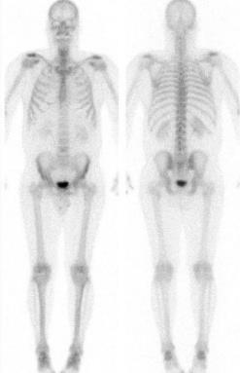
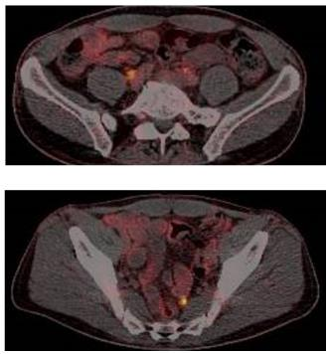
PATIENT Case 1 (cont.)
October 2019 – Restaging
CT CAP/bone scan: negative for metastatic disease
ECOG PS 0
PSMA PET scan positive
How should he proceed?
CT CAP, chest abdomen pelvis computed tomography; ECOG, Eastern Cooperative Oncology Group; PSMA PET, prostate specific membrane antigen positron emission tomography

Slide 31
Salvage lymph node dissection at time of biochemical relapse Prof. David Pfister, MD Professor and Deputy Director of The Department of Urology, University Hospital of Cologne, Germany FEBRUARY 2021

Slide 32
DISCLAIMER AND DISCLOSURES
Please note: The views expressed within this presentation are the personal opinions of the author. They do not necessarily represent the views of the author’s academic institution or the rest of the GU CONNECT group.
This content is supported by an Independent Educational Grant from Bayer.
Prof. David Pfister has received financial support/sponsorship for research support, consultation or speaker fees from the following companies:
Astellas, AstraZeneca, Bayer, Janssen, Merck, MSD, Pfizer

Slide 33
Imaging at time of recurrence
Prostate-specific antigen (PSA) recurrence after radical prostatectomy | LE | Strength rating
Perform prostate-specific membrane antigen (PSMA) positron emission tomography (PET) computed tomography (CT) if the PSA level is >0.2 ng/mL and if the results will influence subsequent treatment decisions. | 2b | Weak
In case PSMA PET/CT is not available, and the PSA level is ≥1 ng/mL, perform fluciclovine PET/CT or choline PET/CT imaging if the results will influence subsequent treatment decisions. |  | Weak
PSA recurrence after radiotherapy
Perform prostate multiparametric magnetic resonance imaging to localise abnormal areas and guide biopsies in patients fit for local salvage therapy. | 3 | Weak
Perform PSMA PET/CT (if available) or fluciclovine PET/CT or choline PET/CT in patients fit for curative salvage treatment. | 2b | Strong
CT, computed tomography; PET, positron emission tomography; PSA, prostate-specific antigen; PSMA, prostate-specific membrane antigen
EAU Guidelines. Edn. presented at the EAU Annual Congress Amsterdam 2020. ISBN 978-94-92671-07-3. https://uroweb.org/guideline/prostate-cancer/
Accessed 20-Jan-2021

Slide 34
Detection of recurrent PC before salvage surgery
Detection of recurrent prostate cancer lesions before salvage lymphadenectomy is more accurate with ⁶⁸Ga-PSMA-HBED-CC (⁶⁸Ga-PSMA)than with ¹⁸F-Fluoroethylcholine (¹⁸F-FEC) PET/CT
PATIENT CHARACTERISTICS
 | ¹⁸F-FEC | ⁶⁸Ga-PSMA | p-value
No. of patients | 38 | 28
Median age at surgery, years | 65 (55-75) | 67 (46-79) | 0.82 (MW)
Gleason score at diagnosis | 18 (47%) | 16 (57%) | 0.88 (Chi)
≤7 | 11 (29%) | 9 (32%)
>7 | 9 (24%) | 3 (11%)
Unknown
Median PSA, ng/mL | 2.7 (0.3-8.4) | 2.35 (0.04-8) | 0.25 (MW)
Primary therapy: | 33 (87%) | 23 (82%) | 0.21 (Chi)
Prostatectomy | 5 (13%) | 3 (11%)
Radiation therapy | 0 (0%) | 2 (7%)
HIFU
Time since primary therapy at surgery, months | 53 (4-163) | 74 (4-197) | 0.12 (MW)
Hormone therapy at PET/CT | 9 (24%) | 12 (43%) | 0.10 (Chi)
Yes | 29 (76%) | 16 (57%)
No
Prior salvage/adjuvant radiation therapy | 24 (63%) | 16 (57%) | 0.62 (Chi)
Yes | 14 (37%) | 12 (43%)
No
Median duration of surgery, minutes | 135 (60-163) | 136 (75-250) | 0.58 (MW)
Chi, Chi-squared test; CT, computed tomograph; FEC, fluoroethylcholine; HIFU, High-intensity focused ultrasound; MW, Mann–Whitney test; PC, prostate cancer; PET, positron emission tomography; PSA, prostate-specific antigen; PSMA, prostate-specific membrane antigen
Pfister D, et al. Eur J Nucl Med Mol Imaging. 2016;43:1410-7

Slide 35
Lesion comparison between PET/CT and histology by Tracer
⁶⁸Ga-PSMA PET/CT shows a better performance than ¹⁸F-FEC PET/CT for the detection of locoregional recurrent and/or metastatic lesions prior to salvage lymphadenectomy
¹⁸F-FEC | Histology positive | Histology negative
PET/CT positive | 74 | 36 | PPV: 67.3% (57.7-75.9%)
PET/CT negative | 30 | 238 | NPV: 88.8% (84.4-92.3%)
 | Sensitivity: 71.2% (64.5-79.6%) | Specificity: 86.9% (82.3%-90.6%) | Accuracy: 82.5% (78.3-86.8%)
⁶⁸Ga-PSMA | Histology positive | Histology negative
PET/CT positive | 53 | 17 | PPV: 75.7% (64.0-98.5%)
PET/CT negative | 8 | 230 | NPV: 96.6% (93.5-98.5%)
 | Sensitivity: 86.9% (75.8-94.2%) | Specificity: 93.1% (89.2%-95.9%) | Accuracy: 91.9% (88.7-95.1%)
95% confidence intervals presented
CT, computed tomograph; FEC, (¹⁸F-)fluoroethylcholine; NPV, negative predictive value; PET, positron emission tomography; PPV, positive predictive value; PSMA, prostate-specific membrane antigen
Pfister D, et al. Eur J Nucl Med Mol Imaging. 2016;43:1410-7

Slide 36
Lymph node detection correlated with PSA value at time of PET
Percentage positive ⁶⁸Ga-PSMA PET/CT
When to perform imaging?
CT, computed tomography; PET, positron emission tomography; PSA, prostate-specific antigen; PSMA, prostate specific membrane antigen
Huits T, et al. BJU Int. 2020;125;876-83

Slide 37
Lymph node detection correlated with PSA value at time of PET
Percentage positive ⁶⁸Ga-PSMA PET/CT
When to perform imaging?
Not too early!
CT, computed tomography; PET, positron emission tomography; PSA, prostate specific antigen; PSMA, prostate specific membrane antigen
Huits T, et al. BJU Int. 2020;125;876-83

Slide 38
Effect of MDT in LN recurrent PC patients-a matched control study
Parameter | SOC | MDT | p-value
Patients, n (%) | 494 (75) | 165 (25)
Age at RP, yr
Median (IQR) | 64 (58-68) | 62 (59-67) | 0.41
PSA at RP, ng/mL
Median (IQR) | 9.3 (6.1-15.0) | 9.8 (6.4-15.0) | 0.52
Year of surgery
Median (IQR) | 2009 (2006-2011) | 2009 (2006-2011) | 0.51
Time from RP to PSA progression following RT, mo
Median (IQR) | 28.7 (13.2-55.6) | 27.1 (12.8-48.1) | 0.15
pT-stage, n (%)
pT2 | 148 (30) | 49 (29.7) | 0.66
pT3a | 157 (31.8) | 47 (28.5)
≥pT3b | 189 (38.3) | 69 (41.8)
pN-status, n (%)
N0 | 382 (77.3) | 130 (78.8) | 0.7
N+ | 112 (22.7) | 35 (21.2)
Gleason score, n (%)
6 | 16 (3.2) | 6 (3.6) | 0.97
7 | 375 (75.9) | 125 (75.8)
≥8 | 103 (20.9) | 34 (20.6)
Surgical margin, n (%)
Negative | 313 (63.4) | 95 (57.6) | 0.19
Positive | 181 (36.6) | 70 (42.4)
100%
MDT
80%
SOC
60%
Cancer-specific survival
40%
Treatment | 60 mo. CSS, % | 120 mo. CSS, % | p-value
SOC | 95.7 | 84.8 | 0.005
MDT | 98.6 | 95.6
20%
0%
0
24
48
72
96
120
144
168
192
216
Time (months)
CSS, cancer-specific survival; IQR, inter-quartile range; MDT, metastasis-directed therapy; LN, lymph node; N, node; PC, prostate cancer; PET, positron emission tomography; PSA, prostate-specific antigen; RP, radical prostatectomy; RT, radiotherapy; SOC, standard-of-care; T, tumour
Steuber T, et al. Eur Urol Focus. 2019;5:1007-13

Slide 39
Long-term Outcomes of salvage lymph node dissection
PATIENT CHARACTERISTICS RELATED TO RP
PATIENT CHARACTERISTICS RELATED TO sLND
Variable | Overall population (N=189; 100%)
Age at RP (yr) | 61 (55-66)
PSA level at RP (ng/mL) | 10.1 (7.0-16.0)
pT stage, n (%)
pT2 | 64 (34)
pT3a | 66 (35)
pT3b/pT4 | 56 (30)
Unknown | 3 (1)
Pathological ISUP group, n (%)
≤3 | 119 (62)
4 | 35 (19)
5 | 35 (19)
LND performed during RP, n (%)
No | 17 (9)
Yes | 163 (86)
Unknown | 9 (5)
pN stage, n (%)
pN0 | 130 (69)
pN1 | 33 (17)
pNx | 17 (9)
Unknown | 9 (5)
Surgical margins, n (%)
Negative | 115 (61)
Positive | 63 (33)
Unknown | 11 (6)
Variable (cont) | Overall population (N=189; 100%)
Number of nodes removed | 8 (4-13)
Number of positive nodes, n (%)
0 | 130 (69)
1 | 12 (6)
2 | 11 (6)
≥3 | 10 (5)
Unknown | 26 (14)
Postprostatectomy RT, n (%)
No | 68 (36)
Yes | 116 (61)
Unknown | 5 (3)
Postprostatectomy ADT, n (%)
No | 74 (39)
Yes | 114 (60)
Unknown | 1 (1)
Variable (cont) | Overall population (N=189; 100%)
Time from RP to PSA rising (mo) | 22 (7-38)
Type of PET/CT tracer, n (%)
¹¹C-choline | 154 (81)
⁶⁸GA-PSMA | 6 (3)
Unknown | 29 (16)
Ongoing ADT at the time of PET/CT, n (%)
No | 98 (52)
Yes | 34 (18)
Unknown | 57 (30)
Site of positive spots at PET/CT, n (%)
Pelvic | 113 (60)
Retroperitoneal | 18 (10)
Both | 27 (14)
Unknown | 31 (16)
Number of positive spots at PET/CT, n (%)
0 | 9 (5)
1 | 91 (48)
2 | 26 (14)
≥3 | 38 (20)
Unknown | 25 (13)
Age at sLND (yr) | 65 (60-60)
PSA level at sLND (ng/mL) | 2.5 (1.1-5.4)
ADT, androgen deprivation therapy; ISUP, International Society of Urological Pathology; LND, lymph node dissection; N, node; p, pathological; PSA, prostate-specific antigen; PSMA, prostate-specific membrane antigen; PET/CT, positron emission tomography/computed tomography; RP, radical prostatectomy; RT, radiation therapy; sLND, salvage lymph node dissection; T, tumour
Bravi C, et al. Eur Urol. 2020;78:661-9

Slide 40
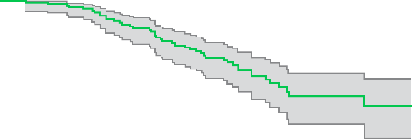
Long-term Outcomes of salvage lymph node dissection
100
80
60
Cancer-specific survival (%)
40
20
0
0
2
4
6
8
10
12
Years from sLND
Number at risk
189
172
142
110
59
29
13
sLND, salvage lymph node dissection
Bravi C, et al. Eur Urol. 2020;78:661-9

Slide 41
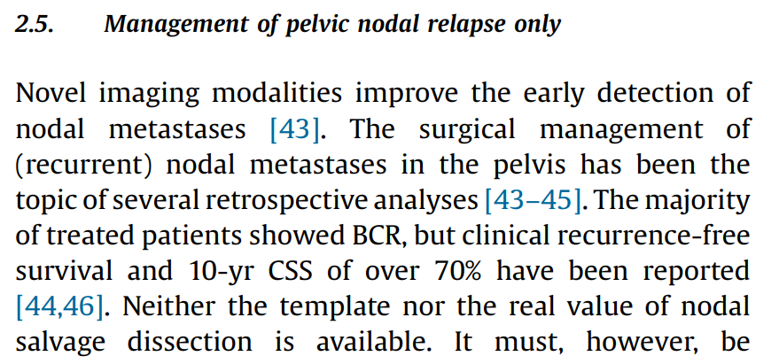
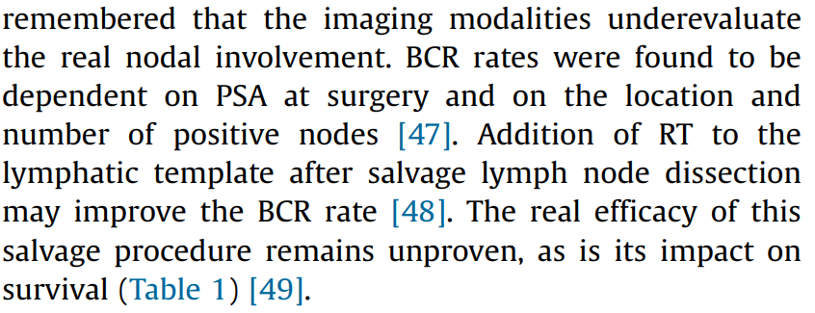
Guideline recommendation
How to identify the right patient for salvage LAD?
BCR, biochemical recurrence; CSS, cancer-specific survival; LAD, lymph adenectomy; PSA, prostate-specific antigen; RT, radiotherapy
Cornford P, et al. Eur Urol. 2020: DOI: 10.1016/j.eururo.2020.09.046

Slide 42
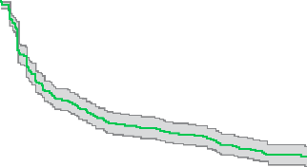
Identification of Patients relying on clinical data
Variable | Overall population (N=654; 100%)
Lymph nodes removed at SLND | 26 (15-38)
Positive lymph nodes at SLND, n (%)
0 | 62 (9)
1 | 150 (23)
2 | 92 (14)
≥3 | 350 (54)
PSA after SLND, ng/mL | 0.3 (0.0-1.0)
PSA difference (after–pre), ng/mL | –1.4 (–2.8 to –0.3
PSA response after SLND (≤0.2 ng/mL), n (%)
No | 368 (56)
Yes | 286 (44)
Undetectable PSA after SLND (<0.1 ng/mL), n (%)
No | 456 (70)
Yes | 198 (30)
100
Calculator of clinical recurrence risk at 1 year
80
Variable | Value
Gleason Grade Group | ≤4
Time from RP to PSA rising (months) | 36
HT administration at the time of PET/CT | No
Retroperitoneum uptake at PET/CT scan | No
Number of positive spots at PET/CT scan | ≤2
PSA at SLND (ng/mL) | 1.5
Predicted risk | 14%
60
Biochemical recurrence- free survival (%)
40
20
0
0
6
12
18
24
30
36
Time (months)
No. at risk
654
(303)
332
(75)
234
(26)
188
(22)
144
(31)
98
(11)
70
Risk calculator for developing recurrent disease within 12 months
CT, computed tomography; HT, hormonal therapy; PET, positron emission tomography; PSA, prostate-specific antigen; RP, radical prostatectomy; SLND, salvage lymph node dissection
Fossati N, et al. Eur Urol. 2019;75:176-83

Slide 43
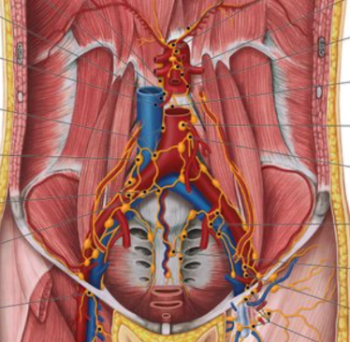
Selecting the templates on ⁶⁸Ga-PSMA-PET results
 | ¹¹C-choline | ⁶⁸Ga-PSMA
1 spot (N=171, 90%) | 24/86 (28%) | 5/85 (6%)
2 spots (N=18, 10%) | 2/7 (29%) | 3/11 (27%)
Significant increased risk of harbouring lymph node metastases in both pelvic sites
Adaption of resection field in case of more spots
No pick-up surgery in case of one spot
PSMA, prostate specific membrane antigen
Bravi C, et al. Eur Urol. 2020;78:779-82

Slide 44
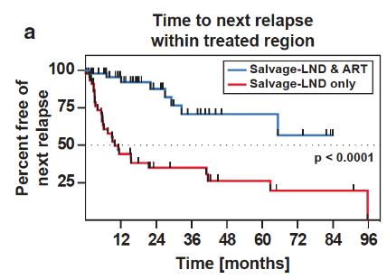
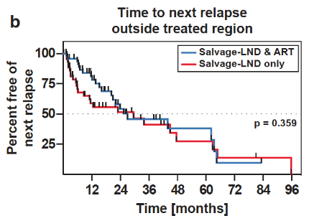
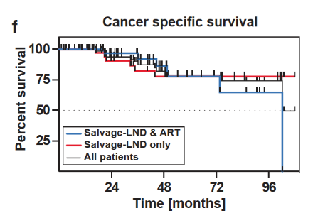
Multimodal treatment improves TumoUr control
ART, ablative radiotherapy; LND, lymph node dissection
Rischke et al. Strahlenther Onkol 2015; 19: 310-20

Slide 45
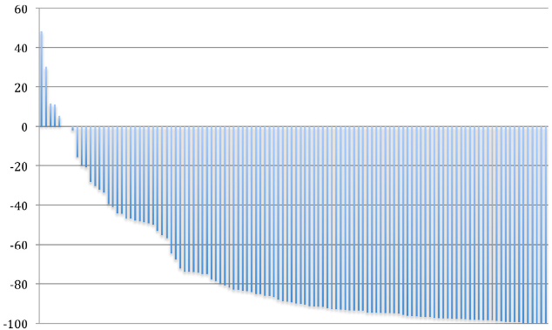
Radioguided surgery- A Milestone in Salvage LAD
Variable | N=121
Median patient age (IQR) | 70 (63-74)
Median PSA at RP (IQR) | 9.5 (6.8-17.9) ng/mL
T stage at RP
<pT2c | 41 (34%)
>pT3a | 78 (64%)
NA | 2 (2%)
N stage at RP
pN0 | 90 (74%)
pN1 | 25 (21%)
pNX | 6 (5%)
Gleason score at RP
5-6 | 13 (11%)
7 | 58 (48%)
8-10 | 44 (36%)
NA | 6 (5%)
Surgical margin status at RP
R0 | 78 (65%)
R1 | 22 (18%)
NA | 21 (17%)
Treatment after RP
No further treatment | 38 (31%)
Salvage radiotherapy | 77 (64%)
Salvage lymphadenectomy | 8 (7%)
Current androgen deprivation before PSMA-targeted RGS | 8 (7%)
Median PSA at PSMA-targeted RGS (IQR) | 1.13 (0.53-2.16) ng/mL
Location of recurrence
Seminal vesicle bed | 26 (22%)
Pelvic lymph nodes | 74 (61%)
Presacral/pararectal lymph nodes | 31 (26%)
Retroperitoneal lymph nodes | 5 (4%)
Number of tumour lesions
1 | 77 (64%)
2 | 29 (24%)
>2 | 15 (12%)
Median time from RP to PMSA-targeted RGS (IQR) | 4.3 (2.2-9.4) yr
PSA RESPONSES 4-8 WK AFTER PSMA-TARGETED RGS
% PSA change
IQR, interquartile range; LAD, lymph adenectomy; N, node; NA, not available; p, pathological; PSA, prostate-specific antigen; PSMA, prostate-specific membrane antigen; R, remaining cancer tissue; RP, radical prostatectomy; RGS, radioguided surgery; T, tumour
Horn T, et al. Eur Urol. 2019;76:517-23

Slide 46
ConclusionS
Modern imaging allows visualisation of early recurrences
Different strategies for patients with biochemical relapse
Clinical tools to select patients for local/focal treatment
Salvage lymph node dissection one option for highly selected patients

Slide 47
Prolonging Survival and Quality of Life: Importance of Treating nmCRPC Assoc. Prof. Alicia K. Morgans, MD, MPH Associate Professor of Medicine Northwestern University Chicago, IL, USA FEBRUARY 2021
nmCRPC, non-metastatic castration resistant prostate cancer

Slide 48
Disclaimer and disclosures
Please note: The views expressed within this presentation are the personal opinions of the authors. They do not necessarily represent the views of the author’s academic institution or the rest of the GU CONNECT group.
This content is supported by an independent educational grant from Bayer.
Assoc. Prof. Alicia Morgans has received financial support/sponsorship for research support, consultation or speaker fees from the following companies:
AstraZeneca, Astellas, Bayer, Genentech, Janssen, Sanofi, Seattle Genetics

Slide 49
Outline
Imaging advances merge patient states
Metastasis-directed therapy is insufficient
Level 1 evidence and guideline recommendation: Intensify systemic therapy
Effects on Metastasis-Free Survival (MFS)
Improved Overall Survival (OS)
Better Quality of Life (QOL)
Conclusions

Slide 50
Why is this a clinical question to debate?
Conventional imaging (technetium bone scan and CT scans) are negative for evidence of disease,
BUT
PSMA PET/CT demonstrates lymph nodes positive disease consistent with metastatic prostate cancer.
CT, computerised tomography; PSMA PET, prostate-specific membrane antigen positron emission tomography

Slide 51
Why is this a clinical question to debate?
Conventional imaging (technetium bone scan and CT scans) are negative for evidence of disease,
BUT
PSMA PET/CT demonstrates lymph nodes positive disease consistent with metastatic prostate cancer.
Regardless of PET imaging results, patients with rising PSA on ADT with negative conventional imaging meet trial definition of nmCRPC!
ADT, androgen deprivation therapy; nmCRPC, non-metastatic castration resistant prostate cancer; PET, positron emission tomography; PSA, prostate-specific antigen

Slide 52
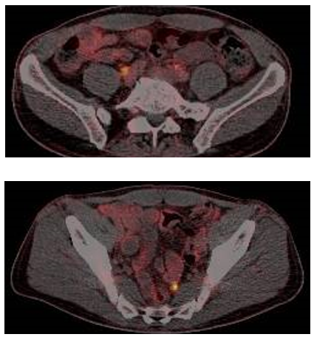
Is nmCRPC a real entity?
nmCRPC, non-metastatic castration resistant prostate cancer

Slide 53
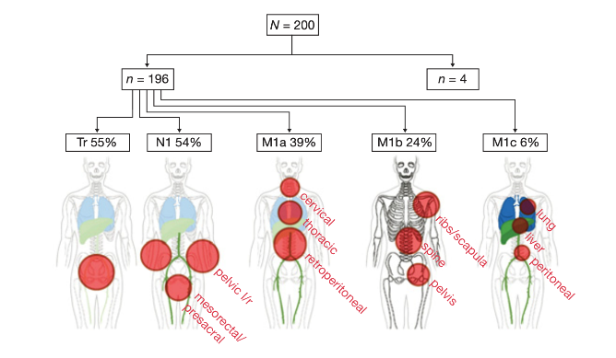
Imaging Advances Lead to Merging of Patient Groups
200 high-risk nmCRPC patients
PSADT ≤10 mo, PSA >2 ng/mL, no pelvic nodes ≥2 cm
no extrapelvic metastases
196 had metastatic lesions on PSMA-PET (98%)
15% had single metastasis
14% had 2-3 metastases
55% with distant metastatic disease
N=200
N=196
N=4
Tr 55%
N1 54%
M1a 39%
M1b 24%
M1c 6%
nmCRPC, non-metastatic castration resistant prostate cancer; PET, positron emission tomography; PSA(DT), prostate-specific antigen (doubling time); PSMA, prostate-specific membrane antigen
Fendler W, et al. Clin Cancer Res. 2019;25:7448-54

Slide 54
What are the SYSTEMIC options?

Slide 55
EAU Guidelines: Strong Recommendation
Recommendation | Strength rating
Offer apalutamide, darolutamide or enzalutamide to patients with M0 CRPC and a high risk of developing metastasis (PSADT <10 months) to prolong time metastases. | Strong
Only Level 1 Evidence of Benefit:
Intensified Systemic Therapy
EAU, European Association of Urology; M0 CRPC, non-metastatic castration resistant prostate cancer; PSADT, prostate-specific antigen doubling time
EAU Guidelines. Edn. presented at the EAU Annual Congress Amsterdam 2020. ISBN 978-94-92671-07-3.
https://uroweb.org/guideline/prostate-cancer/ Accessed 19-Jan-2021

Slide 56
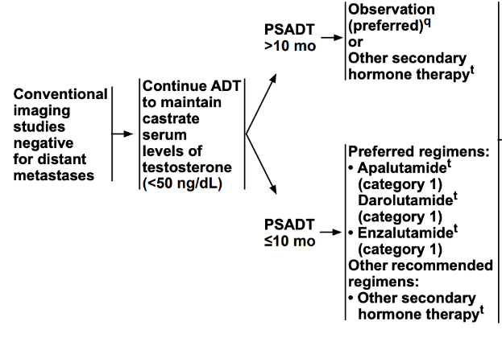
NCCN Guidelines: Category 1 Recommendation
ADT, androgen deprivation therapy; M0, non-metastatic; NCCN, National Comprehensive Cancer Network; PSADT, prostate-specific antigen doubling time
NCCN Clinical Practice Guidelines in Oncology – Prostate Cancer, Version 3.2020. Accessed 19-Jan-2021

Slide 57
Risk of Metastases Increases as PSADT Falls
3.0
2.8
2.6
2.4
Increasing risk
Relative risk for bone metastasis or death
2.2
2.0
1.8
1.6
1.4
20
18
16
14
12
10
8
6
4
2
PSADT (months)
Shorter PSADT
PSADT, prostate-specific antigen doubling time
Smith MR, et al. J Clin Oncol. 2013;31;3800-6; Small EJ, et al. J Clin Oncol. 2018;36(6_suppl):161

Slide 58
Study Designs: SPARTAN, PROSPER, ARAMIS
Key eligibility criteria
nmCRPC (central review)
Rising PSA despite castrate testosterone level (≤50 ng/dL)
Baseline PSA ≥2 ng/mL
PSADT ≤10 months
apalutamide (240 mg/day) + ADT (n=806)
Primary endpoint: MFS
Secondary endpoints: Time to metastasis, PFS, time to symptomatic progression, OS, time to chemotherapy
Exploratory endpoints included: time to PSA progression, PSA response, QOL and time to second PFS
SPARTAN:
Apalutamide vs Placebo^{1,2}
N=1,207
R
Placebo + ADT (n=401)
2:1
Key eligibility criteria
nmCRPC (central review)
Rising PSA despite castrate testosterone level (≤50 ng/dL)
Baseline PSA ≥2 ng/mL
PSADT ≤10 months
enzalutamide (160 mg/day) + ADT (n=933)
Primary endpoint: MFS
Secondary endpoints included: time to PSA progression, PSA response rate, time to next antineoplastic therapy, OS, QOL and safety
PROSPER:
Enzalutamide vs Placebo^{3,4}
N=1,401
R
Placebo + ADT (n=468)
2:1
darolutamide (1,200 mg) (2 × 300-mg tablets b.i.d.) + ADT
(n=955)
Primary endpoint: MFS
Secondary endpoints included: OS, times to: pain progression, first symptomatic skeletal event, first cytotoxic chemotherapy
Exploratory endpoints included: PFS,
time to first PC–related invasive procedure, time to initiation of subsequent antineoplastic therapy, PSA progression and response, deterioration in ECOG PS, QOL
Key eligibility criteria
nmCRPC
Baseline PSA ≥2 ng/mL
PSADT ≤10 months
ARAMIS:
Darolutamide vs Placebo⁵⁻⁷
N=1,509
R
Placebo + ADT (n=554)
2:1
ADT, androgen deprivation therapy; b.i.d., twice daily; ECOG PS, Eastern Cooperative Oncology Group; MFS, metastasis-free survival; nmCRPC, non-metastatic castration resistant prostate cancer; OS, overall survival; PC, prostate cancer; PFS, progression free survival; PSA, prostate-specific antigen; PSADT, prostate-specific antigen doubling time; QoL, quality of life; R, randomisation
1. Small EJ, et al. J Clin Oncol. 2018;36(6_suppl):161; 2. Smith MR, et al. N Eng J Med. 2018;378:1408-18; 3. Hussain M, et al. J Clin Oncol. 2018;36(6_suppl):3; 4. Hussain M, et al. N Engl J Med. 2018;378:2465-74; 5. Fizazi K, et al. J Clin Oncol. 2019;37(7_suppl):140; 6. Fizazi K, et al. N Engl J Med. 2019;380:1235-46; 7. Fizazi K, et al. N Engl J Med. 2020;383:1040-9
Notes:
R = randomization
PFS = progression-free survival
ABI = abiraterone
PRED = prednisone

Slide 59
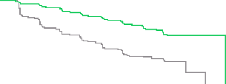
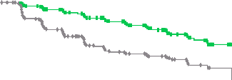
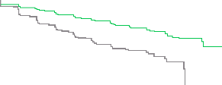
Primary Endpoint: Metastasis-Free Survival
100
apalutamide
Placebo
80
72% reduction of distant progression or death
Median MFS: APA 40.5 vs PBO 16.2 months
24-month MFS benefit
SPARTAN¹
apalutamide
60
Patients alive without metastasis (%)
40
20
HR 0.28 (95% CI 0.23–0.35) P < 0.001
0
0
4
8
12
16
20
24
28
32
36
40
44
No. at risk
apalutamide Placebo
Time since randomization (months)
806
401
713
291
652
220
514
153
398
91
282
58
180
34
96
13
36
5
16
1
3
0
0
0
100
enzalutamide
Placebo
90
80
71% reduction of distant progression or death
Median MFS: ENZA 36.6 vs PBO 14.7 months
22-month MFS benefit
PROSPER²
enzalutamide
70
60
Patients alive without metastasis (%)
50
40
30
20
HR 0.29 (95% CI 0.24–0.35) P < 0.001
10
0
0
3
6
9
12
15
18
21
24
27
30
33
36
39
42
No. at risk
enzalutamide Placebo
Time (months)
933
468
865
420
759
296
637
212
528
157
431
105
418
98
328
64
237
49
159
31
87
16
77
11
31
5
4
1
0
0
1.0
darolutamide
Placebo
0.9
0.8
59% reduction of distant progression or death
Median MFS: DARO 40.4 vs PBO 18.4 months
22-month MFS benefit
ARAMIS³
darolutamide
0.7
0.6
MFS probability
0.5
0.4
0.3
0.2
HR 0.41 (95% CI 0.34–0.50) P < 0.001
0.1
0
0
4
8
12
16
20
24
28
32
36
40
44
48
No. at risk
darolutamide Placebo
Time (months)
955
554
817
368
675
275
506
180
377
117
262
75
189
50
116
29
68
12
37
4
18
0
2
0
0
0
APA, apalutamide; CI, confidence interval; DARO, darolutamide; ENZA, enzalutamide; HR, hazard ratio; MFS, metastasis-free survival; PBO, placebo
1. Smith MR, et al. N Engl J Med. 2018;378:1408-18; 2. Hussain M, et al. N Engl J Med. 2018;378:2465-74; 3. Fizazi K, et al. N Engl J Med. 2019;380:1235-46

Slide 60
Secondary Endpoint: Final Overall Survival
100
80
apalutamide Median 73.9 months
22% reduction in risk of death HR 0.78 (95% CI 0.64-0.96); p=0.016
SPARTAN¹
apalutamide
60
Patients alive (%)
Placebo Median 59.9 months
40
apalutamide
Placebo
20
HR for death 0.78 (95% CI 0.64–0.96) P = 0.016
0
0
4
8
12
16
20
24
28
32
36
40
44
48
52
56
60
64
68
72
76
No. at risk
apalutamide Placebo
Time since randomization (months)
806
401
791
392
774
385
758
373
739
358
717
339
691
328
658
306
625
286
593
263
558
240
499
204
376
156
269
114
181
82
100
38
47
21
19
6
4
2
0
0
100
enzalutamide
Placebo
90
27% reduction in risk of death HR 0.73 (95% CI 0.61-0.89); p=0.001
80
PROSPER²
enzalutamide
70
60
Patients alive (%)
50
 | enzalutamide (n = 933) | Placebo (n = 468)
Median (95% CI), months | 67.0 (64.0–NR) | 56.3 (54.4–63.0)
HR (95% CI) | 0.73 (0.61–0.89)
 | P = 0.001
40
30
20
10
0
0
4
8
12
16
20
24
28
32
36
40
44
48
52
56
60
64
68
72
Patients at risk
enzalutamide Placebo
Time (months)
933
468
926
467
910
459
897
444
874
428
850
404
822
381
782
363
700
321
608 274
517
219
424
177
327
140
244
106
169
64
89
30
33
16
4
3
0
0
100
darolutamide
Placebo
31% reduction in risk of death HR 0.69 (95% CI 0.53-0.88); p=0.003
90
80
ARAMIS³
darolutamide
70
60
Patients alive (%)
50
40
30
20
HR 0.69 (95% CI 0.53–0.88) P = 0.003
10
0
0
4
8
12
16
20
24
28
32
36
40
44
48
52
56
60
Patients at risk
darolutamide Placebo
Time since randomization (months)
955
554
932
530
908
497
863
460
816
432
771
394
680
333
549
261
425
182
293
130
214
93
129
54
69
28
37
16
12
4
0
0
CI, confidence interval; HR, hazard ratio; ITT, intention to treat; NR, not reached
1. Smith MR, et al. Eur Urol. 2021;79:150-8; 2. Sternberg CN, et al. N Engl J Med. 2020;382:2197-206; 3. Fizazi K, et al. N Engl J Med. 2020;383:1040-9

Slide 61
Adverse Events of Interest
Safety | SPARTAN^{1,2} |  | PROSPER³ |  | ARAMIS⁴
 | APA (N=803) | PBO (N=398) | ENZA (N=930) | PBO (N=465) | DARO (N=954) | PBO (N=554)
Any AE, n (%) | 781 (97) | 373 (94) | 876 (94) | 380 (82) | 818 (85.7) | 439 (79.2)
Any serious AE, n (%) | 290 (36) | 99 (25) | 372 (40) | 100 (22) | 249 (26.1) | 121 (21.8)
AE leading to discontinuation, % | 120 (15.0) | 29 (7.3) | 17.0 | 9.0 | 8.9 | 8.7
AE leading to death, n (%) | 24 (3.0) | 2 (0.5) | 51 (5.0) | 3 (1.0) | 38 (4.0)^{c} | 19 (3.4) ^{c}
AE (all grades), %
Fatigue | 33 | 21 | 37 | 16 | 13.2 | 8.3
Hypertension | 28 | 21 | 18 | 6 | 7.8 | 6.5
Rash | 26 | 6.3 | 4 | 3 | 3.1 | 1.1
Falls | 22 | 9.5 | 18 | 5 | 5.2 | 4.9
Fractures | 18 | 7.5 | 18 | 6 | 5.5 | 3.6
Mental impairment disorderª | 5.1^{b} | 3.0^{b} | 8 | 2 | 2.0 | 1.8
ª SPARTAN: disturbance in attention, memory impairment, cognitive disorder and amnesia; PROSPER: as per SPARTAN trial with the addition of Alzheimer's disease, mental impairment, vascular dementia and senile dementia; ARAMIS trial: MedRA High Level Group Term; ^{b} Data taken from first interim analysis as not reported in final analysis¹; ^{c} reported as grade 5 adverse event
Presented for information, safety comparisons across trials should not be made
AE, adverse event; APA, apalutamide; DARO, darolutamide; ENZA, enzalutamide; PBO, placebo
1. Smith MR, et al. N Engl J Med. 2018;378:1408-18; 2. Smith MR, et al. Eur Urol. 2021;79:150-8; 3. Sternberg CN, et al. N Engl J Med. 2020;382:2197-206; 4. Fizazi K, et al. N Engl J Med. 2020;383:1040-9

Slide 62
Treatment Is Associated With Maintenance of HRQoL
SPARTAN¹
FACT-P
PROSPER²
FACT-P
ARAMIS³
FACT-P PCS
APA
Placebo
7
120
6
100
5
Favours enzalutamide
4
80
Mean score
3
2
60
1
LSM (95% CI) treatment difference
Mean (95% CI)
0
40
-1
20
-2
Favours placebo
-3
0
50
-4
DARO
-5
−20
Placebo
0
-6
-7
-40
Baseline
Cycle
BL
17
33
49
65
81
97
D1
16
32
48
64
80
96
112
128
144
160
176
192
EOT
Patients in each cycle
APA | 797 | 781 | 767 | 742 | 717 | 695 | 676 | 649 | 614 | 590 | 456 | 352 | 257 | 167
Placebo | 395 | 389 | 379 | 371 | 350 | 301 | 283 | 265 | 221 | 199 | 136 | 83 | 54 | 35
No. at risk
ENZA
Placebo
Study week
No. at risk
DARO
Placebo
Study week
– –
815
403
718
329
621 239
522 183
427 139
354 90
938
546
882
501
820
376
669
269
512
186
387
119
270
79
199
52
121
31
73
15
37
8
19
1
2
0
191
253
APA, apalutamide; AUC, area under the curve; BL, baseline; CI, confidence interval; DARO, darolutamide; ENZA, enzalutamide; FACT-P, Functional Assessment of Cancer Therapy–Prostate; HRQoL, health-related quality of life; LSM, least squares mean; PBO, placebo; PCS, Prostate Cancer Subscale
1. Saad F et al. Lancet Oncol. 2018;19:1404-1416; 2. Tombal B, et al. Lancet Oncol. 2019;20:556-69; 3. Fizazi K, et al. J. Clin Oncol 2019; 37; no. 15_suppl: 5000-5000

Slide 63
Post-hoc analysis: Time to deterioration of EORTC QLQ-PR25 subscales
 | Median time to deterioration (95% CI)
EORTC QLC-PR25 symptom subscale | Darolutamide (N=955) | Placebo (N=554) | Hazard ratio | HR (95% CI) | Log-rank test p-value
Bowel Symptoms | 18.4 (14.8-18.5) | 11.5 (11.1-14.8) |  | 0.78 (0.66-0.92) | <0.01
Hormone treatment related symptoms | 18.9 (18.2-22.2) | 18.4 (14.8-25.9) |  | 1.06 (0.88-1.27) | 0.52
Incontinence aid | 36.6 (15.1-NE) | 22.1 (14.8-NE) |  | 0.99 (0.67-1.47) | 0.97
Sexual activity | 33.2 (33.0-NE) | 30.1 (25.8-NE) |  | 0.82 (0.66-1.00) | 0.05
Sexual functioning | 22.7 (18.4-NE) | NE (7.5-NE) |  | 0.73 (0.41-1.29) | 0.27
Urinary symptoms | 25.8 (22.0-33.1) | 14.8 (11.2-15.1) |  | 0.64 (0.54-0.76) | <0.01
Favours darolutamide
Favours placebo
0.4
0.6
0.8
1.0
1.2
1.6
2.0
Darolutamide showed statistically and clinically significant delays in time to deterioration compared with placebo for urinary and bowel symptoms
Time to deterioration for the other subscales were not statistically different between groups
CI, confidence interval; EORTC QLQ-PR25, European Organisation for Research and Treatment of Cancer Quality of Life Prostate Cancer Module; HR, hazard ratio; NE, not estimable
Fizazi K, et al. J Clin Oncol. 2019;37(15_suppl):5000 (oral presentation)

Slide 64
Post-hoc analysis: Time to deterioration of EORTC QLQ-PR25 subscales
 | Median time to deterioration (95% CI)
EORTC QLC-PR25 symptom subscale | Darolutamide (N=955) | Placebo (N=554) | Hazard ratio | HR (95% CI) | Log-rank test p-value
Bowel Symptoms | 18.4 (14.8-18.5) | 11.5 (11.1-14.8) |  | 0.78 (0.66-0.92) | <0.01
Hormone treatment related symptoms | 18.9 (18.2-22.2) | 18.4 (14.8-25.9) |  | 1.06 (0.88-1.27) | 0.52
Incontinence aid | 36.6 (15.1-NE) | 22.1 (14.8-NE) |  | 0.99 (0.67-1.47) | 0.97
Sexual activity | 33.2 (33.0-NE) | 30.1 (25.8-NE) |  | 0.82 (0.66-1.00) | 0.05
Sexual functioning | 22.7 (18.4-NE) | NE (7.5-NE) |  | 0.73 (0.41-1.29) | 0.27
Urinary symptoms | 25.8 (22.0-33.1) | 14.8 (11.2-15.1) |  | 0.64 (0.54-0.76) | <0.01
Favours darolutamide
Favours placebo
Stools/bloating
Blood in stools
Interference with daily activities
Frequency
Urge
Interference with daily activities
0.4
0.6
0.8
1.0
1.2
1.6
2.0
Darolutamide showed statistically and clinically significant delays in time to deterioration compared with placebo for urinary and bowel symptoms
Time to deterioration for the other subscales were not statistically different between groups
CI, confidence interval; EORTC QLQ-PR25, European Organisation for Research and Treatment of Cancer Quality of Life Prostate Cancer Module; HR, hazard ratio; NE, not estimable
Fizazi K, et al. J Clin Oncol. 2019;37(15_suppl):5000 (oral presentation)

Slide 65
conclusions
Imaging advances blur the distinction between patient types
Applying the criteria for nmCRPC from clinical trials remains valid
MDT for nmCRPC appears promising
Insufficient evidence available to apply outside of a clinical trial
Level 1 Evidence supports the NCCN and EAU Guidelines for use of apalutamide, darolutamide, or enzalutamide for nmCRPC
Improves MFS, OS, and QOL
EAU, European Association of Urology; MDT, metastasis-directed therapy; MFS, metastases-free survival; NCCN, National Comprehensive Cancer Network; nmCRPC, non-metastatic castration resistant prostate cancer; OS, overall survival; QOL, quality of life

Slide 66
nmCRPC: Case STUDY 2
nmCRPC, non-metastatic castration resistant prostate cancer

Slide 67
Patient Case 2
Mr. TR is a 65-year-old man was diagnosed with high-risk prostate cancer
Clinical stage T2a, PSA 7.2, Gleason 4+3 in multiple cores
He undergoes laparoscopic prostatectomy;
pathology demonstrates pT3bN0, Gleason 4+5, with + surgical margins, postoperative PSA <0.10
He receives adjuvant radiation therapy
Seven months later, his PSA is elevated at 5.4, and repeat PSA one month later is 6.3
Abdominal-pelvic CT and bone scan report no detectable cancer
CT, computed tomography; PSA, prostate specific antigen

Slide 68
Patient Case 2
He starts ADT with leuprolide depot
PSA nadir <0.1
About 3 years after starting ADT, PSA is rising
Latest PSA 7.9
Calculated PSA doubling time is 5 months
Bone scan, chest CT, and abdominal-pelvic CT report no detectable cancer
PSMA PET scan: 1 small pelvic lymph node and 1 small lesion in L2 (appears consistent with recurrent disease)
What do you recommend?
ADT, androgen deprivation therapy; CT, computed tomography; PSA, prostate specific antigen

Slide 69
nmCRPC: Case STUDY 3
nmCRPC, non-metastatic castration resistant prostate cancer

Slide 70
Patient Case 3 Patient *30.12.1941
First diagnosis of locally advanced prostate cancer 2008 initial PSA 6 ng/mL
Open radical prostatectomy pT3b, pN0 R0 L1V0 Gleason Score 7b
PSA-Nadir undetectable
Slow PSA rising since 2011 till 0.3 ng/mL 2017
Patient started treatment with ADT in 2018
 | 2017 | 2018 | 2019 | 01/2020 | 09/2020
PSA (ng/mL) | 0.3 | 0.6 | 0.7 | 0.99 | 2.0
PSA, prostate-specific antigen

Slide 71
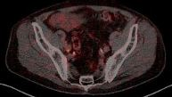
Patient Case 3 PSMA-PET at PSA 2.0 ng/ml with one single lymph node A. iliaca interna
PSMA-PET, prostate specific membrane antigen-positron emission tomography; PSA, prostate-specific antigen

Slide 72
REACH GU CONNECT VIA TWITTER, LINKEDIN, VIMEO & EMAIL OR VISIT THE GROUP’S WEBSITE http://www.guconnect.info
Follow us on Twitter @guconnectinfo
Follow the GU CONNECT group on LinkedIn
Watch us on the Vimeo Channel GU CONNECT
Email sam.brightwell@cor2ed.com

