Slide 2
“Next-Generation” sequencing of therapy for castration-resistant prostate cancer (CRPC)
Tanya Dorff, MD
Associate Clinical Professor of Medicine
Department of Medical Oncology &
Experimental Therapeutics
Head, Genitourinary Cancer Program
City of Hope Comprehensive Cancer Center
Evan Yu, MD
Professor of Medicine
Department of Medical Oncology
University of Washington and Seattle Cancer Care Alliance
Notes:
2

Slide 3
Non Metastatic castration-resistant prostate cancer (nmCRPC)

Slide 4
Clinical Disease-States Model of Prostate Cancer
Clinical metastases: noncastrate
Clinically localized disease
Rising PSA Noncastrate
mCRPC: 1st line
mCRPC: 2nd line
mCRPC: line X
nmCRPC
Noncastrate
Castration-resistant
mCRPC: 3rd line, 4th line, etc.
Two defining criteria of nmCRPC
Rising PSA in the setting of castrate testosterone levels (≤ 50 ng/dL)
No radiographically identifiable metastasis
(n)mCRPC, (non)metastatic castration-resistant prostate cancer; PSA, prostate specific antigen
Scher HI, et al. J Clin Oncol. 2016;34:1402-18

Slide 5
Definition of nmCRPC
Patients with rising PSA with castrate levels of testosterone (≤ 50 ng/dL) despite ongoing ADT
No detectable metastases by conventional imaging (bone scan and CT or MRI)
Generally asymptomatic apart from symptoms from prior therapies
Most patients with nmCRPC are presumed to have tumor recurrence or micrometastatic growth undetectable on conventional imaging
nmCRPC patients with a PSADT < 10 months are high risk of progression and cancer-related mortality
The recent approvals of new-generation androgen-receptor pathway inhibitors address the gap in the management of nmCRPC
ADT, androgen deprivation therapy; CT, computed tomography; MRI, magnetic resonance imaging; nmCRPC, nonmetastatic castration-resistant prostate cancer; mCRPC, metastatic castration-resistant prostate cancer; PSA, prostate specific antigen; PSADT, prostate specific antigen doubling time
Scher HI, et al. J Clin Oncol. 2016;34:1402-18; Saad F, et a;. Can Urol Assoc J 2019; 13: 307-14

Slide 6
PSA and PSADT Are Associated With Shorter Time to Metastasis
PSA
PSADT
1.0
PSA < 7.7 ng/mL
PSA 7.7–24.0 ng/mL
PSA > 24.0 ng/mL
1.0
PSADT < 6.3 months
PSADT 6.3–18.8 months
PSADT > 18.8 months
0.8
0.8
0.6
0.6
Proportion of patients
with bone metastases or dead
Proportion of patients
with bone metastases or dead
0.4
0.4
0.2
0.2
0
0
0
0.5
1.0
1.5
2.0
2.5
3.0
0
0.5
1.0
1.5
2.0
2.5
3.0
Time since randomization, years
Time since randomization, years
PSA, prostate specific antigen; PSADT, prostate specific antigen doubling time
Smith MR, et al. J Clin Oncol. 2005;23:2918-25

Slide 7
nmCRPC is a Deadly Disease
Phase 3 trial of denosumab in patients with nmCRPC
Endpoint | Denosumab | Placebo | HR (95% CI) | P value
Median BMFS, months | 29.5 | 25.2 | 0.85 (0.73–0.98) | 0.028
Time to first BM, months | 33.2 | 29.5 | 0.84 (0.71–0.98) | 0.032
OS, months | 43.9 | 44.8 | 1.01 (0.85–1.20) | 0.91
Median time to metastasis: 29.5 months
Median overall survival: 44.8 months
BM, bone metastasis; BMFS, bone metastasis-free survival; CI, confidence interval; HR, hazard ratio; nmCRPC, nonmetastatic castration-resistant prostate cancer; OS, overall survival
Smith MR, et al. Lancet. 2012;379:39-46

Slide 8
next-generation androgen receptor inhibitors
enzalutamide
apalutamide
darolutamide
darolutamide is structurally distinct from apalutamide and enzalutamide and is characterized by low blood–brain barrier penetration^{1,2}
This could result in less CNS toxicity and improved tolerability
CNS, central nervous system
1. Zurth C, et al. J Clin Oncol. 2018;36 suppl 6S:345; 2. Zurth C, et al. J Clin Oncol. 2019;37 suppl 7S:156 Fizazi K, et al. J Clin Oncol. 2019;37 suppl 7S:140; Images from PubChem database: https://pubchem.ncbi.nlm.nih.gov/

Slide 9
SPARTAN (Apalutamide vs Placebo): Study Design
Key eligibility criteria
nmCRPC (central review)
Baseline PSA ≥ 2 ng/mL
Rising PSA despite castrate testosterone level (≤ 50 ng/dL)
PSADT ≤ 10 months
apalutamide (240 mg/day) + ADT
n = 1,207
R
Placebo + ADT
2:1
78% of patients in placebo group received subsequent approved therapy for mCRPC
Primary endpoint: MFS
Secondary endpoints: Safety, time to PSA progression, time to symptomatic progression, OS, PSA response, QoL
ADT, androgen deprivation therapy; mCRPC, metastatic castration-resistant prostate cancer; MFS, metastasis-free survival; nmCRPC, nonmetastatic castration-resistant prostate cancer; OS, overall survival; PSA, prostate specific antigen; PSADT, prostate specific antigen doubling time; QoL, quality of life; R, randomization
Small EJ, et al. J Clin Oncol. 2018;36 suppl 6S:161; Smith MR, et al. N Eng J Med. 2018;378:1408-18

Slide 10
PROSPER (Enzalutamide vs Placebo): Study Design
Key eligibility criteria
nmCRPC (central review)
Rising PSA despite castrate testosterone level (≤ 50 ng/dL)
Baseline PSA ≥ 2 ng/mL
PSADT ≤ 10 months
enzalutamide (160 mg/day) + ADT
n = 1,401
R
Placebo + ADT
2:1
Primary endpoint: MFS (defined as time from randomization to radiographic progression or death within 112 days of treatment discontinuation)
Secondary endpoints: Safety, time to PSA progression, time to use of new antineoplastic therapy, OS, PSA response, and QoL
48% of patients in placebo group received subsequent approved therapy for mCRPC
ADT, androgen deprivation therapy; mCRPC, metastatic castration-resistant prostate cancer; MFS, metastasis-free survival; nmCRPC, nonmetastatic castration-resistant prostate cancer; OS, overall survival; PSA, prostate specific antigen; PSADT, prostate specific antigen doubling time; QoL, quality of life; R, randomization
Hussain M, et al. J Clin Oncol. 2018;36 suppl 6S:3; Hussain M, et al. N Engl J Med. 2018;378:2465-74

Slide 11
ARAMIS (Darolutamide vs Placebo): Study Design
darolutamide (1,200 mg) + ADT (2 × 300-mg tablets b.i.d.)
n = 955
Primary analysis: MFS
Key eligibility criteria
nmCRPC
Baseline PSA ≥ 2 ng/mL
PSADT ≤ 10 months
n = 1,509
R
Placebo b.i.d. + ADT n = 554
Final analysis: OS
2:1
Primary endpoint: MFS
Secondary endpoints: OS, time to first symptomatic skeletal event, time to initiation of first cytotoxic chemotherapy, time to pain progression, safety, and tolerability
55% of patients in placebo group received subsequent therapy for mCRPC
ADT, androgen deprivation therapy; b.i.d., twice daily; mCRPC, metastatic castration-resistant prostate cancer; MFS, metastasis-free survival; nmCRPC, nonmetastatic castration-resistant prostate cancer; OS, overall survival; PSA, prostate specific antigen; PSADT, prostate specific antigen doubling time; R, randomization
Fizazi K, et al. J Clin Oncol. 2019;37 suppl 7S:140; Fizazi K, et al. N Engl J Med. 2019;380:1235-46; Fizazi K, et al. N Engl J Med. 2020; 383: 1040-1049

Slide 12
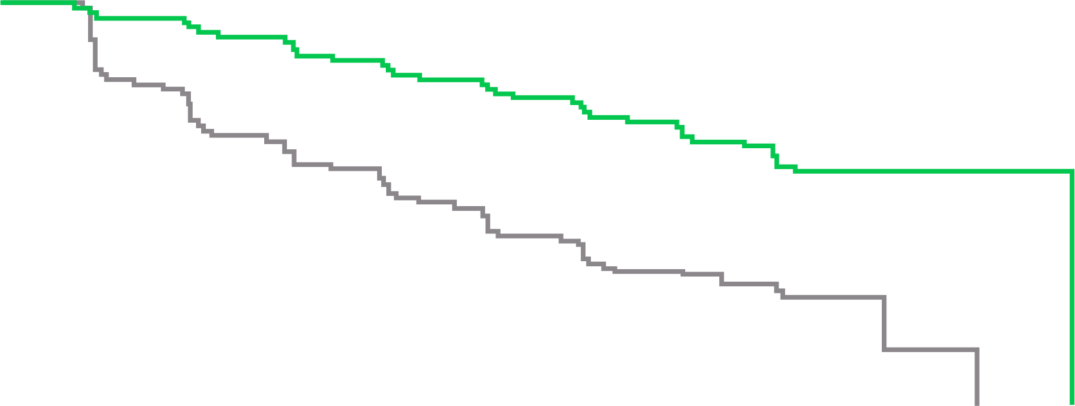
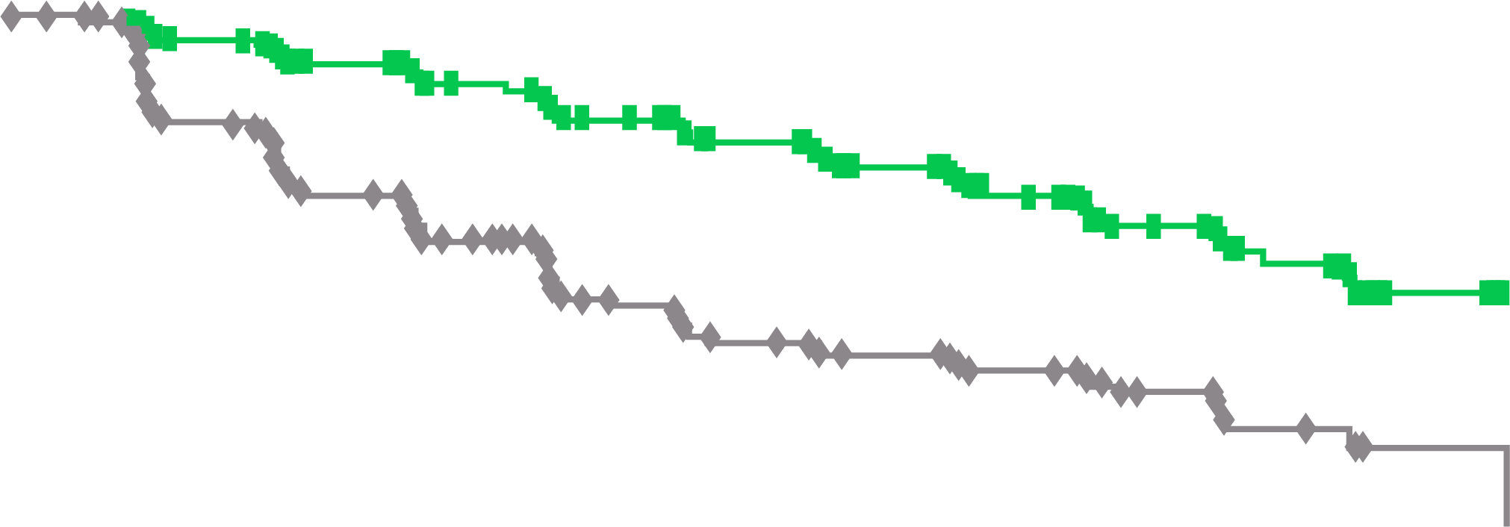
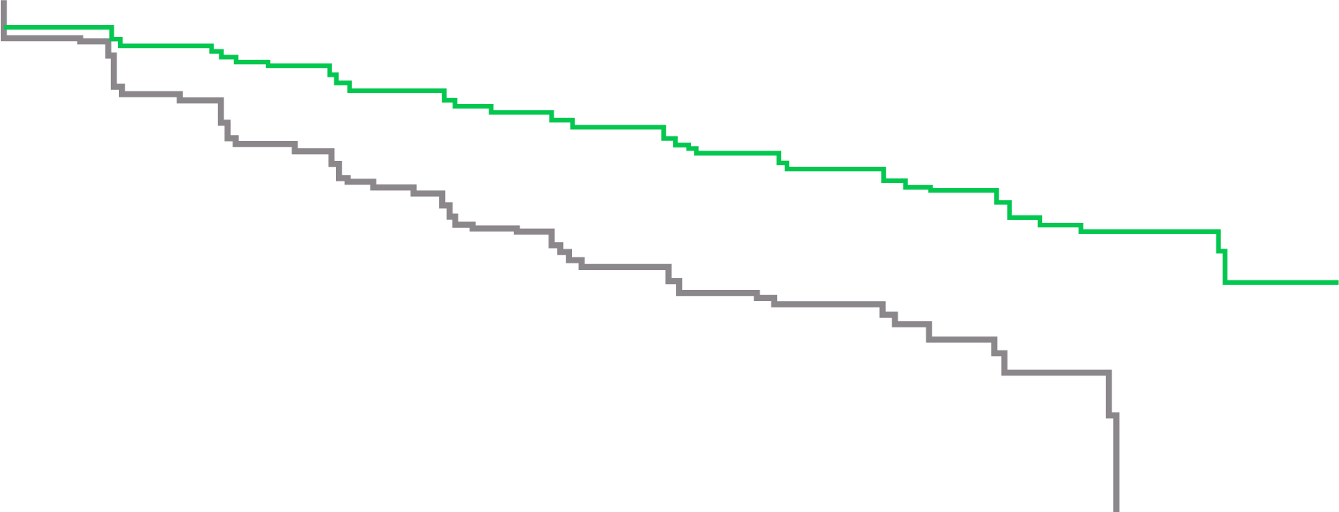
Primary Endpoint: Metastasis-Free Survival
100
apalutamide
Placebo
80
72% reduction of distant progression or death
Median MFS: APA 40.5 vs PBO 16.2 months
24-month MFS benefit
SPARTAN¹
apalutamide
60
Patients alive without metastasis (%)
40
20
HR 0.28 (95% CI 0.23–0.35) P < 0.001
0
0
4
8
12
16
20
24
28
32
36
40
44
No. at risk
apalutamide Placebo
Time since randomization (months)
806
401
713
291
652
220
514
153
398
91
282
58
180
34
96
13
36
5
16
1
3
0
0
0
100
enzalutamide
Placebo
90
80
71% reduction of distant progression or death
Median MFS: ENZA 36.6 vs PBO 14.7 months
22-month MFS benefit
PROSPER²
enzalutamide
70
60
Patients alive without metastasis (%)
50
40
30
20
HR 0.29 (95% CI 0.24–0.35) P < 0.001
10
0
0
3
6
9
12
15
18
21
24
27
30
33
36
39
42
No. at risk
enzalutamide Placebo
Time (months)
933
468
865
420
759
296
637
212
528
157
431
105
418
98
328
64
237
49
159
31
87
16
77
11
31
5
4
1
0
0
1.0
darolutamide
Placebo
0.9
0.8
59% reduction of distant progression or death
Median MFS: DARO 40.4 vs PBO 18.4 months
22-month MFS benefit
ARAMIS³
darolutamide
0.7
0.6
MFS probability
0.5
0.5
0.3
0.2
HR 0.41 (95% CI 0.34–0.50) P < 0.001
0.1
0
0
4
8
12
16
20
24
28
32
36
40
44
48
No. at risk
darolutamide Placebo
Time (months)
955
554
817
368
675
275
506
180
377
117
262
75
189
50
116
29
68
12
37
4
18
0
2
0
0
0
APA, apalutamide; CI, confidence interval; DARO, darolutamide; ENZA, enzalutamide; HR, hazard ratio; MFS, metastasis-free survival; PBO, placebo
1. Smith MR, et al. N Engl J Med. 2018;378:1408-18; 2. Hussain M, et al. N Engl J Med. 2018;378:2465-74; 3. Fizazi K, et al. N Engl J Med. 2019;380:1235-46

Slide 13
Secondary Endpoint: Final Overall Survival
100
80
apalutamide Median 73.9 months
22% reduction in risk of death HR 0.78 (95% CI 0.64-0.96); p=0.016
84% of placebo patients received subsequent life-prolonging therapy
SPARTAN¹
apalutamide
60
Patients alive (%)
Placebo Median 59.9 months
40
apalutamide
Placebo
20
HR for death 0.78 (95% CI 0.64–0.96) P = 0.016
0
0
4
8
12
16
20
24
28
32
36
40
44
48
52
56
60
64
68
72
76
No. at risk
apalutamide Placebo
Time since randomization (months)
806
401
791
392
774
385
758
373
739
358
717
339
691
328
658
306
625
286
593
263
558
240
499
204
376
156
269
114
181
82
100
38
47
21
19
6
4
2
0
0
100
enzalutamide
Placebo
90
27% reduction in risk of death HR 0.73 (95% CI 0.61-0.89); p=0.001
65% of placebo patients received subsequent antineoplastic therapy
80
PROSPER²
enzalutamide
70
60
Patients alive (%)
50
 | enzalutamide (n = 933) | Placebo (n = 468)
Median (95% CI), months | 67.0 (64.0–NR) | 56.3 (54.4–63.0)
HR (95% CI) | 0.73 (0.61–0.89)
 | P = 0.001
40
30
20
10
0
0
4
8
12
16
20
24
28
32
36
40
44
48
52
56
60
64
68
72
Patients at risk
enzalutamide Placebo
Time (months)
933
468
926
467
910
459
897
444
874
428
850
404
822
381
782
363
700
321
608 274
517
219
424
177
327
140
244
106
169
64
89
30
33
16
4
3
0
0
100
darolutamide
Placebo
31% reduction in risk of death HR 0.69 (95% CI 0.53-0.88); p=0.003
55% of placebo patients received subsequent life-prolonging therapy
90
80
ARAMIS³
darolutamide
70
60
Patients alive (%)
50
40
30
20
HR 0.69 (95% CI 0.53–0.88) P = 0.003
10
0
0
4
8
12
16
20
24
28
32
36
40
44
48
52
56
60
Patients at risk
darolutamide Placebo
Time since randomization (months)
955
554
932
530
908
497
863
460
816
432
771
394
680
333
549
261
425
182
293
130
214
93
129
54
69
28
37
16
12
4
0
0
CI, confidence interval; HR, hazard ratio; ITT, intention to treat; NR, not reached
1. Smith MR, et al. Eur Urol. 2021;79:150-8; 2. Sternberg CN, et al. N Engl J Med. 2020;382:2197-206; 3. Fizazi K, et al. N Engl J Med. 2020;383:1040-9

Slide 14
Adverse Events of Interest
Safety | SPARTAN^{1,2,3} |  | PROSPER⁴ |  | ARAMIS⁵
 | APA (n = 803) | PBO (n = 398) | ENZA (n = 930) | PBO (n = 465) | DARO (n = 954) | PBO (n = 554)
Any AE, n (%) | 781 (97) | 373 (94) | 876 (94) | 380 (82) | 818 (85.7) | 439 (79.2)
Any serious AE, n (%) | 290 (36) | 99 (25) | 372 (40) | 100 (22) | 249 (26.1) | 121 (21.8)
AE leading to discontinuation, % | 15.0 | 7.3 | 17.0 | 9.0 | 8.9 | 8.7
AE leading to death, n (%) | 24 (3.0) | 2 (0.5) | 51 (5.0) | 3 (1.0) | 38 (4.0) | 19 (3.4)
AE (all grades), %
Fatigue | 31.9† | 21.4† | 37 | 16 | 13.2 | 8.3
Hypertension | 27.6† | 20.9† | 18.0 | 6.0 | 7.8 | 6.5
Rash | 26.0 | 6.3 | 4 | 3 | 3.1 | 1.1
Falls | 22.0 | 9.5 | 18.0 | 5.0 | 5.2 | 4.9
Fractures | 18.0 | 7.5 | 18 | 6 | 5.5 | 3.6
Mental impairment disorder# | 5.1§ | 3.0§ | 8.0 | 2.0 | 2.0 | 1.8
#SPARTAN: disturbance in attention, memory impairment, cognitive disorder and amnesia; PROSPER: as per SPARTAN trial with the addition of Alzheimer's disease, mental impairment, vascular dementia and senile dementia; ARAMIS trial: cognitive disorder, memory impairment and change in mental status; § Data taken from first interim analysis as placebo group not reported in final analysis¹ ; † Data taken from second interim analysis as placebo group not reported in final analysis²
AE, adverse event; APA, apalutamide; DARO, darolutamide; ENZA, enzalutamide; NA, not available; PBO, placebo
1. Smith MR, et al. N Engl J Med. 2018;378:1408-18; 2. Small EJ, et al. Annals of Oncology 2019; 30: 1813-1820; 3. Smith MR, et al. Eur Urol. 2020; https://doi.org/10.1016/j.eururo.2020.08.011; 4. Sternberg CN, et al. N Engl J Med. 2020;382: 2197-206; 5. Fizazi K, et al. N Engl J Med. 2020; 383: 1040-1049

Slide 15
Treatment Is Associated With Maintenance of HRQoL
SPARTAN¹
FACT-P
PROSPER²
FACT-P
ARAMIS³
FACT-P PCS
7
0.6 (0.3–1.0); P < 0.01
−0.0
*
*
6
APA
5
−2.0
4
Favors enzalutamide
3
2
1
FACT-P total
LSM (95% CI) treatment difference
−4.0
0
−1
−2
Favors placebo
−6.0
−3
Placebo
−4
−5
−8.0
* Significantly different (p<0.05)
−6
−7
2
3
4
5
6
7
9
11
13
17
21
25
29
33
BL
17
33
49
65
81
97
Visit (cycle)
Number at risk
Enzalutamide
Placebo
Study week
Number at risk
APA
Placebo
– –
815
403
718
329
621 239
522 183
427 139
354 90
DARO
PBO
692 290
664 277
639 256
586 191
539 137
505 95
468 58
435 40
707 339
732 358
787 390
750 376
769 382
611 215
(cycle 21 p=0.014, cycle 25 p=0.0009)
AUC, area under the curve; BL, baseline; CI, confidence interval; DARO, darolutamide; ENZA, enzalutamide; FACT-P, Functional Assessment of Cancer Therapy–Prostate; HRQoL, health-related quality of life; LSM, least squares mean; PBO, placebo; PCS, Prostate Cancer Subscale
1. Oudard S, et al. ESMO 2020; Abs# 632P; 2. Tombal B, et al. Lancet Oncol. 2019;20:556-69; 3. Fizazi K, et al. N Engl J Med. 2019;380:1235-46

Slide 16
Next Generation Imaging
NGI using PET or CT and radiotracers such as ¹⁸F-FACBC, ¹¹C-choline, agents targeting PSMA, ¹⁸F-FDHT, and ¹¹C-acetate allows the identification of previously undetectable prostate cancer metastases
Potential to redefine traditionally accepted stages in prostate cancer progression, allowing for earlier treatment with potential impact on long-term outcomes
SPARTAN¹, PROSPER², and ARAMIS³ used conventional imaging techniques
Many patients categorized as having nmCRPC on the basis of traditional imaging techniques could potentially be upgraded to mCRPC
However, given recent FDA approvals of apalutamide, enzalutamide, and darolutamide for nmCRPC, the utility of NGI in the nmCRPC setting is yet to be determined
A retrospective study of high-risk nmCRPC patients according to conventional imaging detected 55% of patients to have distant metastatic disease upon PSMA-PET.⁴ As demonstrated in the SPARTAN, PROSPER and ARAMIS trials, these patients still gained benefit from systemic treatment with ARI’s^{1,2,3}
RADAR III recommends NGI be considered in the nmCRPC setting if PSADT < 6 months and the clinician believes metastatic therapies to be appropriate⁵
ASCO guidelines consider the data on detection capabilities of NGI in the nmCRPC setting and impact on management to be limited⁶
ARI, androgen receptor inhibitor; CT, computed tomography; FDA, Food and Drug Administration; FACBC, fluorocyclobutane-1-carboxylic acid; FDHT, 16β-fluoro-5α-dihydrotestosterone; mCRPC, metastatic castration-resistant prostate cancer; NGI, next-generation imaging; nmCRPC, nonmetastatic castration-resistant prostate cancer; PET, positron emission tomography; PSADT, prostate specific antigen doubling time; PSMA, prostate specific membrane antigen. 1. Smith MR, et al. Eur Urol. 2020; https://doi.org/10.1016/j.eururo.2020.08.011; 2. Sternberg CN, et al. N Engl J Med. 2020;382: 2197-206; 3. Fizazi K, et al. N Engl J Med. 2020; 383: 1040-1049; 4.Fendler WP, et al. Clin Cancer Res 2019; 25: 7448-54; 5. Crawford ED, et al. J Urol. 2019;201:682-92; 6. Trabulsi EJ, et al. Journal of Clinical Oncology 2020; 38: 1963-1996

Slide 17
Key Points
Delaying time to metastatic progression is an important treatment goal in nmCRPC
Recent FDA approvals of apalutamide, enzalutamide, and darolutamide fill the treatment gap for nmCRPC patients
All 3 of the above agents are now also confirmed to offer OS benefit, in addition to MFS benefit
The emergence of next-generation imaging may redefine the classification of nmCRPC in the near future
FDA, Food and Drug Administration; MFS, metastasis-free survival; nmCRPC, nonmetastatic castration-resistant prostate cancer; OS, overall survival

Slide 18
Metastatic castration-resistant prostate cancer (mCrpc)

Slide 19
Objectives
How to optimize use of agents in sequence
It’s a marathon, not a sprint
Individualize the selections when possible
Combinations
How to incorporate new agents
PARP inhibitors
Immune checkpoint inhibitors
¹⁷⁷Lu-PSMA
¹⁷⁷Lu, lutetium 177; PARP, poly-ADP ribose polymerase; PSMA, prostate specific membrane antigen

Slide 20
Current Paradigms for metastatic prostate cancer
CSPC
ADT + abi, apa, enza
ADT + docetaxel
ADT
Genomic profiling
SipT?
SipT?
SipT?
docetaxel, ²²³Raª, or PARPi^{b}
abiraterone or
enzalutamide
abiraterone, enzalutamide, or docetaxel
C
R
P
C
cabaz
PARPi^{b} or ICI^{c}
abi, enza, daro?
cabaz (doc)
²²³Raª
PARPi^{b} or ICI^{c}
abi, enza, daro?
cabaz, doc, ²²³Raª
PARPi^{b} or ICI^{c}
ª For patients with symptomatic bone metastases and no known visceral metastases; ^{b} if DNA repair mutation identified; ^{c} pembrolizumab if MSI is high.
NOTE: darolutamide is not currently approved for CRPC
abi, abiraterone; ADT, androgen deprivation therapy; apa, apalutamide; cabaz, cabazitaxel; CRPC, castration-resistant prostate cancer; CSPC, castration-sensitive prostate cancer; daro, darolutamide; doc, docetaxel; enza, enzalutamide; ICI, immune checkpoint inhibitor; MSI, microsatellite instability; PARPi, poly-ADP ribose polymerase inhibitor; ²²³Ra, radium 223, SipT, sipuleucel-T.
Dorff, T personal communication

Slide 21
Optimizing use of existing therapies: don’t change for PSA alone
Treatment
start
Symptomatic
progression (bone)
7
6
A drifter for 3.5 years
5
Palliative radiation therapy
4
PSA (ng/mL)
3
2
1
0
Time (months)
2
4
5
6
7
8
9
11
12
15
16
17
20
21
22
24
25
27
28
29
32
37
39
41
42
44
45
47
49
3
10
50
13
14
18
19
23
26
30
31
33
34
35
36
38
40
43
46
Screen 1
48
BL
Screen 2
Screen 3
1
Imaging time points
BL, baseline; PSA, prostate specific antigen
Scher HI, et al. J Clin Oncol. 2011;29:3695-704
Notes:
Treat through PSA rise

Slide 22
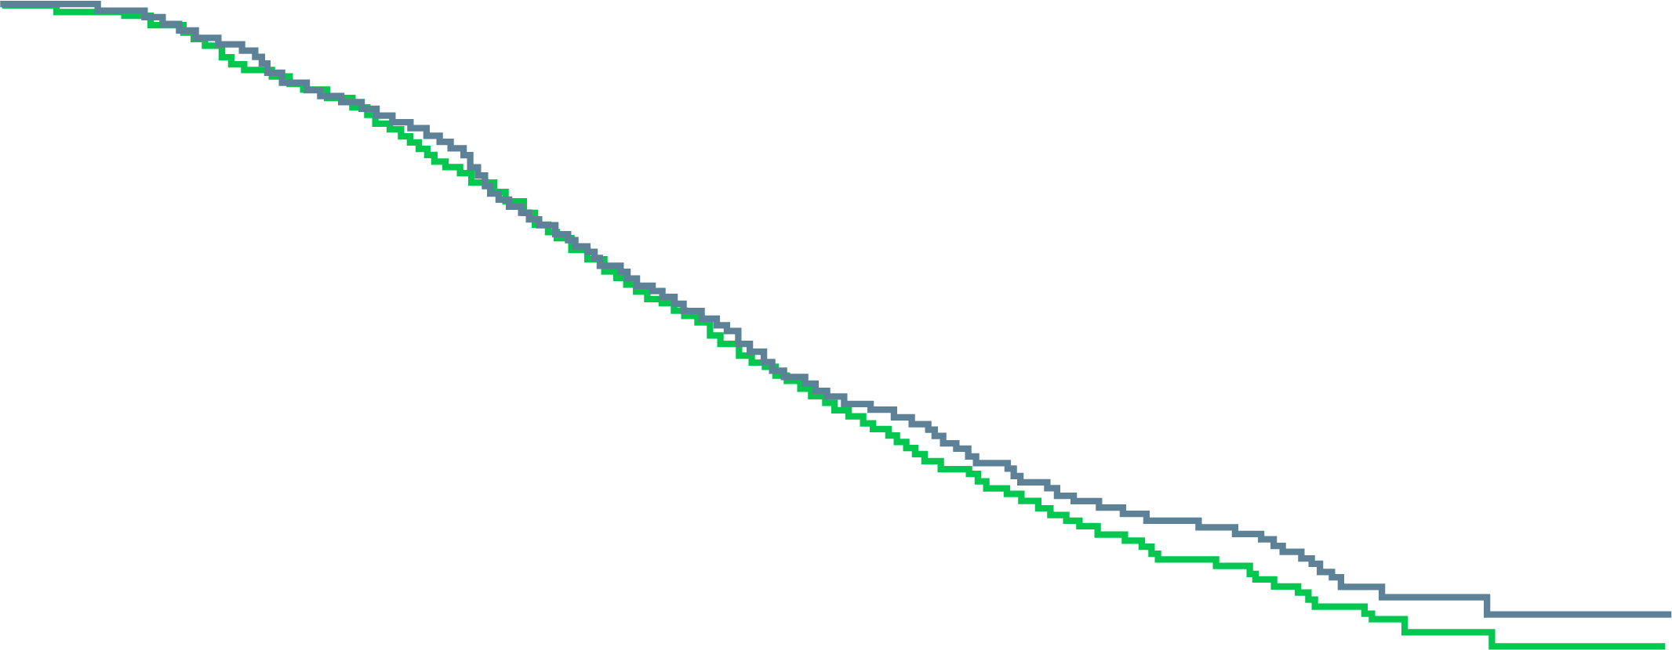
Combinations have not been successful
ALLIANCE A031201 trial enzalutamide ± abiraterone in mCRPC¹
Neoadjuvant: intense adt prior to RP²
No difference in overall survival
Higher rate of grade 3–5 AEs
LHRH + abiraterone + apalutamide no better than LHRH + abiraterone (pathologic response)
Overall survival
enza + AAP
enza
 | APL (n = 59) | APAL (n = 55)
Pathologic response, n (%)
pCR | 6 (10) | 7 (13)
MRD (≤ 5 mm)* | 6 (10) | 5 (9)
pCR or MRD | 12 (20) | 12 (22)
1.0
0.8
enzalutamide + AAP Median 34.2 months (95% CI 31.8–37.5)
0.6
Survival probability
0.4
HR 0.90
95% CI 0.78–1.05
P = 0.19
enzalutamide Median 32.5 months (95% CI 30.4–35.4)
0.2
0
0
12
24
36
48
60
No. at risk
enza enza + AAP
Time since randomization (months)
657
654
569
545
412
397
177
183
39
50
0
1
Figure taken from oral presentation
AAP, abiraterone acetate + prednisone; ADT, androgen deprivation therapy; AE, adverse event; APAL, abiraterone, prednisone, apalutamide, leuprolide; APL, abiraterone, prednisone, leuprolide; CI, confidence interval; enza, enzalutamide; HR, hazard ratio; LHRH, luteinizing hormone-releasing hormone; mCRPC, metastatic castration-resistant prostate cancer; MRD, minimum residual disease; pCR, pathologic complete response; RP, radical prostatectomy
1. Morris MJ, et al. J Clin Oncol. 2019;37(15 suppl):5008; 2. McKay RR, et al. J Clin Oncol. 2020;38(15 suppl):5503

Slide 23
docetaxel combinations
UNSUCCESSFUL
UNDETERMINED or UNDER WAY
docetaxel ± GVAX
docetaxel ± bevacizumab
docetaxel ± dasatinib
docetaxel ± zibotentan or atrasentan
docetaxel ± aflibercept
docetaxel ± lenalidomide (MAINSAIL)
docetaxel ± custirsen (SYNERGY)
docetaxel ± capivasertib
docetaxel ± ²²³Ra
docetaxel added to abiraterone upon progression on abiraterone
docetaxel ± ascorbic acid
docetaxel + ribociclib
docetaxel ± nivolumab (pembrolizumab)
nivolumab + docetaxel (or + enzalutamide or + rucaparib)
carboplatin + docetaxel vs carboplatin + M6620
GVAX, granulocyte colony-stimulating factor gene-transfected tumor cell; M6620, ataxia telangiectasia and rad3-related kinase inhibitor vaccine; ²²³Ra, radium 223

Slide 24
Combinations with Radium 223
Era 223 study¹
EORTC-1333, PEACEIII²
Increased fracture risk when abiraterone is used with ²²³Ra
Excess fractures with combination of enza + ²²³Ra
Bone support eliminated the increased risk
Unclear yet whether advantage for enza + ²²³Ra
Fracture frequency and use of BHAs | AAP + ²²³Ra n = 392 | AAP + placebo n = 394
Patients using BHA at baseline, % | 40 | 42
Patients with ≥ 1 fracture (investigator assessment), % | 29 | 11
Those receiving BHAs, % | 15 | 7
Those not receiving BHAs, % | 37 | 15
Time point, months | Cumulative incidence of bone fractures (95% CI)
 | With exposure to BHA |  | Without exposure to BHA
 | enza + ²²³Ra n = 39ª | enza n = 49 | enza + ²²³Ra n = 37 | enza n = 35
3 | 0 (–) | 0 (–) | 0 (–) | 5.7 (1.0–16.7)
6 | 0 (–) | 0 (–) | 5.6 (1.0–16.3) | 8.8 (2.2–21.0)
9 | 0 (–) | 0 (–) | 22.6 (10.6–37.3) | 8.8 (2.2–21.0)
12 | 0 (–) | 0 (–) | 37.4 (21.8–53.1) | 12.4 (3.9–26.2)
15 | 0 (–) | 0 (–) | 43.6 (26.8–59.3) | 16.6 (5.9–32.0)
18 | 0 (–) | 0 (–) | 43.6 (26.8–59.3) | 16.6 (5.9–32.0)
ª A single fracture occurred in this group at month 27.
Real-world evidence³
Shore et al. found that fracture risk varies depending on concurrent vs “layered” use
Bone support mitigated the risk
AAP, abiraterone acetate + prednisone; BHA, bone health agent; CI, confidence interval; enza, enzalutamide; ²²³Ra, radium 223
1. Smith M, et al. Lancet Oncol. 2019;20:408-19; 2. Tombal BF, et al. J Clin Oncol. 2019;37(15 suppl):5007 (ASCO 2019, oral presentation); 3. Shore ND, et al. J Clin Oncol. 2020;38 suppl 6:50

Slide 25
Sequencing: lower effects of abiraterone after enzalutamide and enzalutamide after abiraterone
response to Abiraterone after treatment with enzalutamide¹
Enzalutamide vs docetaxel in men with CRPC progressing on abiraterone²
Treatment
100
100
*
*
*
enzalutamide
docetaxel
50
50
Maximum PSA change (%)
Best PSA response (% change)
0
0
PSA reduction 30%
−30
−50
PSA reduction 50%
−50
−100
−100
Patients
*Bar is truncated because of a PSA increase > 100%.
CRPC, castration-resistant prostate cancer; PSA, prostate specific antigen
1. Loriot Y, et al. Ann Oncol. 2013;24:1807-12; 2. Suzman DL, et al. Prostate. 2014;74:1278-85.
Notes:
CRPC, castration-resistant prostate cancer; PSA, prostate-specific antigen.
Retrospective reports such as that by Loriot and colleagues indicate that we see far fewer responses to abiraterone in patients who have been treated with enzalutamide than we had seen in the registrational trials, in which prior therapy was excluded. Similarly, Schrader and colleagues presented a relatively disappointing experience with enzalutamide after abiraterone pre-treatment. Interestingly, with the overlapped waterfall plots, one can see that there are responses in both abi – responsive and abi-nonresponsive patient populations. One can almost see 4 subgroups of patients here.

Slide 26
AR-V7 explains some of the cross-resistance
enzalutamide-treated patients
†
†
†
AR-V7 positive
AR-V7 negative
100
*
*
*
†
AR-V7 predicts reduced responses to enzalutamide and abiraterone
†
†
50
†
†
†
†
†
†
Best PSA response (% change)
†
100
AR-V7 status
0
†
negative
positive
†
-50
†
†
†
50
-100
†
†
Best PSA response (% change)
abiraterone-treated patients
0
AR-V7 positive
AR-V7 negative
100
*
*
*
*
†
-50
50
†
Best PSA response (% change)
†
-100
0
But response to docetaxel is not affected by AR-V7 status
-50
†
-100
* Bar is truncated because of a PSA increase > 100%. † Patients in the enzalutamide cohort who had received abiraterone and patients in the abiraterone cohort who had received enzalutamide.
AR-V7, androgen receptor splice variant 7; PSA, prostate specific antigen
Antonarakis ES, et al. N Engl J Med. 2014;371:1028-38; Antonarakis ES, et al. JAMA Oncol. 2015;1:582-91

Slide 27
Chemotherapy vs Radium 223: which sequence?
Consider ²²³Ra first
Consider docetaxel first
Peripheral neuropathy
Visceral metastasis or significant nodal involvement
DNA repair mutation?
Prostate primary in place
Cancer related pain – bone
“Superscan”
Fragile diabetes
Extensive prior radiation (EBXRT or ¹⁷⁷Lu-PSMA)
Clinical trial availability
EBXRT, external beam radiation therapy; ¹⁷⁷Lu, lutetium 177; PSMA, prostate specific membrane antigen; ²²³Ra, radium 223

Slide 28
DNA repair mutations (HRD) may predict response to radium 223
BEST PSA RESPONSE AT 12 WEEKS
BEST ALKALINE PHOSPHATASE RESPONSE AT 12 WEEKS
200%
*
*
*
* FANCI
*
* ATR
* FANCL
*
HRD positive
HRD negative
150%
BRCA2
100%
*
*
HRD positive
HRD negative
100%
80%
60%
50%
ATM
BRCA2
FANCG
40%
0%
CHEK2
BRCA2
PALB2
20%
−50%
* Bars truncated at > 200%.
0%
Retrospective single center study
28 patients with mCRPC and germline or somatic DNA sequencing data available and treated with ²²³Ra
35.7% had a HRD mutation
−20%
FANCG
ATR
−40%
ATM
BRCA2
PALB2
FANCI
CHEK2
−60%
BRCA2
−80%
* Bars truncated at > 100%.
BRCA2
FANCL
mCRPC, metastatic castration-resistant prostate cancer; HRD, homologous recombination deficiency; PSA, prostate specific antigen; ²²³Ra, radium 223
Velho PI, et al. Eur Urol. 2019;76:170-6

Slide 29
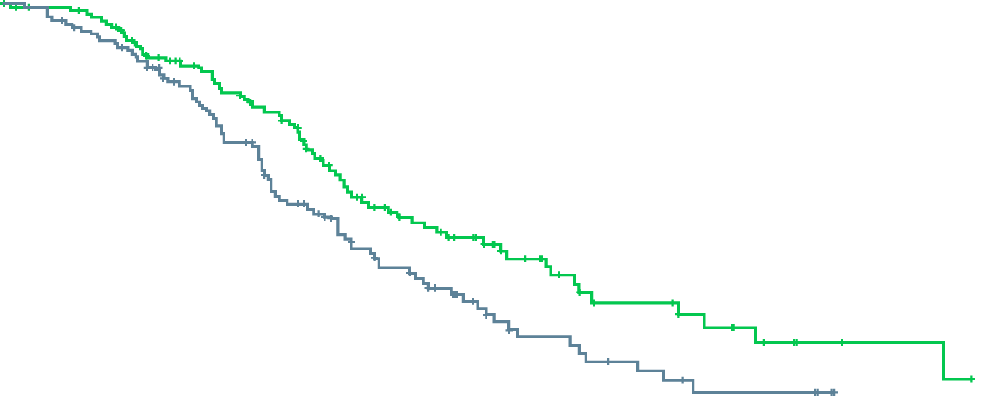
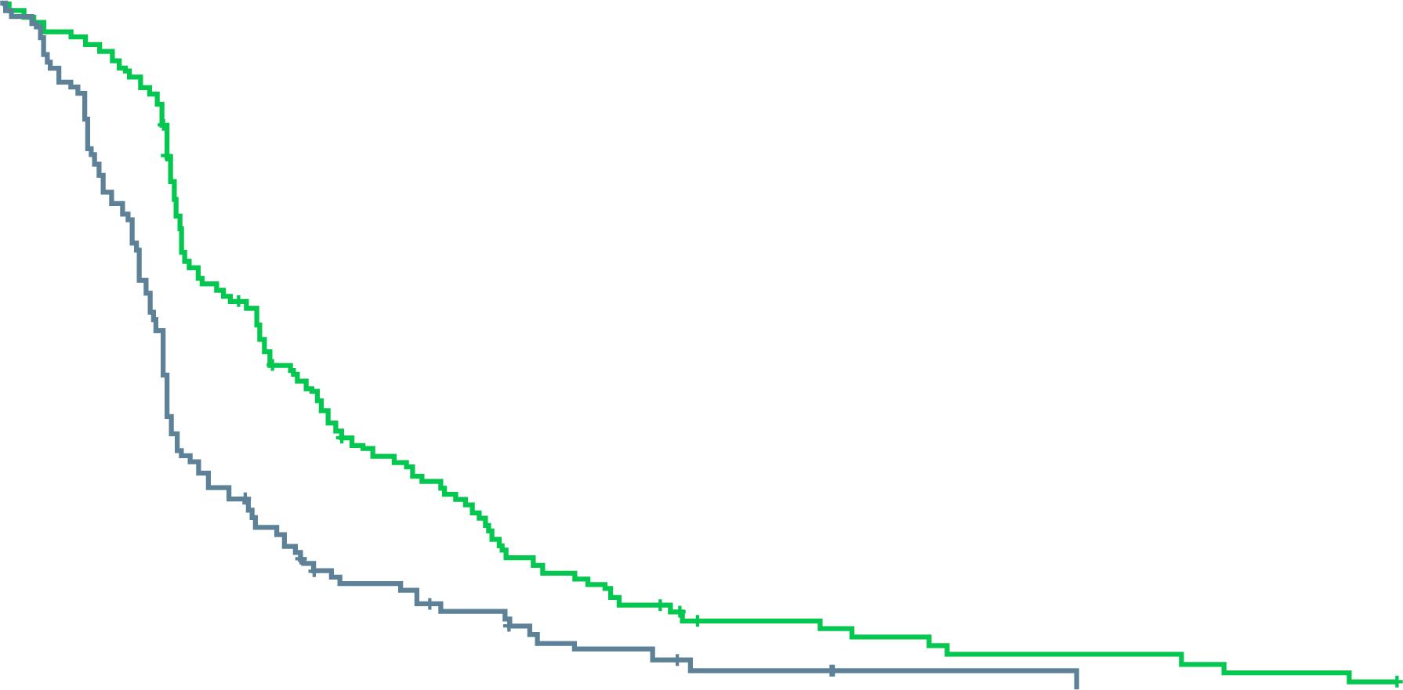
CARD: cabazitaxel more effective than abi or enza after abi or enza
Overall survival
 | No. of patients | Median overall survival (95% CI), months
cabazitaxel | 129 | 13.6 (11.5–17.5)
ASTI | 126 | 11.0 (9.2–12.9)
 | Hazard ratio for death 0.64 (95% CI 0.46–0.89) P = 0.008
100
Men previously treated with both docetaxel and ASTI (abi or enza)
Median age 70 (range 46–85) years in cabazitaxel group
69% had pain progression at trial entry
Overall response rate
cabazitaxel: 37%
ASTI: 12%
Grade ≥ 3 AEs in 56.3% of cabazitaxel group vs 52.4% of ASTI group
In cabazitaxel group, grade 3+ neutropenia in 44.7% (febrile in 3.2%)
In ASTI group, grade 3+ cardiac disorders in 4.8%
90
80
70
60
50
Patients alive (%)
40
30
cabazitaxel
20
10
ASTI
0
0
3
6
9
12
18
24
30
No. at risk
cabazitaxel ASTI
Time (months)
129
126
122
116
96
88
77
64
51
39
21
11
8
3
2
0
Progression-free survival
 | No. of patients | Median progression-free survival (95% CI), months
cabazitaxel | 129 | 4.4 (3.6–5.4)
ASTI | 126 | 2.7 (2.4–2.8)
 | Hazard ratio for progression or death 0.52 (95% CI 0.40–0.68) P < 0.001
100
90
80
70
60
Patients alive without progression (%)
50
40
cabazitaxel
30
20
10
ASTI
0
0
3
6
9
12
18
24
No. at risk
cabazitaxel ASTI
Time (months)
129
126
82
42
39
16
20
7
8
2
4
1
0
0
abi, abiraterone; AEs, adverse events; ASTI, androgen signaling targeted inhibitor; CI, confidence interval; enza, enzalutamide
de Wit R, et al. N Engl J Med. 2019;381:2506-18
Notes:
I found these data quite compelling and practice changing, I’m using a lot more cabazitaxel now. The efficacy is clearly higher. But is it for everyone? There were a good proportion of men in their 70s and 80s included which is reassuring when facing an older patient in our practices, but of course these were ECOG 0-1 patients. Toxicity profile was tolerable – although high rate of neutropenia, little febrile neutropenia and there were 2 deaths from infection on each arm. Notably, however, most men entered the study with pain progression as a qualifying form of progression, very few for PSA alone. Thus when faced with an asymptomatic patient, we might not choose to jump right in with cabazi, there may be room to use abi/enza first, especially if the patient is coming right off doce and could use some recovery time. This was largely NOT an asymptomatic population. Pain response 45% with cabazi vs 19.3% with ASTi

Slide 30
New Agents
PARP inhibitors
Radiopharmaceuticals
Immunotherapy
PARP, poly-ADP ribose polymerase

Slide 31
New agents: PARP inhibitors
High response rate with olaparib in men with DNA repair deficiency
Alterations in BRCA1 or 2, ATM, Fanconi anemia genes, CHEK2¹
TOPARP-B trial: olaparib 300 mg vs 400 mg b.i.d.²
Overall response rate 54% with 400 mg b.i.d.
Overall mPFS 5.4 months
Response rates by altered gene: BRCA1 or 2, 80%; PALB2, 57%; ATM, 37%; CDK12, 25%; others 20%
Rucaparib approved for men with BRCA1 or BRCA2 alterations
PSA response rate 54% and objective response rate 47.5% in patients with a BRCA1 or 2 alteration³
Other mutations had limited benefit, with objective response rates (by altered gene) of 10.5% (ATM), 0 (CDK12), and 11.1% (CHEK2)⁴
Data from additional agents (niraparib, talazoparib) are awaited
b.i.d., twice a day; mPFS, median progression-free survival; PARP, poly-ADP ribose polymerase; PSA, prostate specific antigen
1. Mateo J, et al. N Engl J Med. 2015;373:1697-708; 2. Mateo J, et al. J Clin Oncol. 2019;37(15 suppl):5005; 3. Abida W, et al. Ann Oncol. 2019;30 suppl:v327-8 abstract 846PD; 4. Abida W, et al. Clin Cancer Res. 2020;26:2487-96

Slide 32
PROfound: phase 3 study of PARP inhibitor Olaparib
Olaparib 300 mg BID (n=162)
Primary endpoint
rPFS in cohort A (RECIST 1.1 and PCWG3 by BICR)
Key eligibility criteria
mCRPC with disease progression on prior NHA (e.g. abiraterone acetate or enzalutamide)
Alterations in ≥1 of any qualifying gene with a direct or indirect role in HRRª
Cohort A BRCA1, BRCA2, or ATM alteration (N=245)
Physician’s choice ^{b} (n=83)
2:1 randomisation (Open label)
Upon progression by BICR, physician’s choice patients were allowed to cross over to olaparib
Key secondary endpoints
rPFS in cohorts A and B (by BICR) Confirmed radiographic objective response rate in cohort A (by BICR) Time to pain progression in cohort A OS in cohort A
Cohort B Other alterations (N=142)
Olaparib 300 mg BID (n=94)
Physician’s choice ^{b} (n=48)
Stratification factors
Previous taxane
measurable disease
ª An investigational clinical trial assay, based on the FoundationOne® CDx next-generation sequencing test, used to prospectively select patients with alteration of BRCA1, BRCA2, ATM, BARD1, BRIP1, CDK12, CHEK1, CHEK2, FANCL, PALB2, PPP2R2A, RAD51B, RAD51C, RAD51D, or RAD54L in their tumor tissue.
^{b} Physician’s choice: enzalutamide 160 mg/day, or abiraterone 1,000 mg/day + prednisone 5 mg BID
ATM, ataxia telangiectasia mutated; BICR, blinded independent central review; BID, twice daily; BRCA1/2, breast cancer 1/2; mCRPC, metastatic castration-resistant prostate cancer; NHA, new hormonal agent; OS, overall survival; PCWG3, Prostate Cancer Working Group 3; RECIST, Response Evaluation Criteria In Solid Tumours; rPFS, radiographic progression-free survival; QD, once daily
de Bono J, et al. N Engl J Med. 2020;382:2091-102; Hussain M, et al. N Engl J Med. 2020: DOI: 10.1056/NEJMoa2022485

Slide 33
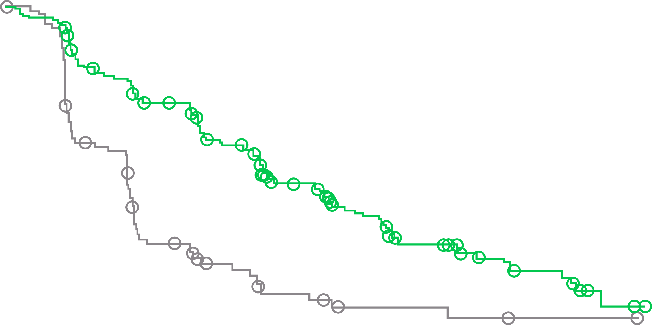
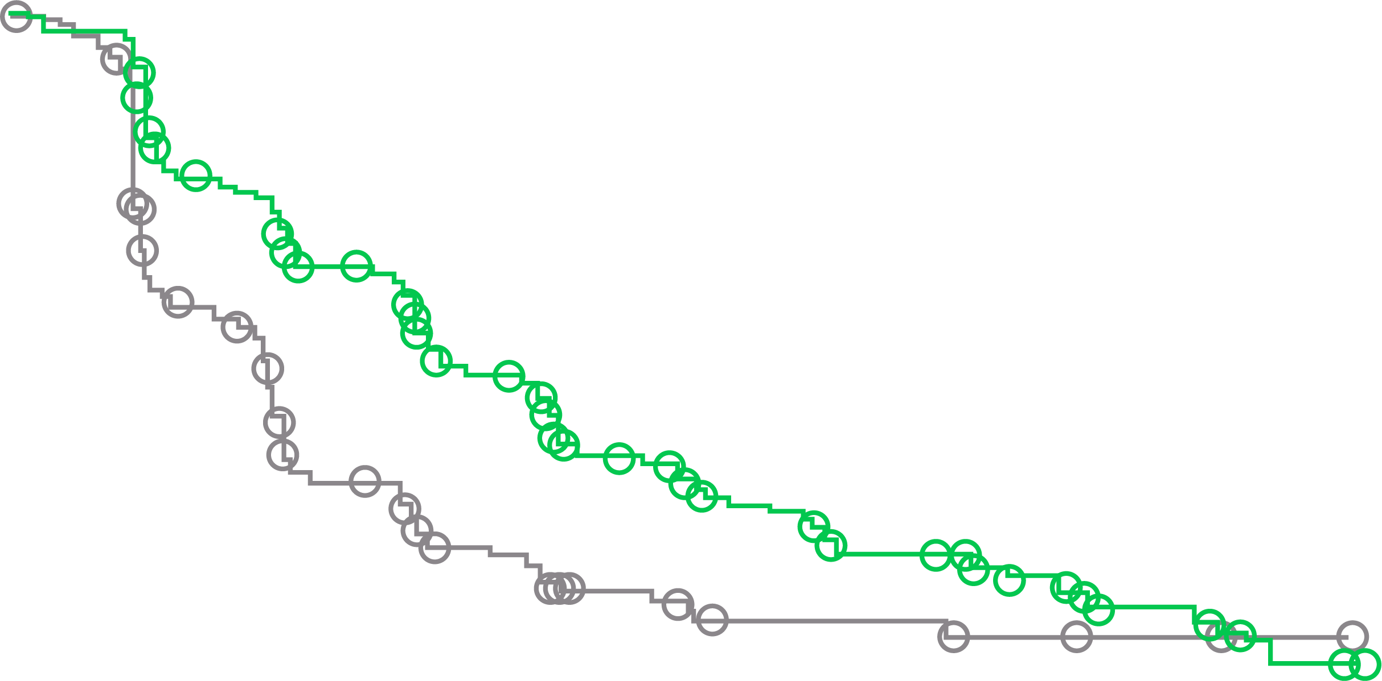
profound study: Progression-free survival
rpfs IN cohort A (PRIMARY ENDPOINT)
rpfs by bicr in overall population (cohorts A+B)
1.00
0.90
1.00
0.80
Value at 6 mo
0.90
0.70
0.80
Value at 6 mo
0.60
0.70
0.60
0.60
Probability of imaging-based progression-free survival
Probability of imaging-based progression-free survival
0.50
0.50
Value at 12 mo
0.50
Value at 12 mo
0.40
0.40
0.30
0.28
0.30
0.22
Olaparib
0.20
0.24
Olaparib
0.20
0.23
0.10
0.13
0.10
Control
0.00
Control
0.00
0.09
0
1
2
3
4
5
6
7
8
9
10
11
12
13
14
15
16
17
18
19
20
21
0
1
2
3
4
5
6
7
8
9
10
11
12
13
14
15
16
17
18
19
20
21
Months since randomization
No. at risk
Olaparib Control
Months since randomization
No. at risk
Olaparib Control
256
131
239
123
188
73
176
67
145
38
143
35
106
20
100
19
67
9
63
8
48
5
43
5
31
5
28
3
21
3
11
2
11
2
3
1
2
1
0
0
0
0
0
0
162
83
149
79
126
47
116
44
102
22
101
20
82
13
77
12
56
7
53
6
42
3
37
3
26
3
24
2
18
2
11
1
11
1
3
1
2
1
0
0
0
0
0
0
 | Olaparib (n=162) | Physician’s choice (n=83)
Median rPFS, months | 7.4 | 3.6
Hazard ratio (95% CI) | 0.34 (0.25–0.47) P < 0.001
 | Olaparib (n=256) | Physician’s choice (n=131)
Median rPFS, months | 5.8 | 3.5
Hazard ratio (95% CI) | 0.49 (0.38–0.63) P < 0.001
BICR, blinded independent central review; CI, confidence interval; mo, month; rPFS, radiographic progression-free survival
Hussain M, et al. Ann Oncol. 2019;30 suppl 5:v881-2, abstract LBA12 (ESMO 2019, oral presentation); de Bono J, et al. N Engl J Med. 2020;382:2091-102

Slide 34
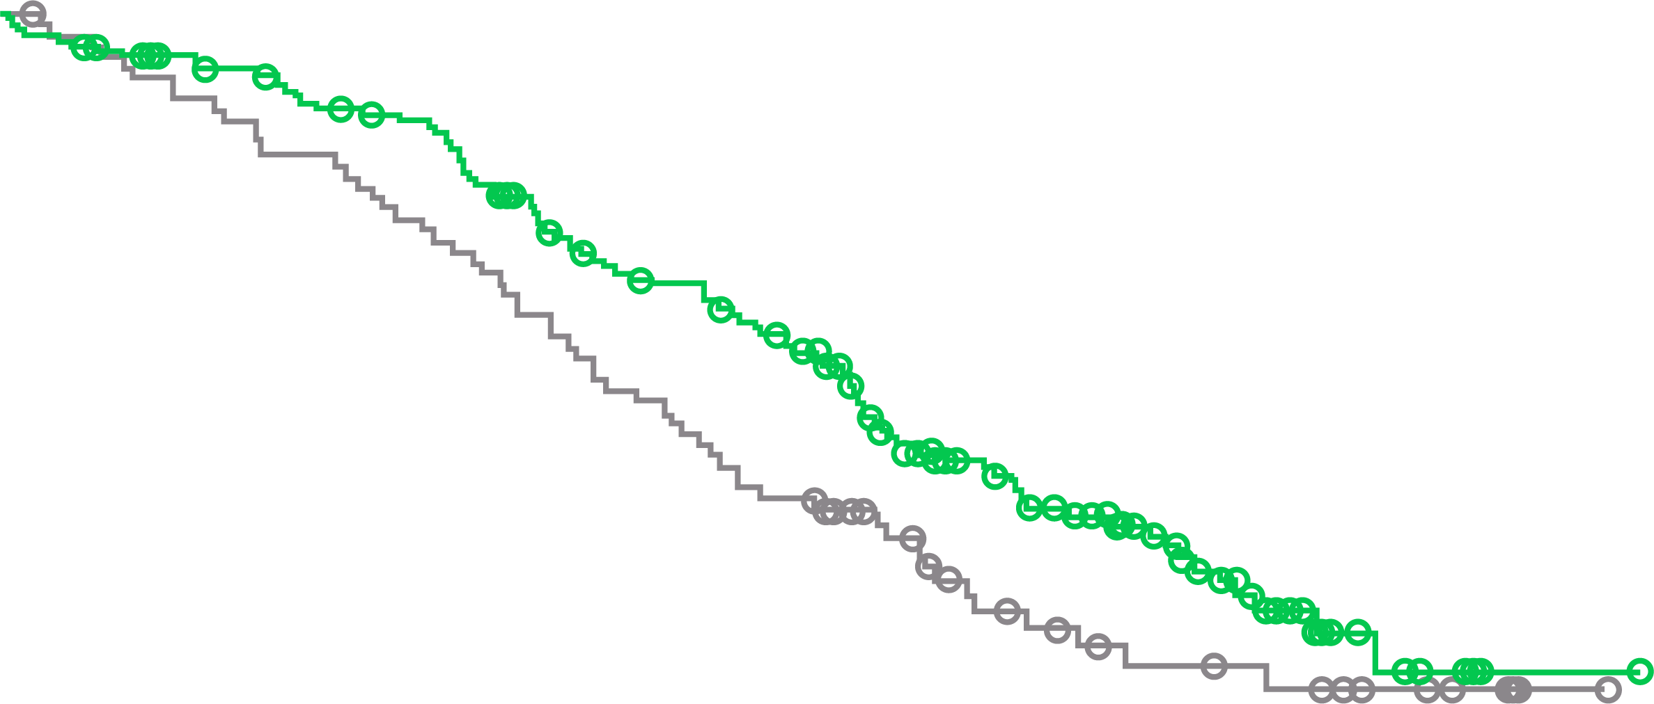
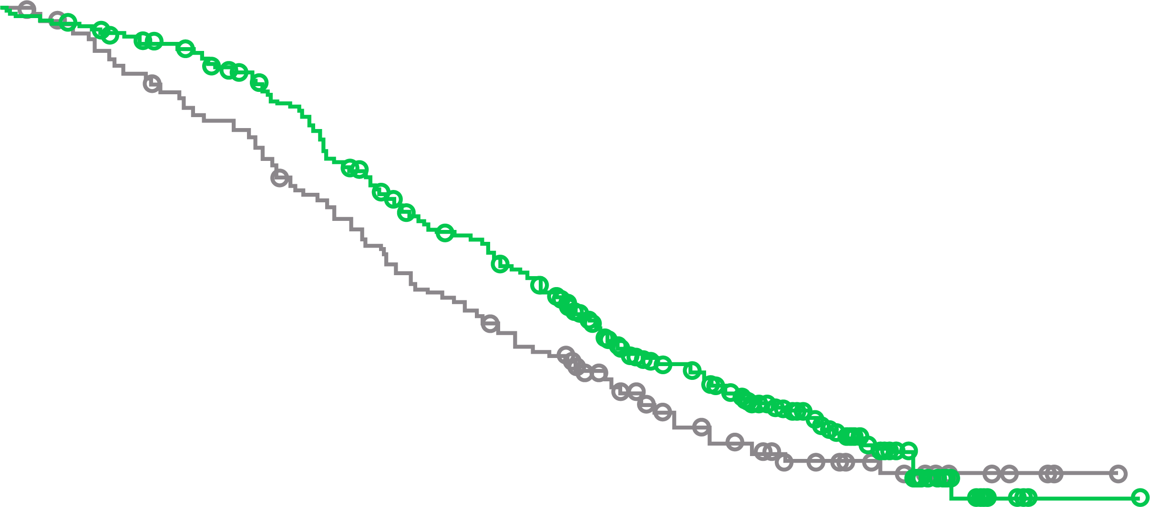
profound: FINAL OVERALL SURVIVAL
OS in cohort A
OS in overall population
100
Olaparib
100
Olaparib
90
Physician’s choice
90
Physician’s choice
80
80
70
70
60
60
OS (%)
50
OS (%)
50
40
40
30
30
20
20
10
10
0
0
2
4
6
8
10
12
14
16
18
20
22
24
26
28
30
32
34
0
0
2
4
6
8
10
12
14
16
18
20
22
24
26
28
30
32
34
No. at risk
Time since randomisation (months)
No. at risk
Time since randomisation (months)
Olaparib Physician’s choice
162
83
155
79
150
74
142
69
136
64
124
58
107
50
101
43
91
37
71
27
56
18
44
15
30
11
18
9
6
6
2
3
1
1
0
0
Olaparib Physician’s choice
256
131
249
125
240
115
228
106
209
96
182
83
157
71
146
63
126
55
96
37
73
27
56
22
39
15
22
11
7
6
2
3
1
1
0
0
 | Cohort A
 | Olaparib (N=162) | Physician’s choice (N=83)
Median OS, months | 19.1 | 14.7
HR (95% CI) | 0.69 (0.50-0.97); p=0.02
Median follow-up, months | 21.9 | 21.0
 | Overall population
 | Olaparib (N=256) | Physician’s choice (N=131)
Median OS, months | 17.3 | 14.0
HR (95% CI) | 0.79 (0.61-1.03); p=0.0515
Median follow-up, months | 20.7 | 20.5
Patients randomised between April 2017 and November 2018; DCO for final OS: 20 March 2020
Among patients with disease progression in the physician’s choice arm , 67% in cohort A and 66% in the overall population crossed over to olaparib
Longer follow-up yielded no new safety signals
CI, confidence interval; HR, hazard ratio; OS, overall survival Hussain M, et al. N Engl J Med. 2020: DOI: 10.1056/NEJMoa2022485

Slide 35
IPATential150: Background and study design
Ipatasertib is an oral adenosine triphosphate-competitive selective inhibitor of AKT1/2/3, which is the central node of the phosphatidylinositol-3-kinase (PI3K)/AKT signalling pathway – a key driver of cancer cell growth and proliferation in prostate cancer^{1,2}
The PI3K/AKT pathway has also been implicated in resistance to anti-androgen therapy as androgen receptor (AR) inhibition is associated with an increase in AKT pathway activation^{2,3}
Approx. 40-60% of patients with metastatic castration-resistant prostate cancer (mCRPC) have lost the AKT phosphatase PTEN. This results in hyperactivation of the PI3K/AKT pathway and is associated with adverse outcomes such as increased tumour grade and stage, earlier biochemical recurrence after radical prostatectomy, metastasis, prostate cancer–specific death, and androgen-independent progression^{4,5}
The IPATential150 trial is investigating dual AR and PI3K/AKT inhibition in patients with previously untreated mCRPC⁶
* PTEN loss defined as minimum of 50% of the specimen’s tumour area with no detectable PTEN staining (by Ventana IHC assay using SP218 antibody)
BID, twice daily; HSPC, hormone-sensitive prostate cancer; IHC, immunohistochemistry; ITT, intention to treat; NGS, next-generation sequencing; ORR, overall response rate; OS, overall survival; PCWG3, Prostate Cancer Working Group 3; PSA, prostate specific antigen; PTEN, phosphatase and tensin homologue; QD, once daily; R, randomisation; rPFS, radiographic progression-free survival; 1. Yang J, et al. Mol Cancer. 2019;18:26; 2. Crumbaker M, et al. Cancers (Basel). 2017;9:34; 3. Wang Y, et al. Current Cancer Drug Targets. 2007;7:591-604; 4. de Bono JS, et al. Clin Cancer Res. 2019;25;928-36; 5. Jamaspishvili T, et al. Nat Rev Urol. 2018;15:222-34; 6. de Bono J, et al. ESMO 2020. Abstract #LBA4. Oral presentation

Slide 36
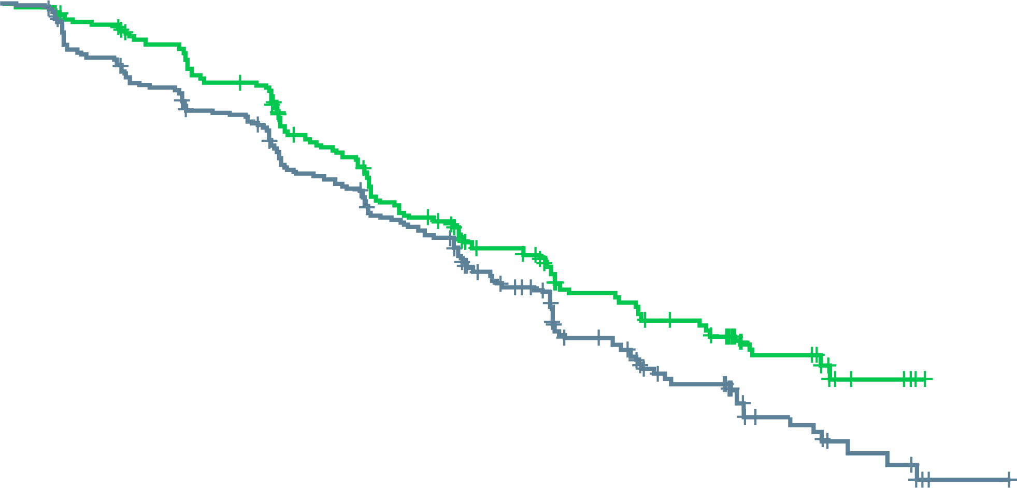
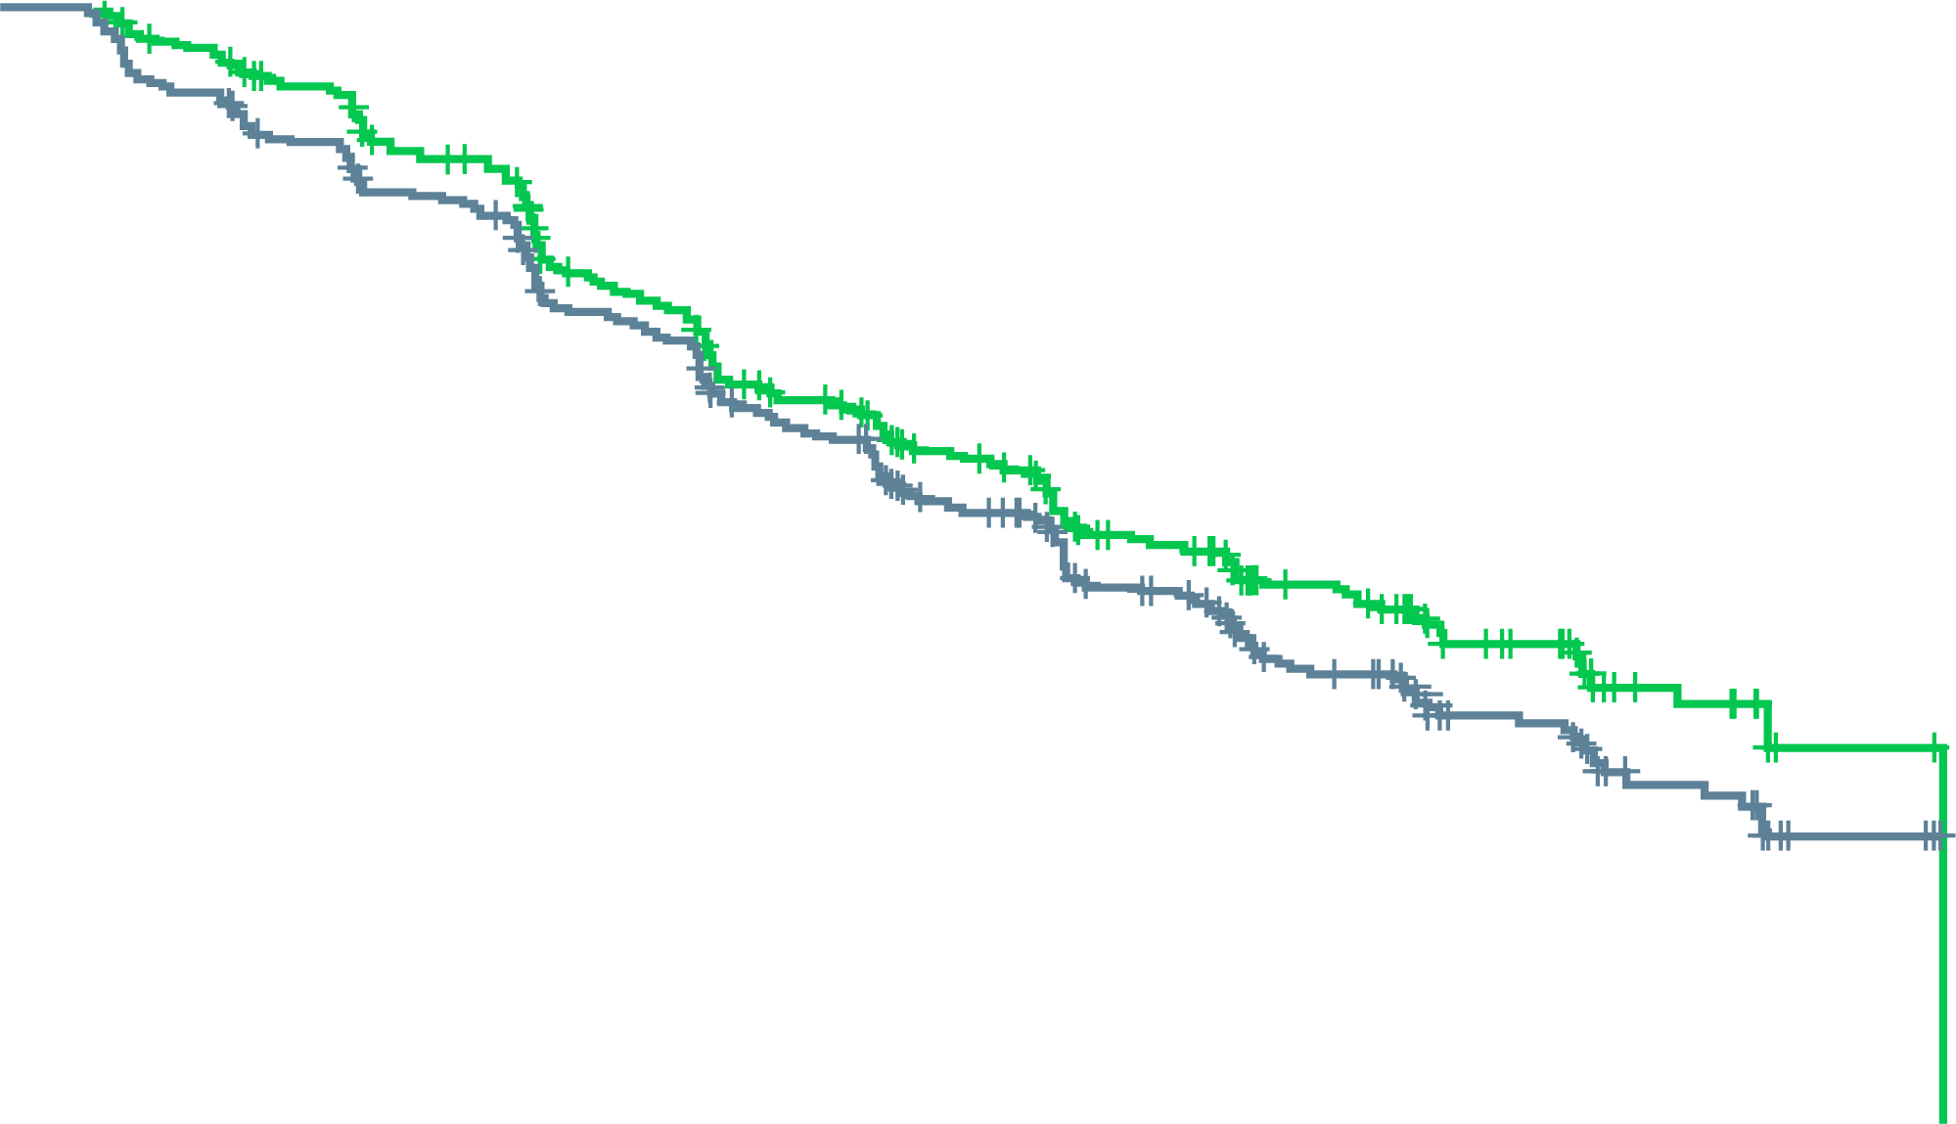
IPATential150: results
Ipatasertib significantly improved radiographic progression-free survival (rPFS) compared to placebo for patients with phosphatase and tensin homologue (PTEN)-loss mCRPC, but not in the intention-to-treat (ITT) population
This effect was consistent across all pre-specified subgroups
rPFS in the PTEN-loss (by IHC) population
rPFS in the ITT population
 | Pbo + AAP (N=261) | Ipat + AAP (N=260)
Patients with event, n (%) | 154 (59) | 124 (48)
1-year event free (95% CI), % | 63.3 (57.3-69.3) | 64.4 (58.3-70.5)
Stratifiedª HR (95% CI) | 0.77 (0.61-0.98); p=0.0335^{b}
 | Pbo + AAP (N=261) | Ipat + AA (N=260)
Patients with event, n (%) | 306 (55) | 252 (46)
1-year event free (95% CI), % | 63.0 (58.9-67.1) | 65.3 (61.1-69.5)
Stratified HR^{c} (95% CI) | 0.84 (0.71-0.99); p=0.0431^{d}
100
100
80
80
60
Pbo + Ipat
60
Pbo + Ipat
Median follow-up: 19 months
Pbo + AAP
Median follow-up: 19 months
Pbo + AAP
rPFS (%)
Min. follow-up: 14 months
rPFS (%)
Min. follow-up: 14 months
40
40
20
20
Median rPFS, 19.2 months (95% CI 16.5-22.3)
Median rPFS: 16.5 months (95% CI 13.9-17.0)
Median rPFS: 18.5 months (95% CI 16.3-22.1)
Median rPFS: 16.6 months (95% CI 15.6-19.1)
0
0
0
3
6
9
12
15
18
21
24
27
30
33
0
3
6
9
12
15
18
21
24
27
30
Patients at risk, n
Time (months)
Patients at risk, n
Time (months)
Pbo + AAP Ipat + AAP
261
260
233
238
206 211
175
182
151
149
105
113
71
72
41
48
22
25
10
12
3
Pbo + AAP Ipat + AAP
554
547
501
495
443
436
377
368
322
310
237
239
165
158
98
103
60
53
29
26
5
2
Data cut-off date: 16 March 2020; ª Stratified for prior taxane-based therapy and PSA-only progression factor; ^{b} Statistically significant at ɑ = 0.05 level; ^{c} Stratified for prior taxane-based therapy, PSA-only progression factor, and tumour PTEN loss status (by IHC); ^{d} Did not meet statistical significance ɑ = 0.01 level AAP, abiraterone acetate + prednisone; CI, confidence interval; HR, hazard ratio; IHC, immunohistochemistry; Ipat, ipatasertib; mCRPC, metastatic castration-resistant prostate cancer; Pbo, placebo; PSA, prostate specific antigen; de Bono J, et al. ESMO 2020. Abstract #LBA4. Oral presentation

Slide 37
IPATential150: results (CONT.)
SECONDARY EFFICACY ENDPOINTS
safety
Secondary endpoints favoured the combination arm
Secondary endpoints (efficacy) | PTEN loss (by IHC) (N=521) |  | ITT (N=1,101)
 | Pbo + AAP | Ipat + AAP | Pbo + AAP | Ipat + AAP
Time to PSA progression, n | 261 | 260 | 554 | 547
Median (95% CI), months | 7.6 (6.4-9.3) | 12.6 (10.2-15.3) | 8.4 (7.4-9.3) | 12.9 (10.3-15.1)
Stratified^{a,b} HR (95% CI) | 0.69 (0.55-0.87); p=0.0013^{c} |  | 0.73 (0.62-0.85); p<0.0001^{c}
PSA response, n/N (%) | 187/261 (72) | 217/260 (84) | 418/554 (76) | 444/546 (81)
p value | 0.0012^{c} |  | 0.0183^{c}
Time to pain progression, n/N (%) | 95/261 (36) | 73/260 (28) | 187/554 (34) | 156/547 (29)
Stratified^{a,b} HR (95% CI) | 0.77 (0.56-1.04) |  | 0.87 (0.70-1.08)
Confirmed ORR, n/N (%) | 37/96 (39) | 60/99 (61) | 98/225 (44) | 122/201 (61)
Difference (95% CI), % | 22 (7-37) |  | 17 (7-27)
 | PTEN loss (by NGS)
rPFS, n | 103 | 105 | – | –
Median (95% CI), months | 14.2 (10.9-18.7) | 19.1 (13.9-NE) | – | –
Stratifiedª HR (95% CI) | 0.65 (0.45-0.95) |  | – | –
Safety, % | Pbo + AAP (N=546) | Ipat + AAP (N=551)
SAEs | 23 | 40
AEs leading to treatment discontinuation | 5 | 21
ª Stratified for prior taxane-based therapy and PSA-only progression factor (PTEN loss [by IHC/NGS]); ^{b} Stratified for prior taxane-based therapy, PSA-only progression factor, and tumour PTEN loss (by IHC) (ITT); ^{c} Descriptive
AAP, abiraterone acetate + prednisone; CI, confidence interval; HR, hazard ratio; IHC, immunohistochemistry; Ipat, ipatasertib; ITT, intention to treat; NE, not evaluable; NGS, next-generation sequencing; ORR, overall response rate; Pbo, placebo; PSA, prostate specific antigen; rPFS, radiographic progression-free survival; PTEN, phosphatase and tensin homologue de Bono J, et al. ESMO 2020. Abstract #LBA4. Oral presentation

Slide 38
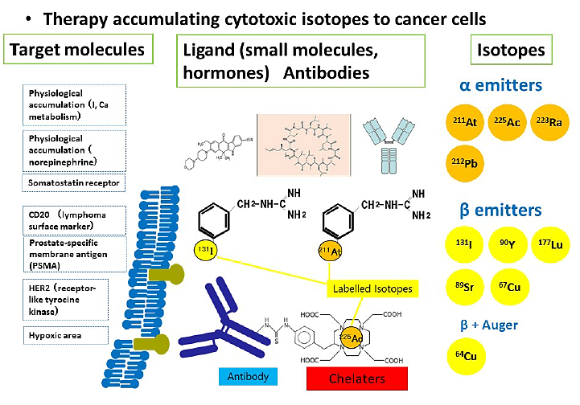
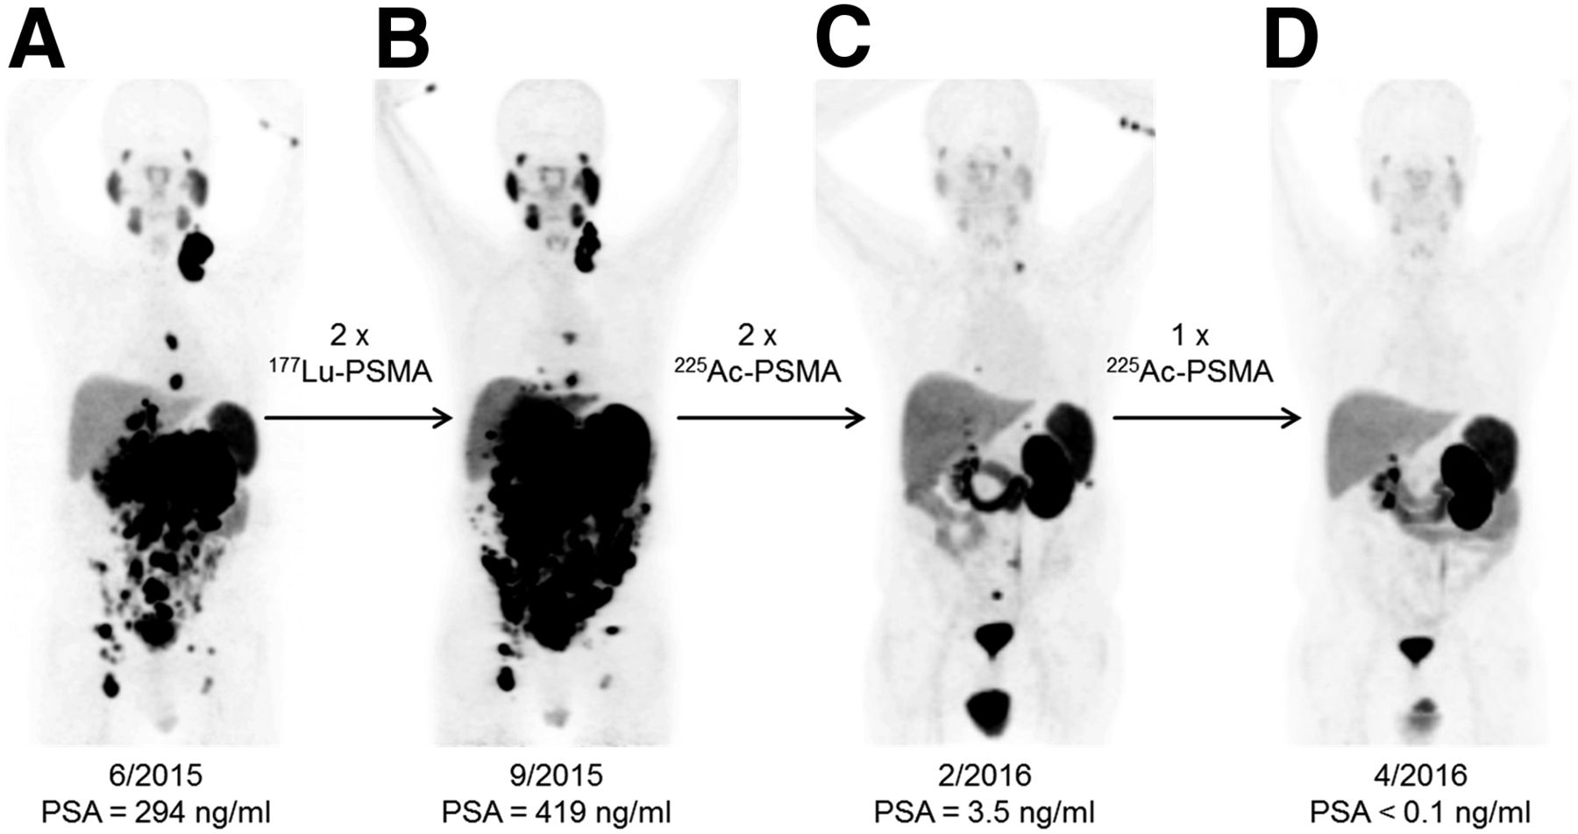
Radiopharmaceutical future: theranostics
Limitations
Expression of the ligand (heterogeneity, downregulation)
²²⁵Ac, actinium 225; ²¹¹At, astatine 211; ⁶⁴Cu, copper 64; ⁶⁷Cu, copper 67; ¹³¹I, iodine 131; ¹⁷⁷Lu, lutetium 177; ²¹²Pb, lead 212; PSA, prostate specific antigen; ²²³Ra, radium 223;⁸⁹Sr, strontium 89; ⁹⁰Y, yttrium 90
Kratochwil C, et al. J Nucl Med 2016; 57:1941-44

Slide 39
New Agents: ¹⁷⁷Lu-PSMA
Australian experience¹
50 patients, median 3 cycles
PSA decline calculated for 49 patients
22 (45%) had best PSA decline ≥ 50%
Main AEs: fatigue, nausea
PSA response to Treatment
Best PSA response to treatment during study
Change from baseline between ¹⁷⁷Lu-PSMA cycles 1 and 2
100
Response
≥ 90%
50–89%
0–49%
≤ 0%
100
Response
≥ 90%
50–89%
0–49%
≤ 0%
80
80
60
60
40
40
20
20
Change in PSA (%)
Change in PSA (%)
0
0
−20
−20
−40
−40
−60
−60
−80
−80
−100
−100
AE, adverse event; ¹⁷⁷Lu, lutetium 177; PSA, prostate specific antigen; PSMA, prostate specific membrane antigen
McBean R, et al. J Med Imaging Radiat Oncol. 2019;63:538-45
Notes:
Nausea largely grade 1

Slide 40
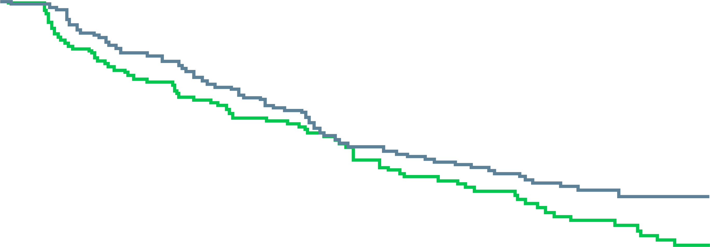
New Agents: ¹⁷⁷Lu-PSMA
TheraP (ANZUP 1603/ NCT03392428)¹
200 men randomized to ¹⁷⁷Lu-PSMA-617 q6 weekly (up to 6 cycles) or cabazitaxel 20 mg/m² q3 weekly (up to 10 cycles)
PSA 50 = 66% for ¹⁷⁷Lu-PSMA-617 vs 37% for cabazitaxel however PSA PFS was similar
SELECTED AEs BY WORSE GRADE
Term | Cabazitaxel (N=85) |  | Lu-PSMA (N=98)
 | G1-2 % | G3-4 % | G1-2 % | G3-4 %
Neutropenia (+/- fever) | 5 | 13 | 6 | 4
Thrombocytopaenia | 4 | 0 | 17 | 11
Dry mouth | 21 | 0 | 59 | 0
Diarrhoea | 52 | 5 | 18 | 1
Dry eye | 4 | 0 | 30 | 0
Dysgeusia | 27 | 0 | 12 | 0
Neuropathy (motor or sensory) | 26 | 1 | 10 | 0
Fatigue | 72 | 4 | 70 | 5
Nausea | 34 | 0 | 39 | 1
Anaemia | 12 | 8 | 18 | 8
Vomiting | 12 | 2 | 12 | 1
TOTAL (all AEs) | 40 | 54 | 53 | 35
Secondary endpoint: PSA PFS (preliminary)
1.00
Lu-PSMA
Cabazitaxel
0.75
Proportion event-free
0.50
0.25
Based on 157 of the required 170 events* HR = 0.69 (95% CI: 0.50–0.95; p = 0.02#)
0.0
0
3
6
9
12
No. at risk
Cabazitaxel
Lu-PSMA
Months
101
99
53
74
30
42
12
23
2
17
*Primary analysis at 170 events (as per SAP) #P < 0.0027 is required to trigger rejection of null hypothesis prior to planned primary analysis at 170 events (as per SAP). There have been 71 deaths in total.
Discontinuations for toxicity occurred in 1/98 (1%) Lu-PSMA vs 3/85 (4%) cabazitaxel-treated
There were no Lu-PSMA related deaths; 5 G5 AEs for cabazitaxel and 11 G5 AEs for Lu-PSMA
¹⁷⁷Lu, lutetium 177; OS, overall survival; PSA, prostate specific antigen; PSMA, prostate specific membrane antigen
1. Hoffman M et al, Journal of Clinical Oncology 2020; 38 (no.6_suppl): abstr 5500 (ASCO 2020, Oral presentation); 2. NCT03511664 at www.ClinicalTrials.gov; 3. Sartor O, et al. Journal of Clinical Oncology 2020; 38 (no.6_suppl): TPS259
Notes:
Nausea largely grade 1

Slide 41
New Agents: ¹⁷⁷Lu-PSMA
VISION trial^{1,2}
Randomized phase 3
Completed accrual of 815 patients
Estimated completion 2021
Will provide OS data for ¹⁷⁷Lu-PSMA
Best standard of care
177Lu-PSMA-617
7.4 GBq q6 wks x6
Patient population
mCRPC
at least 1 prior novel hormone
at least 1 prior taxane
PSMA PET+
Stratification factors
LDH (above/below 260)
Liver mets (Y/N)
PS (0-1 vs 2)
NAAD as BSC (Y/N)
R
2:1
Best standard of care
N=750
Alternative 1° endpoint:
rPFS or OS
¹⁷⁷Lu, lutetium 177; OS, overall survival; PSMA, prostate specific membrane antigen
1. NCT03511664 at www.ClinicalTrials.gov; 2. Sartor O, et al. Journal of Clinical Oncology 2020; 38 (no.6_suppl): TPS259
Notes:
Nausea largely grade 1

Slide 42
Immunotherapy: Pembrolizumab minimally effective in unselected mCRPC (KEYNOTE-199)
mCRPC
≥ 1 prior targeted endocrine therapy
1–2 prior chemotherapy regimens, including docetaxel
ECOG PS 0–2
Measurable disease per RECIST v1.1
mCRPC
≥ 1 prior targeted endocrine therapy
1–2 prior chemotherapy regimens, including docetaxel
ECOG PS 0–2
Bone metastasis with no measurable disease per RECIST v1.1
Any PD-L1 status
mCRPC
ECOG PS 0-2
Receiving enzalutamide
No prior chemotherapy
Any PD-L1 status
Cohort 1: PD-L1 positive
Cohort 3: non-measurable, bone-predominant disease
Cohort 2: PD-L1 negative
ECOG, Eastern Cooperative Oncology Group; mCRPC, metastatic castration-resistant prostate cancer; PD-L1, programmed death-ligand 1; PS, performance status; RECIST, Response Evaluation Criteria in Solid Tumors
De Bono JS, et al. J Clin Oncol. 2018;36(15 suppl):5007
Notes:
At least 1 advanced ADT (i.e. abi or enza)
Cohort 3 without measurable dz
Median f/u 8 months cohort 1, 7.9 months cohort 2, 11.5 months cohort 3
Tucker et al: LRP1b mutations predicted for strong benefit. ?CDK12

Slide 43
Immunotherapy: Pembrolizumab minimally effective in unselected mCRPC patients (KEYNOTE-199)
Change from baseline in psa in cohorts 1, 2, and 3
Best response (recist v1.1, central review)
 | Cohort 1 n = 131 | Cohort 2 n = 67 | Cohort 3 n = 60 | Cohorts 1+2 n = 198 | Cohorts 1+2+3 n = 198
CR | 2 (2%) | 0 | – | 2 (1%) | 2 (< 1%)
PR | 5 (4%) | 2 (3%) | – | 7 (4%) | 7 (3%)
SD (any duration) | 22 (17%) | 14 (21%) | – | 36 (18%) | 36 (14%)
SD ≥ 6 months | 5 (4%) | 2 (3%) | – | 7 (4%) | 7 (3%)
NonCR, nonPDª | 0 | 0 | 22 (37%) | 0 | 22 (9%)
PD | 76 (58%) | 42 (63%) | 33 (55%) | 118 (60%) | 151 (59%)
Not evaluable^{b} | 4 (3%) | 1 (1%) | 1 (2%) | 5 (3%) | 6 (2%)
Not assessable^{c} | 22 (17%) | 8 (12%) | 4 (7%) | 30 (15%) | 34 (13%)
100
80
60
40
20
Change from baseline (%)
0
−20
−40
−60
ª Patients without disappearance of all existing lesions or development of new lesions. 13 of these patients had no CR and no PD for ≥ 6 months.
^{b} Patients who had ≥ 1 post-baseline imaging assessment, none of which were evaluable for response.
^{c} Patients without ≥ 1 post-baseline imaging assessment.
Data cutoff date: Oct 13, 2017.
−80
−100
ª Percentages calculated on the basis of 193 patients who had ≥ 1 post-baseline PSA assessment Data cutoff date: Oct 13, 2017
CR, complete response; mCRPC, metastatic castration-resistant prostate cancer; PD, progressing disease; PD-L1, programmed death-ligand 1; PR, partial response; PSA, prostate specific antigen; RECIST, Response Evaluation Criteria in Solid Tumors; SD, stable disease
De Bono JS, et al. J Clin Oncol. 2018;36(15 suppl):5007 (ASCO 2018, oral presentation)
Notes:
At least 1 advanced ADT (i.e. abi or enza)
Cohort 3 without measurable dz
Median f/u 8 months cohort 1, 7.9 months cohort 2, 11.5 months cohort 3
Tucker et al: LRP1b mutations predicted for strong benefit. ?CDK12

Slide 44
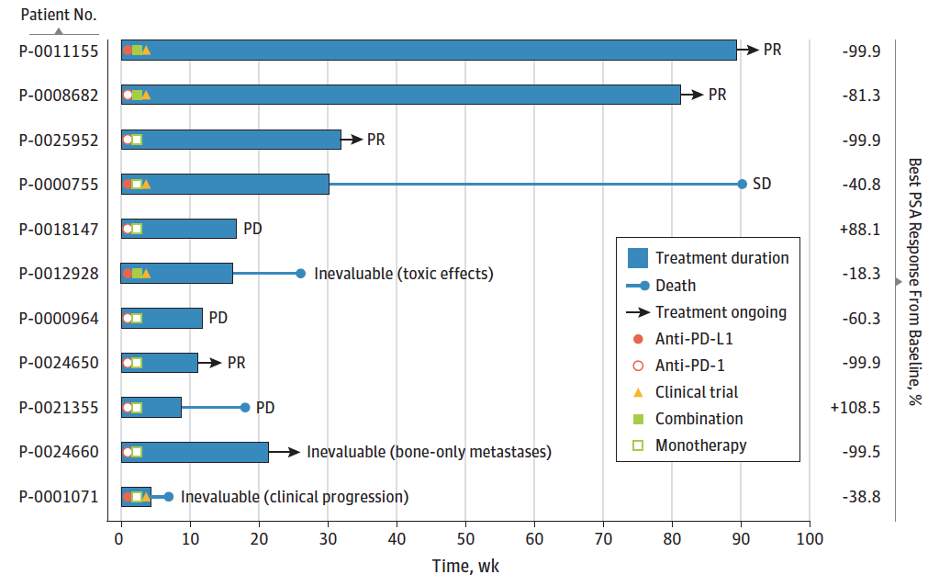
Pembrolizumab in MSI-high prostate cancer
32 (3.1%) of 1,033 of prostate cancer patients tested with germline + somatic DNA sequencing had MSI-high or mismatch-repair deficient status
6 of 11 treated with PD-1/PD-L1 antibody therapy had a PSA decline > 50%, and 4 of those 6 had an objective radiographic response
Duration of response up to 89 weeks
MSI, microsatellite instability; PD, progressing disease; PD-1, programmed cell death protein 1; PD-L1, programmed death-ligand 1; PR, partial response; PSA, prostate specific antigen; SD, stable disease; wk, weeks
Abida W, et al. JAMA Oncol. 2019;5:471-8

Slide 45
CheckMate 650: dual checkpoint inhibition better, but still need to select
OPEN-LABEL, MULTICENTER, PHASE 2 STUDY (NCT02985957)
Patients with mCRPC
Ongoing ADT confirmed by testosterone level ≤ 1.73 nmol/L (50 ng/dL)
ECOG performance status ≤ 1
Cohort 1
Asymptomatic or minimally symptomatic patients who progressed after ≥ 1 second-generation hormone therapy and had not received chemotherapy in the mCRPC setting (n = 45)
Treatment continued until progression or unacceptable toxicity
Treatment beyond progression was permitted
Coprimary endpoints
Investigator-assessed ORR (per RECIST 1.1)
rPFS (per PCWG2 criteria)
Secondary endpoints
Overall survival
Safety
Exploratory endpoints
PSA response rate
Correlation of biomarkers (PD-L1, HRD, DDR, TMB) with efficacy
nivolumab 1 mg/kg i.v. + ipilimumab 3 mg/kg i.v. q3w for up to 4 doses
nivolumab 480 mg i.v. q4w
Cohort 2
Patients who progressed after cytotoxic chemotherapy in the mCRPC setting (n = 45)
ADT, androgen deprivation therapy; DDR, DNA damage repair; ECOG, Eastern Cooperative Oncology Group; HRD, homologous recombination deficiency; i.v., intravenously; mCRPC, metastatic castration-resistant prostate cancer; ORR, objective response rate; PCWG, Prostate Cancer Working Group; PD-L1, programmed death-ligand 1; PSA, prostate specific antigen; q3w, every 3 weeks; q4w, every 4 weeks; RECIST, Response Evaluation Criteria in Solid Tumors; rPFS, radiographic progression-free survival; TMB, tumor mutational burden
Sharma P, et al. J Clin Oncol. 2019;37 suppl 7S:142 (ASCO GU 2019, oral presentation)
Notes:
Early results; ongoing responses were noted for about a year (some past 18 months) despite being off treatment

Slide 46
CheckMate 650: dual checkpoint inhibition better, but still need to select
Objective response, n (%) | Cohort 1 |  | Cohort 2
PD-L1 | PD-L1 < 1% (n = 21) | PD-L1 ≥ 1% (n = 6) | PD-L1 < 1% (n = 12) | PD-L1 ≥ 1% (n = 5)
Complete or partial response | 4 (19.0) | 2 (33.3) | 0 (0) | 2 (40.0)
Stable disease | 8 (38.1) | 2 (33.3) | 6 (50.0) | 0 (0)
Progressing disease or undetermined | 9 (42.9) | 2 (33.3) | 6 (50.0) | 3 (60.0)
In both cohorts, numerically higher objective response rates were observed in patients with PD-L1 expression ≥ 1%
PSA response, n (%) | Cohort 1 |  | Cohort 2
PD-L1 | PD-L1 < 1% (n = 22) | PD-L1 ≥ 1% (n = 6) | PD-L1 < 1% (n = 17) | PD-L1 ≥ 1% (n = 6)
Confirmed PSA response (PSA decline ≥ 50% from baseline) | 2 (9.1) | 3 (50.0) | 1 (5.9) | 0 (0)
Patients with PSA < 0.2 ng/mL | 1 (4.5) | 3 (50.0) | 0 (0) | 0 (0)
PD-L1, programmed death-ligand 1; PSA, prostate specific antigen
Sharma P, et al. J Clin Oncol. 2019;37 suppl 7S:142 (ASCO GU 2019, oral presentation)
Notes:
Early results; ongoing responses were noted for about a year (some past 18 months) despite being off treatment

Slide 47
CheckMate 650: Toxicity of ipilimumab + nivolumab in mCRPC
Event | Cohort 1 (n = 45) |  | Cohort 2 (n = 45)
 | Any grade | Grade 3–5 | Any grade | Grade 3–5
Any treatment-related AE, %ª | 93.3 | 42.2 | 95.6 | 53.3
Most common treatment-related AEs^{b}, %
Diarrhea | 37.8 | 6.7 | 53.3 | 11.1
Fatigue | 33.3 | 2.2 | 44.4 | 0
Maculopapular rash | 20.0 | 0 | 22.2 | 2.2
Rash | 20.0 | 4.4 | 15.6 | 2.2
Nausea | 15.6 | 0 | 24.4 | 2.2
Pruritis | 15.6 | 0 | 8.9 | 0
Hypothyroidism | 13.3 | 0 | 15.6 | 0
Decreased appetite | 11.1 | 0 | 35.6 | 0
Pyrexia | 11.1 | 0 | 8.9 | 0
Colitis | 8.9 | 4.4 | 17.8 | 11.1
Vomiting | 8.9 | 2.2 | 17.8 | 4.4
Any treatment-related AE leading to discontinuation, % | 33.3 | 31.1 | 35.6 | 26.7
Treatment-related deaths | n = 2^{c} |  | n = 2^{d}
ª Includes events reported between first dose and 30 days after last dose. ^{b} Any-grade events reported in ≥ 10% of all patients. ^{c} One grade 5 AE (treatment-related sudden death) occurred after the 4th dose; one patient had grade 4 treatment-related myocarditis with fatal outcome after the 1st dose. ^{d} One patient had grade 4 treatment-related septic shock with fatal outcome after the 2nd dose; one patient had grade 4 treatment-related interstitial lung disease with fatal outcome after the 4th dose.
AE, adverse event; mCRPC, metastatic castration-resistant prostate cancer
Sharma P, et al. J Clin Oncol. 2019;37 suppl 7S:142 (ASCO GU 2019, oral presentation)

Slide 48
Combinations to enhance the activity of checkpoint inhibitors: Sipuleucel-T + Atezolizumab
STUDY DESIGN
OBJECTIVE RESPONSE DATA
ARM 1 atezolizumab 1,200 mg i.v. weeks 1 and 4 followed by sipuleucel-T administered weeks 6, 8, and 10
 | All | Arm 1 | Arm 2 | P value
PSA decline 50%, n (%) | 3 (8.3) | 1 (2.8) | 2 (5.6)
ORR at 6 months, n (%) PR SD PD NE | n = 36 0 11 (30.6) 18 (50) 7 (19.4) | n = 19 0 7 (36.8) 7 (36.8) 5 (26.3) | n = 17 0 4 (23.5) 11 (64.7) 2 (11.8)
ORR at 12 months, n (%) PR SD PD NE | n = 36 0 2 (5.6) 4 (11.1) 30 (83.3) | n = 19 0 2 (10.5) 2 (10.5) 15 (78.9) | n = 17 0 0 2 (11.8) 15 (88.2)
Median rPFS, months | 6.5 | 8.2 | 5.8 | 0.0524
MAINTENANCE If no dose-limiting toxicity patients continue to receive atezolizumab 1,200 mg i.v. every 3 weeks starting week 13 until toxicity or lack of clinical benefit
Randomization week 0
INDUCTION 12 weeks
ARM 2 sipuleucel-T administered weeks 1, 3, and 5
followed by
atezolizumab 1,200 mg i.v. weeks 7 and 10
Primary endpoints: safety and tolerability
Secondary endpoints: rPFS, ORR
Correlative studies include
ELISA, ELISPOT for T-cell activation
sipuleucel-T product parameters
MDSC and PD-L1/CTLA-4/Lag-3 expression
ELISA, enzyme-linked immunosorbent assay; ELISPOT, enzyme-linked immunosorbent spot; i.v., intravenously; MDSC, myeloid-derived suppressor cells; NE, not evaluable; ORR, objective response rate; PD, progressing disease; PR, partial response; PSA, prostate specific antigen; rPFS, radiographic progression-free survival; SD, stable disease
Dorff TB, et al. J Clin Oncol. 2020;38 suppl 6:141

Slide 49
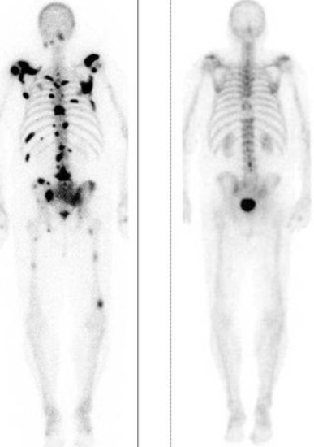
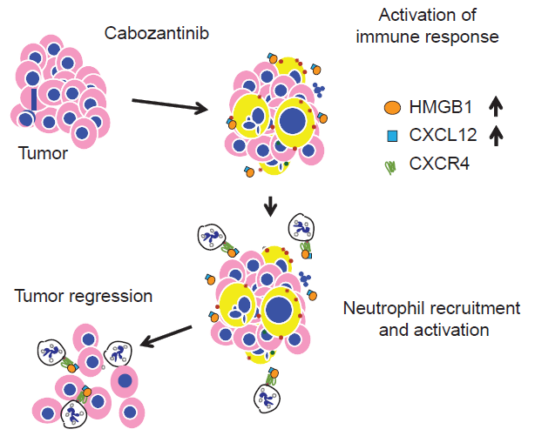
Combinations to enhance activity of checkpoint inhibitors: cabozantinib + atezolizumab
EFFECTS OF CABOZANTINIB ON NEUTROPHIL-MEDIATED ANTITUMOR INNATE IMMUNITY
In pre-clinical models, cabozantinib triggers release of CXCL12 and HMGB1 from dying PTEN/p53-deficient tumor cells to activate an immune response
Dramatic complete responses had been seen with cabozantinib in mCRPC patients
CXCL12, C-X-C motif chemokine 12; HMGB1, High mobility group box 1 protein; mCRPC, metastatic castration-resistant prostate cancer; PTEN, Phosphatase and tensin homolog
Patnaik A, et al. Cancer Discov. 2017;7:750-65

Slide 50
Immune effects of Cabozantinib: Targeting MDSC
cabozantinib reduced Treg and upregulated PD-L1 in patients with metastatic urothelial cancer¹
MDSC negativity correlates with tumor-infiltrating lymphocytes
In pre-clinical models, cabozantinib reduced MDSC and attenuated immunosuppressive activity² to enhance the CTLA-4 antibody effect
CD8⁺, high prolif.
CD8⁺, low prolif.
CD4⁺, high prolif.
CD4⁺, low prolif.
CD8⁺ T cells
Gr-MDSC (IC₅₀ 0.17 µM)
CD8⁺ T cell (IC₅₀ 11.7 µM)
GFP⁺ PCa cell (IC₅₀ 3.2 µM)
100
100
80
CD8⁺ or CD4⁺ T cells (%)
60
50
CD8⁺ T cells (%)
100
40
Relative absorbance
0
20
50
0
Stimulation
cabo (µM)
BEZ (µM) dasa (µM)
–
– – –
+
– – –
+
1 – –
+
10 – –
+
– 1
–
+
– 10
–
+
– –
0.5
+
– –
5
Without MDSC
0
MDSC from control
MDSC from BEZ-treated
−2
−1
0
1
2
MDSC from cabo-treated
Log BEZ (µM)
BEZ, BEZ235, a multikinase inhibitor; cabo, cabozantinib; dasa, dasatinib; GFP, green fluorescent protein; Gr, granulocytic; IC₅₀, half maximal inhibitory concentration; MDSC, myeloid-derived suppressor cells; PCa, prostate cancer; PD-L1, programmed death-ligand 1; Treg, regulatory T cells
1. Apolo AB, et al. J Clin Oncol. 2014;32 suppl 5S:4501; 2. Lu X, et al. Nature. 2017;543:728-32
Notes:
Cabo is VEGF and MET inhibitor
Pam sharma’s group, in chimeric mice

Slide 51
COSMIC-021: Cabozantinib + Atezolizumab (cohort 6)
SUM OF TARGET LESIONS PER INVESTIGATOR BY RECIST v1.1
TREATMENT RELATED ADVERSE EVENTS IN ≥ 10% OF PATIENTS
60
n = 43
Confirmed complete response
Confirmed partial response
Stable disease
Progressive disease
irPR per irRECIST
PD-L1 CPS ≥ 1% PD-L1 CPS < 1%
PD-L1 not assessed
 | CRPC cohort (n = 44)
 | Any grade | Grade 3 | Grade 4
Any AE, n (%) | 42 (95) | 25 (57) | 1 (2.3)*
Fatigue | 22 (50) | 3 (6.8) | 0
Nausea | 19 (43) | 0 | 0
Diarrhea | 17 (39) | 3 (6.8) | 0
Decreased appetite | 17 (39) | 0 | 0
Dysgeusia | 15 (34) | 0 | 0
Palmoplantar erythrodysesthesia | 14 (32) | 1 (2.3) | 0
AST increased | 11 (25) | 2 (4.5) | 0
Vomiting | 11 (25) | 1 (2.3) | 0
ALT increased | 8 (18) | 2 (4.5) | 0
Platelet count decreased | 8 (18) | 0 | 0
Weight decreased | 8 (18) | 0 | 0
White blood cell count decreased | 7 (16) | 2 (4.5) | 0
Hypophosphatemia | 7 (16) | 1 (2.3) | 0
Headache | 7 (16) | 0 | 0
Neutrophil count decreased | 6 (14) | 2 (4.5) | 0
Hypertension | 6 (14) | 1 (2.3) | 0
Stomatitis | 6 (14) | 1 (2.3) | 0
Dysphonia | 6 (14) | 0 | 0
Hyponatremia | 5 (11) | 3 (6.8) | 0
Arthralgia | 5 (11) | 1 (2.3) | 0
Oral pain | 5 (11) | 0 | 0
Rash maculo-papular | 5 (11) | 0 | 0
The combination of cabozantinib + atezolizumab had a tolerable safety profile and showed clinically meaningful activity with durable responses in men with mCRPC
40
20
0
Best percent change from baseline
−20
−40
−60
−80
PD-L1 status
*One grade 4AE of diverticular perforation was reported
AE, adverse event; ALT, alanine aminotransferase; AST, aspartate aminotransferase; CPS, combined positive score; irPR, immune-related partial response; irRECIST, immune-related Response Evaluation Criteria in Solid Tumors; mCRPC, metastatic castration-resistant prostate cancer; PD-L1, programmed death-ligand 1
Agarwal N, et al. J Clin Oncol. 2020;38 suppl 6:139

Slide 52
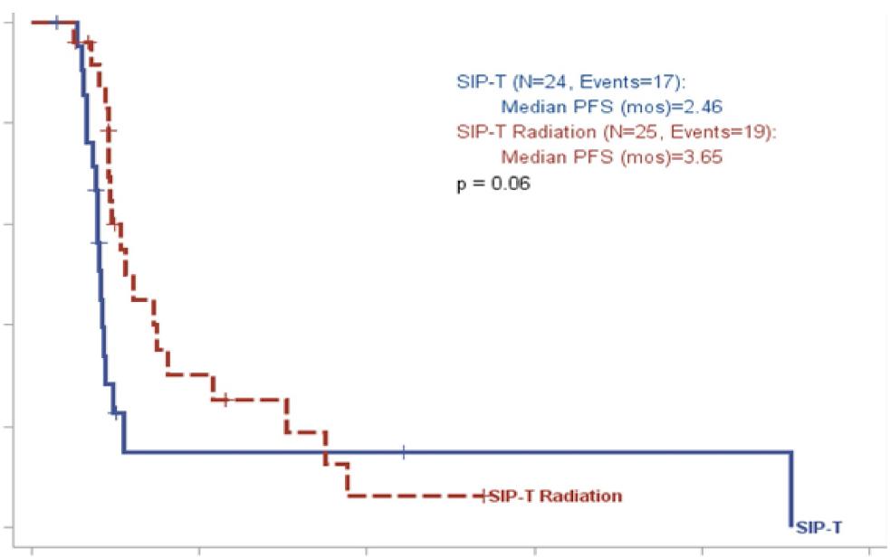
Is there still a role for sipuleucel-T?
The 3-year survival rate was higher in Medicare patients who received sipuleucel-T (SipT) than in those who did not receive it (hazard ratio 0.55, P < 0.0001)¹
A study of SipT ± SBRT did not find improvement²
1.0
Addition of PAP (by pTVG-HP*) did not augment SipT activity³
African Americans in the PROCEED registry had greater overall survival benefit and higher immune activation than did Caucasian men who received SipT⁴
SipT (n = 24, events: 17) Median PFS 2.46 months
SipT + radiation (n = 25, events: 19) Median PFS 3.65 months
P = 0.06
0.8
0.6
Progression-free survival
0.4
0.2
SipT + radiation
0
SipT
0
6
12
18
24
30
Months from treatment
*A cancer vaccine containing plasmid DNA encoding human prostatic acid phosphatase
HR, hazard ratio; PAP, prostatic acid phosphatase; PFS, progression-free survival; SBRT, stereotactic body radiation therapy; SipT, sipuleucel-T
1. McKay RR, et al. J Clin Oncol. 2020;38 suppl:42; 2. Twardowski P, et al. Cancer Treat Res Commun. 2019;19:100116; 3. Wargowski E, et al. J Immunother Cancer. 2018;6:21; 4. Sartor AO, et al. J Clin Oncol. 2019;37(15 suppl):5035

Slide 53
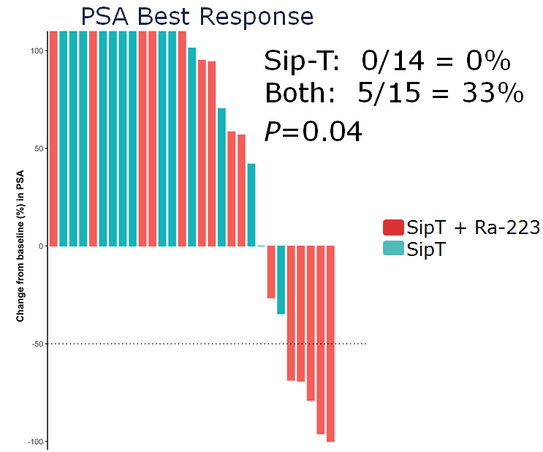
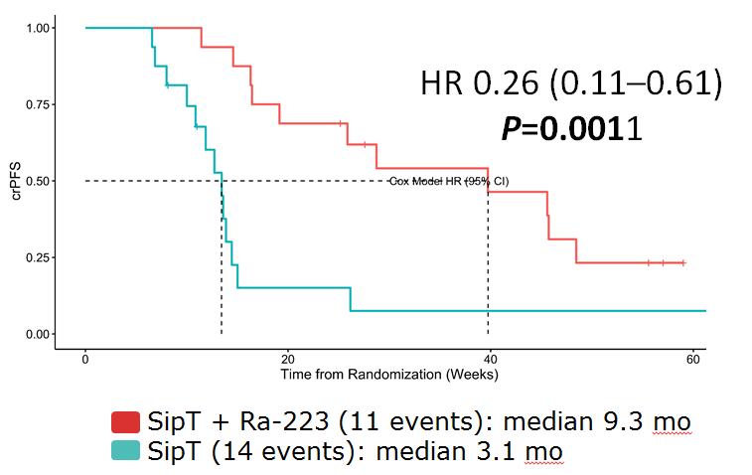
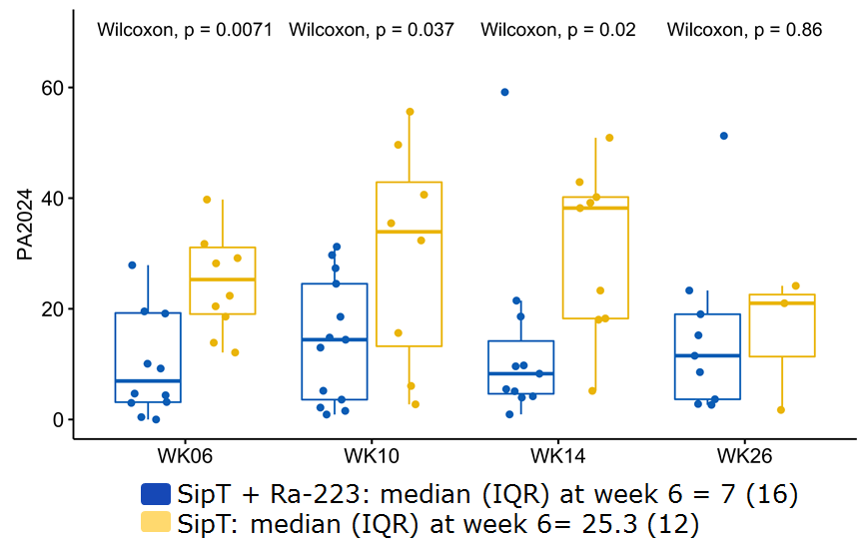
Sipuleucel-T with or without Radium 223 in patients with bone-mCRPC
PSA BEST RESPONSE
TIME TO RADIOGRAPHIC OR CLINICAL PROGRESSION
PA2024, PROLIFERATION INDEX (% CHANGE FROM BASELINE)
crPFS; clinical or radiographic progression-free survival; HR, hazard ratio; IQR, interquartile range; mCRPC, metastatic castration-resistant prostate cancer; mo, months; PSA, prostate specific antigen; Ra-223, radium 223; SipT, sipuleucel-T; WK, week
Marshall CH, et al. J Clin Oncol. 2020;38 suppl 6:130

Slide 54
Changing Landscape of advanced Prostate Cancer treatment in 2020
ADT
abiraterone
apalutamide
enzalutamide
docetaxel*
Clinical metastases: noncastrate
mCRPC: 3rd line, 4th line, etc.
Clinically localized disease
Rising PSA Noncastrate
mCRPC: 1st line
mCRPC: 2nd line
mCRPC: line X
nmCRPC
cabazitaxel (if prior docetaxel)
Noncastrate
Castration resistant
docetaxel (if no prior use)
ADT
abiraterone
enzalutamide
enzalutamide
*For ‘chemofit’ patients
apalutamide
sipuleucel-T
Radium 223 if symptomatic bone metastases
darolutamide
olaparib or rucarapib
Radium 223
ADT, androgen deprivation therapy; mCRPC, metastatic castration-resistant prostate cancer; nmCRPC, nonmetastatic castration-resistant prostate cancer
Based on Product Prescribing Information
Notes:
Thursday, September 14, 2017 –PROSPER RESULTS M0CRPC
Janssen Submits New Drug Application to U.S. FDA for Apalutamide (ARN-509) to Treat Men with Non-Metastatic Castration-Resistant Prostate Cancer- Oct 11th M0CRPC

Slide 55
summary
The range of treatment options for patients with mCRPC has dramatically increased during the past decade
Combinations have not been successful; sequential strategy remains dominant
Sequencing abiraterone → enzalutamide or enzalutamide → abiraterone is less successful than switching to chemotherapy (or PARPi)
Genomic profiling is critical to identifying additional treatment options (PARPi, ICI)
ICI, immune checkpoint inhibitors; mCRPC, metastatic castration-resistant prostate cancer; PARPi, poly (ADP-ribose) polymerase inhibitors

Slide 56
REACH GU CONNECT VIA TWITTER, LINKEDIN, VIMEO, or EMAIL OR VISIT THE GROUP’S WEBSITE http://www.guconnect.info
Follow us on Twitter @guconnectinfo
Follow the GU CONNECT group on LinkedIn
Watch us on the Vimeo channel GU CONNECT
Email elaine.wills@cor2ed.com

