Slide 2
optimising treatment sequence for mcrpc after intensified therapy in mcspc
Dr Neal Shore, MD, FACS
Medical Director, Carolina Urologic Research Center, and
Chief Medical Officer, Surgical Oncology and Urology, GenesisCare, USA august 2021
mCRPC, metastatic castration-resistant prostate cancer; mCSPC, metastatic castration-sensitive prostate cancer

Slide 3
Disclaimer and disclosures
Please note: The views expressed within this presentation are the personal opinions of the authors.
They do not necessarily represent the views of the author’s academic institution or the rest of the
GU CONNECT group.
This content is supported by an independent educational grant from Bayer.
Dr Neal Shore, MD, FACS has received financial support/sponsorship for research support, consultation or speaker fees from the following companies:
Abbvie, Amgen, Astellas, AstraZeneca, Bayer, BMS, Clovis Oncology, Dendreon, Ferring, Foundation Medicine, Janssen, Merck, Myovant, Nymox, Pfizer, Sanofi-Genzyme, Tolmar

Slide 4
introduction
Androgen deprivation therapy (ADT) monotherapy for metastatic prostate cancer has been foundational, yet has limited to poor clinical outcomes
Tumour burden, location, and biology affect overall survival
A new standard of care for metastatic castration-sensitive prostate cancer (mCSPC) is combined therapy
  ADT plus the early addition of either docetaxel or an androgen receptor pathway inhibitor (ARPI)
  Despite level-1 evidence, many patients are still only receiving treatment with monotherapy ADT +/- an older ARPI
Prior treatments, including those for mCSPC, influence future treatment decisions when the patient progresses to metastatic castration-resistant prostate cancer (mCRPC)
  mCRPC patients may have already received treatment with an ARPI
Cross-resistance can occur with ARPIs, so it is preferable to select subsequent therapies with a different mechanism of action
There are several different treatments available for patients with mCRPC, and individualisation of treatment is important, considering patient preference and quality of life
ADT, androgen deprivation therapy; ARPI, androgen receptor pathway inhibitor; mCRPC, metastatic castration-resistant prostate cancer; mCSPC, metastatic castration-sensitive prostate cancer
Lowrance W, et al. Advanced prostate cancer: AUA/ASTRO/SUO guideline. Available from https://www.auanet.org/guidelines/advanced-prostate-cancer. Accessed Jul 30, 2021; NCCN Clinical Practice Guidelines in Oncology – Prostate Cancer, version 2.2021. Accessed Jul 30, 2021

Slide 5
The Development of Novel Hormone Therapy and Chemotherapy in mCSPC
CHAARTED (docetaxel)
First patient in 2007
ASCO 2015¹
LATITUDE
(abiraterone)
First patient in 2013
ASCO 2017²
STAMPEDE
(abiraterone)
First patient in 2006
ESMO 2018 (arm G)³
TITAN
(apalutamide)
First patient in 2015
ASCO 2019⁴
ARCHES
(enzalutamide)
First patient in 2016
ASCO GU 2019⁵
ENZAMET
(enzalutamide)
First patient in 2014
ASCO 2019⁶
PEACE1
(abiraterone + docetaxel + RT)
First patient in 2013
ASCO 2021⁷
ARASENS
(darolutamide + docetaxel)⁸
First patient in 2016;
primary completion: 2021
Trials investigated treatments in addition to ADT
ASCO, American Society of Clinical Oncology; ESMO, European Society for Medical Oncology; GU, genitourinary; mCSPC, metastatic castration-sensitive prostate cancer; RT, radiation therapy
1. Maughan BL, et al. J Clin Oncol. 2015;33(suppl):e16079; 2. Fizazi K, et al. J Clin Oncol. 2017;35(suppl):LBA3; 3. Hoyle AP, et al. Ann Oncol. 2018;29(suppl 8):viii722;
4. Chi KN, et al. J Clin Oncol. 2019;37(15_suppl):5006; 5. Armstrong AJ, et al. J Clin Oncol. 2019;37(7_suppl):687; 6. Sweeney C, et al. J Clin Oncol. 2019;37(18_suppl):LBA2;
7. Fizazi K, et al. J Clin Oncol 39, 2021 (suppl 15; abstr 5000); 8. NCT02799602 at www.clinicaltrials.gov

Slide 6
mCSPC – Docetaxel trials
Trial | Comparator | Phase; size | Primary endpoint | Results (docetaxel vs comparator) | Febrile neutropenia with docetaxel (grade ≥ 3) | Steroids?
GETUG-AFU15 2013¹ | ADT | 3; 385 | OS | mOS 58.9 vs 54.2 months HR 1.01, NS | 7% (↓ with G-CSF) | Corticosteroids for 3 days
CHAARTED 2015² | ADT | 3; 790 | OS | mOS 57.6 vs 44.0 months HR 0.61, p<0.001 | 6.1% | Dexamethasone 3 doses
STAMPEDE 2016³ | ADT | 2/3; 1,776 (2 arms) | OS | mOS 81 vs 71 months HR 0.78, p=0.006 | 15% | Prednisolone 10 mg/day + premedication
ADT, androgen deprivation therapy; G-CSF, granulocyte colony-stimulating factor; HR, hazard ratio; mCSPC, metastatic castration-sensitive prostate cancer;
(m)OS, (median) overall survival; NS, non-significant
1. Gravis G, et al. Lancet Oncol. 2013;14:149-58; 2. Sweeney C, et al. N Engl J Med. 2015;373:737-46; 3. James N, et al. Lancet. 2016;387:1163-77

Slide 7
mCSPC – androgen receptor-directed intensification
Treatment | Trial publication year | Population | Comparator | Phase; study size | Primary endpoint | Treatment vs control
Abiraterone acetate with prednisone | LATITUDE 2017 | mCSPC | ADT + placebo | 3; 1,199 | OS | 53.3 vs 36.5 months (HR: 0.66 [95% CI: 0.56-0.78], p<0.0001)
 | STAMPEDE 2017 | mCSPC and locally advanced prostate cancer | ADT alone | 3; 1,917 | OS | Estimated 83% vs 73% alive at 3 years (HR: 0.63 [95% CI: 0.52-0.76], p<0.001)
Enzalutamide | ENZAMET 2019 | mCSPC | ADT + non-steroidal AR-directed therapy | 3; 1,125 | OS | Estimated 80% vs 72% alive at 3 years (HR: 0.67 [95% CI: 0.52-0.86], p=0.002)
 | ARCHES 2019 | mCSPC–stratified by CHAARTED criteria | ADT + placebo | 3; 1,150 | rPFS or death | NR vs 19 months (HR: 0.39 [95% CI: 0.3-0.5], p<0.001)
Apalutamide | TITAN 2019 | mCSPC | ADT + placebo | 3; 1,052 | rPFS or death | 68.2% vs 47.5% at 24 months (HR: 0.48 [95% CI: 0.39-0.60], p<0.001)
 |  |  |  |  | OS | 82.4% vs 73.5% alive at 24 months (HR: 0.67 [95% CI: 0.51-0.89], p=0.005)
ADT, androgen deprivation therapy; ALT, alanine aminotransferase; AR, androgen receptor; AST, aspartate aminotransferase; CI, confidence interval; HR, hazard ratio;
mCSPC, metastatic castration-sensitive prostate cancer; NR, not reached; OS, overall survival; rPFS, radiographic progression-free survival
Schulte B, et al. Am Soc Clin Oncol Educ Book. 2020;40:198-207

Slide 8
Initiation of 1L treatment following mCSPC diagnosis
mCSPC 1L regimen | Median duration to next regimen (months) | 2014 | 2015 | 2016 | 2017 | 2018 | 2019
ADT + AA | 14.3 | 42.6% | 31.9% | 31.7% | 20.1% | 19.8% | 16.5%
ADT | 8.9 | 20.4% | 19.8% | 22.0% | 21.5% | 15.8% | 26.6%
ADT + NHT ± AA | 14.3 | 10.2% | 11.2% | 14.6% | 19.2% | 27.7% | 34.2%
ADT + DOC ± AA | 10.8 | 8.3% | 19.8% | 14.6% | 22.0% | 17.0% | 10.1%
Other treatment | n/a | 18.5% | 17.2% | 17.1% | 17.3% | 19.8% | 12.7%
Despite level 1 evidence, in 2019, over half of mCSPC patients treated in real-world settings did not receive 1L therapy, now known to significantly improve survival (ADT + NHT or ADT + DOC) over ADT alone
Those who did, received shorter durations of treatment than observed in registrational trials
SOC for mCSPC patients should be ADT + docetaxel or an ARPI
1L, first line; AA, anti-androgen; ADT, androgen deprivation therapy; ARPI, androgen receptor pathway inhibitor; DOC, docetaxel; mCSPC, metastatic castration-sensitive prostate cancer; NHT, novel hormonal therapies; SOC, standard of care
George D, et al. J Clin Oncol. 2021;39(suppl 15):5074

Slide 9
Therapeutic options in mcrpc
mCSPC
setting
mCRPC
1st line
mCRPC
2nd line
+ docetaxel
Docetaxel
Docetaxel
+ abiraterone
Cabazitaxel (if prior docetaxel)
Cabazitaxel (if prior docetaxel)
ADT
Hormonal therapy
Vaccine
Chemotherapy
Radioisotope
PARP inhibitor
Immunotherapy
+ apalutamide
Abiraterone or enzalutamide
(if no prior ARPI)
Abiraterone or enzalutamide
(if no prior ARPI)
+ enzalutamide
Sipuleucel-Tª
Sipuleucel-Tª
Radium-223^{b}
Radium-223^{b}
Treatment choices for mCRPC are dependent on previous treatment for CSPC/mCSPC
PARP inhibitor^{c}
PARP inhibitor^{c}
Pembrolizumab^{d}
Pembrolizumab^{d}
Treatment options vary depending on local approvals and treatment guidelines
ªNot recommended if visceral metastases are present; ^{b}For patients with symptomatic bone metastasis and no known visceral metastasis (in the EU, radium-223 should be restricted for use in patients who have had two previous treatments for metastatic prostate cancer or who cannot receive other treatments); ^{c}PARP inhibitor as per FDA indication: olaparib for men with HRR mutations, after ARPI, before or after taxane; rucaparib for men with BRCA1 or BRCA2 mutations after ARPI and taxane. Mutations can be germline or somatic; ^{d}FDA-approved for men with tumours identified as having high microsatellite instability (MSI high)
ADT, androgen deprivation therapy; ARPI, androgen receptor pathway inhibitor; (m)CSPC, (metastatic) castration-sensitive prostate cancer; BRCA 1/2, breast cancer 1/2; FDA, food and drug administration; HRR, homologous recombination repair; mCRPC, metastatic castration-resistant prostate cancer; MSI, microsatellite instability; PARP, poly (ADP-ribose) polymerase
Adapted from Birtle A. Women for Mankind: Optimal Use of Chemotherapy in Metastatic Prostate Cancer. ESMO 2018; Cornford P, et al. Eur Urol. 2021;79:263-82; NCCN Clinical Practice Guidelines in Oncology – Prostate Cancer, version 2.2021. Accessed Jul 30, 2021

Slide 10
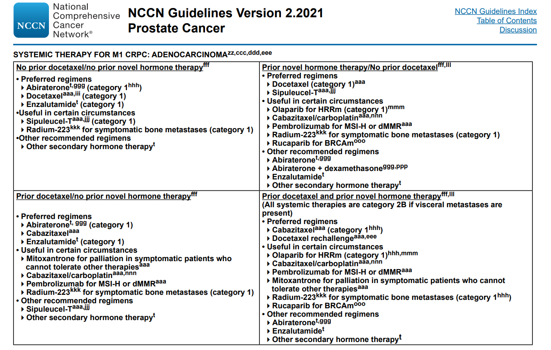
BRCAm, breast cancer mutated; dMMR, deficient DNA mismatch repair; HRRm, homologous recombination repair mutated; CRPC, metastatic castration-resistant prostate cancer; MSI-H, microsatellite instability-high
NCCN Clinical Practice Guidelines in Oncology – Prostate Cancer, version 2.2021. Accessed Jul 30th, 2021

Slide 11
Key phase 3/4 trials in mcrpc
Overall survival results
Study | Treatments | N | Population | HR | 95% CI; p value
TAX 327¹ | Docetaxelª/prednisone vs mitoxantrone/prednisone | 1,006 | mCRPC | 0.76 | 0.62-0.94; p=0.009
TROPIC² | Cabazitaxel/prednisone vs mitoxantrone/prednisone | 755 | mCRPC (post docetaxel) | 0.70 | 0.59-0.83; p<0.0001
COU-AA-301³ | Abiraterone/prednisone vs placebo/prednisone | 1,195 | mCRPC (post docetaxel) | 0.74 | 0.64-0.86; p<0.0001
COU-AA-302⁴ | Abiraterone/prednisone vs placebo/prednisone | 1,088 | mCRPC (pre docetaxel) | 0.81 | 0.70-0.93; p=0.0033
PREVAIL⁵ | Enzalutamide vs placebo | 1,717 | mCRPC (pre docetaxel) | 0.71 | 0.60-0.84; p<0.001
AFFIRM⁶ | Enzalutamide vs placebo | 1,199 | mCRPC (post docetaxel) | 0.63 | 0.53-0.75; p<0.001
ALSYMPCA⁷ | Radium-223 vs placebo | 921 | mCRPC | 0.70 | 0.58-0.83; p<0.0001
IMPACT⁸ | Sipuleucel-T vs placebo | 512 | mCRPC (pre chemotherapy^{b}) | 0.78 | 0.61-0.98; p=0.03
CARD⁹ | Cabazitaxel/prednisone vs ASTI^{c} | 255 | mCRPC (post docetaxel and post abiraterone or enzalutamide) | 0.64 | 0.46-0.89; p=0.008
PROfound¹⁰ | Olaparib vs ASTI^{c} | 387 | mCRPC with HRR mutations (post abiraterone or enzalutamide and post chemotherapy^{d} | 0.69e | 0.50-0.97; p=0.02
ª3-weekly docetaxel cycle; ^{b}18.2% had received previous treatment with chemotherapy; ^{c}enzalutamide or abiraterone plus prednisone; ^{d}approximately 65% of patients had previously progressed on taxanes; ^{e}Results for cohort A of study: patients with alterations in BRCA1, BRCA2, ATM
ASTI, androgen signaling targeted inhibitor; ATM, ataxia telangiectasia mutated; BRCA1/2, breast cancer 1/2; CI, confidence interval; HR, hazard ratio; HRR, homologous recombination repair; mCRPC, metastatic castration-resistant prostate cancer
1. Tannock IF, et al. N Engl J Med. 2004;351:1502-12; 2. de Bono JS, et al. Lancet. 2010;376:1147-54; 3. Fizazi K, et al. Lancet Oncol. 2012;13; 983-92; 4. Ryan CJ, et al. Lancet Oncol. 2015;16:152-60; 5. Beer TM, et al. N Engl J Med. 2014;371:424-33; 6. Scher HI, et al. N Engl J Med. 2012;367:1187-97; 7. Parker C, et al. N Engl J Med. 2013;369: 213-23; 8. Kantoff PW, et al. N Engl J Med. 2010;363:411-22; 9. de Wit R, et al. N Engl J Med. 2019;381:2506-18; 10. Hussain M, et al. N Engl J Med. 2020;383:2345-57

Slide 12
Clinical Factors to support Treatment Choice
Consider prior treatments. Novel mechanism of action preferred
Is the patient symptomatic or asymptomatic?
Consider sites of metastases: visceral vs bone-only disease
Is the patient suitable for chemotherapy?
Is there small cell/neuroendocrine differentiation?
Are there targetable DNA repair mutations?
Is there microsatellite instability?
Consider co-morbidities, quality of life, patient preference
Are there suitable clinical trial options?
PARPi, Poly (ADP-ribose) polymerase inhibitor

Slide 13
Sequencing: modest effects of abiraterone after enzalutamide and enzalutamide after abiraterone
response to Abiraterone after treatment with enzalutamide in mcrpc patients¹
Enzalutamide vs docetaxel in men with CRPC progressing on abiraterone²
Treatment
100
100
*
*
*
enzalutamide
docetaxel
50
50
Maximum PSA change (%)
Best PSA response (% change)
0
0
PSA reduction 30%
−30
−50
PSA reduction 50%
−50
−100
−100
Patients
*Bar is truncated because of a PSA increase > 100%
CRPC, castration-resistant prostate cancer; PSA, prostate-specific antigen
1. Loriot Y, et al. Ann Oncol. 2013;24:1807-12; 2. Suzman DL, et al. Prostate. 2014;74:1278-85
Notes:
CRPC, castration-resistant prostate cancer; PSA, prostate-specific antigen.
Retrospective reports such as that by Loriot and colleagues indicate that we see far fewer responses to abiraterone in patients who have been treated with enzalutamide than we had seen in the registrational trials, in which prior therapy was excluded. Similarly, Schrader and colleagues presented a relatively disappointing experience with enzalutamide after abiraterone pre-treatment. Interestingly, with the overlapped waterfall plots, one can see that there are responses in both abi – responsive and abi-nonresponsive patient populations. One can almost see 4 subgroups of patients here.

Slide 14
Body of evidence suggests Limited Benefit to Sequencing AR-PATHWAY INHIBITORS
Drug | N | ≥50% PSA response | Median PFS/TTPP (months) | Median OS (months)
Enzalutamide ➔ abiraterone + prednisone
Attard G et al.^{1a} | 125 | 2% | 5.6 | Not Reported
Khalaf D et al.² | 75 | 4%† | TTPP: 1.7 months^{b} | 24.7
Abiraterone + prednisone ➔ enzalutamide
Smith MR et al.³ | 33 | 67% | TTPP: 2.8 months | Not Reported
Zhang T et al.⁴ | 9 | 11% | 3.6 | 8.5
Azad AA et al.⁵ | 47 | 26% | 6.6 | 8.6
Khalaf D et al.² | 73 | 36%^{c} | TTPP: 3.5 months^{b} | 28.8
ªLimited benefit of using abiraterone after enzalutamide in the PLATO trial – however was not the primary aim of this trial; ^{c}PSA ≥30% decline from baseline; ^{b}Time to second PSA progression on second therapy
AR, androgen receptor; OS, overall survival; PFS, progression-free survival; PSA, prostate-specific antigen; TTPP, time to PSA progression
1. Attard G, et al. J Clin Oncol. 2018;36:2639-46; 2. Khalaf D, et al. Lancet Oncol. 2019;20:1730-39; 3. Smith MR, et al. Eur Urol. 2017;72:10-13;
4. Zhang T, et al. Clin Genitourin Cancer. 2015;13:392-9; 5. Azad AA, et al. Eur Urol. 2015;67:23-9
Notes:
4 studies of sequencing, all in mCRPC. Smith is post-hoc COU-302 analysis (treatment with abi or enza with intervening chemo). Zhang is chart review at Duke. Khalaf is crossover trial with Chi. Attard is PLATO. Azad is 115 pts from Canadian registry.

Slide 15
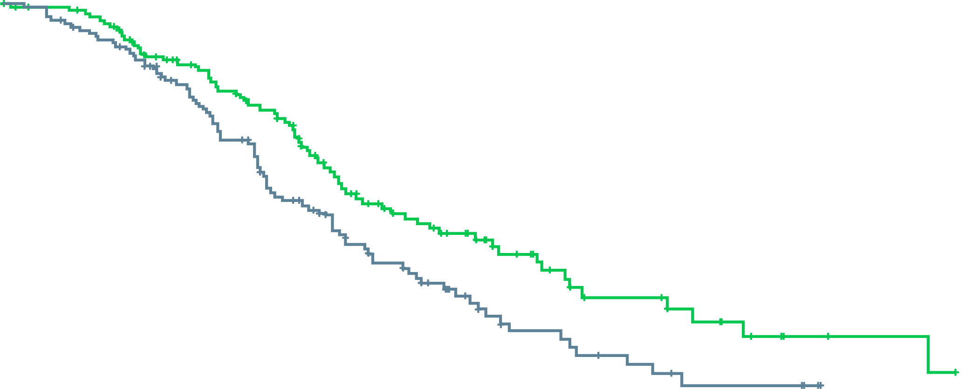
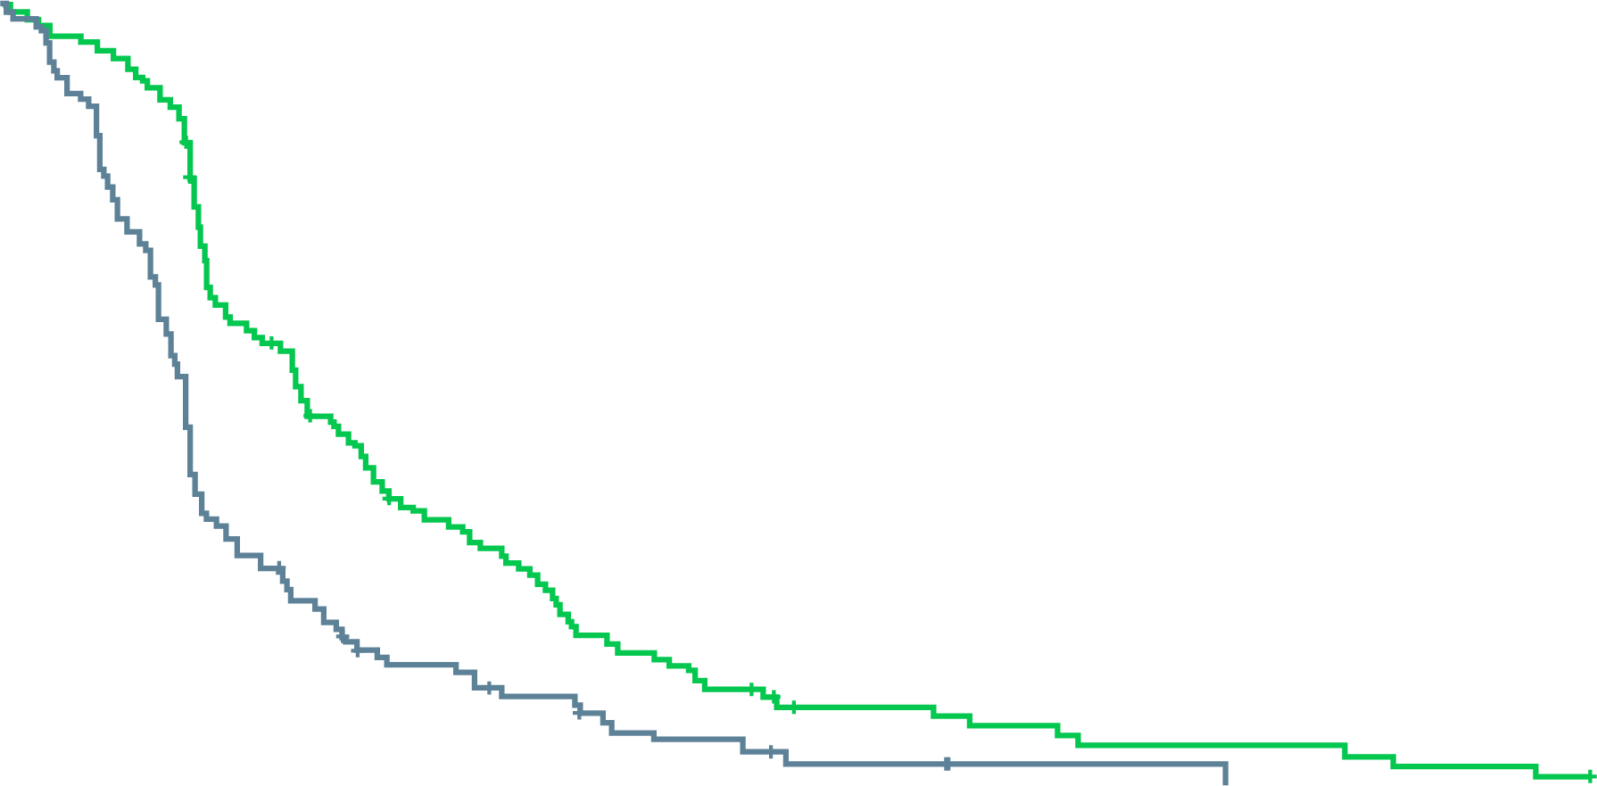
CARD: cabazitaxel more effective than abi or enza after abi or enza
Overall survival
 | No. of patients | Median overall survival (95% CI), months
cabazitaxel | 129 | 13.6 (11.5–17.5)
ASTI | 126 | 11.0 (9.2–12.9)
 | Hazard ratio for death 0.64 (95% CI 0.46–0.89) P = 0.008
100
Men previously treated with both docetaxel
and ARPI (abi or enza)
  Median age 70 (range 46–85) years in cabazitaxel group
  69% had pain progression at trial entry
14% of patients in ARPI treatment group
had a ≥50% PSA response to second
AR targeted agent
Median PFS of 2.7 months for second AR agent
90
80
70
60
50
Patients alive (%)
40
30
cabazitaxel
20
10
ASTI
0
0
3
6
9
12
18
24
30
No. at risk
cabazitaxel
ASTI
Time (months)
129
126
122
116
96
88
77
64
51
39
21
11
8
3
2
0
Progression-free survival
 | No. of patients | Median progression-free survival (95% CI), months
cabazitaxel | 129 | 4.4 (3.6–5.4)
ASTI | 126 | 2.7 (2.4–2.8)
 | Hazard ratio for progression or death 0.52 (95% CI 0.40–0.68) P < 0.001
100
90
80
70
60
Patients alive without
progression (%)
50
40
cabazitaxel
30
20
10
ASTI
0
0
3
6
9
12
18
24
No. at risk
cabazitaxel
ASTI
Time (months)
129
126
82
42
39
16
20
7
8
2
4
1
0
0
abi, abiraterone; AR, androgen receptor; ARPI, androgen receptor pathway inhibitor; CI, confidence interval; enza, enzalutamide; PFS, progression-free survival;
PSA, prostate-specific antigen
de Wit R, et al. N Engl J Med. 2019;381:2506-18
Notes:
I found these data quite compelling and practice changing, I’m using a lot more cabazitaxel now. The efficacy is clearly higher. But is it for everyone? There were a good proportion of men in their 70s and 80s included which is reassuring when facing an older patient in our practices, but of course these were ECOG 0-1 patients. Toxicity profile was tolerable – although high rate of neutropenia, little febrile neutropenia and there were 2 deaths from infection on each arm. Notably, however, most men entered the study with pain progression as a qualifying form of progression, very few for PSA alone. Thus when faced with an asymptomatic patient, we might not choose to jump right in with cabazi, there may be room to use abi/enza first, especially if the patient is coming right off doce and could use some recovery time. This was largely NOT an asymptomatic population. Pain response 45% with cabazi vs 19.3% with ASTi

Slide 16
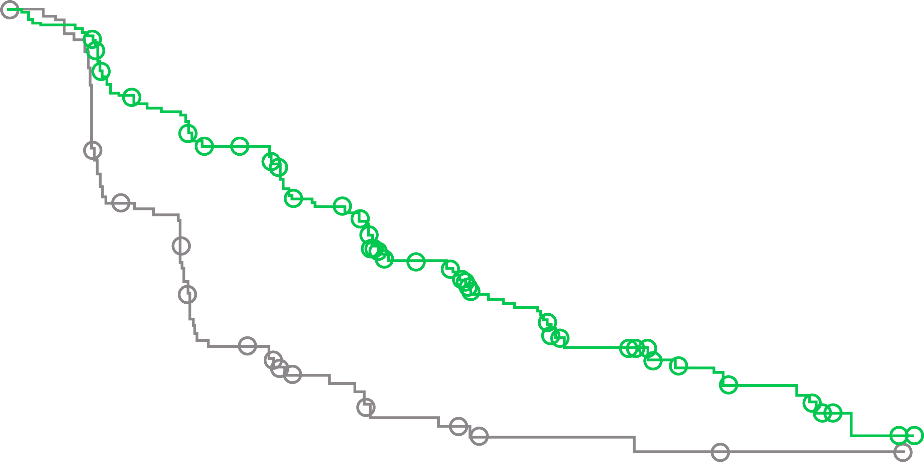
profound study: Progression-free survival
rpfs IN cohort A (PRIMARY ENDPOINT)
Sequencing AR agents not effective
Median PFS of 3.6 months for second ARI
1.00
0.90
0.80
Value at
6 mo
Key eligibility criteria
mCRPC with disease progression on prior NHA (e.g. abiraterone acetate or enzalutamide)
Alterations in ≥1 of any qualifying gene with a direct or indirect role in HRR
Cohort A
BRCA1, BRCA2, or ATM alteration
(N=245)
Olaparib 300 mg BID
(n=162)
0.70
0.60
0.60
Physician’s choiceª
(n=83)
Probability of imaging-based
progression-free survival
0.50
Value at
12 mo
0.40
0.28
2:1 randomisation
(Open label)
Upon progression by BICR,
physician’s choice patients were
allowed to cross over to olaparib
0.30
Olaparib
0.20
0.23
Olaparib 300 mg BID
(n=94)
0.10
Control
Cohort B
Other alterations
(N=142)
0.00
0.09
0
1
2
3
4
5
6
7
8
9
10
11
12
13
14
15
16
17
18
19
20
21
Physician’s choice
(n=48)
No. at risk
Olaparib
Control
Months since randomization
Stratification factors
Previous taxane
Measurable disease
162
83
149
79
126
47
116
44
102
22
101
20
82
13
77
12
56
7
53
6
42
3
37
3
26
3
24
2
18
2
11
1
11
1
3
1
2
1
0
0
0
0
0
0
 | Olaparib (n=162) | Physician’s choice (n=83)
Median rPFS, months | 7.4 | 3.6
Hazard ratio (95% CI) | 0.34 (0.25–0.47) p<0.001
ªPhysician’s choice: enzalutamide 160 mg/day, or abiraterone 1,000 mg/day + prednisone 5 mg BID
AR(I), androgen receptor (inhibitor); ATM, ataxia telangiectasia mutated; BICR, blinded independent central review; BID, twice daily; BRCA1/2, breast cancer 1/2; CI, confidence interval; HRR, homologous recombination repair; mCRPC, metastatic castration-resistant prostate cancer; NHA, new hormonal agent; (r)PFS, (radiographic) progression-free survival
de Bono J, et al. N Engl J Med. 2020;382:2091-102; Hussain M, et al. Ann Oncol. 2019;30(suppl 5):v881-2 (ESMO 2019 oral presentation)

Slide 17
Chemotherapy vs Radium-223: which sequence?
Consider Ra-223 first
Consider docetaxel first
Bone-predominant disease with symptoms
Visceral metastasis or significant
nodal involvement
DNA repair mutation?
Prostate primary in place
Peripheral neuropathy
“Superscan”
Fragile diabetes
Aggressive disease with fast progression
Clinical trial availability
EBXRT, external beam radiation therapy; ¹⁷⁷Lu, lutetium 177; PSMA, prostate-specific membrane antigen; Ra-223, radium-223

Slide 18
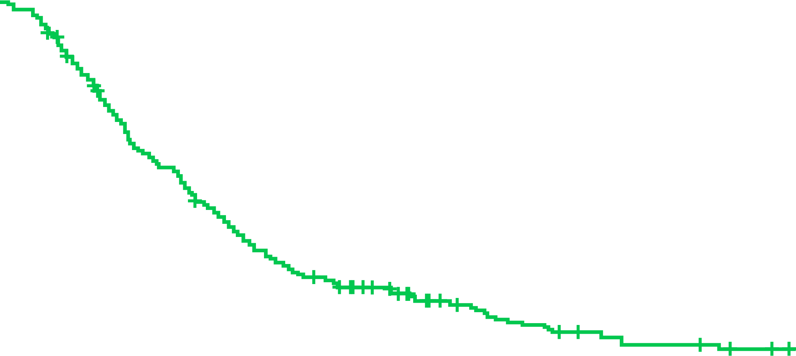
Chemotherapy after Ra-223 treatment still provides OS benefit for mCRPC patients
(Real-world data)
Longest OS was observed in the radium-223 pre-chemotherapy cohort
OS did not differ significantly between radium-233 pre-chemotherapy or post-chemotherapy cohort, or between the radium-223 monotherapy and radium-223 combination cohorts
OS FROM RADIUM-223 INITIATION
OS FROM INITIATION OF FIRST-LINE mCRPC THERAPY
 | N | Median OS, months (95% CI)
Chemotherapy subgroups Patients treated with chemotherapy Patients treated with radium-223 pre-chemotherapy Patients treated with radium-223 post-chemotherapy | 147 64 83 | 38.7 (34.4, 44.2) 39.4 (33.0, 48.8) 37.4 (32.0, 43.5)
Radium-223 therapy subgroups Patients treated with radium-223 combination therapy Patients treated with radium-223 monotherapy | 92 128 | 35.2 (27.9, 43.3) 32.0 (26.9, 36.0)
1.0
Median (95% CI):
12.4 (10.2, 13.9)
0.8
0.6
Censored
Probability
0.4
0.2
0
0
10
20
30
40
50
60
Months
At risk
220
122
53
23
8
2
0
CI, confidence interval; mCRPC, metastatic castration-resistant prostate cancer; OS, overall survival; Ra-223, radium-223
McKay R, J Clin Oncol. 2020;38(6_suppl):223 (poster)

Slide 19

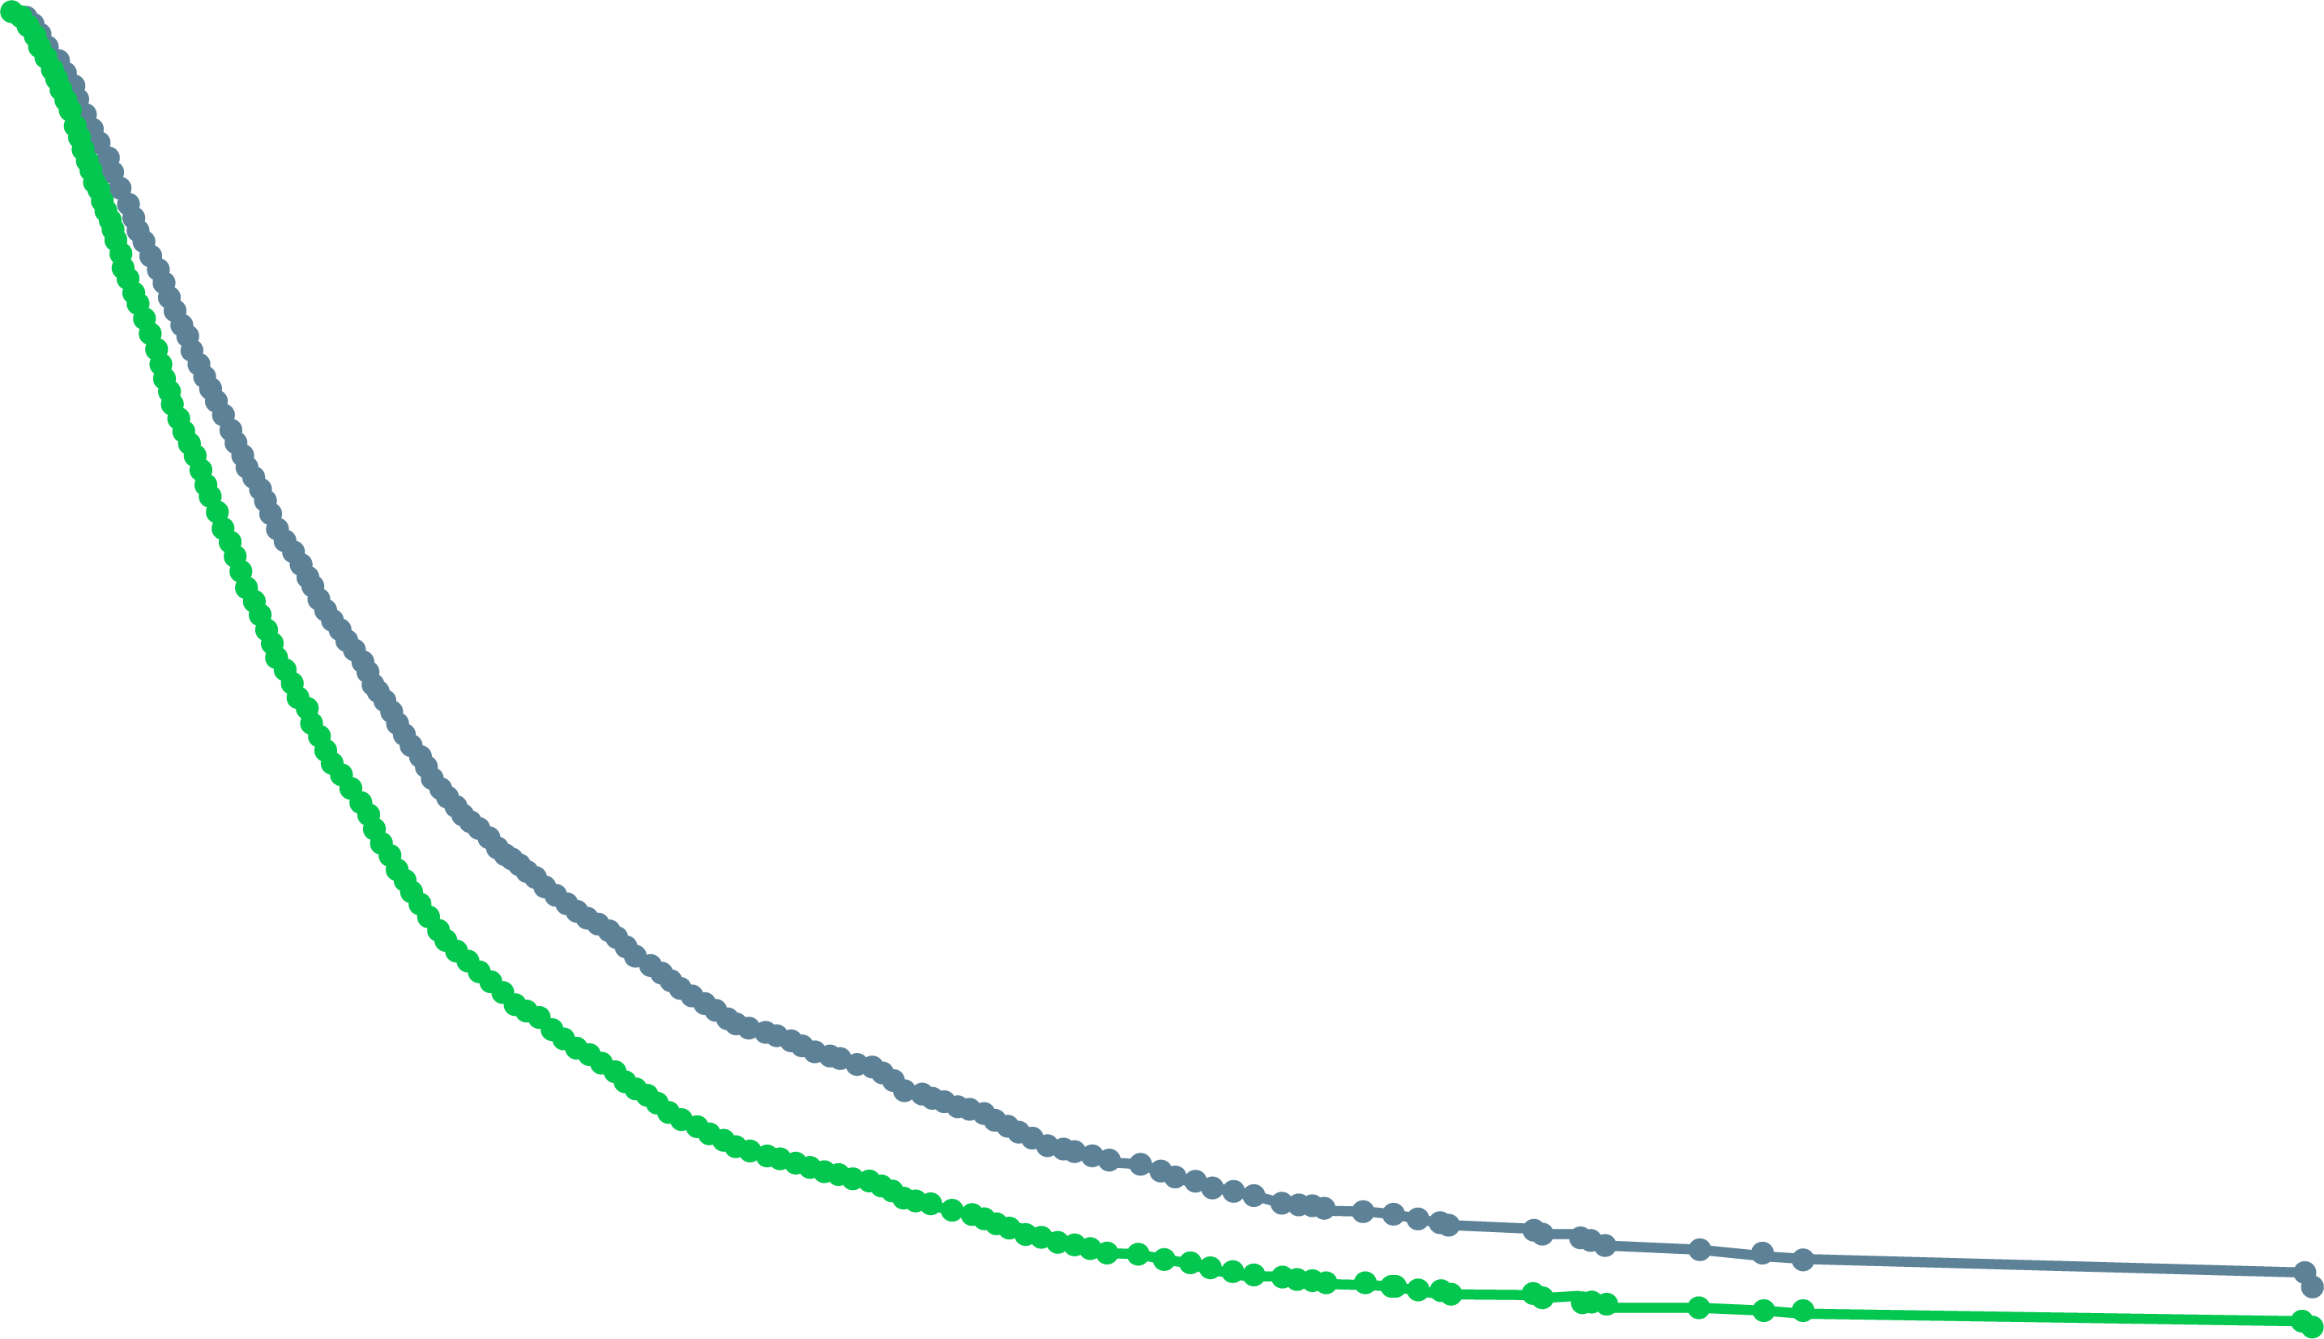

Ra-223 early vs late in the treatment sequence (retrospective analysis)
Patients who received Ra-223 in second-line versus third-line or later had better outcomes
Patients who received Ra-223 early received less chemotherapy, but had better survival
OVERALL SURVIVAL
1.0
Adjusted Cox model of overall survival:
Early-use vs late-use of Ra-223
Early Ra-223 (2nd line)
Primary outcomes
Overall survival
Secondary outcomes
Event-free survival
Time to first hospitalisation
Time to first emergency
department visit
0.8
HR 0.79 (95% CI: 0.66-0.95)
versus
Adjusted median survival time:
10.7 months in early-use and 8.3 months in late-use groups
0.6
All men with
mCRPC receiving
at least 2 lines of
life-prolonging
therapy (LPT) for
mCRPC between
2012 and 2017 in
Ontario, Canada
Cox regression
models using
counting
process data
Probability of survival
0.4
Ra-223 Early use
Ra-223 Late use
Late Ra-223 (3rd or later)
0.2
Adjusted for fixed and time-varying covarietes, including age, prostate
specific antigen, haemoglobin, Charlson Comorbidity Index (CCI), use of bone
health agents, prior systemic treatments, Gleason score, TNM score,
androgen deprivation therapy (ADT) and standardised pain score
0
0
6
12
18
24
30
36
42
48
54
60
66
72
At risk
Early use
Late use
Follow-up time (months)
442
496
89
75
20
13
≤5
≤5
0
0
ADT, androgen deprivation therapy; CCI, Charlson Comorbidity Index; CI, confidence interval; HR, hazard ratio; LPT, life-prolonging therapy; mCRPC, metastatic castration-resistant prostate cancer; Ra-223, radium-223; TNM, tumour, node, metastasis
Mbuagbaw L, et al. J Clin Oncol. 2021;39(6_suppl):136 (Poster session)

Slide 20
Pembrolizumab in MSI-high prostate cancer
32 (3.1%) of 1,033 of prostate cancer patients tested with germline + somatic DNA sequencing had
MSI-high or mismatch-repair deficient status
6 of 11 treated with PD-1/PD-L1 antibody therapy had a PSA decline
>50%
8 patients were evaluable for radiographic response
Duration of therapy ranged from 4.6 to 89 weeks or longer
Patient No.
P-0011155
PR
-99.9
P-0008682
PR
-81.3
P-0025952
PR
-99.9
P-0000755
SD
-40.8
P-0018147
PD
+88.1
Treatment duration
Death
Treatment ongoing
Anti-PD-L1
Anti-PD-1
Clinical trial
Combination
Monotherapy
P-0012928
Inevaluable (toxic effects)
-18.3
Best PSA response from baseline (%)
P-0000964
PD
-60.3
P-0024650
PR
-99.9
P-0021355
PD
+108.5
P-0024660
Inevaluable (bone-only metastases)
-99.5
P-0001071
Inevaluable (clinical progression)
-38.8
0
10
20
30
40
50
60
70
80
90
100
Time (week)
MSI, microsatellite instability; PD, progressing disease; PD-1, programmed cell death protein 1; PD-L1, programmed death-ligand 1; PR, partial response;
PSA, prostate-specific antigen; SD, stable disease
Abida W, et al. JAMA Oncol. 2019;5:471-8

Slide 21
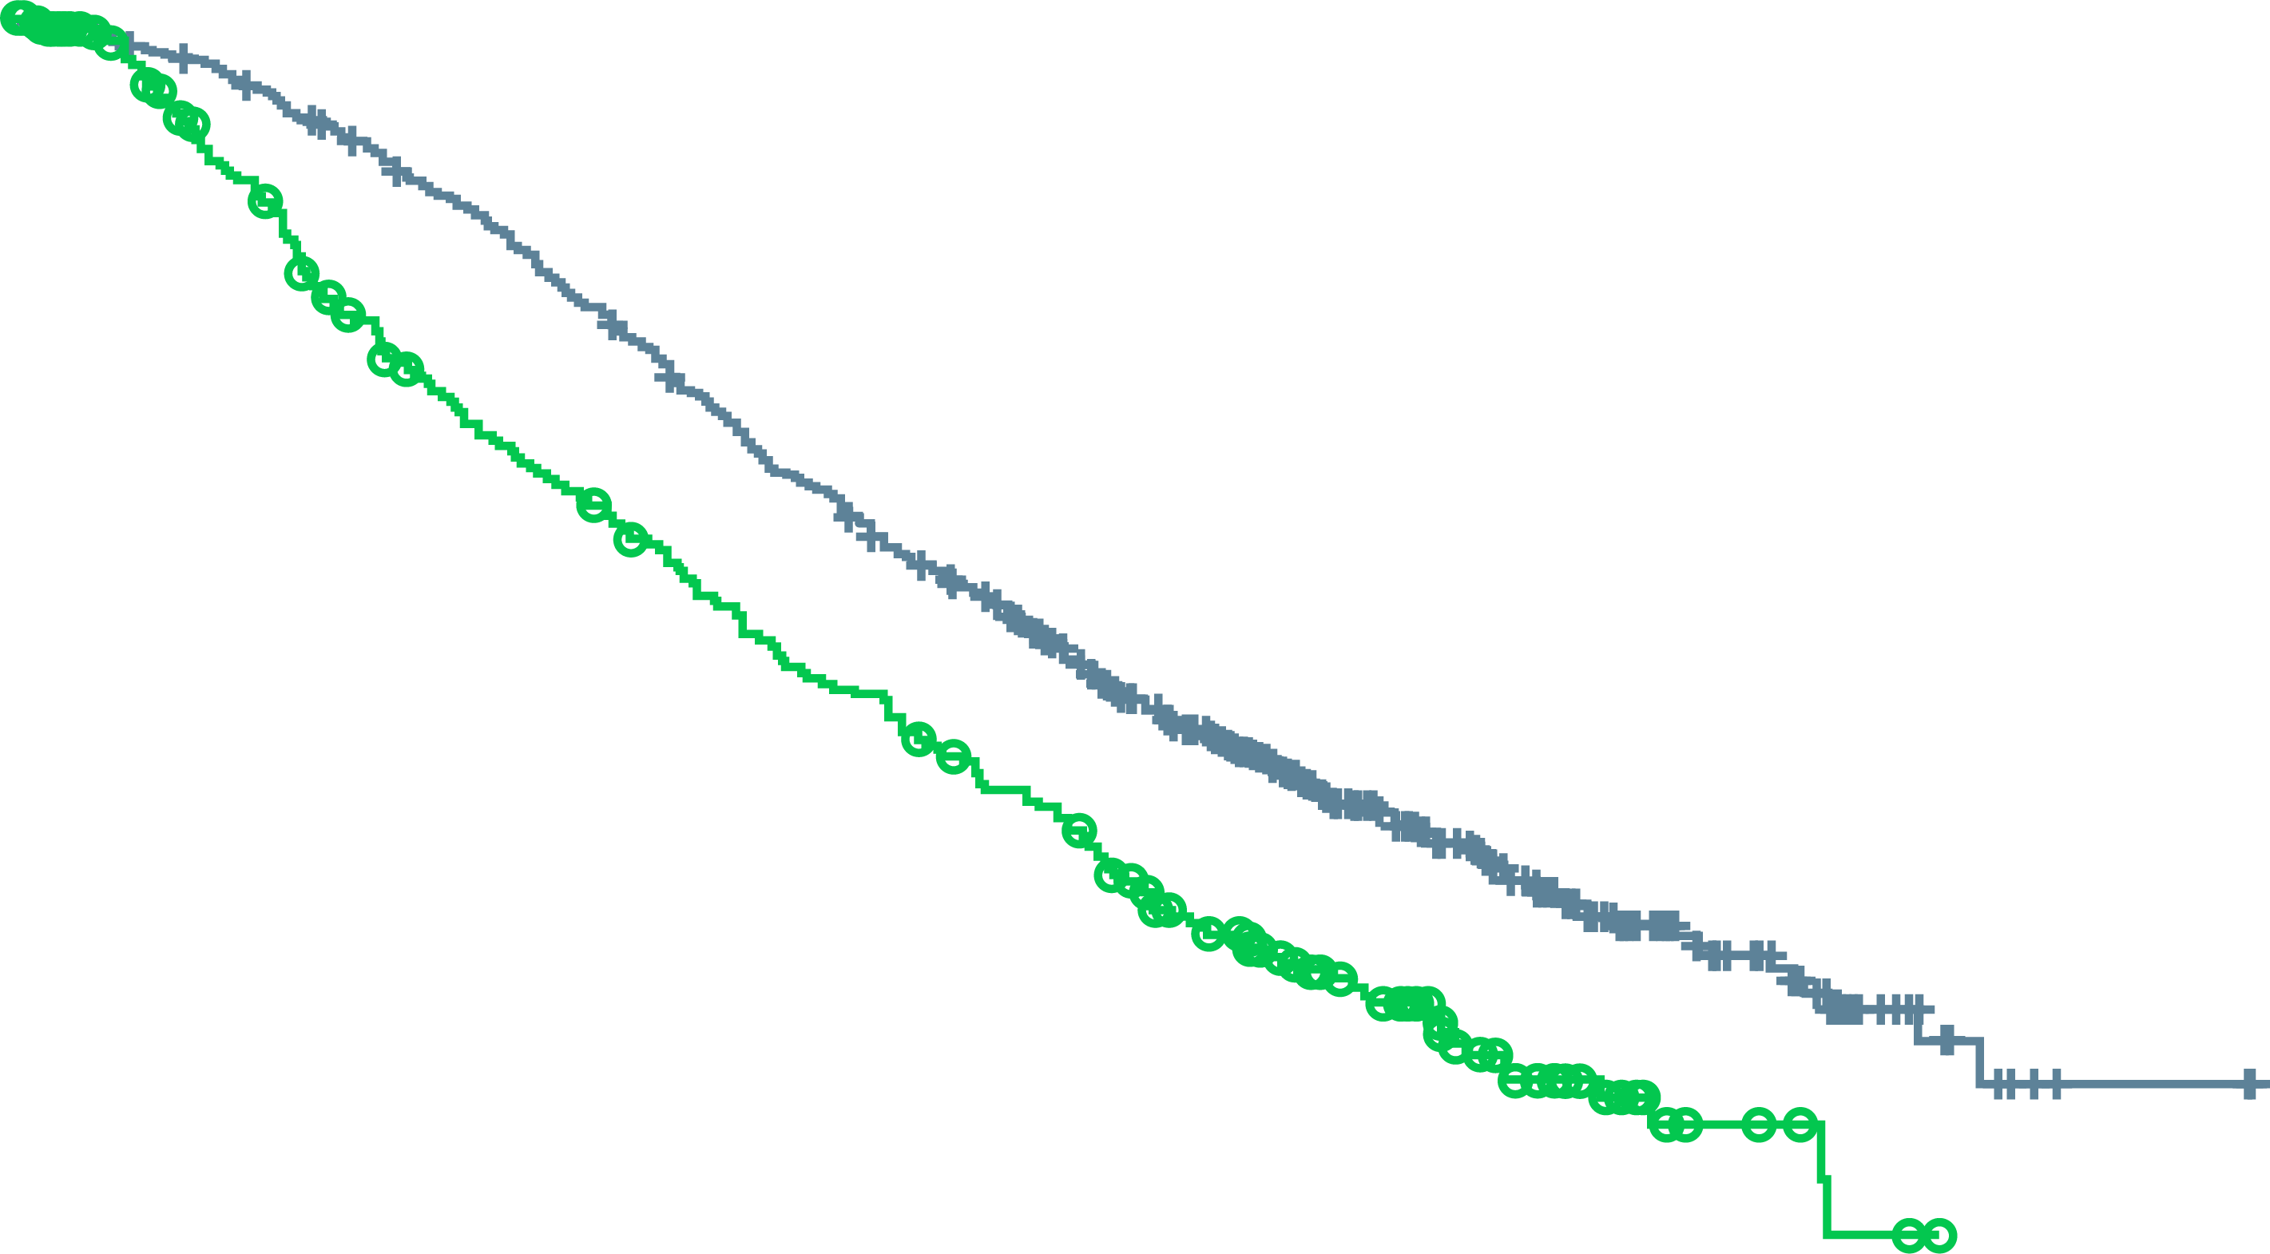
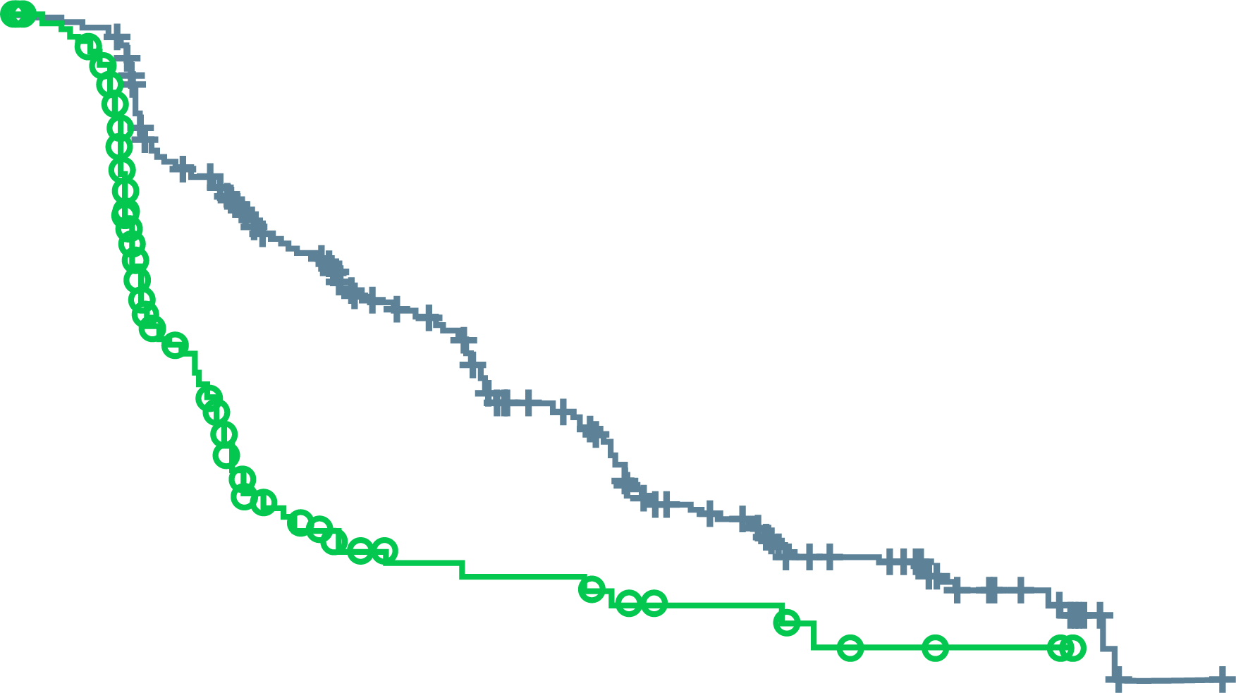
VISION Trial: ¹⁷⁷Lu-PSMA-617 prolongs Overall survival
ALTERNATE PRIMARY ENDPOINTS
OS all randomised patients (N=831)
Imaging-based progression-free survival (n=581)
100
100
90
HR 0.62 (95% CI: 0.52-0.74)
p<0.001 (one-sided)
Median 15.3 vs 11.3 months
90
HR 0.40 (99.2% CI: 0.29-0.57)
p<0.001
Median 8.7 vs 3.4 months
80
80
70
70
60
60
Event-free probability (%)
Patients without
disease progression (%)
50
50
40
40
30
30
20
20
10
¹⁷⁷Lu-PSMA-617 + SOC (n=551)
SOC alone (n=280)
10
¹⁷⁷Lu-PSMA-617 + SOC (n=385)
SOC alone (n=196)
0
0
0
2
4
6
8
10
12
14
16
18
20
22
24
26
28
30
32
0
2
4
6
8
10
12
14
16
18
20
22
No. of patients
still at risk
¹⁷⁷Lu-PSMA-617 + SOC
SOC alone
Time from randomisation (months)
No. of patients
still at risk
¹⁷⁷Lu-PSMA-617 + SOC
SOC alone
Time from randomisation (months)
551
280
535
238
506
203
470
173
425
155
377
133
332
117
289
98
236
73
166
51
112
33
63
16
36
6
15
2
5
0
2
0
0
0
385
196
362
119
272
36
215
19
182
14
137
13
88
7
71
7
49
3
21
2
6
0
1
0
CI, confidence interval; ¹⁷⁷Lu-PSMA-617, Lutetium-177-prostate specific membrane antigen-617; HR, hazard ratio; OS,overall survival; rPFS, radiographic progression-free survival; SOC, standard of care
Sartor O, et al. N Engl J Med. 2021. DOI: 10.1056/NEJMoa2107322

Slide 22
Conclusions
Standard of care for mCSPC requires consideration of early addition of either docetaxel or an
AR-pathway inhibitor (abiraterone acetate, apalutamide, enzalutamide) to ADT
Treatment decisions for mCRPC patients are dependent on the treatment previously received in the CSPC setting
The aim is to give mCRPC patients as many novel life prolonging treatments as possible, whilst preserving quality of life
  Sequencing treatments with different mechanism of actions is preferred
ADT, androgen deprivation therapy; AR, androgen receptor; mCRPC, metastatic castration-resistant prostate cancer;
(m)CSPC, (metastatic) castration-sensitive prostate cancer

Slide 23

REACH GU CONNECT VIA
TWITTER, LINKEDIN, VIMEO, or EMAIL
OR VISIT THE GROUP’S WEBSITE http://www.guconnect.info
Follow us on Twitter
@guconnectinfo
Follow the
GU CONNECT
group on LinkedIn
Watch us on the
Vimeo channel
GU CONNECT
Email
sam.brightwell@cor2ed.com

