Slide 2
Treatment for nstemi: early vs late treatment
Prof. Dr. Uwe Zeymer, MD
Klinikum Ludwigshafen, Ludwigshafen, Germany
Prof. Dr. Giovanni Esposito, MD PhD
University of Naples Federico II, Naples, Italy
NSTEMI, non-ST elevation myocardial infarction

Slide 3
Disclaimer and disclosures
Please note: The views expressed within this presentation are the personal opinions of the authors.
They do not necessarily represent the views of the author’s academic institution or the rest of the CORONARY CONNECT group.
These slides are adapted from the virtual ACS Forum event which was held in December 2020.
The ACS Forum and this content are supported by an Independent Educational Grant from Amgen.
Prof. Dr. Uwe Zeymer has received financial support/sponsorship for research support, consultation or speaker fees from the following companies:
Amgen, AstraZeneca, Bayer, B. Braun Medical, Boehringer Ingelheim, Biotronik, Correvio,
Daiichi-Sankyo, Eli Lilly, Medtronic, The Medicines Company (Novartis), MSD, Novartis, Sanofi-Aventis
Prof. Dr. Giovanni Esposito has received financial support/sponsorship for research support, consultation or speaker fees from the following companies:
Abbott, Amgen, Alvimedica (CID), Boston Scientific, Edwards Lifesciences, Medtronic, Sanofi

Slide 4
Introduction
In patients with ST-segment elevation myocardial infarction (STEMI), generally characterized by a complete thrombotic occlusion, it is well established early diagnosis and early/immediate reperfusion is associated with lower mortality¹
However, the optimal timing of revascularisation in patients with non-ST-segment elevation myocardial infarction (NSTEMI) continues to be a topic of debate:
  An early invasive strategy which treats the culprit lesion as soon as possible
  A delayed invasive strategy that aims to stabilise the plaque through the use of medical therapy prior to percutaneous coronary intervention (PCI)
Current ACC/AHA and ESC guidelines recommend an early invasive strategy for initially stabilised
high-risk NSTEMI patients based on evidence from clinical trials using selected patients and composite endpoints^{2,3}
Timing of the invasive procedure also impacts the timing of drug administration
Here we review key data for early and late invasive strategies for patients with NSTEMI
ACC, American College of Cardiology; AHA, American Heart Association; ESC, European Society of Cardiology
1. Ibanez B, et al. European Heart Journal 2018; 39: Pages 119–177; 2. Amsterdam E, et al. Circulation 2014; 130: e344-426;
3. Collet J-P, et al. Eur Heart J. 2020. DOI: 10.1093/eurheartj/ehaa575

Slide 5
Timing of drug management

Slide 6
Timing of drug management in relation to angiography
Time of angio.
Time of
P2Y12
Time of anticoag.
Time of GPI
Time of PCSK9i
Time of statins
Time of ezetimibe
Time of ACEi
ACEi, angiotensin-converting enzyme inhibitor; angio., angiography; anticoag., anticoagulant; GPI; glycoprotein IIb-IIIa inhibitor;
NSTE-ACS, non-ST-segment elevation acute coronary syndrome; PSCK9i, proprotein convertase subtilisin kexin 9 inhibitor

Slide 7
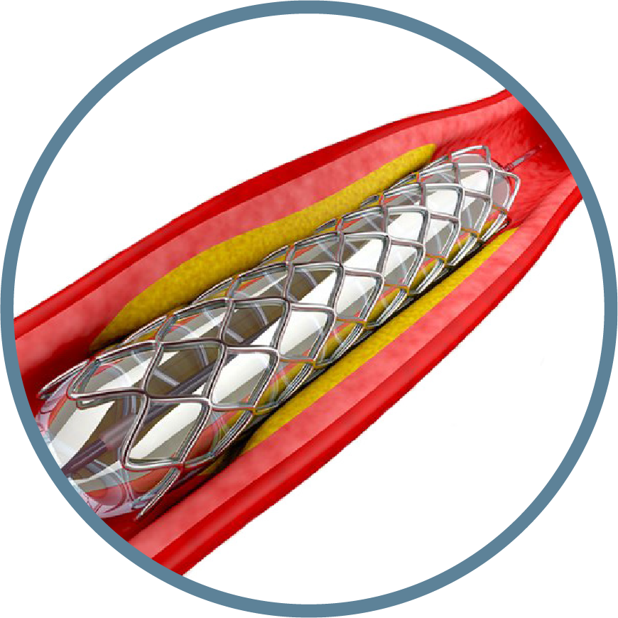

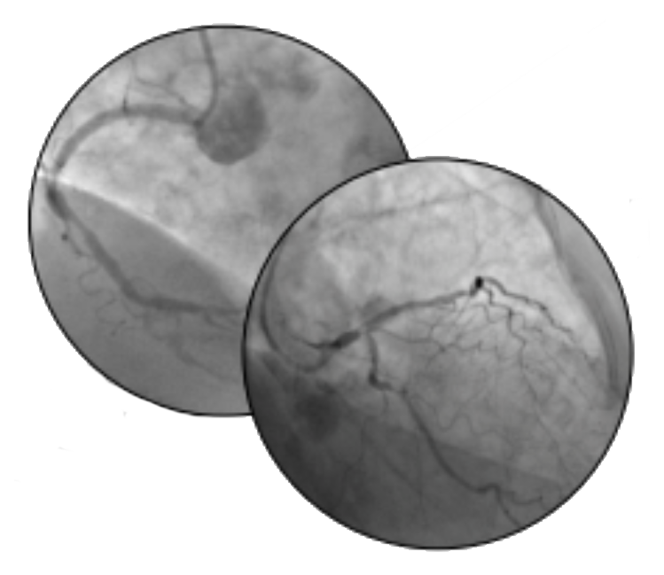


Antiplatelet pretreatment
Upstream P2Y12 loading (pretreatment)
Pros More time for the drug to achieve full antiplatelet effects More ischemic protection while waiting for coronary angiography Less acute stent thrombosis Less need for bailout glycoprotein IIIb/IIIa inhibitors | Cons Increased bleeding Useless for patients who ultimately show no coronary artery disease Harmful for patients who need immediate coronary artery bypass grafting Increased cost due to prolonged hospitalisation if surgical revascularisation required
PCI
Downstream P2Y12 loading (no pretreatment)
Pros No loading dose to patients referred for immediate coronary artery bypass grafting No loading dose to patients with no coronary artery disease More time for personalised decisions based on angiographic and procedural considerations | Cons Less time for the drug to achieve full antiplatelet effects More periprocedural myocardial infarction More periprocedural stent thrombosis More need for bailout glycoprotein IIb/IIIa inhibitors
Coronary angiography
First medical contact
Capodanno D et al. Expert Rev Cardiovasc Ther. 2016; 14: 811-20

Slide 8
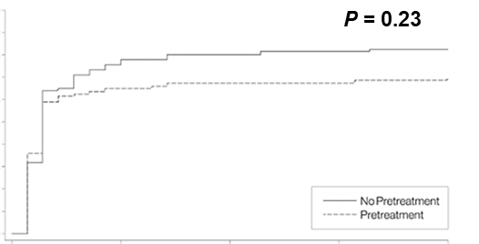
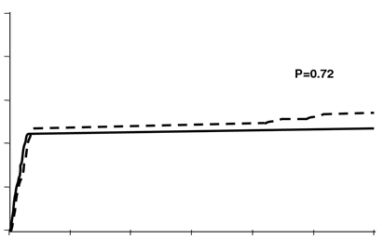
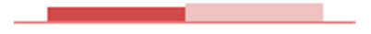
Early P2Y12 inhibition
Prasugrel
Ticagrelor
15
0.04
p=0.50
10
0.03
Patients with Endpoint Event (%)
0.02
Cumulative incidence
5
0.01
0
0.00
0
5
10
15
20
25
30
0
15
30
45
Clopidogrel
Days from first dose
Days since randomisation
Montalescot G, et al. N Engl J Med. 2013;369:999-1010
Tarantini G, et al. J Am Coll Cardiol. 2020;76:2450-9
67% ACS
CREDO
13% ACS
PRAGUE-8
100% ACS
ARMYDA-5
PRELOAD
10
p=0.23
9
Death/MI/stroke/re-intervention
within 7 days
20
8
7
16
p=0.72
6
p=0.75
5
Combined endpoint occurrence (%)
12
4
No pretreatment
Pretreatment
Cumulative incidence of MACE (%)
3
1.0%
8
2
0.8%
4
In lab load
Preload
1
0
0
7
14
21
28
0
Time from randomisation (days)
5
10
15
20
25
30
Days after PCI
915
900
839
838
834
836
834
834
832
832
Days after PCI
Steinhubl S, et al. JAMA. 2002;288:2411-20
Widimski P, et al. Eur Heart J. 2008;29:1495-503
Di Sciascio G, et al. J Am Coll Cardiol. 2010;56:550-7
ACS, acute coronary syndrome; GP, glycoprotein; MACE, major adverse cardiovascular events; MI, myocardial infarction; PCI, percutaneous coronary intervention;
UR, urgent revascularisation

Slide 9
Benefit of early loading to PCI time for statins
30-day MACE
1
Time of study drug
administration
Overall (adjusted HR)
Up to 2 hours before PCI
Between 2 and 4 hours before PCI
Between 4 and 12 hours before PCI
More than 12 hours before PCI
Favours
atorvastatin
Favours
placebo
0.5
0
Log odds ratio
-0.5
-1
-1.5
0.5
0.75
1
1.33
2
3
4
5
 | SLOPE | INTERCEPT
p value | <0.0001 | <0.0001
HR (95% CI)
-2
-25
-5
15
35
55
75
Time between randomisation and PCI (hours)
Navarese EP, et al. Am J Cardiol. 2014;113:1753-64
Lopes RD, et al. JAMA Cardiol. 2018;3:1113-8
CI, confidence interval; HR, hazard ratio; MACE, major adverse cardiac events; PCI, percutaneous coronary intervention

Slide 10
timing of Invasive management
Early vs delayed

Slide 11
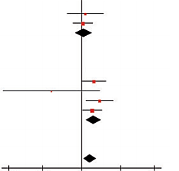
We don’t want to miss a total occlusion
Impact of total occlusion in NSTEMI – Total mortality
N=40,777 patients, 10,415 (25.5%) had total occlusion (TO) of the culprit artery
Study or Subgroup | Log (Risk Ratio) | SE | Total occlusion Total | Subtotal/no occlusion Total | Weight | Risk Ratio IV, random, 95% CI | Year | Risk Ratio IV, random, 95% CI
1 Relative Risk
Warren, et al. 2015 | 0.157 | 0.3759 | 262 | 1057 | 10.9% | 1.17 (0.56-2.44) | 2015
Karwowski, et al. 2016 | 0.0583 | 0.2037 | 728 | 2039 | 25.0% | 1.06 (0.71-1.58) | 2016
Subtotal (95% CI) |  |  | 990 | 3096 | 35.9% | 1.08 (0.76-1.54)
Heterogeneity: Tau²=0.00; Chi²=0.05, df=1 (p=0.82); I²=0%
Test for overall effect: Z=0.45 (p=0.65)
2 Hazard Ratio
Wang, et al. 2009 | 0.5128 | 0.2466 | 528 | 1429 | 20.0% | 1.67 (1.03-2.71) | 2009
Bahrmann, et al. 2011 | -1.2379 | 1.0107 | 130 | 318 | 1.8% | 0.29 (0.04-2.10) | 2011
Kim, et al. 2012 | 0.7467 | 0.2837 | 543 | 1195 | 16.6% | 2.11 (1.21-3.68) | 2012
Shin, et al. 2014 | 0.4415 | 0.1994 | 903 | 903 | 25.6% | 1.56 (1.05-2.30) | 2014
Subtotal (95% CI) |  |  | 2104 | 3845 | 64.1% | 1.65 (1.20-2.26)
Heterogeneity: Tau²=0.02; Chi²=3.80, df=3 (p=0.28); I²=21%
Test for overall effect: Z=3.10 (p=0.002)
Total (95% CI) |  |  | 3094 | 6941 | 100.0% | 1.42 (1.08-1.86)
Heterogeneity: Tau²=0.04; Chi²=7.38, df=5 (p=0.19); I²=32%
Test for overall effect: Z=2.51 (p=0.01)
Test for subgroup differences: Chi²=3.02, df=1 (p=0.08); I²=66.9%
0.05
0.02
1
5
20
Favours TO
Favours non-TO
CI, confidence interval; df, degrees of freedom; IV, inverse-variance; NSTEMI, non-ST-segment elevation myocardial infarction; SE standard error
Khan AR, et al. Eur Heart J. 2017;38:3082-9

Slide 12
ISAR–COOL: nearly STEMI-like approach
Immediate (n=203; median 2.4 hours);
delayed (n=207; median 86 hours): NSTE-ACS
p=0.04
p=0.12
30-day event rate (%)
p=0.54
p=0.25
Immediate intervention, < 6 hours after randomisation; delayed intervention, 3-5 days after randomisation
ISAR–COOL, intracoronary stenting with antithrombotic regimen cooling-off; MI, myocardial infarction; NSTE-ACS, non-ST-segment elevation acute coronary syndrome;
STEMI, ST-segment elevation myocardial infarction
Neumann F-J, et al. JAMA. 2003;290:1593-9

Slide 13
ABOARD study: STEMI-like approach
Immediate (n=175; median 70 min.);
early (n=177; median 21 hours): NSTE-ACS
0.14
0.12
Primary endpoint: peak troponin I
0.10
Median IQR
Immediate 2.1 (0.3-7.1)
Early 1.7 (0.3-7.2)
0.08
Probability density
0.06
0.04
p=0.70
0.02
0.00
0
5
10
15
20
Troponin I (ng/mL)
IQR, interquartile range; NSTE-ACS, non-ST-segment elevation acute coronary syndrome; STEMI, ST-segment elevation myocardial infarction
Montalescot G, et al. JAMA. 2009;302:947-54

Slide 14
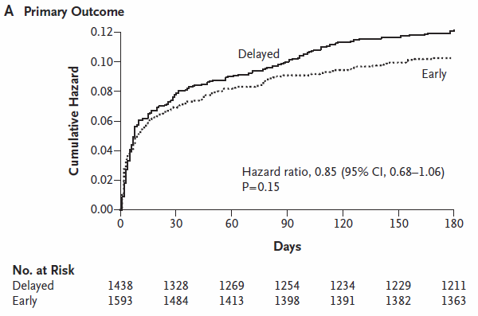
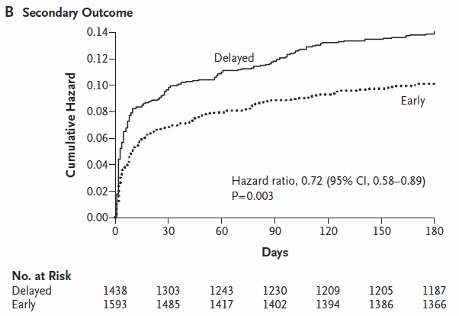
Early vs delayed invasive intervention in ACS:
TIMACS trial
3,031 patients with NSTE-ACS randomised to early (<24 hours; median 14 hours) vs delayed
(>36 hours; median 50 hours) intervention
Death, MI, or stroke
Death, MI, stroke, or refractory ischaemia
ACS, acute coronary syndrome; CI, confidence interval; MI, myocardial infarction; No. number; NSTE-ACS, non-ST-segment elevation acute coronary syndrome
Mehta S, et al. N Engl J Med. 2009;360:2165-75

Slide 15
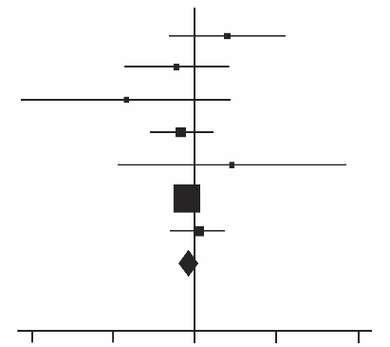
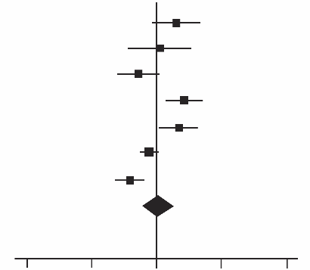
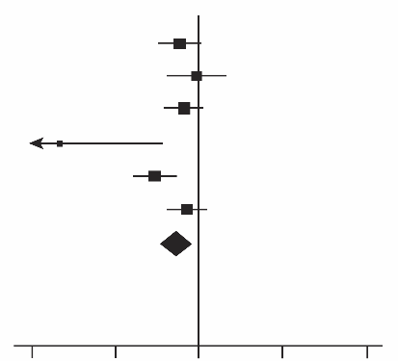
Early vs delayed invasive intervention in ACS: meta-analysis
7 RCTs (N=5,370) comparing early vs delayed (>36 hours; median 50 hours) intervention
All-cause mortality
MI
Refractory ischaemia
OR
D-L, Random 95% CI)
OR
D-L, Random 95% CI)
OR
D-L, Random 95% CI)
ABOARD
ELISA
ISAR-COOL
LIPSIA-NSTEMI
OPTIMA
TIMACS
Zhang, et al. 2010
Total
0.01
0.1
1
10
100
0.01
0.1
1
10
100
0.01
0.1
1
10
100
Favours early
Favours delayed
Favours early
Favours delayed
Favours early
Favours delayed
OR (95%CI)
0.83 (0.64-1.09);
p=0.18
OR (95%CI)
1.15 (0.65-2.01);
p=0.63
OR (95%CI)
0.55 (0.35-0.86);
p=0.008
ACS, acute coronary syndrome; CI, confidence interval; D-L, DerSimonian and Laird; OR, odds ratio; MI, myocardial infarction; RCT, randomised controlled trial
Navarese E, et al. Ann Intern Med. 2013;158:261-70

Slide 16
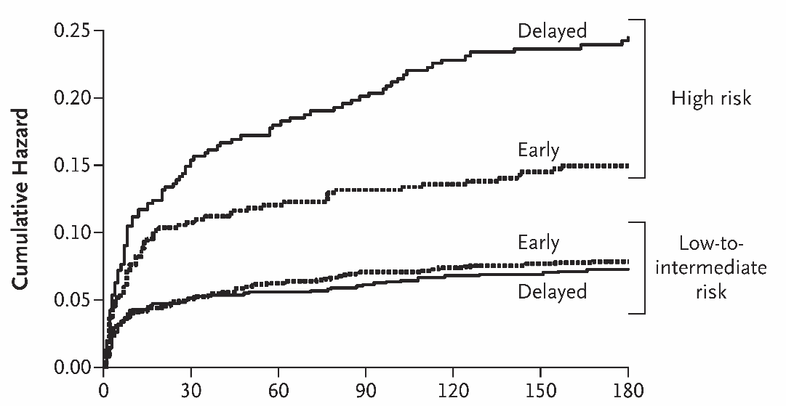
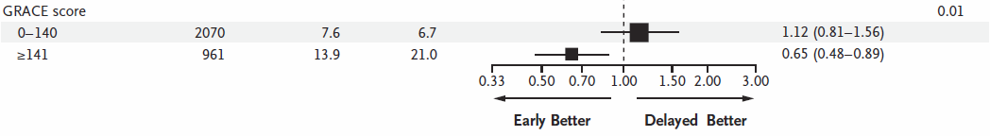
TIMACS trial: primary outcome stratified according to GRACE risk score at baseline
Death, MI,
or stroke
GRACE score >140
Cumulative hazard
GRACE score ≤140
Days
Modified from original
CI, confidence interval; GRACE, Global Registry of Acute Coronary Events; MI, myocardial infarction
Mehta S, et al. N Engl J Med. 2009;360:2165-75

Slide 17
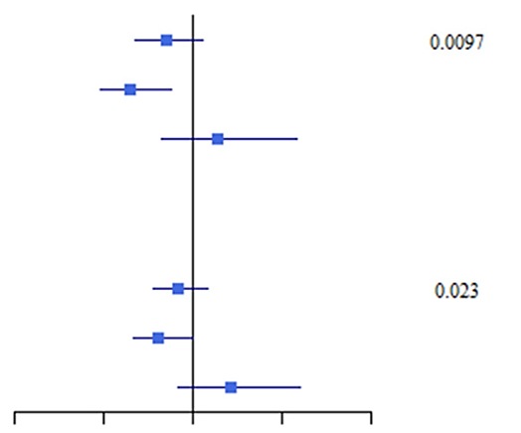
Verdict trial: early (within 12 hours) vs standard invasive (within 48-72 hours) angiography and treatment in NSTE-ACS
Death, MI, refractory ischaemia,
rehospitalisation for heart failure (HF)¹
Primary endpoint
in TIMACS and VERDICT²
50
HR (95%CI)
Interaction p
40
TIMACS
Overall 0.85 (0.68-1.06)
GRACE ≥140 0.65 (0.48-0.88)
GRACE<140 1.14 (0.82-1.58)
0.0097
30
Cumulative event (%)
20
10
VERDICT
Overall 0.92 (0.78-1.08)
GRACE ≥140 0.81 (0.67-1.00)
GRACE<140 1.21 (0.92-1.60)
N=2,147
0.023
0
0
1
2
3
4
At risk
Standard
Early invasive
Time (years)
0
0.5
1
1.5
2
HR (95%CI)
CI, confidence interval; GRACE = Global Registry of Acute Coronary Events; HR, hazard ratio; MI, myocardial infarction;
NSTE-ACS, non-ST-segment elevation acute coronary syndrome
1. Kofoed KF, et al. Circulation. 2018;138:2741-50; 2. Jolly SS, Mehta SR. Circulation. 2018;138:2751-3

Slide 18
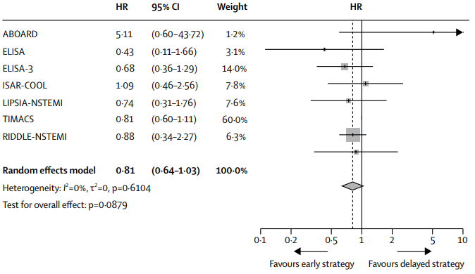
Timing of angiography: meta-analysis
Total mortality: overall NSTE-ACS group
Individual patient-based meta-analysis
 | HR | 95% CI | Weight
ABOARD | 5.11 | (0.60-43.72) | 1.2%
ELISA | 0.43 | (0.11-1.66) | 3.1%
ELISA-3 | 0.68 | (0.36-1.29) | 14.0%
ISAR-COOL | 1.09 | (0.46-2.56) | 7.8%
LIPSIA-NSTEMI | 0.74 | (0.31-1.76) | 7.6%
TIMACS | 0.81 | (0.60-1.11) | 60.0%
RIDDLE-NSTEMI | 0.88 | (0.34-2.27) | 6.3%
Random effects model | 0.81 | (0.64-1.03) | 100.0%
Heterogeneity: I²=0%, 𝜏²=0, p=0.6104
Test for overall effect: p=0.0879
HR
0.1
0.2
0.5
1
2
5
10
Favours early strategy
Favours delayed strategy
CI, confidence interval; HR, hazard ratio; NSTE-ACS, non-ST-segment elevation acute coronary syndrome
Jobs A, et al. Lancet. 2017;390:737-46

Slide 19

Time to coronary angiography in early/immediate invasive and delayed invasive trials
Notable heterogeneity between trials regarding time of angiography
Bars depict interquartile ranges and median times from randomisation to coronary angiography in the early/immediate invasive group (RED BARS) and delayed invasive group (BLUE BARS). Description of the main finding of the primary endpoint with an early vs delayed invasive strategy is also provided.
Immediate invasive, invasive strategy within 2 hours of hospital admission; early invasive, coronary angiography performed within 24 hours of hospital admission
CK-MB, creatine kinase myocardial band; MACE, major adverse cardiovascular events; MI, myocardial infarction; PCI, percutaneous coronary intervention
Collet J-P, et al. Eur Heart J. 2020. DOI: 10.1093/eurheartj/ehaa575

Slide 20




OPTIMAL TIMING OF INVASIVE STRATEGY IN PATIENTS WITH
NSTE-ACS
Individual patient data meta-analysis
(8 RCTs; N=5,324)
CI, confidence interval; HR, hazard ratio; NSTE-ACS, non-ST-segment elevation acute coronary syndrome; RCT, randomised controlled trial
Jobs A, et al. Lancet. 2017;390:737-46

Slide 21

Selection of NSTE-ACS treatment strategy according to risk stratification
Symptom onset
First medical contact ➞ NSTE-ACS diagnosis
PCI centre
Yes
EMS or non-PCI centre
Yes
Immediate transfer to PCI centre
Yes
Risk
identification
Very high
Very high
Yes
High
Same day transfer
High
Yes
Low
Yes
Therapeutic strategy
Immediate invasive
(<2 hours)
Early invasive
(<24 hours)
Selective
invasive
Very high risk
Haemodynamic instability
Cardiogenic shock
Recurrent/refractory chest pain despite medical treatment
Life-threatening arrhythmias
Mechanical complications of MI
Acute heart failure clearly related to NSTE-ACS
ST-segment depression >1 mm/
6 leads plus ST-segment elevation aVr and/or V1
High risk
Established NSTEMI diagnosis
Dynamic new or presumably new contiguous ST/T-segment changes (symptomatic or silent)
Resuscitated cardiac arrest without ST-segment elevation or cardiogenic shock
GRACE risk score >140
Low risk
Lack of any of the very-high-risk or high-risk characteristics
Risk
category
aVR, augmented vector right; EMS, emergency medical services; GRACE, Global Registry of Acute Coronary Events; MI, myocardial infarction; NSTE-ACS, non-ST-segment elevation acute coronary syndrome; NSTEMI, non-ST-segment elevation myocardial infarction; PCI, percutaneous coronary intervention; V1 vector 1
Collet J-P, et al. Eur Heart J. 2020. DOI: 10.1093/eurheartj/ehaa575

Slide 22
Summary: Early vs Delayed Invasive Strategy
An early invasive strategy appears to reduce refractory ischemia but does not appear to confer mortality benefit in all patients
  Benefit is strongly associated with the patient’s risk profile
Avoids unnecessary initial dual antiplatelet therapy
An early invasive strategy within 4-24 hours after diagnosis of NSTEMI
- Saves time until definitive diagnosis and discharge
- Saves money because it shortens hospital stays
- Saves lives in high risk patients
CABG, coronary artery bypass graft; NSTEMI, non-ST-segment elevation myocardial infarction; PCI, percutaneous coronary intervention

Slide 23




REACH CORONARY CONNECT VIA
TWITTER, LINKEDIN, VIMEO & EMAIL
OR VISIT THE GROUP’S WEBSITE http://www.coronaryconnect.com/
Follow us on Twitter
@CoronaryConnect
Follow the
CORONARY CONNECT
Group on LinkedIn
Watch us on the
Vimeo Channel
CORONARY CONNECT
Email
carrie.brubaker
@cor2ed.com

