Slide 1






SKIN TOXICITIES
RELATED TO TARGETED THERAPY
IN GI AND LIVER ONCOLOGY
Supported By
Supported by an Independent Educational Grant from Bayer
CME credit available.
Visit programme home page on
https://checkpoint.cor2ed.com

Slide 2

INTRODUCTION
Welcome to this educational programme on skin toxicities related to targeted therapy in gastrointestinal (GI) and liver oncology
This programme has been developed by a panel of experts:
  Dr Catherine Frenette, hepatologist from San Diego, USA
  Dr Victor Hugo Fonseca de Jesus, medical oncologist from São Paulo, Brazil
  Natasha Pinheiro, nurse practitioner from New York, USA
  Dr Nicole LeBoeuf, dermatologist from Boston, USA
Targeted therapies result in more dermatologic adverse events (AEs) than do non-targeted therapies¹
Dermatologic AEs may lead to dosing changes and both physical and psychological discomfort or pain². These events have a considerable economic burden and increase the risk of total treatment interruption, potentially leading to cancer exacerbation^{2,3}
Pre-emptively addressing and treating potential skin toxicities may improve patients’ quality of life and allow them to remain longer on therapy²
Upon completion of this educational programme you will:
  understand adverse skin reactions to targeted therapy in GI and liver cancers
  know how to prevent and manage skin toxicities associated with targeted therapies in GI and liver cancers
  be able to involve a multidisciplinary team in the prevention, diagnosis, and management of skin toxicities associated with targeted therapy in GI and liver cancers
      The magnifying glass symbol appears on a number of slides within this slide set to indicate more detailed information on a particular topic or area.
AE, adverse event
1. Guztmer R, et al. Dtsch Arztebl Int. 2012;109:133-40. 2. Joshi SS, et al. Cancer. 2010;116:3916-23. 3. Borovicka JH, et al. Arch Dermatol. 2011;147:1403-9.

Slide 3
CONTENTS
1. INTRODUCTION
2. skin toxicity associated with targeted therapy
3. Prevention and Management of skin toxicity
4. Multidisciplinary approach to preventing and
managing skin toxicity
5. SUMMARY AND CLOSE
6. ADDITIONAL RESOURCES

Slide 4



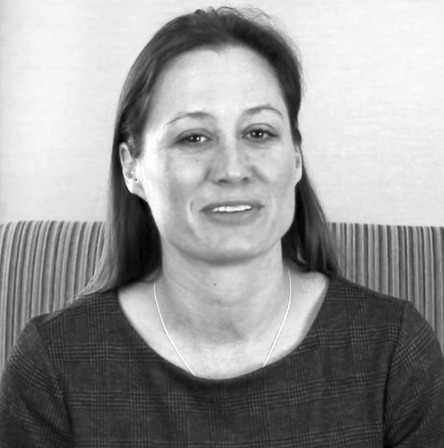



INTRODUCING THE
SCIENTIFIC COMMITTEE
V
V
V
V
DR CATHERINE FRENETTE, Hepatologist, Scripps Clinic Center for Organ and Cell Transplantation, San Diego, USA
DR VICTOR HUGO FONSECA DE JESUS,
Medical oncologist, Carmago Cancer Center, São Paulo, Brazil
NATASHA PINHEIRO,
Nurse practitioner, Memorial Sloan Kettering Cancer Center, New York, USA
DR NICOLE LEBOEUF, Dermatologist, Harvard Medical School, Boston, USA
Medical Director of Liver Transplantation and the HCC Program at the Scripps Clinic Center for Organ and Cell Transplantation
Fellow of AST and AGA
Member of HCC CONNECT
MSc in oncology
Board certification from the Brazilian Society of Medical Oncology
Co-chair of Upper Gastrointestinal Cancer Division at A.C. Camargo Cancer Center
Member of GI CONNECT
MSc in nursing; adult nurse practitioner from Long Island University
Active member of the Nursing Advisory Board, Cholangiocarcinoma Foundation
Active member of ONS
Member of GI NURSES CONNECT
Director of the Program in Skin Toxicities for Anticancer Therapy
Clinical Director of Cutaneous Oncology
Assistant Professor of Dermatology at Harvard Medical School
Honorary collaborator with the CONNECTs groups
AGA, American Gastroenterology Association; AST, American Society of Transplantation; GI, gastrointestinal; HCC, hepatocellular carcinoma; ONS, Oncology Nursing Society

Slide 5



WHAT WILL YOU LEARN?
Understand skin toxicities associated with targeted therapy in GI and liver cancers
Know how to prevent and manage skin toxicities associated with targeted therapies in GI and liver cancers
Be able to involve a multidisciplinary team in the prevention, diagnosis, and management of skin toxicities associated with targeted therapy in GI and liver cancers
GI, gastrointestinal

Slide 6

SKIN TOXICITY
ASSOCIATED WITH TARGETED THERAPY

Slide 7
LEARNING OBJECTIVE
Understand skin toxicity associated with targeted therapy in GI and liver cancers
WHAT
WHY
WILL YOU LEARN?
IS THIS IMPORTANT?
By knowing what skin toxicity to expect, you will be able to:
        better educate patients and carers
        diagnose and treat skin reactions at an earlier stage
        maintain an appropriate dose and duration of therapy
What skin toxicity may occur during treatment with targeted therapy in GI and liver cancers
GI, gastrointestinal

Slide 8





ADVERSE EVENTS
ARE MOST COMMONLY GRADED USING THE CTCAE
AEs are defined as any unfavourable and unintended sign, symptom, or disease temporally associated with the use of a medical treatment or procedure that may or may not be considered related to the medical treatment or procedure
The Common Terminology Criteria for Adverse Events (CTCAE) are used to grade AEs
Version 5.0 was published in November 2017 by the U.S. Department of Health and Human Services
GRADE 1
Mild
GRADE 2
Moderate
GRADE 3
Severe or medically significant, but not immediately life-threatening
GRADE 4
Life-threatening consequences
GRADE 5
Death related to AE
Asymptomatic or mild symptoms
Clinical or diagnostic observations only
Intervention not indicated
Limiting age- appropriate instrumental activities of daily living (ADL)*
Minimal, local, or non-invasive intervention indicated
Limiting self-care ADL**
Disabling
(Prolongation of) hospitalisation indicated
Urgent intervention indicated
*Instrumental ADL are preparing meals, shopping for groceries or clothes, using the telephone, managing money, etc.
**Self-care ADL are bathing, dressing and undressing, feeding self, using the toilet, taking medications, and not being bedridden.
AE, adverse event; CTCAE, Common Terminology Criteria for Adverse Events; ADL, activities of daily living
National Cancer Institute. Cancer Therapy Evaluation Program. Common Terminology Criteria for Adverse Events v5.0. 27 November 2017. (Accessed 31 January 2020.)

Slide 9
MESTT CAN BE USED TO GRADE EFGR-INHIBITOR
RELATED SKIN TOXICITY IN THE TRIAL SETTING
The Multinational Association for Supportive Care in Cancer (MASCC) EGFR Inhibitor Skin Toxicity Tool (MESTT) is a grading system specific for skin toxicity related to EGFR inhibitors^{1,2}
The complexity of the MESTT makes it unsuitable for routine clinical use,² but it is relevant in the trial setting
Grading EGFR-inhibitor related acneiform rash with the MESTT¹
Acneiform rash, description | Grade 1 |  | Grade 2 |  | Grade 3
 | 1A | 1B | 2A | 2B | 3A | 3B
Papulopustular eruption (grade individually for face, scalp, chest, and back) | < 5 papules or pustules OR 1 area of erythema or oedema < 1 cm in size | < 5 papules or pustules OR 1 area of erythema or oedema < 1 cm in size AND pain or pruritus | 6–20 papules or pustules OR 2–5 areas of erythema or oedema < 1 cm in size | 6–20 papules or pustules OR 2–5 areas of erythema or oedema < 1 cm in size AND pain, pruritus, or effect on emotions or functioning | > 20 papules or pustules OR > 5 areas of erythema or oedema < 1 cm in size | > 20 papules or pustules OR > 5 areas of erythema or oedema < 1 cm in size AND pain, pruritus, or effect on emotions or functioning
EGFR, epidermal growth factor receptor; MESTT, MASCC EGFR inhibitor Skin Toxicity Tool
1. Lacouture ME, et al. Support Care Cancer. 2010;18:509-22. 2. Hofheinz R-D, et al. Oncologist. 2016;21:1483-91.

Slide 10
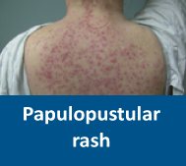
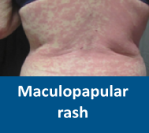
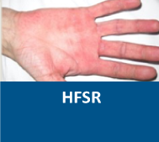
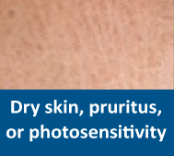
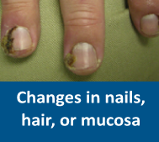
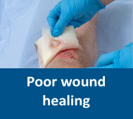
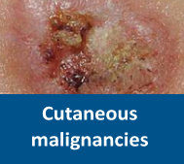
SKIN TOXICITIES BY DRUG CLASS ANY GRADE
Drug class | Examples | Papulopustular rash | Maculopapular rash | HFSR | Dry skin, pruritus, or photosensitivity | Changes in nails, hair, or mucosa | Poor wound healing | Cutaneous malignancies
EGFR inhibitors | cetuximab¹ erlotinib² panitumumab³ | ++ | +/− | − | ++ | + | − | −
MKIs | sorafenib⁴ sunitinib⁵ regorafenib⁶ lenvatinib⁷ cabozantinib⁸ avapritinib⁹ | + | +/− | ++ | + | + | ++ | −
VEGF(R) inhibitors | bevacizumab¹⁰ aflibercept¹¹ ramucirumab¹² | − | +/− | − | + | + | ++ | −
BCR–ABL TKIs | imatinib¹³ nilotinib*¹⁴ dasatinib*¹⁵ | + | +/− | − | + | + | − | −
BRAF inhibitors | encorafenib¹⁶ | ++ | +/− | + | ++ | + | − | +
This table is based on the listed drugs’ Prescribing Information and the clinical experience of the Scientific Committee.
At the time of creation of this educational programme, the PARP inhibitor olaparib was approved for use in pancreatic cancer. As PARP inhibitors are generally not associated with skin toxicity, it was considered out of scope.
++ very common
+ common
+/− uncommon
− rare
*Not approved for use in GI or liver cancers but sometimes used off label in patients with GIST.
1. Erbitux (cetuximab) Prescribing Information. 2. Tarceva (erlotinib) Prescribing Information. 3. Vectibix (panitumumab) Prescribing Information. 4. Nexavar (sorafenib) Prescribing Information. 5. Sutent (sunitinib) Prescribing Information. 6. Stivarga (regorafenib) Prescribing Information. 7. Lenvima (lenvatinib) Prescribing Information. 8. Cabometyx (cabozantinib) Prescribing Information. 9. Ayvakit (avapritinib) Prescribing Information. 10. Avastin (bevacizumab) Prescribing Information. 11. Zaltrap (aflibercept) Prescribing Information. 12. Cyramza (ramucirumab) Prescribing Information. 13. Gleevec (imatinib) Prescribing Information. 14. Tasigna (nilotinib) Prescribing Information. 15. Sprycel (dasatinib) Prescribing Information.
16. Braftovi (encorafenib) Prescribing Information.

Slide 11
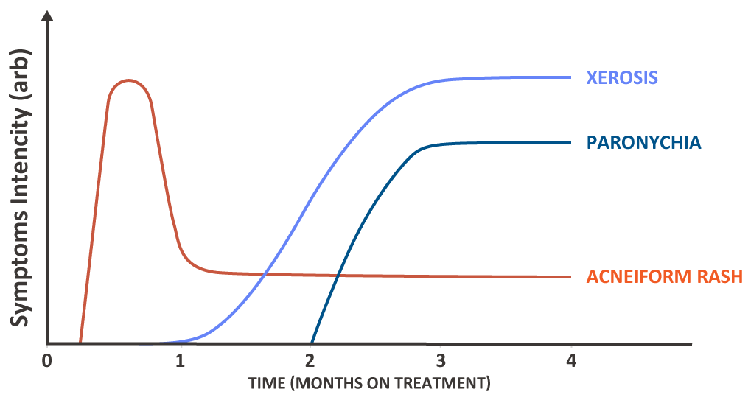
EGFR INHIBITORS ARE MOST OFTEN ASSOCIATED
WITH PAPULOPUSTULAR RASH, DRY SKIN, AND PRURITUS
Skin toxicity occurs in about 90% of patients treated with EGFR inhibitors, and 10–20% of patients experience grade 3 or 4 toxicity¹
The earliest and most common skin AE is papulopustular rash, which develops in 60–80% of patients, usually within the first 2 weeks²
Other common skin toxicities include dry skin, pruritus, and nail and hair abnormalities^{1–5}
Usual timeline of common skin toxicities associated with EGFR inhibitors²
AE, adverse event; EGFR, epidermal growth factor receptor.
1. Lacouture ME, et al. Clin Colorectal Cancer. 2018;17: 85-96. 2. Beech J, et al. Future Oncol. 2018;14:2531-41. 3. Erbitux (cetuximab) Prescribing Information. 4. Tarceva (erlotinib) Prescribing Information. 5. Vectibix (panitumumab) Prescribing Information.

Slide 12
COMMON SKIN TOXICITIES WITH EGFR INHIBITORS
IN GI AND LIVER CANCERS, AS REPORTED IN THE PRESCRIBING INFORMATION
Skin AEs reported in ≥ 10% of patients in clinical trials: % any grade (% grade ≥ 3)
Category | AE | cetuximab in CRC¹ |  |  | erlotinib in pancreatic cancer² | panitumumab in CRC³
 |  | cetuximab | cetuximab + FOLFIRI | cetuximab + irinotecan* | erlotinib + gemcitabine | panitumumab | panitumumab + FOLFOX
Skin | Rash | 95 (16) | 86 (18) | 88 (14) | 70 (5) | 18–57 (1–7) | 32–56 (10–17)
 | Acne |  | 14 (2) |  |  | 14 (1) | 14 (3)
 | Erythema |  |  |  |  | 66 (6) | 16 (2)
 | Pruritus | 47 (2) | 14 (0) |  |  | 58 (3) | 23 (< 1)
 | Dry skin | 57 (0) | 22 (0) |  |  | 10 (0) | 21 (2)
 | HFS |  | 19 (4) |  |  |  | 9 (1)
 | Skin fissures |  | 19 (2) |  |  | 20 (1) | 16 (< 1)
Nails | Nail disorder or changes | 31 (0) |  |  |  | 10 (0) | 10 (1)
 | Paronychia |  | 20 (4) |  |  | 25 (2) | 21 (3)
Hair | Alopecia |  |  |  |  |  | 15 (0)
Mucosa | Stomatitis or mucositis | 32 (1) | 31 (3) |  | 22 (< 1) | 7 (< 1) | 25-27 (4–5)
AE, adverse event; CRC, colorectal cancer; FOLFIRI, leucovorin calcium (calcium folinate), 5-fluorouracil, and irinotecan; FOLFOX,
leucovorin calcium (calcium folinate), 5-fluorouracil, and oxaliplatin; GI, gastrointestinal; HFS, hand–foot syndrome
1. Erbitux (cetuximab) Prescribing Information. 2. Tarceva (erlotinib) Prescribing Information. 3. Vectibix (panitumumab) Prescribing Information.
This table is not intended for between-drug comparisons.
*The Prescribing Information reports only the most common AEs.

Slide 13
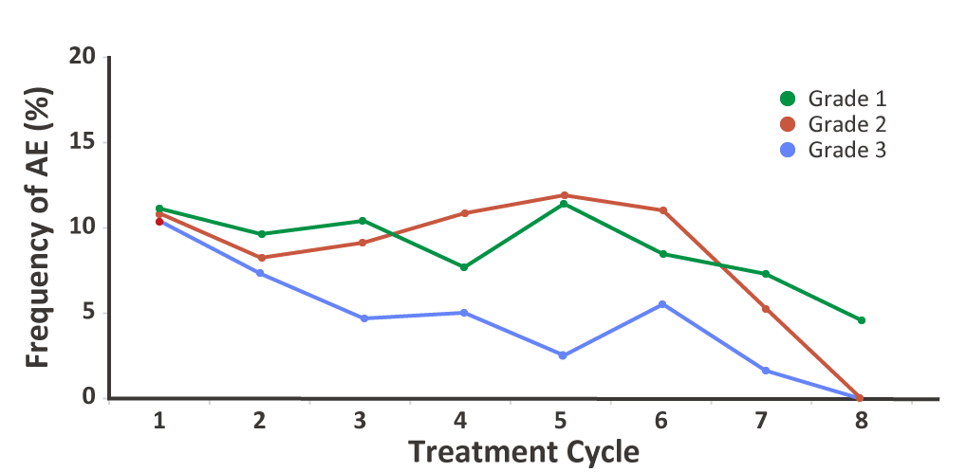
THE MOST NOTABLE SKIN TOXICITY
WITH MKIs IS HAND–FOOT SKIN REACTION (HFSR)
Skin toxicities are very common during treatment with MKIs, although the incidence of individual skin toxicities differs depending on the drug and tumour indication¹
The most notable skin toxicity with MKIs is HFSR¹
Incidence of HFSR in patients with metastatic CRC treated with regorafenib in the CORRECT study²
1 cycle: 3 weeks on therapy followed by 1 week off therapy. Treatment continued until there was no more clinical benefit or unacceptable toxicity occurred.
CRC, colorectal cancer; HCC, hepatocellular carcinoma; HFSR, hand–foot skin reaction; MKI, multiple kinase inhibitor.
1. Guztmer R, et al. Dtsch Arztebl Int. 2012;109:133-40. 2. Grothey A, et al. Poster presented at ASCO Annual Meeting I, 2013. J Clin Oncol. 2013;31:15 suppl.3637.

Slide 14
COMMON SKIN TOXICITIES WITH MKIs
IN GI AND LIVER CANCERS, AS REPORTED IN THE PRESCRIBING INFORMATION
Skin AEs reported in ≥ 10% of patients in clinical trials: % any grade (% grade ≥ 3)
Category | AE | sorafenib in HCC¹ | sunitinib in GIST² | sunitinib in pancreatic NET² | regorafenib in CRC³ | regorafenib in HCC³ | regorafenib in GIST³ | lenvatinib in HCC⁴ | cabozantinib in HCC⁵ | avapritinib in GIST⁶
Skin | HFSR | 21 (8) | 14 (4) | 23 (6) | 45 (17) | 51 (12) | 67 (22) | 27 (3) | 46 (17)
 | Rash | 19 (1) | 14 (1) | 18 (0) | 26 (6) |  | 30 (7) | 14 (0) | 21 (2) | 23 (2)
 | Pruritus | 14 (< 1)
 | Dry skin | 10 (0) |  | 15 (0)
 | Skin discolouration |  | 30 (0)
Hair | Alopecia | 14 (0) |  |  |  |  | 24 (2) |  |  | 13
 | Hair colour changes |  |  | 29 (1) |  |  |  |  |  | 21 (< 1)
Mucosa | Mucositis or stomatitis |  | 29 (1) | 48 (6) | 33 (4) | 13 (1) | 40 (2) | 11 (< 1) | 13–14 (2)
Wound healing | Impaired wound healing | Not reported in ≥ 10% of patients in clinical trials but identified during post-marketing experience and/or warnings included in Prescribing Information
This table is not intended for between-drug comparisons.
AE, adverse event; CRC, colorectal cancer; GIST, gastrointestinal stromal tumor; HCC, hepatocellular carcinoma; HFSR, hand–foot skin reaction; MKI, multiple kinase inhibitor.
1. Nexavar (sorafenib) Prescribing Information. 2. Sutent (sunitinib) Prescribing Information. 3. Stivarga (regorafenib) Prescribing Information. 4. Lenvima (lenvatinib) Prescribing Information. 5. Cabometyx (cabozantinib) Prescribing Information. 6. Ayvakit (avapritinib) Prescribing Information.

Slide 15
VEGF(R) INHIBITORS ARE MOST OFTEN
ASSOCIATED WITH POOR WOUND HEALING
Cutaneous side-effects do not dominate the safety profile of VEGF(R) inhibitors¹
Impaired wound healing is the main skin-related AE seen with VEGF(R) inhibition^{1–4}
The Prescribing Information on each VEGF(R) inhibitor contains warnings about impaired wound healing^{2–4}
                VEGF(R) inhibitors are often combined with chemotherapeutic agents, so statements on frequencies of AEs must be viewed with caution because the event may be related to the chemotherapeutic agent, not the VEGF(R) inhibitor
Discontinue the VEGF(R) inhibitor in patients with wound-healing complications
Do not administer the VEGF(R) inhibitor for at least 28 days after surgery, until the wound is fully healed
Withhold the VEGF(R) inhibitor for 28 days before elective surgery
      …that require medical intervention (ramucirumab and bevacizumab)
…or necrotizing fasciitis (bevacizumab)
AE, adverse event; VEGFR, vascular endothelial growth factor receptor.
1. Wozel G, et al. J Dtsch Dermatol Ges. 2010;8:243-9. 2. Avastin (bevacizumab) Prescribing Information. 3. Zaltrap (aflibercept) Prescribing Information. 4. Cyramza (ramucirumab) Prescribing Information.

Slide 16
COMMON SKIN TOXICITIES WITH VEGF(R) INHIBITORS IN GI AND
LIVER CANCERS, AS REPORTED IN THE PRESCRIBING INFORMATION
Skin AEs reported in clinical trials: % any grade (% grade ≥ 3)
Category | AE | bevacizumab in CRC¹* | bevacizumab in HCC²** | aflibercept in CRC³ | ramucirumab in gastric cancer⁴ |  | ramucirumab in CRC⁴ | ramucirumab in HCC⁴
 |  |  | bevacizumab + atezolizumab | aflibercept + FOLFIRI | ramucirumab | ramucirumab + paclitaxel | ramucirumab + FOLFIRI
Skin | Exfoliative dermatitis | > 10 |  |  |  |  |  | Only AEs occurring in ≥ 10% of patients reported; no skin AEs
 | Dry skin | > 10
 | HFS |  | 2 | 11 (3)† |  |  | 13 (1)†
 | Skin hyperpigmentation |  |  | 8 (0)†
Mucosa | Stomatitis |  |  | 50 (13)† |  | 20 (1)† | 31 (4)†
Hair | Alopecia |  | 2
Wound healing | Impaired wound healing | 15 |  | 0.3 (and evidence from animal studies) | “can occur”
This table is not intended for between-drug comparisons.
*Only the most common any-grade AEs across indications are reported (no CRC-specific data).
**Bevacizumab + atezolizumab is not yet approved for use in HCC.
† These AEs were most probably related to the chemotherapeutic agent.
AE, adverse event; CRC, colorectal cancer; FOLFIRI, leucovorin calcium (calcium folinate), 5-fluorouracil, and irinotecan; GI, gastrointestinal; HCC, hepatocellular carcinoma; HFS, hand–foot syndrome.
1. Avastin (bevacizumab) Prescribing Information. 2. Cheng A-L, et al. Oral presentation at ESMO Asia 2019. Ann Oncol. 2019;30 suppl 9:ix183-202. 3. Zaltrap (aflibercept) Prescribing Information. 4. Cyramza (ramucirumab) Prescribing Information.

Slide 17
BCR–ABL TKIs ARE ASSOCIATED
WITH RASH AND PIGMENTARY CHANGES
Rash is a common side-effect of BCR–ABL TKIs^{1–3}
BCR–ABL TKIs are also associated with pigmentary changes, including both hypo- and hyperpigmentation of the skin
  It is usually mild and self-limiting and responds well to topical treatment⁴
  However, later-generation BRC–ABL TKIs, such as ponatinib, can cause more significant skin reactions, including pityriasis rubra pilaris-like, hyperkeratotic, folliculocentric, and ichthyosiform rash⁵
BCR–ABL, Philadelphia translocation; TKI, tyrosine kinase inhibitor.
1. Gleevec (imatinib) Prescribing Information. 2. Tasigna (nilotinib). Prescribing Information. 3. Sprycel (dasatinib) Prescribing Information. 4. Scott LC, et al. Sarcoma. 2005;9:157-60. 5. Alloo A, et al. Br J Dermatol. 2015;173:574-7.

Slide 18
COMMON SKIN TOXICITIES WITH BCR–ABL TKIs
IN GI CANCERS, AS REPORTED IN THE PRESCRIBING INFORMATION
Skin AEs reported in ≥ 5% of patients in clinical trials: % any grade (% grade ≥ 3)
Category | AE | imatinib in GIST¹ |  |  | nilotinib in GIST²* | dasatinib in GIST³**
 |  | imatinib 400 mg | imatinib 800 mg | imatinib as adjuvant treatment
Skin | Rash or dermatitis | 38 (8) | 50 (9) | 9–39 (< 1–3) | 27 (1) | 11–21 (0–2)
 | Pruritus | 15 (5) | 19 (4) | 11–13 (< 1) | 13 (0) | 12 (1)
 | Dry skin |  |  | 7 (< 1)
 | Photosensitivity reaction |  |  | 7 (0)
Mucosa | Stomatitis or pharyngitis | 9 (5) | 10 (4) | 5 (< 1)
Hair | Alopecia | 12 (4) | 15 (3) | 10–11 (0) | 10 (0)
This table is not intended for between-drug comparisons.
*Not FDA approved. Clinical trial data shown.
**Not FDA approved. Insufficient clinical trial data available. Data on other (adult) indications shown, as listed in the Prescribing Information.
AE, adverse event; BCR–ABL, Philadelphia translocation; GI, gastrointestinal; GIST, gastrointestinal stromal tumor; TKI, tyrosine kinase inhibitor.
1. Gleevec (imatinib) Prescribing Information. 2. Blay J-Y, et al. Lancet Oncol. 2015;16:550-60. 3. Sprycel (dasatinib) Prescribing Information.

Slide 19
BRAF INHIBITORS ARE ASSOCIATED
WITH RASH AND CUTANEOUS MALIGNANCIES
The BRAF inhibitor encorafenib was already used in melanoma, but in April 2020 it was approved by the FDA for use in combination with cetuximab in patients with metastatic CRC and a BRAF V600E mutation¹
Rash is a common side-effect of BRAF inhibitors¹
Cutaneous malignancies have been reported during the use of BRAF inhibitors^{1,2}
In the BEACON CRC study, in which patients with CRC received encorafenib + cetuximab, cutaneous squamous cell carcinomas, including keratoacanthoma, occurred in 1.4% and a new primary melanoma occurred in 1.4% of patients²
CRC, colorectal cancer; BRAF, v-raf murine sarcoma viral oncogene homolog B1; FDA, U.S. Food and Drug Admninstration.
1. Braftovi (encorafenib) Prescribing Information. 2. Kopetz S, et al. N Engl J Med. 2019;381:1632-1643.

Slide 20
COMMON SKIN TOXICITIES WITH BRAF INHIBITORS
IN GI CANCERS, AS REPORTED IN THE PRESCRIBING INFORMATION
Skin AEs reported in clinical trials: % any grade (% grade ≥ 3)
Category | AE | encorafenib + cetuximab in CRC^{1,2}
Skin | Rash or acneiform dermatitis | 26–32 (0–1)
 | Pruritus | 14 (0)
 | Dry skin | 13 (0)
 | Melanocytic naevus | 14 (0)
 | HFSR* | 4 (<1)
Mucosa | Stomatitis* | 6 (0)
The rates of skin toxicity with encorafenib in CRC are potentially confounded by the co-administration of cetuximab.
*Not included in Prescribing Information. Clinical trial data shown.
AE, adverse event; BRAF, v-raf murine sarcoma viral oncogene homolog B1; CRC, colorectal cancer; GI, gastrointestinal; HFSR, hand–foot skin reaction.
1. Braftovi (encorafenib) Prescribing Information. 2. Kopetz S, et al. N Engl J Med. 2019;381:1632-1643.

Slide 21

PAPULOPUSTULAR RASH
Symptoms^{1–3} | Location^{1–3} | Onset | Incidence | Differential diagnosis³
Itching and burning erythematous follicular papules that may evolve into pustules Can be accompanied by telangiectasia, diffuse erythema, and pain | Usually confined to the seborrhoeic areas (face, scalp, neck, retroauricular area, upper trunk) Sometimes on the lower back, abdomen, buttocks, arms, legs | Usually occurs early in the treatment course⁴ In a cetuximab study, the median time to onset of rash was 10 days⁵ | Most common with EGFR inhibitors; rash occurs in 60–80% of patients⁴ Common with MKIs and BRAF inhibitors as well; rash occurs in 14–30% of patients treated for GI/liver cancers^{6–12} | Acne vulgaris Comedones and nodules Itch is rare Scalp involvement is rare Steroid acne Monomorphic papules resembling comedinal acne or malassezia folliculitis Antibiotic-resistant folliculitis Rosacea or periorificial dermatitis Itch is rare Located only on the face
Papulopustular rash is also referred to as acneiform rash, acne-like rash, or folliculitis
BRAF, v-raf murine sarcoma viral oncogene homolog B1; EGFR, epidermal growth factor receptor; MKI, multiple kinase inhibitor.
1. Widakowich C, et al. Oncologist. 2007;12;1443-55. 2. Lacouture ME, et al. Support Care Cancer. 2011;19:1079-95. 3. Segaert S, et al. Eur J Cancer. 2009;45 suppl 1:295-308.
4. Beech J, et al. Future Oncol. 2018;14:2531-41. 5. Jonker DJ, et al. N Engl J Med. 2007;357:2040-8. 6. Nexavar (sorafenib) Prescribing Information. 7. Sutent (sunitinib) Prescribing Information. 8. Stivarga (regorafenib) Prescribing Information. 9. Lenvima (lenvatinib) Prescribing Information. 10. Cabometyx (cabozantinib) Prescribing Information. 11. Ayvakit (avapritinib) Prescribing Information. 12. Braftovi (encorafenib) Prescribing Information.

Slide 22
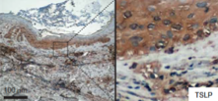
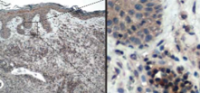
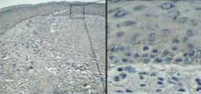
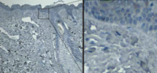
PAPULOPUSTULAR RASH
PATHOLOGY
EGFR/ERK signalling is required during de novo hair eruption in hair-follicle stem cells to secure barrier integrity and prevent invasion by the commensal microbiota¹
When EGFR/ERK signalling is inhibited, commensal skin microbes can invade the follicular opening of erupting hair and provoke an atopic-like (Th2-dominated) inflammatory skin disease¹
Histologically, early infiltration of T lymphocytes is seen, followed by a hyperkeratotic appearance of the follicular infundibula and a florid, neutrophilic suppurative infiltrate²
 | Patient 1 | Patient 2
Baseline¹
Rash developed on treatment with cetuximab
ERK, Extracellular signal-regulated kinase; EGFR, epidermal growth factor receptor; Th, T helper cell.
1. Klufa J, et al. Sci Transl Med. 2019;11:eaax2693. 2. Segaert S, et al. Eur J Cancer. 2009;45 suppl 1:295-308.

Slide 23
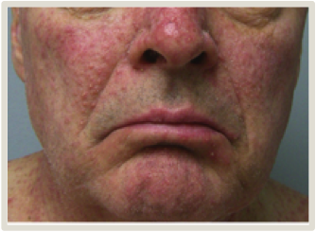
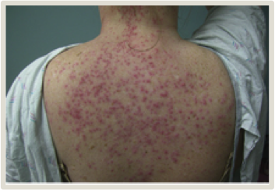
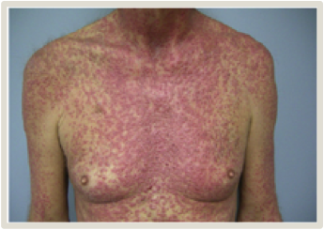
PAPULOPUSTULAR RASH GRADING
Grade 1 | Grade 2 | Grade 3 | Grade 4
Papules or pustules (or both) covering < 10% of the body surface area (BSA) that may or may not be associated with symptoms of pruritus or tenderness | Papules or pustules (or both) covering 10–30% of BSA that may or may not be associated with symptoms of pruritus or tenderness Associated with psychosocial impact Limiting instrumental ADL* Papules or pustules (or both) covering > 30% of BSA with or without mild symptoms | Papules or pustules (or both) covering >30% of BSA with moderate or severe symptoms Limiting self-care ADL** Associated with local superinfection, and oral antibiotics are indicated | Life-threatening consequences Papules or pustules (or both) covering any % of BSA and which may or may not be associated with symptoms of pruritus or tenderness and are associated with extensive superinfection with intravenous antibiotics indicated
* Instrumental ADL are preparing meals, shopping for groceries or clothes, using the telephone, managing money, etc. ** Self-care ADL are bathing, dressing and undressing, feeding self, using the toilet, taking medications, and not being bedridden.
ADL, activities of daily living; BSA, body surface area
1. National Cancer Institute. Cancer Therapy Evaluation Program. Common Terminology Criteria for Adverse Events v5.0. 27 November 2017. (Accessed 31 January 2020.) Images from Lacouture ME, et al. Clin Colorectal Cancer. 2018;17:85-96.

Slide 24
MACULOPAPULAR RASH
Symptoms¹ | Incidence | Onset | Pathophysiology | Differential diagnosis
Flat, red area on the skin that is covered with small confluent bumps (papules) Skin tenderness Mucosal involvement Systemic involvement Associated with pruritus Location Frequently affects the upper trunk | Rash, including maculopapular rash, is reported to be a very common skin toxicity with targeted therapies^{2–14} | Usually within 1–4 weeks from the start of treatment¹⁵ | Unlike papulopustular rash, which is specific to certain targeted therapies, maculopapular rash is a non-specific allergic reaction to treatment | Reaction to another drug Viral exanthem Urticaria Graft-versus-host disease after transplantation If severe: SCAR!
Maculopapular rash is also referred to as morbilliform rash, maculopapular eruption, morbilliform exanthema, and maculopapular exanthema
Be aware of potential SCARs, delayed type IV hypersensitivity reactions to drugs¹⁶
Urgently consult a dermatologist in case of:
blisters
skin tenderness
mucous membrane involvement
rapid progression, turning dusky (grey or purple overtones)
skin sloughing
SCAR, severe cutaneous adverse reaction.
1. National Cancer Institute. Cancer Therapy Evaluation Program. Common Terminology Criteria for Adverse Events v5.0. 27 November 2017. (Accessed 31 January 2020.) 2. Erbitux (cetuximab) Prescribing Information. 3. Tarceva (erlotinib) Prescribing Information. 4. Vectibix (panitumumab) Prescribing Information. 5. Nexavar (sorafenib) Prescribing Information. 6. Sutent (sunitinib) Prescribing Information.
7. Stivarga (regorafenib) Prescribing Information. 8. Lenvima (lenvatinib) Prescribing Information. 9. Cabometyx (cabozantinib) Prescribing Information. 10. Gleevec (imatinib) Prescribing Information.
11. Tasigna (nilotinib). Prescribing Information. 12. Sprycel (dasatinib) Prescribing Information. 13. Ayvakit (avapritinib) Prescribing Information 14. Braftovi (encorafenib) Prescribing Information.
15. Ely JW, Stone MS. Am Fam Physician. 2010;81:726-34. 16. Bellón T. Drug Saf. 2019;42:973-92.

Slide 25
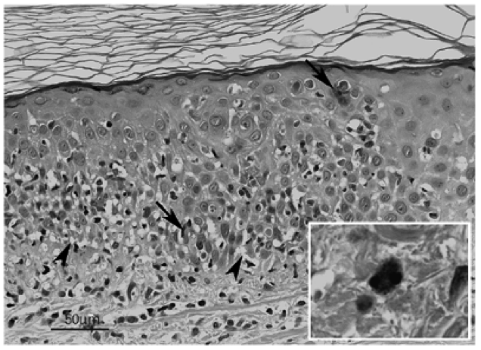
MACULOPAPULAR RASH
PATHOLOGY
Characterised by orthokeratosis, focal basal spongiosis, mild exocytosis of lymphocytes, Civatte bodies (arrow, dyskeratotic, or apoptotic keratinocytes) in all epidermal layers, hydropic degeneration of basal keratinocytes (arrowhead), and a superficial perivascular infiltrate of lymphocytes with few eosinophils (inset)
Haematoxylin and eosin staining of drug-induced maculopapular rash
1. Brönnimann M, Yawalkar N. Curr Opin Allergy Clin Immunol. 2005;5:317-21.

Slide 26
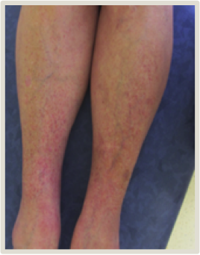
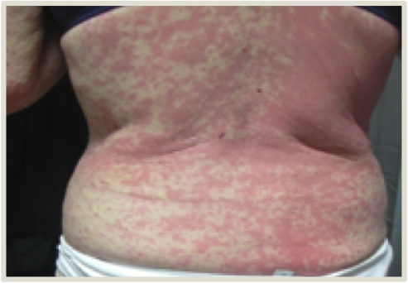
MACULOPAPULAR RASH
GRADING
Grade 1 | Grade 2 | Grade 3
Macules or papules covering < 10% of BSA with or without symptoms (e.g. pruritus, burning, tightness) | Macules or papules covering 10–30% of BSA with or without symptoms Limiting instrumental ADL* Rash covering > 30% of BSA with or without mild symptoms | Macules or papules covering > 30% of BSA with moderate or severe symptoms Limiting self-care ADL**
For the grading of SCAR, please refer to CTCAE v5.0.
* Instrumental ADL are preparing meals, shopping for groceries or clothes, using the telephone, managing money, etc. ** Self-care ADL are bathing, dressing and undressing, feeding self, using the toilet, taking medications, and not being bedridden.
ADL, activities of daily living; BSA, body surface area; SCAR, severe cutaneous adverse reaction.
National Cancer Institute. Cancer Therapy Evaluation Program. Common Terminology Criteria for Adverse Events v5.0. 27 November 2017. (Accessed 31 January 2020.) Images courtesy of Siegfried Segaert, MD, PhD.

Slide 27
HAND–FOOT SKIN REACTION (HFSR) RASH
Symptoms^{1–5} | Onset | Incidence | Differential diagnosis⁵
Tenderness of the palms of the hands and soles of feet Lesions are sharply demarcated, erythematous, oedematous, and very tender Followed by thickened or hyperkeratotic skin with or without blistering Inflamed and painful calluses Location: Areas of pressure or friction, such as the heels and metatarsal heads | Days to weeks from the start of treatment^{5,6} In the phase 3 CORRECT study of regorafenib in CRC, the median time to first occurrence was 15 days⁶ | HFSR was reported in 14–67% of patients with GI or liver cancers treated with MKIs^{7–11} 3–22% of patients have grade ≥ 3 HFSR HFSR is dose-dependent Avapritinib is rarely associated with HFSR¹² | HFSR is distinct from HFS (also known as palmar-plantar erythrodysaesthesia) which is associated with chemotherapy
HFSR versus HFS⁵ | HFSR | HFS
Treatment association | MKIs | Chemotherapy
Onset | Days to weeks | Weeks to months
Distribution | Pressure or friction points | Diffuse involvement of palms or soles (or both)
Presentation | •Dysaesthesia •Erythema •Pain •Epidermal blistering •Calluses | •Dysaesthesia •Erythema •Pain •Oedema •Scaling
CRC, colorectal cancer; HFS, hand–foot syndrome; HFSR, hand–foot skin reaction; MKI, multiple kinase inhibitor
1. Segaert S, et al. Eur J Cancer. 2009;45 suppl 1:295-308. 2. Manchen E, et al. J Support Oncol. 2011;9:13-23. 3. Lacouture ME, et al. Oncologist. 2008;13:1001-11. 4. De Wit M, et al. Support Care Cancer. 2014;22:837-46. 5. McLellan B, Kerr H. Dermatol Ther. 2011;24:396-400. 6. Grothey A, et al. J Clin Oncol. 2013;31:suppl 3637. 7. Nexavar (sorafenib) Prescribing Information. 8. Sutent (sunitinib) Prescribing Information. 9. Stivarga (regorafenib) Prescribing Information. 10. Lenvima (lenvatinib) Prescribing Information. 11. Cabometyx (cabozantinib) Prescribing Information. 12. Ayvakit (avapritinib) Prescribing Information.

Slide 28
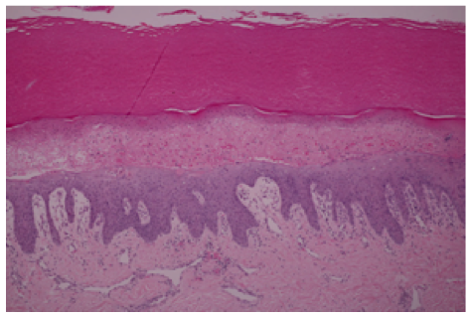
HFSR
PATHOLOGY
Pathological features of HFSR include:¹
epidermal keratinocyte apoptosis, dyskeratosis, and vacuolar degeneration with intraepidermal blister formation, followed by
massive acanthosis, papillomatosis, and parakeratotic hyperkeratosis
The pathophysiology of HFSR with targeted therapy has been extensively studied for sorafenib and sunitinib
These drugs target RAF (sorafenib only), c-KIT, fms-related tyrosine kinase receptor 3 (Flt3), VEGFR, and PDGFR kinases to inhibit tumour-related angiogenesis and tumour growth²
HFSR might occur with these agents because keratinocytes in the epidermis synthesise PDGF-α and PDGF-β, which bind to PDGFRs on dermal fibroblasts, capillaries, and eccrine glands^{2,3}
Dermal eccrine glands also express c-KIT and PDGFR, both of which are targets of sorafenib^{2,3}
Co-inhibition of VEGFR and PDGFR could therefore potentially reduce the ability of vessels to repair themselves in high-pressure areas of the hands and feet, thus causing HFSR in areas such as the palms and soles, which may be repeatedly exposed to subclinical trauma³
Haematoxylin and eosin staining of a HFSR.⁴ Well-defined linear band of necrotic keratinocytes, giving rise to subcorneal blister with epidermal acanthosis and parakeratosis. Mild perivascular lymphocytic cell infiltrate and telangiectasia in the upper dermis.
HFSR, hand–foot skin reaction; PDGF(R), platelet-derived growth factor (receptor); VEGFR, vascular endothelial growth factor receptor.
1. Segaert S, et al. Eur J Cancer. 2009;45 suppl 1:295-308. 2. Lacouture ME, et al. Oncologist. 2008;13:1001-11. 3. Gomez P, Lacouture ME. Oncologist. 2011;16:1508-19. 4. Chanprapaph K, et al. Am J Clin Dermatol. 2016;17:387-402.

Slide 29
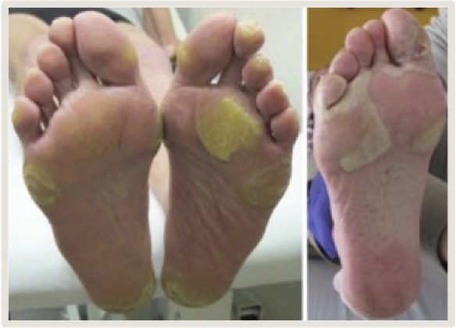
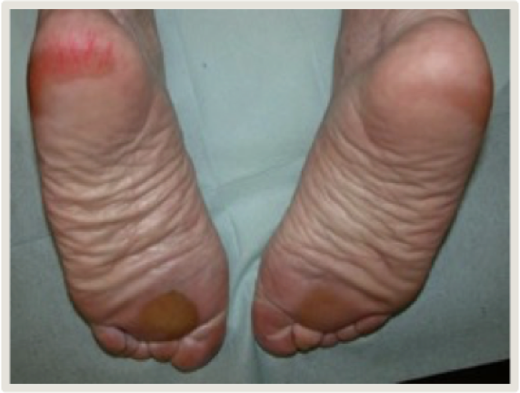
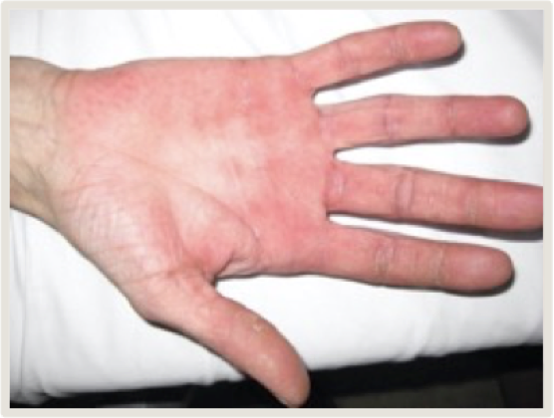
HFSR
GRADING
Note that the pain can be out of proportion to the clinical picture. Therefore, HFSR should be graded primarily on the basis of symptoms and secondarily according to the clinical picture.
Grade 1 | Grade 2 | Grade 3
Minimal skin changes or dermatitis (e.g. erythema, oedema, or hyperkeratosis) without pain | Skin changes (e.g. peeling, blisters, bleeding, fissures, oedema, or hyperkeratosis) with pain Limiting instrumental ADL* | Severe skin changes (e.g. peeling, blisters, bleeding, fissures, oedema, or hyperkeratosis) with pain Limiting self-care ADL**
CTCAE v5.0 has no specific grading for HFSR. The grading used for HFS can also be used for HFSR.¹
* Instrumental ADL are preparing meals, shopping for groceries or clothes, using the telephone, managing money, etc.
** Self-care ADL are bathing, dressing and undressing, feeding self, using the toilet, taking medications, and not being bedridden.
ADL, activities of daily living; CTCAE, Common Terminology Criteria for Adverse Events; HFS, hand–foot syndrome; HFSR, hand–foot skin reaction.
1. National Cancer Institute. Cancer Therapy Evaluation Program. Common Terminology Criteria for Adverse Events v5.0. 27 November 2017. (Accessed 31 January 2020.) Images from McLellan B, et al. Ann Oncol. 2015:26:2017-26.

Slide 30
HFSR as a predictor of response
Some studies have indicated that HFSR is positively correlated with response to MKIs
Sorafenib in HCC¹ | Regorafenib in HCC² | Regorafenib in CRC³ | Lenvatinib in HCC⁴ | Sunitinib in GIST⁵
A meta-analysis of 12 cohort studies with 1,017 patients suggested that HFSR is associated with a longer overall survival (OS) and time to progression (TTP) in patients with HCC treated with sorafenib | A retrospective analysis of the RESORCE trial, in which patients with HCC received 2nd-line regorafenib or placebo after sorafenib, showed that HFSR during treatment with regorafenib was associated with longer OS | A post-hoc analysis of the CORRECT trial, in which patients with previously treated metastatic CRC received regorafenib or placebo, suggested that patients who had HFSR had a greater treatment benefit from regorafenib | A retrospective study including 152 patients with HCC from Japan treated with lenvatinib showed that any grade HFSR was associated with longer TTP | A retrospective study including 416 patients with GIST suggested that HFSR is associated with improved ORR, PFS, and OS
Pooled HR for OS: 0.45 (95% CI 0.36–0.55) Pooled HR for TTP: 0.41 (95% CI 0.28–0.60) | Median OS in patients with vs without HFSR: 14.1 months (95% CI 11.7–16.5) vs 6.6 months (95% CI 5.0–8.5) HR: 0.52 (95% CI 0.40–0.67) | Efficacy in patients with vs without HFSR: PFS: 3.4 vs 1.8 months (HR 0.54, 95% CI 0.45–0.66) OS: 9.5 vs 4.7 months (HR 0.41, 95% CI 0.41–0.53) | TTP in patients with vs without HFSR: Not reached vs 8.9 months (P = 0.007) | Efficacy in patients with vs without HFSR: ORR: 22.2% vs 10.7% PFS: 11.0 vs 5.5 months OS: 35.7 vs 16.6 months All P < 0.01
HCC, hepatocellular carcinoma; HR, hazard ratio; FSR, hand–foot skin reaction; ORR, overall response rate; OS, overall survival; PFS, progression-free survival; TTP, time to progression
1. Wang P, et al. Expert Rev Gastroenterol Hepatol. 2018;12:1-8. 2. Bruix J, et al. J Clin Oncol. 2018;36 suppl 4:412. 3. Grothey A, et al. J Clin Oncol. 2017:35 suppl:3551 . 4. Hiraoka A, et al. Cancer Med. 2019;8:3719-28. 5. Puzanov I, et al. J Clin Oncol. 2011;29 suppl 15:e21113

Slide 31



Additional skin toxicities DRY SKIN
Symptoms¹⁻³ | Incidence⁴⁻¹⁶ | Differential diagnosis
Flaky, dull, scaly, and itchy skin Onset 1–3 months after treatment initiation Often persistent, lasting several months | EGFR inhibitors: up to 57% MKIs: up to 15% BRAF inhibitor: 13% VEGF(R) inhibitors: up to >10% BCR–ABL TKIs: up to 7% | Atopic dermatitis Ichthyosis vulgaris Nutritional deficiency Paraneoplastic Note: dry skin can be exacerbated by cirrhosis!
Dry skin is also referred to as xerosis (cutis)
Grading¹⁷
Grade 1 | Grade 2 | Grade 3
Covering < 10% of BSA Not associated with erythema or pruritus | Covering 10–30% of BSA Associated with erythema or pruritus Limiting instrumental ADL* | Covering > 30% of BSA Associated with pruritus Limiting self-care ADL**
* Instrumental ADL are preparing meals, shopping for groceries or clothes, using the telephone, managing money, etc. ** Self-care ADL are bathing, dressing and undressing, feeding self, using the toilet, taking medications, and not being bedridden.
ADL, activities of daily living; BCR–ABL, Philadelphia translocation; BRAF, v-raf murine sarcoma viral oncogene homolog B1 ; BSA, body surface area; EGFR, epidermal growth factor receptor; MKI, multiple kinase inhibitor; VEGFR, vascular endothelial growth factor receptor
1. Belum VR, et al. Curr Oncol Rep. 2013;15:249-59. 2. Robert C, et al. Semin Oncol. 2012;39:227-40. 3. Lacouture ME, et al. Clin Colorectal Cancer. 2018:17:85-96. 4. Erbitux (cetuximab) Prescribing Information. 5. Tarceva (erlotinib) Prescribing Information. 6. Vectibix (panitumumab) Prescribing Information. 7. Nexavar (sorafenib) Prescribing Information. 8. Sutent (sunitinib) Prescribing Information.
9. Stivarga (regorafenib) Prescribing Information. 10. Lenvima (lenvatinib) Prescribing Information. 11. Cabometyx (cabozantinib) Prescribing Information. 12. Avastin (bevacizumab) Prescribing Information. 13. Zaltrap (aflibercept) Prescribing Information. 14. Cyramza (ramucirumab) Prescribing Information. 15. Gleevec (imatinib) Prescribing Information. 16. Braftovi (encorafenib) Prescribing Information. 17. National Cancer Institute. Cancer Therapy Evaluation Program. Common Terminology Criteria for Adverse Events v5.0. 27 November 2017. (Accessed 31 January 2020.)

Slide 32
Additional skin toxicities Pruritus
Symptoms¹⁻³ | Incidence⁴⁻¹⁶ | Differential diagnosis
Can exist alone or be related to dry skin or rash Onset 2–3 weeks after treatment initiation | EGFR inhibitors: up to 58% BCR–ABL TKIs: up to 19% MKIs: up to 14% BRAF inhibitor: 14% | Related to cholestasis (note: not always accompanied by laboratory changes!) Renal failure Thyroid disease Paraneoplastic Other infectious skin condition
Grading¹⁷
Grade 1 | Grade 2 | Grade 3
Mild or localised topical intervention indicated | Widespread and intermittent Skin changes due to scratching Oral intervention indicated Limiting instrumental ADL* | Widespread and constant Systemic corticosteroid or immunosuppressive therapy indicated Limiting self-care ADL** or sleep
* Instrumental ADL are preparing meals, shopping for groceries or clothes, using the telephone, managing money, etc. ** Self-care ADL are bathing, dressing and undressing, feeding self, using the toilet, taking medications, and not being bedridden.
ADL, activities of daily living; BCR–ABL, Philadelphia translocation; BRAF, v-raf murine sarcoma viral oncogene homolog B1 ; BSA, body surface area; EGFR, epidermal growth factor receptor; MKI, multiple kinase inhibitor; VEGFR, vascular endothelial growth factor receptor
1. Belum VR, et al. Curr Oncol Rep. 2013;15:249-59. 2. Robert C, et al. Semin Oncol. 2012;39:227-40. 3. Lacouture ME, et al. Clin Colorectal Cancer. 2018:17:85-96. 4. Erbitux (cetuximab) Prescribing Information. 5. Tarceva (erlotinib) Prescribing Information. 6. Vectibix (panitumumab) Prescribing Information. 7. Nexavar (sorafenib) Prescribing Information. 8. Sutent (sunitinib) Prescribing Information.
9. Stivarga (regorafenib) Prescribing Information. 10. Lenvima (lenvatinib) Prescribing Information. 11. Cabometyx (cabozantinib) Prescribing Information. 12. Avastin (bevacizumab) Prescribing Information. 13. Zaltrap (aflibercept) Prescribing Information. 14. Cyramza (ramucirumab) Prescribing Information. 15. Gleevec (imatinib) Prescribing Information. 16. Braftovi (encorafenib) Prescribing Information. 17. National Cancer Institute. Cancer Therapy Evaluation Program. Common Terminology Criteria for Adverse Events v5.0. 27 November 2017. (Accessed 31 January 2020.)

Slide 33
Additional skin toxicities Photosensitivity
Symptoms¹⁻³ | Incidence⁴⁻¹⁶ | Differential diagnosis
Skin reaction due to increased sensitivity of the skin to light Onset < 24 hours after sun exposure | BCR–ABL TKIs: up to 7% | Related to other medication Lupus
Grading¹⁷
Grade 1 | Grade 2 | Grade 3 | Grade 4
Painless erythema covering < 10% of BSA | Tender erythema covering 10–30% of BSA | Erythema covering > 30% of BSA Erythema with blistering Oral corticosteroid therapy indicated Pain control indicated | Life-threatening consequences Urgent intervention indicated
* Instrumental ADL are preparing meals, shopping for groceries or clothes, using the telephone, managing money, etc. ** Self-care ADL are bathing, dressing and undressing, feeding self, using the toilet, taking medications, and not being bedridden.
ADL, activities of daily living; BCR–ABL, Philadelphia translocation; BRAF, v-raf murine sarcoma viral oncogene homolog B1 ; BSA, body surface area; EGFR, epidermal growth factor receptor; MKI, multiple kinase inhibitor; VEGFR, vascular endothelial growth factor receptor
1. Belum VR, et al. Curr Oncol Rep. 2013;15:249-59. 2. Robert C, et al. Semin Oncol. 2012;39:227-40. 3. Lacouture ME, et al. Clin Colorectal Cancer. 2018:17:85-96. 4. Erbitux (cetuximab) Prescribing Information. 5. Tarceva (erlotinib) Prescribing Information. 6. Vectibix (panitumumab) Prescribing Information. 7. Nexavar (sorafenib) Prescribing Information. 8. Sutent (sunitinib) Prescribing Information.
9. Stivarga (regorafenib) Prescribing Information. 10. Lenvima (lenvatinib) Prescribing Information. 11. Cabometyx (cabozantinib) Prescribing Information. 12. Avastin (bevacizumab) Prescribing Information. 13. Zaltrap (aflibercept) Prescribing Information. 14. Cyramza (ramucirumab) Prescribing Information. 15. Gleevec (imatinib) Prescribing Information. 16. Braftovi (encorafenib) Prescribing Information. 17. National Cancer Institute. Cancer Therapy Evaluation Program. Common Terminology Criteria for Adverse Events v5.0. 27 November 2017. (Accessed 31 January 2020.)

Slide 34
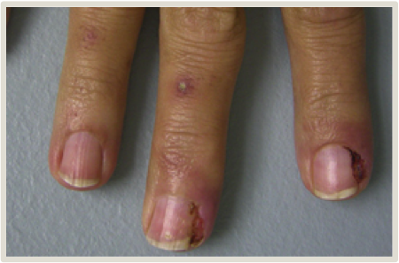
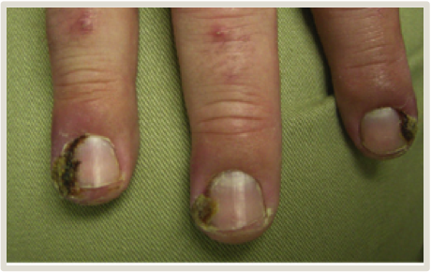
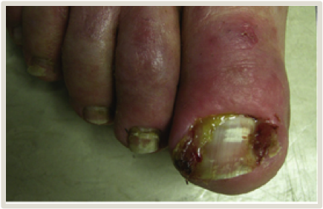
Additional skin toxicities Paronychia^{1,2}
Symptoms^{1,2} | Incidence⁸⁻²⁰ | Differential diagnosis
Inflammation in the nail fold; can be very painful Secondary superinfection with S. aureus may occur Onset > 2 months from treatment initiation | EGFR inhibitors: up to 25% | Ingrown toenail Bacterial infection Candida Pyogenic granuloma
Grading²¹
Grade 1 | Grade 2 | Grade 3
Nail fold oedema or erythema Disruption of the cuticle | Nail fold oedema or erythema with pain Associated with discharge or nail plate separation Local or oral intervention indicated Limiting instrumental ADL* | Operative intervention or intravenous antibiotics indicated Limiting self-care ADL**
* Instrumental ADL are preparing meals, shopping for groceries or clothes, using the telephone, managing money, etc. ** Self-care ADL are bathing, dressing and undressing, feeding self, using the toilet, taking medications, and not being bedridden.
ADL, activities of daily living; EGFR, epidermal growth factor receptor;.
1. Lacouture ME, et al. Support Care Cancer. 2011;19:1079-95. 2. Segaert S, et al. Eur J Cancer. 2009;45 suppl 1:295-308. 3. McLellan B, Kerr H. Dermatol Ther. 2011;24:396-400. 4. Etienne G, et al. N Engl J Med. 2002;347:446.
5. De Wit M, et al. Support Care Cancer. 2014;22:837-46. 6. Boers-Doets CB, et al. Future Oncol. 2013;9:1883-92. 7. Boers-Doets CB, et al. Oncologist. 2012;17:135-44. 8. Erbitux (cetuximab) Prescribing Information. 9. Tarceva
(erlotinib) Prescribing Information. 10. Vectibix (panitumumab) Prescribing Information. 11. Nexavar (sorafenib) Prescribing Information. 12. Sutent (sunitinib) Prescribing Information. 13. Stivarga (regorafenib) Prescribing
Information. 14. Lenvima (lenvatinib) Prescribing Information. 15. Cabometyx (cabozantinib) Prescribing Information. 16. Avastin (bevacizumab) Prescribing Information. 17. Zaltrap (aflibercept) Prescribing Information.
18. Cyramza (ramucirumab) Prescribing Information. 19. Gleevec (imatinib) Prescribing Information. 20. Ayvakit (avapritinib) Prescribing Information. 21 National Cancer Institute. Cancer Therapy Evaluation Program. Common Terminology Criteria for Adverse Events v5.0. 27 November 2017. (Accessed 31 January 2020.) Images from Lacouture ME, et al. Clin Colorectal Cancer. 2018:17:85-96.

Slide 35
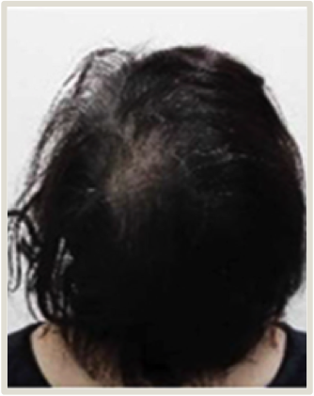
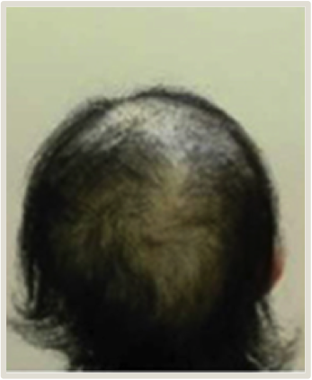
Additional skin toxicities Alopecia^{1,3,4}
Symptoms^{1,3,4} | Incidence⁸⁻²⁰ | Differential diagnosis
Alopecia (hair loss) is the main hair-related AE with targeted therapy Onset 2–3 months from treatment initiation Other hair changes include hair-colour changes, trichomegaly, and hypertrichosis | MKIs: up to 24% BCR–ABL TKIs: up to 15% | Systemic causes include: thyroid disease hypogonadism PCOS nutritional deficiencies (vitamins, iron)
Grading²¹
Grade 1 | Grade 2
Hair loss of < 50% of normal for that individual Not obvious from a distance, only on close inspection Does not require a wig or hair piece to camouflage | Hair loss of ≥ 50% normal for that individual Readily apparent to others A wig or hair piece is necessary to completely camouflage the hair loss Associated with psychosocial impact
* Instrumental ADL are preparing meals, shopping for groceries or clothes, using the telephone, managing money, etc. ** Self-care ADL are bathing, dressing and undressing, feeding self, using the toilet, taking medications, and not being bedridden.
AE, adverse event; BCR–ABL, Philadelphia translocation; MKI, multiple kinase inhibitor.
1. Lacouture ME, et al. Support Care Cancer. 2011;19:1079-95. 2. Segaert S, et al. Eur J Cancer. 2009;45 suppl 1:295-308. 3. McLellan B, Kerr H. Dermatol Ther. 2011;24:396-400. 4. Etienne G, et al. N Engl J Med. 2002;347:446. 5. De Wit M, et al. Support Care Cancer. 2014;22:837-46. 6. Boers-Doets CB, et al. Future Oncol. 2013;9:1883-92. 7. Boers-Doets CB, et al. Oncologist. 2012;17:135-44. 8. Erbitux (cetuximab) Prescribing Information. 9. Tarceva (erlotinib) Prescribing Information. 10. Vectibix (panitumumab) Prescribing Information. 11. Nexavar (sorafenib) Prescribing Information. 12. Sutent (sunitinib) Prescribing Information. 13. Stivarga (regorafenib) Prescribing Information. 14. Lenvima (lenvatinib) Prescribing Information. 15. Cabometyx (cabozantinib) Prescribing Information. 16. Avastin (bevacizumab) Prescribing Information. 17. Zaltrap (aflibercept) Prescribing Information. 18. Cyramza (ramucirumab) Prescribing Information. 19. Gleevec (imatinib) Prescribing Information. 20. Ayvakit (avapritinib) Prescribing Information. 21 National Cancer Institute. Cancer Therapy Evaluation Program. Common Terminology Criteria for Adverse Events v5.0. 27 November 2017. (Accessed 31 January 2020.) Images from Kinoshita T, et al. Front Oncol. 2019;9:733.

Slide 36
Additional skin toxicities Stomatitis^{5–7}
Symptoms⁵⁻⁷ | Incidence⁸⁻²⁰ | Differential diagnosis
Inflammation of the oral mucosa, encompassing mucositis, dry mouth, dysgeusia, dysphagia, and oral dysaesthesia Onset 5–14 days after the start of a treatment cycle | MKIs: up to 48% EGFR inhibitors: up to 32% BCR–ABL TKIs: up to 10% | Nutritional deficiencies (zinc) Pill oesophagitis Aphthous ulcers Candida Herpes Xerostomia related to underlying liver disease
Grading²¹
The CTCAE v5.0 has no specific grading for stomatitis; follow the general grading for this AE.¹ The grading of stomatitis reflects the impact of the AE on the patient’s life. Specific symptoms can be graded separately.
Grade 1 | Grade 2 | Grade 3 | Grade 4
Mild symptoms of dry mouth, oral pain, etc. without significant dietary alteration not interfering with oral intake | Moderate symptoms of dry mouth, oral pain, dysgeusia, etc. leading to change in diet, eating or swallowing interfering with oral intake limiting instrumental ADL* | Severe symptoms of dry mouth, oral pain, dysphagia, etc. calling for tube feeding, total parenteral nutrition, or hospitalisation limiting self-care ADL** | Dysphagia with life-threatening consequences Urgent intervention indicated
* Instrumental ADL are preparing meals, shopping for groceries or clothes, using the telephone, managing money, etc. ** Self-care ADL are bathing, dressing and undressing, feeding self, using the toilet, taking medications, and not being bedridden.
AE, adverse event; ADL, activities of daily living; BCR–ABL, Philadelphia translocation; BRAF, v-raf murine sarcoma viral oncogene homolog B1 ; EGFR, epidermal growth factor receptor; MKI, multiple kinase inhibitor.
1. Lacouture ME, et al. Support Care Cancer. 2011;19:1079-95. 2. Segaert S, et al. Eur J Cancer. 2009;45 suppl 1:295-308. 3. McLellan B, Kerr H. Dermatol Ther. 2011;24:396-400. 4. Etienne G, et al. N Engl J Med. 2002;347:446.
5. De Wit M, et al. Support Care Cancer. 2014;22:837-46. 6. Boers-Doets CB, et al. Future Oncol. 2013;9:1883-92. 7. Boers-Doets CB, et al. Oncologist. 2012;17:135-44. 8. Erbitux (cetuximab) Prescribing Information. 9. Tarceva
(erlotinib) Prescribing Information. 10. Vectibix (panitumumab) Prescribing Information. 11. Nexavar (sorafenib) Prescribing Information. 12. Sutent (sunitinib) Prescribing Information. 13. Stivarga (regorafenib) Prescribing
Information. 14. Lenvima (lenvatinib) Prescribing Information. 15. Cabometyx (cabozantinib) Prescribing Information. 16. Avastin (bevacizumab) Prescribing Information. 17. Zaltrap (aflibercept) Prescribing Information.
18. Cyramza (ramucirumab) Prescribing Information. 19. Gleevec (imatinib) Prescribing Information. 20. Ayvakit (avapritinib) Prescribing Information. 21 National Cancer Institute. Cancer Therapy Evaluation Program. Common Terminology Criteria for Adverse Events v5.0. 27 November 2017. (Accessed 31 January 2020.)

Slide 37
POOR WOUND HEALING
Symptoms¹ | Incidence²⁻⁹
Wound dehiscence Ecchymosis Surgical site bleeding Wound infection | VEGF(R) inhibitors: up to 15% MKIs: poor wound healing has been reported (rates unknown)
Grading¹⁰
Grade 1 | Grade 2 | Grade 3 | Grade 4
Wound complication for which topical intervention is indicated Incisional separation for which intervention is not indicated | Wound complication or incisional separation for which local care is indicated | Wound complication or fascial disruption without evisceration for which operative intervention is indicated | Wound complication with life-threatening consequences Symptomatic hernia with evidence of strangulation Fascial disruption with evisceration Major surgery indicated (e.g. grafting, amputation)
MKI, multiple kinase inhibitor; VEGFR, vascular endothelial growth factor receptor
1. Gordon CR, et al. Ann Plast Surg. 2009;62:707-9. 2. Avastin (bevacizumab) Prescribing Information. 3. Zaltrap (aflibercept) Prescribing Information. 4. Cyramza (ramucirumab) Prescribing Information. 5. Nexavar (sorafenib) Prescribing Information. 6. Sutent (sunitinib) Prescribing Information. 7. Stivarga (regorafenib) Prescribing Information.
8. Lenvima (lenvatinib) Prescribing Information. 9. Cabometyx (cabozantinib) Prescribing Information. 10. National Cancer Institute. Cancer Therapy Evaluation Program.
Common Terminology Criteria for Adverse Events v5.0. 27 November 2017. (Accessed 31 January 2020.)

Slide 38
Cutaneous malignancies
Types¹ | Incidence¹
Cutaneous squamous cell carcinoma Keratoacanthoma | BRAF inhibitors in CRC: 1-2%
Grading a Treatment-related secondary malignancy²
Note that CTCAE v5.0 includes Grades 3-5 for the category of treatment-related secondary malignancies, but also includes a category of “other neoplasms, benign, malignant and unspecified”, which does allow for Grades 1 and 2.
Grade 1 | Grade 2 | Grade 3 | Grade 4
Asymptomatic or mild symptoms Clinical or diagnostic observations only Intervention not indicated | Moderate Minimal, local or noninvasive intervention indicated Limiting age-appropriate instrumental ADL* | Non-life-threatening secondary malignancy | Acute life-threatening secondary malignancy
* Instrumental ADL are preparing meals, shopping for groceries or clothes, using the telephone, managing money, etc.
BRAF, v-raf murine sarcoma viral oncogene homolog B1 ; CTCAE, Common Terminology Criteria for Adverse Events
1. Braftovi (encorafenib) Prescribing Information. 2. National Cancer Institute. Cancer Therapy Evaluation Program. Common Terminology Criteria for Adverse Events v5.0.
27 November 2017. (Accessed 31 January 2020.)

Slide 39


SUMMARY
Cutaneous AEs are common with targeted therapy in patients with GI or liver cancers and include:
papulopustular rash
maculopapular rash
HFSR
dry skin, pruritus, and photosensitivity
changes in nails, hair, or mucosa
poor wound healing
cutaneous malignancies
Each drug class has a specific skin-toxicity profile
e.g. HFSRs are most often related to MKIs, and cutaneous malignancies are specific to BRAF inhibitors
AE, adverse event; BRAF, v-raf murine sarcoma viral oncogene homolog B1 ; EGFR, epidermal growth factor receptor; GI, gastrointestinal; HFSR, hand–foot skin reaction; MKI, multiple kinase inhibitor.

Slide 40

SKIN TOXICITY
PREVENTION AND MANAGEMENT

Slide 41
LEARNING OBJECTIVE
Know how to prevent and manage skin toxicities associated with targeted therapy in GI and liver cancers
WHAT
WHY
WILL YOU LEARN?
IS THIS IMPORTANT?
The things you as a healthcare professional should know about the prevention and management of skin toxicities, including dose modification and alternative dosing schedules
What patients can do to prevent and manage skin toxicities
Pre-emptively addressing and treating potential skin toxicities may improve patients’ quality of life and allow them to remain on therapy longer
GI, gastrointestinal

Slide 42






PREVENTATIVE RATHER THAN REACTIVE THERAPEUTIC
STRATEGIES ARE MORE EFFICIENT TO CONTROL AEs
In all patients treated with targeted therapies, prophylactic measures include:
A full-body skin examination is recommended before treatment is started.
Effective patient education is key to preventing and treating skin toxicities
using broad-spectrum (UVA/UVB) sunscreen (SPF 30+)
avoiding sun exposure
using skin moisturisers
(bland emollients)
nail care
oral care
Management of low-grade toxicity is similar to these prophylactic measures
Management of high-grade toxicity depends on the type of toxicity and the grade
AE, adverse event; SPF, sun protection factor; UVA, ultraviolet A; UVB, ultraviolet B;
1. Lacouture ME, et al. J Clin Oncol. 2010;28:1351-7. 2. Beech J, et al. Future Oncol. 2018;14:2531-41. 3. Segaert S, et al. Eur J Cancer. 2009;45 suppl 1:295-308. 4. Lacouture ME, et al. Support Care Cancer. 2011;19:1079-95.

Slide 43


PREVENTION AND MANAGEMENT OF
SKIN TOXICITIES INVOLVES A MULTIMODAL STRATEGY
EFFECTIVE MANAGEMENT OF SKIN TOXICITIES INVOLVES A MULTIMODAL STRATEGY THAT INCLUDES:
patient education
prophylactic and supportive care
dose modification (including flexible dosing)
WHEN PRE-EMPTIVE MEASURES ARE INSUFFICIENT TO AVOID AES, EARLY TREATMENT IS CRUCIAL FOR AE MANAGEMENT
Encourage patients to contact their healthcare provider straight away upon first appearance of symptoms
AE, adverse event

Slide 44
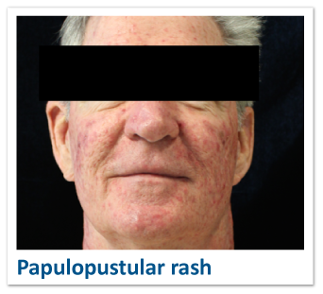
PREVENTION AND MANAGEMENT OF
PAPULOPUSTULAR RASH
Prevention | Grade 1 | Grade 2 | Grade 3 | Grade 4
Minimise skin dryness Bathe and shower in lukewarm water Use fragrance-free, mild soap for sensitive skin Use bland emollient (ointment or cream) Avoid UV radiation Use broad-spectrum (UVA/UVB) sunscreen (SPF 30+) Wear sun-protective clothing (hats, long sleeves) Topical corticosteroids Consider oral antibiotics Consider establishing a connection with a dermatologist | Topical corticosteroids Topical antibiotic for pustules or superinfection Consider oral tetracycline antibiotics | Consider increasing potency of topical corticosteroids Add an oral tetracycline antibiotic Culture the lesion in case of lack of response or suspected superinfection CONSULT A DERMATOLOGIST when the AE does not respond to intervention | CONSULT A DERMATOLOGIST As for grade 2 Consider increasing potency of topical corticosteroids Culture lesions Short course of oral corticosteroids when the AE does not respond to intervention | Intravenous antibiotics and corticosteroids Hospitalisation
Consult a dermatologist if:
any skin AE necessitates changes to the cancer treatment
a grade 2 skin AE does not respond to intervention
any grade 3 skin AE occurs
you are uncomfortable treating the skin AE yourself
AE, adverse event; SPF, sun protection factor; UVA, ultraviolet A; UVB, ultraviolet B
These recommendations are based on review of the literature and expert experience.
1. Beech J, et al. Future Oncol. 2018;14:2531-41. 2. Lacouture ME, et al. Support Care Cancer. 2011;19:1079-95. 3. Segaert S, et al. Eur J Cancer. 2009;45 suppl 1:295-308.
Image courtesy of Dr Nicole LeBoeuf

Slide 45

WHEN USING CORTICOSTEROIDS FOR SKIN TOXICITY,
CONSIDER POTENCY AND VEHICLE
Scalp
Class I–III solution or foam
The potency of topical steroid to be used depends on the body part affected
  Corticosteroids are better absorbed in regions of thin epidermis than in regions of thicker epidermis
  High-potency steroids are used for the palms and soles
  Medium- to high-potency steroids are useful for regions of thinner epidermis or occlusion, such as the eyelid and groin
  Low-to-medium strength preparations are used for large surface areas, to reduce the risk of systemic absorption
It is important to consider the vehicle most suitable for the affected body part
  Ointments provide the best penetration of the steroid, but because they are thick and greasy they are not always well tolerated
  Foams and liquid solutions are available for body parts with dense hair, such as the scalp
Face
Class V or VI
Breasts
Class V or VI
Groin
Class V or VI
Palms
Class I
Body:
Widespread: class III or IV Focal or more severe: class I for 2 weeks at a time
Soles
Class I
These recommendations are based on review of the literature and expert experience.
1. Ference JD, Last AR. Am Fam Physician. 2009;79:135-40.

Slide 46
WHO Classification of Topical Corticosteroids
Potency | Class | Topical corticosteroid | Formulation
Ultra high | I | Clobetasol propionate | Cream, 0.05%
 |  | Diflorasone diacetate | Ointment, 0.05%
High | II | Amcinonide | Ointment, 0.1%
 |  | Betamethasone dipropionate | Ointment, 0.05%
 |  | Desoximetasone | Cream or ointment, 0.025%
 |  | Fluocinonide | Cream, ointment, or gel, 0.05%
 |  | Halcinonide | Cream, 0.1%
 | III | Betamethasone dipropionate | Cream, 0.05%
 |  | Betamethasone valerate | Ointment, 0.1%
 |  | Diflorasone diacetate | Cream, 0.05%
 |  | Triamcinolone acetonide | Ointment, 0.1%
Potency | Class | Topical corticosteroid | Formulation
Moderate | IV | Desoximetasone | Cream, 0.05%
 |  | Fluocinolone acetonide | Ointment, 0.025%
 |  | Hydrocortisone valerate | Ointment, 0.2%
 |  | Triamcinolone acetonide | Cream, 0.1%
 | V | Betamethasone dipropionate | Lotion, 0.02%
 |  | Betamethasone valerate | Cream, 0.1%
 |  | Fluocinolone acetonide | Cream, 0.025%
 |  | Hydrocortisone butyrate | Cream, 0.1%
 |  | Hydrocortisone valerate | Cream, 0.2%
 |  | Triamcinolone acetonide | Lotion, 0.1%
Low | VI | Betamethasone valerate | Lotion, 0.05%
 |  | Desonide | Cream, 0.05%
 |  | Fluocinolone acetonide | Solution, 0.01%
 | VII | Dexamethasone sodium phosphate | Cream, 0.1%
 |  | Hydrocortisone acetate | Cream, 1%
 |  | Methylprednisolone acetate | Cream, 0.25%
WHO, World Health Organization
Ference JD, Last AR. Am Fam Physician. 2009;79:135-40.
Bolognia JL, et al. Glucocorticosteroids. Dermatology. 3rd ed. 2012. Ch 125, 2075-88.

Slide 47
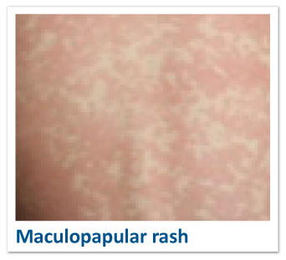
MANAGEMENT OF
Be aware of potential SCARs, delayed type IV hypersensitivity reactions to drugs^{3.}
Urgently consult a dermatologist in case of:
blisters
skin tenderness
mucous membrane involvement
rapid progression, turning dusky (grey or purple overtones)
skin sloughing
MACULOPAPULAR RASH^{1,2}
Grade 1 | Grade 2 | Grade 3 | SCAR
Topical steroids Oral antihistamine (in case of itch) | As for grade 1 Consider increasing potency of topical corticosteroid CONSULT DERMATOLOGIST when the AE does not respond to intervention | CONSULT A DERMATOLOGIST As for grade 2 Consider prednisone 1 mg/kg/day or equivalent | CONSULT A DERMATOLOGIST Admission or emergency evaluation depending on clinical features
Consult a dermatologist if a SCAR is suspected
a skin AE necessitates changes to the cancer treatment
a grade 2 skin AE does not respond to intervention
any grade 3 skin AE occurs
you are uncomfortable treating the skin AE yourself
AE, adverse event; SCAR, severe cutaneous adverse reaction
These recommendations are based on review of the literature and expert experience.
1. Tang N, Ratner D. Dermatol Surg. 2016;42 suppl 1:S40-8. 2. De Wit M, et al. Support Care Cancer. 2014;22:837-46. 3. Bellón T. Drug Saf. 2019;42:973-92.

Slide 48
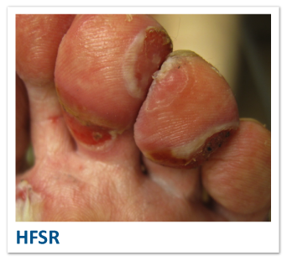
PREVENTION AND MANAGEMENT OF
Practical tips
Avoiding heat and friction is key to preventing HFSR
Use of pumice, pedicures etc. is NOT recommended after starting therapy
NSAIDs are contraindicated in patients with liver cirrhosis, due to risk of bleeding and renal failure
HFSR
Prevention | Grade 1 | Grade 2 | Grade 3
Consider establishing a connection with the dermatologist Skin exam and activity assessment when possible Treat pre-existing conditions (fungal disease [athlete’s foot], dermatitis, callosities) Minimise skin dryness Bathe and shower in lukewarm water Use fragrance-free, mild soap for sensitive skin Use bland emollient (ointment or cream) Urea cream Avoid repetitive tasks or vigorous exercise Vaseline with gloves for hand-oriented tasks (e.g. gardening) Lubricate feet in anticipation of activity Well-fitting shoes and socks (avoid cotton socks during significant activity; consider athletic shoes and socks) | Urea 20–40% cream on calluses or hyperkeratotic areas Super-potent topical steroids ointment | As for grade 1 Consider dose interruption/reduction Pain management (topical or systemic as needed)* Topical antibiotics or wound care (or both) for blisters and erosions CONSULT DERMATOLOGIST when the AE does not respond to intervention | CONSULT A DERMATOLOGIST As for grade 2 Interrupt targeted therapy Consider dose reduction on reinstitution Potential need for oral analgesic*
Consult a dermatologist if:
the skin AE necessitates changes to the cancer treatment
a grade 2 skin AE does not respond to intervention
any grade 3 skin AE occurs
you are uncomfortable treating the skin AE yourself
*NSAIDs are contraindicated in patients with liver cirrhosis, due to risk of bleeding and renal failure.
AE, adverse event; HFSR, hand–foot skin reaction; NSAID, non-steroidal anti-inflammatory drug
These recommendations are based on review of the literature and expert experience.1. Grothey A et al. Oncologist. 2014;19:669-80. 2. Lacouture ME, et al. Oncologist. 2008;13:1001-11. 3. McLellan B, et al. Ann Oncol. 2015;26:2017-26. Image courtesy of Dr Nicole LeBoeuf

Slide 49
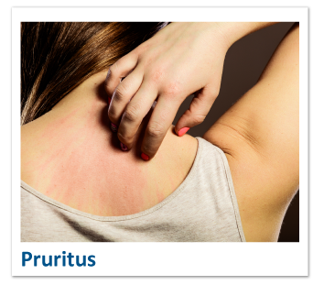
PREVENTION AND MANAGEMENT
PRURITUS
Prevention | Grade 1 | Grade 2 | Grade 3
Minimise skin dryness Bathe and shower in lukewarm water Use fragrance-free, mild soap for sensitive skin Use bland emollient (ointment or cream) Consider establishing a connection with a dermatologist | Topical therapy (menthol, pramoxine, doxepin, etc.) Consider topical corticosteroid Consider oral antihistamine (sedating at bedtime and non-sedating during the day) | Maximise oral antihistamine dose (sedating at bedtime and non-sedating during the day) Consider topical corticosteroid Evaluate for reversible causes of itch (iron deficiency, thyroid dysfunction, etc.) CONSULT DERMATOLOGIST when the AE does not respond to intervention | CONSULT A DERMATOLOGIST Consider oral corticosteroid (short term) Consider oral gabapentin or pregabalin Consider non-steroid agents (e.g. sertraline, mirtazapine, doxepin, aprepitant)
Consult a dermatologist if:
the skin AE necessitates changes to the cancer treatment
a grade 2 skin AE does not respond to intervention
any grade 3 skin AE occurs
you are uncomfortable treating the skin AE yourself
AE, adverse event
These recommendations are based on review of the literature and expert experience.
1. Lacouture ME, et al. Support Care Cancer. 2011;19:1079-95. 2. Potthoff K, et al. Ann Oncol. 2011;22:524-35.

Slide 50
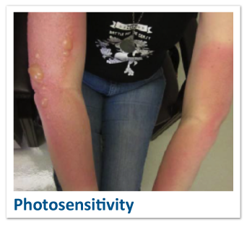
PREVENTION AND MANAGEMENT OF
PHOTOSENSITIVITY
Practical tips
Make patients aware that UVA penetrates window glass
NSAIDs are contraindicated in patients with liver cirrhosis, due to risk of bleeding and renal failure
Prevention | Grade 1 | Grade 2 | Grade 3
Avoid UV radiation Use broad-spectrum (UVA and UVB) sunscreen (SPF 30+) and lip balm, under all weather conditions; reapply every 2 hours when outdoors Avoid midday sun (10 am–2 pm) Wear sun-protective clothing (hats, long sleeves) Wear sunglasses | Cooling gels or compresses Analgesia if required Consider topical steroid | Topical corticosteroid Antihistamines in case of itch CONSULT DERMATOLOGIST when the AE does not respond to intervention | CONSULT DERMATOLOGIST As for grade 2 Oral corticosteroid Oral analgesic (NSAIDs* or narcotics) Wound care, ointment-based emollient Add antibiotic ointment if there are signs of a secondary infection (mupirocin ointment)
Consult a dermatologist if:
the skin AE necessitates changes to the cancer treatment
a grade 2 skin AE does not respond to intervention
any grade 3 skin AE occurs
you are uncomfortable treating the skin AE yourself
*NSAIDs are contraindicated in patients with liver cirrhosis, due to risk of bleeding and renal failure.
AE, adverse event; NSAID, non-steroidal anti-inflammatory drug; SPF, sun protection factor; UVA, ultraviolet A; UVB, ultraviolet B
These recommendations are based on review of the literature and expert experience.
Beech J, et al. Future Oncol. 2018;14:2531-41. 2. Sinha R, et al. Br J Dermatol. 2012;167:987-94. Image courtesy of Dr Nicole LeBoeuf

Slide 51
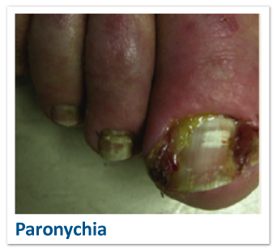

PREVENTION AND MANAGEMENT OF
PARONYCHIA
Prevention | Grade 1 | Grade 2 | Grade 3
Wear shoes with a wide toe box Avoid sharp angles on nails when trimming Consider establishing a connection with a dermatologist | Consider dilute vinegar soaks or povidone-iodine-based ointments High-potency topical corticosteroid Tape to pull lateral nail fold away Culture if there is pus | As for grade 1 Oral antibiotics (tetracyclines first line, otherwise based on culture Consider topical or oral analgesic (or both)* CONSULT DERMATOLOGIST when the AE does not respond to intervention or is complicated by granulation tissue in need of therapy | CONSULT DERMATOLOGIST Continue systemic antibiotics Consider nail avulsion
Consult a dermatologist if:
the skin AE necessitates changes to the cancer treatment
a grade 2 skin AE does not respond to intervention
grade 2 paronychia is complicated by granulation tissue in need of therapy
any grade 3 skin AE occurs
you are uncomfortable treating the skin AE yourself
NSAIDs are contraindicated in patients with liver cirrhosis, due to risk of bleeding and renal failure.
AE, adverse event; NSAID, non-steroidal anti-inflammatory drug
These recommendations are based on review of the literature and expert experience.
1. Beech J, et al. Future Oncol. 2018;14:2531-41. 2. Haneke E. Dermatol Res Pract. 2012;2012:783924. 3. Lacouture ME, et al. Support Care Cancer. 2011;19:1079-95. 4. Potthoff K, et al. Ann Oncol. 2011;22:524-35. 5. Sollena P, et al. Drugs Context. 2019; 8:212613.
Image from Lacouture ME, et al. Clin Colorectal Cancer. 2018:17:85-96.

Slide 52
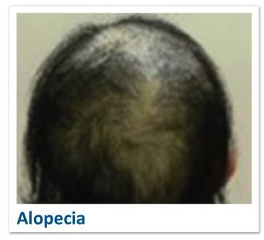
PREVENTION AND MANAGEMENT OF
ALOPECIA
Prevention | Grade 1 | Grade 2
Minoxidil twice daily Gentle hair care Avoid excessive processing (combing, blow-drying, colouring, etc.) UV protection (hats, sunscreen in areas of sparse hair) Consider establishing a connection with a dermatologist | Scalp inflammation: Class 1 topical steroid Anti-dandruff shampoo Signs of secondary infection: topical or oral antibiotics | As for grade 1 CONSULT DERMATOLOGIST when the AE does not respond to intervention
Practical tip:
Treating inflammation early limits irreversible scarring alopecia
Consult a dermatologist if:
the skin AE necessitates changes to the cancer treatment
a grade 2 skin AE does not respond to intervention
you are uncomfortable treating the skin AE yourself
AE, adverse event
These recommendations are based on review of the literature and expert experience.
1. Lacouture ME, et al. Support Care Cancer. 2011;19:1079-95. 2. Rossi A, et al. J Cosmet Dermatol. 2017;16:537-41.
Image from Kinoshita T, et al. Front Oncol. 2019;9:733.

Slide 53
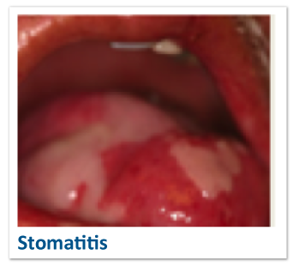
PREVENTION AND MANAGEMENT OF
STOMATITIS
Practical tip:
NSAIDs are contraindicated in patients with liver cirrhosis, due to risk of bleeding and renal failure
Consult a dermatologist if:
the skin AE necessitates changes to the cancer treatment
a grade 2 skin AE does not respond to intervention
any grade 3 skin AE occurs
you are uncomfortable treating the skin AE yourself
Prevention | Grade 1 | Grade 2 | Grade 3 | Grade 4
Practice good oral hygiene using of a soft toothbrush or swab after each meal and before going to sleep Avoid foods that cause symptoms Consider alcohol-free dexamethasone oral solution 0.5 mg/5 mL 4 times daily (swish for 2 minutes and spit)¹* Consider establishing a connection with a dermatologist | Mouthwash (saline- or chlorhexidine-based) Topical steroids (swish and spit or topical application) | Increase the frequency of mouthwash Dietary modification (e.g. avoid hot, spicy, or acidic food and drinks) Use antiseptic and analgesic mouthwashes for symptomatic relief Consider topical or systemic anti-inflammatory and analgesic drugs** CONSULT DERMATOLOGIST when the AE does not respond to intervention | CONSULT DERMATOLOGIST As grade 2 Consider non-oral nutrition | Requires tube feeding, analgesic**, systemic antibiotic or antifungal treatment, or hospitalisation
*Based on the SWISH-study protocol, a phase 2 study investigating the efficacy of dexamethasone mouthwash for everolimus-related stomatitis prevention in hormone receptor-positive metastatic breast cancer.¹
** NSAIDs are contraindicated in patients with liver cirrhosis, due to risk of bleeding and renal failure.
AE, adverse event; NSAID, non-steroidal anti-inflammatory drug
These recommendations are based on review of the literature and expert experience.
1. Rugo HS, et al. Lancet Oncol. 2017;18:654-62. 2. De Wit M, et al. Support Care Cancer. 2014;22:837-46. 3. Krishnamoorthy SK, et al. Therap Adv Gastroenterol. 2015;8:285-97.
Image from Lacouture ME, et al. Support Care Cancer 2011;19:1079-95

Slide 54
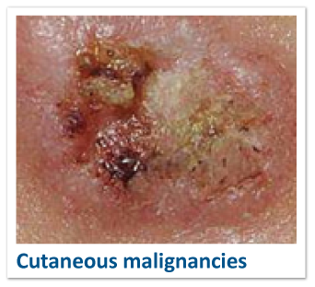
PREVENTION AND MANAGEMENT OF
CUTANEOUS MALIGNANCIES
Prevention | Management
Avoid UV radiation Use broad-spectrum (UVA or UVB) sunscreen (SPF 30+) and lip balm under all weather conditions; reapply every 2 hours when outdoors Avoid midday sun (10 am–2 pm) Wear sun-protective clothing (hats, long sleeves) Consider establishing a connection with a dermatologist Perform dermatologic evaluations before starting, every 2 months during treatment, and for up to 6 months after discontinuation¹ Advise patients to contact their healthcare provider immediately for change in or development of new skin lesions¹ | CONSULT DERMATOLOGIST Manage suspicious skin lesions with excision and dermatopathologic evaluation¹
Consult a dermatologist if:
the skin AE necessitates changes to the cancer treatment
Any grade 3 skin AE occurs
you are uncomfortable treating the skin AE yourself
AE, adverse event; SPF, sun protection factor; UVA, ultraviolet A; UVB, ultraviolet B
1. Braftovi (encorafenib) Prescribing Information.
Image from Aslam AM, Patel AN. BMJ. 2016;352:i1513.

Slide 55
DOSE REDUCTIONS AND DRUG HOLIDAYS
EGFR INHIBITORS IN GI AND LIVER CANCERS
Management of skin toxicities may involve dose adjustments as defined in each drug's Prescribing Information.
EGFR inhibitor | Dose modification for skin toxicity |  |  | Discontinuation for skin toxicity
cetuximab¹ | 1st occurrence, grade 3 or 4 •Delay infusion 1–2 weeks •Upon improvement continue at 250 mg/m² | 2nd occurrence, grade 3 or 4 •Delay infusion 1–2 weeks •Upon improvement continue at 200 mg/m² | 3rd occurrence, grade 3 or 4 •Delay infusion 1–2 weeks •Upon improvement continue at 150 mg/m² | •No improvement of a grade 3 or 4 AE upon delaying infusion for 1–2 weeks •4th occurrence of a grade 3 or 4 AE
erlotinib² | Severe rash not responsive to medical management •Withhold drug until rash is resolved to baseline level or grade ≤ 1 •Reduce dose by 50 mg when restarting therapy |  |  | Severe bullous, blistering, or exfoliating skin conditions
panitumumab³ | 1st occurrence, grade 3 •Withhold 1 or 2 doses •Upon improvement to grade < 3 resume at original dose | 2nd occurrence, grade 3 •Withhold 1 or 2 doses •Upon improvement to grade < 3 resume at 80% of original dose | 3rd occurrence, grade 3 •Withhold 1 or 2 doses •Upon improvement to grade < 3 resume at 60% of original dose | •4th occurrence of a grade 3 AE •Grade 3 AE that does not improve after withholding 1 or 2 doses •Grade 4 AE
AE, adverse event, EGFR, epidermal growth factor receptor; GI, gastrointestinal.
1. Erbitux (cetuximab) Prescribing Information. 2. Tarceva (erlotinib) Prescribing Information. 3. Vectibix (panitumumab) Prescribing Information.

Slide 56
DOSE REDUCTIONS AND DRUG HOLIDAYS
MKIs IN GI AND/OR LIVER CANCERS
MKI | Dose modification for skin toxicity |  |  | Discontinuation for skin toxicity
sorafenib¹ | Grade 2, 1st occurrence and no improvement in ≤ 7 days of topical treatment, or 2nd or 3rd occurrence: interrupt until grade is ≤ 1 and resume at a dose reduced by 1 level |  | Grade 3, 1st or 2nd occurrence: interrupt until grade is ≤ 1 and resume at a dose reduced by 1 level | • 4th occurrence of a grade 2 AE • 3rd occurrence of a grade 3 AE
 | After improvement to grade ≤ 1 and ≥ 28 days of treatment at a reduced dose, the dose may be increased 1 level
sunitinib² | Interrupt or modify dose by 12.5 mg increments or decrements according to individual safety and tolerability
regorafenib³ | Interrupt treatment for • a grade 2 HFSR that is recurrent or does • not improve in < 7 days, despite dose reduction ≥ 7 days for a grade 3 HFSR any grade 3 or 4 AE | Reduce dose to 120 mg • upon 1st occurrence of a grade 2 HFSR • after recovery of a grade 3 or 4 AE | Reduce dose to 80 mg • upon recurrence of a grade 2 HFSR at the 120 mg dose • after recovery of a grade 3 or 4 AE at the 120 mg dose | • Failure to tolerate 80 mg dose • Grade 4 AE; resume only if the potential benefit outweighs the risks
lenvatinib⁴ | No specific recommendations for skin toxicity. The recommendations for ‘other adverse reactions’, including diarrhoea, hypocalcaemia and haemorrhagic events are:
 | Persistent or intolerable grade 2 or 3 AE • Withhold until improvement to grade ≤ 1 • Resume at reduced dose |  |  | Grade 4 AE
cabozantinib⁵ | Withhold for • an intolerable grade 2 AE • a grade 3 or 4 AE | Upon resolution or improvement to baseline level or grade 1, reduce the daily dose by 20 mg. Patients who were on a 20 mg/day dose remain on that dose. |  | Failure to tolerate 20 mg dose
avapritinib⁶ | Withhold for a grade 3 or 4 AE until improvement to grade ≤ 2 Resume at the same dose or a reduced dose, as clinically appropriate
AE, adverse event; GI, gastrointestinal; HFSR, hand–foot skin reaction; MKI, multiple kinase inhibitor
1. Nexavar (sorafenib) Prescribing Information. 2. Sutent (sunitinib) Prescribing Information. 3. Stivarga (regorafenib) Prescribing Information. 4. Lenvima (lenvatinib) Prescribing Information. 5. Cabometyx (cabozantinib) Prescribing Information. 6. Ayvakit (avapritinib) Prescribing Information.

Slide 57
DOSE REDUCTIONS AND DRUG HOLIDAYS
VEGF(R) INHIBITORS IN GI AND LIVER CANCERS
The Prescribing Information on each VEGF(R) inhibitor contains warnings about impaired wound healing^{1–3}
Discontinue the VEGF(R) inhibitor in patients with wound-healing complications
…that require medical intervention (ramucirumab and bevacizumab)
…or necrotizing fasciitis (bevacizumab)
Do not administer the VEGF(R) inhibitor for ≥ 28 days after surgery, until the wound is fully healed
Withhold the VEGF(R) inhibitor for ≥ 28 days before elective surgery
GI, gastrointestinal; VEGFR, vascular endothelial growth factor receptor
1. Avastin (bevacizumab) Prescribing Information. 2. Zaltrap (aflibercept) Prescribing Information. 3. Cyramza (ramucirumab) Prescribing Information.

Slide 58
DOSE REDUCTIONS AND DRUG HOLIDAYS
BCR–ABL TKIs IN GI AND LIVER CANCERS
BCR–ABL TKI | Dose modification for skin toxicity
imatinib¹ | Severe AE • Withhold until the event has resolved • When the AE is resolved, treatment can be resumed as appropriate depending on the initial severity of the event
nilotinib²* | Moderate or severe AE • Withhold until the event has resolved • Consider resuming at a reduced dose • If clinically appropriate, consider re-escalation to the original dose
dasatinib³* | Severe AE • Withhold until the event has resolved or improved • Resume as appropriate at a reduced dose, depending on the severity and recurrence of the event
*Not FDA approved for use in GI or liver cancers. Dose modification advice for other indications is shown (as stated in the Prescribing Information).
AE, adverse event, BCR–ABL, Philadelphia translocation; FDA, U.S. Food and Drug Admninstration; GI, gastrointestinal; TKI, tyrosine kinase inhibitor
1. Gleevec (imatinib) Prescribing Information. 2. Tasigna (nilotinib) Prescribing Information. 3. Sprycel (dasatinib) Prescribing Information.

Slide 59
DOSE REDUCTIONS AND DRUG HOLIDAYS
BRAF INHIBITORS IN GI AND LIVER CANCERS
BRAF inhibitor | Dose modification for skin toxicity |  |  | Discontinuation for skin toxicity
encorafenib (combined with cetuximab)¹ | Dermatologic AE (not HFSR) Grade 2 that does not improve in < 2 weeks Withhold until grade is ≤ 1 Resume at same dose Grade 3: withhold until grade is ≤ 1 1st occurrence: resume at same dose Recurrent: reduce dose | Recurrent grade 2 or 1st occurrence of grade 3 HFSR Withhold for ≤ 4 weeks Resume at reduced dose if improvement to grade ≤ 1 or baseline level Consider this approach or discontinuation for a 1st occurrence of grade 4 HFSR | Dose modification 1st reduction: 225 mg/day 2nd reduction: 150 mg/day | If cetuximab is discontinued, discontinue encorafenib Permanently discontinue: if patient is unable to tolerate 150 mg/day for grade 4 AEs other than HFSR for recurrent grade 4 HFSR if no improvement of grade 2 or 3 HFSR after withholding treatment for ≤ 4 weeks Consider discontinuing upon 1st occurrence of grade 4 HFSR for recurrent grade 3 HFSR
 | Note: dose modification is not recommended for new primary cutaneous malignancies
AE, adverse event; BRAF, v-raf murine sarcoma viral oncogene homolog B1; GI, gastrointestinal, HFSR, hand–foot skin reaction
1. Braftovi (encorafenib) Prescribing Information.

Slide 60
DOSING
Flexible dosing strategies have been studied with regorafenib in CRC and with sunitinib in RCC^{1–3}
The NCCN guidelines recommend a dose-escalation strategy when using regorafenib for CRC⁴
In clinical practice, the data on sunitinib in RCC are extrapolated to GI cancers
FLEXIBLE DOSING
Regorafenib | Sunitinib
ReDOS¹ Randomised, open-label, phase 2 trial in 123 patients with refractory metastatic CRC, comparing: standard dose (160 mg/day; 3 weeks on, 1 week off) vs dose escalation (80 mg/day in week 1, 120 mg/day in week 2, and 160 mg/day in week 3 if no significant drug-related AEs occurred) Results More patients started cycle 3 in the dose-escalation group than in the standard-dose group (43% vs 26%; P = 0.043) Dose escalation did not appear to jeopardise efficacy The most common AEs were the same in each group The dose-escalation strategy appeared to reduce the severity of some common AEs, including HFSR | RESTORE³ Randomised, open-label, phase 2 trial in 74 treatment-naïve patients with clear-cell metastatic RCC, comparing: standard 4/2 schedule (4 weeks on, 2 weeks off) vs 2/1 schedule (2 weeks on, 1 week off) Results The 2/1 schedule was associated with less toxicity and a higher failure-free survival rate at 6 months than was the 4/2 schedule, without compromising efficacy (ORR and TTP) Neutropenia and fatigue in particular were less common with the 2/1 schedule
REARRANGE² Randomised phase 2 trial in 299 patients with metastatic CRC, comparing: standard dose (160 mg/day; 3 weeks on, 1 week off) vs reduced dose (120 mg/day; 3 weeks on, 1 week off) vs intermittent dosing (160 mg/day; 1 week on, 1 week off) Results There was no difference in survival outcomes The primary endpoint of improving global tolerability in the reduced-dose and intermittent-dosing groups was not met Flexible dosing resulted in numerical improvement in relevant AEs, including fatigue, HFSR, and hypertension
AE, adverse event; CRC, colorectal cancer; HFSR, hand–foot skin reaction; ORR, overall response rate; TTP, time to progression
1. Bekaii-Saab TS, et al. Lancet Oncol. 2019;20:1070-82. 2. Argilés G, et al. Ann Oncol. 2019;30 suppl 4:iv135(O-026). 3. Lee JL, et al. Ann Oncol. 2015;26:2300-5. 4. NCCN Guidelines. Colon Cancer. Version 2.2020 (3 March 2020).

Slide 61
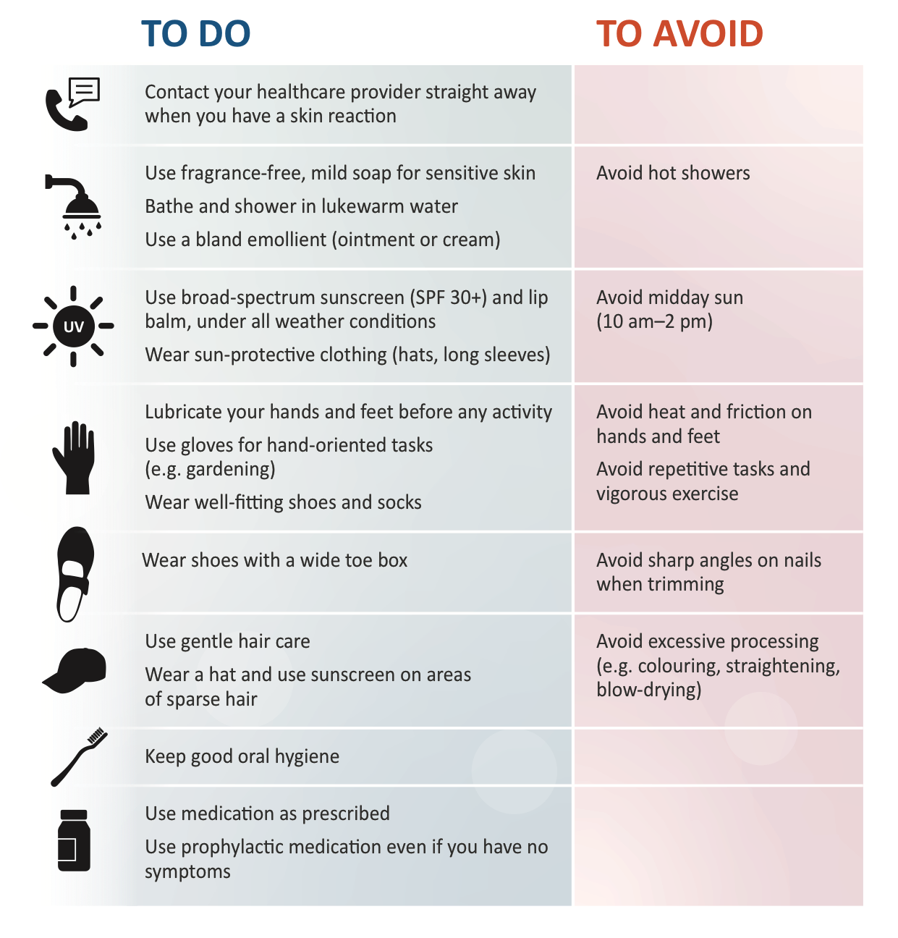
WHAT PATIENTS
CAN DO
Use the link found next to this slide set to download your own version of the leaflet, designed to help patients prevent and manage skin toxicities related to their targeted therapy.
Fight CRC also provide additional helpful patient resources:
https://fightcolorectalcancer.org/resources/skin-toxicity-resources/
CRC, colorectal cancer.

Slide 62
SUMMARY
Effective management of skin toxicities involves a multimodal strategy that
includes:
patient education
prophylactic and supportive care
dose modification (including flexible dosing)
Management
Management of low-grade toxicity is similar to prophylactic measures
Management of high-grade toxicity depends on the type of toxicity and the grade
For all patients treated with targeted therapies, prophylactic measures include:
using broad-spectrum sunscreen
avoiding sun exposure
using skin moisturisers
nail and oral care
Consult a dermatologist if:
the skin AE necessitates changes to the cancer treatment
a grade 2 skin AE does not respond to intervention
any grade 3 skin AE occurs
you are uncomfortable treating the skin AE yourself
AE, adverse event.

Slide 63

SKIN TOXICITY
MULTIDISCIPLINARY APPROACH TO PREVENTION AND MANAGEMENT

Slide 64
LEARNING OBJECTIVE
be able to involve a multidisciplinary team in the prevention, diagnosis, and management of skin toxicities associated with targeted therapy in GI and liver cancers
WHAT
WHY
WILL YOU LEARN?
IS THIS IMPORTANT?
In this case-based section you will learn about the role of a multidisciplinary team in the prevention, diagnosis, and management of skin toxicities
When each member of the multidisciplinary team participates in prevention, diagnosis, and management, skin toxicities can be more effectively prevented and managed and diagnosed earlier

Slide 65


HCC patient case – part 1
Mr Graham
Patient
Clinical
challenge
Multidisciplinary team decision
63-year old Mr Graham is diagnosed with HCC
After progressing on locoregional therapy, he received sorafenib for 9 months at full dose, with one dose modification for HFSR
Mr Graham has now progressed on sorafenib and is about to start regorafenib
How can we prevent the occurrence of HFSR during 2nd-line treatment with regorafenib?
Consult a dermatologist before starting regorafenib
Discuss with the patient whether to start regorafenib at a full dose or at a reduced dose
Educate on prevention, including gentle skin care, minimizing skin dryness and avoiding heat and friction
Prescribe urea cream for pre-emptive use and a topical corticosteroid for use with the first signs of HFSR
HCC, hepatocellular carcinoma; HFSR, hand–foot skin reaction.

Slide 66
HCC patient case – part 2
Mr Graham
Patient
Clinical
challenge
Multidisciplinary team decision
After 6 months of treatment with regorafenib, Mr Graham develops severe HFSR
Why did the patient develop HFSR now?
Should regorafenib be stopped or should the dose be changed?
Reinforce education on preventative measures, as the symptoms started after increased physical activity
Reduce the dose of regorafenib and escalate to highest tolerated dose when the HFSR resolves to grade < 1
Consult a dermatologist for further treatment and guidance
HFSR, hand–foot skin reaction.

Slide 67
GI CANCER patient case – part 1
MS WILLIAMS
Patient
Clinical
challenge
Multidisciplinary team decision
55-year old Ms Williams is diagnosed with RAS wild type, microsatellite stable, left-sided mCRC with a heavy disease burden, including bi-lobar liver metastases, lung metastases and lymphadenopathy
She is about to start FOLFOX + cetuximab
Ms Williams works in sales and does not want people to know she has cancer. Therefore, she is very worried about the possibility of getting a treatment-related rash
What can we do to help prevent papulopustular rash?
Educate the patient on minimizing skin dryness and avoiding UV radiation
Start topical corticosteroids
As the patient is so worried, the team decides prophylactic oral antibiotics are indicated as well
FOLFOX, leucovorin calcium (calcium folinate), 5-fluorouracil, and oxaliplatin; GI, gastrointestinal; mCRC, metastatic colorectal cancer, UV, ultraviolet.

Slide 68
GI CANCER patient case – part 2
MS WILLIAMS
Patient
Clinical
challenge
Multidisciplinary team decision
6 months later, Ms Williams is responding to treatment very well and is feeling good. She has even been on holiday to the Bahama’s
Despite being compliant with using her prophylactic topical corticosteroids and oral doxycycline, she has developed a grade 1/2 papulopustular rash on her face
Why did the patient develop rash now?
How should the rash be treated?
Sun exposure can trigger a flare of papulopustular rash, so insufficient sun protection on holiday might have triggered it. Doxycycline-related photosensitivity might also have contributed
She may have developed resistance to the antibiotic
The team decides to keep the cancer treatment unchanged and refer Ms Williams to the dermatologist for treatment of the rash
GI, gastrointestinal.

Slide 69
SUMMARY
When each member of the multidisciplinary team participates in prevention, diagnosis, and management, skin toxicities can be more effectively prevented and managed and diagnosed earlier

Slide 70

SUMMARY
AND CLOSE

Slide 71
BEFORE YOU GO…
  Thank you for participating in this educational programme on skin toxicities related to targeted therapy in GI and liver oncology
  You now understand more about:
    the skin toxicity associated with targeted therapy in GI and liver cancers
    preventing and managing skin toxicities associated with targeted therapies in GI and liver cancers
    involving a multidisciplinary team in the prevention, diagnosis, and management of skin toxicities associated with targeted therapy in GI and liver cancers
  We hope you have found this educational programme useful for your daily practice
  Throughout the slide set, there are links to additional information and resources
    If you wish, you can revisit either resource at any time and dig deeper into a specific topic
    On ESMO OncologyPRO you will find more information about MKI-related skin toxicities
ESMO, European Society for Medical Oncology; GI, gastrointestinal; MKI, multiple kinase inhibitor

Slide 72
THANK YOU
  Please visit the accredited e-learning at COR2ED Checkpoint to further explore:
    the skin toxicity associated with targeted therapy in GI and liver cancers
    the prevention and management of skin toxicities associated with targeted therapies in GI and liver cancers
    involvement of a multidisciplinary team in the prevention, diagnosis, and management of skin toxicities associated with targeted therapy in GI and liver cancers
  You can complete an assessment at the end of the e-learning and apply for your CME credit or MOC point.
CME, continuing medical education; GI, gastrointestinal; MOC, Maintenance of Certification

Slide 73
ADDITIONAL
RESOURCES AND INFORMATION

Slide 74

WHAT PATIENTS
CAN DO
  Fight Colorectal Cancer offers a variety of resources dedicated to educating patients and caregivers on skin toxicities such as Hand Foot Skin Reaction, Hand Foot Syndrome, and EGFR rash. All resources are reviewed by members of Fight CRC’s distinguished medical advisory board. Find access to these resources at https://fightcolorectalcancer.org/resources/skin-toxicity-resources/
    Skin Toxicity Mini Magazine: offered in print or online
    Patient testimonies: watch videos of patients detailing their experiences with side effects of the skin
    Expert videos: watch videos of experts in the field discussing skin toxicities in lay terminology
ESMO, European Society for Medical Oncology; GI, gastrointestinal; MKI, multiple kinase inhibitor

Slide 75
abbreviationS
  ABIM, American Board of Internal Medicine
  ACCME, Accreditation Council for Continuing Medical Education
  ADL, activities of daily living
  AE, adverse event
  AGA, American Gastroenterology Association
  AMA, American Medical Association
  ASCO, American Society of Clinical Oncology
  AST, American Society of Transplantation
  BCR–ABL, Philadelphia translocation
  BRAF, v-raf murine sarcoma viral oncogene homolog B1
  BSA, body surface area
  CME, continuing medical education
  CRC, colorectal cancer
  CTCAE, Common Terminology Criteria for Adverse Events
  EACCME, European Accreditation Council for Continuing Medical Education
  EGFR, epidermal growth factor receptor
  ERK, Extracellular signal-regulated kinase
  ESMO, European Society for Medical Oncology
  FDA, U.S. Food and Drug Admninstration
  Flt3, fms-related tyrosine kinase receptor 3
  FOLFIRI, leucovorin calcium (calcium folinate), 5-fluorouracil, and irinotecan
  FOLFOX, leucovorin calcium (calcium folinate), 5-fluorouracil, and oxaliplatin
  GI, gastrointestinal
  GIST, gastrointestinal stromal tumor
  HCC, hepatocellular carcinoma
  HFS, hand–foot syndrome
  HFSR, hand–foot skin reaction
  HR, hazard ratio
  MASCC, Multinational Association for Supportive Care in Cancer
  mCRC, metastatic colorectal cancer
  MESTT, MASCC EGFR inhibitor Skin Toxicity Tool
  MKI, multiple kinase inhibitor
  MOC, Maintenance of Certification
  NA, not applicable
  NCCN, U.S. National Comprehensive Cancer Network
  NSAID, non-steroidal anti-inflammatory drug
  ONS, Oncology Nursing Society
  ORR, overall response rate
  OS, overall survival
  PARP, poly ADP ribose polymerase
  PCOS, polycystic ovary syndrome
  PDGF(R), platelet-derived growth factor (receptor)
  PFS, progression-free survival
  PRA, Physician's Recognition Award
  RCC, renal cell carcinoma
  SCAR, severe cutaneous adverse reaction
  SPF, sun protection factor
  Th, T helper cell
  TKI, tyrosine kinase inhibitor
  TTP, time to progression
  UEMS, Union of European Medical Specialists
  UVA, ultraviolet A
  UVB, ultraviolet B
  VEGFR, vascular endothelial growth factor receptor
  WHO, World Health Organization

Slide 76
REFERENCES
  Alloo A, et al. Br J Dermatol. 2015;173:574-7.
  Argilés G, et al. Ann Oncol. 2019;30 suppl 4:iv135(O-026).
  Avastin (bevacizumab) Prescribing Information.
  Ayvakit (avapritinib) Prescribing Information.
  Beech J, et al. Future Oncol. 2018;14:2531-41.
  Bekaii-Saab TS, et al. Lancet Oncol. 2019;20:1070-82.
  Bellón T. Drug Saf. 2019;42:973-92.
  Belum VR, et al. Curr Oncol Rep. 2013;15:249-59.
  Blay J-Y, et al. Lancet Oncol. 2015;16:550-60.
  Boers-Doets CB, et al. Future Oncol. 2013;9:1883-92.
  Boers-Doets CB, et al. Oncologist. 2012;17:135-44.
  Bolognia JL, et al. Glucocorticosteroids. Dermatology. 3rd ed. 2012. Ch 125, 2075-88.
  Borovicka JH, et al. Arch Dermatol. 2011;147:1403-9.
  Braftovi (encorafenib) Prescribing Information.
  Brönnimann M, Yawalkar N. Curr Opin Allergy Clin Immunol. 2005;5:317-21.
  Bruix J, et al. J Clin Oncol. 2018;36 suppl 4:412.
  Cabometyx (cabozantinib) Prescribing Information.
  Chanprapaph K, et al. Am J Clin Dermatol. 2016;17:387-402.
  Cheng A-L, et al. Oral presentation at ESMO Asia 2019. Ann Oncol. 2019;30 suppl 9:ix183-202.
  Cyramza (ramucirumab) Prescribing Information.
  De Wit M, et al. Support Care Cancer. 2014;22:837-46.
  Ely JW, Stone MS. Am Fam Physician. 2010;81:726-34.
  Erbitux (cetuximab) Prescribing Information.
  Etienne G, et al. N Engl J Med. 2002;347:446.
  Ference JD, Last AR. Am Fam Physician. 2009;79:135-40.
  Gleevec (imatinib) Prescribing Information.
  Gomez P, Lacouture ME. Oncologist. 2011;16:1508-19.
  Gomez P, Lacouture ME. Oncologist. 2011;16:1508-19.
  Gordon CR, et al. Ann Plast Surg. 2009;62:707-9.
  Grothey A et al. Oncologist. 2014;19:669-80.
  Grothey A, et al. Poster presented at ASCO Annual Meeting I, 2013. J Clin Oncol. 2013;31:15 suppl.3637.
  Guztmer R, et al. Dtsch Arztebl Int. 2012;109:133-40.
  Haneke E. Dermatol Res Pract. 2012;2012:783924.
  Hiraoka A, et al. Cancer Med. 2019;8:3719-28.
  Hofheinz R-D, et al. Oncologist. 2016;21:1483-91
  Jonker DJ, et al. N Engl J Med. 2007;357:2040-8.
  Joshi SS, et al. Cancer. 2010;116:3916-23.
  Klufa J, et al. Sci Transl Med. 2019;11:eaax2693.
  Kopetz S, et al. N Engl J Med. 2019;381:1632-1643.
  Krishnamoorthy SK, et al. Therap Adv Gastroenterol. 2015;8:285-97.
  Lacouture ME, et al. Clin Colorectal Cancer. 2018;17: 85-96.
  Lacouture ME, et al. J Clin Oncol. 2010;28:1351-7.
  Lacouture ME, et al. Oncologist. 2008;13:1001-11.
  Lacouture ME, et al. Support Care Cancer. 2010;18:509-22.
  Lacouture ME, et al. Support Care Cancer. 2011;19:1079-95.
  Lee JL, et al. Ann Oncol. 2015;26:2300-5.
  Lenvima (lenvatinib) Prescribing Information.
  Manchen E, et al. J Support Oncol. 2011;9:13-23.
  McLellan B, et al. Ann Oncol. 2015;26:2017-26
  McLellan B, Kerr H. Dermatol Ther. 2011;24:396-400.
  National Cancer Institute. Cancer Therapy Evaluation Program. Common Terminology Criteria for Adverse Events v5.0. 27 November 2017. (Accessed 31 January 2020.).
  NCCN Guidelines. Colon Cancer. Version 2.2020 (3 March 2020).

Slide 77
REFERENCES CONTINUED
  NCCN Guidelines. Colon Cancer. Version 2.2020 (3 March 2020).
  Nexavar (sorafenib) Prescribing Information.
  Potthoff K, et al. Ann Oncol. 2011;22:524-35.
  Puzanov I, et al. J Clin Oncol. 2011;29 suppl 15:e21113
  Robert C, et al. Semin Oncol. 2012;39:227-40.
  Rossi A, et al. J Cosmet Dermatol. 2017;16:537-41
  Rugo HS, et al. Lancet Oncol. 2017;18:654-62.
  Scott LC, et al. Sarcoma. 2005;9:157-60.
  Segaert S, et al. Eur J Cancer. 2009;45 suppl 1:295-308.
  Sinha R, et al. Br J Dermatol. 2012;167:987-94.
  Sollena P, et al. Drugs Context. 2019; 8:212613.
  Sprycel (dasatinib) Prescribing Information.
  Stivarga (regorafenib) Prescribing
  Sutent (sunitinib) Prescribing Information.
  Tang N, Ratner D. Dermatol Surg. 2016;42 suppl 1:S40-8.
  Tarceva (erlotinib) Prescribing Information.
  Tasigna (nilotinib) Prescribing Information.
  Vectibix (panitumumab) Prescribing Information.
  Wang P, et al. Expert Rev Gastroenterol Hepatol. 2018;12:1-8.
  Widakowich C, et al. Oncologist. 2007;12;1443-55.
  Wozel G, et al. J Dtsch Dermatol Ges. 2010;8:243-9.
  Zaltrap (aflibercept) Prescribing Information.

Slide 78

COR2ED CHECKPOINT
COR2ED Checkpoint, made available on https://checkpoint.cor2ed.com and organised by COR2ED, is accredited by the European Accreditation Council for Continuing Medical Education (EACCME) to provide the following CME activity for medical specialists.
Each medical specialist should claim only those credits that he/she actually spent in the educational activity. The EACCME is an institution of the European Union
of Medical Specialists (UEMS). Only those e-learning materials that are displayed on the UEMS-EACCME website have formally been accredited.
Through an agreement between the European Union of Medical Specialists (UEMS) and the American Medical Association (AMA), physicians may convert EACCME credits to an equivalent number of AMA PRA Category 1 CreditsTM.
Information on the process to convert EACCME credit to AMA credit can be found
at www.ama-assn.org/education/earn-credit-participation-international-activities
AMA, American Medical Association; CME, continuing medical education; EACCME, European Accreditation Council for Continuing Medical Education; PRA, Physician's Recognition Award; UEMS, Union of European Medical Specialists

Slide 79

EUROPEAN ACCREDITATION COUNCIL FOR
CONTINUING MEDICAL EDUCATION (EACCME) CREDIT
COR2ED Checkpoint, made available on https://checkpoint.cor2ed.com and organised by COR2ED, is accredited by the European Accreditation Council for Continuing Medical Education (EACCME) to provide the following CME activity for medical specialists.
Each medical specialist should claim only those credits that he/she actually spent in the educational activity. The EACCME is an institution of the European Union of Medical Specialists (UEMS). Only those e-learning materials that are displayed on the UEMS-EACCME website have formally been accredited.
Through an agreement between the European Union of Medical Specialists (UEMS) and the American Medical Association (AMA), physicians may convert EACCME credits to an equivalent number of AMA PRA Category 1 CreditsTM.
Information on the process to convert EACCME credit to AMA credit can be found
at www.ama-assn.org/education/earn-credit-participation-international-activities
AMA, American Medical Association; CME, continuing medical education; EACCME, European Accreditation Council for Continuing Medical Education; PRA, Physician's Recognition Award; UEMS, Union of European Medical Specialists

Slide 80

CME CREDITS AND MAINTENANCE OF CERTIFICATION (MOC) POINTS
This activity has been planned and implemented in accordance with the accreditation requirements and policies of the Accreditation Council for Continuing Medical Education (ACCME) through the joint providership of Siyemi Learning and COR2ED. Siyemi Learning is accredited by the ACCME to provide continuing medical education for physicians.
Siyemi Learning designates this enduring material for a maximum of 1.5 AMA PRA Category 1 Credit™. Physicians should claim only the credit commensurate with the extent of their participation in the activity.
Successful completion of this CME activity, which includes participation in the evaluation component, enables the participant to earn up to 1.5 MOC points in the American Board of Internal Medicine’s (ABIM) maintenance of Certification (MOC) program. Participants will earn MOC points equivalent to the amount of CME credits claimed for the activity. It is the CME activity provider’s responsibility to submit participant completion information to ACCME for the purpose of granting ABIM MOC credit.
ACCME, Accreditation Council for Continuing Medical Education; AMA, American Medical Association; CME, continuing medical education; EACCME, European Accreditation Council for Continuing Medical Education; MOC, Maintenance of Certification; PRA, Physician's Recognition Award; UEMS, Union of European Medical Specialists

Slide 81
Financial disclosures
Dr. Catherine Frenette, Scripps Clinic Center for Organ and Cell Transplantation, San Diego, USA
Received financial support/sponsorship for research support, consultation or speaker fees from the following companies:
  Bayer
  Bristol Meyers Squibb
  Eisai
  Exelixis
Dr. Victor Hugo Fonseca de Jesus, Carmago Cancer Center, São Paulo, Brazil
Has no relevant financial relationships to disclose
Natasha Pinheiro, Memorial Sloan Kettering Cancer Center, New York, USA
Has no relevant financial relationships to disclose
Dr. Nicole LeBoeuf, Harvard Medical School, Boston, USA
Received financial support/sponsorship for research support, consultation or speaker fees from the following companies:
  Bayer
  Seattle Genetics

Slide 82
Acknowledgment and Disclaimers
The full programme is supported through an Independent Educational Grant from Bayer
The material and content contained within this slide deck are for healthcare professionals only
The material is provided for informational and educational purposes only. The information provided is not intended as a substitute for medical professional help, advice, diagnosis, or treatment and may not be applicable to every case or country.
The views of the Scientific Committee responsible for creating this resource are their own personal opinion. They do not necessarily represent the views of the members’ academic or medical institutions or the GI, HCC, or GI NURSES CONNECT groups.
Content created: September 2020
GI, gastrointestinal; HCC, hepatocellular carcinoma

