Slide 2
Challenging clinical situations:
Heart failure with ACS
Prof. Dr. Ángel Cequier Fillat, MD, PhD
University Hospital Bellvitge, Barcelona, Spain
APRIL 2021

Slide 3
Disclaimer and disclosures
Please note: The views expressed within this presentation are the personal opinions of the authors.
They do not necessarily represent the views of the author’s academic institution or the rest of the CORONARY CONNECT group.
These slides are adapted from the virtual ACS Forum event which was held in December 2020.
The ACS Forum and this content are supported by an Independent Educational Grant from Amgen.
Prof. Dr. Ángel Cequier Fillat, MD, PhD has received financial support/sponsorship for research support, consultation or speaker fees from the following companies:
Abbott Vascular, Amgen, Bayer, Biomenco (Spain), Biosensors International, Biotronik, Boehringer Ingelheim, Cordis, Daiichi-Sankyo, Ferrer International, Medtronic, OrbusNeich, Sanofi, Spanish Society of Cardiology, Terumo

Slide 4
INTRODUCTION
Acute heart failure is a frequent complication of acute coronary syndrome (ACS) and is associated
with a two to four-fold higher risk of in-hospital mortality compared with ACS patients without acute heart failure
The diagnosis of ACS in the setting of acute heart failure can be challenging:
  Patients may present with atypical or absent chest pain
  Electrocardiograms can be confounded by pre‐existing abnormalities
  Cardiac biomarkers are frequently elevated in patients with acute heart failure independently of ACS
Guidelines recommend an immediate invasive strategy for patients with acute heart failure and ACS, regardless of electrocardiographic or biomarker findings
Cardiogenic shock (CS) as an extreme of acute heart failure may also complicate ACS
  CS is observed in approximately 5-10% of ACS cases and continues to have high mortality
ACS in the setting of acute heart failure is a complex clinical scenario that requires careful evaluation
Collet J-P, et al. Eur Heart J. 2020;DOI:10.1093/eurheartj/ehaa575; Harjola V-P, et al. Eur J of Heart Failure 2020;22:1298-1314; Bagai J, et al. Curr Cardiol Rep. 2019;21: 17. doi: 10.1007/s11886-019-1102-3

Slide 5
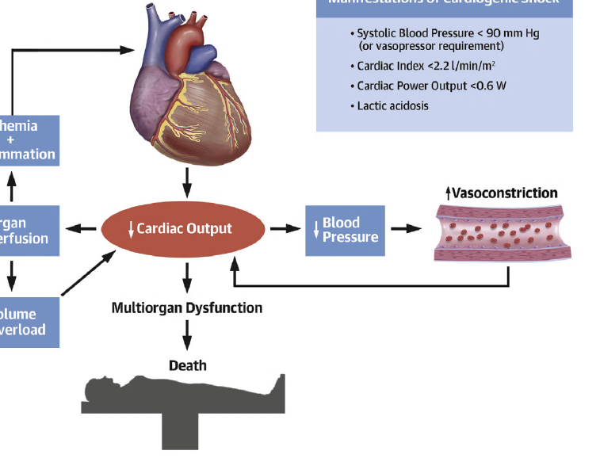
Ischaemia, vasoconstriction, volume overload, and inflammation
Progressive physiological cycles
Primary cardiac insult
myocardial dysfunction
Manifestations of cardiogenic shock
Systolic blood pressure <90 mm Hg
(or vasopressor requirement)
Cardiac Index <2.2 l/min/m2
Cardiac power output <0.6 W
Lactic acidosis
Hypoxemia (vasoconstriction)
Microcirculatory dysfunction
Pulmonary oedema
Systemic Inflammatory Response Syndrome (SIRS)
Bacterial translocation
Ischaemia
+
inflammation
Organ
perfusion
Cardiac output
Organ
perfusion
Sympathetic stimulation
Renin-angiotensin activation
Tubuloglomerular feedback
Venoconstriction
Volume
overload
Tehrani BN, et al. J Am Coll Cardiol Heart Fail. 2020;8:879-91

Slide 6
Prognosis of ACS with HF
ACS, acute coronary syndrome; HF, heart failure

Slide 7
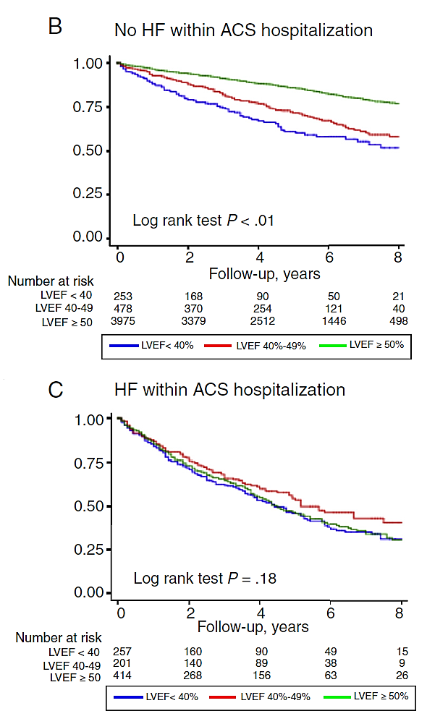
Impact on prognosis of HF and LVEF in ACS
No HF within ACS hospitalisation
HF within ACS hospitalisation
1.00
1.00
0.75
0.75
0.50
0.50
0.25
0.25
Log rank test p<0.01
Log rank test p=0.18
0.00
0.00
0
2
4
6
8
0
2
4
6
8
No. at risk
LVEF <40
LVEF 40-49
LVEF ≥50
Follow-up, years
No. at risk
LVEF <40
LVEF 40-49
LVEF ≥50
Follow-up, years
253
478
3,975
168
370
3,379
90
254
2,512
50
121
1,446
21
40
498
257
201
414
160
140
268
90
89
156
49
38
63
15
9
26
LVEF <40%
LVEF 40-49%
LVEF ≥50
LVEF <40%
LVEF 40-49%
LVEF ≥50
ACS, acute coronary syndrome; HF, heart failure; LVEF, left ventricular ejection fraction
Agra R, et al. Rev Esp Cardiol (Engl Ed). 2018;71:820-8

Slide 8
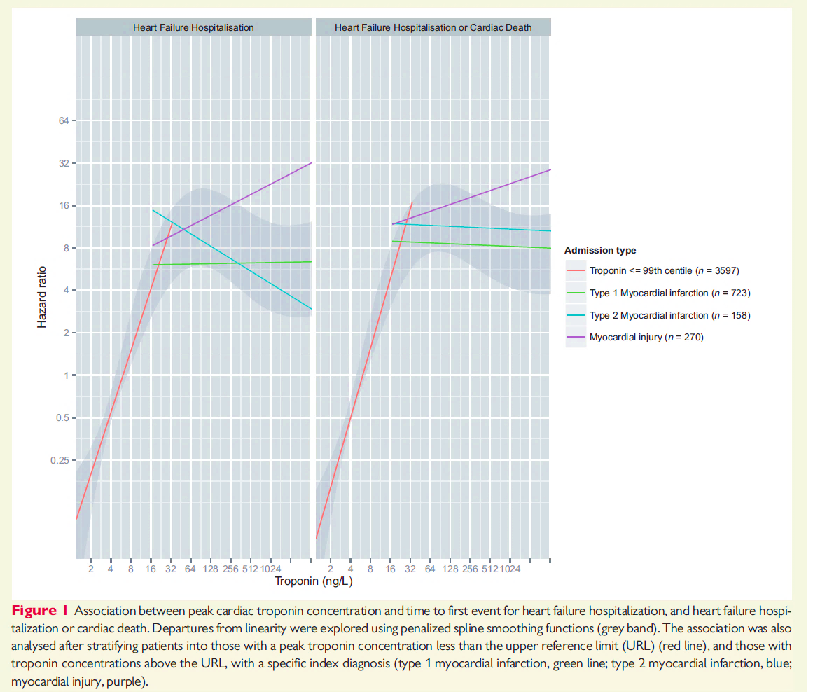
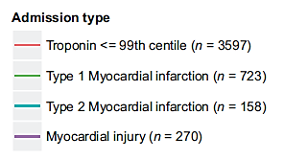
High-sensitivity cardiac Troponin I and risk of
HF in ACS
HF
hospitalisation
HF hospitalisation
or cardiac death
Association between peak cardiac troponin concentration and time to first event for HF, and HF hospitalisation or cardiac death
Hazard ratio (HR)
Troponin ≤99th centile (n=3,597)
Type 1 myocardial infarction (MI)
(n=723)
Type 2 MI (n=158)
Myocardial injury (n=270)
Troponin (ng/L)
ACS, acute coronary syndrome; HF, heart failure; LVEF, left ventricular ejection fraction
Stelzle D, et al. Eur Heart J Qual Care Clin Outcomes. 2018;4:36-42

Slide 9
MANAGEMENT

Slide 10
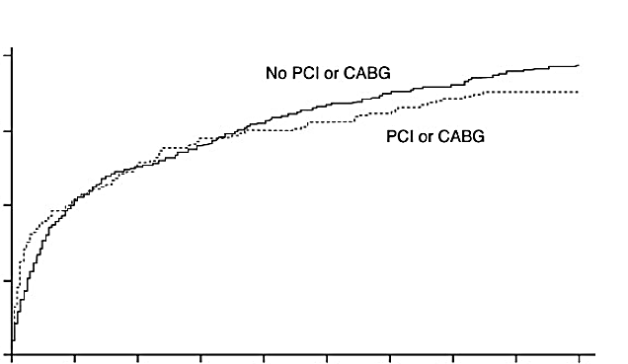
Impact of in-hospital revascularisation on survival in NSTE-ACS and HF
Cumulative death rate from admission to 6 months by revascularisation
in patients with NSTE-ACS and congestive heart failure (CHF)
0.20
No percutaneous coronary intervention
(PCI) or coronary artery bypass graft (CABG)
0.15
PCI or CABG
0.10
p<0.001
0.05
0.00
0
20
40
60
80
100
120
140
160
180
Days since admission
NSTE-ACS, non-ST-segment elevation acute coronary syndrome
Steg PG, et al. Circulation. 2008;118:1163-71

Slide 11
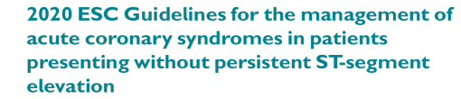

Recommendations for coronary revascularisation
Recommendations | Classª | Level^{b}
Timing of invasive strategy
An immediate invasive strategy (<2 h) is recommended in patients with at least one of the following very high-risk criteria: Haemodynamic instability or CS Recurrent or refractory chest pain despite medical treatment Life-threatening arrhythmias Mechanical complications of MI Heart failure clearly related to NSTE-ACS Presence of ST-segment depression >1 mm in ≥6 leads additional to ST-segment elevation in aVR and/or V1 | I | C
ª Class of recommendation; ^{b} Level of evidence
aVR, augmented vector right; CS, cardiogenic shock; h, hours; MI, myocardial infarction; NSTE-ACS, non-ST-segment elevation acute coronary syndrome; V1, vector 1
Adapted from Collet J-P, et al. Eur Heart J. 2020. DOI: 10.1093/eurheartj/ehaa575

Slide 12
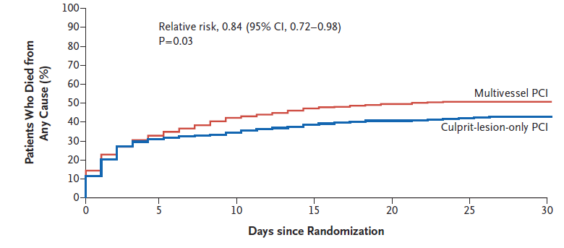
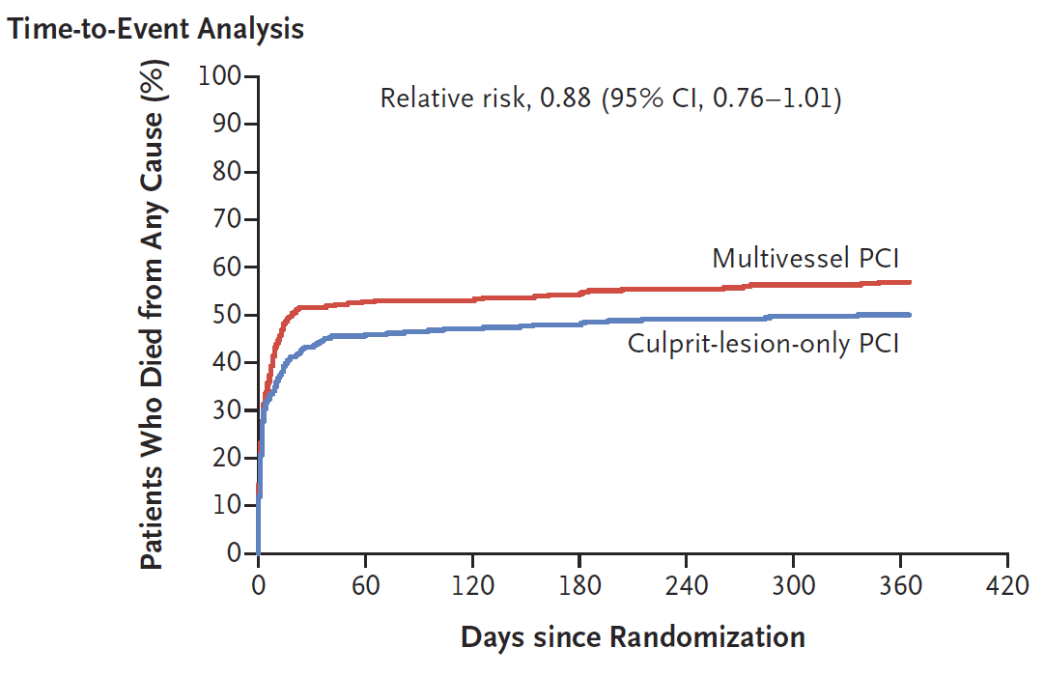
PCI in patients with AMI and CS
30-days death from any cause
CULPRIT SHOCK trial
706 patients multivessel disease
(MVD) + AMI + CS
Randomized to PCI culprit lesion only (staged optional) vs immediate multivessel (MV) PCI
30-day composite of death or severe renal failure was lower among those who underwent PCI of the culprit lesion only
1-year mortality did not differ significantly between the two groups
Patients who died from
any cause (%)
Relative risk (95% CI), 0.84 (0.72-0.98); p=0.03
Days since randomisation
1-year death from any cause
Patients who died from
any cause (%)
Relative risk (95% CI), 0.88 (0.76-1.01)
Days since randomisation
AMI, acute myocardial infarction; CI, confidence interval; PCI, percutaneous coronary intervention
Thiele H, et al. N Engl J Med. 2017;377:2419-32; Thiele H, et al. N Engl J Med. 2018;379:1699-710

Slide 13
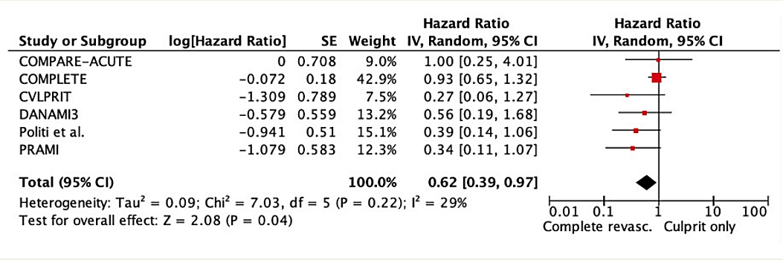
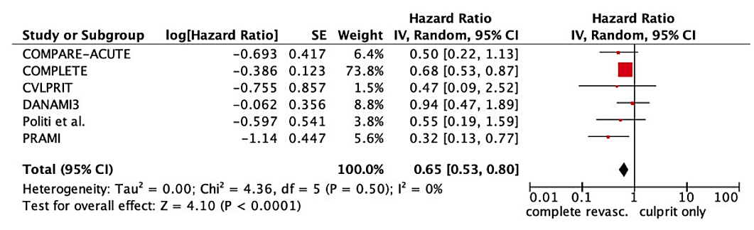
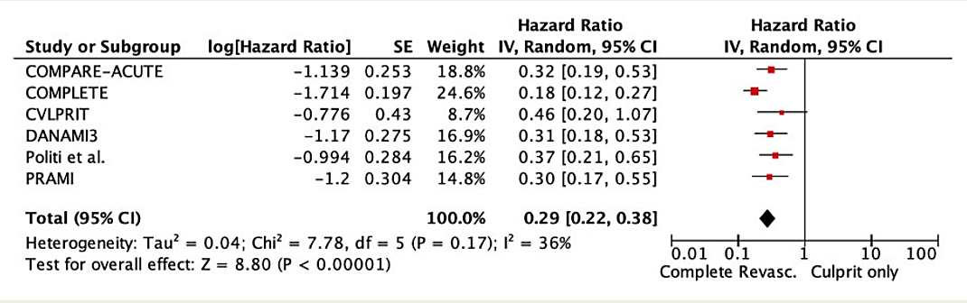
Complete revascularisation in STEMI and MVD
Meta-analysis of
randomised Trials
Cardiovascular (CV) death
MI
Repeat revascularisation
Killip ≥II-IV: 5-11%
CI, confidence Interval; MI, myocardial infarction; MVD, multivessel disease; SE, standard error; STEMI, ST-segment elevation myocardial infarction
Pavasini R, et al. Eur Heart J. 2019;DOI:10.1093/eurheartj/ehz896

Slide 14
MV vs culprit revascularisation in NSTE-ACS
Systematic review and meta-analysis
Short term
Long term
Odds ratio
1.14 (1.01-1.29)
1.37 (0.98-1.91)
0.92 (0.71-1.19)
0.88 (0.51-1.50)
0.35 (0.29-0.43)
1.94 (1.01-3.72)
MACE
MI
All-cause death
Repeat PCI
CABG
CVA
MACE
MI
All-cause death
Repeat revascularisation
(CABG and PCI)
0.1
0.2
0.5
1
2
5
10
0.1
0.2
0.5
1
2
5
10
Favours MVR
Favours CVR
Favours MVR
Favours CVR
CABG, coronary artery bypass graft; CVA, cerebrovascular accident; CVR, culprit vessel revascularisation; MACE, major adverse cardiovascular events;
MI, myocardial infarction; MV(R), multivessel (revascularisation); NSTE-ACS, non-ST-segment elevation acute coronary syndrome; PCI, percutaneous coronary intervention
Siebert VR, et al. Am J Cardiol. 2019;124:1501-11

Slide 15
Predictors of evolution

Slide 16
Clinical and anatomical criteria to identify high-risk PCI
Clinical criteria:
  Ejection fraction ≤30%
  ACS + haemodynamic instability
  Refractory ACS
  Mechanical complications of AMI
  Age ≥75 years
  History of CVA, diabetes, chronic renal failure, peripheral vascular disease, or chronic obstructive
  pulmonary disease
  Killip class II-IV or CHF
  Cardiogenic shock <24 hours
ACS, acute coronary syndrome; AMI, acute myocardial infarction; CHF, congestive heart failure; CVA, cerebrovascular accident
Atkinson TM, et al. JACC Cardiovasc Interv. 2016;9:871-3; Myat A, et al. JACC Cardiovasc Interv. 2015;8:229-44
Notes:
16

Slide 17
Clinical and anatomical criteria to identify high-risk PCI
Anatomical criteria:
  Intervention to an unprotected LMCA (or equivalent)
  Distal left main bifurcation intervention
  Multivessel disease
  PCI in a degenerated CABG
  Last remaining coronary vessel
  Duke Myocardial Jeopardy score ≥8/12 or SYNTAX score ≥33
  Target vessel providing a collateral supply to an occluded second vessel that supplies
  >40% of the left ventricular myocardium
CABG, coronary artery bypass graft; LMCA, left main coronary artery; PCI, percutaneous coronary intervention
Atkinson TM, et al. JACC Cardiovasc Interv. 2016;9:871-3; Myat A, et al. JACC Cardiovasc Interv. 2015;8:229-44
Notes:
17

Slide 18
Challenges in the future

Slide 19
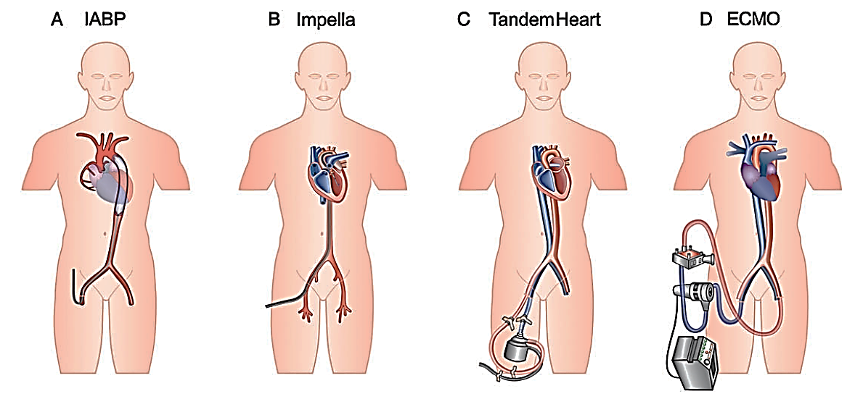
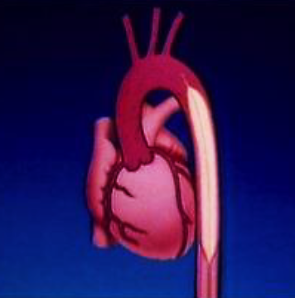
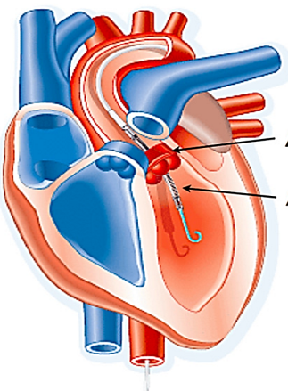
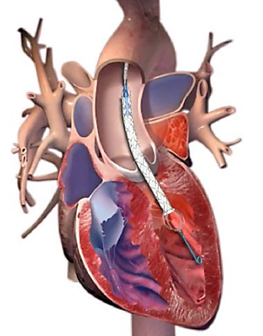
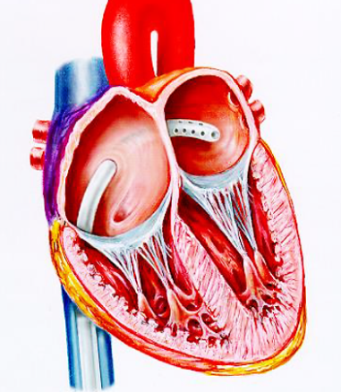
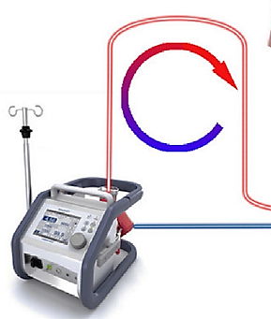
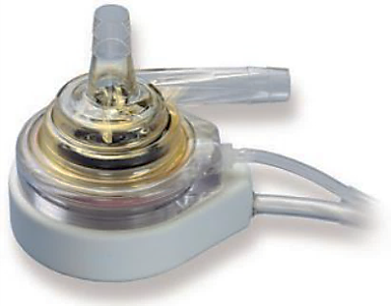
Left ventricular mechanical circulatory support devices
A. IABP
B. Impella®/PHP
C. Tandem Heart
D. ECMO
ECMO, extracorporeal membrane oxygenation; IABP, intra-aortic balloon (counterpulsation); PHP, percutaneous heart pump
Adapted from Werdan KJ, et al. Eur Heart J 2014;35:156-67

Slide 20
Haemodynamics during Impella®-protected PCI in high-risk patients with reduced EF
Pressure is
systematically maintained with Impella® at levels warranting vital organ perfusion
SBP
MBP
p<0.001
p<0.001
180
160
140
120
100
160
80
60
40
p=0.003
20
p=0.002
0
Pre-PCI
During PCI
(lowest value)
Assistance end
EF, ejection fraction; MBP, mean blood pressure; PCI, percutaneous coronary intervention; SBP, systolic blood pressure
Russo G, et al. Int J Cardiol. 2019;274:221-25

Slide 21

Ongoing trials in CS investigating percutaneous mechanical circulatory support
Study name | Trial ID | Start/completion date | Key inclusion criteria | Experimental arm | Comparator arm | N | Primary endpoint
ANCHOR | NCT04184635 | 2020/2023 | AMI + CS | VA-ECMO + IABP | Conventional circulatory support | 400 | Death in the ECMO group and death or rescue ECMO in the control group
DanGer (formerly DanShock) | NCT01633502 | 2012/2022 | STEMI + CS + LVEF <45% | Impella® CP | Conventional circulatory support | 360 | All-cause mortality
ECMO-CS | NCT02301819 | 2014/2021 | CS | VA-ECMO | Conventional circulatory support | 120 | All-cause mortality or resuscitated cardiac arrest or another mechanical circulatory support implantation
ECMO-RRT | NCT02870946 | 2016/2021 | CS + ECMO | ECMO + RRT | ECMO | 262 | All-cause mortality
ECLS-SHOCK | NCT03637205 | 2019/2022 | AMI + CS | ECLS + PCI (or CABG surgery) | PCI (or CABG surgery) | 420 | All-cause mortality
EUROSHOCK | NCT03813134 | 2019/2023 | ACS + CS + PCI | VA-ECMO + PCI | PCI | 428 | All-cause mortality or heart failure
HYPO-ECMO | NCT02754193 | 2016/2021 | CS + VA-ECMO | ECMO + hypothermia | ECMO | 334 | All-cause mortality
IABP18 | NCT03635840 | 2018/2021 | AMI + CS | IABP prior to revascularization | Revascularization | 92 | All-cause mortality
Prague OHCA | NCT01511666 | 2013/2021 | OHCA ± CS | Prehospital mechanical compressions, cooling and in- hospital ECLS | Standard care | 170 | 6-month survival with good neurological outcome (CPC 1–2)
REVERSE | NCT03431467 | 2018/2021 | CS | Impella® + VA-ECMO | VA-ECMO | 96 | Recovery from CS
Ongoing trials in CS investigating percutaneous mechanical circulatory support
RED circle indicates Impella; BLUE circle indicates ECMO
ACS, acute coronary syndrome; AMI, acute myocardial infarction; CABG, coronary artery bypass graft;
CPC, cerebral performance category; CS, cardiogenic shock; ECLS, extracorporeal life support; (VA-)ECMO, (venoarterial) extracorporeal membrane oxygenation; ESC, European Society of Cardiology; IABP, intra-aortic balloon (counterpulsation); LVEF, left ventricular ejection fraction; OHCA, out of hospital cardiac arrest; PCI, percutaneous coronary intervention;
RRT, renal replacement therapy; STEMI, ST-segment elevation myocardial infarction
Collet J-P, et al. Eur Heart J. 2020. DOI: 10.1093/eurheartj/ehaa575 (supplementary data)

Slide 22
SUMMARY
Patients with cardiogenic shock, immediate coronary angiography is indicated and PCI should
be performed
Percutaneous mechanical circulatory support (MCS) devices and/or venoarterial extracorporeal membrane oxygenation may be considered in selected patients, depending on age, comorbidities, neurological function, and severity of CS. Several clinical trials are ongoing comparing different devices
Although coronary revascularisation should be performed as soon as possible, the optimal timing for MCS requires further evaluation
Currently, no survival benefit has been demonstrated for these devices compared with intra-aortic balloon pump (IABP) use
Collet J-P, et al. Eur Heart J. 2020. DOI: 10.1093/eurheartj/ehaa575; Bagai J, et al. Curr Cardiol Rep. 2019; 21: 17. doi: 10.1007/s11886-019-1102-3

Slide 23




REACH CORONARY CONNECT VIA
TWITTER, LINKEDIN, VIMEO & EMAIL
OR VISIT THE GROUP’S WEBSITE http://www.coronaryconnect.com/
Follow us on Twitter
@CoronaryConnect
Follow the
CORONARY CONNECT
Group on LinkedIn
Watch us on the
Vimeo Channel
CORONARY CONNECT
Email
carrie.brubaker
@cor2ed.com

