Slide 2
GU CONNECT
PARP inhibitors in Prostate Cancer
Latest developments
Prof. Neeraj Agarwal, MD
Director, Genitourinary Oncology Program,
Huntsman Cancer Institute, University of Utah, USA
MARCH 2022
PARPi, poly-ADP ribose polymerase inhibitors

Slide 3
Disclaimer and disclosures
Please note: The views expressed within this presentation are the personal opinions of the author.
They do not necessarily represent the views of the author’s academic institution, or the rest of the
GU CONNECT group.
This content is supported by an Independent Educational Grant from AstraZeneca.
Prof. Neeraj Agarwal has received received financial support/sponsorship from the following companies:
Consultancy fees: Astellas, AstraZeneca, Argos, Aveo, Bayer Oncology, Bristol Myers Squibb, Calithera, Clovis, Eisai, Eli Lilly, EMD Serono, Exelixis, Foundation Medicine, Genentech, Janssen, Merck, MEI Pharma, Nektar, Novartis, Pfizer, Pharmacyclics, Seattle Genetics
Research funding: Active Biotech, Astra Zeneca, Bavarian Nordic, Bayer Oncology, BN Immunotherapeutics, Bristol Myers Squibb, Calithera, Celldex, Clovis, Eisai, Eli Lilly, EMD Serono, Exelixis, Genentech, Glaxo Smith Kline, Immunomedics, Janssen, Medivation, Merck, Nektar, New link Genetics, Novartis, Pfizer, Prometheus, Rexahn, Roche, Sanofi, Seattle Genetics, Takeda, Tracon

Slide 4
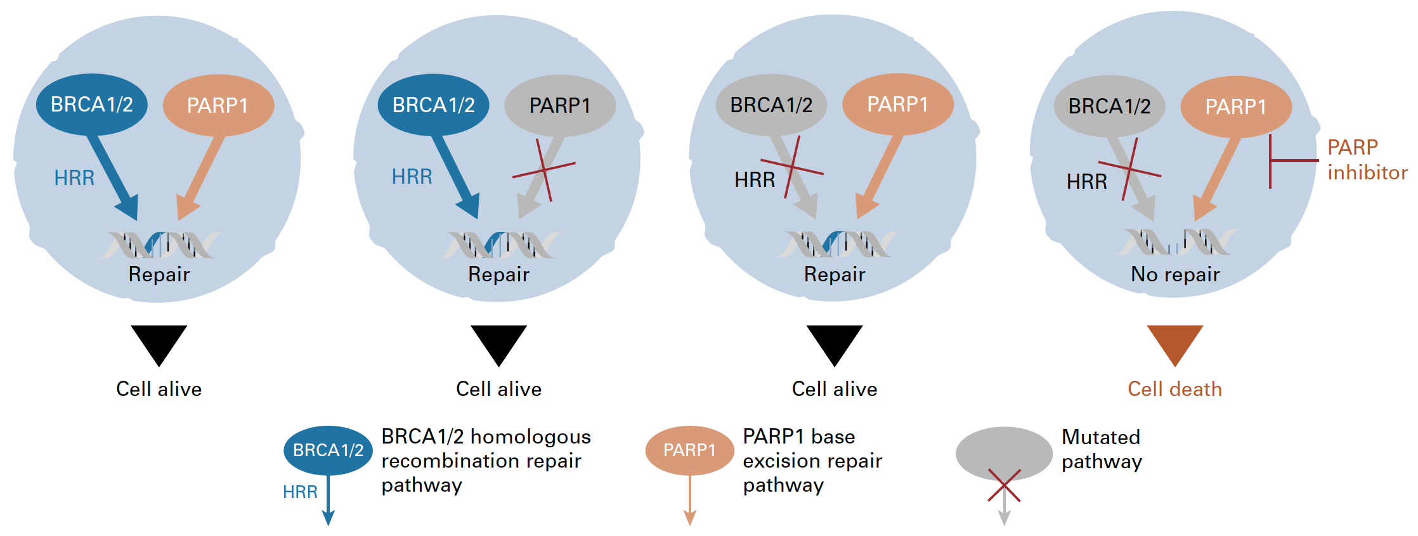

PARP inhibitors:
‘Synthetic Lethality’ in cancer
BRCA: “copy editor”; homologous recombination repair (HRR)
PARP: “spell check”; base excision repair (BER)
BER
BER
BER
BER
BER
PARP is required for single-strand break repair (e.g. via BER)
MOA – inhibiting SSB/BER is synthetic lethal with HRD
BER, base excision repair; BRCA1/2, breast cancer type 1/2 susceptibility protein; HRD, homologous recombination deficiency; HRR, homologous recombination repair; MOA, mode of action; PARP, poly-ADP ribose polymerase; SSB, single-strand break
Adapted from Gourley C, et al., J Clin Oncol. 2019;37(25):2257-69; Banerjee S, et al. Nat Rev Clin Oncol 2010; 7: 508-19

Slide 5
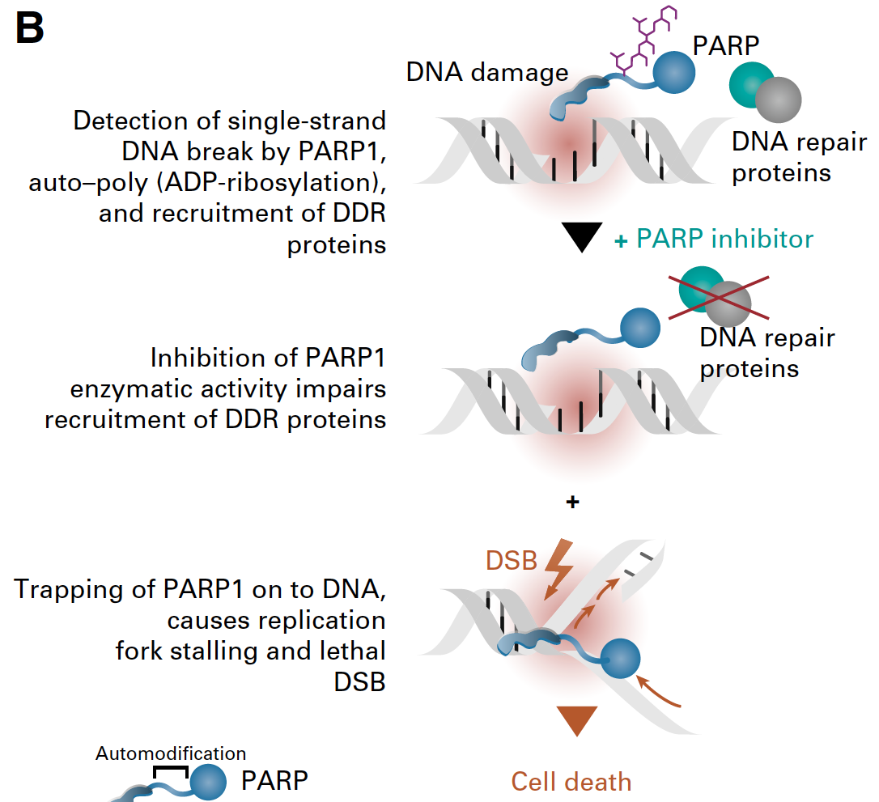
PARP inhibitors: eNZYMATIC INHIBITION & PARP trapping
MOA – trapping PARP is synthetic lethal with HRD
ADP, adenosine diphosphate; DDR, DNA damage response; DSB, double-strand break; HRD, homologous recombination deficiency; MOA, mode of action; PARP, poly-ADP ribose polymerase
Adapted from Gourley C, et al. J Clin Oncol 2019; 37: 2257-69

Slide 6
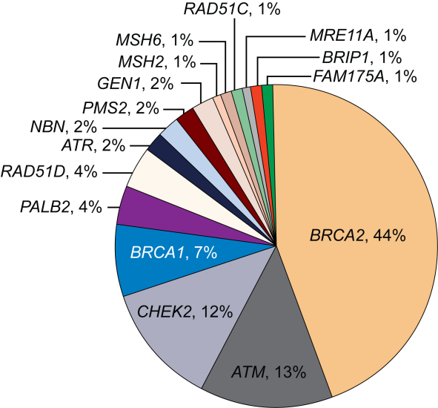
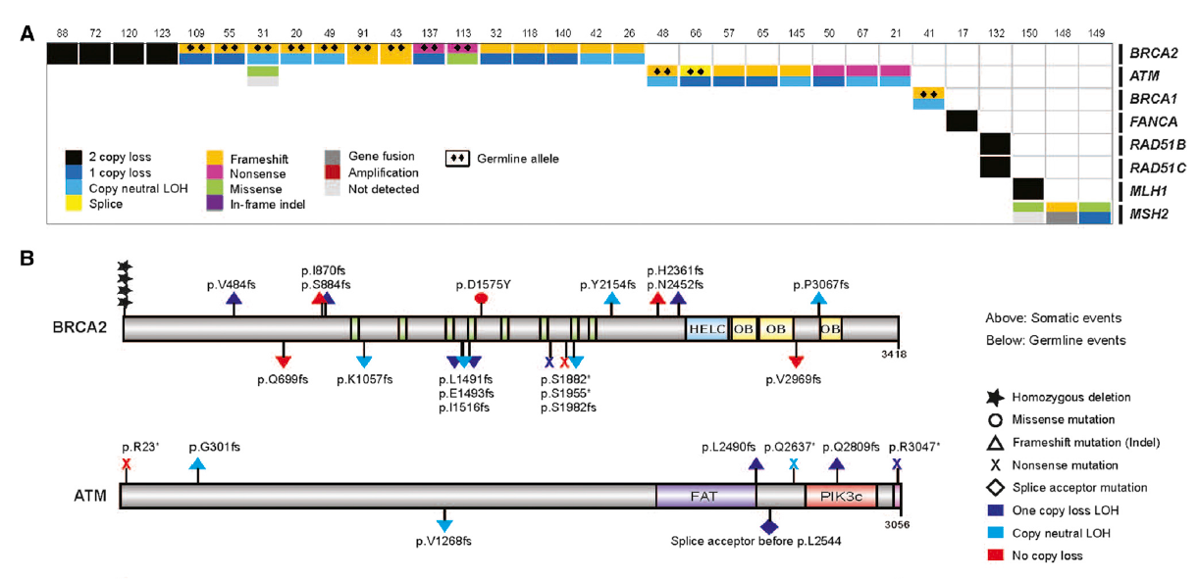
DNA Repair Gene Alterations (Somatic and Germline) Are Common in Metastatic prostate cancer
Somatic
Germline
~23% of men with mCRPC have DNA repair pathway aberrations
The incidence of DNA repair alterations is higher in men with metastatic prostate cancer than those with localised disease
~12% of men with metastatic prostate
cancer have germline mutations in one or more of the 16 DNA repair genes
LOH, loss of heterozygosity; mCRPC, metastatic castration resistant prostate cancer; PC, prostate cancer
1. Robinson D, et al. Cell. 2015;161:1215-28; 2. Pritchard CC, et al. N Engl J Med. 2016;375:443-53; 3. Antonarakis ES, et al. Eur Urol. 2018;74:218-25

Slide 7
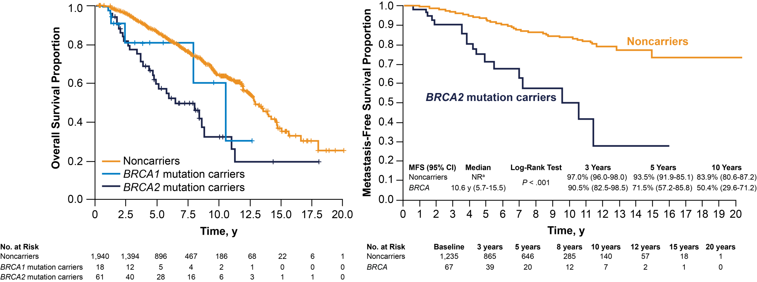
BRCA2 Carriers With Prostate Cancer Have Worse Prognosis^{1,2}
Noncarriers
BRCA1/2 mutation carriers
ª Median survival not reached after a median of 64 months of follow-up
BRCA1/2, breast cancer type 1/2 susceptibility protein; CI, confidence interval; MFS, metastasis-free survival; NR, not reached; y, years
1. Castro E, et al. J Clin Oncol. 2013;31:1748-57; 2. Castro E, et al. Eur Urol. 2015;68:186-93

Slide 8
PROfound: phase 3 data with
Olaparib in mCRPC
Olaparib 300 mg BID
(n=162)
Primary endpoint
rPFS in cohort A (RECIST 1.1 and PCWG3 by BICR)
Key eligibility criteria
mCRPC with disease progression on prior NHA (abiraterone acetate or enzalutamide)
Alterations in ≥1 of any qualifying gene with a direct or indirect role in HRR ª
Cohort A
BRCA1, BRCA2, or ATM alteration
(N=245)
Physician’s choice ^{b}
(n=83)
2:1 randomisation
(Open label)
Upon progression by BICR,
physician’s choice patients were
allowed to cross over to olaparib
Key secondary endpoints
rPFS in cohorts A and B (by BICR) Confirmed radiographic objective response rate in cohort A (by BICR) Time to pain progression in cohort A OS in cohort A
Cohort B
Other alterations
(N=142)
Olaparib 300 mg BID
(n=94)
Physician’s choice ^{b}
(n=48)
Stratification factors
Previous taxane
Measurable disease
ª An investigational clinical trial assay, based on the FoundationOne® CDx next-generation sequencing test, used to prospectively select patients with alteration of BRCA1, BRCA2, ATM, BARD1, BRIP1, CDK12, CHEK1, CHEK2, FANCL, PALB2, PPP2R2A, RAD51B, RAD51C, RAD51D, or RAD54L in their tumour tissue
^{b} Physician’s choice: enzalutamide 160 mg/day, or abiraterone 1,000 mg/day + prednisone 5 mg BID
ATM, ataxia telangiectasia mutated; BICR, blinded independent central review; BID, twice daily; BRCA1/2, breast cancer type 1/2 susceptibility protein; HRR, homologous recombination repair; mCRPC, metastatic castration resistant prostate cancer; NHA, new hormonal agent; OS, overall survival; PCWG3, Prostate Cancer Working Group 3; RECIST, Response Evaluation Criteria In Solid Tumours; rPFS, radiographic progression-free survival; QD, once daily
de Bono J, et al. N Engl J Med. 2020;382:2091-2102; Hussain M, et al. N Engl J Med. 2020;383(24):2345-57

Slide 9
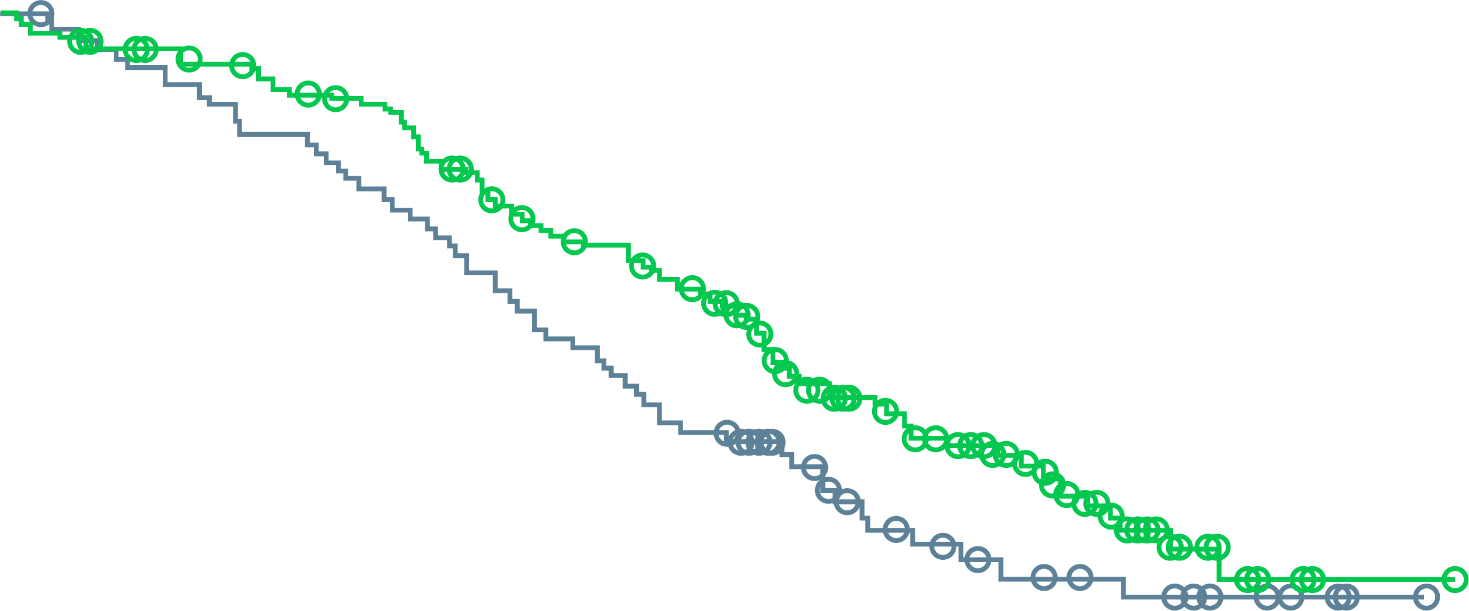
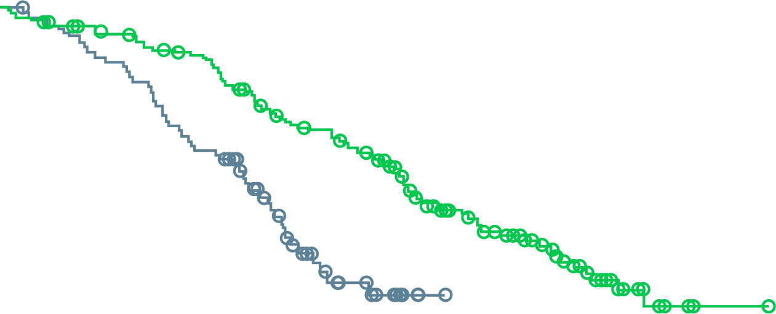
profound: FINAL OVERALL SURVIVAL
OS in cohort A (BRCA1&2, ATM)
CROSSOVER-ADJUSTED OS in
COHORT A
 | No. of Deaths/ No. of Patients | Median OS (95% CI), months
Olaparib | 91/162 | 19.1 (17.4-23.4)
Control | 57/83 | 14.7 (11.9-18.8)
Hazard ratio for death, 0.69 (95% CI, 0.50-0.97) 2-sided p=0.02
Patients who crossed over, 67% (56/83) Hazard ratio for death, 0.42 (95% CI, 0.19-0.91)
100
91%
84%
100
90
73%
61%
90
80
54%
42%
80
70
70
60
60
Percent of patients alive
Percent of patients alive
50
50
40
40
30
Olaparib
30
Olaparib
20
Control
20
Control
10
10
0
0
0
2
4
6
8
10
12
14
16
18
20
22
24
26
28
30
32
34
0
2
4
6
8
10
12
14
16
18
20
22
24
26
28
30
32
34
No. at risk
Olaparib
Control
Months since randomisation
No. at risk
Olaparib
Control
Months since randomisation
162
83
155
79
150
74
142
69
136
64
124
58
107
50
101
43
91
37
71
27
56
18
44
15
30
11
18
9
6
6
2
3
1
1
0
0
162
83
155
79
150
73
142
67
136
56
124
47
107
29
101
15
91
9
71
3
56
0
44
0
30
0
18
0
6
0
2
0
1
0
0
0
>80% crossover!
ATM, ataxia telangiectasia mutated; BRCA1/2, breast cancer type 1/2 susceptibility protein; CI, confidence interval; HR, hazard ratio; OS, overall survival
Hussain M, et al. N Engl J Med. 2020;383(24):2345-57

Slide 10
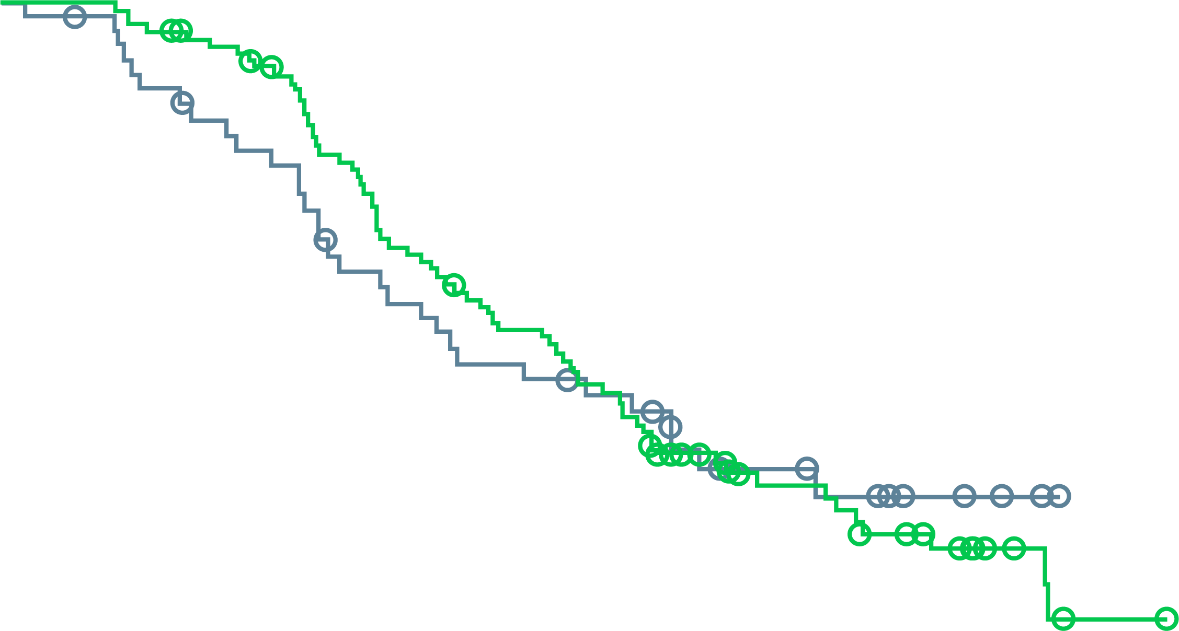
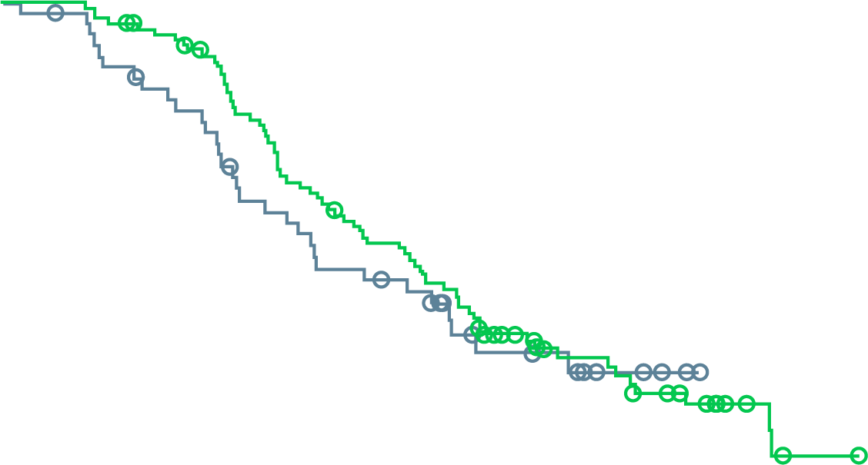
profound: FINAL OVERALL SURVIVAL
OS in cohort B
CROSSOVER-ADJUSTED OS in
COHORT B
 | No. of Deaths/ No. of Patients | Median OS (95% CI), months
Olaparib | 69/94 | 14.1 (11.1-15.9)
Control | 31/48 | 11.5 (8.2-17.1)
Hazard ratio for death, 0.96 (95% CI, 0.63-1.49)
Patients who crossed over, 63% (30/48) Hazard ratio for death, 0.83 (95% CI, 0.11-5.98)
100
94%
81%
100
90
57%
47%
90
80
34%
32%
80
70
70
60
60
Percent of patients alive
Percent of patients alive
50
50
Control
40
40
Control
30
Control
30
20
Olaparib
20
Olaparib
10
10
0
0
0
2
4
6
8
10
12
14
16
18
20
22
24
26
28
30
32
34
0
2
4
6
8
10
12
14
16
18
20
22
24
26
28
30
32
34
No. at risk
Olaparib
Control
Months since randomisation
No. at risk
Olaparib
Control
Months since randomisation
94
48
94
46
90
41
86
37
73
32
58
25
50
21
45
20
35
18
25
10
17
9
12
7
9
4
4
2
1
0
0
0
0
0
0
0
94
48
94
46
90
41
86
37
73
29
58
25
50
21
45
19
35
11
25
9
17
7
12
4
9
1
4
0
1
0
0
0
0
0
0
0
CI, confidence interval; HR, hazard ratio; OS, overall survival
Hussain M, et al. N Engl J Med. 2020;383(24):2345-57

Slide 11
Olaparib: Side effect profile
Event | Olaparib (N=256) |  | Control (N=130) |  | Crossover (N=83)
 | All grades | Grade ≥3 | All grades | Grade ≥3 | All grades | Grade ≥3
Any adverse event, n (%) | 246 (96) | 133 (52) | 115 (88) | 52 (40) | 77 (93) | 49 (59)
Anaemia | 127 (50) | 58 (23) | 20 (15) | 7 (5) | 43 (52) | 24 (29)
Nausea | 110 (43) | 4 (2) | 27 (21) | 0 | 24 (29) | 2 (2)
Fatigue or asthenia | 107 (42) | 8 (3) | 43 (33) | 7 (5) | 21 (25) | 8 (10)
Decreased appetite | 80 (31) | 4 (2) | 24 (18) | 1 (<1) | 15 (18) | 2 (2)
Diarrhoea | 55 (21) | 2 (<1) | 9 (7) | 0 | 12 (14) | 0
Vomiting | 51 (20) | 6 (2) | 17 (13) | 1 (<1) | 16 (19) | 1 (1)
Constipation | 49 (19) | 0 | 19 (15) | 0 | 12 (14) | 0
Back pain | 36 (14) | 2 (<1) | 18 (14) | 2 (2) | 8 (10) | 0
Peripheral oedema | 34 (13) | 0 | 10 (8) | 0 | 3 (4) | 0
Cough | 29 (11) | 0 | 3 (2) | 0 | 4 (5) | 0
Dyspnoea | 27 (11) | 6 (2) | 5 (4) | 0 | 4 (5) | 1 (1)
Arthralgia | 26 (10) | 1 (<1) | 14 (11) | 0 | 4 (5) | 0
Urinary tract infection | 21 (8) | 5 (2) | 15 (12) | 5 (4) | 12 (14) | 3 (4)
Any serious adverse event, n (%) | 94 (37) | NA | 39 (30) | NA | 27 (33) | NA
Interruption of treatment because of adverse event, n (%) | 119 (46) | NA | 25 (19) | NA | 44 (53) | NA
Hussain M, et al. N Engl J Med. 2020;383(24):2345-57

Slide 12
TRITON2: open label, single-arm, phase 2 study of rucaparib in mCRPC patients
Screening
Key eligibility criteria
Treatment
28-day cycles
Identification of a deleterious somatic or germline alteration in HRR gene*
mCRPC
Deleterious somatic or germline alteration in HRR gene
Disease progression on AR-directed therapy (eg, abiraterone, enzalutamide, or apalutamide) for PC and 1 prior taxane-based chemotherapy for CRPC
ECOG PS 0 or 1
No prior PARP inhibitor, mitoxantrone, cyclophosphamide, or platinum-based chemotherapy
Rucaparib 600 mg BID
HRR genes
BRCA1 BRCA2 ATM | BARD1 BRIP1 CDK12 CHEK2 | FANCA NBN PALB2 RAD51 | RAD51B RAD51C RAD51D RAD54L
Tumour assessments every 8 weeks for 24 weeks, then every 12 weeks
PSA assessments every 4 weeks
Treatment until radiographic progression or discontinuation for other reason
Primary endpoints†
Patients with measurable disease at baseline: confirmed ORR per modified RECIST/PCWG3 by central assessment
Patients with no measurable disease at baseline: confirmed PSA response (≥50% decrease) rate§
*Alterations detected by local testing or central testing of blood or tumour samples. † Efficacy analyses in TRITON2 will be conducted separately based on HRR gene with alteration and presence/absence of measurable disease. ‡ RECIST modified to include up to 10 target lesions, maximum 5 per site, not including prostatic bed or bone lesions; MRI allowed. § The proportion of patients with a ≥50% decrease from baseline confirmed by a second consecutive measurement; PSA measurements performed by local laboratory.
AR, androgen receptor; BID, twice daily; CRPC, castration-resistant prostate cancer; ECOG PS, Eastern Cooperative Oncology Group Performance Status; HRR, homologous recombination repair, mCRPC, metastatic castration-resistant prostate cancer; MRI, magnetic resonance imaging; ORR, objective response rate; PARP, poly (ADP-ribose) polymerase; PC, prostate cancer; PCWG3, prostate cancer working group 3; PSA, prostate specific antigen; RECIST, Response Evaluation Criteria in Solid Tumours version 1.1
Abida W, et al. J Clin Oncol 2020; 38:3763-72

Slide 13
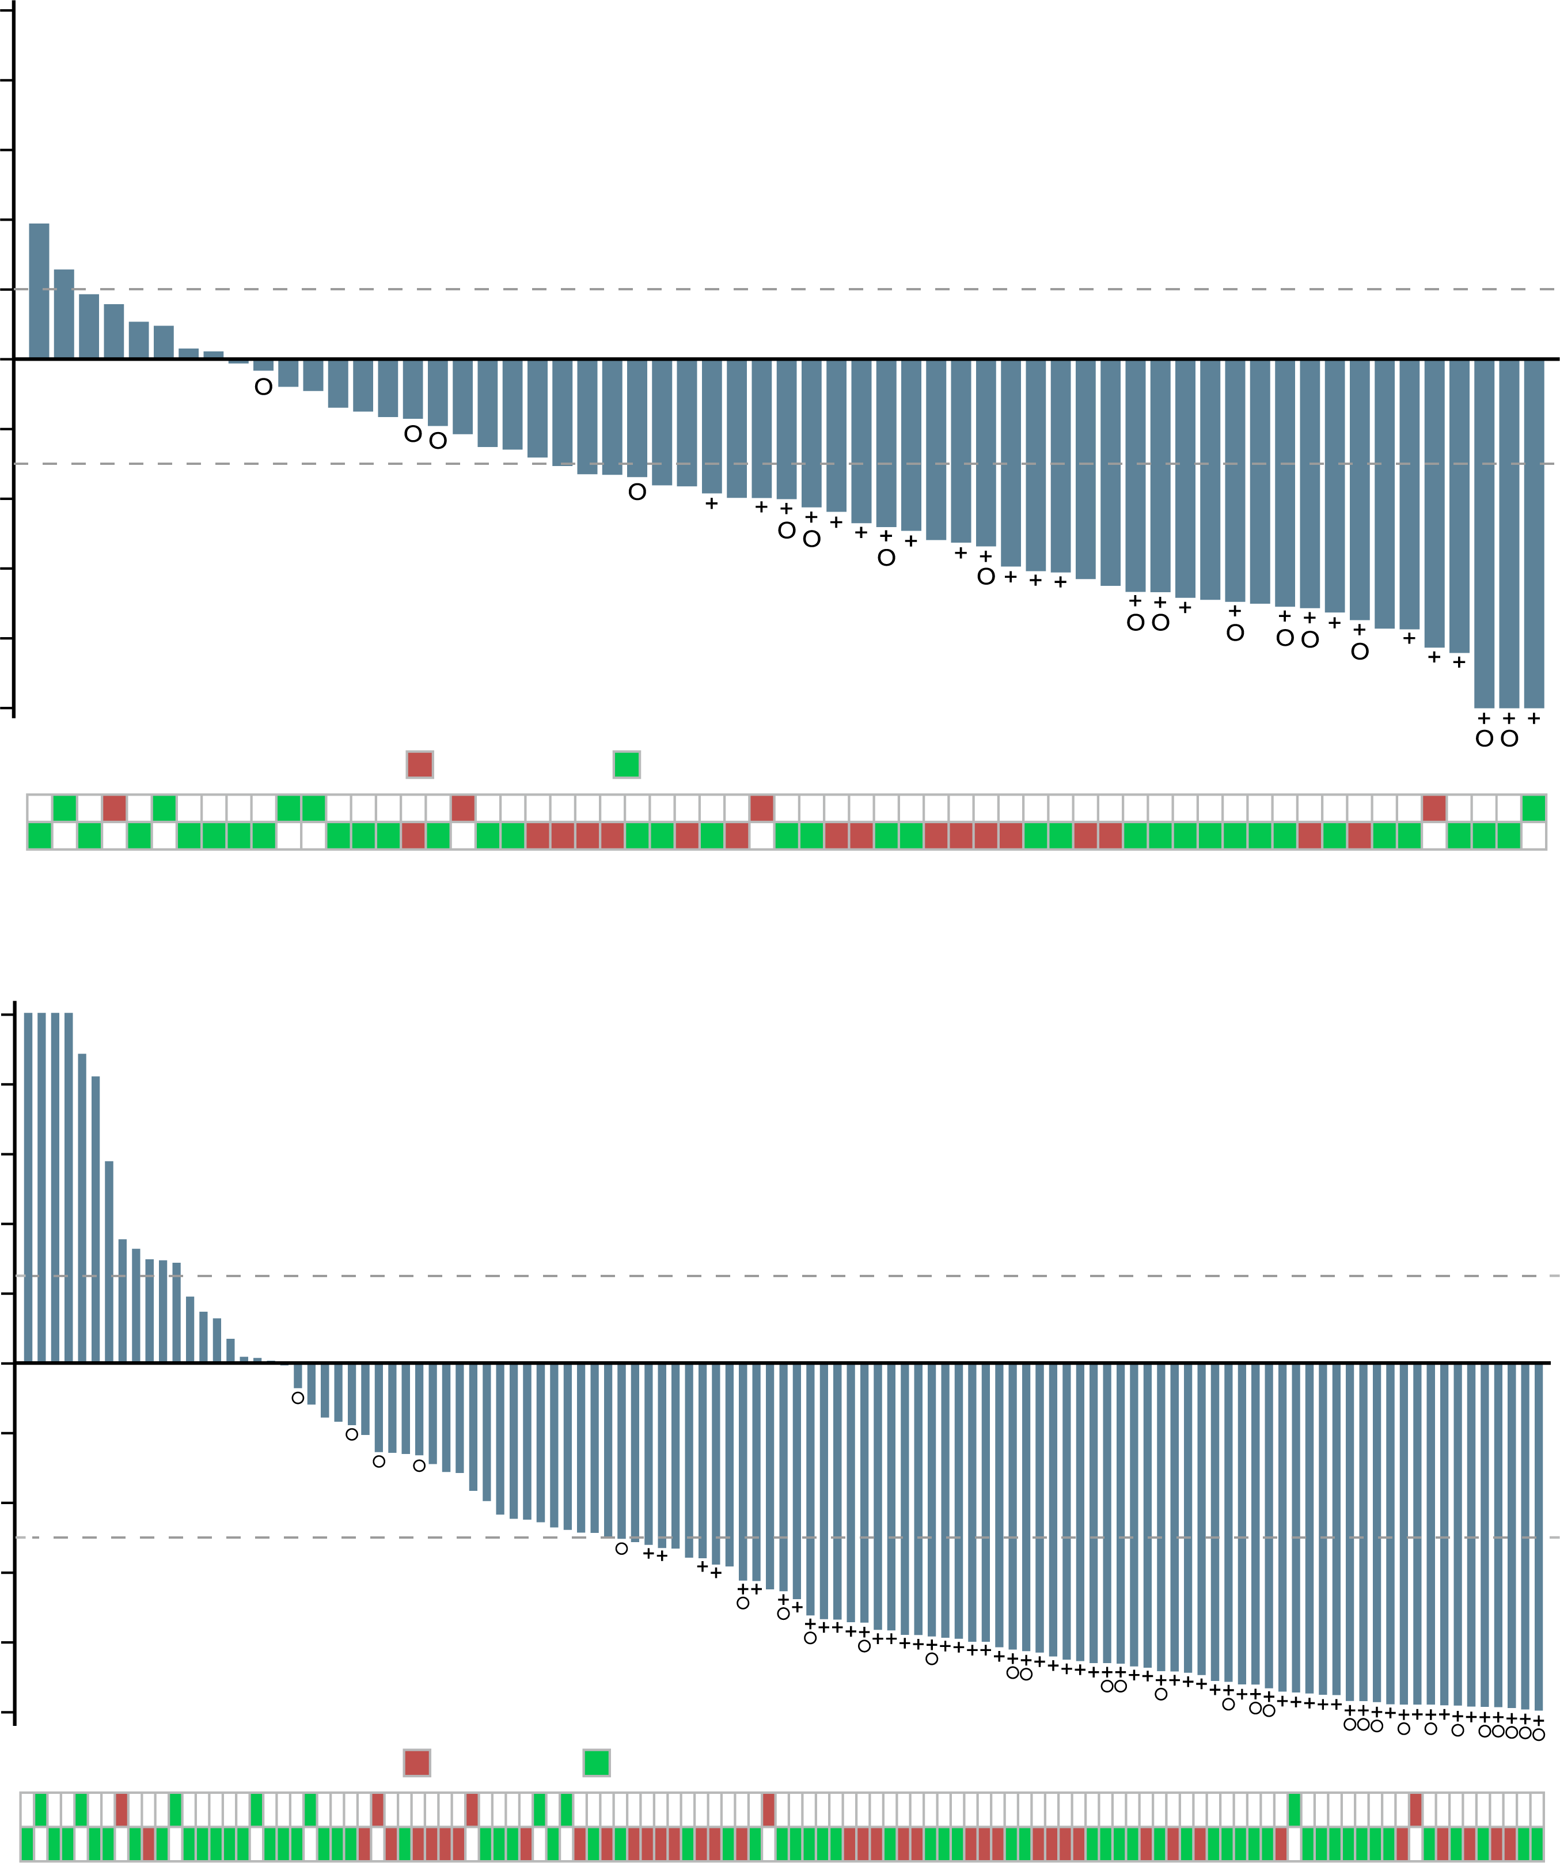
TRITON2: Rucaparib Efficacy in mCRPC patients with BRCA1 & 2 alterations
Tumour response (evaluable population)
PSA RESPONSE (EFFICACY POPULATION)
A
B
100
+ = Confirmed radiographic response
o = Ongoing
100
+ = Confirmed PSA response
o = Ongoing
80
80
60
60
40
40
20
20
Change from baseline (%)
0
0
Change from baseline (%)
-20
-20
-40
-40
-60
-60
-80
-80
-100
-100
Germline/somatic status:
Germline
Somatic
Germline/somatic status:
Germline
Somatic
BRCA1
BRCA1
BRCA2
BRCA2
Best change from baseline in (A) sum of target lesion(s) in the independent radiology review-evaluable population and in (B) prostate-specific antigen (PSA) in the overall efficacy population
BRCA1/2, breast cancer type 1/2 susceptibility protein; PSA, prostate specific antigen
Abida W, et al. J Clin Oncol. 2020;38:3763-72

Slide 14
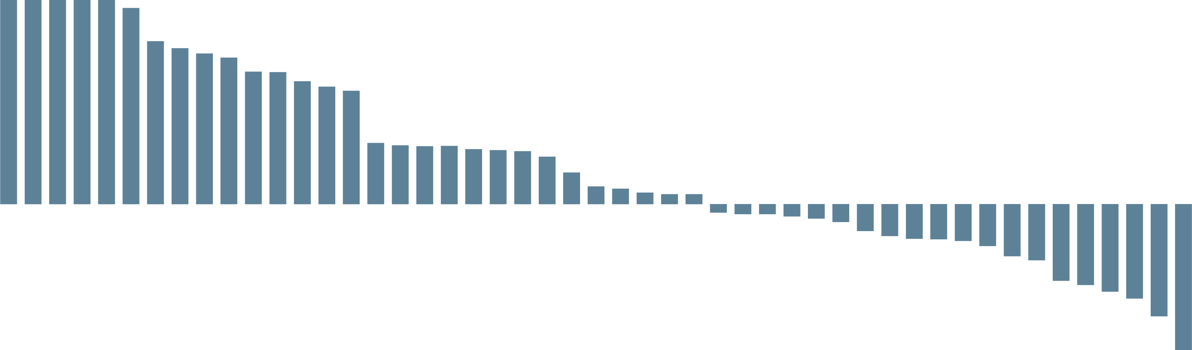
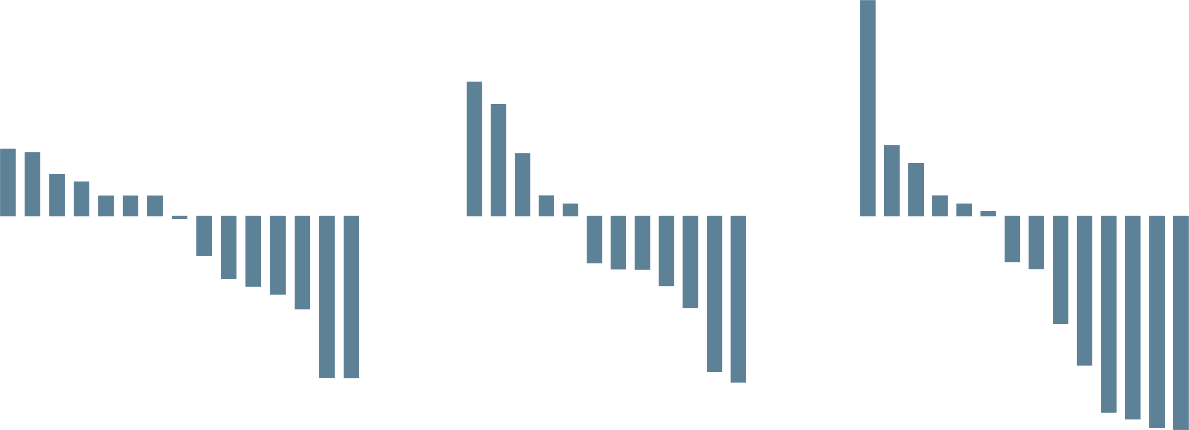
TRITON2: Rucaparib in mCRPC non-BRCA DDR gene alterations
78 patients
ATM
49 patients
CDK12
15 patients
CHEK2
12 patients
Other DDR gene
14 patients
Measurable
disease
19 patients
No measurable
disease
30 patients
Measurable
disease
10 patients
No measurable
disease
5 patients
Measurable
disease
9 patients
No measurable
disease
3 patients
Measurable
disease
14 patients
B
C
D
A
100
90
80
70
60
50
40
30
20
10
0
-10
-20
-30
-40
-50
-60
-70
-80
-90
-100
+ = Confirmed PSA response
o = Ongoing
100
90
80
70
60
50
40
30
20
10
0
-10
-20
-30
-40
-50
-60
-70
-80
-90
-100
+ = Confirmed
PSA response
o = Ongoing
100
90
80
70
60
50
40
30
20
10
0
-10
-20
-30
-40
-50
-60
-70
-80
-90
-100
+ = Confirmed
PSA response
o = Ongoing
100
90
80
70
60
50
40
30
20
10
0
-10
-20
-30
-40
-50
-60
-70
-80
-90
-100
+ = Confirmed
PSA response
o = Ongoing
o
o
o
o
o
Change from baseline (%)
o
Change from baseline (%)
o
o
o
o
o
o
o
o
o
o
o
o
+
o
+
o
+
+
o
+
o
+
+
o
+
o
+
o
+
o
Patient | 1 | 2 | 3 | 4 | 5 | 6 | 7 | 8 | 9 | 10 | 11 | 12 | 13 | 14 | 15 | 16 | 17 | 18 | 19 | 20 | 21 | 22 | 23 | 24 | 25 | 26 | 27 | 28 | 29 | 30 | 31 | 32 | 33 | 34 | 35 | 36 | 37 | 38 | 39 | 40 | 41 | 42 | 43 | 44 | 45 | 46 | 47 | 48 | 49
Treatment duration (mo) | 1 | 2 | 2 | 2 | 6 | 4 | 14 | 3 | 1 | 5 | 3 | 11 | 7 | 4 | 3 | 6 | 8 | 1 | 5 | 4 | 2 | 2 | 3 | 5 | 2 | 3 | 12 | 7 | 5 | 7 | 6 | 3 | 13 | 3 | 4 | 4 | 6 | 10 | 22 | 3 | 4 | 6 | 2 | 5 | 2 | 3 | 6 | 7 | 7
Radiographic response |  |  |  |  |  |  |  |  |  |  |  |  |  |  |  |  |  |  |  |  |  |  |  |  |  |  |  |  |  |  |  |  |  |  |  |  |  |  |  |  |  |  |  |  |  |  |  | PR | PR
Best change in SLD (%) |  | 3 |  | -12 |  |  |  |  |  |  |  |  | -17 |  |  |  |  |  |  | 13 | 31 |  |  |  | 1 |  |  | -49 | -13 | -9 | -6 |  |  |  | 7 |  | -23 | -21 |  |  | 13 |  |  | 11 | -26 |  |  | -39 | -66
ATM | U | B | U | B | U | U | U | B | U | U | M | M | U | U | U | U | U | U | B | U | M | U | U | U | B | U | B | U | M | U | M | U | U | U | U | B | B | B | B | U | M | B | U | U | U | U | U | U | U
BRIP1
CDK12
CHEK2 |  |  |  |  |  |  |  |  |  |  |  |  | U |  |  |  |  |  | U |  |  |  |  |  | B |  |  | U |  |  |  |  |  |  |  |  |  |  |  |  |  | U |  |  |  |  |  |  | U
FANCA |  |  |  |  |  |  |  |  |  |  |  |  |  |  |  |  |  |  |  |  |  |  |  |  | B
NBN
PALB2
RAD51
RAD51B
RAD54L |  |  |  |  |  |  |  |  |  |  |  |  |  |  |  |  |  |  |  |  |  |  |  |  |  |  |  | U
BRCA2 |  |  |  |  |  |  |  |  |  |  |  |  |  |  |  |  |  |  |  |  |  |  | U
Patient | 50 | 51 | 52 | 53 | 54 | 55 | 56 | 57 | 58 | 59 | 60 | 61 | 62 | 63 | 64
Treatment duration (mo) | 2 | 6 | 2 | 2 | 4 | 4 | 13 | 5 | 6 | 4 | 3 | 7 | 10 | 5 | 8
Radiographic response
Best change in SLD (%) | -14 | -14 |  | 31 |  | -12 |  |  | -13 | 5 | -13 | 14 |  |  | -5
ATM
BRIP1
CDK12 | U | M | B | B | U | B | B | B | U | M | M | B | B | B | B
CHEK2 |  |  |  |  |  |  |  |  |  |  | B |  | U
FANCA
NBN
13 | 65 | 19 | 25 | 28 | 66 | 67 | 42 | 60 | 62 | 49 | 68
7 | 1 | 5 | 2 | 7 | 5 | 2 | 6 | 3 | 10 | 7 | 4
 |  |  |  |  |  |  |  |  |  | PR
-17 | 37 |  | 1 | -49 | -4 | -6 |  | -13 |  | -66 | -14
U |  | B | B | U |  |  | B |  |  | U
 |  |  |  |  |  | M
 |  |  |  |  |  |  |  | M | B
U | U | U | B | U | B | M | U | B | U | U | U
 |  |  | B |  | B
 |  |  |  |  | B
69 | 70 | 71 | 25 | 28 | 72 | 66 | 67 | 73 | 74 | 75 | 76 | 77 | 78
2 | 3 | 4 | 2 | 7 | 7 | 5 | 2 | 4 | 6 | 8 | 13 | 14 | 14
 |  |  |  |  |  |  |  |  | PR | PR |  | CR | PR
 | -15 | 1 | 1 | -49 | -18 | -4 | -6 | 7 | -44 | -44 | -47 | -100 | -63
 |  |  | B | U
 |  |  |  |  |  |  | M |  |  |  |  |  | M
 |  |  | B | U |  | B | M
 | U |  | B |  |  | B |  |  |  |  |  | M
 |  | U |  |  | B | B |  | M
Best change from baseline in PSA in patients with an ATM alteration (A), CDK12 alteration (B),
CHEK2 alteration (C), or other DDR gene alteration (D). PSA increases for patients 1-5 were 319%,
142%, 126%, 109%, and 106%; bars were capped at 100% for visual clarity. Patients 55, 56, 57, 61, 62, 63, and 64 had 2 distinct CDK12 alterations identified through tissue and/or plasma testing and were considered to have biallelic loss.
Measurable disease
Germline
Somatic
Unknown
ATM, ataxia telangiectasia mutated; BRCA (2), breast cancer type (2) susceptibility protein CR, complete response; DDR, DNA damage repair; mCRPC, metastatic castration resistant prostate cancer; mo, month; PR, partial response; PSA, prostate specific antigen; SLD, sum of the longest diameter
Abida W, et al. Clin Cancer Res. 2020;26:2487-96

Slide 15
Rucaparib side effects
Individual TEAE (preferred terms) occurring in ≥15% of patients | Any grade | Grade ≥3
Asthenia/fatigue | 71 (61.7) | 10 (8.7)
Nausea | 60 (52.2) | 3 (2.6)
Anaemia/decreased hemoglobin | 50 (43.5) | 29 (25.2)
ALT/AST increased | 38 (33.0) | 6 (5.2)
Decreased appetite | 32 (27.8) | 2 (1.7)
Constipation | 31 (27.0) | 1 (0.9)
Thrombocytopenia/decreased platelets | 29 (25.2) | 11 (9.6)
Vomiting | 25 (21.7) | 1 (0.9)
Diarrhoea | 23 (20.0) | 0
Dizziness | 21 (18.3) | 0
Blood creatinine increased | 18 (15.7) | 1 (0.9)
ALT, alanine aminotransferase; AST, aspartate aminotransferase; TEAE, treatment-emergent adverse event
Abida W, et al. J Clin Oncol. 2020;38:3763-72

Slide 16
Rationale for combining PARP inhibitors and NHAs
Androgen receptor (AR) signalling regulates DNA repair in prostate cancer, providing a rationale for combined AR targeting with PARP inhibition²
PARP involved in androgen-receptor dependent transcription¹
  PARP inhibition may increase activity of NHAs¹
NHA-induced HRR deficiency increasing susceptibility to PARP inhibition^{2,3}
Combined effects may lead to antitumour activity in HRRm and non-HRRm prostate cancer¹
AR, androgen receptor; HRR, homologous recombination repair; HRRm, homologous recombination repair gene mutation; NHA, novel hormonal agent;
PARP, poly-ADP ribose polymerase
1. Schiewer MJ, et al Cancer Discov. 2012;2:1134-49; 2. Polkinghorn WR, et al. Cancer Discov. 2013;3:1245-53; 3. Asim M, et al. Nat Commun. 2017;8:374
Saad F, et al. J Clin Oncol 40, 2022 (suppl 6; abstr 11); Chi K, et al. J Clin Oncol. 2022; 40 (suppl 6; abstr 12)

Slide 17
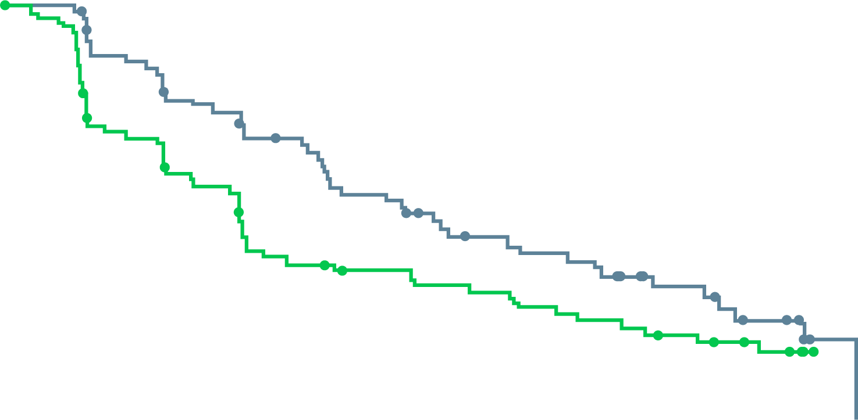
Olaparib and abiraterone:
A randomised phase II study
Patients with mCRPC, unselected by HRRm status, with prior docetaxel treatment
Randomised 1:1 to full dose of olaparib + abiraterone vs placebo + abiraterone†
Statistically significant improvement in rPFS with olaparib + abiraterone, irrespective of HRRm status
Investigator-assessed rpfs
rPFS BY HRRm SUBGROUP*
1.0
 | Ola + abi (N=71) | Abi (N=71)
Events, n (%) | 46 (65) | 54 (76)
 | HR 0.65 95% CI, 0.44-0.97; p=0.034
HRRm
N=23 (16%)
0.62
0.8
0.6
8.2
13.8
HRRm partially
characterised
N=46 (32%)
0.95
Proportion of patients event-free
0.4
0.2
Non-HRRm
N=73 (51%)
0.54
∆=5.6
0.0
0
3
6
9
12
15
18
21
24
27
30
0.25
0.50
1.00
2.00
* Dashed line and shaded area show HR and 95% CI, respectively, for the intent to treat population; † Olaparib 300 mg bd, abiraterone 1000 mg od and all patients also received prednisone/prednisolone 5 mg bd
Time from randomisation (months)
HRR (95% CI)
Abi, abiraterone; bd, twice daily; CI, confidence interval; HR, hazard ratio; HRRm, homologous recombination repair mutation; mCRPC, metastatic castration-resistant prostate cancer; od, once daily; Ola, Olaparib; rPFS, radiographic progression-free survival
Clarke N, et al. Lancet Oncol. 2018;19:975-86; Carr T, et al. Cancers. 2021;13:5830. Adapted from: Saad F, et al. J Clin Oncol 40, 2022 (suppl 6; abstr 11) (ASCO GU 2022 oral presentation)

Slide 18
PROpel Study Design
a global, randomised, double-blind phase 3 trial
Key eligibility criteria
1L mCRPC
  Docetaxel allowed at mCSPC stage
  No prior abiraterone
  Other NHAs allowed if stopped
  ≥12 months prior to enrolment
  Ongoing ADT
  ECOG performance status 0-1
Stratification Factors
Site of distant metastases: bone only vs visceral vs other
Prior taxane at mCSPC: yes vs no
Primary endpoint:
Radiographic progression or death (rPFS) by investigator assessment
Key secondary endpoint:
OS (alpha control)
Additional endpoints:
TFST, ORR, PFS2
HRRm^{b} prevalence (retrospective testing)
Health-related quality of life
Safety and tolerability
Olaparib
300 mg BID +
abiraterone 1000 mg QDª
(n=399)
Randomise
1:1
Placebo +
abiraterone 1000 mg QDª
(n=397)
NCT03732820
First patient randomized: Nov 2018​; Last patient randomized: Mar 2020; DCO1: July 30, 2021, for interim analysis of rPFS and OS.
Multiple testing procedure is used in this study: 1-sided alpha of 0.025 fully allocated to rPFS. If the rPFS result is statistically significant, OS to be tested in a hierarchical fashion with alpha passed on to OS.
ªFull dose of Olaparib and/or abiraterone used, in combination with prednisone or prednisolone 5 mg bid. ^{b}HRRm, homologous recombination repair mutation, including 14 genes panel.
1L, first-line; ADT, androgen deprivation therapy; BICR, blinded independent central review; BID, twice daily; ECOG, Eastern Cooperative Oncology Group ; HRR, homologous recombination repair; mCRPC, metastatic castration resistant prostate cancer; mHSPC, metastatic hormone sensitive prostate cancer; NHA, novel hormonal agents; ORR, objective response rate; OS, overall survival; PFS2, time to second progression; PO, orally; QD, per day; rPFS, radiographic progression-free survival; TFST, time to first subsequent therapy or death; TTPP, time to pain progression
Clarke NW, et al. J Clin Oncol. 2019;37, no. 7_suppl:TPS340; ClinicalTrials.gov identifier: NCT03732820. Accessed Feb 2022. https://clinicaltrials.gov/ct2/show/NCT03732820;
Saad F, et al. J Clin Oncol 40, 2022 (suppl 6; abstr 11) (ASCO GU 2022 oral presentation)

Slide 19
PROpel primary endpoint: rPFS by investigator-assessment
34% risk reduction of progression or death with olaparib + abiraterone
12-month rate
71.8%
63.4%
1.0
24-month rate
51.4%
33.6%
0.9
 | Olaparib + abiraterone (n=399) | Placebo + abiraterone (n=397)
Events, n (%) | 168 (42.1) | 226 (56.9)
Median rPFS (months) | 24.8 | 16.6
HR (95% CI) | 0.66 (0.54‒0.81); p<0.0001
0.8
0.7
0.6
0.5
Probability of rPFS
0.4
0.3
0.2
Pre-specified 2-sided alpha: 0.0324
0.1
Median rPFS improvement of 8.2 months
favors olaparib + abirateroneª
0.0
0
2
4
6
8
10
12
14
16
18
20
22
24
26
28
30
Time from randomisation (months)
No. at risk
Olaparib + abiraterone
399
395
367
354
340
337
313
309
301
277
274
265
251
244
277
221
219
170
167
163
104
100
87
59
57
28
26
25
5
4
4
0
Events: 394; Maturity 49.5%
ªIn combination with prednisone or prednisolone
CI, confidence interval; HR, hazard ratio.
Placebo + abiraterone
397
393
359
356
338
334
306
303
297
266
264
249
232
228
198
190
186
143
141
137
87
84
73
45
43
21
17
16
2
2
1
0
CI, confidence interval; HR, hazard ratio; rPFS, radiographic progression-free survival
Saad F, et al. J Clin Oncol. 2022; 40 (suppl 6; abstr 11) (ASCO GU 2022 oral presentation)

Slide 20
PROpel: rPFS by blinded independent central reviewª
39% risk reduction of progression or death with olaparib + abiraterone. Highly consistent with the primary analysis
12-month rate
73.8%
60.6%
1.0
 | Olaparib + abiraterone (n=399) | Placebo + abiraterone (n=397)
Events, n (%) | 157 (39.3) | 218 (54.9)
Median rPFS (months) | 27.6 | 16.4
HR (95% CI) | 0.61 (0.49‒0.74) p<0.0001^{b}
24-month rate
53.7%
34.1%
0.9
0.8
0.7
0.6
0.5
Probability of rPFS
0.4
0.3
0.2
0.1
Median rPFS improvement of 11.2 months
favours olaparib + abiraterone^{c}
0.0
0
2
4
6
8
10
12
14
16
18
20
22
24
26
28
30
Time from randomisation (months)
No. at risk
ªPredefined sensitivity analysis. ^{b}Nominal. ^{c}In combination with prednisone or prednisolone
Olaparib + abiraterone
399
389
353
347
332
331
314
309
303
283
275
267
249
240
221
217
215
165
161
159
96
89
80
55
53
30
28
26
5
4
4
0
Placebo + abiraterone
397
388
345
340
322
319
294
289
282
251
245
226
209
204
177
172
168
131
126
124
73
70
62
39
38
21
16
15
2
2
1
0
CI, confidence interval; HR, hazard ratio; rPFS, radiographic progression-free survival
Saad F, et al. J Clin Oncol. 2022; 40 (suppl 6; abstr 11) (ASCO GU 2022 oral presentation)

Slide 21
PROpel: subgroup analysis of rPFS
rPFS benefit observed across all pre-specified subgroups
Number of
patients, n
Median rPFS,
months
HR (95% CI)
All patients
796
16.6
0.66 (0.54‒0.81)
24.8
Age at randomisation
<65
227
16.4
0.51 (0.35‒0.75)
NR
≥65
569
16.7
0.78 (0.62‒0.98)
22.0
ECOG performance status at baseline
0
558
16.8
0.67 (0.52‒0.85)
24.9
1
14.6
0.75 (0.53‒1.06)
236
17.5
Global interaction test not significant at 10% level
Site of distant metastases
Bone only
434
22.2
0.73 (0.54‒0.98)
27.6
Visceral
105
10.9
0.62 (0.39‒0.99)
13.7
Other
257
13.7
0.62 (0.44‒0.85)
20.5
Docetaxel treatment at mHSPC stage
Yes
13.8
0.61 (0.40‒0.92)
189
27.6
No
16.8
0.71 (0.56‒0.89)
607
24.8
Baseline PSA
Below median baseline PSA
22.0
0.75 (0.55‒1.02)
396
25.2
Above or equal to median baseline PSA
13.8
0.63 (0.48‒0.82)
397
18.5
HRRm statusª
HRRm
13.9
0.50 (0.34‒0.73)
226
NR
Non-HRRm
19.0
0.76 (0.60‒0.97)
552
24.1
0.1
1
10
Olaparib + abiraterone better
Placebo + abiraterone better
Global interaction test not significant at 10% level. ªThe HRRm status of patients in PROpel was determined retrospectively using results from tumour tissue and plasma ctDNA HRRm tests. Patients were classified as HRRm if (one or more) HRR gene mutation was detected by either test; patients were classified as non-HRRm patients if no HRR gene mutation was detected by either test; patients were classified as unknown HRRm if no valid HRR test result from either test was achieved. 18 patients did not have a valid HRR testing result from either a tumour tissue or ctDNA test and were excluded from the subgroup analysis. This subgroup analysis is post hoc exploratory analysis.
CI, confidence interval; ctDNA, circulating tumour DNA; ECOG, Eastern Cooperative Oncology Group; HR, hazard ratio; HRR(m), homologous recombination (mutation); mHSPC, metastatic hormone sensitive prostate cancer; NR, not reached; PSA, prostate specific antigen; rPFS, radiographic progression-free survival
Saad F, et al. J Clin Oncol. 2022; 40 (suppl 6; abstr 11) (ASCO GU 2022 oral presentation)

Slide 22
PROpel: overall survival
28.6% maturity; trend towards improved OS with
olaparib + abiraterone
1.0
0.9
 | Olaparib + abiraterone (n=399) | Placebo + abiraterone (n=397)
Events, n (%) | 107 (26.8) | 121 (30.5)
Median OS (months) | NR | NR
HR (95% CI) | 0.86 (0.66‒1.12) p=0.29
0.8
0.7
0.6
0.5
Probability of OS
0.4
0.3
0.2
Pre-specified 2-sided alpha: 0.001
0.1
0.0
0
2
4
6
8
10
12
14
16
18
20
22
24
26
28
30
32
Time from randomisation (months)
No. at risk
Olaparib + abiraterone
399
398
398
394
391
387
385
379
374
369
364
359
349
343
333
322
316
313
290
263
231
193
159
135
116
92
73
51
37
24
11
4
1
0
Placebo + abiraterone
397
394
392
386
385
383
381
377
374
371
368
363
353
345
335
322
314
308
286
258
223
186
151
121
104
88
63
44
22
13
6
0
0
0
Events: 228
CI, confidence interval; HR, hazard ratio; NR, not reached; OS, overall survival
Saad F, et al. J Clin Oncol. 2022; 40 (suppl 6; abstr 11) (ASCO GU 2022 oral presentation)

Slide 23
PROpel: most common adverse events
AE profile was consistent with the known toxicity
profiles for the individual drugs
Olaparib + abiraterone (n=399)
Placebo + abiraterone (n=399)
ª
Grade ≥3
All grade
Grade ≥3
All grade
Safety was assessed through the reporting of AEs according to the National Cancer Institute Common Terminology Criteria for Adverse Events (NCI CTCAE v4.03) and laboratory assessments.
ªAnaemia category includes anaemia, decreased haemoglobin level, decreased red-cell count, decreased haematocrit level, erythropenia, macrocytic anaemia, normochromic anaemia, normochromic normocytic anaemia, and normocytic anaemia.
AE, adverse event
Saad F, et al. J Clin Oncol. 2022; 40 (suppl 6; abstr 11) (ASCO GU 2022 oral presentation)

Slide 24
PROpel: cardiac and thromboembolic adverse events
Cardiac failure and arterial thromboembolic events were balanced between the two arms
Numerically higher venous thromboembolic events were reported for olaparib + abiraterone
  Pulmonary embolism was the most commonly reported venous thromboembolic event
  Pulmonary embolism events were mostly incidental finding by CT scans and did not lead to discontinuation of olaparib or abiraterone
 | Olaparib + abiraterone (n=399) | Placebo + abiraterone (n=397)
Cardiac failure SMQ, n (%) | 6 (1.5) | 5 (1.3)
Embolic and thrombotic events, arterial SMQ, n (%) | 8 (2.0) | 10 (2.5)
Embolic and thrombotic events, venous SMQ, n (%) Pulmonary embolism | 29 (7.3) 26 (6.5) | 13 (3.3) 7 (1.8)
CT, computed tomography; MedRA, medical dictionary for regulatory activities; SMQ, standardised MedDRA query
Saad F, et al. J Clin Oncol. 2022; 40 (suppl 6; abstr 11) (ASCO GU 2022 oral presentation)

Slide 25
PROpel: FACT-P quality of life over time
Quality of life comparable between treatment arms
Least-squares mean change from baseline
in FACT-P total score*
20
15
Combination of olaparib and abiraterone resulted in no detriment to quality of life allowing most patients stay on therapy
10
Olaparib + abiraterone (N=399)
Placebo + abiraterone (N=397)
5
Least-squares mean change from
baseline in FACT-P total score*
0
-5
-10
-15
-20
5
9
13
17
21
25
29
33
37
41
45
49
53
61
69
77
85
93
101
109
117
Analysis visit (weeks)
* Plot includes 95% confidence limits. FACT-P total score change from baseline values can be a minimum of -156 and a maximum of 156.
A clinically meaningful change in FACT-P total score is 10.
FACT-P, Functional Assessment of Cancer Therapy-Prostate
Saad F, et al. J Clin Oncol. 2022; 40 (suppl 6; abstr 11) (ASCO GU 2022 oral presentation)
Notes:
Health-related quality of life, as determined by the FACT-P assessment, was not affected by the combination therapy.

Slide 26
MAGNITUDE: Randomised, Double-Blind, Placebo-Controlled Study
Prospectively selected biomarker cohorts designed to test HRR BM+ and HRR BM–
Study start:
February 2019
Prescreening for
BM statusª
Allocation
to cohort
1:1
randomisation
Patient eligibility
L1 mCRPC
  ≤4 months prior AAP allowed for mCRPC
ECOG PS 0 or 1
BPI-SF worst pain score ≤3
Stratifications
Prior taxane-based chemo for mCSPC
Prior ARi for nmCRPC or mCSPC
Prior AAP for L1 mCRPC
BRCA1/2 vs other HRR gene alterations (HRR BM+ cohort)
Primary endpoint
rPFS by central review
HRR BM+
Planned N=400
Niraparib + AAP
HRR BM+ panel:
ATM
BRCA1
BRCA2 BRIP1 CDK12 CHEK2 FANCA HDAC2 PALB2
Secondary endpoints
Time to cytotoxic chemotherapy
Time to symptomatic progression
OS
Placebo + AAP
Other prespecified endpoints
Time to PSA progression
ORR
PFS2
Time to pain progression
Patient-reported outcomes
Niraparib + AAP
HRR BM–
Planned N=600
Placebo + AAP
Note: Patients could request to be unblinded by the study steering
committee and go on to subsequent
therapy of the investigator's choice.
Clinical data cut-off was October 8, 2021 for the final rPFS analysis.
ª Tissue and Plasma assays: FoundationOne tissue test (FoundationOne®CDx), Resolution Bioscience liquid test (ctDNA), AmoyDx blood and tissue assays, Invitae germline testing (blood/saliva), local lab biomarker test results demonstrating a pathogenic germline or somatic alteration listed in the study biomarker gene panel.
AAP, abiraterone acetate + prednisone/prednisolone; AR, androgen receptor; ARi, androgen receptor inhibitor; BM, biomarker; BPI-SF, Brief Pain Inventory–Short Form; ctDNA, circulating tumor deoxyribonucleic acid; ECOG PS, Eastern Cooperative Oncology Group performance status; HRR, homologous recombination repair; L1, first line; mCRPC, metastatic castration-resistant prostate cancer; mCSPC, metastatic castration-sensitive prostate cancer; nmCRPC, nonmetastatic castration-resistant prostate cancer; ORR, overall response rate; OS, overall survival; PFS, progression-free survival; PFS2, progression-free survival on first subsequent therapy; PSA, prostate-specific antigen; rPFS, radiographic progression-free survival. Chi K, et al. J Clin Oncol. 2022; 40 (suppl 6; abstr 12) (ASCO GU 2022 oral presentation)
Notes:
Kim Chi to voiceover
Importance/stringency of BICR
Study is grounded in RW clinical practice (pts can receive prior AAP). Knowing more about what pts received prior to will allow us to see how, longitudinally, pts do
Patients could receive a subsequent PARP inhibitor (could request to be unblinded and go onto subseq therapy of investigator's choice).
Open label cohort was enrolled at a later time

Slide 27
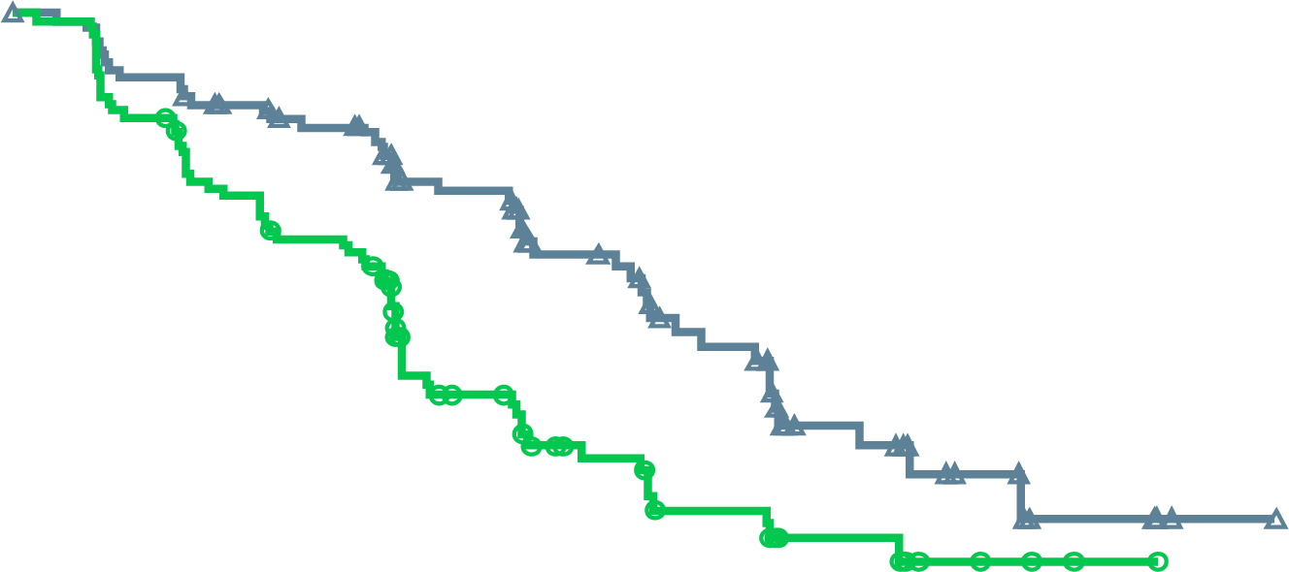
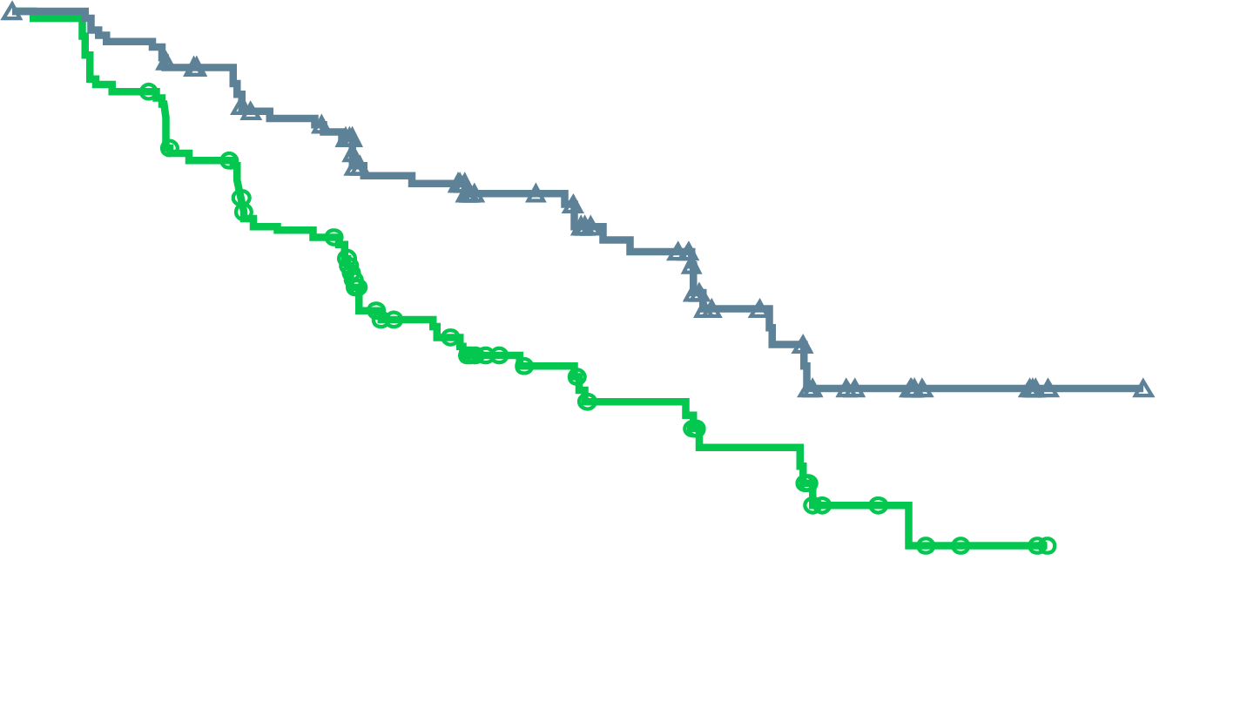
MAGNITUDE BRCA1/2-mutated: Primary Endpoint NIRA + AAP Significantly Reduced the Risk of Progression or Death by 47%
rPFS assessed by central review
rPFS assessed by investigator
NIRA + AAP: 16.6 mo
NIRA + AAP: 19.3 mo
PBO + AAP: 10.9 mo
PBO + AAP: 12.4 mo
HR: 0.53 (95% CI, 0.36-0.79)
p=0.0014
HR: 0.50 (95% CI, 0.33-0.75)
Nominal p=0.0006
No. at risk
NIRA + AAP | 113 | 103 | 90 | 65 | 45 | 31 | 18 | 9 | 4 | 1 | 0
PBO + AAP | 112 | 97 | 77 | 43 | 28 | 20 | 11 | 5 | 2 | 0 | 0
No. at risk
NIRA + AAP | 113 | 107 | 90 | 64 | 49 | 36 | 23 | 10 | 5 | 1 | 0
PBO + AAP | 112 | 99 | 73 | 45 | 32 | 23 | 14 | 6 | 2 | 0 | 0
Median follow-up 16.7 months
Median follow-up 16.7 months
AAP, abiraterone acetate + prednisone/prednisolone; CI, confidence interval; HR, hazard ratio; NIRA, niraparib; PBO, placebo;
rPFS, radiographic progression-free survival.
Chi K, et al. J Clin Oncol. 2022; 40 (suppl 6; abstr 12) (ASCO GU 2022 oral presentation)
Notes:
Here, control arm does worse which is driving the difference. The combination of Nira + AA provides a consistent benefit

Slide 28
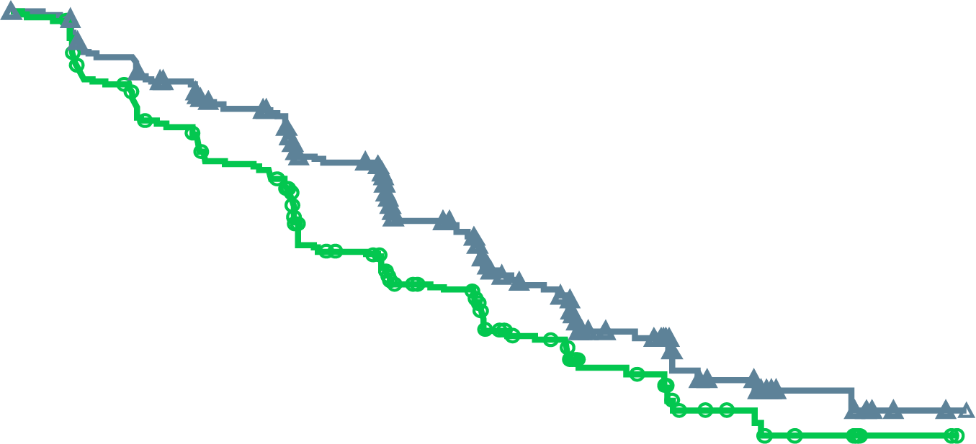
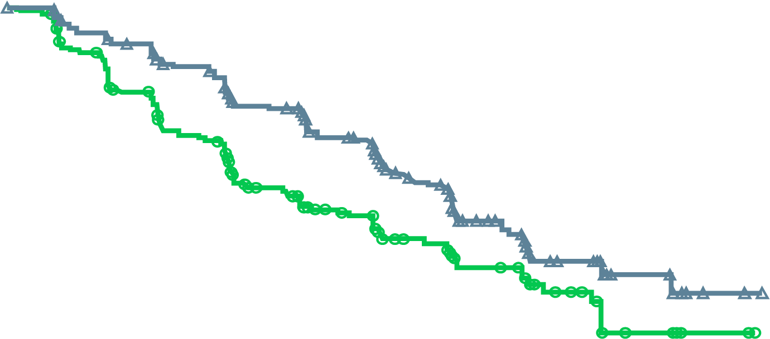
MAGNITUDE All HRR BM+: Primary Endpoint
NIRA + AAP Significantly Reduced the Risk of Progression or Death by 27%
rPFS assessed by central review
rPFS assessed by investigator
NIRA + AAP: 19.0 mo
NIRA + AAP: 16.5 mo
HR: 0.73 (95% CI, 0.56-0.96)
p=0.0217
PBO + AAP: 13.7 mo
HR: 0.64 (95% CI, 0.49-0.86)
Nominal P = 0.0022
PBO + AAP: 13.9 mo
No. at risk
NIRA + AAP | 212 | 192 | 167 | 129 | 96 | 64 | 45 | 21 | 10 | 2 | 0
PBO + AAP | 211 | 182 | 149 | 102 | 78 | 53 | 35 | 15 | 9 | 2 | 0
No. at risk
NIRA + AAP | 212 | 197 | 174 | 136 | 108 | 75 | 50 | 23 | 11 | 2 | 0
PBO + AAP | 211 | 187 | 145 | 103 | 81 | 58 | 41 | 20 | 9 | 2 | 0
Median follow-up 18.6 months
AAP, abiraterone acetate + prednisone/prednisolone; BM, biomarker; CI, confidence interval; HR, hazard ratio; HRR, homologous recombination repair;
NIRA, niraparib; PBO, placebo; rPFS, radiographic progression-free survival.
Chi K, et al. J Clin Oncol. 2022; 40 (suppl 6; abstr 12) (ASCO GU 2022 oral presentation)
Notes:
Add a comment pertaining to the rigor of BICR-this can probably be voiced by Kim Chi

Slide 29
MAGNITUDE All HRR BM+: Prespecified Subgroup Analysis of rPFS Showed Consistency of Effect
Median (months)
Events/N
Median (months)
Events/N
Variable
Subgroup
niraparib
control
HR (95% CI)
niraparib
control
Variable
Subgroup
niraparib
control
HR (95% CI)
niraparib
control
All HRR+ patients
All
16.5
13.7
0.74 (0.57–0.97)
100/212
117/211
Past taxane–based chemotherapy
Yes
13.4
10.9
0.89 (0.48–1.66)
20/40
21/41
Age group
<65
13.9
13.9
1.01 (0.61–1.66)
32/61
30/62
No
16.6
13.8
0.71 (0.53–0.96)
80/172
96/170
≥65-74
19.4
13.6
0.58 (0.38–0.89)
34/88
57/100
Past androgen receptor-targeted
therapyª
Yes
NE
4.3
0.19 (0.03–1.23)
2/8
3/4
≥75
16.4
10.9
0.76 (0.46–1.24)
34/63
30/49
No
16.5
13.8
0.76 (0.58-1.00)
98/204
114/207
Race group
Asian
22.0
10.9
0.48 (0.22–1.05)
9/29
22/41
Prior AAP use^{b}
Yes
13.9
14.6
0.95 (0.54–1.67)
23/47
26/45
White
14.4
13.8
0.83 (0.61–1.13)
82/160
83/153
No
16.7
12.7
0.71 (0.52–0.96)
77/165
91/166
Other
18.4
9.0
0.47 (0.20–1.14)
9/23
12/17
Presence of visceral metastases
Yes
11.0
8.1
1.03 (0.60–1.77)
34/51
22/39
Baseline ECOG performance
status
0
19.5
13.9
0.65 (0.46–0.92)
53/130
76/146
No
19.4
13.8
0.64 (0.47–0.87)
66/161
95/172
1
13.1
10.5
0.84 (0.55–1.28)
47/82
41/65
Bone only metastasis at entry
Yes
19.4
15.4
0.72 (0.45–1.14)
32/78
41/85
Baseline BPI-SF#3 Score
0
16.7
16.8
0.75 (0.51–1.12)
47/108
53/103
No
14.8
10.9
0.73 (0.53–1.02)
68/134
76/126
1 to 3
13.9
10.5
0.78 (0.52–1.17)
46/88
50/86
Number of bone lesions at baseline
≤10
19.4
15.4
0.76 (0.53–1.10)
54/127
65/128
>3
13.7
13.7
0.68 (0.26–1.79)
6/14
14/22
>10
13.8
8.4
0.69 (0.47–1.04)
46/85
52/83
Region
Asia Pacific
19.5
13.8
0.64 (0.35–1.17)
17/43
27/52
Baseline PSA above median
Yes
15.7
8.3
0.58 (0.40–0.82)
56/110
66/101
Europe
14.4
13.7
0.82 (0.58–1.14)
68/128
71/120
No
16.7
18.2
0.93 (0.62–1.40)
44/102
51/110
North and South America
16.6
16.4
0.60 (0.30–1.18)
15/41
19/39
Gene mutation type
BRCA
16.6
10.9
0.55 (0.38–0.81)
45/113
64/112
Other HRR
14.8
16.4
0.99 (0.68–1.45)
55/99
53/99
0.1
1
0.1
1
Favoring Niraparib
Favoring Control
Favoring Niraparib
Favoring Control
ªPast AR-targeted therapy was considered prior novel anti-androgen therapy, such as enzalutamide, apalutamide, or darolutamide.
^{b}Prior AAP use was up to 4 months prior to study start.
AAP, abiraterone acetate + prednisone/prednisolone; AR, androgen receptor; BM, biomarker; BPI-SF, Brief Pain Inventory–Short Form; CI, confidence interval; ECOG PS, Eastern Cooperative Oncology Group performance status; HR, hazard ratio; HRR, homologous recombination repair; NE, not estimable; PSA, prostate-specific antigen; rPFS, radiographic progression-free survival.
Chi K, et al. J Clin Oncol. 2022; 40 (suppl 6; abstr 12) (ASCO GU 2022 oral presentation)
Notes:
Statistically there was no heterogeneity of effect across subgroups. ECOG 0, no prior AAP use, no visceral metastases and patients with a BRCA alteration had the greatest benefit with niraparib.

Slide 30
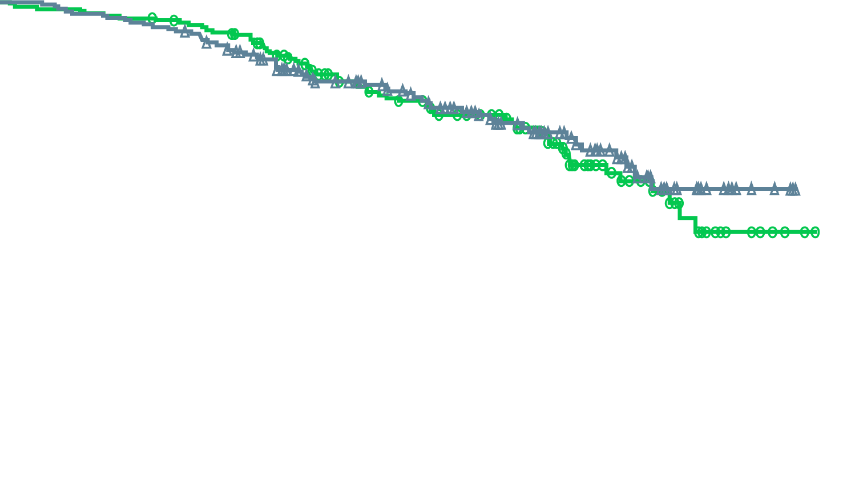
MAGNITUDE All HRR BM+: Overall Survival First Interim Analysis With Median Follow-up of 18.6 Months
NIRA + AAP: NE
(55 death events)
PBO + AAP: NE
(59 death events)
HR: 0.94 (95% CI, 0.65-1.36)
p=0.733 (boundary for significance, 0.0005)
No. at risk
NIRA + AAP | 212 | 207 | 200 | 180 | 146 | 110 | 84 | 52 | 20 | 4 | 0
PBO + AAP | 211 | 206 | 202 | 187 | 141 | 113 | 82 | 47 | 22 | 5 | 0
46.3% of the required death events for the final analysis observed and thus overall survival data are immature
.
AAP, abiraterone acetate + prednisone/prednisolone; BM, biomarker; CI, confidence interval; HR, hazard ratio; HRR, homologous recombination repair; NE, not estimable; NIRA, niraparib; PBO, placebo
Chi K, et al. J Clin Oncol. 2022; 40 (suppl 6; abstr 12) (ASCO GU 2022 oral presentation)
Notes:
Kim Chi to voiceover that the immature result was consistent across genetic alterations. Median FU time is 18.6 months

Slide 31
MAGNITUDE HRR BM+: TEAEs Consistent With the Known Safety Profile for Each Therapy
Treatment-emergent adverse events occurring at >20% in the NIRA arm or otherwise of clinical interest, n (%) |  | NIRA + AAP, n=212 |  | PBO + AAP, n=211
 |  | All grades | Grade ≥3 | All grades | Grade ≥3
Haematologic | Anaemia | 98 (46.2) | 63 (29.7) | 43 (20.4) | 16 (7.6)
 | Thrombocytopaenia | 45 (21.2) | 14 (6.6) | 18 (8.5) | 5 (2.4)
 | Neutropaenia | 29 (13.7) | 14 (6.6) | 12 (5.7) | 3 (1.4)
 | Acute myeloid leukaemia/ Myelodysplastic syndrome | 0 | 0 | 1 (0.5) | 1 (0.5)
Cardiovascular | Hypertension | 67 (31.6) | 33 (15.6) | 47 (22.3) | 30 (14.2)
 | Arrhythmia | 27 (12.7) | 6 (2.8)ª | 12 (5.7) | 3 (1.4)
 | Cardiac failure | 4 (1.9) | 3 (1.4)ª | 4 (1.9) | 1 (0.5)
 | Ischaemic heart disease | 4 (1.9) | 4 (1.9) | 8 (3.8) | 6 (2.8)^{b}
General disorders | Fatigue | 56 (26.4) | 7 (3.3) | 35 (16.6) | 9 (4.3)
Gastrointestinal | Constipation | 65 (30.7) | – | 29 (13.7) | –
 | Nausea | 50 (23.6) | 1 (0.5) | 29 (13.7) | 0
Hepatotoxicity |  | 25 (11.8) | 4 (1.9) | 26 (12.3) | 10 (4.7)
Cerebrovascular disorders |  | 6 (2.8) | 2 (0.9) | 2 (0.9) | 1 (0.5)ª
ª Includes 1 grade 5 event.
^{b} Includes 3 grade 5 events.
AAP, abiraterone acetate + prednisone/prednisolone; BM, biomarker; HRR, homologous recombination repair; NIRA, niraparib; PBO, placebo.
Chi K, et al. J Clin Oncol. 2022; 40 (suppl 6; abstr 12) (ASCO GU 2022 oral presentation)
Notes:
Additional details:
Re: arrhythmia: higher numbers of the following in NIRA vs PBO (all grade): Tachycardia (7 vs 4), Palpitations (6 vs 1), Atrial Fibrillation (5 vs 3), Sinus tachycardia (5 vs 0)
Sinus tachycardia was related to anemia, majority of arrhythmias were grade 1-2 and related to older age and anemia like extrasystoles, sinus tachycardia. The key is how many patients had atrial fibrillation or ventricular tachyarrhythmias which require specific acute and/or chronic management.
Grade 3 arrhythmias included tachycardia (n=1) atrial fibrillation (n=2) in the NIRA group; palpitations (n=1), atrial flutter (n=1), and ventricular tachycardia (n=1) in the PBO group
Grade 3+ cardiac failure included cardiac failure (n=1 gr4), cardiac failure congestive (n=1 gr3), and 1 death in the NIRA group; cardiac failure (n=1 gr3) in the PBO group
Grade 3+ ischemic heart disease included myocardial infarction (n=2 gr 3 and n=1 gr4) and 1 death due to cardiorespiratory arrest in the NIRA group; myocardial infarction (n=1 gr3), coronary artery disease (n=2 gr3), and 3 deaths (myocardial infarction n=2 and acute myocardial infarction n=1) in the PBO group

Slide 32
MAGNITUDE All HRR BM+: HRQol Was Maintained with the combination of
NIRA + AAP
15
Clinically meaningful change
10
Better HRQoL
5
FACT-P total score
(change from baseline)
NIRA + AAP
0
-5
Worse HRQoL
PBO + AAP
-10
Clinically meaningful change
-15
2
3
4
5
6
7
9
11
13
15
17
19
21
23
No. at risk
NIRA + AAP
PBO + AAP
Cycle
190
184
175
179
176
180
170
167
162
159
164
152
151
146
136
129
115
104
94
83
85
64
66
50
54
37
39
24
Note: The threshold for definition of FACT-P total score deterioration is ≤10.
AAP, abiraterone acetate + prednisone/prednisolone; BM, biomarker; FACT-P, Functional Assessment of Cancer Therapy-Prostate; HRR, homologous recombination repair; HRQoL, health-related quality of life; NIRA, niraparib; PBO, placebo.
Chi K, et al. J Clin Oncol. 2022; 40 (suppl 6; abstr 12) (ASCO GU 2022 oral presentation)
Notes:
Health-related quality of life was not affected by the combination treatment.

Slide 33
PARPi COMBINATIONS in earlier stages of prostate cancer
Study | Phase | Treatment line | Treatment arms | Patient population | Estimated completion date/status
AMPLITUDE (NCT04497844) | 3 | 2L | Niraparib plus abiraterone acetate vs Placebo plus abiraterone acetate | mCSPC Deleterious germline or somatic HRR gene-mutated | November 15, 2024
TALAPRO-3 (NCT04821622) | 3 | 2L | Talazoparib plus enzalutamide vs Enzalutamide plus placebo | mCSPC DDR gene-mutated | Recruiting
1L, first-line; 2L, second-line; ARSi, androgen receptor-signalling inhibitor; CRPC, castration-resistant prostate cancer; DDR, DNA damage repair;
HRR, homologous recombination repair; mCRPC, metastatic castration-resistant prostate cancer; mCSPC, metastatic castration-sensitive prostate cancer.
www.clinicaltrials.gov

Slide 34
summary
Both trials, PROpel and MAGNITUDE, establish that combination of a PARPi + abiraterone in the first-line setting for HRR mutation positive mCRPC patients improves radiographic progression-free survival
Even though overall survival data are immature for both trials, we expect the combination of a PARPi + abiraterone in the first-line setting for HRR mutation positive mCRPC patients will be approved by the FDA in the near future and can be offered to our patients
In particular, once approved the combination of olaparib + abiraterone may be applicable to HRR mutation negative mCRPC patients if OS benefit results are noted
Further studies are investigating AR signaling inhibitors in combination with PARPi in earlier stages of advanced prostate cancer, ie. mCSPC
FDA, Food and Drug Administration; HRR, homologous recombination repair; mCRPC, metastatic castration-resistant prostate cancer; mCSPC, metastatic castration-sensitive prostate cancer; OS, overall survival; PARP, poly-ADP ribose polymerase
www.clinicaltrials.gov
Notes:
Read from slide.

Slide 35

REACH GU CONNECT VIA
TWITTER, LINKEDIN, VIMEO & EMAIL
OR VISIT THE GROUP’S WEBSITE https://guconnect.cor2ed.com/
Follow us on Twitter
@guconnectinfo
Follow the
GU CONNECT
group on LinkedIn
Watch us on the
Vimeo Channel
GU CONNECT
Email
sam.brightwell
@cor2ed.com

