Slide 2
An unusual Acute coronary syndrome: Case study 1 Dr Miklos Rohla, MD, PhD 3rd Medical Department, Cardiology and Intensive Care Medicine, Wilhelminenspital, Vienna, Austria March 2021

Slide 3
Disclaimer and disclosures
Please note: The views expressed within this presentation are the personal opinions of the authors. They do not necessarily represent the views of the author’s academic institution or the rest of the CORONARY CONNECT group.
These slides are adapted from the virtual ACS Forum event which was held in December 2020. The ACS Forum and this content are supported by an Independent Educational Grant from Amgen.
Dr. Miklos Rohla has received financial support/sponsorship for research support, consultation or speaker fees from the following companies:
Sanofi

Slide 4
patient
Female, 19 years of age
Presents to the emergency department with dizziness and sudden-onset chest pain that started 3 hours before
Prior medical history
No significant prior illnesses
Family-history negative
Non-smoker
Contraception with intrauterine device

Slide 5
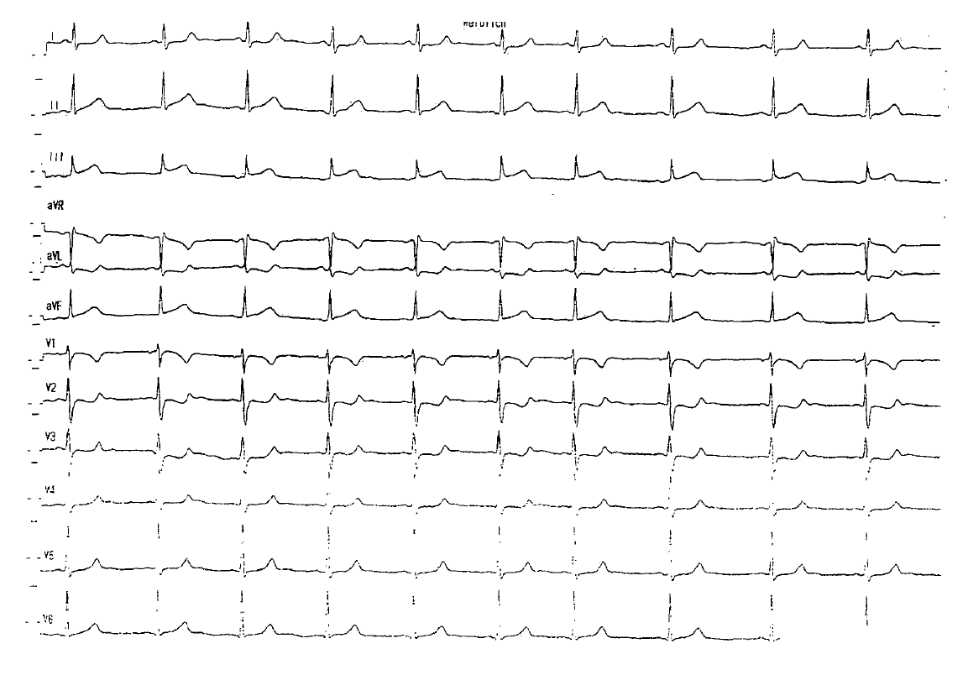
Electrocardiogram

Slide 6
Echocardiogram
Provided by Dr. Rohla

Slide 7
What should we do?
1st Troponin I 0.13 μg/L (assay cut-off 0.045 μg/L)
Strategy?
Antithrombotic treatment?
Angiography within 24 hours (high risk)
None
Selective invasive (low risk)
Acetylsalicylic (ASA) acid only
Non-invasive
ASA + P2Y12 Inhibitor
Collet J-P, et al. Eur Heart J. 2020. DOI: 10.1093/eurheartj/ehaa575

Slide 8
Provided by Dr. Rohla

Slide 9
Angio
Provided by Dr. Rohla

Slide 10
Angio
Provided by Dr. Rohla

Slide 11
Angio
Provided by Dr. Rohla

Slide 12
What should we do?
Percutaneous coronary intervention (PCI)
Conservative treatment

Slide 13
What should we do?
PCI
Conservative treatment
Glycoprotein IIb/IIIa inhibitor
PCI, percutaneous coronary intervention

Slide 14
Transthoracic echocardiogram
What I didn’t tell you
Provided by Dr. Rohla

Slide 15
Transthoracic echocardiogram
What I didn´t tell you
Provided by Dr. Rohla

Slide 16
Transoesophageal echocardiogram
What I didn´t tell you
Provided by Dr. Rohla

Slide 17
discharge
Creatine kinase (CK) max. 494 U/L, Troponin I 7.6 μg/L (assay cut-off 0.045 μg/L)
Initial antithrombotic treatment?
ASA monotherapy
DAPT
Single APT + NOAC
Triple therapy
APT, antiplatelet therapy; ASA, acetylsalicylic acid; DAPT, dual antiplatelet therapy; NOAC, novel anticoagulants

Slide 18
Discharge
CK max. 494 U/L, Troponin I 7.6 μg/L (assay cut-off 0.045 μg/L)
Initial antithrombotic treatment?
ASA monotherapy
DAPT
Single APT + NOAC
Triple therapy
APT, antiplatelet therapy; ASA, acetylsalicylic acid; CK, creatine kinase; DAPT, dual antiplatelet therapy; NOAC, novel anticoagulants

Slide 19
Discharge
CK max. 494 U/L, Troponin I 7.6 μg/L (assay cut-off 0.045 μg/L)
Management?
Pharmacotherapy
PFO closure
CK, creatine kinase; PFO, patent foramen ovale

Slide 20
Discharge
CK max. 494 U/L, Troponin I 7.6 μg/L (assay cut-off 0.045 μg/L)
Management?
Pharmacotherapy
PFO closure scheduled
CK, creatine kinase; PFO, patent foramen ovale

Slide 21
3 weeks later
Hypermenorrhoea, anaemia Hb 8.4 g/dL
Continue antithrombotic therapy
Drop ASA
Drop NOAC
ASA, acetylsalicylic acid; Hb, haemoglobin; NOAC, novel anticoagulants

Slide 22
3 weeks later
Hypermenorrhoea, anaemia Hb 8.4 g/dL
ASA dropped
Tranexamic acid for 5 days
ASA, acetylsalicylic acid; Hb, haemoglobin

Slide 23
PFO closure
PFO, patent foramen ovale
Provided by Dr. Rohla

Slide 24
summary
The patient successfully underwent a PFO closure and has recovered well
Why was the patient given a GP IIb/IIIa inhibitor?
It was likely that this was not an atherosclerotic plaque but a thrombus that has developed due to a paradoxical embolism
Dr. Rohla did not want to perform PCI in a 19-year old woman with a treatable/preventable cause of paradoxical coronary embolism, so the decision was made to try to pharmacologically resolve the thrombus
Why prescribe a NOAC instead of, or combined with aspirin?
In this patient with a very low bleeding risk, an initial approach of anticoagulation and antiplatelet therapy was chosen to prevent a subsequent paradoxical thromboembolic event until PFO closure.
After the episode of severe hypermenorrhea, an off-label NOAC monotherapy was chosen since the aetiology of the event was believed to be thromboembolic (as opposed to atherosclerotic), major bleeding rates are comparable between NOACs and aspirin and the short half-life of NOACs allows for better management of bleeding complications
Would you have treated the patient differently or are you in agreement with Dr. Rohla’s treatment?
GPI, glycoprotein IIb/IIIa inhibitor; MI, myocardial infarction; NOAC, novel anticoagulants; PFO, patent foramen ovale

Slide 25
REACH CORONARY CONNECT VIA TWITTER, LINKEDIN, VIMEO & EMAIL OR VISIT THE GROUP’S WEBSITE http://www.coronaryconnect.com/
Follow us on Twitter @CoronaryConnect
Follow the CORONARY CONNECT
Group on LinkedIn
Watch us on the Vimeo Channel CORONARY CONNECT
Email carrie.brubaker @cor2ed.com

