Slide 2
HIGHLIGHTS BY
Prof. Robert Maki MD, PhD
University of Pennsylvania Perelman School of Medicine
Abramson Cancer Center, Philadelphia, USA
SEPTEMBER 2021

Slide 3
Disclosures
Please note: Views expressed within this presentation are the personal opinions of the author.
They do not necessarily represent the views of the author’s academic institution or the rest of
SARCOMA CONNECT group.
This content is supported by an independent educational grant from Bayer.
Disclosures: Prof. Robert maki has received honoraria from the following:
Consulting fees/honoraria: American Board of Internal Medicine, American Society for Clinical Oncology, Bayer, Deciphera, Foundation Medicine, Immune Design, Karyopharm, Presage, Tracon
Clinical trials support to institution: Bayer, Karyopharm, Lilly, Pfizer, Presage, Regeneron, Sarcoma Alliance for Research through Collaboration, Springworks

Slide 4
background
Multidisciplinary Tumour Board
Treatment options in Sarcoma

Slide 5
Multidisciplinary management of sarcomas: Potluck – everyone brings something
Systemic therapy
Pathology
Surgery
(Interventional)
Radiology
Radiation
Other team members

Slide 6
Chemotherapy for sarcoma: two intentions
Curative intent
  Adjuvant chemotherapy
  Neoadjuvant chemotherapy
Palliative intent
  Treatment of metastatic disease
    Standard agents
    Clinical trials

Slide 7
Extremity soft tissue sarcomas
Adjuvant
neoadjuvant therapy

Slide 8
Common Soft Tissue Sarcomas
13,460 cases per year (US 2021), ~50 subtypes < 1 % of adult cancer
Liposarcoma (LS)
(3 subtypes)
20%
Other
(>40 subtypes)
28%
Leiomyosarcoma (LMS)
14%
MPNST 2%
Fibrosarcoma 3%
Synovial sarcoma 5%
GIST
9%
Undifferentiated
pleomorphic sarcoma
(UPS) 14%
Myxofibrosarcoma (MFS) 5%
GIST, gastrointestinal stromal tumour; LS, liposarcoma; LMS, leiomyosarcoma; MFS, myxofibrosarcoma; MPNST, malignant peripheral nerve sheath tumour;
UPS, undifferentiated pleomorphic sarcoma
Brennan MF, et al. (2013). Management of Soft Tissue Sarcoma. Springer-Verlag, NY, USA

Slide 9
Adjuvant chemotherapy
Diagnosis-dependent
GIST: 3 years imatinib is standard of care (SOC) for higher-risk disease
Paediatric sarcomas: also SOC
  Ewing sarcoma: VAdrC-IE
  Rhabdomyosarcoma: VDactinoC
  Osteosarcoma: doxorubicin/cisplatin ± MTX
Extremity sarcomas – benefit of chemoRx less clear
  Most studies showed no benefit
  Meta-analysis data supports its use (with ifosfamide)
  Neoadjuvant chemoRx may be better than adjuvant chemoRx
Retroperitoneal sarcoma: mostly a surgical disease
chemoRx, chemotherapy; GIST, gastrointestinal stromal tumour; MTX, methotrexate; SOC, standard of care;
VAdrC-IE, vincristine, doxorubicin, cyclophosphamide alternating with ifosfamide, etoposide; VDactinoC, VAdrC, ifosfamide, etoposide

Slide 10
Largest individual adjuvant study in adults: no survival advantage for doxorubicin + ifosfamide
High-risk soft tissue sarcoma patients: doxorubicin/ifosfamide / lenograstim vs observation alone
  351 patients recruited, 1995-2003
  5 cycles of doxorubicin 75 mg/m² + ifosfamide 5 g/m² q3w
Interim analysis for futility led to early study closure
 | Estimated 5-yr RFS | Estimated 5-yr OS
Treatment | 55% | 67%
Observation | 53% | 68%
The hypothesis that adjuvant chemotherapy improves recurrence-free
survival and overall survival was rejected
OS, overall survival; q3w, every 3 weeks; RFS, relapse-free survival
Woll PJ, et al. Lancet Oncol. 2012;13:1045-54

Slide 11
However…2008 meta-analysis showed improved survival for ifosfamide-based therapy
Largest adjuvant study compiled to date
Update to a 1997 meta-analysis
  Greater use of ifosfamide
  18 trials
  1,953 patients
New data are
still needed…
Hazard ratios | Overall survival
Any chemo | 0.77 (p=0.01)
Dox only | 0.84 (p=0.09)
Dox + Ifos | 0.56 (p=0.01)
Dox, doxorubicin; Ifos, ifosfamide
Pervaiz N, et al. Cancer. 2008;113:573-81

Slide 12
New neoadjuvant data: tailored vs standard Rx
Primary STS Dx:
  UPS
  Leiomyosarcoma
  MPNST
  Myxoid Liposarcoma
  Synovial
  Sarcoma NOS
Outcomes
  Primary: DFS (specifically if tailored > standard Rx)
  Secondary included: OS
varies by
histology
  Clinician “best” Rx
R
  vs.
  AIM
AIM, standard chemotherapy consisting of epirubicin plus ifosfamide; DFS, disease-free survival; Dx, diagnosis; MPNST, malignant peripheral nerve sheath tumour;
NOS, not otherwise specified; OS, overall survival; Rx, chemotherapy; STS, soft tissue sarcoma; UPS, undifferentiated pleomorphic sarcoma
Gronchi A, et al. Lancet Oncol. 2017;18:812-22; Gronchi A, et al. J Clin Oncol. 2020;38:2178-86

Slide 13
Demographics
Characteristic | Standard Rx (n=145) | Tailored Rx (n=142)
Age, years, mean | 48 | 49
Female gender | 37% | 40%
Tumour size, mm, mean | 112 | 105
Histology (n, %)
Myxoid liposarcoma | 37 (26%) | 28 (20%)
Synovial | 36 (25%) | 34 (24%)
MPNST | 15 (10%) | 12 (9%)
Leiomyosarcoma | 12 (8%) | 16 (11%)
UPS | 43 (30%) | 50 (35%)
Other | 2 (1%) | 2 (1%)
RT preop | 12% | 13%
RT postop | 66% | 67%
% R0 margin | 78% | 81%
MPNST, malignant peripheral nerve sheath tumour; R, resection; RT, radiation therapy; Rx, chemotherapy; UPS, undifferentiated pleomorphic sarcoma
Gronchi A, et al. Lancet Oncol. 2017;18:812-22; Gronchi A, et al. J Clin Oncol. 2020;38:2178-86

Slide 14
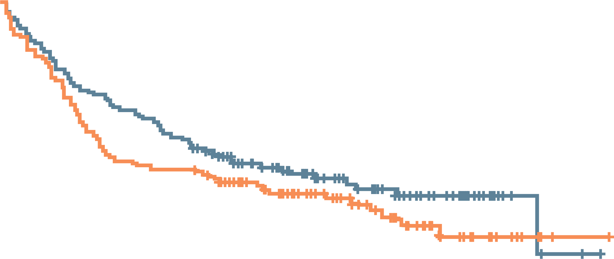
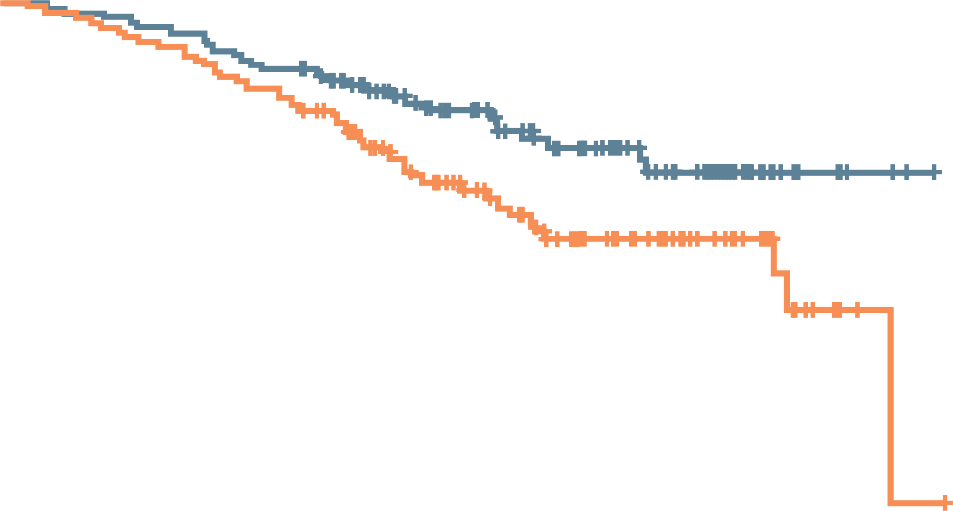
DFS and OS: Standard vs Tailored therapy
1.0
Standard chemotherapy
Histotype-tailored chemotherapy
Standard chemotherapy: censored
Histotype-tailored chemotherapy: censored
1.0
0.8
0.8
0.6
0.6
Disease-free survival
Overall survival
Standard chemotherapy
Histotype-tailored chemotherapy
Standard chemotherapy: censored
Histotype-tailored chemotherapy: censored
0.4
0.4
0.2
5-year DFS 47.4% vs 54.6%
HR, 1.23; 95% CI, 0.8-1.73; P=0.32
0.2
5-year OS 65.9% vs 75.7%
HR, 1.77; 95% CI, 1.10-2.83; P=0.02
0
12
24
36
48
60
72
84
96
0
12
24
36
48
60
72
84
96
Time to relapse (months)
Time to death (months)
No. at risk:
Standard CT
HT CT
No. at risk:
Standard CT
HT CT
145
142
115
101
100
86
77
65
55
44
36
23
8
8
2
1
0
0
145
142
142
135
131
125
104
92
72
61
45
35
13
13
2
1
0
0
DFS
OS
CI, confidence interval; CT, chemotherapy; DFS, disease-free survival; HR, hazard ratio; HT, histotype-tailored; OS, overall survival
Gronchi A, et al. Lancet Oncol. 2017;18:812-22; Gronchi A, et al. J Clin Oncol. 2020;38:2178-86

Slide 15
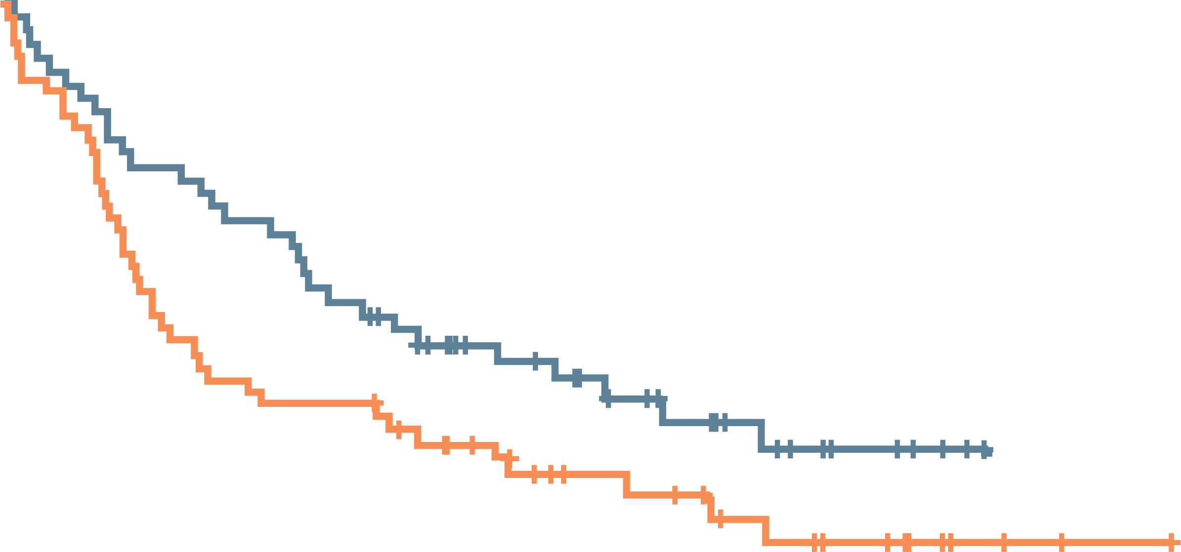
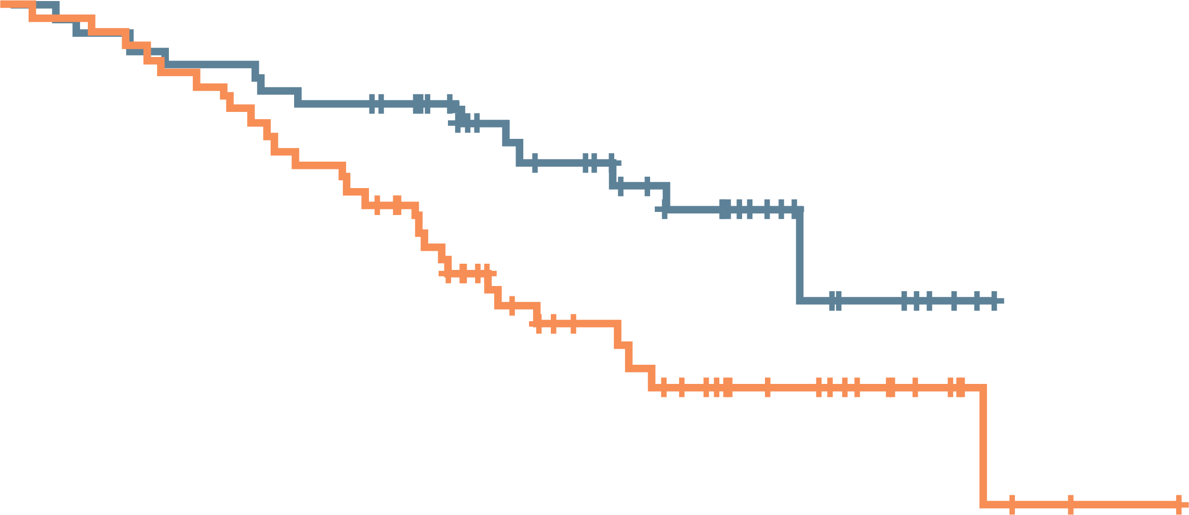
Who did better?
Only when predicted survival <60%
Sarculator-predicted OS <60%
Sarculator-predicted OS <60%
1.0
Standard chemotherapy
Histotype-tailored chemotherapy
Standard chemotherapy: censored
Histotype-tailored chemotherapy: censored
1.0
0.8
0.8
0.6
0.6
Disease-free survival
Overall survival
0.4
0.4
Standard chemotherapy
Histotype-tailored chemotherapy
Standard chemotherapy: censored
Histotype-tailored chemotherapy: censored
0.2
HR, 1.47; 95% CI, 0.92-2.37; P=0.11
0.2
HR, 1.91; 95% CI, 1.00-3.66; P=0.05
0
1
2
3
4
5
6
7
8
0
1
2
3
4
5
6
7
8
Time to relapse (years)
Time to death (years)
No. at risk:
Standard CT
HT CT
No. at risk:
Standard CT
HT CT
60
65
48
40
39
33
28
25
20
17
11
10
3
3
0
1
0
0
60
65
57
60
53
53
38
38
28
24
13
15
3
4
0
1
0
0
DFS
OS
CI, confidence interval; CT, chemotherapy; DFS, disease-free survival; HR, hazard ratio; HT, histotype-tailored; OS, overall survival
Gronchi A, et al. Lancet Oncol. 2017;18:812-22; Gronchi A, et al. J Clin Oncol. 2020;38:2178-86

Slide 16
Take-home messages
No placebo control – everyone got something
RT typically given after surgery in this trial
No study of adjuvant vs neoadjuvant therapy
  Increasingly we give everything preoperatively
Limitations
  Epirubicin was the anthracycline – does that matter?
  Hard to give ifosfamide >60 years of age
Rule of 60s: consider therapy in patients <60 years, <60% expected survival
RT, radiotherapy

Slide 17
Retroperitoneal sarcomas
Well-differentiated / dedifferentiated liposarcoma

Slide 18
Retroperitoneal sarcomas
Two major subtypes
  Both usually present with large tumours >10 cm
Well-differentiated / dedifferentiated liposarcoma
  Local-regional recurrence common (70%)
  Uncommon metastatic disease (20%)
Leiomyosarcoma
  Local-regional recurrence uncommon (20%)
  Metastatic disease common (>50%)
Principal therapy
  Surgery
  Chemotherapy for unresectable disease
  Radiation for unresectable leiomyosarcoma, usually not liposarcoma

Slide 19
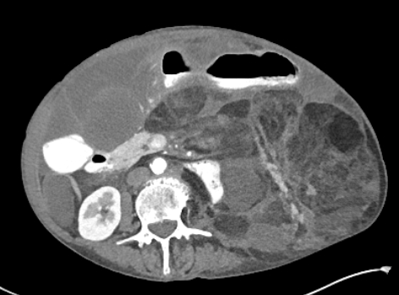
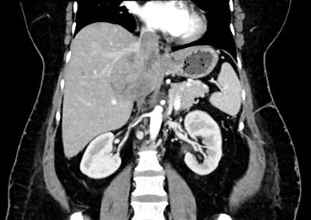


Retroperitoneal sarcomas
WDDDLS
Leiomyosarcoma
WDDDLS, well-differentiated and dedifferentiated liposarcoma

Slide 20
STRASS trial (EORTC-62092): Is radiation useful before surgery for retroperitoneal sarcomas?
Primary STS Dx:
  WDDDLS
  Leiomyosarcoma
  Other
Outcomes
  Primary: Abdominal RFS
  Secondary included: RFS, OS
  RT → Surgery
R
  vs.
  Surgery
RT: 3DCRT or IMRT
50.4 Gy, 1.8 Gy/fraction,
28 fractions, 5.5 weeks
3DCRT, 3D conformal radiotherapy; Dx, diagnosis; IMRT, intensity modulated radiotherapy; OS, overall survival; RFS, recurrence-free survival; RT, radiotherapy;
STS, soft tissue sarcoma; WDDDLS, well-differentiated and dedifferentiated liposarcoma
Bonvalot S, et al. Lancet Oncol. 2020;21:1366-77

Slide 21
Demographics (n=266)
Characteristic | Surgery (n=133) | Surgery + RT (n=133)
Age, years, median | 61 | 61
Female gender | 50% | 47%
Tumour size, mm, median | 167 | 160
Histology (n, %)
WDDDLS | 96 (72%) | 97 (73%)
Leiomyosarcoma | 22 (17%) | 16 (12%)
Other/data missing | 11 (8%) | 19 (14%)
WHO PS 0 | 75% | 83%
Tumour Grade at Bx (1: low / 2: intermediate / 3: high) | 32%/29%/14% | 33%/35%/9%
Table simplified for readability
Bx, biopsy; RT, radiotherapy; WDDDLS, well-differentiated and dedifferentiated liposarcoma; WHO, World Health Organization
Bonvalot S, et al. Lancet Oncol. 2020;21:1366-77

Slide 22
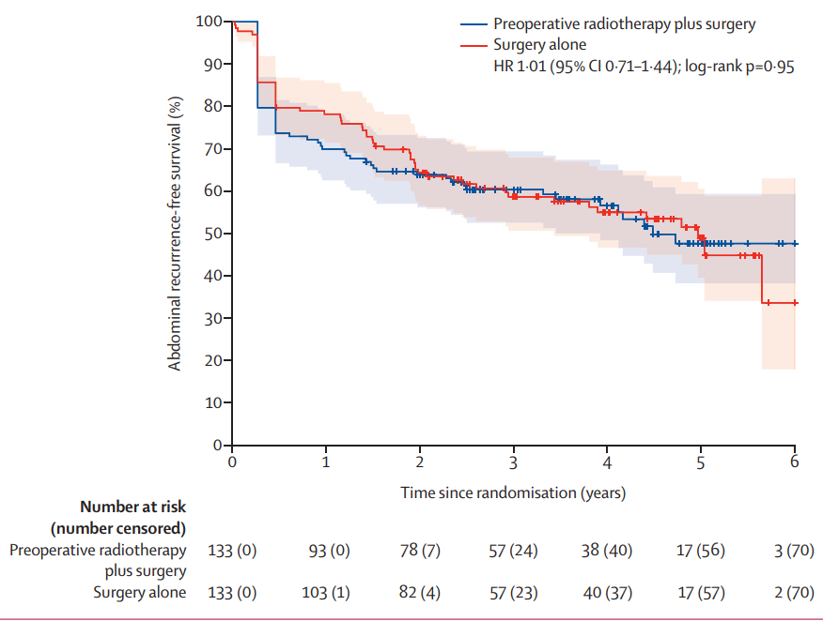
Abdominal RFS
CI, confidence interval; HR, hazard ratio; RFS, recurrence-free survival
Bonvalot S, et al. Lancet Oncol. 2020;21:1366-77

Slide 23
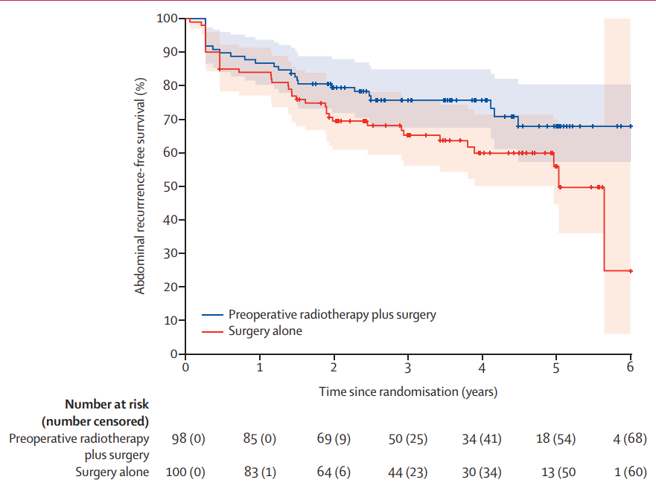
Abdominal RFS: Liposarcoma only
RFS, recurrence-free survival
Bonvalot S, et al. Lancet Oncol. 2020;21:1366-77

Slide 24
Take-home messages
No difference in overall survival with use of RT, but follow up is short as of 2021
Liposarcoma patients are the only subgroup that may benefit from radiation since local control is the most problematic issue. Study needs longer follow up
Leads to next study: Neoadjuvant chemotherapy before surgery – AIM for WDDDLS, doxorubicin/dacarbazine for leiomyosarcoma (NCT04031677)
Both this and prior study are great examples of expert centres cooperating to study rare cancers
AIM, standard chemotherapy consisting of epirubicin plus ifosfamide; RT, radiotherapy; WDDDLS, well-differentiated and dedifferentiated liposarcoma

Slide 25
Immunotherapy and kinase-targeted therapies

Slide 26
Treatment for metastatic sarcoma
Are there symptoms from advanced disease?
  If yes, combination regimens have a better chance of alleviating symptoms
  If no symptoms, single agents are reasonable
Consider disease sensitivity based on histopathology
Agents
  doxorubicin
  ifosfamide (synovial sarcoma, myxoid liposarcoma)
  pazopanib (synovial sarcoma, leiomyosarcoma)
  gemcitabine / docetaxel (UPS, leiomyosarcoma)
  trabectedin, eribulin, dacarbazine
  some subtype specific drugs
    Angiosarcoma: taxanes
    Epithelioid sarcoma: tazemetostat
UPS, undifferentiated pleomorphic sarcoma

Slide 27
But who cares about anything except immunotherapy?
Today: focus on immune checkpoint inhibitors – ICI – no special handling needed
Cellular therapies against NY-ESO-1 are active against synovial sarcoma and
myxoid liposarcoma
ICI, immune checkpoint inhibitors; NY-ESO-1, New York esophageal squamous cell carcinoma-1

Slide 28
First ICI trials in advanced sarcomas
Year (published) | Drug(s) | N | Diagnosis | RR (%)
2013¹ | ipilimumab | 6 | synovial sarcoma | 0
2017² | pembrolizumab | 86 | bone sarcoma STS | 5 18
2017³ | nivolumab | 12 | uterine LMS | 0
2018⁴ | nivolumab nivolumab + ipilimumab | 43 42 | bone & STS | 5 16
2018⁵ | pembrolizumab + metronomic cyclophosphamide | 57 | STS (incl GIST) | 2
2019 | nivolumab | 21 | STS | 0
2019⁶ | axitinib + pembrolizumab | 33 | bone & STS | 25
GIST, gastrointestinal stromal tumour; ICI, immune checkpoint inhibitors; LMS, leiomyosarcoma; RR, response rate; STS, soft tissue sarcoma
1. Maki RG, et al. Sarcoma. 2013;2013:168145; 2. Tawbi HA, et al. Lancet Oncol. 2017;18:1493-1501; 3. Ben-Ami E, et al. Cancer. 2017;123:3285-90;
4. D’Angelo SP, et al. Lancet Oncol. 2018;19:416-26; 5. Toulmonde M, et al. JAMA Oncol. 2018;4:93-7; 6. Wilky BA, et al. Lancet Oncol. 2019;20:837-48

Slide 29
SARC028: Pembrolizumab
300
Leiomyosarcoma (n=10)
Undifferentiated pleomorphic sarcoma (n=10)
Poorly differentiated or dedifferentiated liposarcoma (n=9)
Synovial sarcoma (n=8)
Histology subtype-specific responses (n=40)
UPS: 4/10
Dedifferentiated LPS: 2/10
Synovial sarcoma: 1/10
Leiomyosarcoma: 0/10
Median PFS for all patients: 18 weeks
200
Change in target lesion size from baseline (%)
100
0
−30% reduction
−100
Patients
LPS, liposarcoma; PFS, progression-free survival; UPS, undifferentiated pleomorphic sarcoma
Tawbi HA, et al. Lancet Oncol. 2017;18:1493-1501

Slide 30
Sarcoma gene expression signatures from public databases
Heat map of the Pearson correlation of centroids from each SIC class of discovery cohorts (TCGA SARC, GSE21050, GSE21122 and GSE30929, n=608), with five immune classes and two groups of unclassified samples.
The Sarcoma Immune Class (SIC) exhibit strongly different TMEs
CTLA-4, cytotoxic T lymphocyte antigen 4; DDLPS, dedifferentiated liposarcoma; LAG3, lymphocyte activating 3; LMS, leiomyosarcoma; NK, natural killer; PD-1, programmed death 1; PD-L1, programmed death ligand 1; PD-L2, programmed death ligand 2; SIC, sarcoma immune class; TIM3, T cell immunoglobulin and mucin-domain containing 3; TLS, tertiary lymphoid structures; TME, tumour microenvironment; UPS, undifferentiated pleomorphic sarcoma
Petiprez F, et al. Nature. 2020;577:556-60

Slide 31
Pembrolizumab responders had signs of tertiary lymphoid structures (TLS)
SIC
Representative immunofluorescence staining of a TLS
for CD3 (magenta), CD20 (green) and PD1 (cyan)
DAPI staining is shown in blue
The merged image shows CD3+PD1+ double-positive cells (yellow arrows)
Number of TLS among 5 SICs of 73 tumours of NTUH cohort (n=73)
Overall SIC E tumours were associated with the highest response rate to pembrolizumab vs tumours from
other SICs (P=0.026)
I/O, immuno-oncology; SIC, sarcoma immune class; TLS, tertiary lymphoid structures
Petiprez F, et al. Nature. 2020;577:556-60

Slide 32
ASCO 2021: TLS IHC screening for I/O therapy
Unselected patients Rx PD-1 antagonist – median PFS
  4.1 months – SARC028 – 4 cohorts of 10 patients each¹
  1.4 months – PEMBROSARC trial, unselected n=57²
PEMBROSARC trial, response by TLS status³
  Screened 240 patients for TLS(+)
  48 were (+) by central review (20%), 35 included on trial: WDDDLS, UPS, leiomyosarcoma
  Therapy: pembrolizumab IV q3w and oral cyclophosphamide
IHC, immunohistochemistry; I/O, immuno-oncology; IV, intravenous; PD-1, programmed death 1; PFS, progression-free survival; q3w, every 3 weeks; Rx, chemoatherapy; TLS, tertiary lymphoid structures; UPS, undifferentiated pleomorphic sarcoma; WDDDLS, well-differentiated and dedifferentiated liposarcoma
1. Tawbi HA, et al. Lancet Oncol. 2017;18:1493-1501; 2. Toulmonde M, et al. JAMA Oncol. 2018;4:93-7; 3. Italiano A, et al. J Clin Oncol. 2021;39(15_suppl):11507

Slide 33
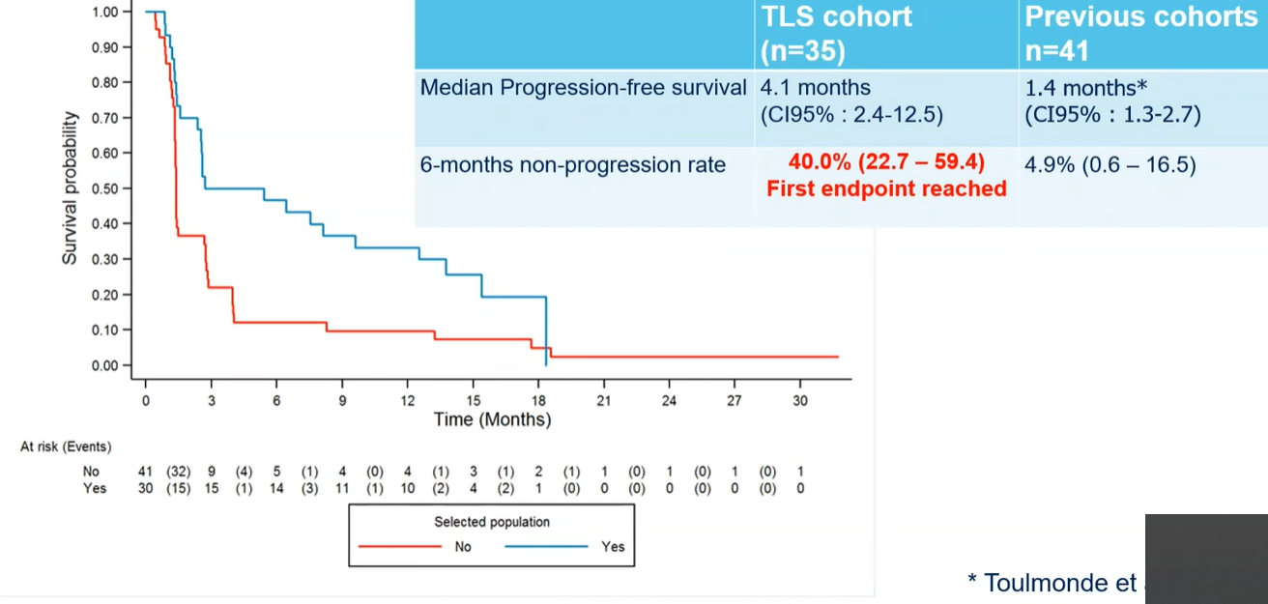
Comparison of selected patients vs unselected patients of prior study
 | TLS cohort N=35 | Previous cohorts N=41
Median progression-free survival | 4.1 months (95% CI: 2.4-12.5) | 1.4 months* (95% CI: 1.3-2.7)
6 months non-progression rate | 40.0 (22.7-59.4) First endpoint reached | 4.9% (0.6-16.5)
CI, confidence interval; TLS, tertiary lymphoid structures
*Toulmonde et al. Jama Oncol. 2017
Italiano A, et al. J Clin Oncol. 2021;39(15_suppl):11507 (ASCO 2021 abstract #11507)

Slide 34
ASCO 2021: TLS IHC screening for I/O therapy
Primary endpoint: 6 month non-progression rate
8/30 (27%) had RECIST PR
13/30 (43%) had tumour shrinking of any sort
Median PFS 4.1 months, median OS 14.5 months
Compare to prior response rate in French trial of 2%
Raises the question of how we can best screen patients
IHC, immunohistochemistry; I/O, immuno-oncology; OS, overall survival; PFS, progression-free survival; PR, partial response;
RECIST, Response Evaluation Criteria in Solid Tumours; TLS, tertiary lymphoid structures
Italiano A, et al. J Clin Oncol. 2021;39(15_suppl):11507

Slide 35
Immunotherapy: Take-home messages
Cellular therapeutics (NY-ESO-1, MAGE-A4) are active in myxoid liposarcoma, synovial sarcoma
PD-1, (PD-L1) inhibitors are active in specific diagnoses amongst the 70 or so sarcoma subtypes
  UPS, angiosarcoma, dedifferentiated liposarcoma and others (e.g. ASPS) have supportive trials data
Biomarker screening increases the odds of success
As with other cancers, combination immunotherapy trials are underway
ASPS, alveolar soft part sarcoma; MAGE-A4, melanoma-associated antigen 4; NY-ESO-1, New York esophageal squamous cell carcinoma 1; PD-1, programmed death 1; PD-L1, programmed death ligand 1; UPS, undifferentiated pleomorphic sarcoma

Slide 36
Late-breaking abstracts from ESMo 2021

Slide 37
CHORDOMA IN REGOBONE: STUDY DESIGN
Background:
REGOBONE (NCT02389244) = investigator-initiated study to explore the activity of regorafenib in patients with relapsed advanced and/or metastatic chordoma as well as cohorts of other primary bone sarcomas in separate parallel cohorts
REGOBONE has shown prior signals of regorafenib activity in osteosarcoma, chondrosarcoma and Ewing sarcoma cohorts
Regorafenib (REGO)
160 mg qd + BSC
3 weeks on/1 week off
Disease progression
per independent
Blinded central
review
O
F
F
T
R
E
A
T
M
E
N
T
Advanced and/or metastatic chordoma
After 0 to 2 prior lines of systemic therapy
R
2:1
Non-comparative design:
16 vs 8 pts
Matching Placebo (PL)
qd + BSC
3 weeks on/1 week off
Unblinding
Cross-over offered for
placebo arm or
continued REGO for
treatment arm
Treatment duration: until objective progression, unacceptable toxicity, or patient withdrawal
Disease staging at baseline and repeated at months 1, 2, 3, 4, then every 8 weeks until end of study drug dosing
After cross-over disease restaging with the original schedule
Open-label REGO
allowed until next
progression
Primary endpoint (PFS rate at 6 months) not achieved
Source: Duffaud F. et al. ESMO 2021 LBA58
BSC, best standard of care; PFS; progression-free survival; qd, once a day; REGO, regorafenib

Slide 38
LMS-04: Study design
Background:
LMS-04 (NCT02997358) = Randomised Phase III multicentric study comparing efficacy of doxorubicin with trabectedin followed by trabectedin in non-progressive patients versus doxorubicin alone as first-line therapy in patients with metastatic or unresectable leiomyosarcoma (uterine or soft tissue)
LMS 04: Ph-III first-line therapy for locally advanced/metastatic LMS
Doxorubicin 75 mg/m² q3 weeks*
Max 6 cycles
N=76
First line
Ut-LMS; ST-LMS
Locally advanced/meta
No previous CT
N=150
N=300
R
1:1
Doxorubicin 60 mg/m² + trabectedin 1.1 mg/m² q3 weeks**
Max 6 cycles
N=74
Surgery if indicated
Trabectedin 1.1 mg/m²
3h q3 weeks; until PD
Max 17 cycles
CR, PR
or SD
Stratification factors:
Uterus vs soft tissue
Locally advanced vs metastatic
* + Lenograstim 150 µg/m²/day s.c. d3-9; ** + Pegfilgrastim 6 mg s.c. day 2
CT, chemotherapy; PFS, progression-free survival; RX, radiological; CBR, clinical benefice rate; LMS, leiomyosarcoma; PFS inv, investigator-assessed PFS; ST-LMS, soft tissue leiomyosarcoma; Ut-LMS, Uterine leiomyosarcoma
Source: Pautier P, et al. ESMO 2021 LBA59

Slide 39
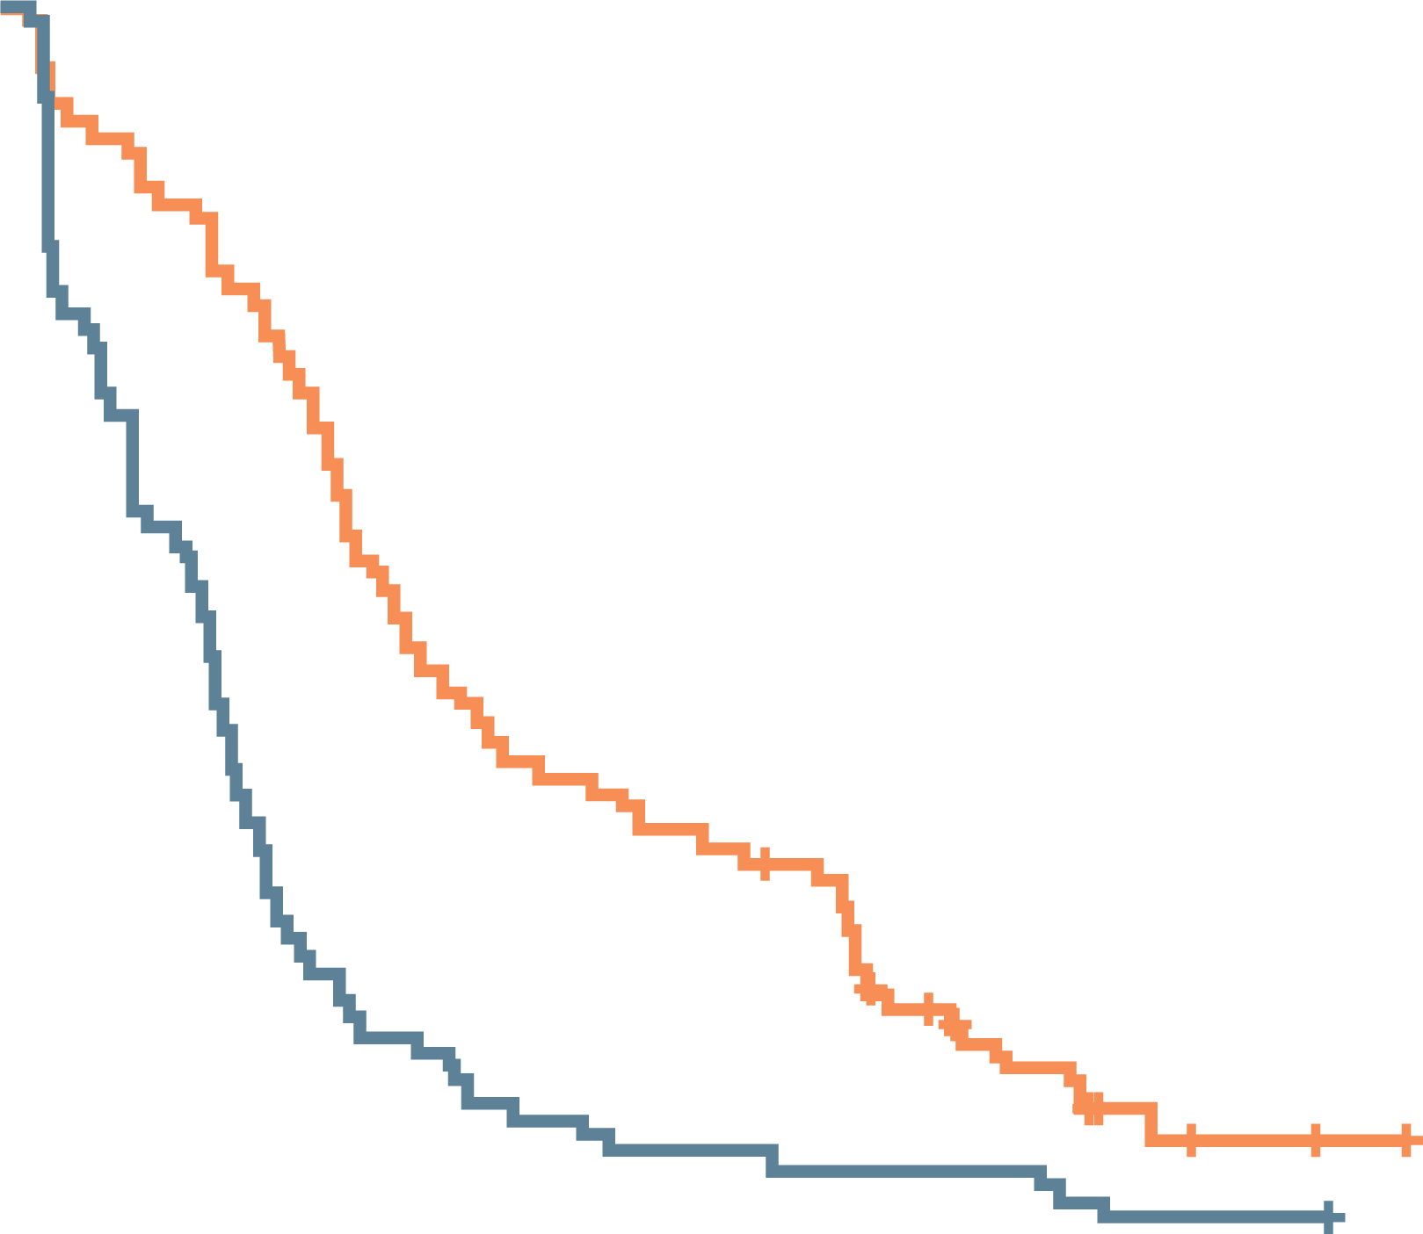
LMS-04: PFS BY BICR, ITT POPULATION
Progression-free survival
100%
 | Doxo N=76 | Doxo + Trab N=74
Events, n (%) | 74 (97%) | 65 (88%)
Median PFS, months | 6.2 | 12.2
 | HR 0.41 95% CI 0.29-0.58; P<0.0001
Conclusion:
Safety profile of doxorubicin + trabectedin = consistent and manageable toxicity
Doxorubicin + Trabectedin should be a new standard of care for 1L treatment of metastatic LMS
80%
60%
Survival probabilities
40%
20%
0%
0
5
10
15
20
25
30
35
40
45
50
55
Time from randomization to progression
or death (months)
1: Arm A: doxorubicin
2: Arm B: doxorubicin
+ trabectedin
75
74
43
61
16
46
8
29
5
24
4
21
4
9
1
4
1
2
0
0
1L, first-line; BICR, blinded independent central review; CI, confidence interval; Doxo, doxorubicin; HR, hazard ratio; ITT, intent to treat; LMS, leiomyosarcoma;
PFS, progression-free survival; Trab, trabectedin
Median follow-up was 37 months
Source: Pautier P, et al. ESMO 2021 LBA59

Slide 40
Sarcoma treatment: Summary
First, get the diagnosis right – expert pathology
Primary therapy – increasingly neoadjuvant Rx, just like other cancers
  Osteosarcoma is a prime example (since the 1970s!)
Metastatic disease
  Increasingly Rx is a function of primary diagnosis
    The LMS-04 study indicates a possible new standard of care for 1st line therapy for metastatic leiomyosarcoma patients
  Clinical trials for later stage disease now often focussed on specific histologies or groups of them
  Rare, so need multicentre trials
Act locally (patient level), think globally (collaborative, diagnosis-specific trials)
Rx, chemotherapy

Slide 41
REACH SARCOMA CONNECT VIA
TWITTER, LINKEDIN, VIMEO & EMAIL
OR VISIT THE GROUP’S WEBSITE http://www.sarcomaconnect.info
Follow us on Twitter
@sarcomaconnect
Follow the
Sarcoma CONNECT
group on LinkedIn
Watch us on the
Vimeo Channel
Sarcoma CONNECT
Email
Froukje.sosef1
@cor2ed.com

