Slide 2
Safety of low levels of
LDL-Cholesterol
Jan Přeček, MD
University Hospital Olomouc, Olomouc, Czech Republic
December 2020

Slide 3
Disclaimer and disclosures
Please note: The views expressed within this presentation are the personal opinions of the author.
They do not necessarily represent the views of the author’s academic institution or the rest of the CORONARY CONNECT group.
This content is supported by an Independent Educational Grant from Amgen.
Dr. Jan Přeček declares no financial support/sponsorship for research support, consultation or speaker fees

Slide 4
background
Low-density lipoprotein cholesterol (LDL-C) is well established as a major cardiovascular (CV) risk factor
Accumulating evidence supports a linear association between LDL-C levels and CV risk
However, the lower limit of LDL-C that might offer CV benefits without any safety concerns is still a topic of debate
Moreover, there are concerns about lowering cholesterol too much, since data show an association with an increased risk for cancer, intracranial haemorrhage, neurocognitive disorders and all-cause mortality
The safety of pharmacological treatment to very low levels of LDL-C is becoming increasingly important with highly effective lipid-lowering drugs such as PCSK9 inhibitors
PCSK9, proprotein convertase subtilisin/kexin type 9
Ference BA, et al. Eur Heart J. 2017;38(32):2459-72; Faselis C, et al. Curr Pharm Des. 2018;24(31):3658-64; Zhou L, et al. BMJ Open 2020; 10: e036976

Slide 5
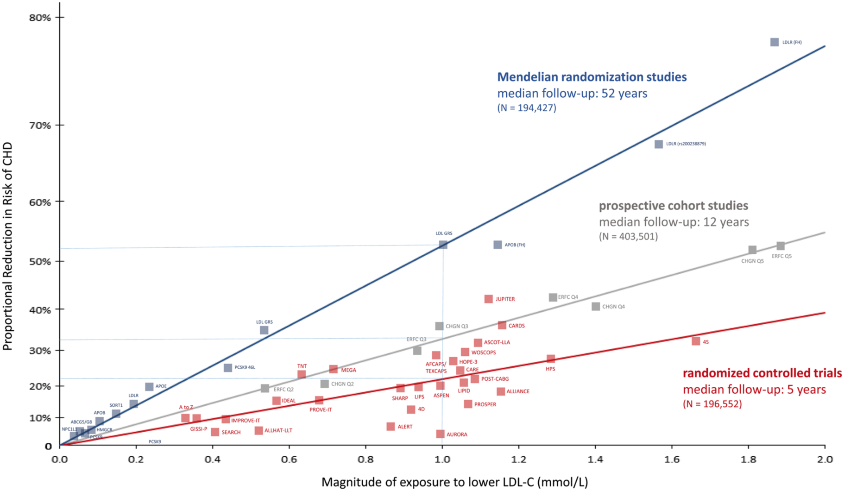
LDL-c: main factor in the development of atherosclerosis
Reduction in Risk of CV events with lowering of LDL-c
CHD, coronary heart disease; LDL-C, low density lipoprotein cholesterol
Ference B, et al. Eur Heart J. 2017;38(32):2459-72

Slide 6
Recommended treatment goals for LDL-C lowering therapy
2016 vs 2019 ESC guidelines
Risk category | LDL-C goals (starting with untreated LDL-C)
 | 2016 | 2019
Very-high risk | <1.8 mmol/L (70 mg/dL) or ≥50% ↓ if LDL-C 1.8–3.5 mmol/L (70–135 mg/dL) | <1.4 mmol/L (55 mg/dL) and ≥50% ↓
High-risk | <2.6 mmol/L (100 mg/dL) or ≥50% ↓ if LDL-C 2.6–5.2 mmol/L (100–200 mg/dL) | <1.8 mmol/L (70 mg/dL) and ≥50%↓
Moderate-risk | <3.0 mmol/L (115 mg/dL) | <2.6 mmol/L (100 mg/dL)
Low-risk | <3.0 mmol/L (115 mg/dL) | <3.0 mmol/L (115 mg/dL)
For patients with ASCVD experiencing a second vascular event within 2 years while taking maximally tolerated statin, an LDL-C goal of <1.0 mmol/L (<40 mg/dL) should be considered
ASCVD, atherosclerotic cardiovascular disease; ESC, European society of cardiology; LDL-C, low density lipoprotein cholesterol
Adapted from: Catapano AL, et al. Eur Heart J. 2016;37:2999-3058; Mach F, et al. Eur Heart J. 2020;41(1):111-88

Slide 7
Expected clinical benefits of LDL-C lowering therapies
Intensity of lipid lowering treatment
Treatment | Average LDL-C reduction
Moderate intensity statin | ~ 30%
High intensity statin | ~ 50%
High intensity statin plus ezetimibe | ~ 65%
PCSK9 inhibitor | ~ 60%
PCSK9 inhibitor plus high intensity statin | ~ 75%
PCSK9 inhibitor plus high intensity statin plus ezetimibe | ~ 85%
% reduction LDL-C
Baseline LDL-C
Absolute reduction LDL-C
Relative risk reduction
Baseline risk
Absolute risk reduction
LDL-C, low density lipoprotein cholesterol; PCSK9, proprotein convertase subtilisin/kexin type 9
Mach F, et al. Eur Heart J. 2020;41(1):111-88

Slide 8
Physiological aspects of LDL
Low-density lipoprotein (LDL) is the final step of the lipoprotein metabolism cascade and is the vehicle by which cholesterol is delivered to peripheral tissues through LDL receptors
All mammalian cells have the capacity to synthesize their own cholesterol. Tissues requiring high cholesterol intake (e.g. adrenal glands for hormone synthesis) usually have supplemental sources other than LDL
The liver is the main organ receiving LDL particles
  Approximately 3 out of 4 LDL particles finish their metabolic life in the liver
  The hepatic LDL/LDL-R system is, along with HDL, the main pathway to excrete cholesterol with bile into the faeces, which is almost the only mechanism to get rid of cholesterol
  When the LDL-LDL-R pathway is not efficient enough, LDL accumulates and infiltrates the artery wall, inducing atheroma plaque formation
LDL-R, LDL, low density lipoprotein receptor
Masana L. Rev Esp Cardiol (Engl Ed). 2018;71(7):591-2

Slide 9
Populations indicating safety of low levels of LDL
Newborn^{1,2}
“Natural” populations (South America, Africa)^{3,4}
total cholesterol: ~2 - 4 mmol/L
related to diet and other lifestyle factors
maximum growth acceleration, maturation of the central nervous system
often associated with reduction of coronary events⁷
Genetic disorders causing extremely low LDL-levels
LDL-C: 0.7-1.8 mmol/L
Intensive lipid-lowering therapy⁵
combination therapy (e.g. statins with ezetimibe/PCSK9 inhibitor)
PCSK9 inhibitors
e.g. loss-of-function variants in PCSK9⁶
LDL, low density lipoprotein; LDL-C, low density lipoprotein cholesterol; PCSK9, proprotein convertase subtilisin/kexin type 9
1. O'Keefe JH, et al. J Am Coll Cardiol. 2004; 43:2142-46; 2. Dietschy J, et al. J Clin Lipdol. 2004; 45: 1375-1397; 3. Kaplan H, et al. Lancet. 2017;389(10080):1730-9; 4. Shaper AG, et al. Int J Epidemiol. 2012;41(5):1221-5; 5. Preiss D, et al. JACC 2020; 75: 1945-1955; 6. Kent S, et al. Circ Cardiovasc Genet. 2017;10(4):e001632; 7. Cohen JC, et al. N Engl J Med. 2006;354(12):1264-72

Slide 10
Naturally very low LDL-c levels
Mutations in genes associated with the regulation of LDL-C levels including low-density lipoprotein receptor (LDL-R), HMGCR, apolipoprotein E (APOE) and PCSK9
  associated with naturally low LDL-C levels
Loss of function mutations in PCSK9
  Occur in 1-3% of the human population
  Associated with naturally low LDL-C levels and reduced CVD risk
    ARIC Study
      A total of 12,887 individuals (3363 black and 9525 white subjects) who were followed for 15 years
      included PCSK9 loss-of-function mutation carriers
        CHD risk reduction was 88% in black and 47% in white PCSK9 loss-of-function mutation carriers
        no changes in overall mortality rates
        incidence of cancer or haemorrhagic stroke not reported
ARIC, Atherosclerosis risk in communities; CHD, coronary heart disease; CVD, cardiovascular disease; HMGCR, 3-hydroxy-3-methyl-glutaryl-coenzyme A reductase; LDL-C, low density lipoprotein cholesterol; PCSK9, proprotein convertase subtilisin/kexin type 9
McCormack T, et al. Int J Clin Pract. 2016;70(11):886-97; Cohen JC, et al. N Engl J Med. 2006;354(12):1264-72

Slide 11
Meta-analysis of statin and nonstatin therapy
Data sources:
  Statins – CTTC meta-analysis
  Non-statins:
    IMPROVE-IT trial (ezetimibe)
    FOURIER (evolocumab)
    REVEAL (anacetrapib)
Trial characteristics
Trial | No. of participants | Type of intervention | Drug | Achieved LDL-C, mmol/L |  | Median duration of follow-up, y | Overall no. of major vascular events
 |  |  |  | Control arm | Experimental arm
CTTC (<2 mmol/L) | NR | HMGCR inhibitor (statin) | Various | 1.7 | NR | 4.9 | 1,922
IMPROVE-IT | 18,144 | NPC1L1 inhibitor | Ezetimibe | 1.8 | 1.4 | 6.0 | 5,104
FOURIER (<1.8 mmol/L) | 2,034 | PCSK9 inhibitor | Evolocumab | 1.7 | 0.5 | 2.1 | 184
REVEAL | 30,449 | CETP inhibitor | Anacetrapib | 1.6 | 1.4 | 4.1 | 4,282
CETP, cholesteryl ester transfer protein; CTTC, cholesterol treatment trialists collaboration; HMGCR, 3-hydroxy-3-methylglutaryl-CoA reductase; LDL-C, low density lipoprotein cholesterol; NPC1L1, Niemann-Pick C1-Like 1; PCSK9, proprotein convertase subtilisin/kexin type 9
Sabatine MS, et al. JAMA Cardiol. 2018;3(9):823-8

Slide 12
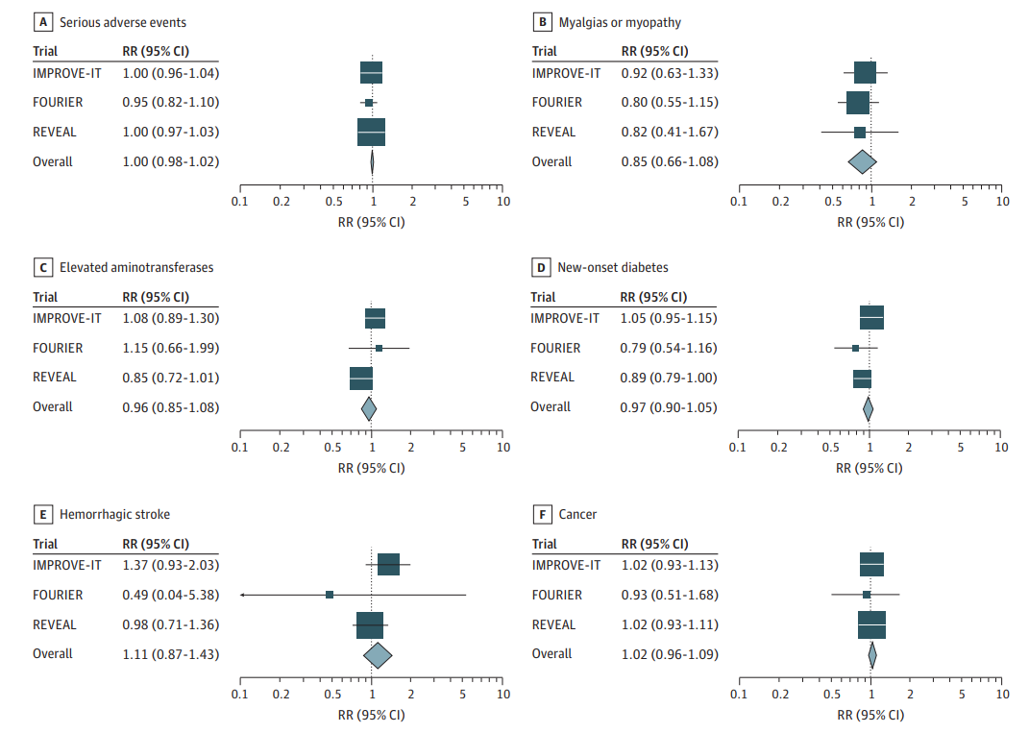
Safety outcomes in non-statin trials
 | Patients with event, no. |  | Meta-analysis data
Safety outcome | Experimental arm | Control arm | Risk ratio (95% CI) | p value
Any serious adverse event | 12,809 | 12,836 | 1.00 (0.98-1.02) | 0.89
Myalgias or myopathy | 116 | 135 | 0.85 (0.66-1.08) | 0.19
Aminotransferase elevation | 488 | 510 | 0.96 (0.85-1.08) | 0.48
New-onset diabetes | 1,272 | 1,320 | 0.97 (0.90-1.05) | 0.46
Haemorrhagic stroke | 132 | 118 | 1.11 (0.87-1.43) | 0.40
Cancer | 1,747 | 1,715 | 1.02 (0.96-1.09) | 0.55
In summary, there is a consistent relative risk reduction
in major vascular events per further reduction in LDL-C
in patient populations starting as low as a median of
1.6 mmol/L (63mg/dL) and achieving levels as low as a median of 0.5 mmol/L (21 mg/dL), with no offsetting adverse effects
These data suggest further lowering of LDL-C thresholds for initiating more intensive therapy, or simply targeting LDL-C at least as low as approximately 0.5 mmol/L or
20 mg/dL, would further reduce CV risk
CI, confidence interval; CV, cardiovascular; LDL-C, low density lipoprotein cholesterol; RR, risk ratio
Sabatine MS, et al. JAMA Cardiol. 2018;3(9):823-8

Slide 13
NEUROCOGNITIVE disorders aND low LDL-C
The brain is the most cholesterol-rich organ in the body and constitutes approx. 25% of the body’s cholesterol
  Cholesterol is an essential component for neuronal physiology
Cholesterol metabolism in brain is independent from that in peripheral tissues due to the blood-brain barrier and cholesterol levels must be accurately maintained in order to keep brain function well
Defects in brain cholesterol metabolism has been linked to neurodegenerative diseases, such as Alzheimer’s disease, Huntington’s disease, Parkinson’s disease, and some cognitive deficits typical of the old age
LDL-C, low density lipoprotein cholesterol
Björkhem I, et al. Arterioscler Thromb Vasc Biol. 2004:24:806-15; Zhang J et al. Protein Cell. 2015;6(4):254-64; Olsson AG et al. J Intern Med. 2017;281(6):534-53

Slide 14
NEUROCOGNITIVE disorders aND low LDL-C
Statins
Pcsk9 inhibitors
Systematic review and meta-analysis of short and long-term cognitive effects¹
  11 studies (3 short-term, 8 long-term)
  patients without baseline cognitive dysfunction
  Short-term cognition studies
    short-term trials did not show a consistent effect of statins on cognition
  Long-term cognition studies
    long-term data may support a beneficial role for statins in the prevention of dementia
    23,443 pts; mean exposure to statins: 3 to 24.9 years
    3 studies found no association between statin use and incident dementia; 5 studies found a favourable effect
    pooled results revealed a 29% reduction in incident dementia in statin-treated patients; HR 0.71 (95% CI 0.61-0.82)
Patients with primary hypercholesterolaemia - a meta-analysis²
  increased incidence of neurocognitive adverse events in patients on PCSK9i [OR 2.34 (95% CI 1.11-4.93), P = 0.02] compared with placebo
FOURIER trial³
  22,655 patients, median follow-up 2.2 years
  proportions of patients reporting cognitive decline at the end of the study were similar for placebo versus evolocumab
EBBINGHAUS trial (sub-study of FOURIER patients )⁴
  1,204 patients; median follow-up 19 months
  no significant difference in cognitive function observed between evolocumab and placebo treatment groups
PCSK9i therapy is unlikely to cause cognitive impairment in short-term follow-up. Longer follow-up and more diverse trial populations are needed
CI, confidence interval; HR, hazard ratio; LDL-C, low density lipoprotein cholesterol; PCSK9i, proprotein convertase subtilisin/kexin type 9 inhibitor; OR, odds ratio; pts, patients
1. Swiger KJ, et al. Mayo Clin Proc. 2013;88(11):1213-21; 2. Lipinski MJ, et al. Eur Heart J. 2016;37:536-45; 3. Gencer B, et al. J Am Coll Cardiol. 2020;75:2283-93; 4. Giugliano RP, et al. N Engl J Med. 2017;377:633-43

Slide 15
Summary
Elevated LDL-C is clearly an established major risk factor for the development of atherosclerotic cardiovascular disease (ASCVD)
  Risk reduction is proportional to the absolute and relative LDL-C reduction achieved
Intensive lipid-lowering therapy (using combination therapy and especially PCSK9 inhibitors) achieves very low levels of LDL-C
Achieving very low levels of LDL-C provides additional clinical benefit in reducing the incidence of ASCVD and is not associated with serious side effects
LDL-C, low density lipoprotein cholesterol; PCSK9, proprotein convertase subtilisin/kexin type 9

Slide 16




REACH CORONARY CONNECT VIA
TWITTER, LINKEDIN, VIMEO & EMAIL
OR VISIT THE GROUP’S WEBSITE http://www.coronaryconnect.com/
Follow us on Twitter
@CoronaryConnect
Follow the
CORONARY CONNECT
Group on LinkedIn
Watch us on the
Vimeo Channel
CORONARY CONNECT
Email
carrie.brubaker
@cor2ed.com

